Slide 1

Design And Analysis A Solar System For A Villa
Preparing By
Supervisor
Mohammad Yasin
Ayham Osta
Dr. Raed Jaber

Slide 2
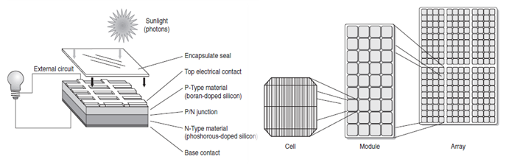
Photovoltaic System
is an electric power system designed to supply usable solar power by means of photovoltaics.
PV systems convert light directly into electricity's

Slide 3
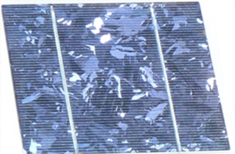
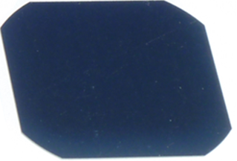
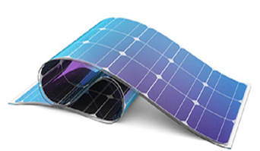
Polycrystalline Silicon Cell
Type of PV Modules
Monocrystalline Silicon Cell
Thin Film Cells

Slide 4
Advantages and Disadvantages
Advantages
1. Green energy 2. it is thus free and abundant
3. Operating and maintenance costs for PV panels are considered to be low
Disadvantages
1. You need an adequate roof space
2. If the north or east prevails over the location of the house, there is a difficulty in it

Slide 5
The Effect of Weather
Cloudy Environment
Snowy Environment
Lightning
Extreme Temperatures

Slide 6
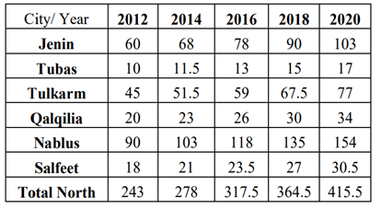
Network General Analysis
electrical network in the West Bank suffers from a lack of capacity we need to cover the missing capacity in several ways, such as solar cells
The electric power demands in (MW) in the northern districts of the West Bank

Slide 7
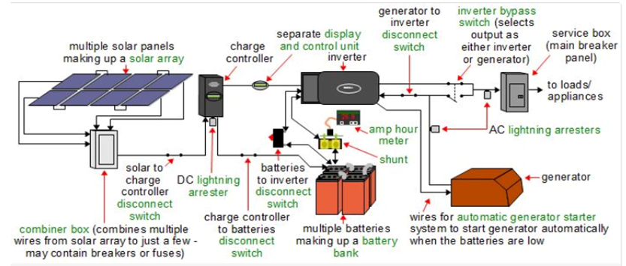
Type Of Connection with Grid
Off-Grid

Slide 8
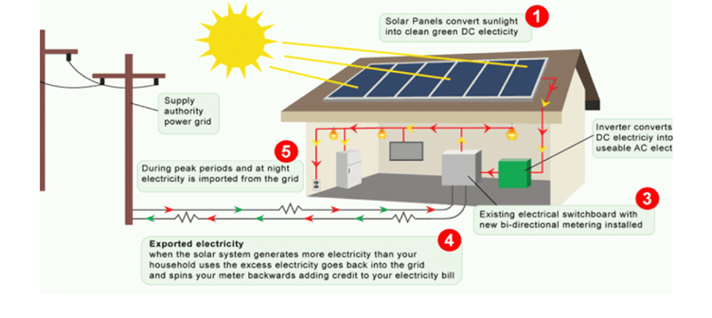
Type Of Connection with Grid
ON-Grid

Slide 9
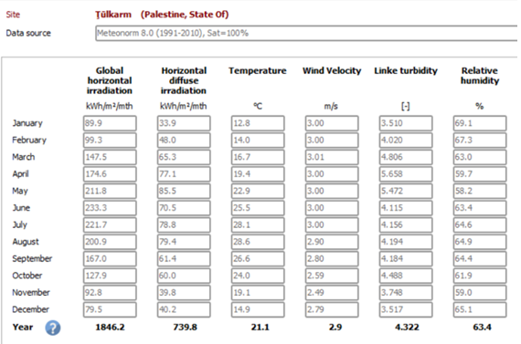
Weather Data
Solar Radiation
The electromagnetic radiation emitted by the sun
Temperature Effect
Temperature increases reduce the
effectiveness of solar panels
Photovoltaic modules are tested at
a temperature of 25 degrees

Slide 10
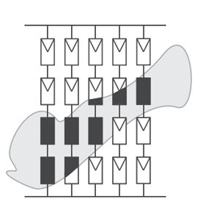
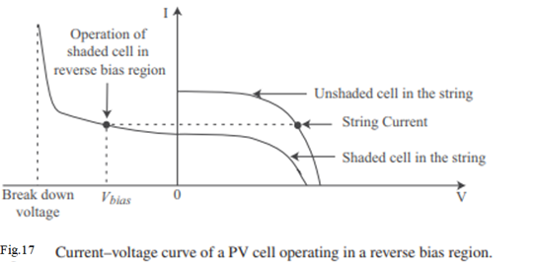
Partial Shading Effects
Since the short-circuit current of a PV cell is proportional to the insolation level, the partial shading effect is a reduction of the photocurrent for the shaded PV cells while the unshaded cells continue to operate at a higher photocurrent.

Slide 11
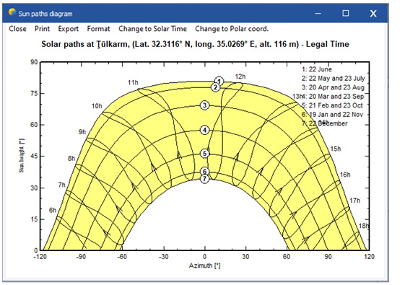
Sun Paths
sun path diagram of a given location which shows the path of the sun across sky from the summer to winter solstice

Slide 12
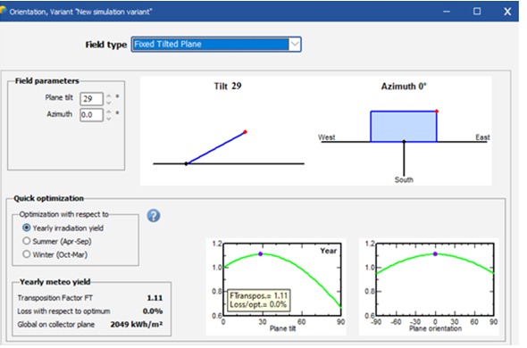
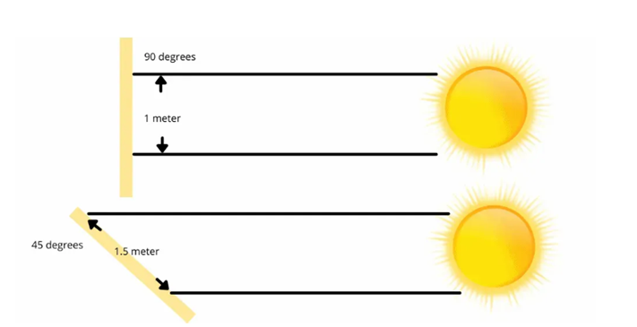
Tilt Angle of PV
Because your panels create the most energy when the sun is directly perpendicular to them,

Slide 13
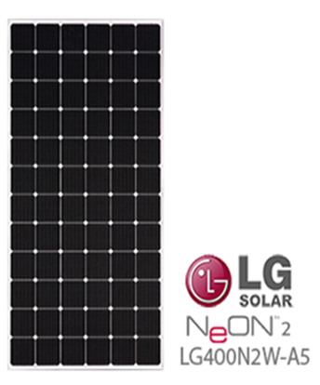
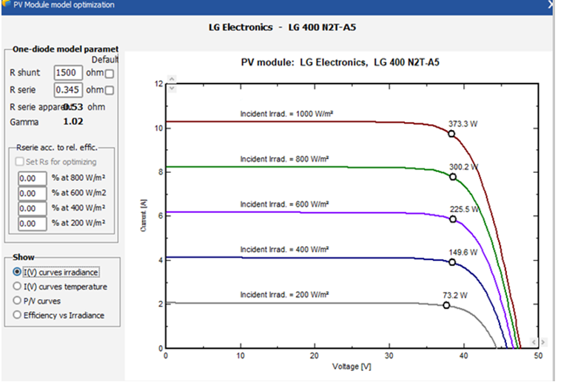
Hardware system
Solar Panels
solar panels from LG company with model number LG 400 N2W-A5

Slide 14
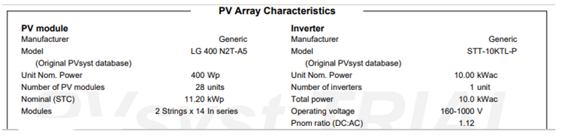
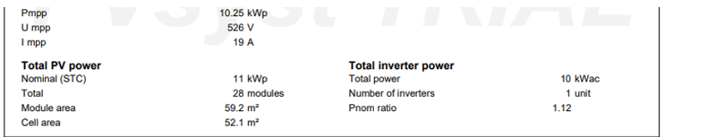
Hardware system
Number of PV module , Inverter , Total PV Power and the Mpp Value

Slide 15
losses In pv Systems
changes in battery voltage
changes in ambient temperature

