Slide 1

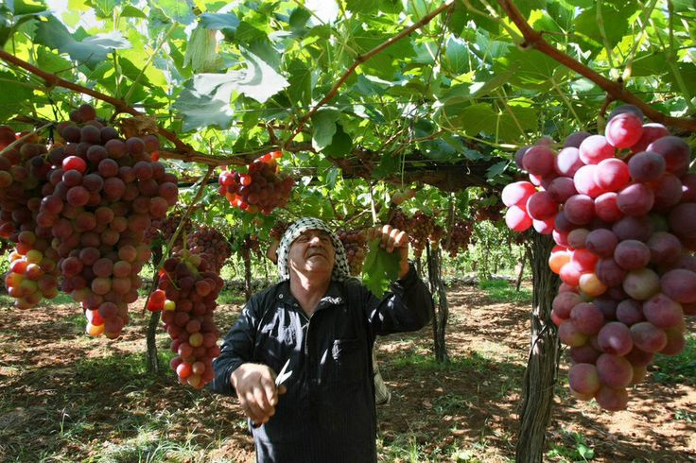




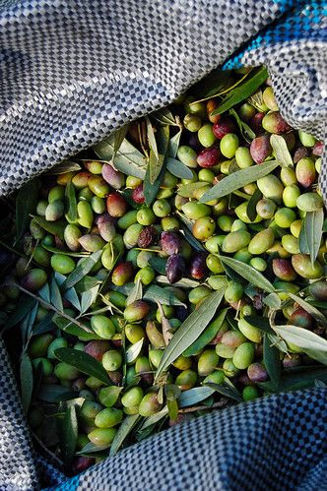

www.reallygreatsite.com
By : Woroud Fouleh & Raghad Mustafa
Supervisor: Dr. Emad Natsheh

Slide 2



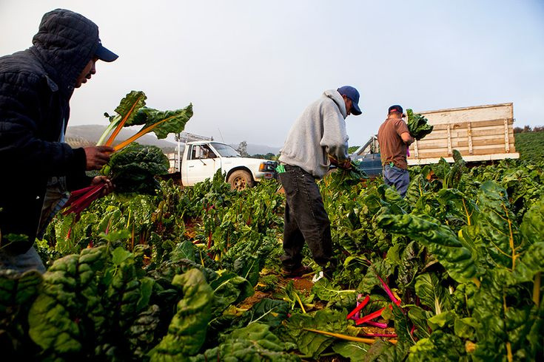
Introduction
Agriculture is a cornerstone of resilience for Palestinians, providing a vital source of income and sustenance amidst economic and political challenges. Qitaf addresses the struggles of farmers and landowners by creating a platform that streamlines access to agricultural resources, job opportunities, and markets. By empowering Palestinian farmers, fostering collaboration, and enhancing food security, Qitaf plays a crucial role in supporting the agricultural sector, which is vital for the stability and prosperity of Palestinian communities.

Slide 3



Problems
Economic Instability
Communication Barriers
Labor Shortages
Wars, restrictions, and high unemployment rates limit opportunities for growth
No platform exists to connect landowners, producers, job seekers, and buyers effectively
Landowners struggle to find workers for harvesting
Marketing Issues
Limited Job Opportunities
Agricultural Problems
Producers face difficulties in advertising and selling their agricultural products.
Lack of structured platforms for roles like delivery personnel.
Farmers lack a collaborative space to exchange solutions for ongoing challenges.

Slide 4



Objectives
Foster Collaboration
Empower Farmers
Build Trust
Enhance Food Security
Support the Economy
Improve User Experience
Provide Job Opportunities
Offer Production Services

Slide 5






Tools & Platforms
MongoDB
VS Code
GitHub
FireBase
Andriod Studio
Postman

Slide 6


Technologies
Backend
Frontend

Slide 7


Welcome

Slide 8
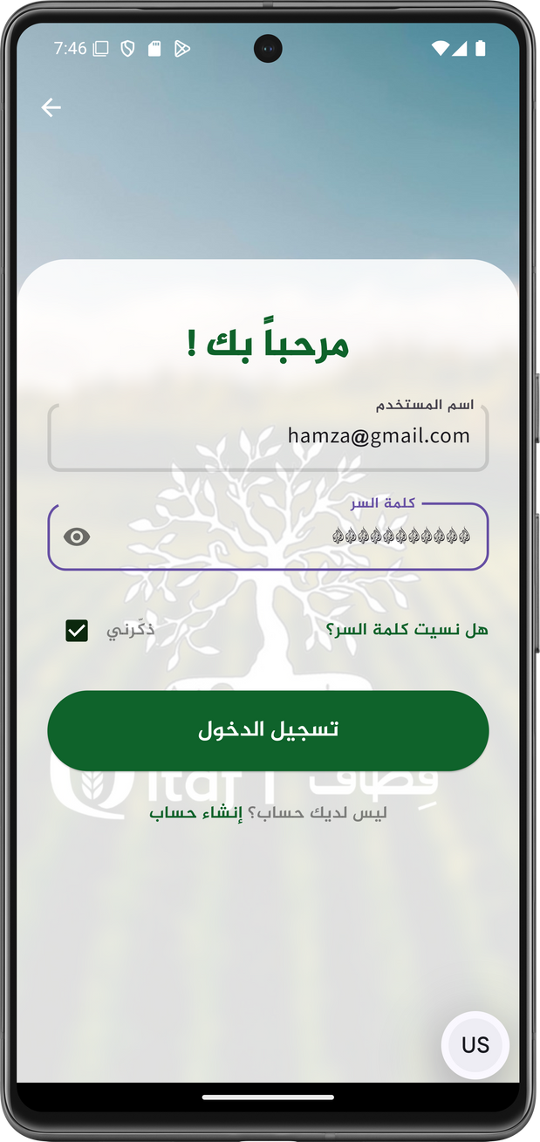
LOGIN

Slide 9
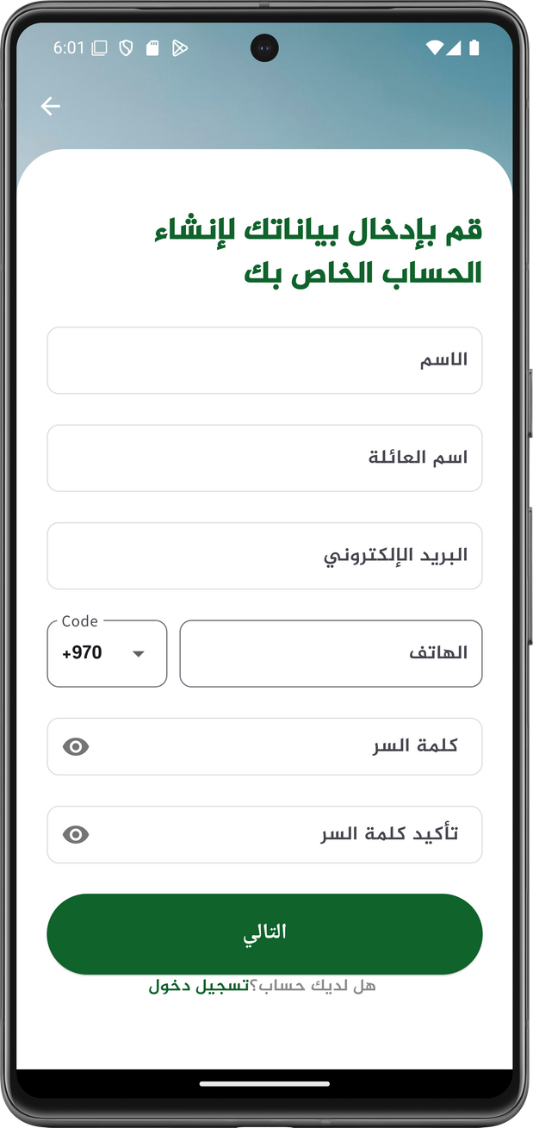
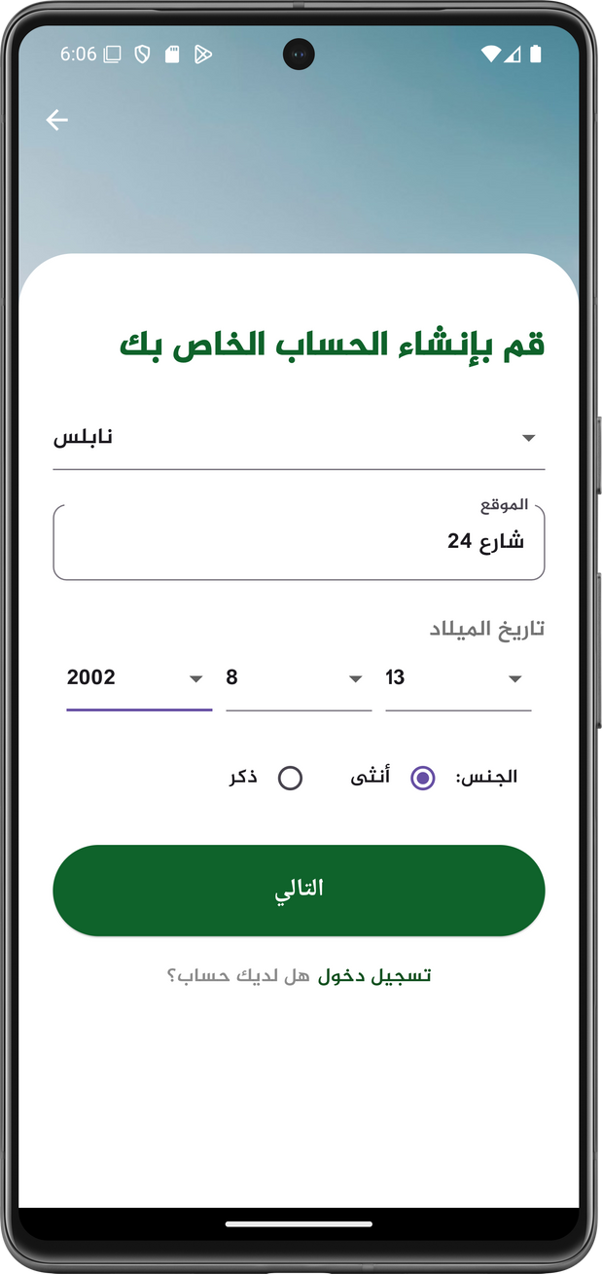
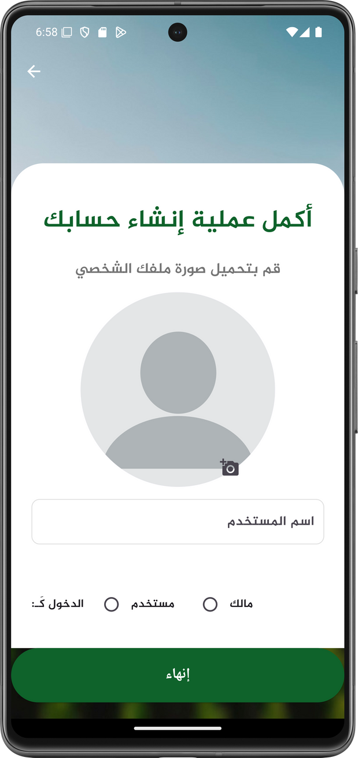
SIGN UP

Slide 10
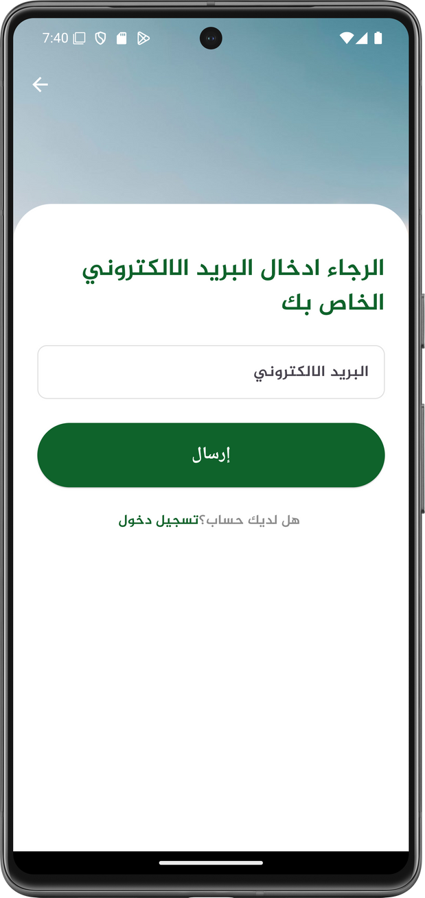

FORGOT PASSWORD

Slide 11
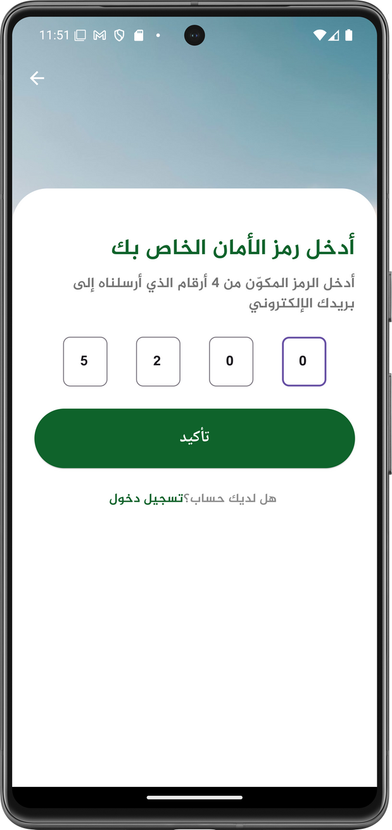
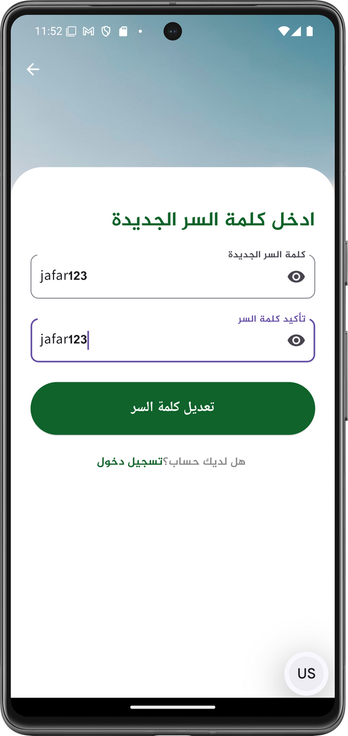
FORGOT PASSWORD

Slide 12




Purchase products
The users can check for available products, make an order, choose the suitable deliver and payment method, then recieve his products
The three main processes!
Working on agricultural land
The user can view the available agricultural lands for work and submit a request to work on them.
Booking in a production line
The user can easily and conveniently book an appointment for the relevant production line.

Slide 13
Purchase products
The users can check for available products, make an order, choose the suitable deliver and payment method, then recieve his products
The three main processes!
Working on agricultural land
The user can view the available agricultural lands for work and submit a request to work on them.
Booking in a production line
The user can easily and conveniently book an appointment for the relevant production line.

Slide 14
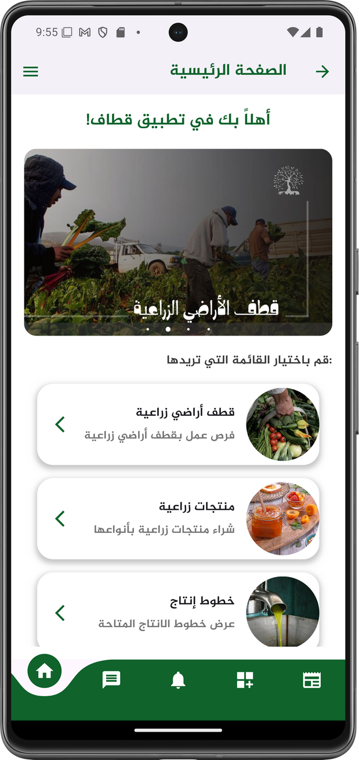
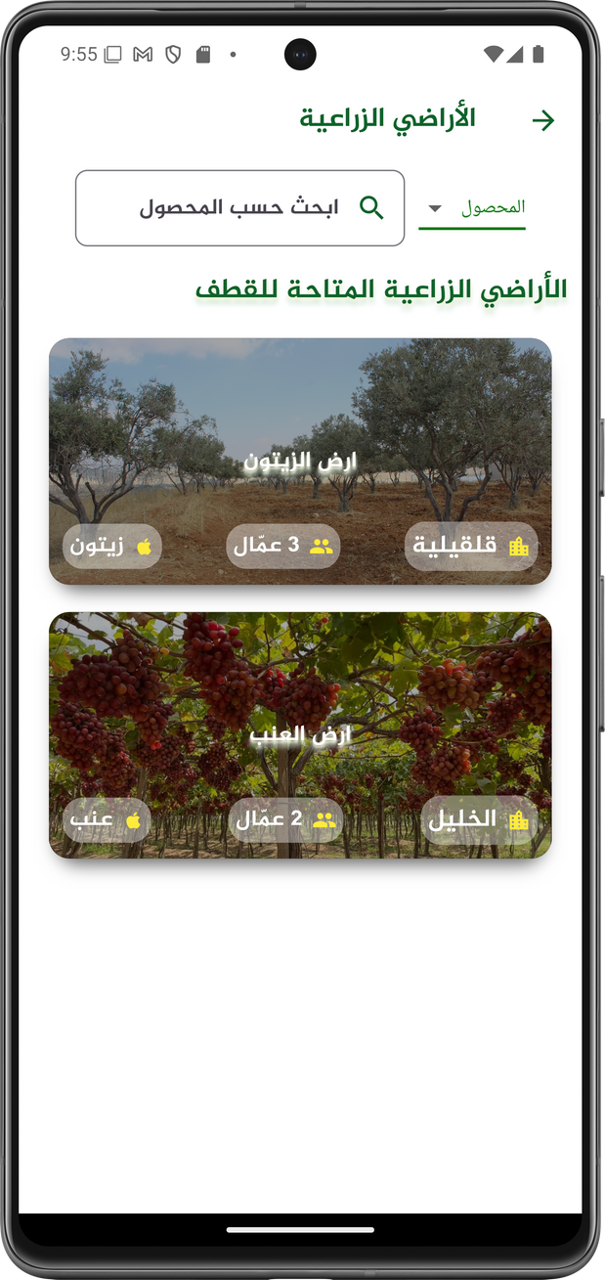

Working on agricultural land

Slide 15
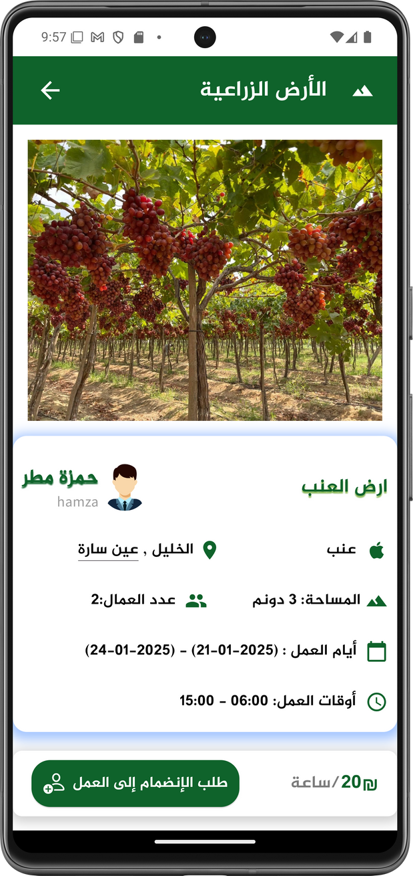
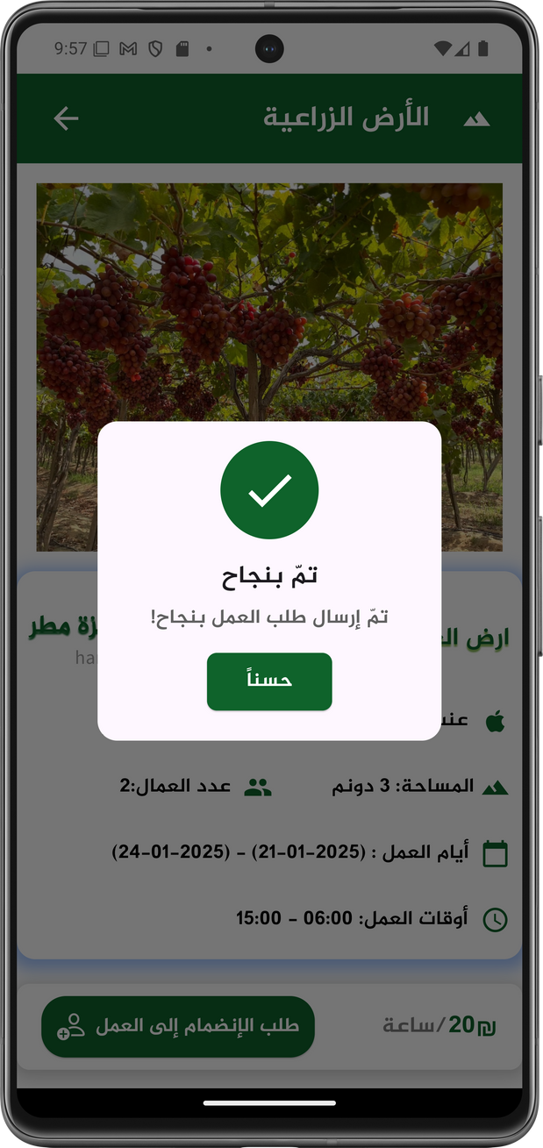
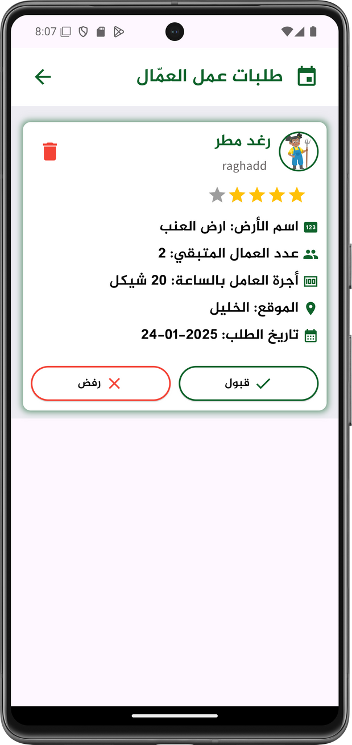

Working on agricultural land
To the owner

Slide 16
Purchase products
The users can check for available products, make an order, choose the suitable deliver and payment method, then recieve his products
The three main processes!
Working on agricultural land
The user can view the available agricultural lands for work and submit a request to work on them.
Booking in a production line
The user can easily and conveniently book an appointment for the relevant production line.

Slide 17
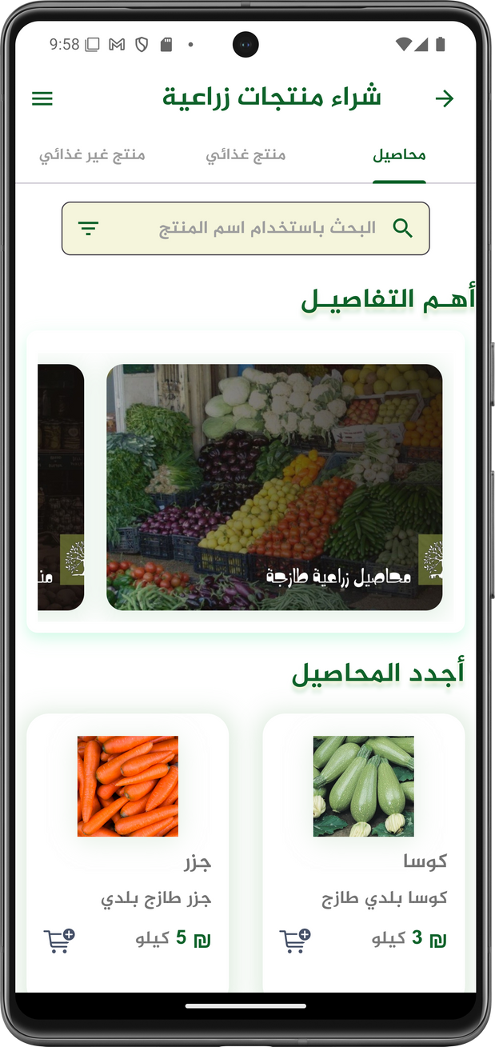
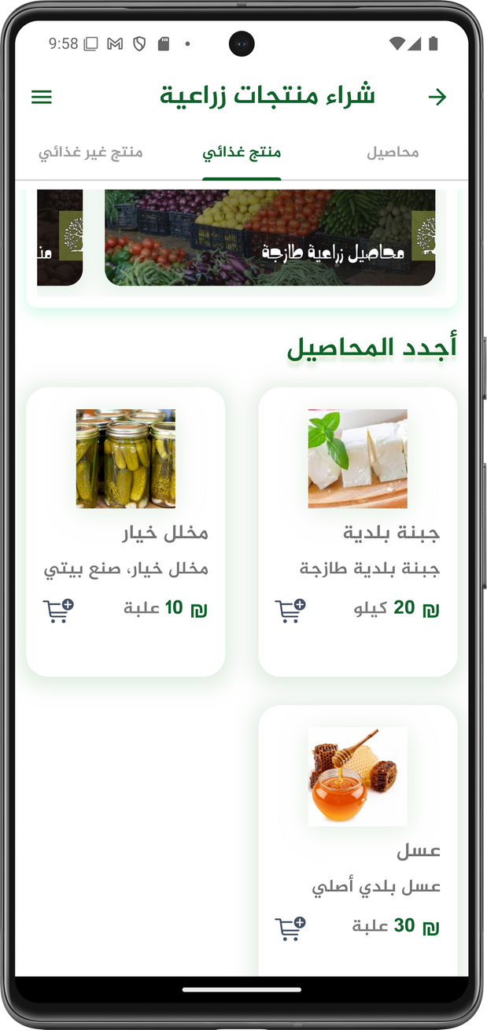
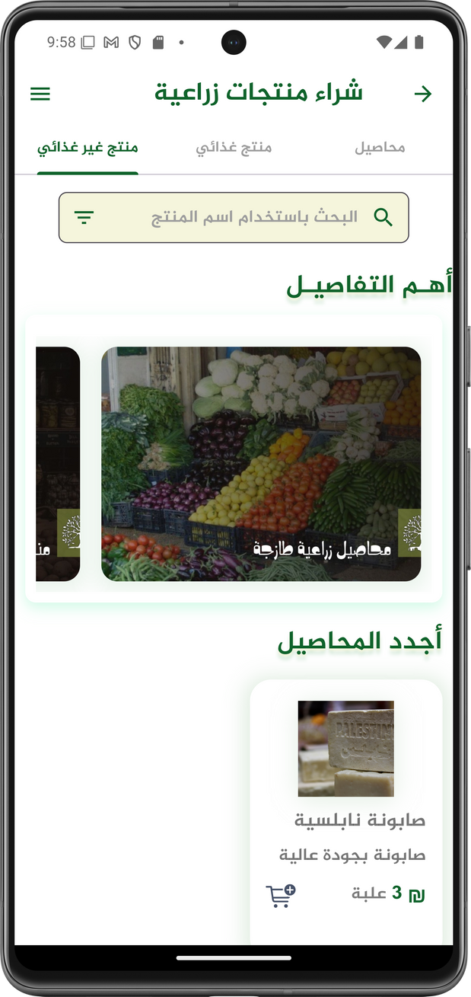
Purchase
Products

Slide 18
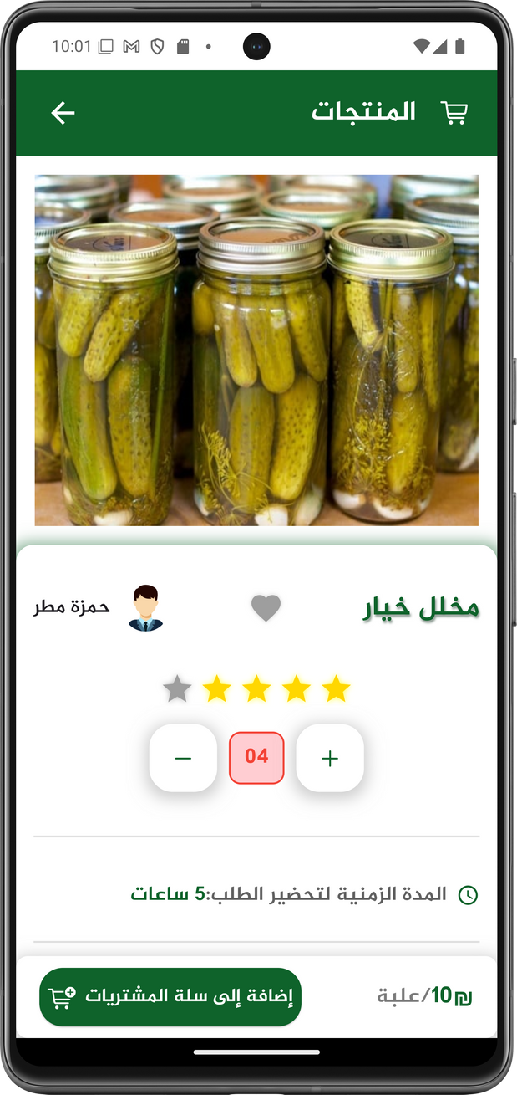
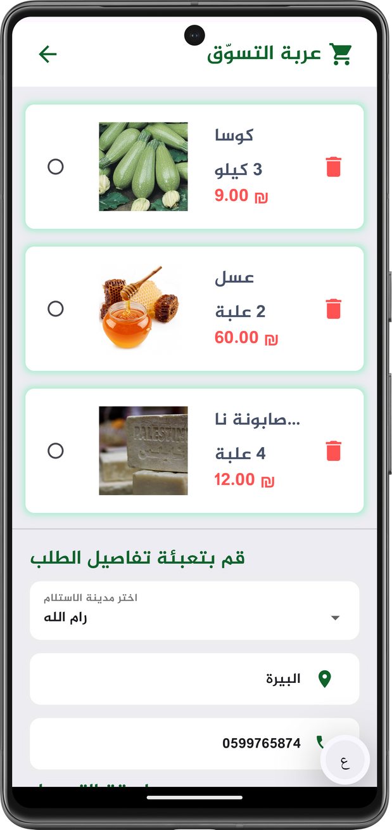
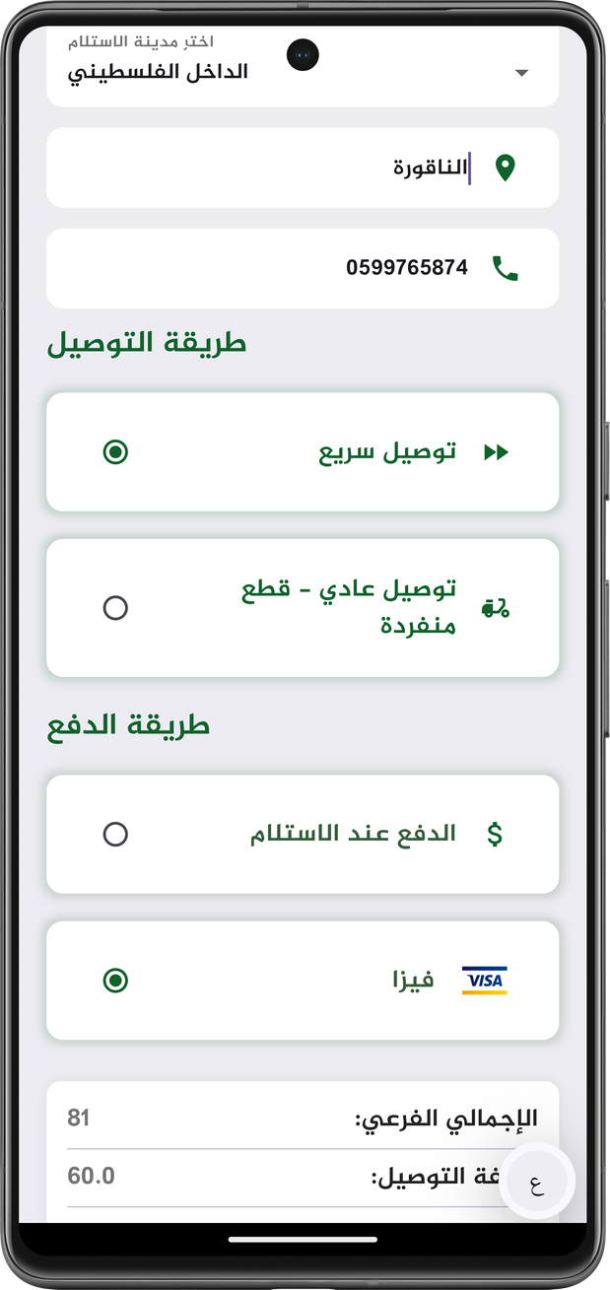

Purchase
Products

Slide 19
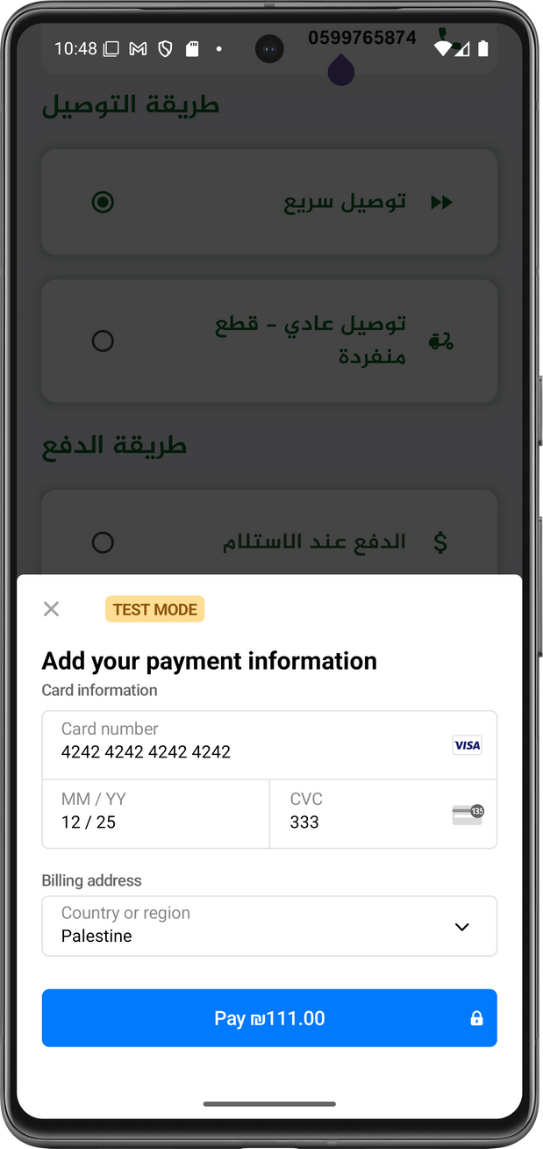
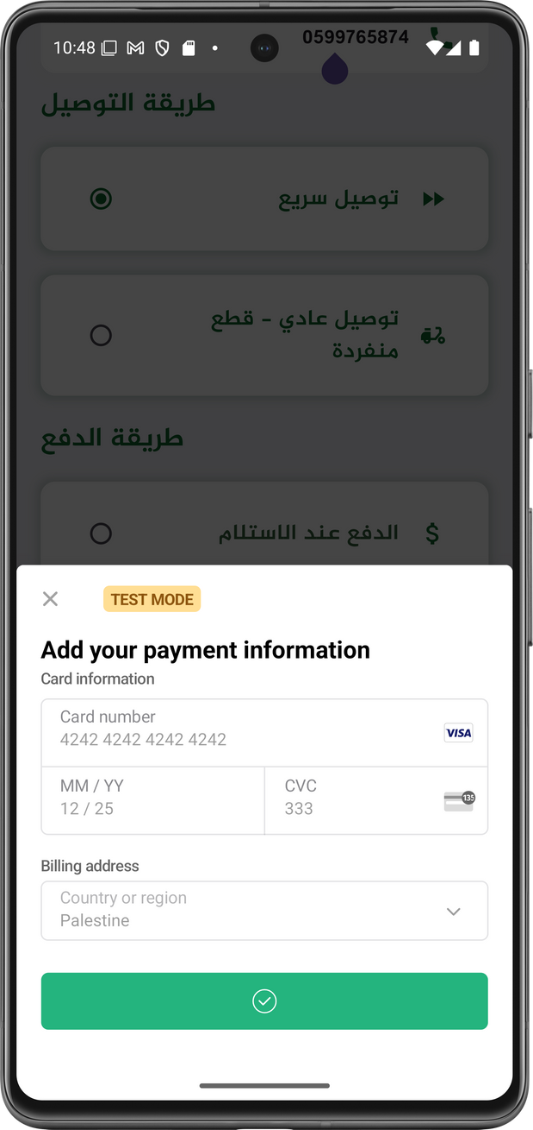
Purchase
Products
Payment using
STRIPE!

Slide 20
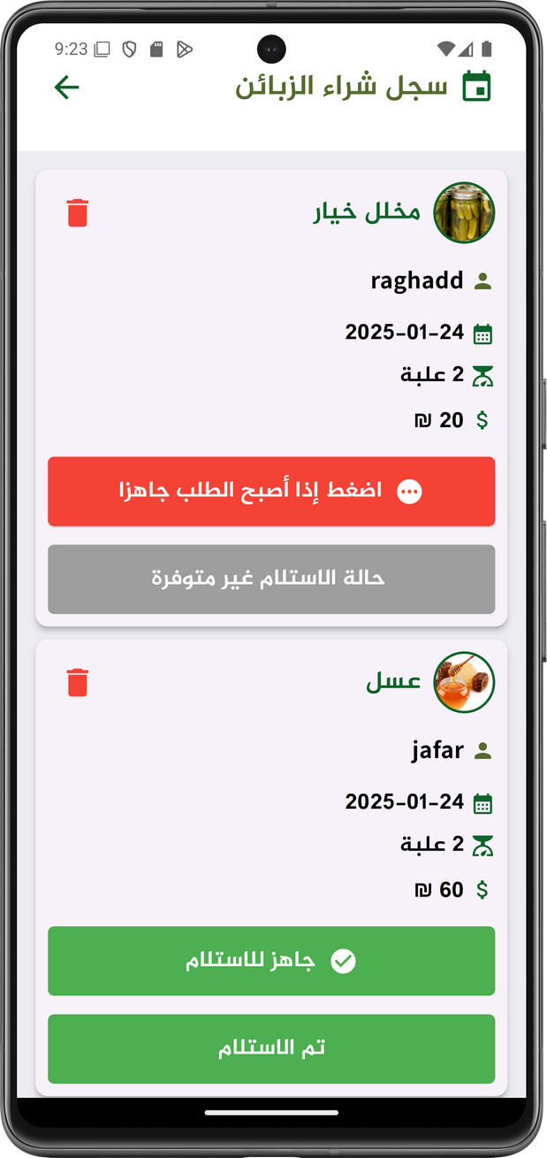
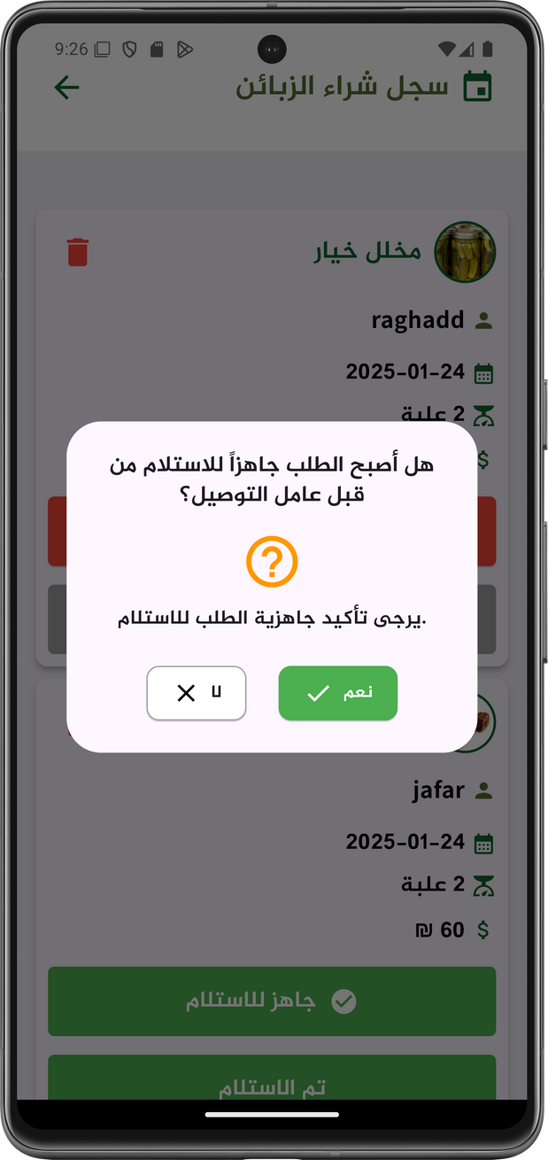
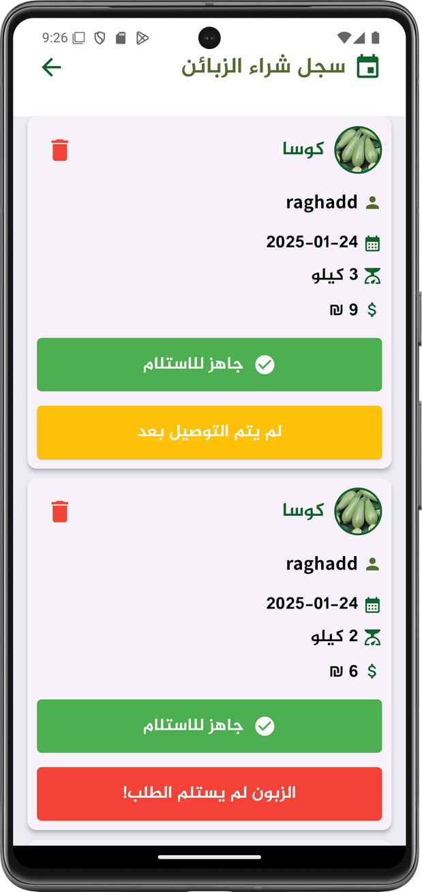
Purchase
Products
Product owners prepare them.

Slide 21
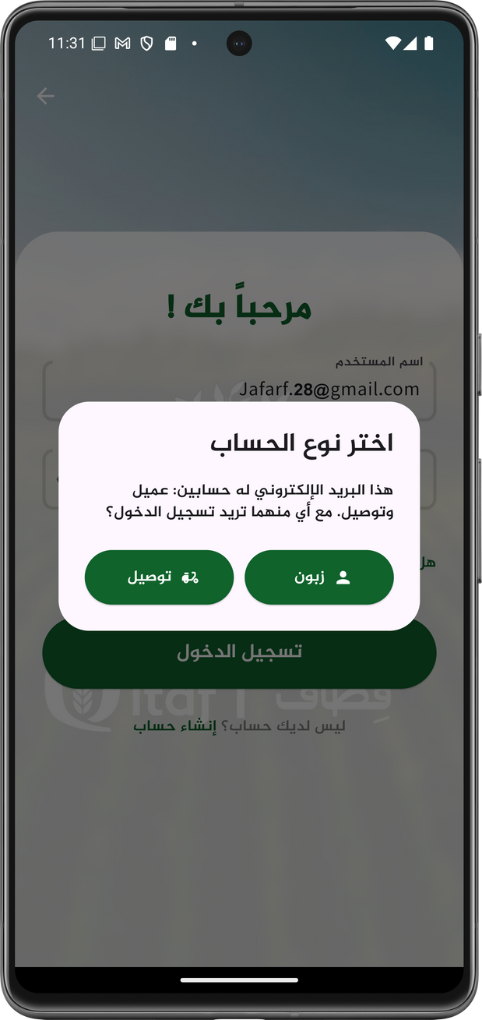
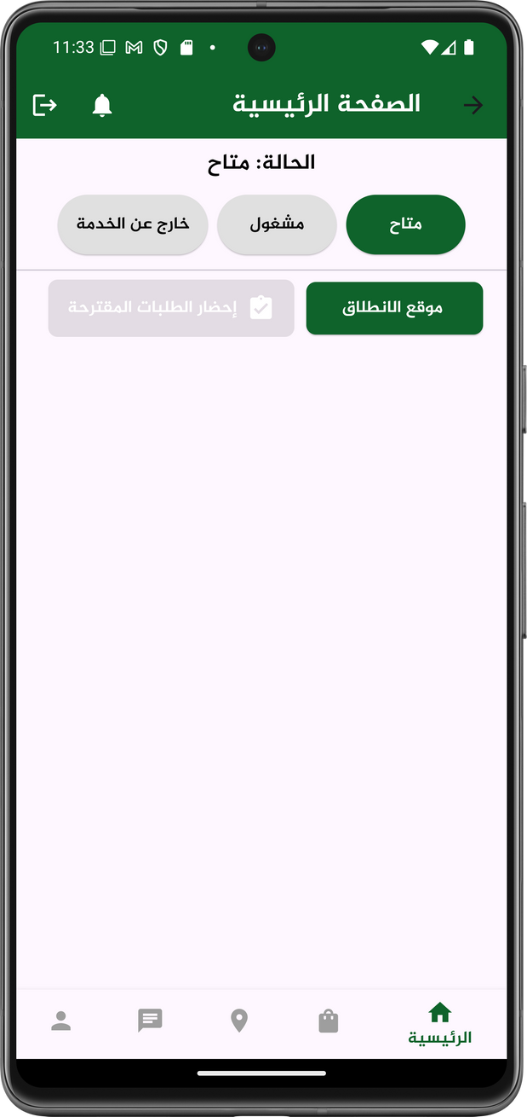
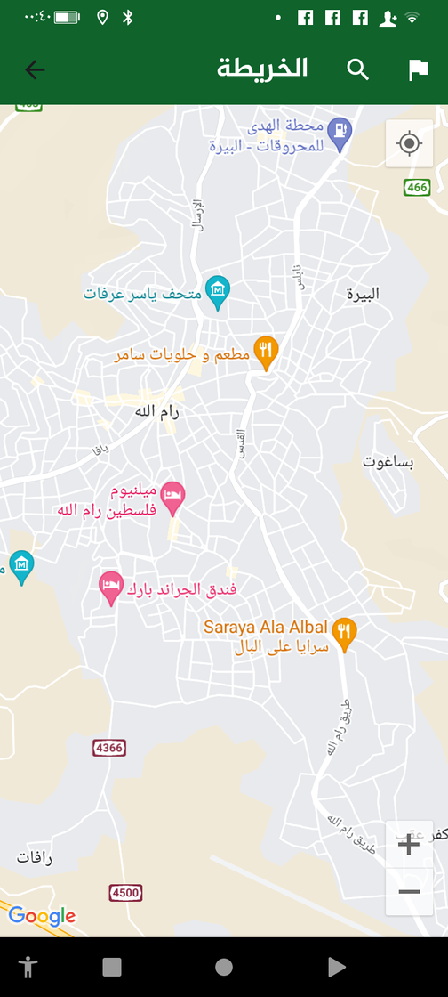
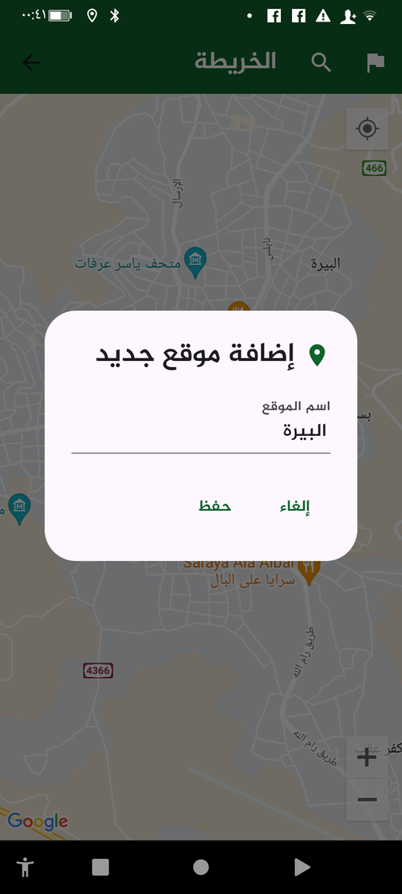
Purchase
Products
Delivery process

Slide 22
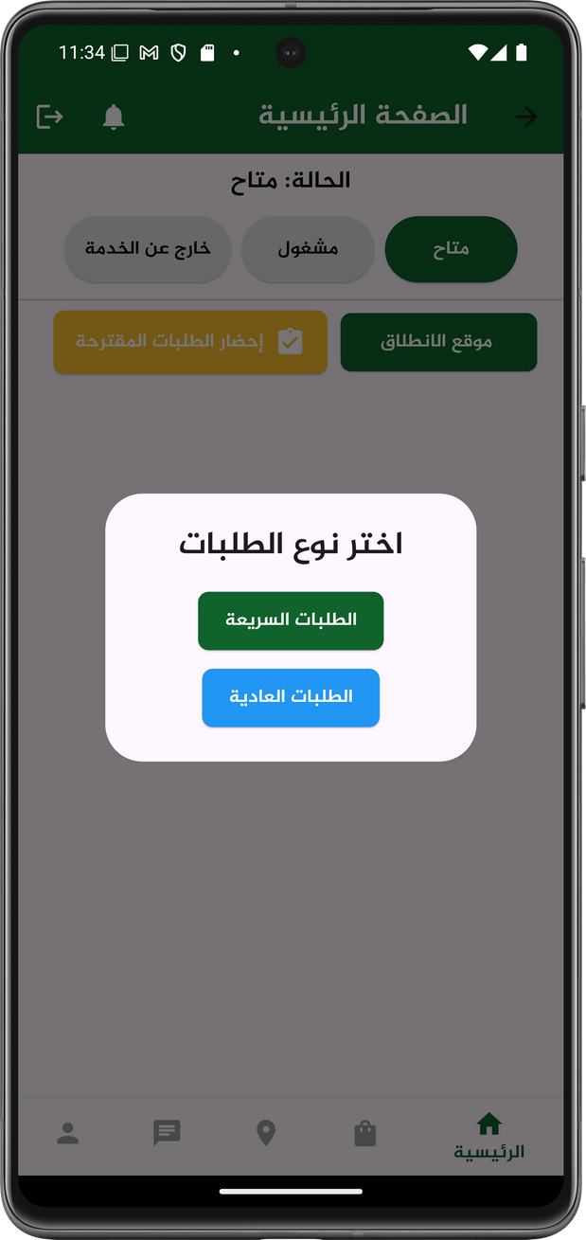
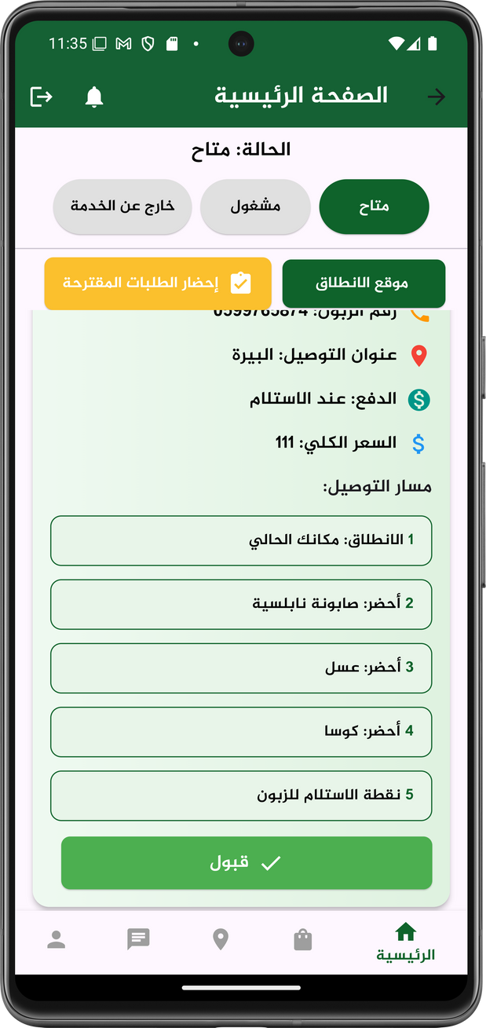
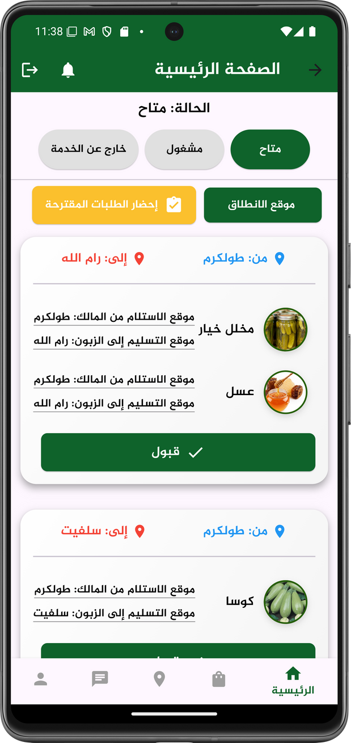
Purchase
Products
Delivery process

Slide 23
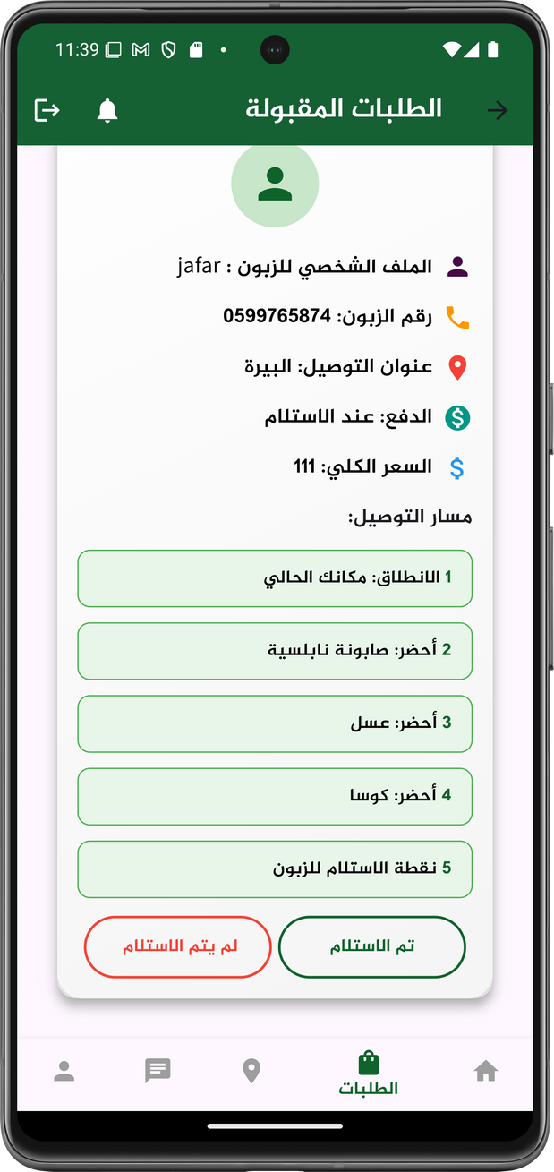
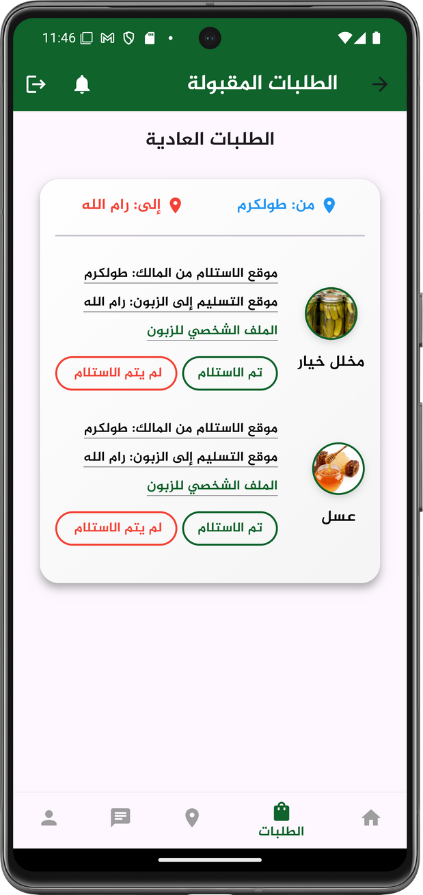
Purchase
Products
Delivery process

Slide 24
Purchase products
The users can check for available products, make an order, choose the suitable deliver and payment method, then recieve his products
The three main processes!
Working on agricultural land
The user can view the available agricultural lands for work and submit a request to work on them.
Booking in a production line
The user can easily and conveniently book an appointment for the relevant production line.

Slide 25
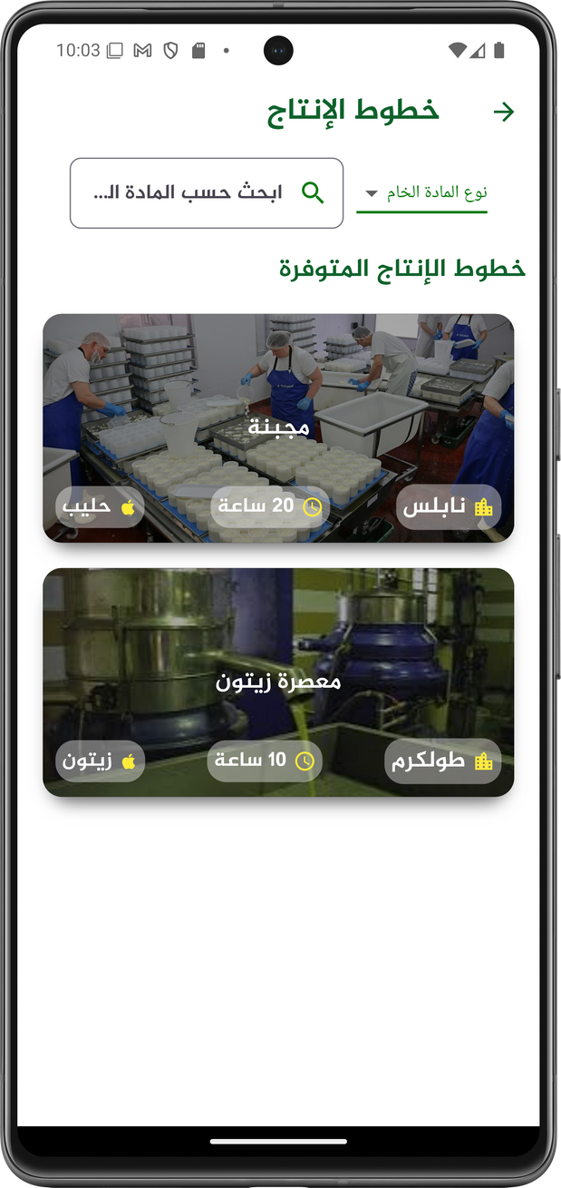
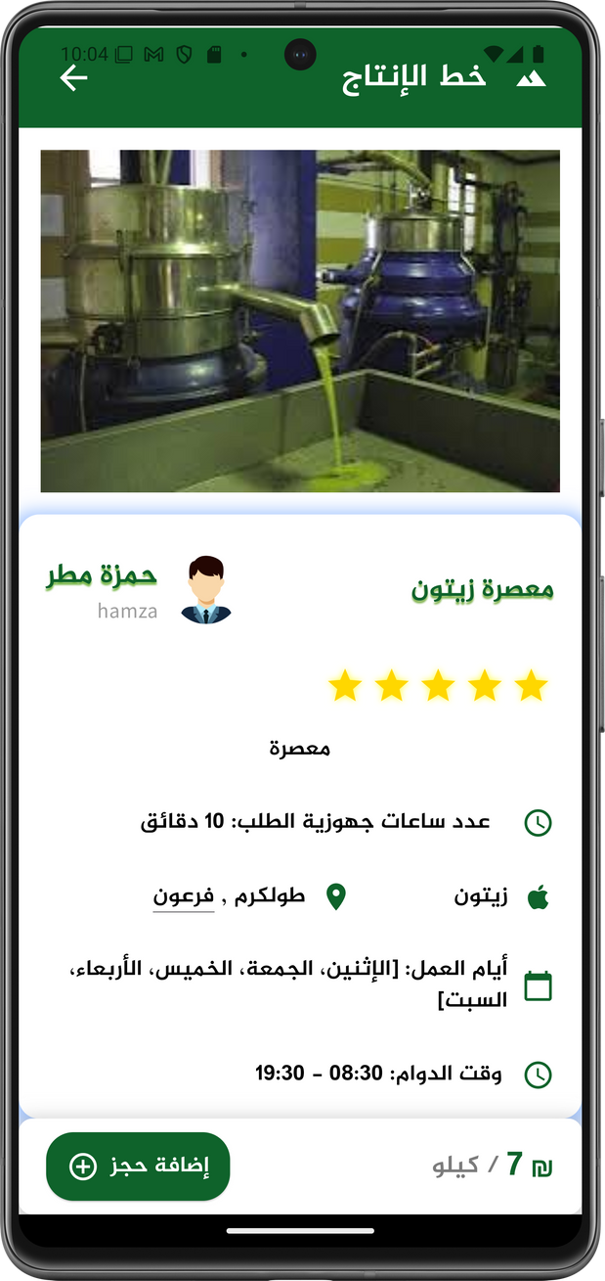
Booking in a production line

Slide 26
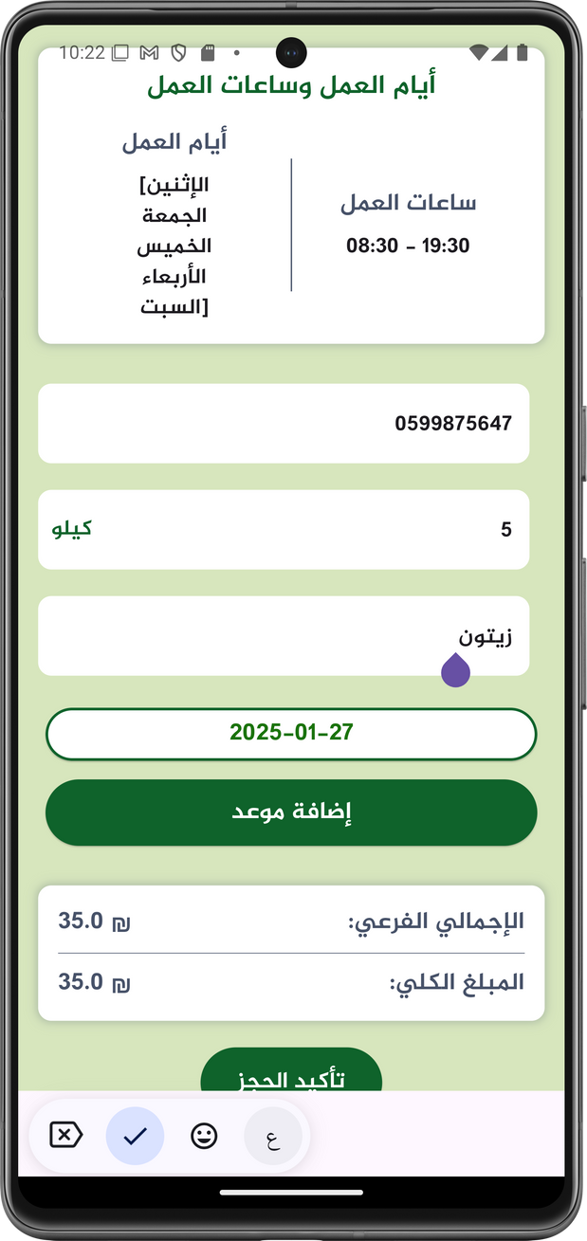
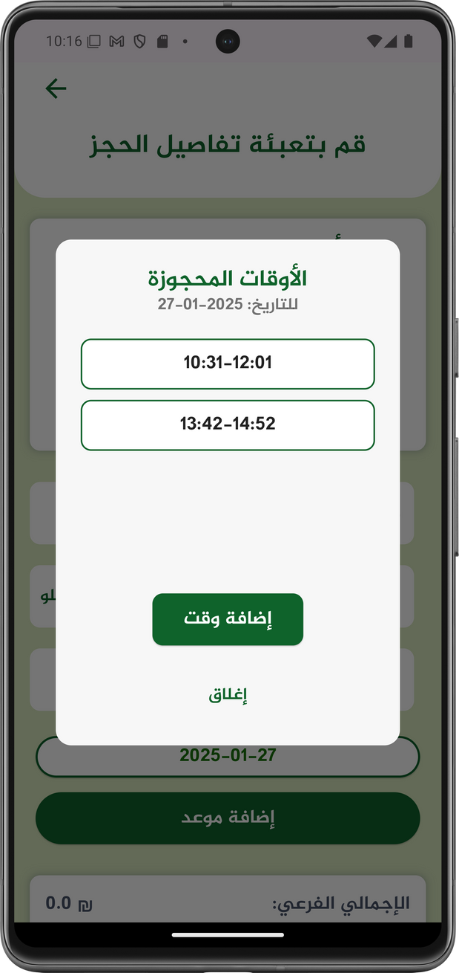
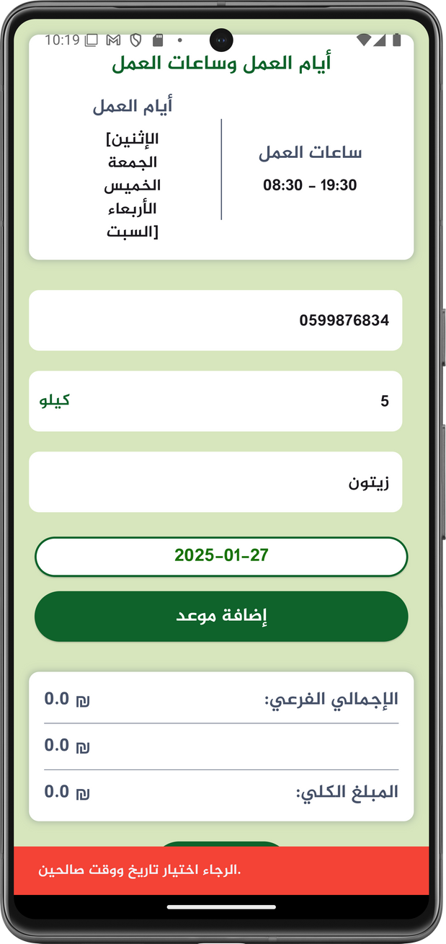
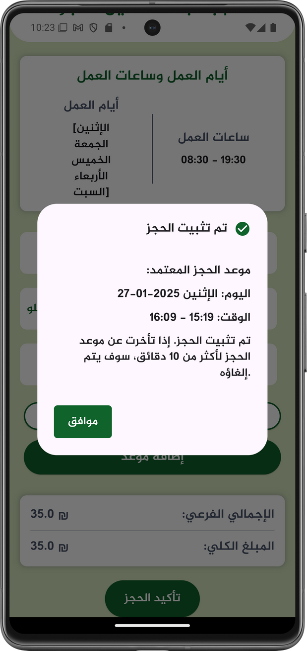
Booking in a production line

Slide 27











Other Features
Notifications System
Application Statistics
Edit profile
Reporting system
Chat individually or within groups
A forum for discussion and inquiries
Rating system
Advertisements system

Slide 28






Other Features
Discount System
Get locations
Add lands. lines and products
Apply to delivery work
Earn points
Viewing user profiles
Search and filter

Slide 29
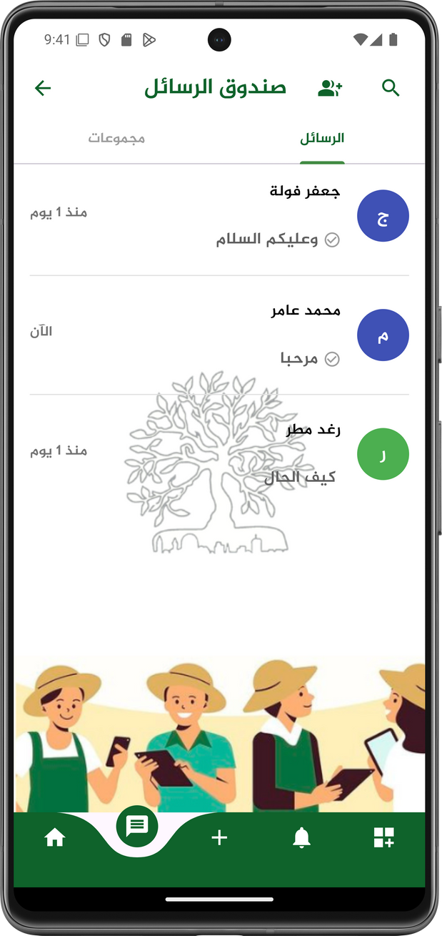
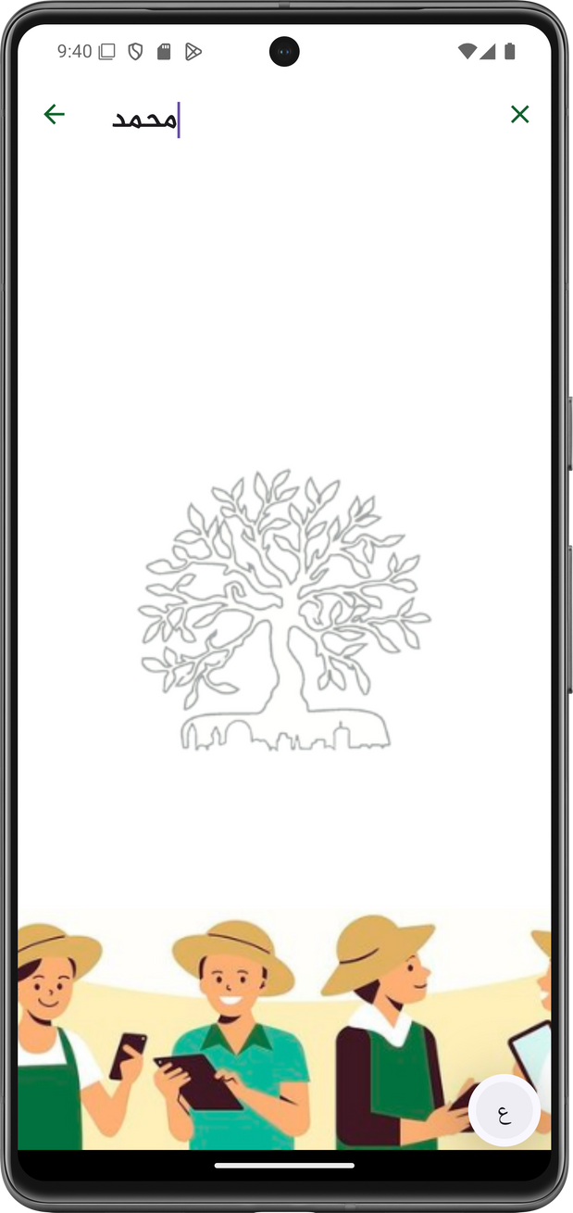
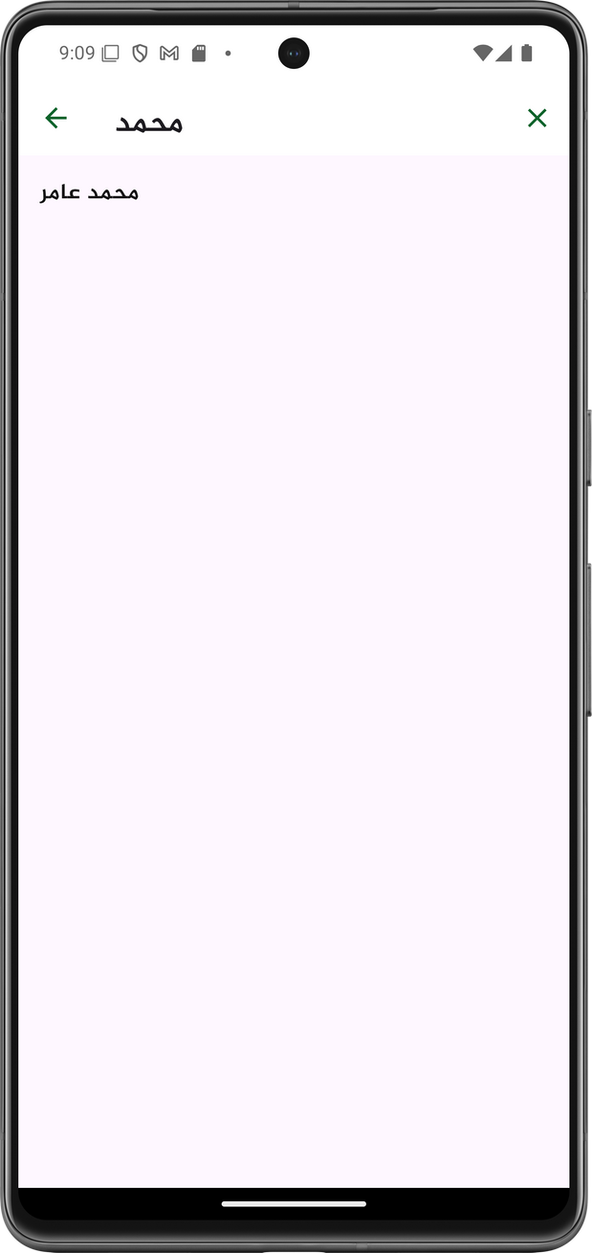
CHAT
INDIVIDUAL

Slide 30
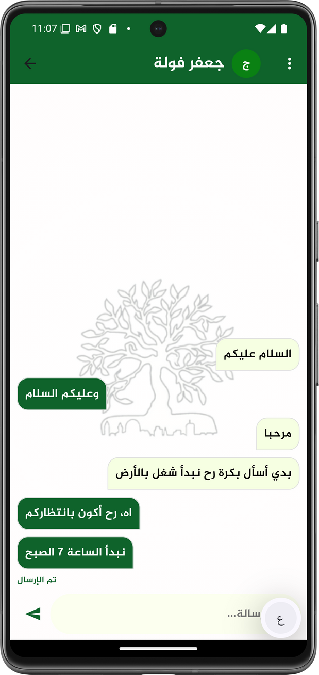
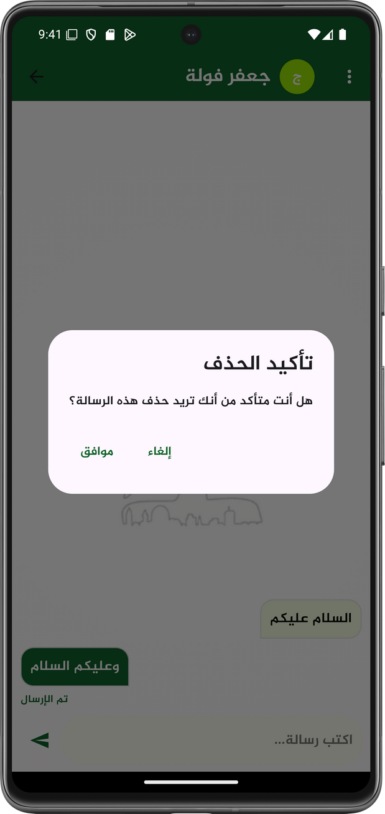
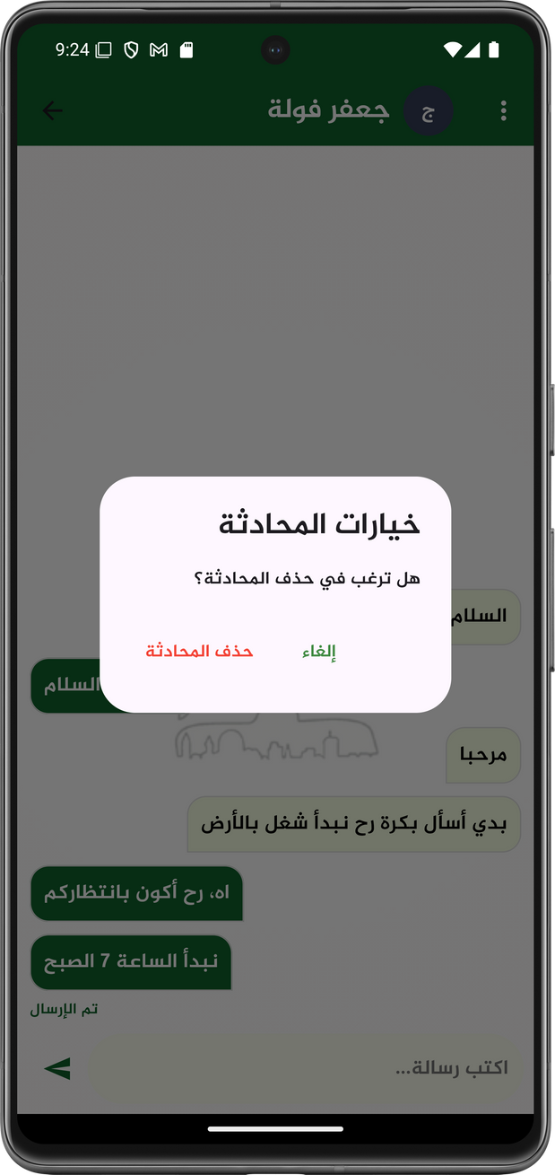
CHAT
INDIVIDUAL

Slide 31
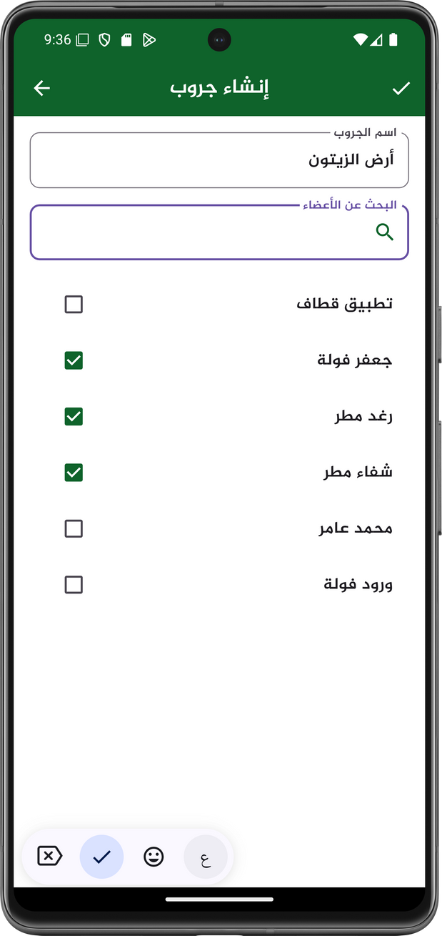

CHAT
GROUP

Slide 32
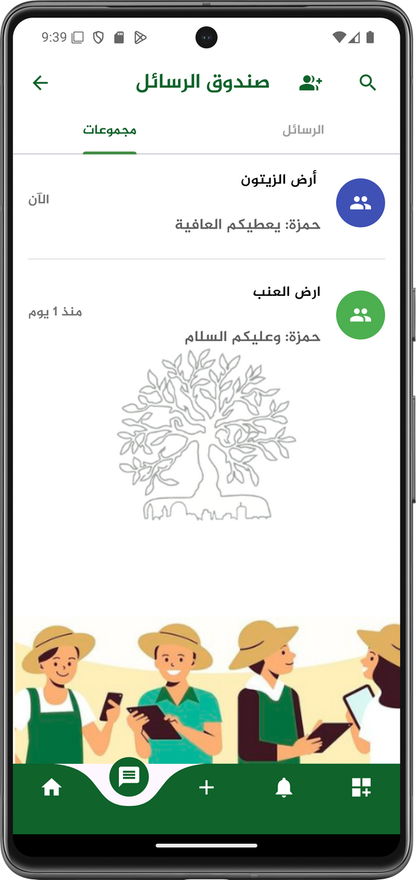
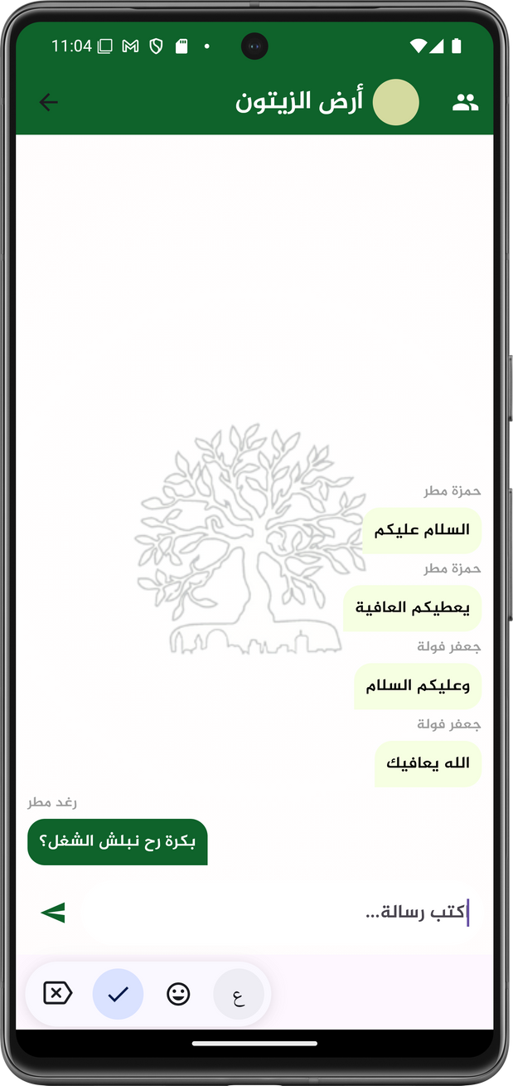
CHAT
GROUP

Slide 33



Notifications

Slide 34



Notifications
Live

Slide 35



Discussion
Forum

Slide 36


for producation lines
Rating
for products
for workers

Slide 37


Points + Discount
Earn
points
Get
Discount
Purchase
products
Rating

Slide 38


POINTS &
DISCOUNTS

Slide 39
Unreceived orders
Reporting
Workers
Missing a booking appointment

Slide 40




Reporting

Slide 41


Add Lands, Lines and products

Slide 42

Personal
Profile
Customer

Slide 43



Personal
Profile
Owner

Slide 44


Personal
Profile
Owner

Slide 45

Personal
Profile
Delivery Man

Slide 46




Apply to delivery work

Slide 47


Apply to delivery work

Slide 48


Advertisements

Slide 49

Advertisements

Slide 50

Advertisements

Slide 51



Application Statistics

Slide 52



Search and filter

Slide 53



Get laocations and paths

Slide 54




View Users profiles

Slide 55


Previuos
Activities
Owner

Slide 56



Previuos
Activities
Customer

Slide 57


Previuos
Activities
Customer

Slide 58


Constraints
Firebase Integration
Dependency Issues
CORS Issue
Database Challenges
Arabic Design Difficulties
Google Maps API

Slide 59

Future Work
Add recommendation system
Add delivery man tracking system
Tracking special order by owner and customer

Slide 60



THANK YOU!

