Slide 1


Faculty of Engineering & Information Technology
Department of Industrial and Mechanical Engineering
Sustainability analysis -best practices development and improvement
By:
Wasan Daraghmeh
Sara Na’na
Shahd Ibraheem
Qais Malhis
Supervisor :
Dr.Basheer Shaheen

Slide 2
TABLE OF CONTENTS
Introduction
1
2
Problem Statement, Scope and Objectives
3
Methodology
4
Data collection
5
Data analysis
6
recommendation

Slide 3
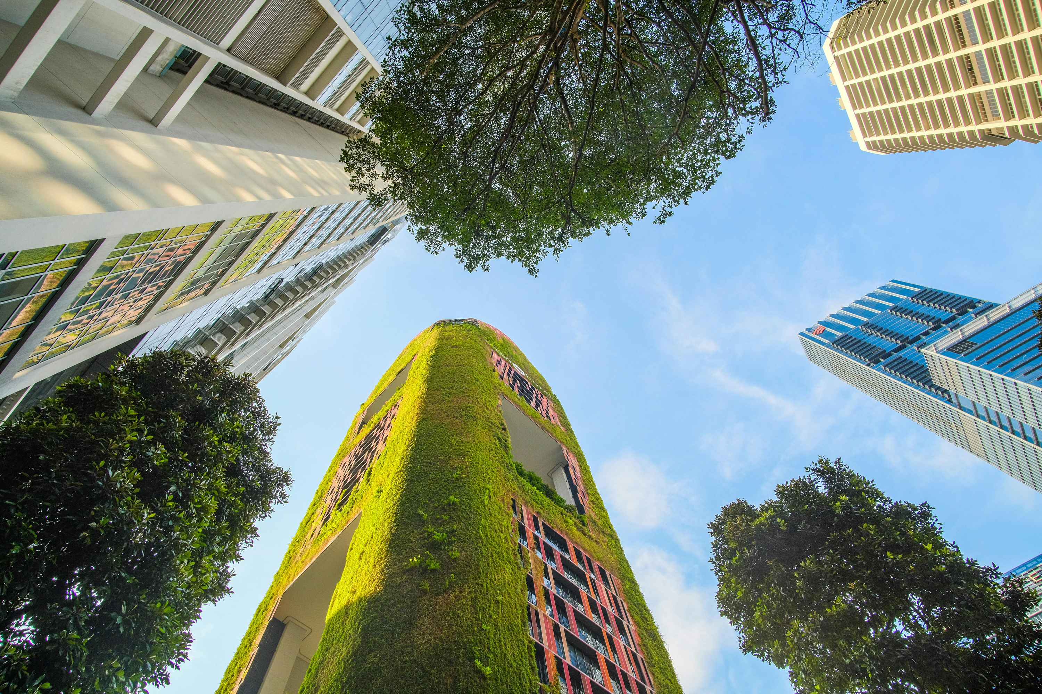
INTRUDOCTION

Slide 4
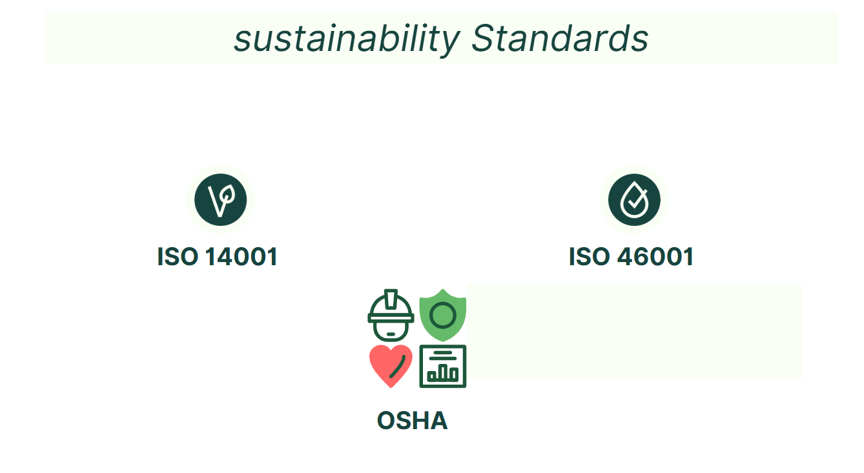

Slide 5

PROBLEM STATEMENT

Slide 6
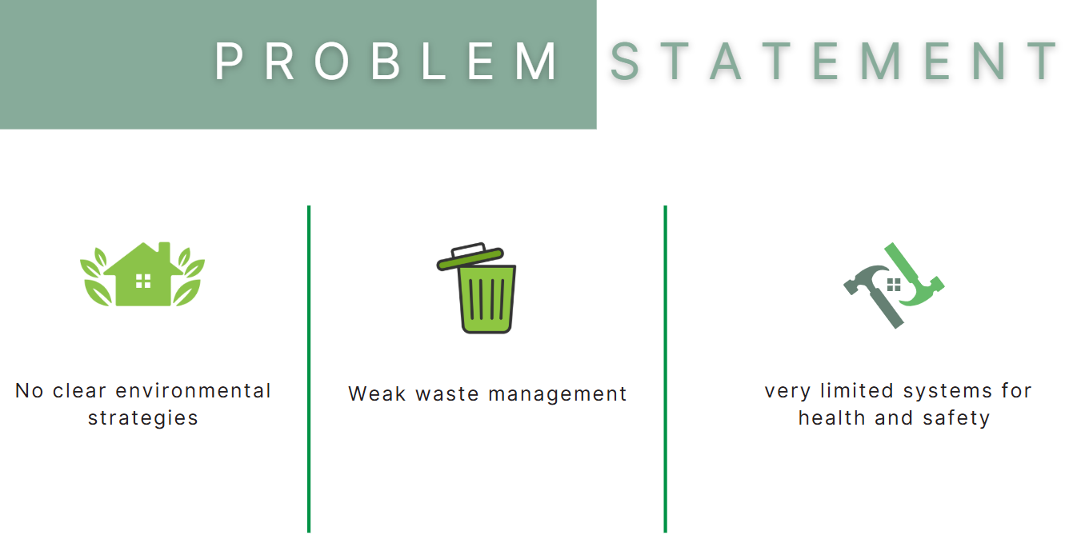

Slide 7
PREVIOUS WORKS
Research was conducted on the Google Scholar database, between 2018 and 2024.
Fifty research works were collected, and then fifteen studies were actively selected based on two key selection criteria
The research has been grouped into two sections :
Previous works related to FOOD and SUSTAINABILITY.
previous works related to SMALL AND MEDIUM ENTERPRISES and SUSTAINABILITY

Slide 8
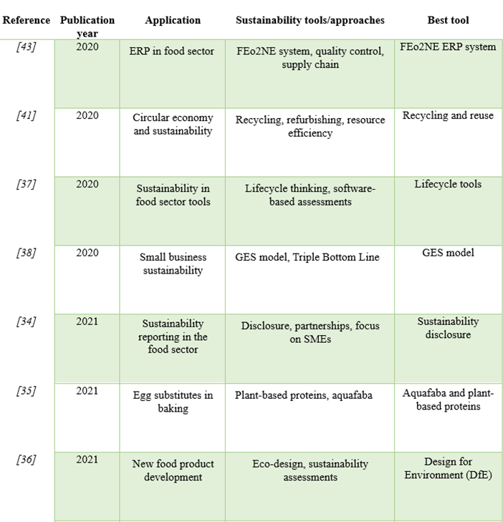
Summary of previous works

Slide 9
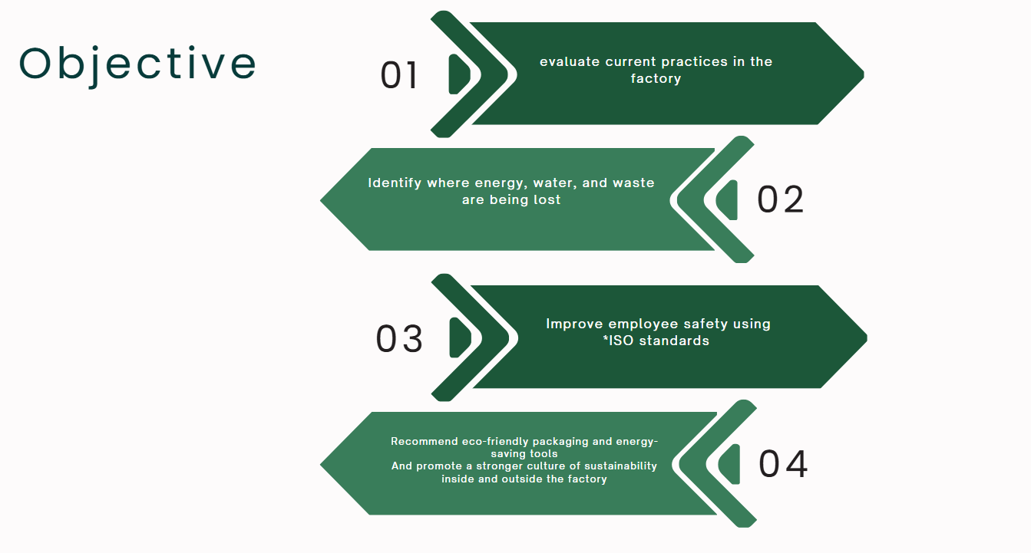

Slide 10

METHODOLOGY

Slide 11
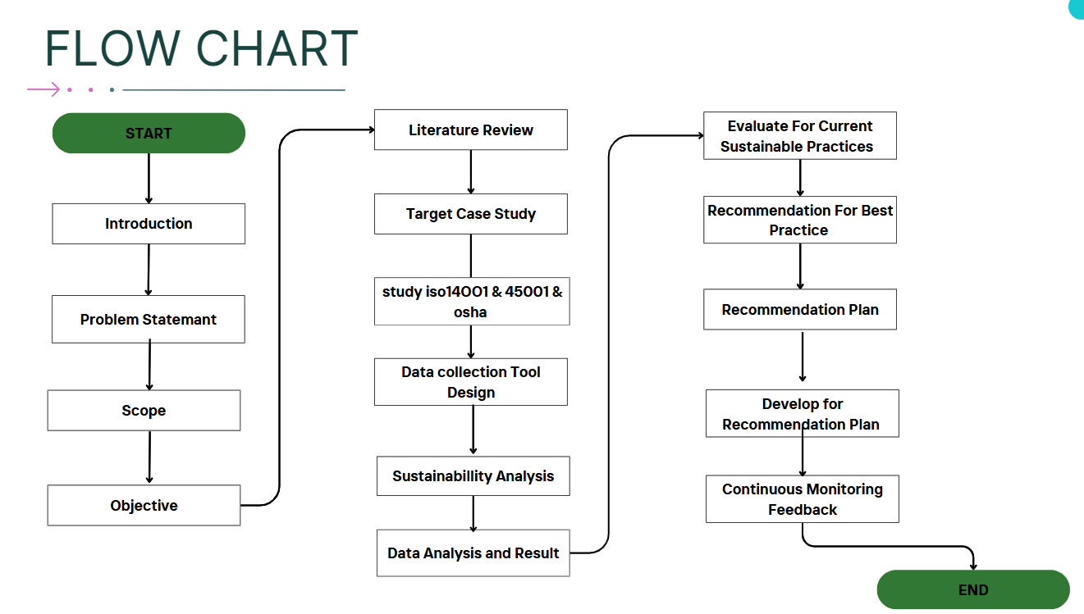

Slide 12



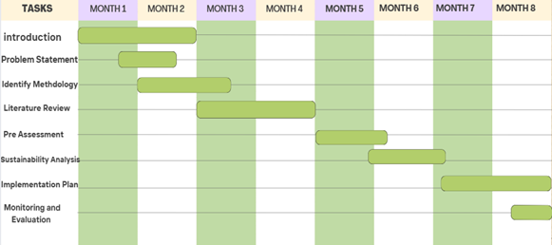
METHODOLOGY TIMELINE

Slide 13
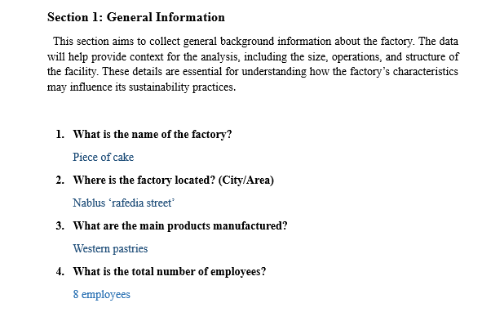

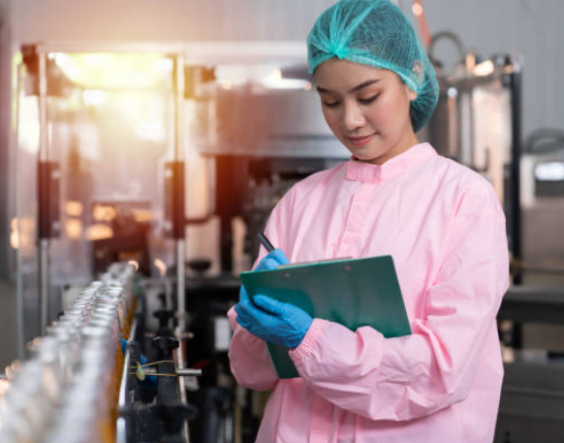
Data Collection Tools
1. Questionnaires
2. Interviews
3. Observation
3. Observations
4. Focus Groups
5.Document and Record Review

Slide 14
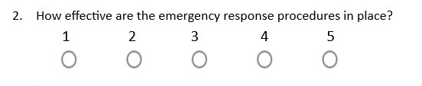

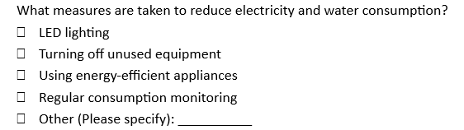

Data Collection Method
✔ Closed-ended (MCQ, Yes/No, Likert scale)
✔ Open-ended (for deeper insights)
✔ Language: Simple and clear wording to avoid confusion
✔ Length: Short, focused questions to boost response rate

Slide 15

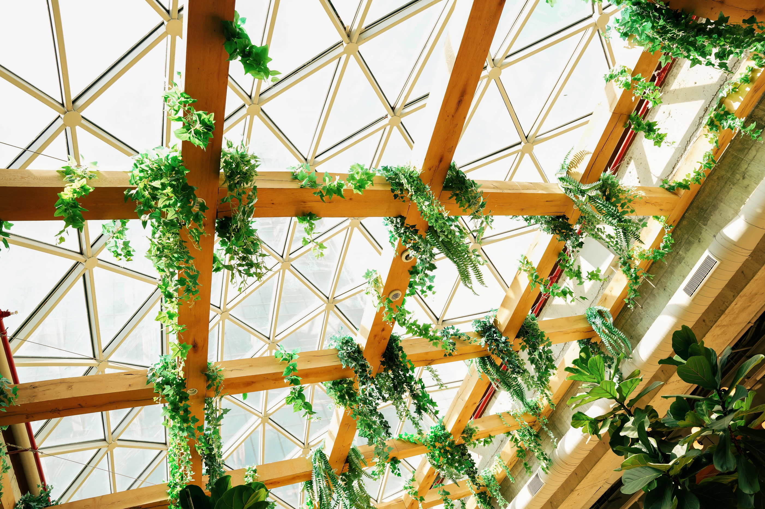
TYPES OF Research :
Observation Research
Primary Research
Secondary Research

Slide 16
Data type is divided into two main sections
              Quantitative Data : This information can be measured and analyzed statistically.
01
              ➤ Example: How many customers purchased the product last month?
Qualitative Data: It's non-numerical metadata. Common sources include text analysis and observations.
02
➤ Example: How do customers view a product?

Slide 17
interviews as a Qualitative Research Tool
Structured
Semi-Structured
Unstructured rsearch

Slide 18
interviews as a Qualitative Research Tool
Type | Key Features | Advantages | Disadvantages
Structured | Fixed set of closed-ended questions, same for all | - Easy to compare responses- High reliability and validity | - Limited scope- No flexibility to explore new insights
Semi-Structured | Guided by a thematic framework with open-ended questions | - Balanced flexibility and structure- Allows follow-up questions | - Requires good interview skills- Harder to analyze consistently
Unstructured | No predefined format, highly conversational | - Rich, in-depth data- Comfortable for participants | - Low reliability- Difficult to compare or generalize

Slide 19

Questionnaire Distribution
🌐 Online
Google Forms
Survey Monkey
Email
📝 Paper-based
Used for
face-to-face cases
☎️ Phone interviews
Used for
clarification

Slide 20

DATA ANALYSIS

Slide 21


GENERAL INFORMATION ABOUT THE FACTORY
Working days: 7 days/week
Employees: 8 (50% male – 50% female)
Works in two daily shifts, 8 hours each.
Working space: 90 m², plus 60 m² for warehouse and office.

Slide 22
TYPES OF SUSTAINABILITY COVERED IN THIS STUDYTION
Social Sustainability Assessment
Economic Sustainability Assessment
Environmental Sustainability
Assessment

Slide 23
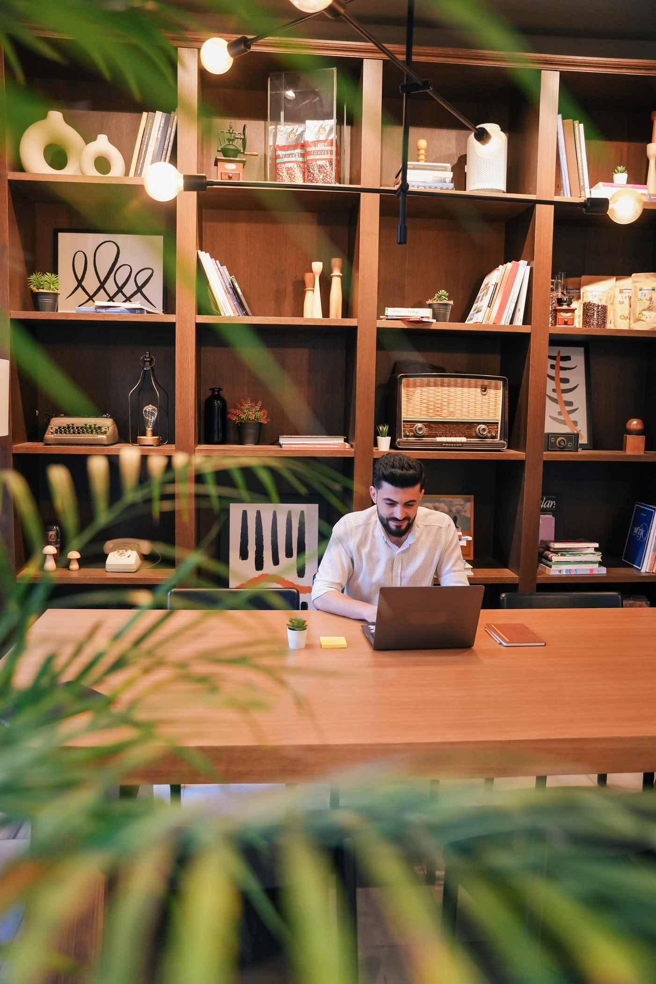
Faucets:
4 (2 bathroom, 2 sink)
Estimated usage
WATER CONSUMPTION MONITORING
1.12 m³/day → 33.6 m³/month
Water bills show average
29.78 m³/month
Gap
~3.8 m³/month → Possible leaks

Slide 24
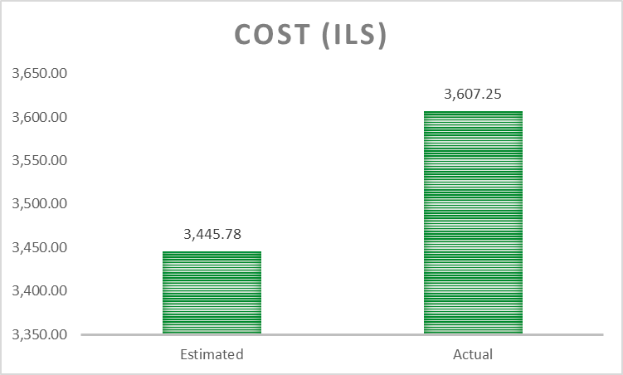
ENERGY CONSUMPTION
Estimated cost
3,445.78 ILS/month
Actual bills
3,607.25 ILS/month
Gap
~161 ILS only → Good accuracy

Slide 25
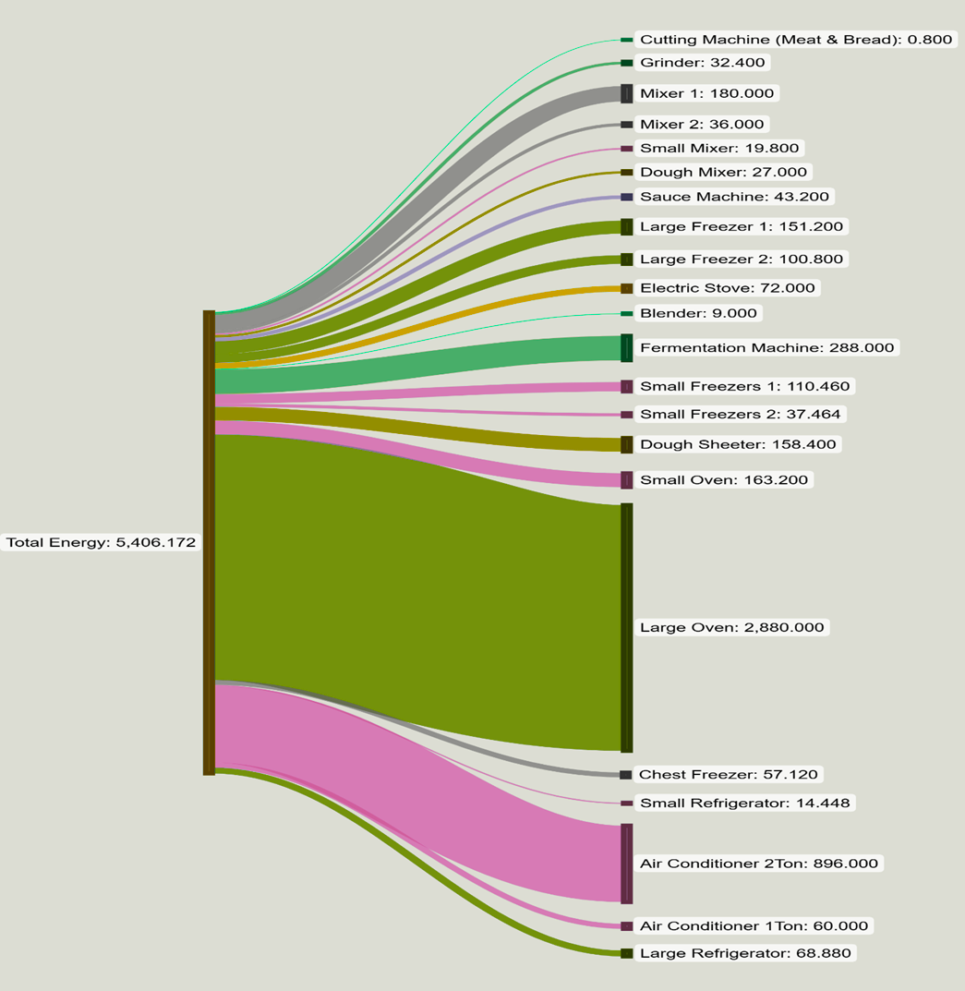
Sankey Diagram
The Sankey diagram shows how energy is used across different machines, helping identify the biggest energy consumers.

Slide 26
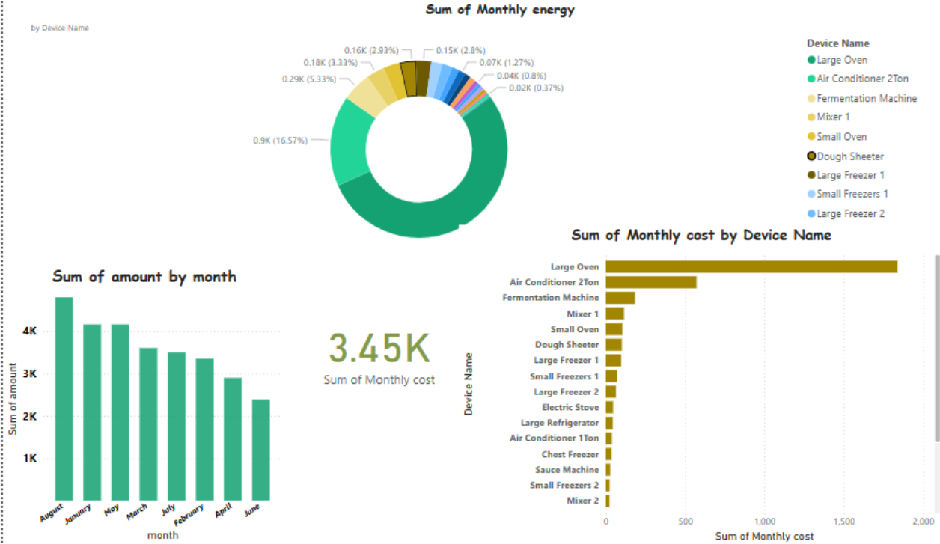

Slide 27

WASTE REDUCTION & RAW MATERIALS
Efforts Made
Gaps
Improved storage to avoid material damage
No use of reclaimed materials
Agreements with suppliers to return expired items
No recycling for organic waste

Slide 28
CLEANER PRODUCTION PRACTICES
Current Situation
Rating Results (Likert Scale)
No written cleaning procedures
Pollution reduction: 3/5
No green products or formal training
Chemical use reduction: 3/5
Environmental practices need major improvement

Slide 29









OTHER ENVIRONMENTAL ASPECTS
♻️ Packaging
35% of packaging is plastic
No biodegradable or eco-friendly alternatives used
🔋 Renewable Energy
No renewable energy yet
Future plan to install solar panels
Environmental Improvements
Diesel vehicle replaced with electric one
New tray designs + recipes reduce food waste
Good Housekeeping
No waste sorting or recycling from cleaning
Cleaning done manually with basic tools (vinegar, chlorine)
No certified program or ISO-compliant system

Slide 30


General Conclusion
Environmental practices at "Piece of Cake" are basic and unstructured.
There is no formal waste management, no renewable energy, and weak integration of sustainability in packaging, supply chain, and cleaning systems.
Some small steps were taken (electric vehicle, recipe adjustment), but overall, a long-term plan is urgently needed.
The factory must adopt clear policies, improve training, and implement structured systems to achieve environmental sustainability.

Slide 31

Recommendation

Slide 32

Implementing Key Energy Saving Strategies
Appliance Optimization
Smart Lighting & Controls
Behavioral Change & Monitoring
Infrastructure & Renewables
Strategic Integration

Slide 33
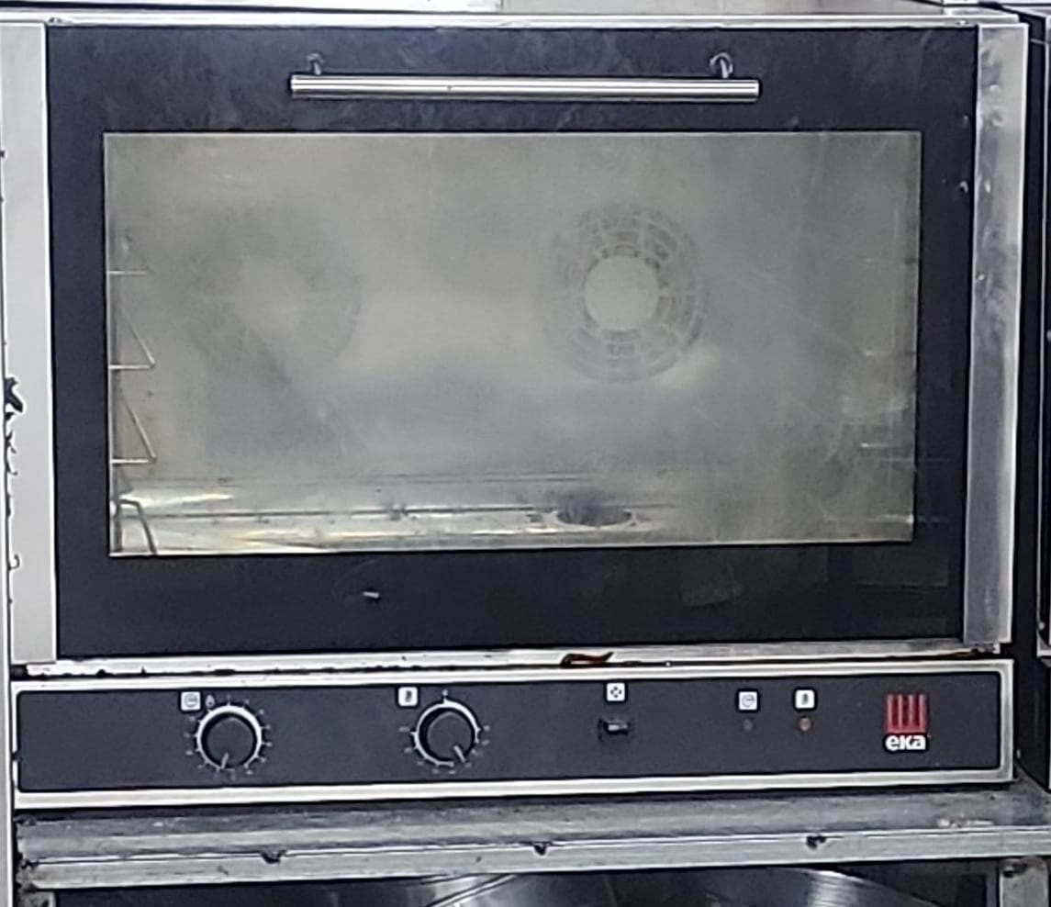
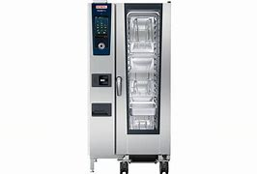
Industrial Oven – Energy Saving Plan
Finding &Key Action
  Ovens are the top energy consumers.
  Keep oven running – avoid frequent on/off
Objectives
  Fewer heating cycles
  Stable temperature
  Better capacity & quality
  Less waste, more efficiency
Implementation
  Daily production schedule
  Train staff on timing
Device Upgrade
  Replace high-energy devices.
  Use efficient alternatives to cut cost and improve performance

Slide 34
Replacing Old Devices to Improve Efficiency
Current Situation
Device: Large industrial electric oven.
Proposed Replacement: Rational iCombi Pro 20-1/1
Benefits of Replacement
40% less energy consumption. Better product quality
Faster preheating and baking
Easier cleaning, lower maintenance
Fewer breakdowns and heat issues

Slide 35
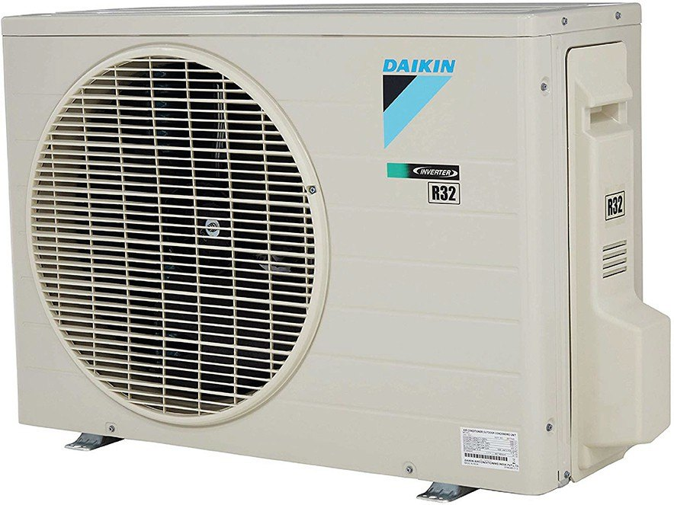
Replacing Old Devices to Improve Efficiency
Current Situation Device: Conditioner 2 Air Ton.
Proposed Replacement: Daikin Inverter 2 Ton – Split Type AC
Benefits of Replacement
Estimated 30–50% reduction in electricity use.
Smart operation reduces actual runtime.
Better thermal comfort and faster response.
Lower pressure on the facility's power system.
Longer lifespan than traditional models.
Capacity: 20 x 1/1 GN trays
Temperature Range: 30°C – 300°C
Power: 37.2 kW, 3-phaseSmart Features:
iDensityControl: Smart climate control
iCookingSuite: Auto cooking programs
iCareSystem: Self-cleaning and sanitizing system

Slide 36
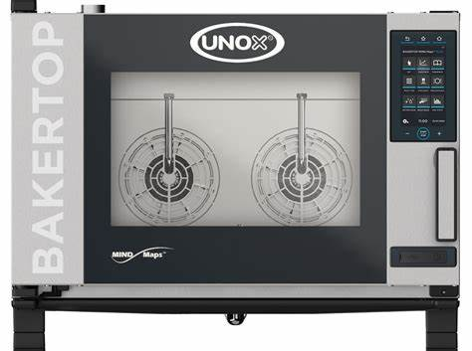
Replacing Old Devices to Improve Efficiency
Current Situation
Device:Traditional fermentation chamber.
Proposed Replacement: Eurofours Smart Proofer
Benefits of Replacement
Weekly Consumption: 72 kWh.
• Issues:
•Long daily usage (6 hours/day × 6 days).
•Lacks precise temperature and humidity control.
•Consumes a fixed amount of energy regardless of load.
•Inconsistent fermentation quality.
20–30% energy savings and fewer malfunctions.
Consistent, faster fermentation with minimal supervision
Improved product quality through smart control

Slide 37

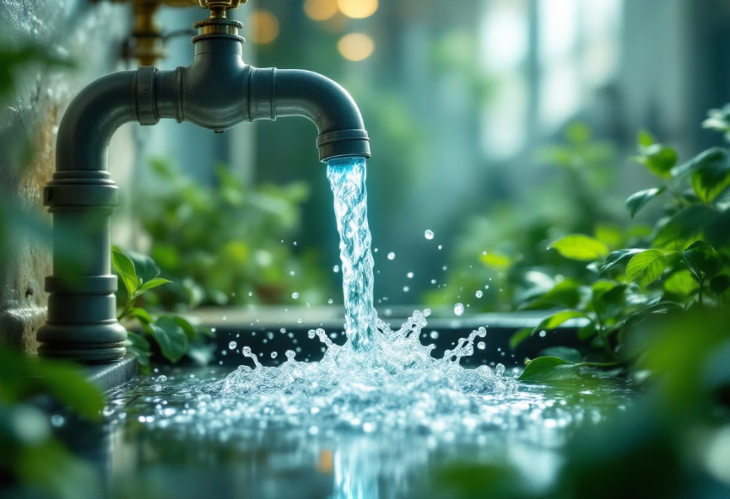
Water Conservation for Factories
Key Recommendations
Expected Impact
🔧Install low-flow taps.
The daily water usage will decrease, and so will the monthly bill.
🔁Recycle prewash water.
🚿Use push-taps with auto shutoff.
🔍Conduct monthly leak checks.
380
NIS 59
🧼Implement dual sink systems.
👷Train employees on water efficiency.
Liters saved daily
Monthly savings

Slide 38
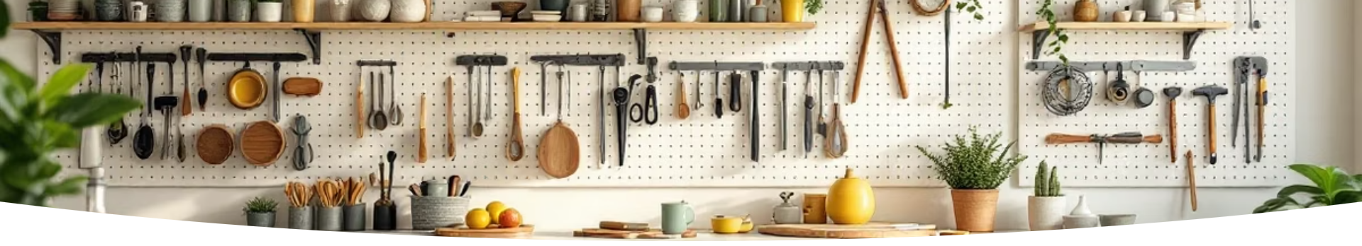




Good Housekeeping – 5S for Energy & Water Efficiency
Seiri (Sorting)
Seiton (Set on order)
Seiso (Shine)
Seiketsu (Standardize)
Shitsuke (Sustain)

Slide 39

Benefits of implementing 5S:
01
Reduce resource consumption.
02
Extend equipment lifespan.
03
Minimize operational errors.
04
Improve the work environment.

Slide 40

Thank
you

