Slide 1
Graduation Project II
Developing Green Road Index Using Analytical Hierarchy Process
Prepared by:
Amjad A. Bani-Odeh
Mohammad M. Eshtayeh
Abdulraheem T. Juma’h
Raghad A. AL-Bazz
Under supervision of:
Dr. Amjad Issa

Slide 2
Project Outline
Chapter One: Introduction
Chapter Two: Literature Review
Chapter Three: Methodology
Chapter Four: Data Analysis
Chapter Five: Results and Discussions
Chapter Six: Conclusion and Recommendations

Slide 3
Chapter One: Introduction
General Background
Significance of the Project
Objectives
Project Constraints
Design Criteria

Slide 4

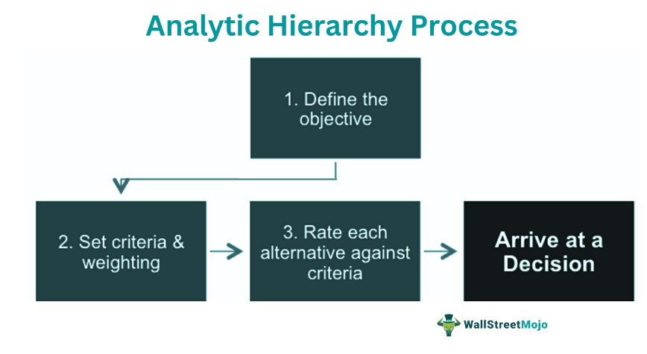
General Background
The Analytic Hierarchy Process (AHP) is a method for organizing and analyzing complex decisions, using math and psychology. It was developed by Thomas L. Saaty in the 1970s and has been refined since then.
It contains three parts: the ultimate goal or problem you’re trying to solve, all of the possible solutions, called alternatives, and the criteria you will judge the alternatives on.

Slide 5
Significance of the Project
AHP gives a proven, effective means to deal with complex decision making.
AHP is the easiest way of decision-making techniques.
AHP method is considered one of the most convenient methodologies in order to evaluate transportation issues.
AHP provides a way to rank the alternatives of a problem by deriving priorities.
This project is considered the first project prepared using AHP method.

Slide 6
Objectives
This project aims to develop the GRI using AHP method in order to identify the weights of each criterion among (environment, geometric design, safety and cost) in the green roads. In the same way each criterion has 4-5 factors in which their weights are identified using AHP method.

Slide 7
Project Constraints
During this research, some obstacles were encountered, the most important is the lack of previous similar research studies related to the topic, as the topic is new. In addition to the number of the experts.

Slide 8
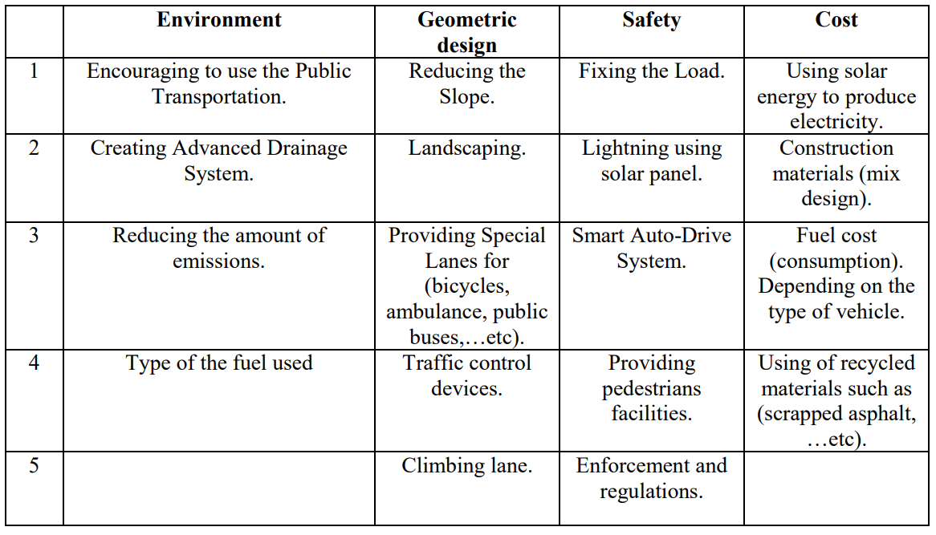
Design Criteria
The project team used the design criteria that were discussed in GP I. However, they modified them and added another 3 factors to have a total of 18. Next, they divided them into 4 criteria as shown in the table.

Slide 9
Chapter Two: Literature Review
An Analytical Hierarchy Process model to evaluate road section design (2016)
Book of proceeding International conference on green technology and design (2019)
Managing Sustainable Urban Public Transport Systems: An AHP Multicriteria Decision Mode (2021)
Prioritization of green infrastructure planning principles using analytic hierarchy process: The case of Addis Ababa (2023)
Sharjah Sustainable City: An Analytic Hierarchy Process
Approach to Urban Planning Priorities (2023)

Slide 10
Chapter Three: Methodology
18 Factor
4 Design Criteria
Questionnaire
Analyze the
data
GRI

Slide 11
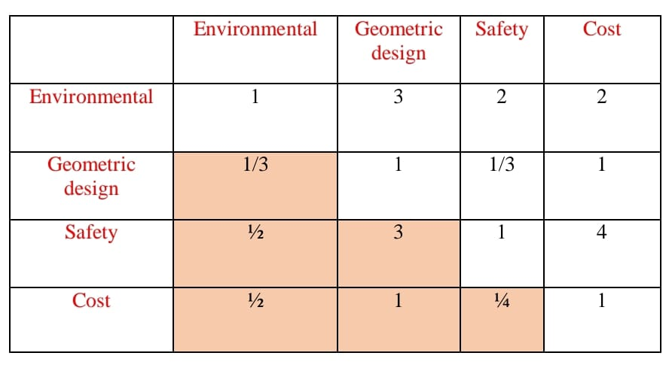

Slide 12
Average Value
Average value of the matrices has been calculated using AHP method.
Consistency ratio index
The results were verified using consistency ratio index.
The Weight
4 Criteria
4 - 5 Sub-criteria Factors.
GRI and sub-criteria indices were developed.
Conclusions and Recommendations were presented.

Slide 13
Chapter Four: Data Analysis
This chapter discusses the data analysis and findings of the study. The questionnaire used in this study was carefully analyzed to ensure that the data gathered was presented clearly with the aid of tables, percentages and graphs, where possible. A retrospective chart analysis was conducted to capture the data essential to accomplish the research objectives.
The questionnaire consists of 5 matrices that were developed to ensure the accuracy and objectivity of the data.
The survey was accustomed to choose transportation experts living in Nablus and Tulkarm governorates.

Slide 14
Matrices
Green Road
 | Environmental | Geometric Design | Safety | Cost
Environmental | 1 | 3.12 | 2.40 | 2.43
Geometric Design | 0.32 | 1 | 1.42 | 2.13
Safety | 0.42 | 0.71 | 1 | 3.22
Cost | 0.41 | 0.47 | 0.31 | 1
Total | 2.15 | 5.30 | 5.13 | 8.78

Slide 15
Normalizing Pairwise Matrix
Normalizing |  |  |  | Total | Eigen Vector
Environmental | Geometric Design | Safety | Cost
0.47 | 0.59 | 0.47 | 0.28 | 1.80 | 0.450
0.15 | 0.19 | 0.28 | 0.24 | 0.86 | 0.214
0.19 | 0.13 | 0.20 | 0.37 | 0.89 | 0.222
0.19 | 0.09 | 0.06 | 0.11 | 0.45 | 0.114
Total |  |  |  |  | 1

Slide 16
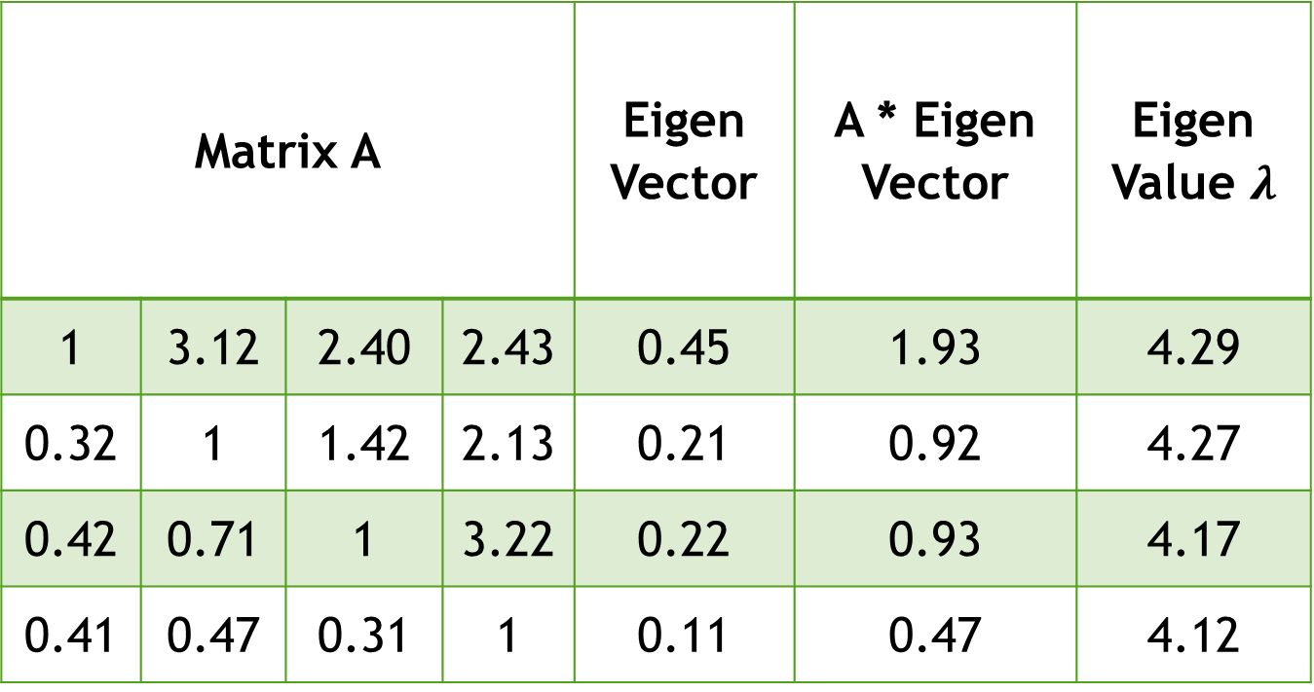
Matrix A |  |  |  | Eigen Vector | A * Eigen Vector | Eigen Value $λ$
1 | 3.12 | 2.40 | 2.43 | 0.45 | 1.93 | 4.29
0.32 | 1 | 1.42 | 2.13 | 0.21 | 0.92 | 4.27
0.42 | 0.71 | 1 | 3.22 | 0.22 | 0.93 | 4.17
0.41 | 0.47 | 0.31 | 1 | 0.11 | 0.47 | 4.12

Slide 17
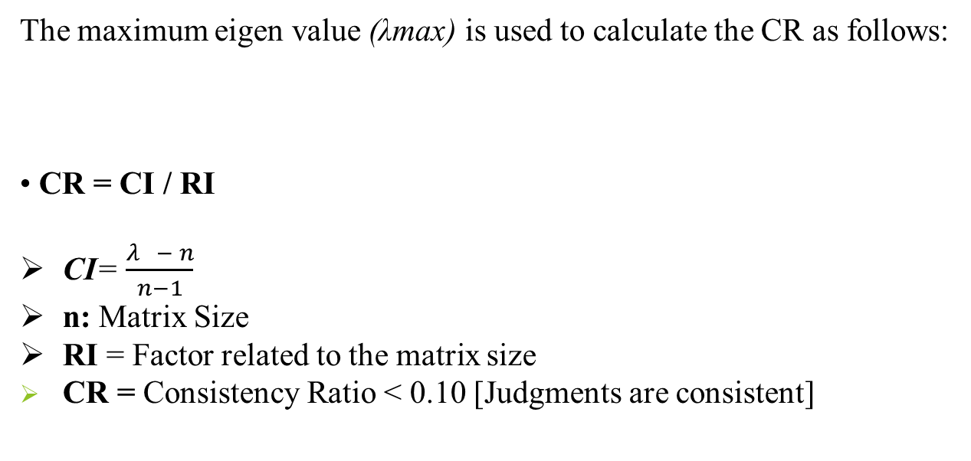
Calculations
The maximum eigen value (λmax) is used to calculate the CR as follows:
CR = CI / RI
CI= $\frac{λ{− n}}{n−1}$
n: Matrix Size
RI = Factor related to the matrix size
CR = Consistency Ratio < 0.10 [Judgments are consistent]

Slide 18
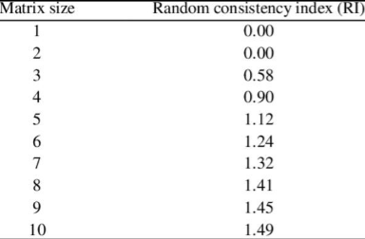
Values of RI

Slide 19

Sample of Calculations
$CI= \frac{4.21− 4}{4−1}=0.071$
n: 4
RI = According to the table, for a size of 4, RI = 0.9
CR = $\frac{0.071}{0.9}=0.078<0.1$
[Judgments are consistent]

Slide 20
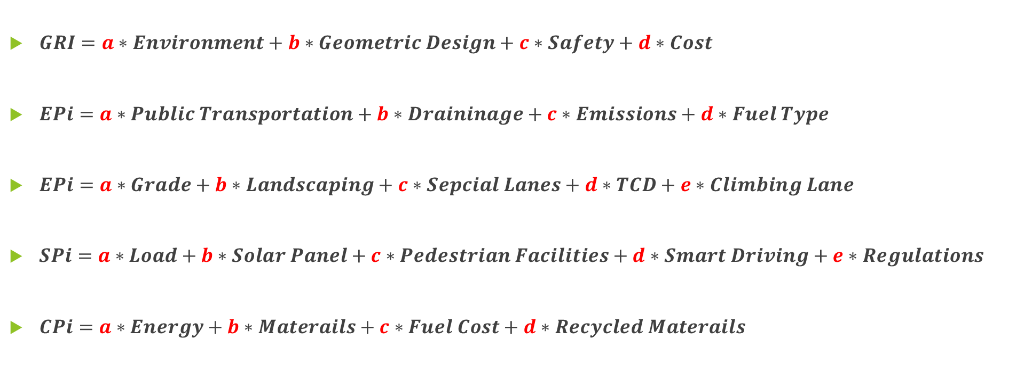
Equations
$GRI=a∗Environment+b∗Geometric Design+c∗Safety+d∗Cost$
$EPi=a∗Public Transportation+b∗Draininage+c∗Emissions+d∗Fuel Type$
$EPi=a∗Grade+b∗Landscaping+c∗Sepcial Lanes+d∗TCD+e∗Climbing Lane$
$SPi=a∗Load+b∗Solar Panel+c∗Pedestrian Facilities+d∗Smart Driving+e∗Regulations$
$CPi=a∗Energy+b∗Materails+c∗Fuel Cost+d∗Recycled Materails$

Slide 21
Results
Green Road
Criteria | Environmental | Geometric Design | Safety | Cost
Eigen Vector (Priority Weight) | 0.450 | 0.214 | 0.222 | 0.114
$$GRI=0.450 Environmental+0.214 Geometric Design+0.222 Safety+0.114 Cost$$

Slide 22
Results
Environment
Criteria | Encouraging to use the Public Transportation. | Creating Advanced Drainage System. | Reducing the amount of emissions. | Type of the fuel used
Symbol | A | B | C | D
Eigen Vector | 0.43 | 0.21 | 0.23 | 0.13
Safety
Criteria | Load | Lightening | pedestrians facilities | Smart Auto-Drive | Enforcement
Symbol | J | K | L | M | N
Eigen Vector | 0.259 | 0.245 | 0.212 | 0.134 | 0.150
$$EPi=0.43A+0.23C+0.21B+0.13D$$
$$SPi=0.259J+0.245K+0.212L+0.134M+0.150N$$

Slide 23
Results
Geometric Design
Criteria | Reducing The Slope | Landscaping | Providing Special Lanes For (Bicycles, Ambulance, Public Bus). | Traffic Control Devices. | Climbing Lane
Symbol | E | F | G | H | I
Eigen Vector | 0.30 | 0.22 | 0.21 | 0.16 | 0.11
Cost
Criteria | Using solar energy to produce electricity | Construction materials (mix design) | Fuel cost | Using of recycled materials
Symbol | O | P | Q | R
Eigen Vector | 0.38 | 0.25 | 0.19 | 0.18
$$GDPi=0.30E+0.22F+0.21G+0.16H+0.11I$$
$$CPi=0.38O+0.25P+0.19Q+0.18R$$

Slide 24

Conclusion
The most important criterion in designing the green road is the Environmental one which got the highest priority over the geometric design, safety and the cost criteria.

Slide 25
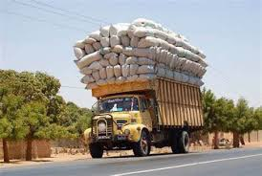
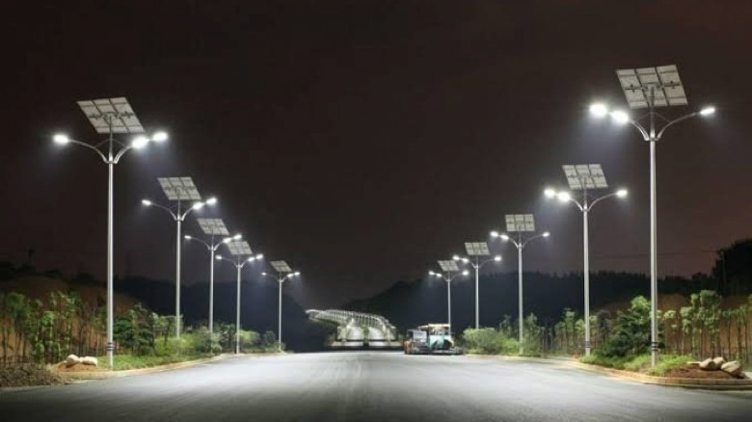
Conclusion
At the second place, the safety requirement takes the place. Safety is a fundamental consideration in green road design, as it influences various aspects of the transportation system.

Slide 26
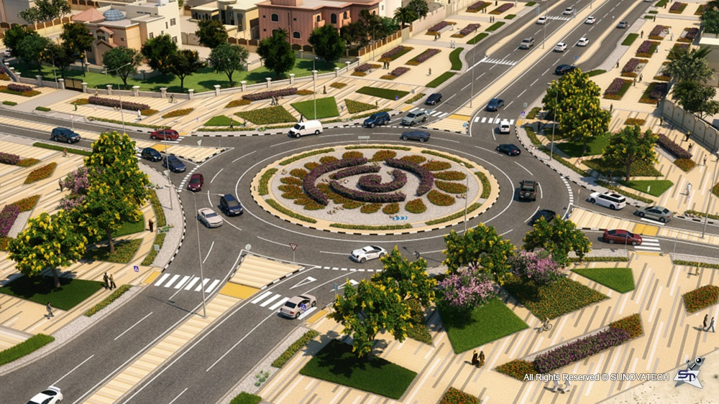
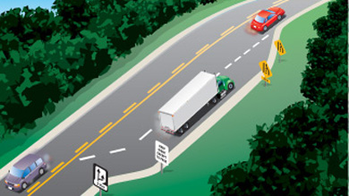
Conclusion
As for the third priority, the geometric design takes the place, it plays a crucial role in the overall design of green roads. Green roads are typically designed with a focus on sustainability and environmental considerations. The geometric design, which includes the layout, alignment, and dimensions of the road, can have several effects on the green design aspects.

Slide 27

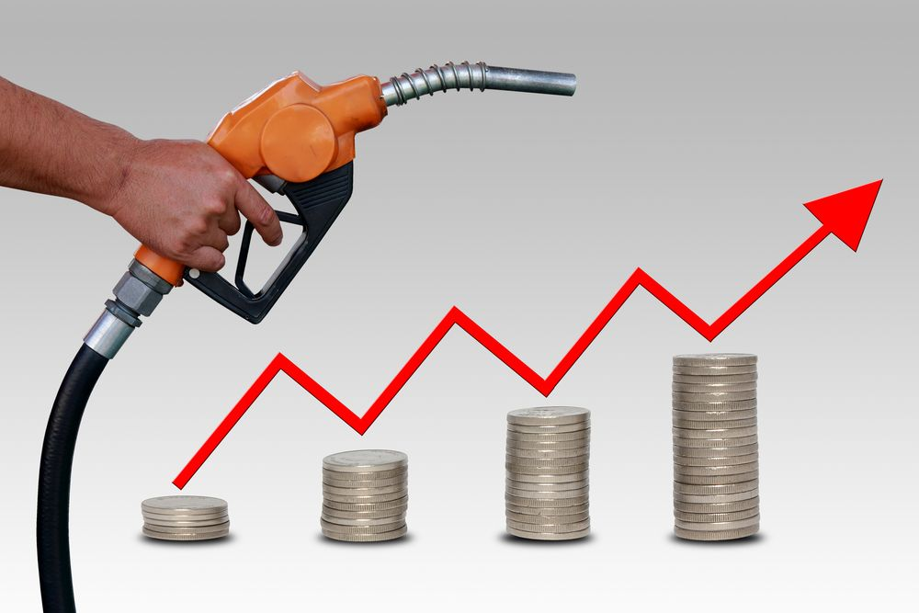
Conclusion
The final priority is the cost, the cost of constructing green roads can have a significant impact on their design.

Slide 28
Recommendations
It’s preferred that the previously mentioned results should be followed and considered by the organizations, private sector, and ministers that are responsible for design the roads.
Try investigating whether these results are suitable to be applied in different cities or not.
It’s recommended to make a manual for green roads similar to the manual already made for the green buildings.

Slide 29
2022 – 2023
THANK YOU

