Slide 1

FAULT DETECTION IN TRANSMISSION LINE USING ARTIFICIAL INTELLIGENCE
Presented by: Sameer Othman 12028528
Abdelkareem kukhun 12027894
Khaled Azaizeh 12115273

Slide 2

Introduction
Reliability of power transmission lines is essential for stable electricity supply. Faults occur due to environmental conditions, equipment failure, or operational issues. Traditional fault detection methods, like impedance-based methods and traveling wave fault location (TWFL), have limitations in modern, complex power systems, especially with renewable energy integration.
General Background
Traditional methods struggle with accuracy under dynamic conditions (e.g., load variations, high grounding resistance). AI-based approaches face challenges like high computational demands and latency, limiting their real-world use.
Problem Statement
AI can process vast data, recognize patterns, and adapt to changes. AI models like ANN and CNN offer precise fault detection. Advances in edge computing enable real-time fault detection in transmission lines.
Motivation for Using AI

Slide 3
Introduction
The study aims to develop an affordable AI-based device for real-time fault detection and localization in power transmission lines. Goals: Real-time fault detection and localization
High accuracy and scalability
Bridging the gap between AI research and real- world applications
Purpose of the Research
The device integrates traditional fault detection methods with AI models. Components:
PTs & CTs: Measure voltage and current ADCs: Convert analog signals to digital
Raspberry Pi: For AI processing using TensorFlow and
PyTorch
Reactance method for fault location
Methodology
The device focuses on specific fault scenarios and is limited by hardware constraints and high-voltage signal management. Field testing will be necessary for validation.
Scope and Limitations

Slide 4
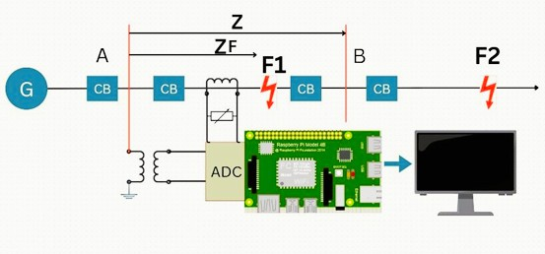
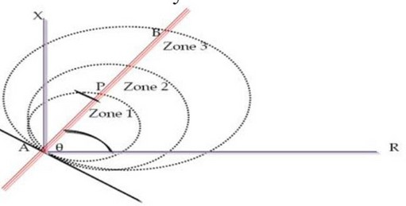
2.PROJECT DESIGN
2.1 METHODOLOGY
In our project, when a fault occurs, current and voltage signals from transformers are transmitted to the microcontroller via an ADC. The microcontroller calculates the fault distance, and artificial intelligence algorithms are used to predict and refine the results, which are then displayed.
Fault detection in transmission lines is based on resistance values, which help determine fault distance. The transmission line is divided into regions with specific resistance ranges, such as A to P for the first region, P to B for the second, and so on. This division enhances the selectivity and reliability of the power system's protection.

Slide 5
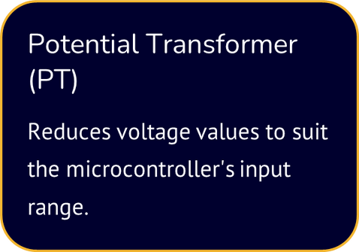
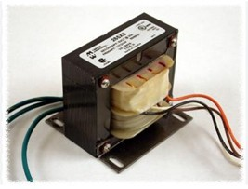
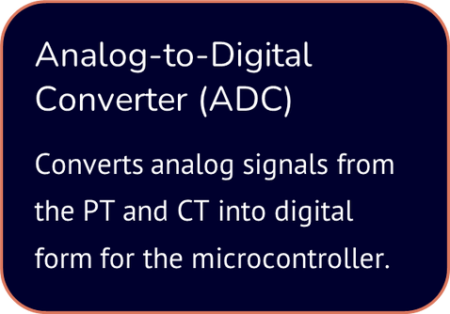
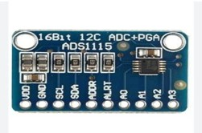
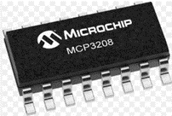
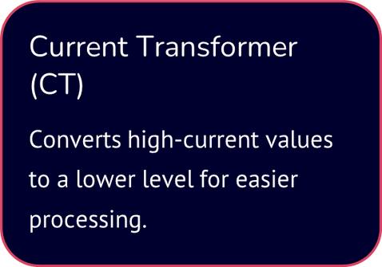
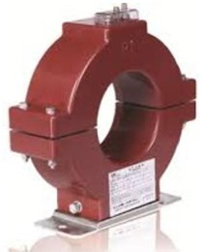

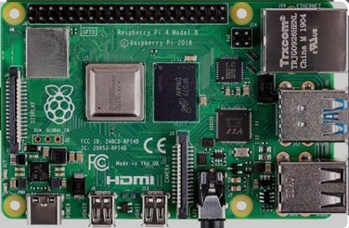

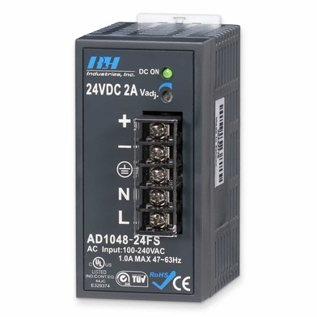
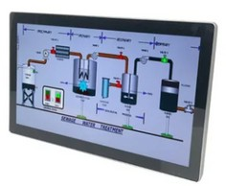
2.PROJECT DESIGN
2.2 DESIGN DESCRIPTION
Power Supply
Display

Slide 6

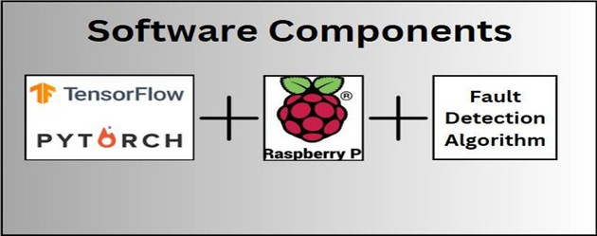

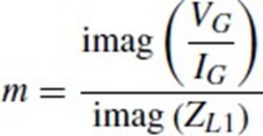
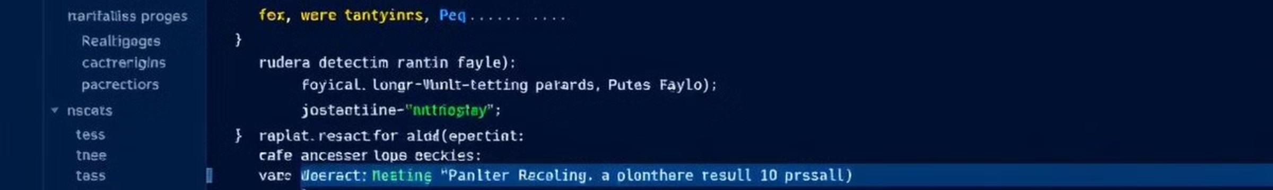
2.PROJECT DESIGN
2.3 DESIGN DESCRIPTION
To operate the device, software packages are required for programming and running the device.
The implementation involves preprocessing input data by filtering noise and normalizing values, followed by applying machine learning models .

Slide 7
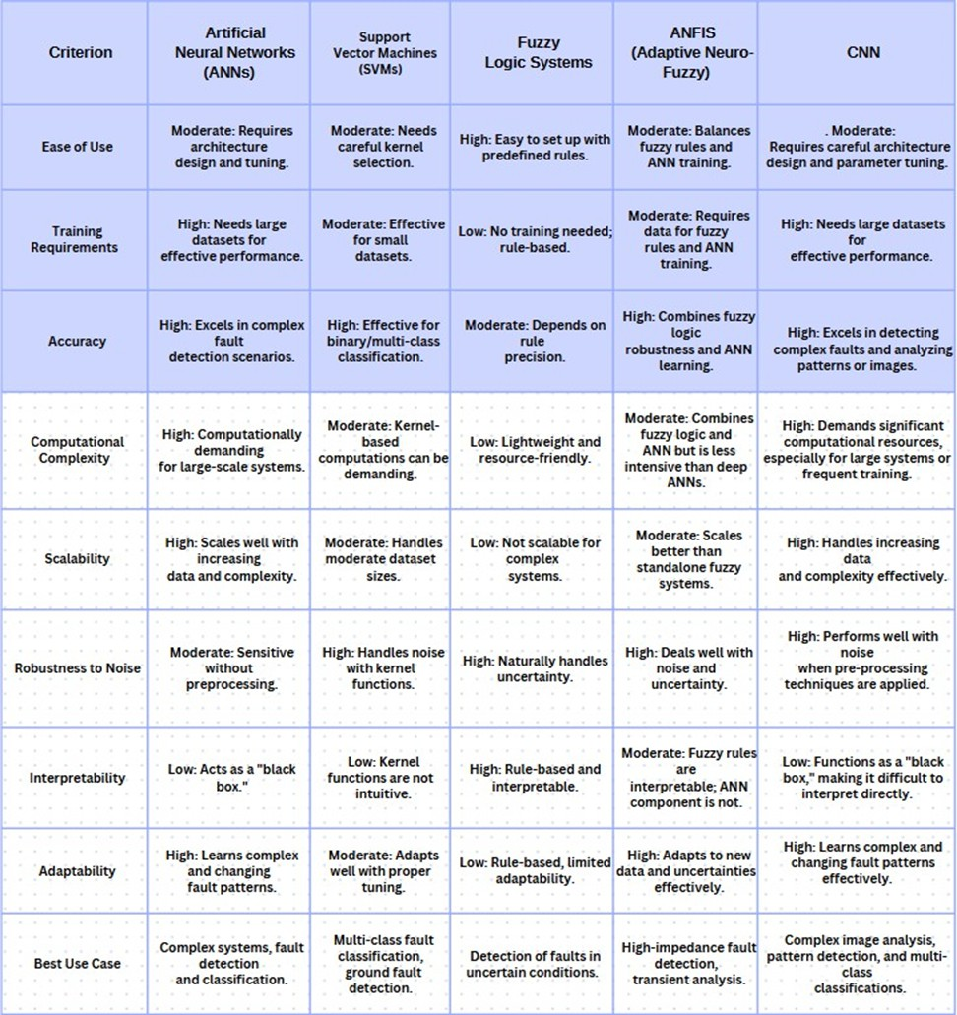
3.ARTIFICIAL INTELLIGENCE
As mentioned in Chapter 2, there are many artificial intelligence models that can be utilized. The following table presents a comparison between different types of models.
we will use ANN because it is not difficult to work with, offers excellent accuracy, has available frameworks for training, and is one of the most popular types of AI.

Slide 8


3.ARTIFICIAL INTELLIGENCE
3.1 ARTIFICIAL NEURAL NETWORKS(ANNS) AND HOW THEY WORK
3.1.1. STRUCTURE OF ARTIFICIAL NEURAL NETWORKS
An ANN typically consists of three main layers:
1- Input Layer: This layer receives the voltage and current signals (Vₐ, Vᵦ, V𝒸, iₐ, iᵦ, i𝒸) as input data, with 6 total input features representing the fundamental components of three-phase voltages and currents. The data is structured to capture the magnitudes of these components (50 Hz) over three consecutive post-fault samples of each phase, providing a clear representation of the system's behavior during faults.
Hidden Layers
Input Layer
Output Layer
2- Hidden Layers: The hiddenlayers are wherethe core computations occur. A networkcan contain one or more hidden layers, depending on its complexity. Each neuron within these layers connects to every neuronin the previous layer and processes the weighted sum of its inputs using a mathematical function.
3- Output Layer: The output is the fault distance, a single value that represents the result of the network’s calculations. This output is crucial for identifying the location of faults in the system, enabling timely fault management and maintenance actions.

Slide 9
3.ARTIFICIAL INTELLIGENCE
3.1.2HOW ARTIFICIAL NEURAL NETWORKS WORK

Slide 10
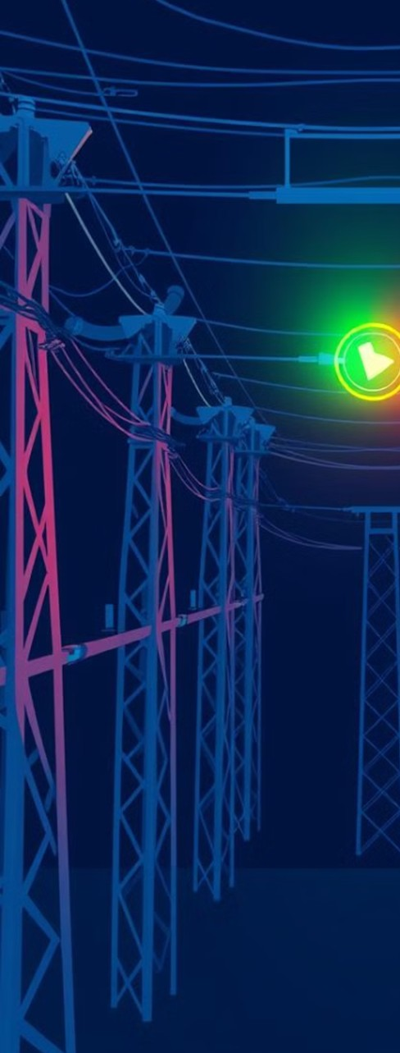

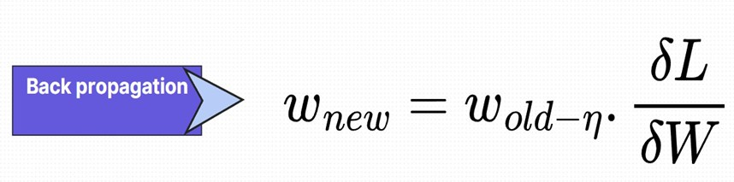
3.ARTIFICIAL INTELLIGENCE
3.1.2HOW ARTIFICIAL NEURAL NETWORKS WORK
Back Propagation: Back propagation adjusts the network’s weights and biases to minimize error. It involves:
Error Calculation: Comparing the network’s output with the target value using a loss function.
  Gradient Computation: Using the chain rule to calculate how each weight should change.
  Weight Update: Updating weights and biases with an optimization algorithm like gradient descent.

Slide 11


3.ARTIFICIAL INTELLIGENCE
4.3 APPLICATIONS
Speech and LanguageProcessing
Machine translation and voice assistants.
3.2 ADVANTAGES OF ANNS
Adaptability
ANNs can model complex relationships betweeninputs and outputs
Image Processing
Facial recognition and object detection.
Generalization
·Once trained, they can generalize well to unseendata.
Versatility
Power Systems
Fault detection and classification in transmission lines.
·ANNs are suitablefor a wide range of applications, includingregression, classification, and sequence prediction.

Slide 12
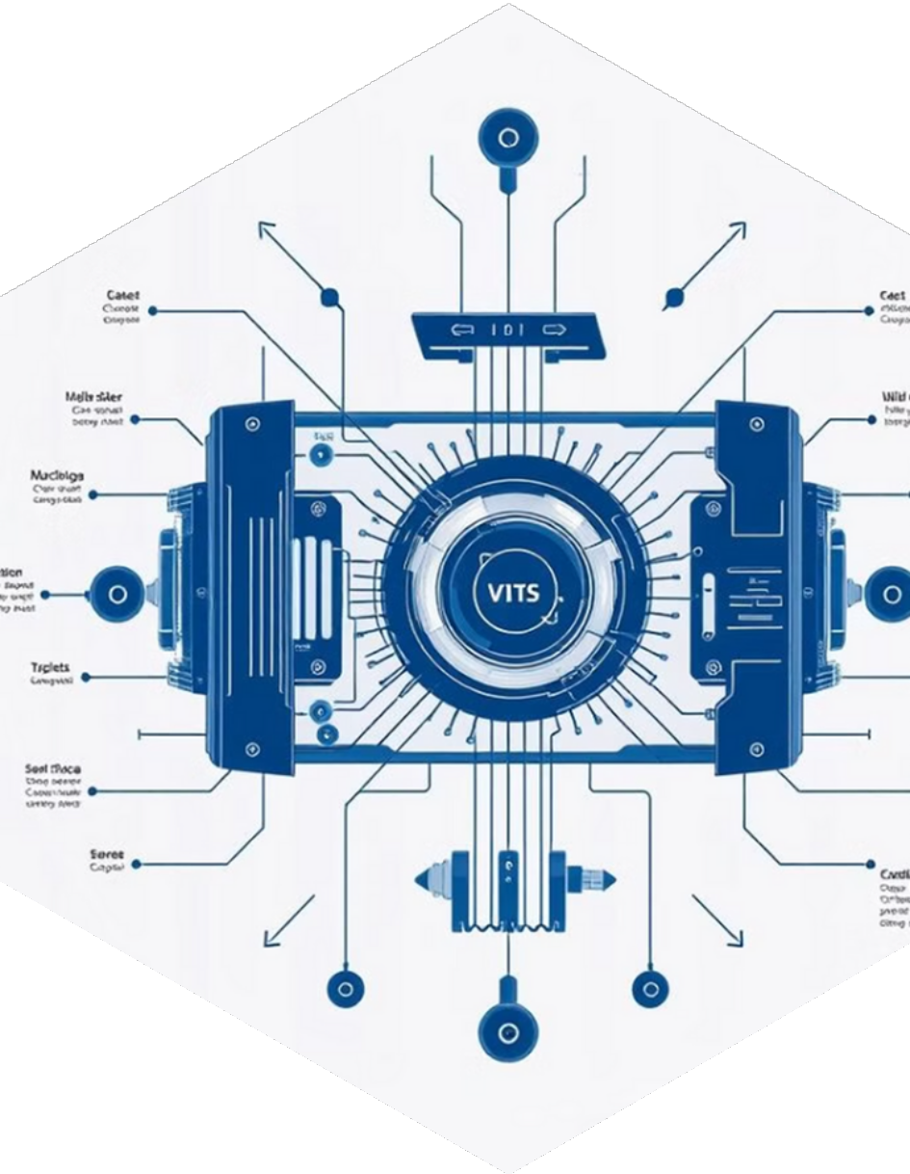




3.4 CHALLENGES AND GAPS
Real-World Applicability
The limitations of latency and hardware
4
Limited Fault Scenarios
Integration of Renewable Energy

Slide 13



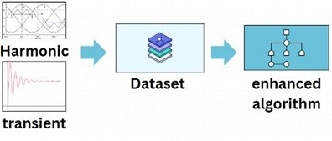

3.5 Future Directions
Hybrid Approaches:
By integrating traditional methods with AI models, fault detection accuracy and adaptability in complex networks could be enhanced..
Advanced Feature Engineering: Harmonic and transient characteristics can be added to datasets to enhance algorithm
performance and robustness.
3. Edge Computing:
By distributing computation at sensor nodes, it is possible to reduce latency and enable real- time fault detection, addressing current hardware constraints.

Slide 14
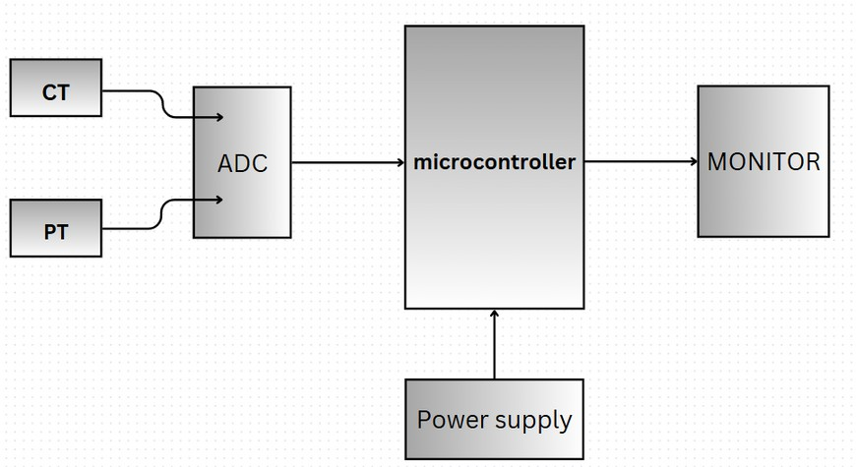
4.CONCLUSION
  SUMMARY OF FINDINGS
This study explored AI techniques, like ANNs and CNNs, to detect and predict faults in electrical transmission lines. By analyzing voltage and current signals, a device was developed to improve fault localization and system reliability.
  KEY CONTRIBUTIONS
Device Design and Implementation: A device was built with transformers, ADC, and a Raspberry Pi for real-time data processing. ANNs were used to accurately predict fault locations, with protective enclosures and network connectivity ensuring reliability.
Integration of AI in Fault Detection:AI models were trained for various fault scenarios, offering better accuracy and scalability than traditional methods. The implementation of real-time data processing algorithms ensures prompt fault detection, minimizing system downtime.
Division of Transmission Lines: Transmission lines were divided into regions based on resistance values, allowing selective fault localization and improving the protection system.

Slide 15


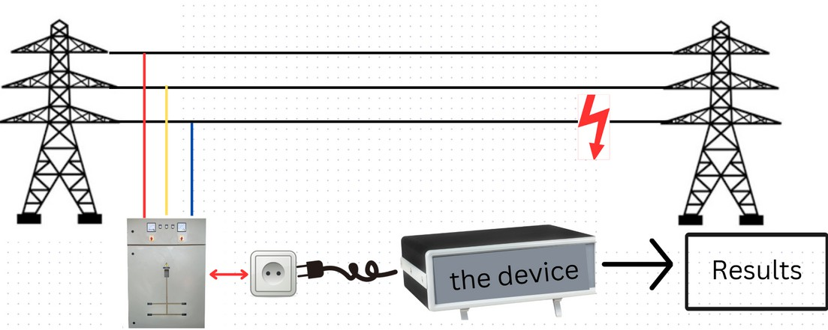
4.CONCLUSION
4.3 Expected Outcomes
4.4 Future Work

Slide 16

4.CONCLUSION
4.5 Final Remarks
In conclusion, this study highlights the effectiveness of AI-based fault detection systems in electrical transmission networks, improving reliability and efficiency. It contributes to the academic discussion on AI applications and lays the groundwork for future advancements in grid reliability and fault management.
Any questions

