Slide 1
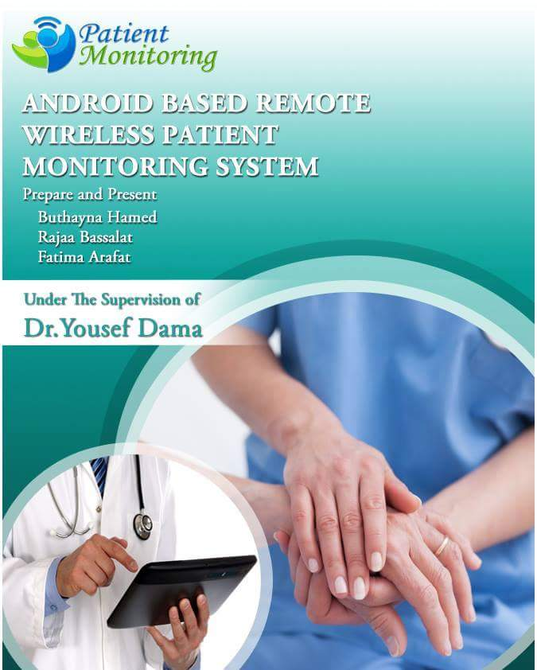

Slide 2
Outline
Introduction
Standards
Project General Idea
Methodology of Executing
Project Implementation
Conclusions
Future work

Slide 3
Introduction
  Concept of Patient monitoring
Patient monitoring is part of Telemedicine.
The Patient Monitoring offers a number of advantages:
1-provide efficient methods of performing patient monitoring over distances.
2-providing real-time access to medical information and monitoring data.
3-Reduced Costs.

Slide 4
Motivation
Modern day monitoring devices make use of telecommunications technologies to enable healthcare.
These systems usually incorporate the use of sensor technology, a telecommunications link and a remote monitoring center.
Remote monitoring is usually achieved by the health professional via the Internet using a web portal.
However, the use of mobile and wireless technology will help improve the flexibility of these systems.

Slide 5
  Aims and Objectives
The aim of the project is to combine the use of mobile and wireless technology with sensor technology to create a robust patient monitoring system.

Slide 6
Standards
IEEE 802.15.4 Standard
IEEE 802.15.4 is a standard which specifies the physical layer and media access control for low-rate wireless .
ZigBee: is a specification based on the IEEE 802.15.4 standard for wireless personal area networks (WPANs).

Slide 7
Open Source Standard
Open source software is a software whose source code is available for modification or enhancement by anyone and “Source code" is the part of software that most computer users don't ever see.

Slide 8
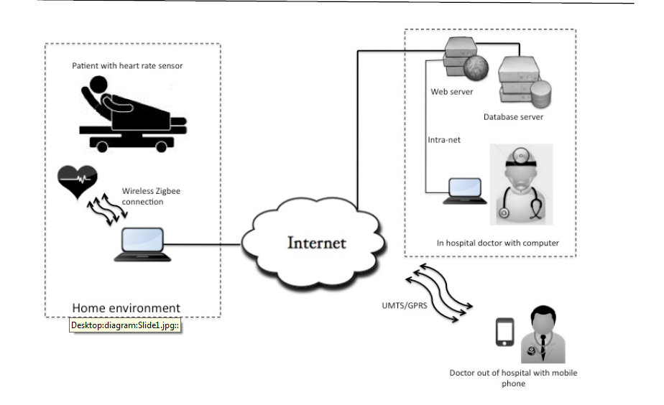
Project General Idea

Slide 9

Methodology of Executing
Programs and software
1. Android software
Android is a Linux-based operating system designed for mobile devices developed by Google.

Slide 10
2. Database Server
Designing the database, a Web client/server approach was adopted using an Apache HTTP web server and a MySQL database server.
The Web interface was designed using PHP and basic HTML to create dynamic Web pages and enable access control to the backend database server.

Slide 11

3. Arduino microcontroller program
Arduino is an open-source prototyping platform based on easy-to-use hardware and software.

Slide 12
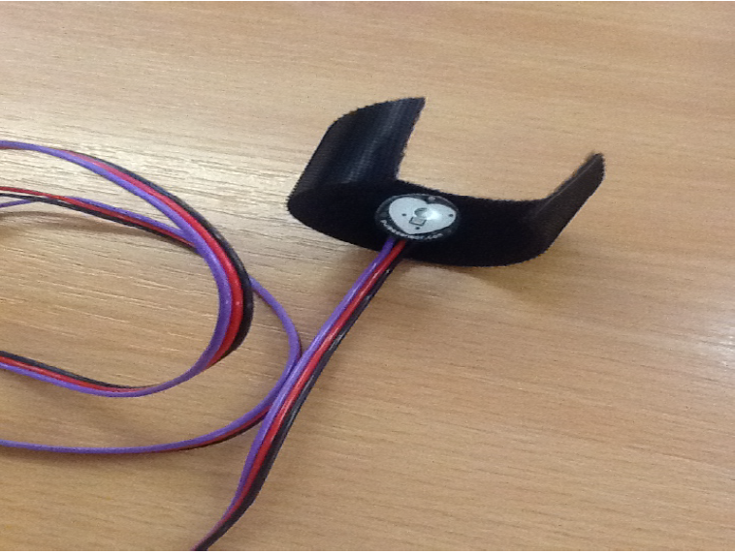
Project Implementation
Sensor
Sensors as a hardware component, are an integral part of any monitoring system.
Pulse sensor for measuring heart rate

Slide 13
The microcontroller used for this project is the Arduino Uno. The microcontroller board is programmable using the Arduino software, and codes can be uploaded to the board using a computer USB connection without an external hardware programmer.
Arduino Uno microprocessor

Slide 14
The wireless interface connection from the Arduino microcontroller to a home computer is achieved using an XBeeLibelium shield and a pair of XBee transceivers.
XBee transceiver and XBee shield

Slide 15
Sensor Authentication
The authentication of the heart rate device was achieved using a simple method.
The patient’s identification number is posted along with the rest of the heart rate data to the PHP web page.
The PHP page then transfers the heart rate values to the patient’s heart rate records

Slide 16
Database Server
Medical health records including vital signs monitoring data should be collected and stored in a local database at the healthcare provider site .
simple database was created to reflect database usage in health centers.
The heart rate variables are sent real-time from the sensor over the Internet using HTTP traffic.

Slide 17
Mobile Unit
The main aim of the mobile application is to enable the physician an authorized remote access to the patient health information.
The Eclipse programming environment was used to develop the mobile application in this project. The Android SDK is required to develop Android and included in the Eclipse IDE library.
There are many site to build the application in easy way some of them are trial and the other are full free :
1. Good Barber- Trial
2. MIT app inventor-free
3. appsGeyser-free
4. appypie - free
5. Android studio

Slide 18
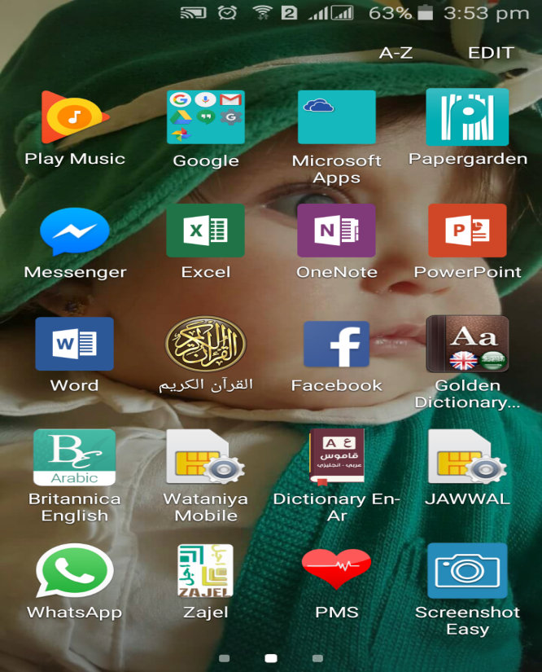
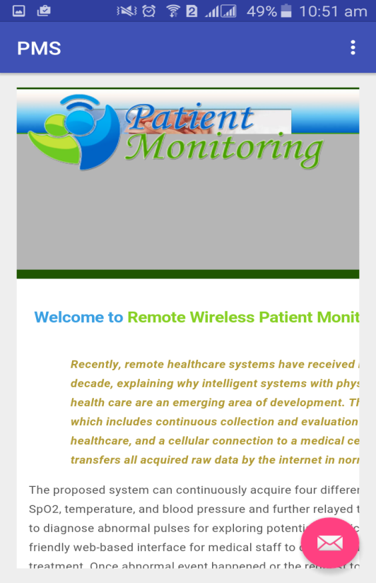
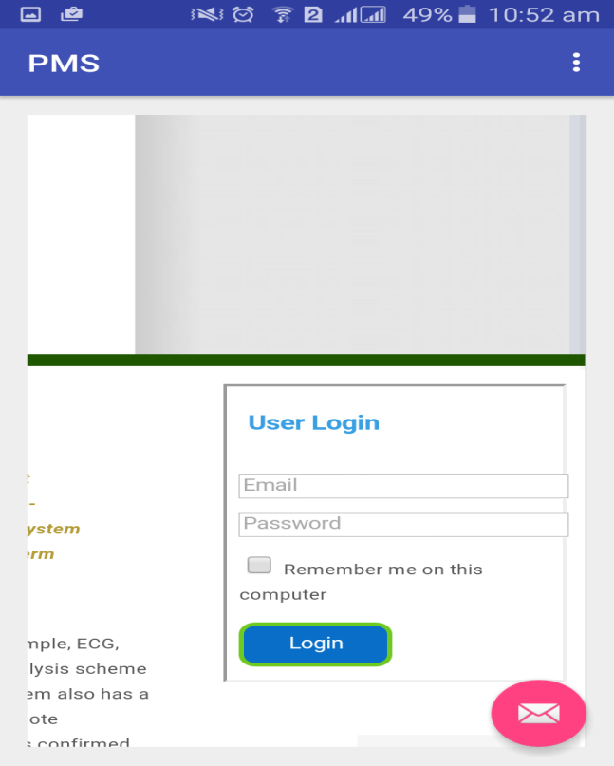
Mobile Unit :
The Android Application (PMS)designed opens the Url of the website directly therefore it will consist all the data in the website .

Slide 19
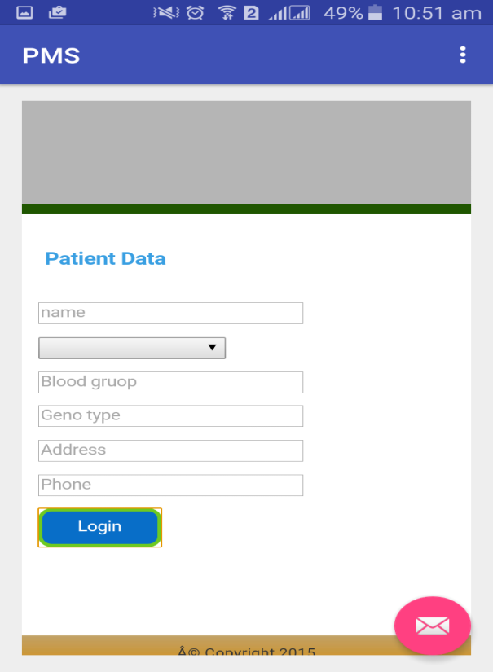
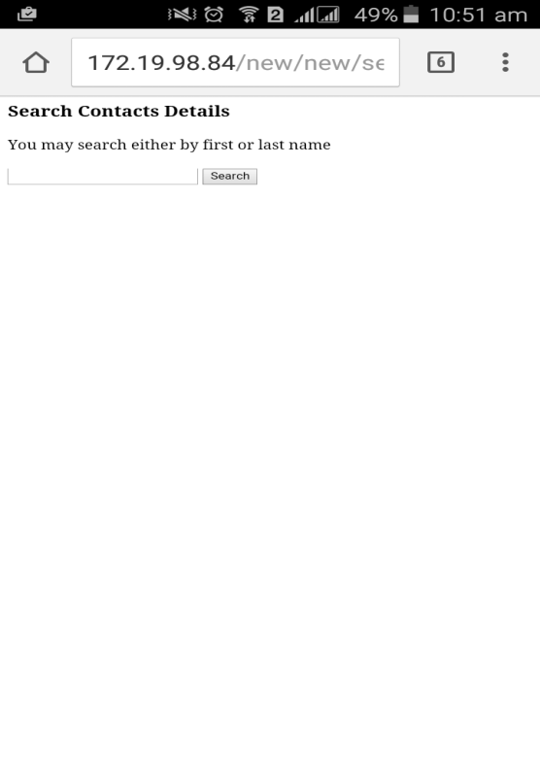
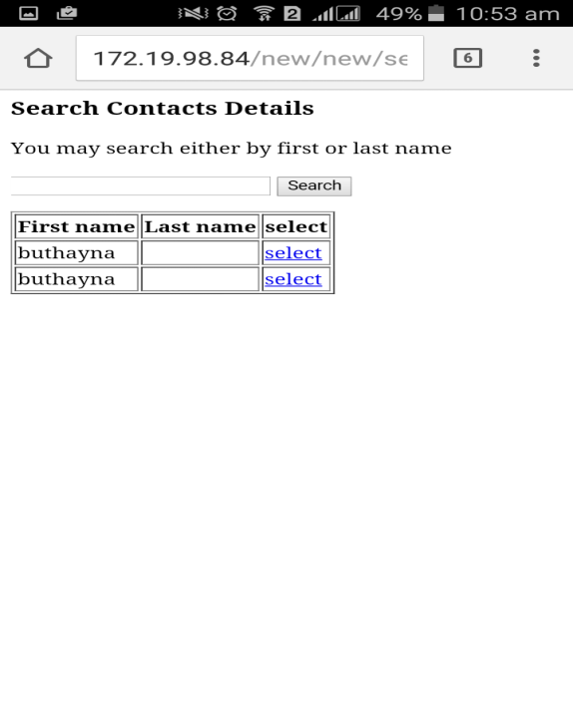
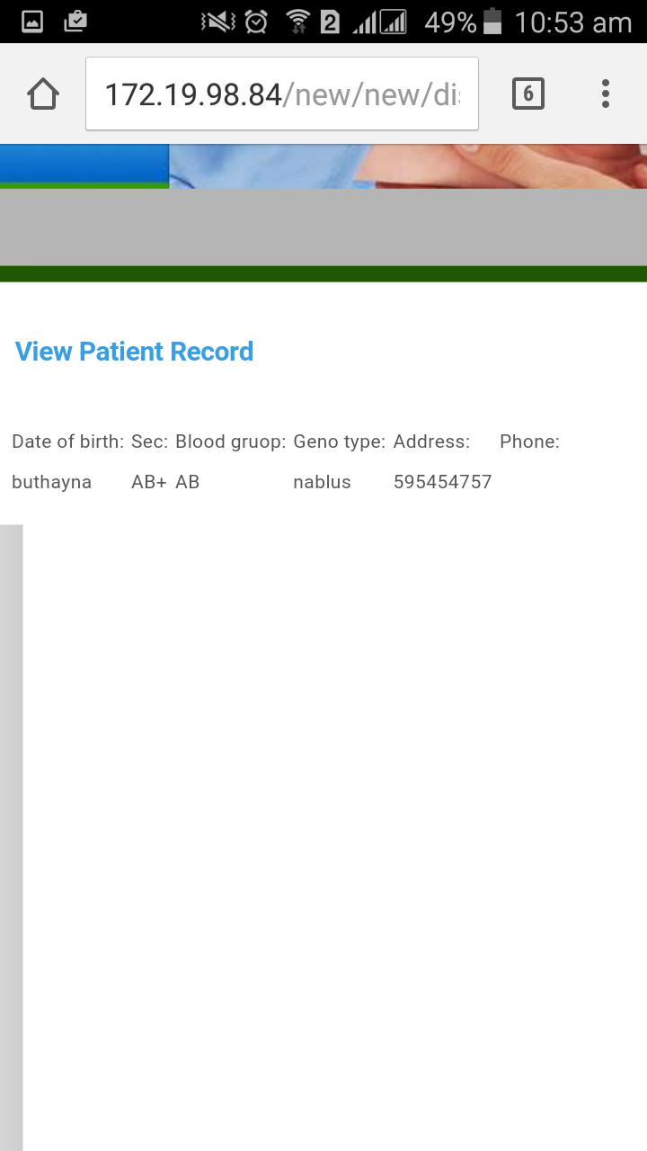
Mobile Unit :

Slide 20
Data Collection
The final activity of the application is; the monitoring activity, where the measured heart rate values of a selected remote patient saved in the medical information server are collected real-time and displayed to the user.

Slide 21
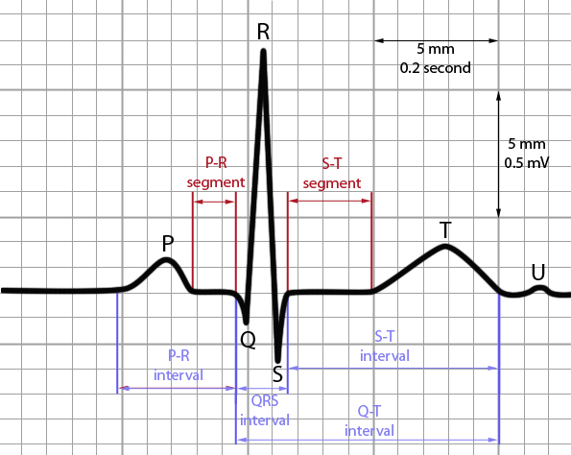
Result
The Pulse sensor Arduino sketch was uploaded into the microcontroller from the Arduino development environment using a computer serial port connection.
The output signal is affected by noise and motion artifacts due to movements, errors are encountered , the desired signal must be as the curve bellow:
ECG Interval

Slide 22
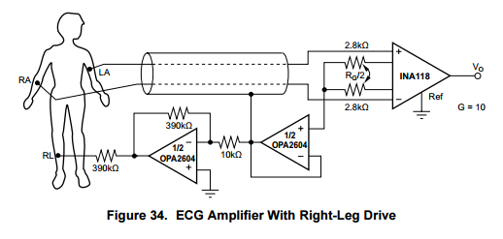
To obtain this signal the following circuit must be constructed :
Unfortunately this circuit didn't work . Another method to improve the output signal is to use matlab code works as pipeline to eliminate irregular peak form, presence of low-frequency component in ECG due to patient breathing etc .

Slide 23
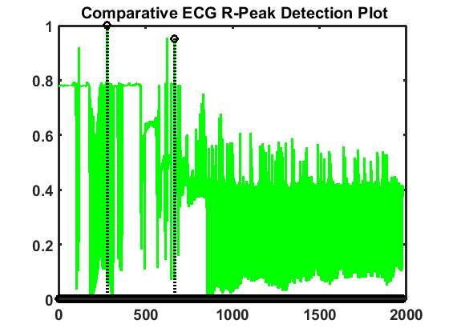
The output of the matlab code is as follow :

Slide 24
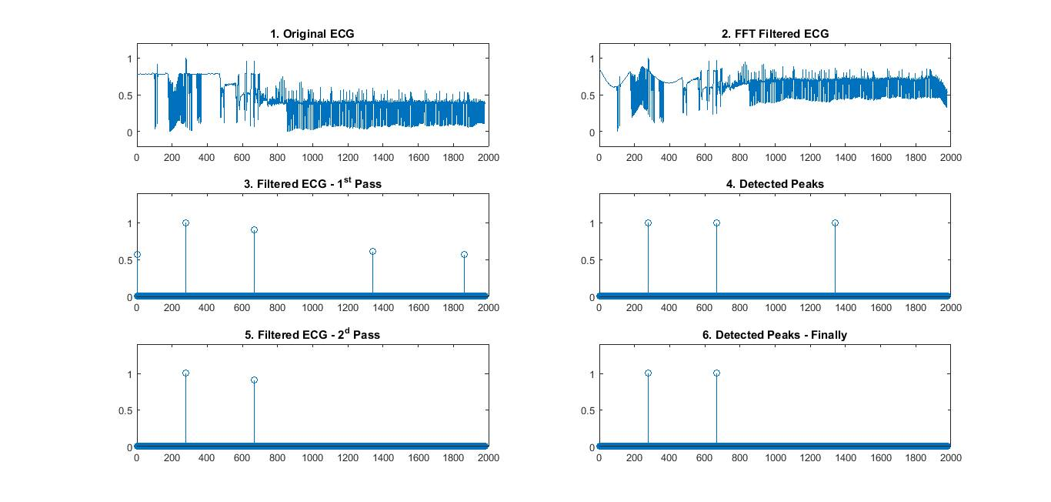

Slide 25
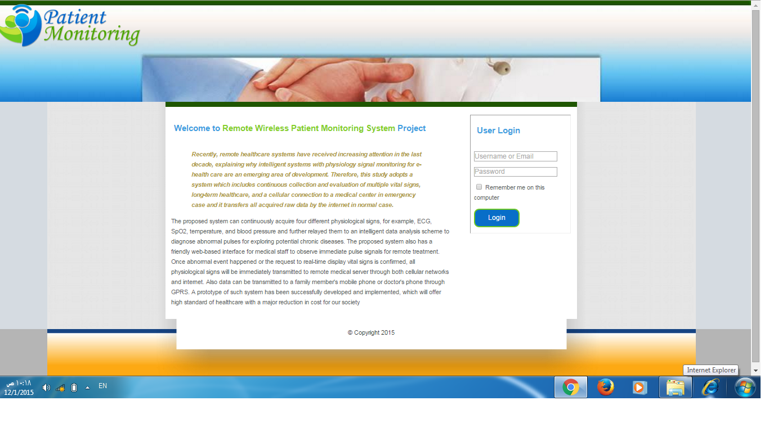
Web Portal
The Web portal provides an interface to view the measured heart rate values by authorized users. This is achieved using a standard Web browser with Internet access.
Web portal

Slide 26
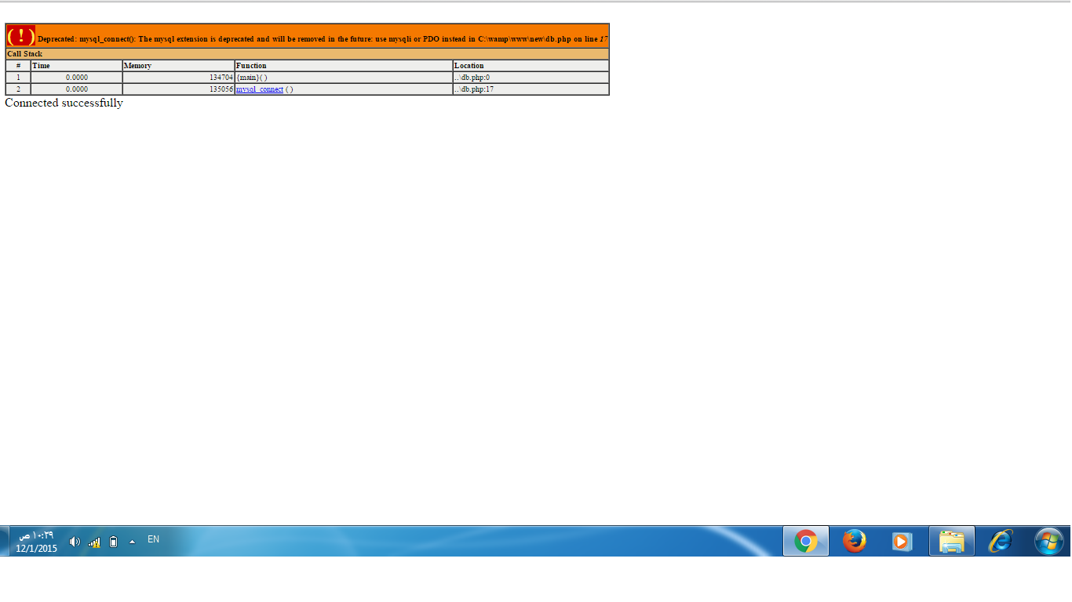
After the user had been authenticated, the user proceeded to view the subject’s heart rate values by selecting his name from a queried list of his patients.
User login page on Web portal

Slide 27
Conclusions and future work
Conclusions
According to the growth of the elderly in the world, it is expected that there would be a high demand on healthcare delivery and its attending costs.
Motivated by this, this project aimed to create a robust patient monitoring system, which would help health professionals track a patient’s health status remotely.
This project sought to achieve this aim by integrating available sensor technology with mobile and wireless communication technologies.

Slide 28
Future Work
This application will be developed further, to make the system more efficient by using Multiple Sensors.
Therefore, incorporating the use of other sensors such as temperature, respiratory rate and pulse oximetry sensors within the same remote monitoring architecture can further extend the overall efficiency of the process.

Slide 29
Thanks

