Slide 1
An-Najah National University
Faculty of Engineering
Industrial Engineering Department
Graduation Project Report
Reducing Safety Risks at the Palestinian Stone and Marble Industrial Sector
Group Members:
Ahmad Ghanayem
Nabeel Khaleeliya
Presented to : Dr. Tamer Haddad
Dr. Ramiz Assaf
Under Supervision of
Dr . Ramiz Assaf

Slide 2
Background
The growing number of workers in the industrial sector meant that more and more people are exposed to various forms of risks , and there was a need for a new discipline that studies these risk.

Slide 3
Experts in this field distinguish between two main concepts :
Safety
Health

Slide 4
Problem Statement
stone and marble of the largest sectors in Palestine, containing more than 200 facilities, with the increasing number of casualties among workers has become increasingly higher .

Slide 5
Goals and Objectives
The main goal of the project is to identify the most significant risks and hazards , to improve the safety and health conditions in this sector.

Slide 6
Scope of the project
This project is limited to the health and safety problems in the stone quarries and marble workshops in the West Bank
this project is not intended to examine all the facilities in the West Bank but alternatively a sample of about 10% (20 plants and quarries) .

Slide 7
Significance of the work
The rationale behind this project can be explained by the large number of injuries and accidents happening in these facilities , and that the main reason for those accidents is the absence of safety procedures.

Slide 8
Structure
We will identify risks in the stone and marble we then evaluated based on marginal land and repetitive, and then find solutions to all these problems.

Slide 9
Earlier Coursework and Standards
Earlier Coursework
The courses that can be related to the main theme of the project are :
Methods Engineering (65420)
Ergonomics and Safety Engineering (65480)
Computational Applications Lab (65310).

Slide 10
Relevant Standards
International Electrotechnical Commission - Risk Management \ Risk Assessment Techniques (IEC/FDIS 31010).
Palestinian Civil Defense Guidelines

Slide 11
Literature Review
  Safety and Health management
Health
Safety
Welfare
Occupational or work-related ill health

Slide 12
Accidents & Near Misses& Dangerous occurrence
Accident
Near miss
Dangerous occurrence

Slide 13
Hazard and risk
Hazard .
Risk.

Slide 14
Risk Assessment
There are two basic forms of risk assessment:
Quantitative Risk Assessment
Qualitative Risk Assessment

Slide 15
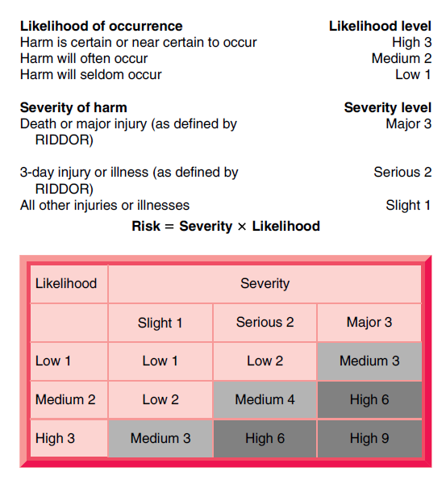
Ex: Quantitative Risk Assessment
Figure 4 : Summary of Risk Control Principles

Slide 16
  Multi-criteria risk analysis to improve safety in manufacturing systems
One of the most popular tools to model reliability and failures is FMECA (Failure Mode , Effect And Criticality Analysis Technique).
a multi-criteria decision making tool is used such as AHP\ANP techniques to include the cost as a factor in the decision making process.

Slide 17
Risk analysis methodologies can include three main phases:
An identification phase :
An evaluation phase
A ranking phase
RPN : Risk Priority Number : An indicator to the level of priority for a problem.
RPN= S * O * D , where :
S= Severity \ O= Probability of Occurrence
D=Probability of (not) detecting.
TRPN : Total Risk Priority Number : An indication to the overall safety situation in the facility
TRPN= TRPN1 + TRPN2 + TRPN3

Slide 18
Methodology
Literature Review
Site Visits
Risk Assessment Using Surveys
Risk Analysis
Introducing controls

Slide 19
Site Visits and Risk Assessment
In this stage of the project , the team will visit a number of sites and stone quarries that were a representative sample of the entire sector.
Managers and employees will be interviewed to form a first impression about the nature of work in these facilities , then based on that , a survey questionnaire will be designed to gather valuable information about the risks and hazards that are present in this type of business.

Slide 20
Risk Analysis
The results of the survey will be used as a basis for a thorough risk assessment and evaluation process that will consist of several stages and activates such as recognition , categorization , quantification and ranking.

Slide 21
الاستبيان

