Slide 1
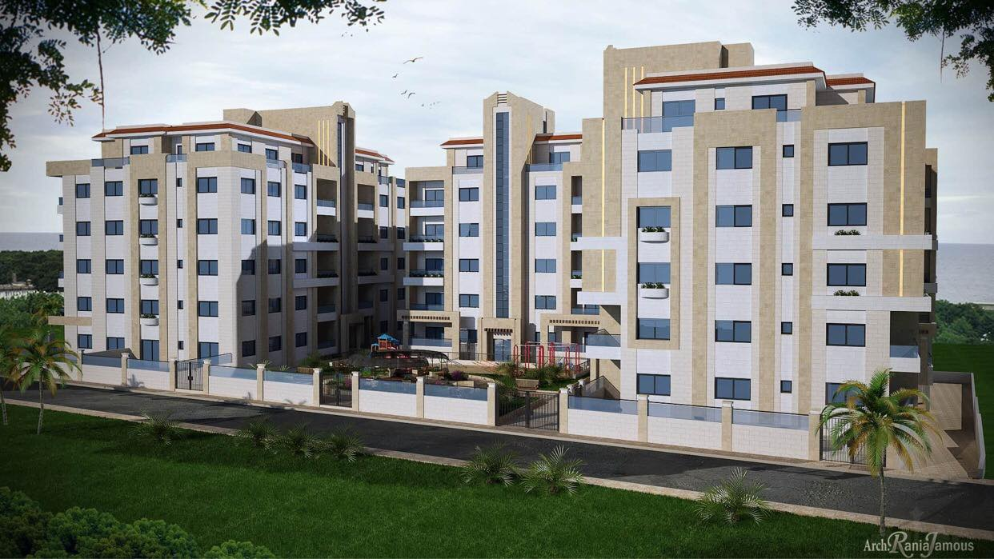

Faculty of Engineering & Information Technology
Department of Civil Engineer
Graduation Project II
Design & Analysis for AL-Fakhama Compound in Tulkarm City
Prepared By:
Tareq JaBer
Majdi Saifi
Mohammad Abd Aljalil
Mohammad Abo Alrub
Under supervision of: Dr. Mohammad Samaaneh

Slide 2
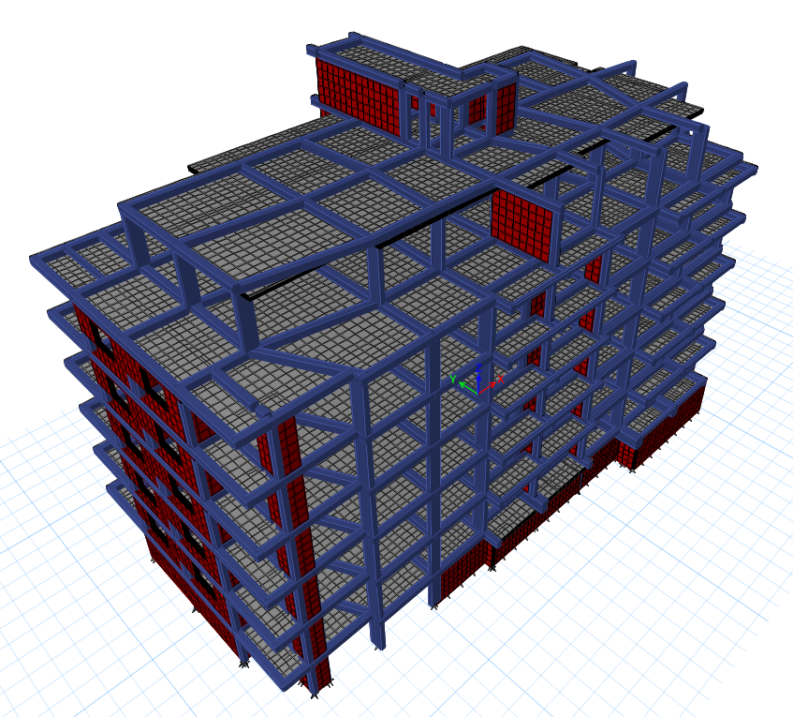
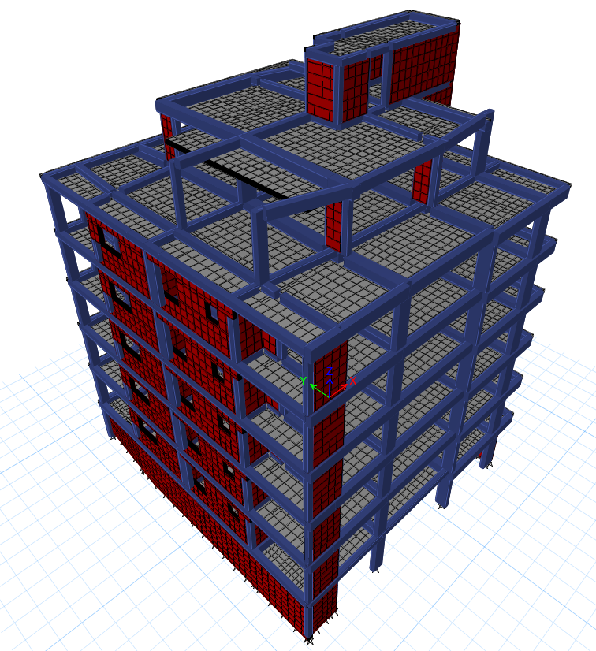
Contents
1
2
3
Introduction
Preliminary Dimensions
Modeling Using ETABs
4
5
6
Seismic Force Analysis
Design for Structural Elements
Design of Footing
7
Shear Wall

Slide 3
1
Introduction
1.1: Project Description
This compound consists of 4 blocks, these blocks have a mutual basement floor with an area of 1856m2 , the basement will be used as a parking lot, each block consists of 5 floors and a roof , areas of blocks range about “363 up to 691m2”, all floors and the roofs are used for a residential use (as an Apartments).
In this project 2 blocks will be Designed which are Block 1 and Block 2 as shown in the figure below.

Slide 4
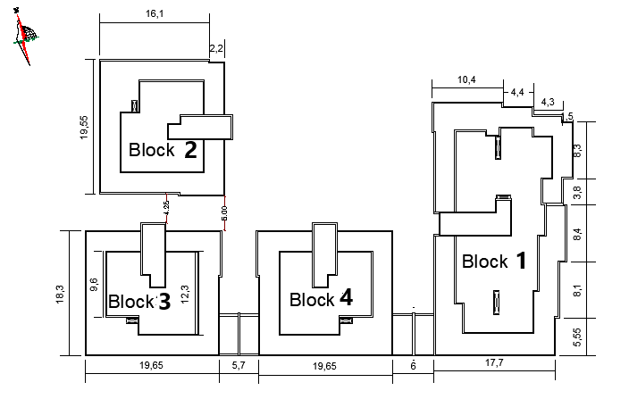
1
Introduction
5

Slide 5

1
Introduction
1.2: Codes & Materials
Codes:
ACI318-14
ASCE7-10
IBC-2012
Materials:
Concrete $f^{′}c=28MPa (B350)$ & $f^{′}c$ = 24MPa (B300)
Reinforcing Steel Fy = 420 MPa (Grade 60)
Soil Bearing capacity = 200 kN/m2
Material | Unit Weight γ kN/m3
Ceramic Tiles | 23.6
Cement mortar | 20.4
thin-set adhesive | 17.3
Sand | 17
Masonry stone | 26
Plain concrete | 23
Brick | 12

Slide 6
1
Introduction
1.3: Loads
1.3.1: Load Types
(1)Dead Load:
consist of the own weight of the structure.
Block 1
•Beams weight = 4270.4 kN
•Columns weight = 4723.6 kN
•Shear wall weight = 7024.75 kN
•Slab weight = 18562.63 kN
Total weight due to dead loads = 34581 kN
Block 2
•Beams weight = 2039 kN
•Columns weight = 2508.09 kN
•Shear wall weight = 6470 kN
•Slab weight = 9568.37kN
Total weight due to dead loads = 20585 kN

Slide 7
1
Introduction
1.3: Loads
Usage | Live Load (KN/m²)
Residential buildings | 2.5
Roof | 5
Stair &staircase | 5
1.3.1: Load Types
(2)Live Load:
The same for block 1&2
Total live load for Block one =12671.05 KN
Total live load for Block two =6643.6 KN

Slide 8
1
Introduction
1.3: Loads
1.3.1: Load Types
(3)Superimposed Load:
come from the weight of all non-structural elements.
Item | Unit weight Ɣ (KN/m³) | Thickness (mm) | Calculations | Weight per m² (KN/m²)
Mortar | 20.4 | 20 | 0.02*20.4 | 0.408
Ceramic Tiles | 23.6 | 10 | 0.01*23.6 | 0.236
Thin-set adhesive | 17.3 | 6 | 0.006*17.3 | 0.1038
Sand | 17 | 30 | 0.03*17 | 0.51
Partitions 10cm |  |  |  | 1+0.24
Total Super Dead Load |  |  |  | 2.49

Slide 9
1
Introduction
1.3: Loads
For earthquake load, adjustment may be done in order to take into consideration the possibility of the earthquake hitting the building not exactly on X or Y axes.
→in X: Ex + 0.3 Ey.
→in Y: Ey + 0.3 Ex.
for earthquake load is taking vertical effect into consideration, as well as the redundancy factor (ρ)
E = Eh + Ev in equation A3+A4+3B.
E = Eh - Ev in equation A5+B4.
5. (1.2+0.2S_{DS}) D + 1.0 ρQ_{E} + L + 0.2S.
6. (0.9-0.2S_{DS}) D + 1.0 ρQ_{E}
1.3.2: Load Combinations
(A)Basic service load combinations:
D
D + L
D + (0.6W or 0.7E)
D + 0.75L + 0.75(0.7E) + 0.75S
0.6D + 0.7E
(B)Basic ultimate load combinations:
1.4D
1.2D + 1.6L + 0.5(L_{r} or S or R)
1.2D + 1.0E + L + 0.2S
0.9D + 1.0E

Slide 10
Beams
Main Beams
Preliminary Dimensions
Slab
Two-way solid slab
Columns
Rectangular
Square

Slide 11
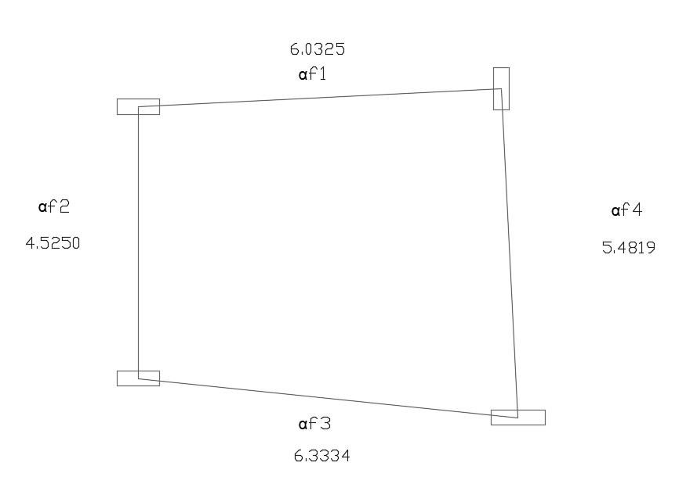

2
Preliminary Dimensions
2.1: Slab
For Block 1
We decide to use Two-Way Solid Slab.
Block 1
Largest span / smallest span = 6.3334/4.525 = 1.39 < 2, so the panel approximately rectangular in shape.
$αℱ$m = 0.6725 between 0.2 and 2.
Use h = 16cm for all floors
Use h = 20cm for roof floor

Slide 12


2
Preliminary Dimensions
2.1: Slab
Two-Way Solid Slab
we took critical panel
Slab thickness h = 16 cm
h = ; β= 1.42
h = $\frac{6.0334∗(0.8+\frac{420}{1400})}{36+5∗1.42(0.6725−0.2)}=0.16m$

Slide 13
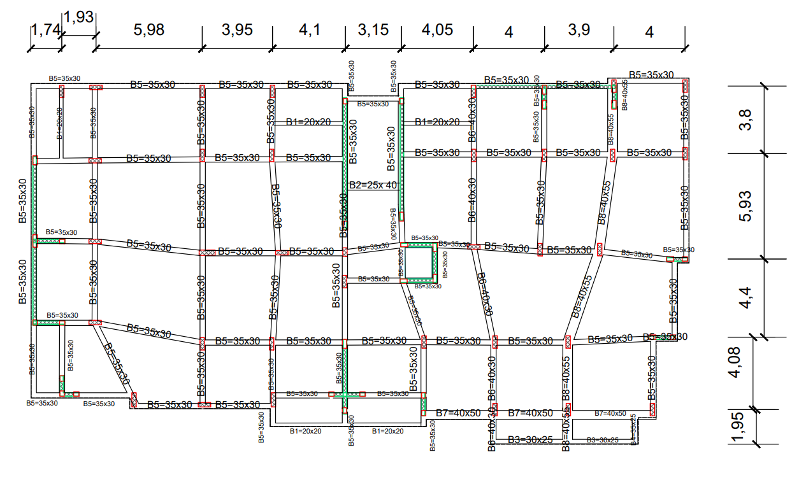
2
Preliminary Dimensions
2.2: Beams
Table of Beams for Block one:
Name of Beam | Depth(mm) | Width(mm)
B1 | 200 | 200
B2 | 250 | 400
B3 | 300 | 250
B4 | 350 | 250
B5 | 350 | 300
B6 | 400 | 300
B7 | 400 | 500
B8 | 400 | 550
B9 | 500 | 300
B10 | 700 | 500
B11 | 700 | 600

Slide 14
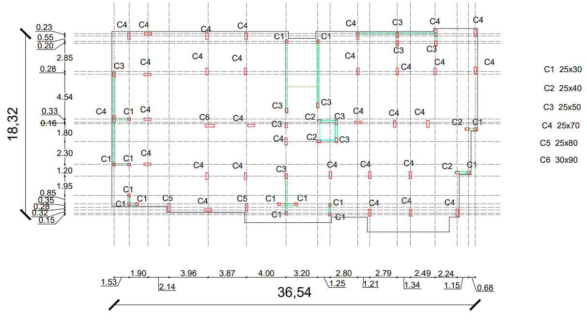
2
Preliminary Dimensions
2.3: Columns
Block 1 columns:
Column Number | Type | Dimension in x(m) | Dimension in y(m)
C1 | R | 0.25 | 0.3
C2 | R | 0.25 | 0.4
C3 | R | 0.25 | 0.5
C4 | R | 0.25 | 0.7
C5 | R | 0.25 | 0.8
C6 | R | 0.3 | 0.9

Slide 15
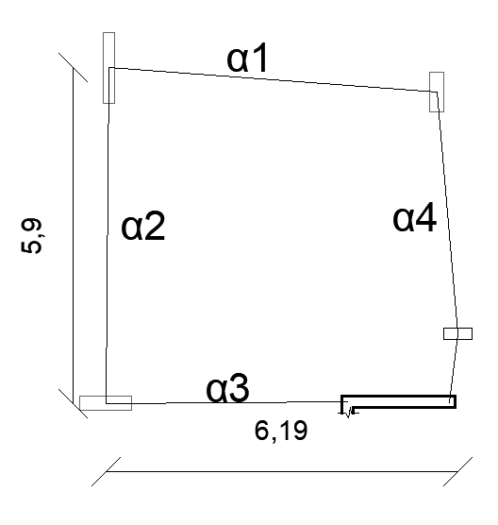

2
Preliminary Dimensions
2.1: Slab
For Block 2
We decide to use Two-Way Solid Slab.
Block 2
Largest span / smallest span = 6.19/5.9 = 1.03 < 2, so the panel approximately rectangular in shape.
$αℱ$m = 0.3825 between 0.2 and 2.
Use h = 16cm for all floors
Use h = 20cm for roof floor

Slide 16

2
Preliminary Dimensions
2.1: Slab
Two-Way Solid Slab
we took critical panel
Slab thickness h = 16 cm
h = ; β= 1.05
h = $\frac{5.89∗(0.8+\frac{420}{1400})}{36+5∗1.05(0.3825−0.2)}=0.16m$
07-Jan-21

Slide 17
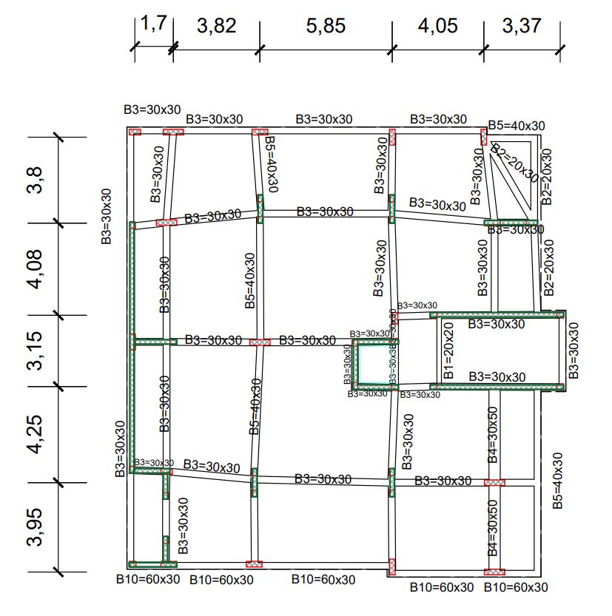
2
Preliminary Dimensions
2.2: Beams
Table of beams for Block 2:
Name of Beam | Depth(mm) | Width(mm)
B1 | 200 | 200
B2 | 300 | 200
B3 | 300 | 300
B4 | 500 | 300
B5 | 300 | 400
B6 | 500 | 400
B7 | 600 | 400
B8 | 300 | 500
B9 | 500 | 500
B10 | 300 | 600
B11 | 500 | 600
07-Jan-21

Slide 18
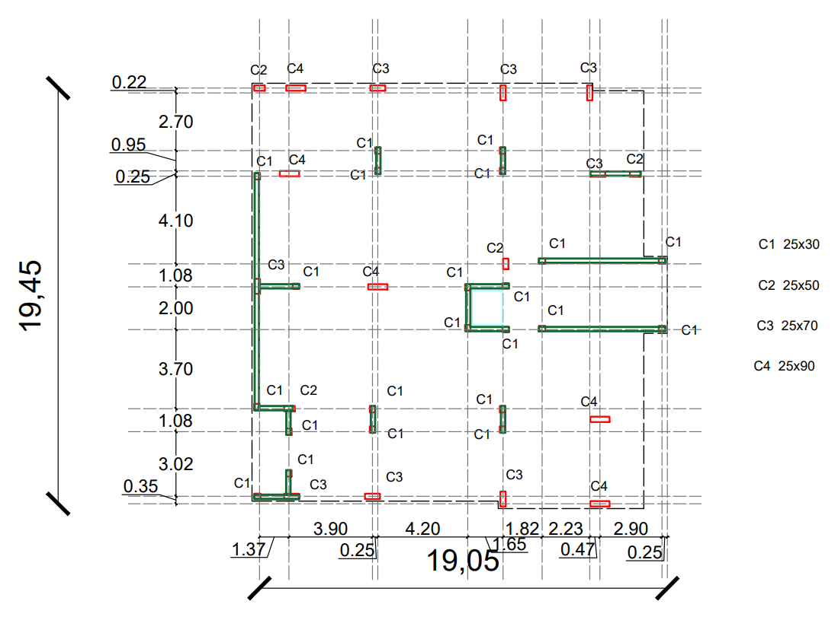
2
Preliminary Dimensions
2.3: Columns
Block 2 columns:
Column Number | Type | Dimension in x(m) | Dimension in y(m)
C1 | R | 0.25 | 0.3
C2 | R | 0.25 | 0.5
C | R | 0.25 | 0.7
C4 | R | 0.25 | 0.9
07-Jan-21

Slide 19
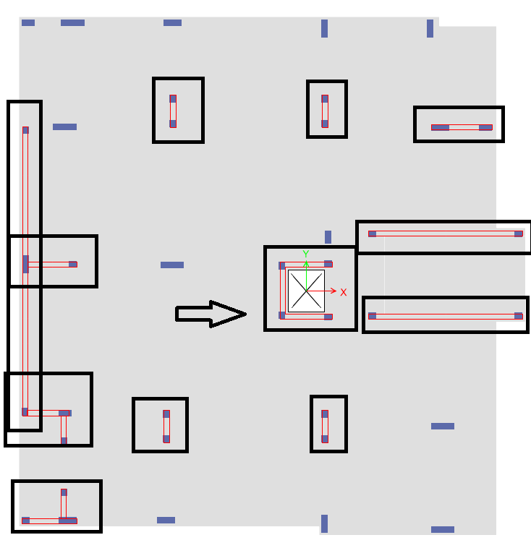
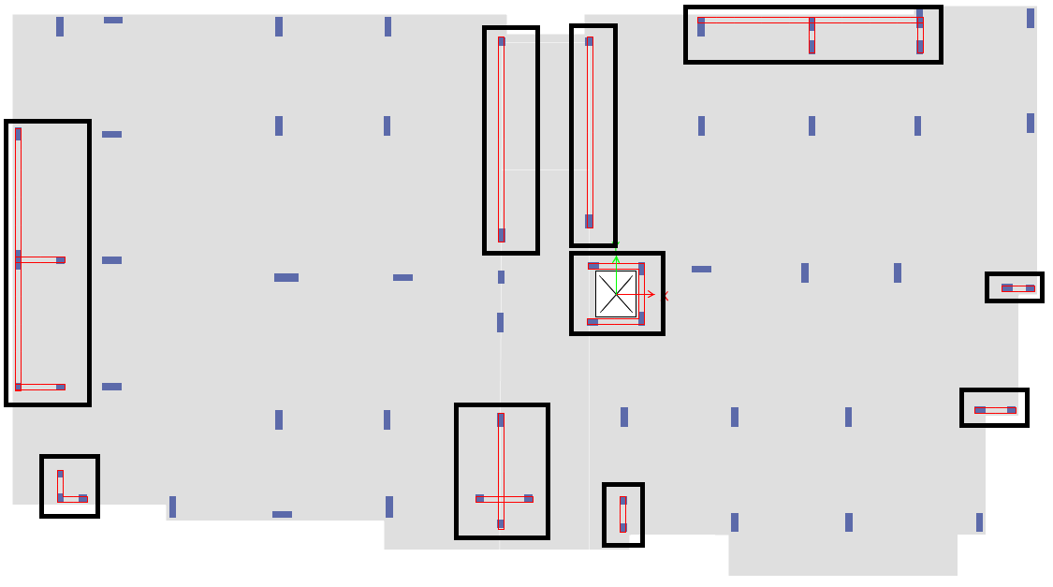
2
Preliminary Dimensions
2.4: Shear walls
More shear walls have been added in the two blocks in order to eliminate torsional mode in each block.
07-Jan-21

Slide 20
3
Modeling Using ETABs
3.1: Model Checks
Compatibility check
Equilibrium check
Internal force check ( stress – strain check )
Deflection check.
Period check.
Base shear (ELF ,Response Spectrum).
Story drift.
P-delta.
07-Jan-21

Slide 21
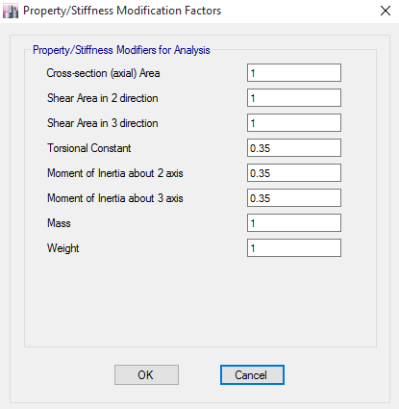
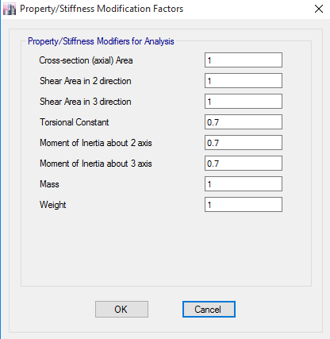
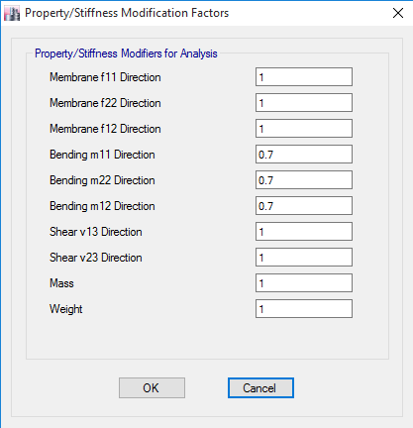
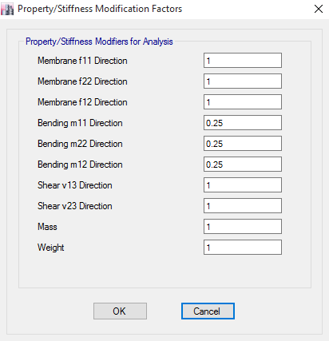
3
Modeling Using ETABs
3.2: Element modifiers
07-Jan-21

Slide 22
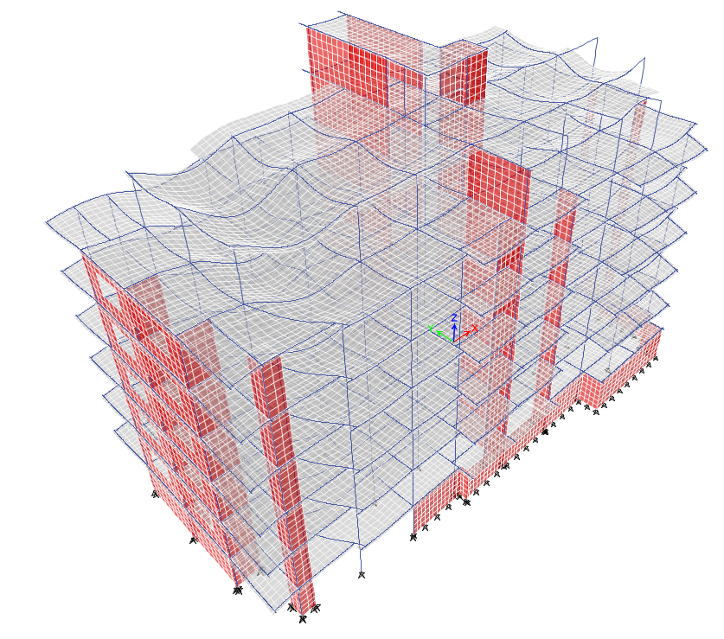
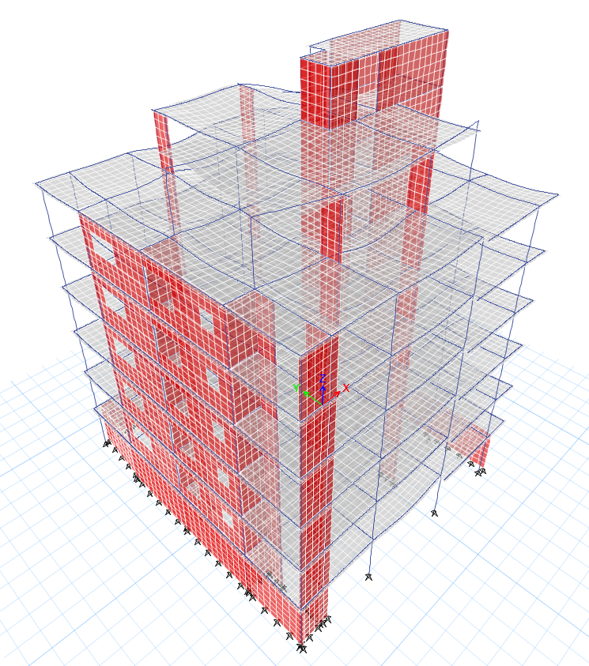
3
Modeling Using ETABs
3.1: Model Checks
3.1.1: Compatibility Check
It is a check used to ensure that the structure is compatible, which means that the structural members works and moves as one mass and to ensure the connection between members as shown in pictures below:
07-Jan-21

Slide 23
3
Modeling Using ETABs
3.1: Model Checks
3.1.2: Equilibrium check
It is a check used to ensure that the total load on the structure equal total reaction by using equilibrium Equations which means Sum of forces in Direction must be equal Zero in that direction
Loads that have been checked are the loads defined in previous slides and Added to structure which are :
Dead load (D)
live load (LL)
super Dead Load (SD)
07-Jan-21

Slide 24
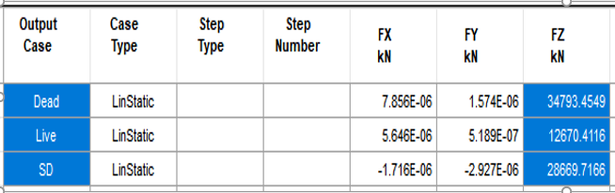
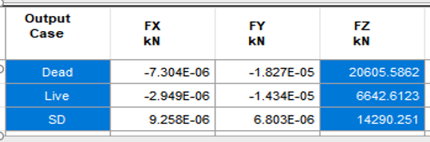
3
Modeling Using ETABs
3.1: Model Checks
3.1.2: Equilibrium Check
Block 2:
Block 1:
Load | Etabs (Fz) | Manual (Fz) | Error
Dead | 34793.45 | 34581.27 | 0.613
SD | 28669.7 | 28380 | 1.01
Live | 12670.41 | 12671.05 | 0.005
Load | Etabs (Fz) | Manual (Fz) | Error
Dead | 20605.58 | 20585.44 | 0.097
SD | 14290.25 | 14569.44 | 1.916
Live | 6642.61 | 6643.6 | 0.014
All of them less than 5 %, then it’s ok.
All of them less than 5 %, then it’s ok.
07-Jan-21

Slide 25
3
Modeling Using ETABs
3.1: Model Checks
3.1.3: Internal force check
It is a check used to ensure that the distribution of loads are correct (each member according to its stiffness) and that done by checking that the internal forces of structural members from Etabs is approximately equal to Manual Calculations.
Internal forces that will be checked is the dominant force for that Member and It is by taking a Random members with sufficient number for each block.
Members – internal forces that will be checked:
Beams – Moment force (dominant)
Column – Axial Force (dominant)
*In this check one sample will be taken for each member check due to sufficient samples in main report.
07-Jan-21

Slide 26
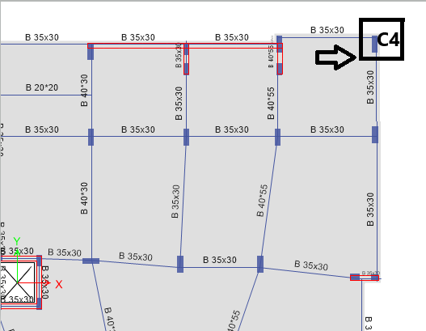
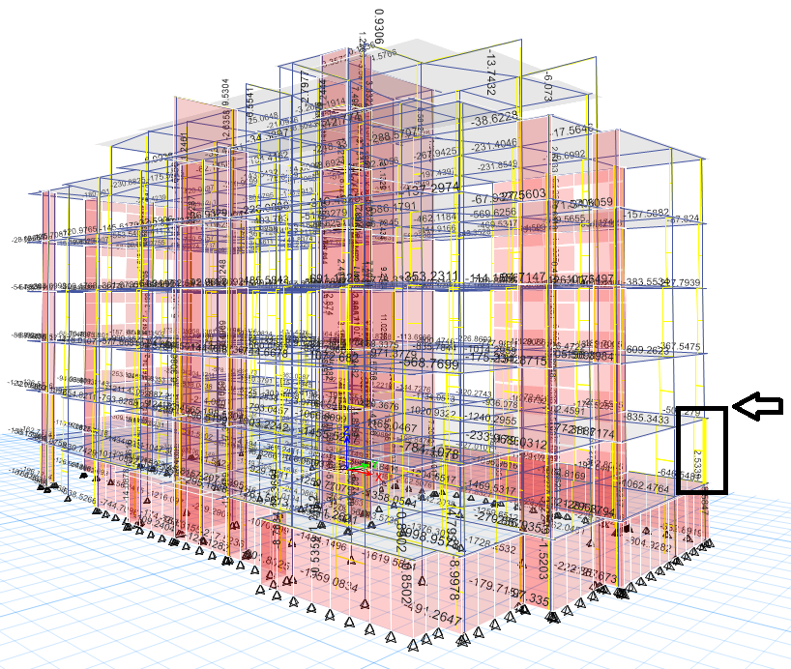
3
Modeling Using ETABs
3.1: Model Checks
3.1.3: Internal force check
Column that has been checked in block one:
Column 4 (25*70cm) at GF floor
By manual Calculations (From Combo D + SD + L)
Slab thickness = 16 cm, LL= 2.5kN/m2 and SD = 2.5kN/m2.
Roof thickness = 20 cm, LL= 5kN/m2 and SD = 1.5kN/m2.
Column own weight = 0.25 * 0.7 * 25 * 16.25 = 71.4 kN
Load of main beams on column = 5 * (0.5 * 4.15) * (0.54) * 0.35 * 0.3 * 25 +((0.5 * 3.65) * (0.54) * 0.35 * 0.3 * 25 * 5 = 20.6 kN
Load of slab on column = 4.52 * 5 * (0.16 * 25 + 2.5 + 2.5) =181.25 kN
Load masonry wall = 8 * 3.65 + 21 * 3.65 * 5= 381.8 KN
Total load on column = 71.4 + 20.6 + 181.25 + 381.8 = 655.05 kN
07-Jan-21

Slide 27
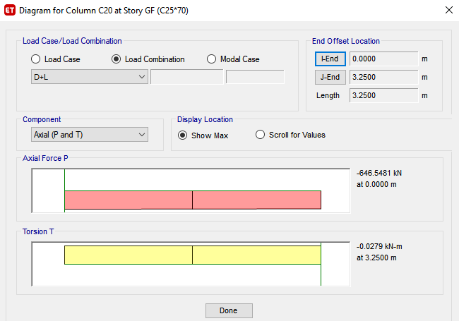
3
Modeling Using ETABs
3.1: Model Checks
3.1.3: Internal force check
Etabs results:
Etabs=646.5481 KN
%Difference between hand and Etabs results:
%Difference = | (Hand – Etabs / Etabs) | *100%
%Difference = 0.6% < 10 % then it’s acceptable.
07-Jan-21

Slide 28
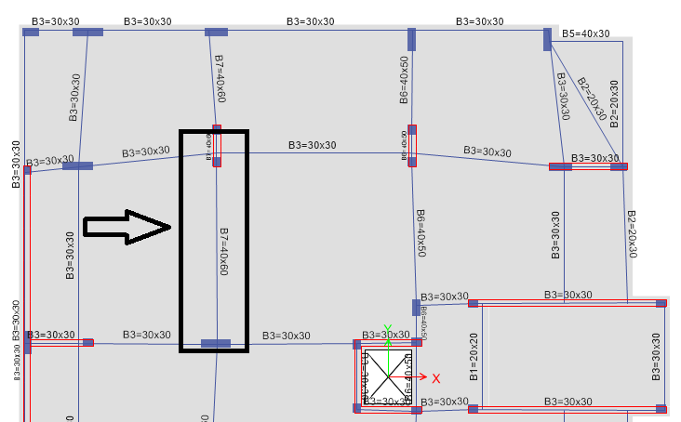
3
Modeling Using ETABs
3.1: Model Checks
3.1.3: Internal force check
Beam that has been checked in block two:
B7 (40*60cm) at fourth floor
By manual Calculations (From Combo D + SD + L)
Slab thickness = 16 cm, LL= 2.5kN/m2 and SD = 2.5kN/m2.
Roof thickness = 20 cm, LL= 5kN/m2 and SD = 1.5kN/m2.
W_{SLAB} = D + L = 25 * 0.16 + 2.5 + 2.5 = 9 kN/m2.
M₀ = W_{u} ℓ₂ l_{n}²/8 = (16 * 9 * 5.4 / 8) + (21 * 5.4^2 /8) = 173.8 kN.m.
07-Jan-21

Slide 29
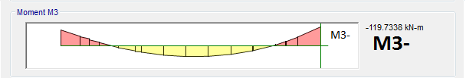
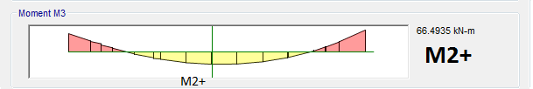
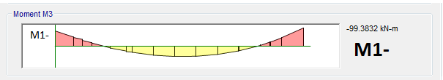
3
Modeling Using ETABs
3.1: Model Checks
3.1.3: Internal force check
For ETABS results, see the following figures:
M_{ETABS} = (99.3 + 119.7) * 0.5 + 66.5 = 176.1 kN.m.
%difference = ((176.1-173.8)/176.1) *100 = 1.3% < 10% → OK
07-Jan-21

Slide 30
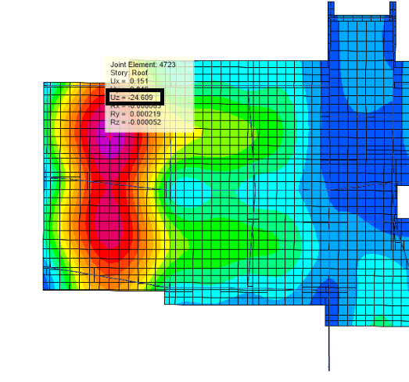
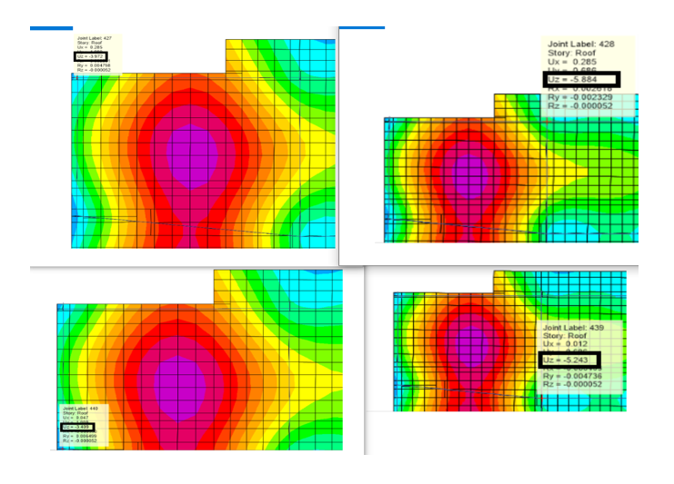
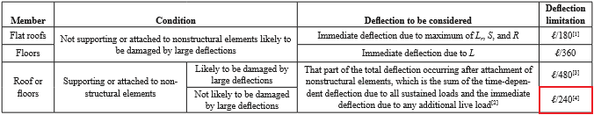
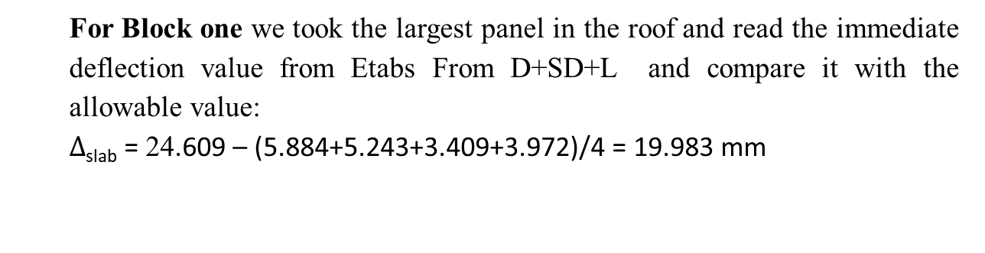
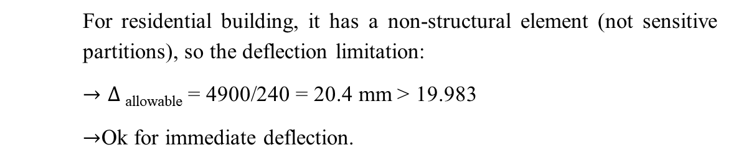
3
Modeling Using ETABs
3.1: Model Checks
3.1.4: Deflection check
Immediate deflection:
For Block one we took the largest panel in the roof and read the immediate deflection value from Etabs From D+SD+L and compare it with the allowable value:
$∆$_{slab} = 24.609 – (5.884+5.243+3.409+3.972)/4 = 19.983 mm
For residential building, it has a non-structural element (not sensitive partitions), so the deflection limitation:
$→∆$_{allowable} = 4900/240 = 20.4 mm < 19.983
$→$Ok for immediate deflection.
07-Jan-21

Slide 31
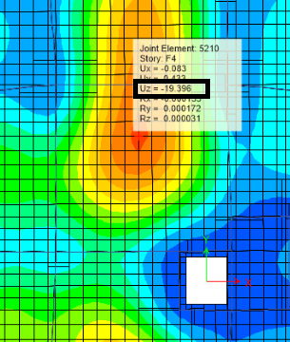
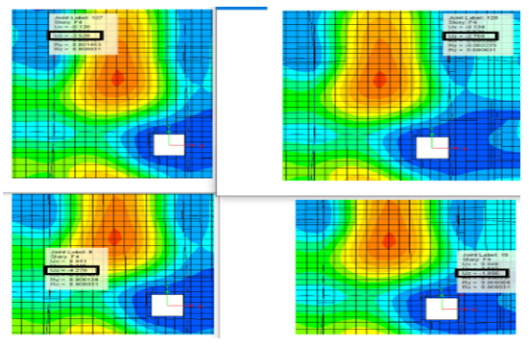
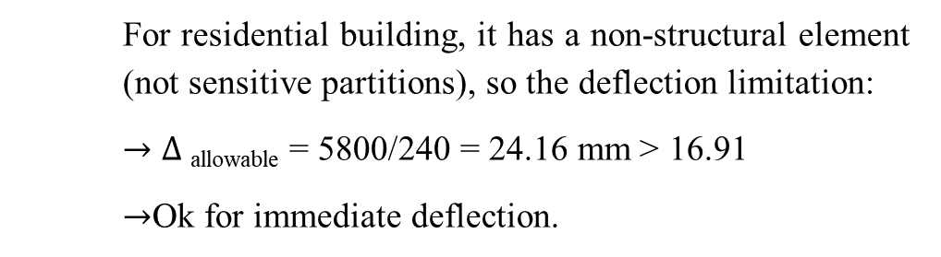
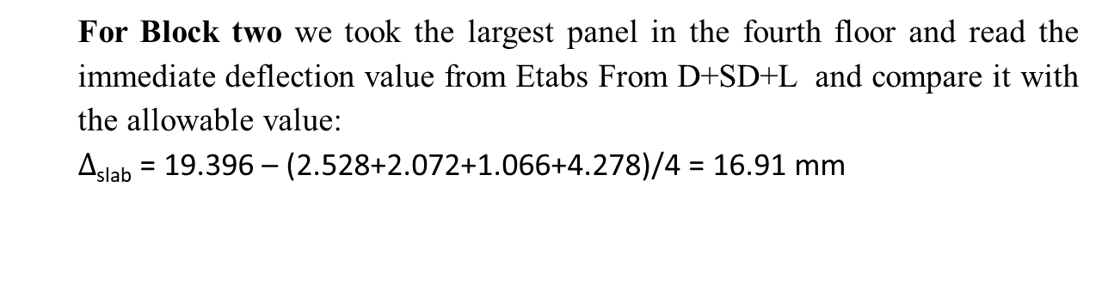
3
Modeling Using ETABs
3.1: Model Checks
3.1.4: Deflection check
For Block two we took the largest panel in the fourth floor and read the immediate deflection value from Etabs From D+SD+L and compare it with the allowable value:
$∆$_{slab} = 19.396 – (2.528+2.072+1.066+4.278)/4 = 16.91 mm
For residential building, it has a non-structural element (not sensitive partitions), so the deflection limitation:
$→∆$_{allowable} = 5800/240 = 24.16 mm < 16.91
$→$Ok for immediate deflection.
07-Jan-21

Slide 32
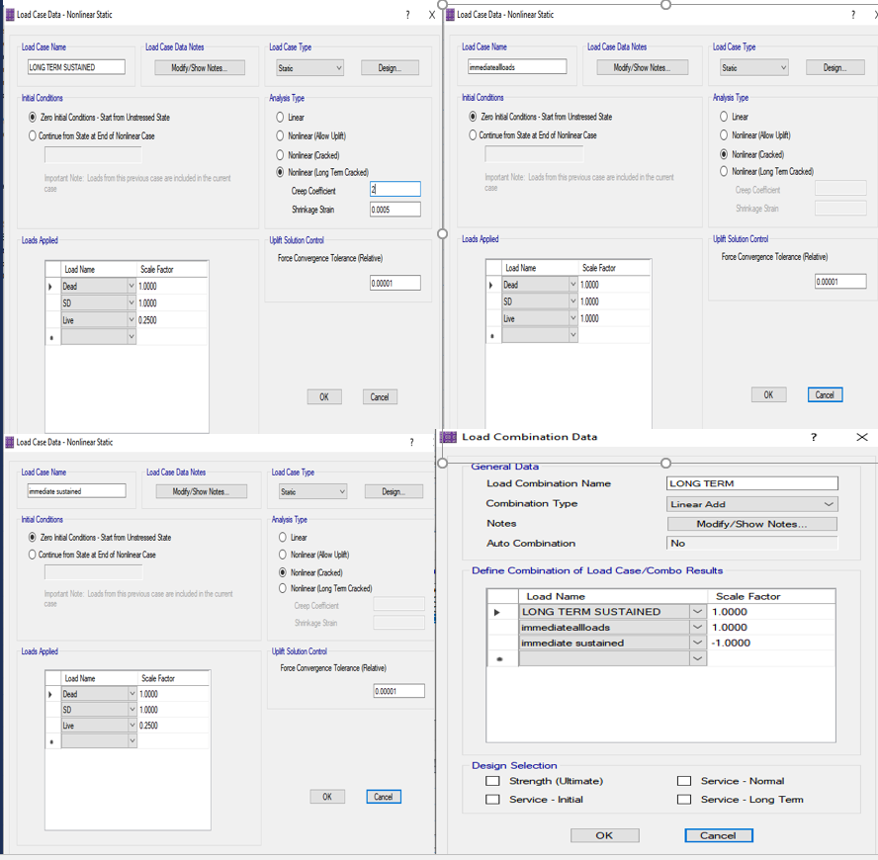
3
Modeling Using ETABs
3.1: Model Checks
3.1.4: Deflection check
Long-term deflection
The definition of long term deflection is shown in the following figure by safe programme:
07-Jan-21

Slide 33
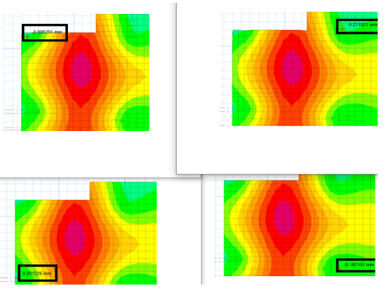
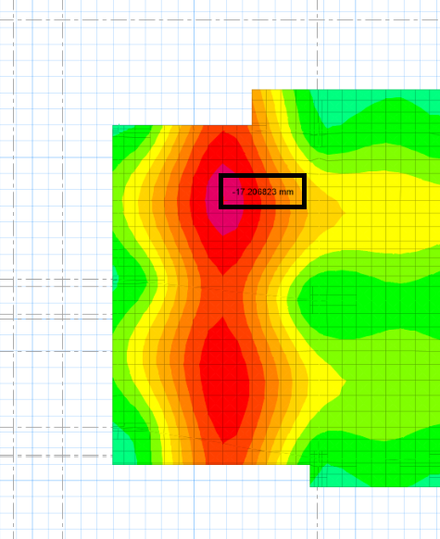
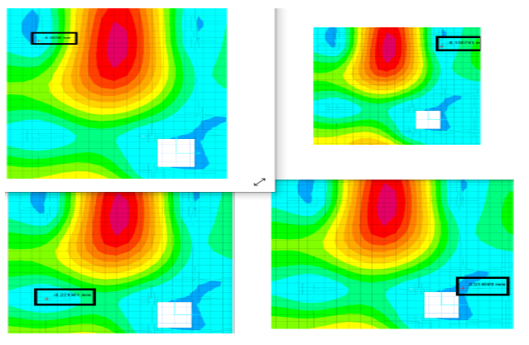
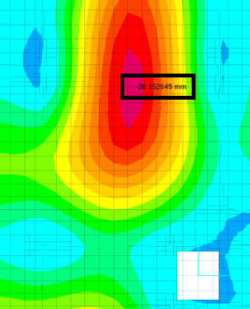

3
Modeling Using ETABs
3.1: Model Checks
3.1.4: Deflection check
Block 1 :
$∆$_{slab} = 17.20 – (0.031+0.09+0.21+0.18)/4 = 20.4 mm
Allowable deflection = 20.4 mm < 17.07 mm
$→$Ok for long term deflection.
Block 2 :
$∆$_{slab} = 26.17 – (2.15+1.014+1.18+2.22)/4 = 24.029 mm
Allowable deflection = 24.16 mm < 24.029 mm
$→$Ok for long term deflection.
07-Jan-21

Slide 34
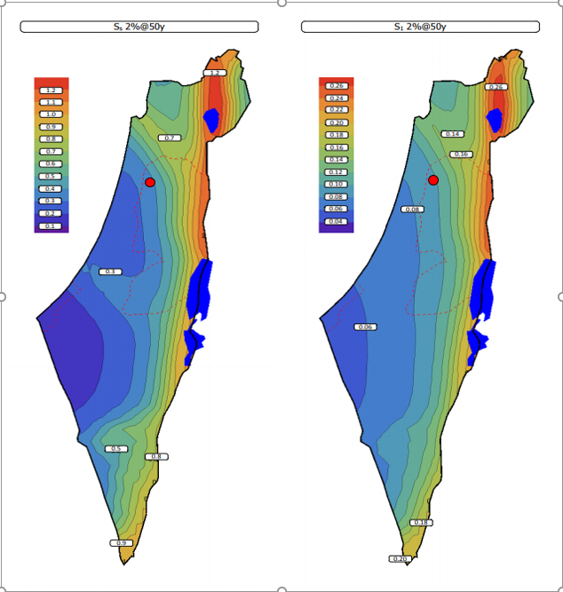
4
Seismic Force Analysis
4.1: Mapped acceleration parameter ‘Ss & S1’
the project the mapped acceleration parameter for short period
Ss = 0.375 second
and the mapped acceleration parameter for 1s period
S₁ = 0.09 second
07-Jan-21

Slide 35
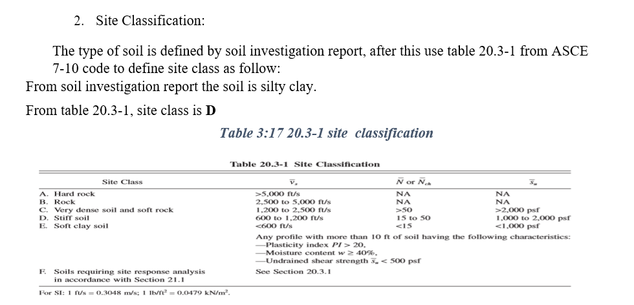
4
Seismic Force Analysis
07-Jan-21

Slide 36
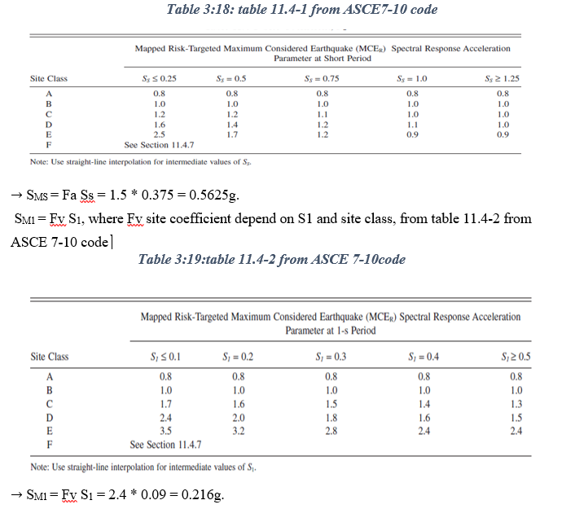
4
Seismic Force Analysis
07-Jan-21

Slide 37


4
Seismic Force Analysis
07-Jan-21

Slide 38


4
Seismic Force Analysis
07-Jan-21

Slide 39
4
Seismic Force Analysis
The System of Load Resistance
Determining the System helps in Getting more information and values for seismic Design Calculations by a horizontal load in a certain amount on structure then compute the reaction on walls, then compare Lateral load percentage Resisted by walls with table below.
Percentage of Loads Resisting by Walls: | Type
Less than 25% | Moment Resisting Frame System
25% to 75% | Dual System
More than 75% | Shear Wall Resisting System
07-Jan-21

Slide 40




4
Seismic Force Analysis
For Y-direction:
Wall reaction
Total reaction
%load resisted by walls = (3620.8/3867.22) × 100%= 93.62%,
so the system is Shear Wall Resisting System (Building Frame System) in the Y direction.
Block one:
To find the resisting system, applied a lateral force in X and Y direction and determine the portion of the force that resisted by the moment frame and columns.
For X-direction:
Wall reaction
Total reaction
%Load resisted by walls = (2905.1/3149.49) × 100%= 92.24%,
so the system is Shear Wall Resisting System (Building Frame System) in the X direction.
07-Jan-21

Slide 41




4
Seismic Force Analysis
For Y-direction:
Wall reaction
Total reaction
%load resisted by walls = (1560.27/1699.67) × 100%= 91.79%,
so the system is Shear Wall Resisting System (Building Frame System) in the Y direction.
Block two:
To find the resisting system, applied a lateral force in X and Y direction and determine the portion of the force that resisted by the moment frame and columns.
For X-direction:
Wall reaction
Total reaction
%Load resisted by walls = (2117.4/2193.64) × 100%= 96.52%,
so the system is Shear Wall Resisting System (Building Frame System) in the X direction.
07-Jan-21

Slide 42


4
Seismic Force Analysis
Period Check
It is a check used to ensure logical time period for structure.
there are two manual methods to calculate time period:
1-ASCE 7-10 ( IBC code) 𝑇𝑎 = 𝐶𝑡 ℎ𝑛^𝑥
Ct: coefficient depending on the type of structure
hn: Height of structure
x: coefficient depending on the type of structure.
There is also a formula in code, it’s approximate method for Frame System with average story height = 3m and less than 12 stories
Ta=0.1*#stories
2- Rayleigh method : more realistic than another formula and more difficult (will not be used)
m: mass of the story
𝑇𝑛 = $2π\sqrt{\frac{m}{k}}$. K: stiffness of story
07-Jan-21

Slide 43


Max. value represent by this formula
𝑇𝑎 𝑚𝑎𝑥. = 𝐶𝑢 𝑇𝑎.
Where Cu is a coefficient depending on the spectral response acceleration at 1 sec. 𝑆𝐷1.
𝑆𝐷1 = 2/3 SM1 = 2/3 𝑆1 × 𝐹𝑣, the type of soil is silty clay
(TYPE D), 𝑆1 = 0.09𝑔
and 𝐹𝑣 = 2.4 so SD1= 0.144 so Cu=1.612 As shown
 | Etabs (Sec) | Manual (Sec) | %difference
Tx | 0.846 | 0.45284 | 87.04 | Not ok, more than 5%
TY | 0.592 | 0.45284 | 30.73 | Not ok, more than 5%
4
Seismic Force Analysis
Period Check
Block one:
Etabs result:
Tx =0.846 seconds
Ty = 0.592 seconds.
Ta (Manual) By Code formula:
𝑇𝑎 = 𝐶𝑡 ℎ𝑛𝑥
Ct = 0.0488, x = 0.75
hn = 19.5 m
Ta = 0.45284 seconds.
For both direction
 | Etabs (Sec) | Ta max(Sec) | %difference
Tx | 0.846 | 0.7299 | 16.031 | Not ok, more than 5%
TY | 0.592 | 0.7299 | 18.9 | Not ok, more than 5%
07-Jan-21

Slide 44

Max. value represent by this formula
𝑇𝑎 𝑚𝑎𝑥. = 𝐶𝑢 𝑇𝑎.
Where Cu is a coefficient depending on the spectral response acceleration at 1 sec. 𝑆𝐷1.
𝑆𝐷1 = 2/3 SM1 = 2/3 𝑆1 × 𝐹𝑣, the type of soil is silty clay
(TYPE D), 𝑆1 = 0.09𝑔
and 𝐹𝑣 = 2.4 so SD1= 0.144 so Cu=1.612 As shown
 | Etabs (Sec) | Manual (Sec) | %difference
Tx | 0.562 | 0.45284 | 24.10 | Not ok, more than 5%
TY | 1.264 | 0.45284 | 179.12 | Not ok, more than 5%
4
Seismic Force Analysis
Period Check
Block two:
Etabs result:
Tx =0.562 seconds
Ty = 1.264 seconds.
Ta (Manual) By Code formula:
𝑇𝑎 = 𝐶𝑡 ℎ𝑛𝑥
Ct = 0.0488, x = 0.75
hn = 19.5 m
Ta = 0.45284 seconds.
For both direction
 | Etabs (Sec) | Ta max(Sec) | %difference
Tx | 0.562 | 0.7299 | 23.01 | Not ok, more than 5%
TY | 1.264 | 0.7299 | 73.15 | Not ok, more than 5%
07-Jan-21

Slide 45


4
Seismic Force Analysis
The design coefficient and factors for seismic force resisting system. Depends on the Seismic Design Category, from table 12.2-1.
After these values we can start calculating Base Shear and check difference between Manual and ETABs Values.
07-Jan-21

Slide 46

4
Seismic Force Analysis
For Y-direction(manual):
C_{s} = (S_{DS} × I_{e}) /R = (0.375×1.25) / 5 = 0.09375
C_{s, min} = 0.044 𝑆_{𝐷𝑆}𝐼_{𝑒} ≥ 0.01 → 0.020625 < 0.09375 →ok
C_{s, max} = (S_{D1} × I_{e})/ (T×R) = (0.144×1.25)/ (0.592×5) =
0.060811 < 0.09375 → not ok
So take C_{s} = C_{s max} = 0.060811
V_{By} = C_{s} W = 0.060811 × 66325.91665 = 4033.33 kN
ETABs Results:
%difference:
𝐷𝑖𝑓𝑓𝑒𝑟𝑎𝑛𝑐𝑒 (x)% = 0.2879 % → less 𝑡ℎ𝑎𝑛 5% → 𝑶𝒌𝒂𝒚
𝐷𝑖𝑓𝑓𝑒𝑟𝑎𝑛𝑐𝑒 (y)% = 0.2879 % → less 𝑡ℎ𝑎𝑛 5% → 𝑶𝒌𝒂𝒚
Base shear check (ELF calculations)
Block one:
For X-direction(Manual):
C_{s} = (S_{DS} × I_{e}) /R = (0.375×1.25) / 5 = 0.09375
C_{s, min} = 0.044 𝑆_{𝐷𝑆}𝐼_{𝑒} ≥ 0.01 → 0.020625 < 0.0937555 →ok
C_{s, max} = (S_{D1} × I_{e})/ (T×R) = (0.1444×1.25)/ (0.729979×5) =
0.049316 < 0.09375 → not ok
So take C_{s} = C_{s max} = 0.049316
W = Dead load + S.D load + 0.25 Live
W = 34793.4549 + 28669.7651 + (0.25 *12670.4116) – 304.90625 = 66325.91665 kN
Note that we subtract the half of columns of base story
W = 66325.91665 kN
V_{Bx} = C_{s} W = 0.049316 × 66325.91665 = 3270.95 kN
07-Jan-21

Slide 47

4
Seismic Force Analysis
For Y-direction(manual):
C_{s} = (S_{DS} × I_{e}) /R = (0.375×1.25) / 5 = 0.09375
C_{s, min} = 0.044 𝑆_{𝐷𝑆}𝐼_{𝑒} ≥ 0.01 → 0.020625 < 0.09375 →ok
C_{s, max} = (S_{D1} × I_{e})/ (T×R) = (0.144×1.25)/ (0.729979×5) =
0.049316 < 0.09375 → not ok
So take C_{s} = C_{s max} = 0.049316
V_{By} = C_{s} W = 0.049316 × 35968.49258 = 1773.83 kN
ETABs Results:
%difference:
𝐷𝑖𝑓𝑓𝑒𝑟𝑎𝑛𝑐𝑒 (x)% = 0.6649 % → less 𝑡ℎ𝑎𝑛 5% → 𝑶𝒌𝒂𝒚
𝐷𝑖𝑓𝑓𝑒𝑟𝑎𝑛𝑐𝑒 (y)% = 0.6650 % → less 𝑡ℎ𝑎𝑛 5% → 𝑶𝒌𝒂𝒚
Base shear check (ELF calculations)
Block two:
For X-direction(Manual):
C_{s} = (S_{DS} × I_{e}) /R = (0.375×1.25) / 5 = 0.09375
C_{s, min} = 0.044 𝑆_{𝐷𝑆}𝐼_{𝑒} ≥ 0.01 → 0.020625 < 0.0937555 →ok
C_{s, max} = (S_{D1} × I_{e})/ (T×R) = (0.1444×1.25)/ (0.562222×5) =
0.06405 < 0.09375 → not ok
So take C_{s} = C_{s max} = 0.06405
W = Dead load + S.D load + 0.25 Live
W = 20605.5877 + 14290.2514 + (0.25* 6642.6139) – 588 = 35968.49258 kN
Note that we subtract the half of columns of base story
W = 66325.91665 kN
V_{Bx} = C_{s} W = 0.06405 × 35968.49258 = 2304.03 kN
07-Jan-21

Slide 48




4
Seismic Force Analysis
Base shear check (RS calculations)
RS must be defined in modeling Program ( ETABs is used) as shown below.
By using Seismic Design Values that have been calculated before
SDS= 0.375 , SD1=0.144 , Site Class= D
I=1.25 , R= 5 and g=9.806 m/sec^2
Old scale factor =$\frac{g ∗I}{R}$=2451.66
07-Jan-21

Slide 49






4
Seismic Force Analysis
Block one:
Results:
Difference with ELF: while VELFx = 3261.53 kN ,VELFy = 4021.72 KN
for X-direction
%𝐷𝑖𝑓𝑓𝑒𝑟𝑎𝑛𝑐𝑒= [(V_{ELF}– V_{R. S})/V_{ELF}] *100 = 43.54%
→ R.S = 56.45% ELF → which isn’t acceptable must be modified.
New scale factor (X)= (V_{ELF}/V_{R. S}) *old scale factor =
(3261.53/ 1841.34) *2451.66 = 4342.59
for Y-direction
%𝐷𝑖𝑓𝑓𝑒𝑟𝑎𝑛𝑐𝑒= [(V_{ELF}– V_{R. S})/V_{ELF}] *100 = 41.59%
→ R.S = 58.40% ELF → which isn’t acceptable must be modified
New scale factor(Y) = (V_{ELF}/V_{R. S}) *old scale factor =
(4021.72/ 2348.93) *2451.66 = 4197.6
Block two:
Results:
Difference with ELF: while VELFx = 2319.35 kN ,VELFy=1785.63 KN
for X-direction
%𝐷𝑖𝑓𝑓𝑒𝑟𝑎𝑛𝑐𝑒 = [(V_{ELF}– V_{R. S})/V_{ELF}] *100 = 30.32% → R.S = 69.67% ELF
→ which isn’t acceptable must be modified.
New scale factor (X)= (V_{ELF}/V_{R. S}) *old scale factor =
(2319.35/ 1615.98) *2451.66 = 3518.76
for Y-direction
%𝐷𝑖𝑓𝑓𝑒𝑟𝑎𝑛𝑐𝑒 = [(V_{ELF}– V_{R. S})/V_{ELF}] *100 = 29.62% → R.S = 70.37% ELF
→ which isn’t acceptable → must modified
New scale factor (Y) = (V_{ELF}/V_{R. S}) *old scale factor =
(1785.634/ 1256.59) *2451.66 = 3483.83

Slide 50


4
Seismic Force Analysis
4.3: Check story drift:
$δ$_{M} = C_{d}$δ$_{max} / I_{e}
Where:
C_{d}: deflection amplification factor = 4.5
$δ$_{max}: max elastic displacement at location
I_{e}: importance factor = 1.25
The value of max inelastic response displacement ($δ$_{M}) should comparison with allowable story drift ($∆$_{a}) from table12.12-1 in ASCE7-10 as shown above.
$∆$_{a} = 0.015 h_{sx}, where h_{sx} is the story height below level x.
Taking Result from ETABs in a table that summarized the drift calculations as following ratio:
Drift _{ETABs} = Drift _{STORY} / h _{STORY}
Max allowable displacement should be 0.015
07-Jan-21

Slide 51


4
Seismic Force Analysis

Slide 52

4
Seismic Force Analysis
4.4: Check torsional irregularly:
$A_{X}={\left(\frac{δ_{max}}{1.2 δ_{avg}}\right)}^{2}$
Block 1 : X – Direction:
Story | Load Case/Combo | Direction | Max Drift | Avg Drift | Ratio
Staircase | EnvService | X | 2.385 | 2.259 | 1.056
Staircase | EnvService | X | 2.446 | 2.222 | 1.101
Roof | EnvService | X | 11.313 | 6.946 | 1.629
Roof | EnvService | X | 11.101 | 6.692 | 1.659
F4 | EnvService | X | 2.787 | 2.308 | 1.207
F4 | EnvService | X | 2.882 | 2.329 | 1.237
F3 | EnvService | X | 2.853 | 2.36 | 1.209
F3 | EnvService | X | 2.937 | 2.385 | 1.231
F2 | EnvService | X | 2.784 | 2.32 | 1.2
F2 | EnvService | X | 2.867 | 2.346 | 1.222
F1 | EnvService | X | 2.442 | 2.057 | 1.187
F1 | EnvService | X | 2.523 | 2.081 | 1.212
GF | EnvService | X | 1.618 | 1.387 | 1.166
GF | EnvService | X | 1.691 | 1.412 | 1.197
Basement | EnvService | X | 0.102 | 0.087 | 1.173
Basement | EnvService | X | 0.089 | 0.082 | 1.079
07-Jan-21

Slide 53

4
Seismic Force Analysis
4.4: Check torsional irregularly:
$A_{X}={\left(\frac{δ_{max}}{1.2 δ_{avg}}\right)}^{2}$
Block 1 : Y – Direction:
Story | Load Case/Combo | Direction | Max Drift | Avg Drift | Ratio
Staircase | EnvService | Y | 1.464 | 1.373 | 1.066
Staircase | EnvService | Y | 1.407 | 1.268 | 1.11
Roof | EnvService | Y | 2.398 | 1.907 | 1.257
Roof | EnvService | Y | 2.493 | 1.696 | 1.47
F4 | EnvService | Y | 2.717 | 1.616 | 1.681
F4 | EnvService | Y | 2.752 | 1.507 | 1.826
F3 | EnvService | Y | 2.76 | 1.626 | 1.697
F3 | EnvService | Y | 2.777 | 1.53 | 1.816
F2 | EnvService | Y | 2.601 | 1.537 | 1.692
F2 | EnvService | Y | 2.64 | 1.465 | 1.802
F1 | EnvService | Y | 2.195 | 1.31 | 1.675
F1 | EnvService | Y | 2.264 | 1.271 | 1.782
GF | EnvService | Y | 1.415 | 0.883 | 1.603
GF | EnvService | Y | 1.497 | 0.871 | 1.718
Basement | EnvService | Y | 0.195 | 0.143 | 1.36
Basement | EnvService | Y | 0.176 | 0.133 | 1.321
07-Jan-21

Slide 54



4
Seismic Force Analysis
4.4: Check torsional irregularly:
As we see almost all values more than the ratio 1.2 so there is Irregularity and must be taken in the design.
Cause torsional irregularity exists as defined in Table 12.3-1 shall have the effects accounted for by multiplying M_{ta} at each level by a torsional amplification factor (Ax) as illustrated in Fig. 3.57 and determined from the following equation:
$A_{X}={\left(\frac{δ_{max}}{1.2 δ_{avg}}\right)}^{2}$
07-Jan-21

Slide 55
4
Seismic Force Analysis
4.5: Check P-delta
A simplified formula for stability coefficient:
θ = P_{x} / K_{x} h_{x}
K_{x}: story stiffness at level x.
If θ < 0.10 then there is no need for taking the P-Delta effect into consideration.
If 0.10 < θ < θ_{max}, then we need to magnified the moments by factor equal (1/1- θ).
If θ > θ_{max}, then the structure isn’t ok (it’s too flexible)
θ _{max} = 0.5/βC_{d} ≤ 0.25
where β is the ratio of shear demand to shear capacity for the story between Levels x and x – 1. This ratio is permitted to be conservatively taken as 1.0
θ = P_{x} ∆_{in} I_{e}/ C_{d} V_{x} h_{x}
Where:
θ: Stability coefficient.
P_{x}: Total un-factored vertical design load at and above level x.
∆_{in}: Design story drift.
I_{e}: Importance factor.
C_{d}: Deflection amplification factor.
V_{x}: Seismic shear force.
h_{x}: story height below level x.
07-Jan-21

Slide 56


Block 1 :
All the results less than 0.1 so neglect P-delta analysis
07-Jan-21

Slide 57


Block 2 :
All the results less than 0.1 so neglect P-delta analysis
07-Jan-21

Slide 58
Design of Beams
Design of Footing
Design for Structural Elements
Design of Columns
Design of Slabs
Design of Stairs

Slide 59




5
Design for Structural Elements
5.1: Design of Beams
5.1.1: Flexural
$$M_{+}=45.86 KN.m$$
Verification on design:
For $M_{+}=45.86 KN.m$ $→ρ=\frac{0.85f_{c}}{f_{y}} \left(1−\sqrt{1−\frac{2.61M_{U}}{bd^{2}f_{c}} } \right)=ρ=\frac{0.85∗24}{420} \left(1−\sqrt{1−\frac{2.61∗45.86∗{10}^{6}}{300∗{290}^{2}∗24} } \right)= 0.00506>ρ_{MIN}= 0.0033 OK$
$$A_{S+}= ρbd=0.00506∗300∗290=441 {mm}^{2}$$
Error = 0%
07-Jan-21

Slide 60




5
Design for Structural Elements
5.1: Design of Beams
5.1.1: Flexural
Any structural member that has (Pu < 0.1*Ag*$f′c$) is concerned to be a beam. Pu approximately equal to zero in this beam so design as it beam
At least two top and bottom bars extended l_{d} in the columns, where l_{d}: development length of steel bars in tension.
Continuous bottom bars shall have area not less than one-fourth the maximum area of bottom bars along the span. These bars shall be anchored to develop fy in tension at the face of support.
As _{min} = ρ_{min} b d = 0.0033*300*290 = 287.1 mm².$→$ so use 4$Ø$10 for shrinkage.
As⁺ = 441 mm2 < As _{min} = 287.1 mm2 $→$Use 4$Ø$12
As _{L}⁻ = 515 mm2 < As _{min} = 287.1 mm2 $→$Use 4$Ø$14
As _{R}⁻ = 444 mm2 < As _{min} = 287.1 mm2 $→$Use 4$Ø$12
$→$2$Ø$12 shall be continuous at bottom face and 2$Ø$14, 2$Ø$12 shall be continuous at top face.
07-Jan-21

Slide 61




5
Design for Structural Elements
5.1: Design of Beams
5.1.2: Shear
(Verification on the design)
Vu = 83.38 kN.
Vu/Ø = 83.38/0.75 = 111.17 kN
Vc = 1/6 $\sqrt{f′c}$ x bw x d
Vc = 1/6 $\sqrt{24}$ x 300 x 290 = 71.03 kN → ØVc = 53.27 kN
Vc < Vu/Ø
Vs = Vu/Ø – Vc = 111.17 – 71.03 = 40.14 kN → ØVs = 30.105 kN
Vs < Vs_{max} = (2/3) $\sqrt{f′c}$ x bw x d = (2/3)*$\sqrt{24}$ x 300 x 290 = 284.14 kN → so section is adequate.
So Av/s = (Vs / fyt*d) = (40.14*1000/420*290) = 0.33 mm²/mm
(Av/s)_{min} = max of (0.062$\sqrt{f′c}$ bw/fyt, 0.35bw/fyt) = max of (0.217, 0.25) = 0.25mm²/mm.
A_{v}/s = 0.33 mm2/m > (Av/s) _{min}
%Difference = (0.34-0.33)/0.33 *100% = 3.0% < 10% →Ok.
07-Jan-21

Slide 62

5
Design for Structural Elements
5.1: Design of Beams
5.1.2: Shear
A_{v}/s = 0.34 mm2/m
$→$Stirrups with 10 mm diameter will be used for shear reinforcing.
Av = 2*78.5 = 157 mm²
S = 157/0.34 = 461.76 mm
The maximum transverse spacing of stirrup legs is given by (Section 9.7.6.2.2 in ACI318-19):
If Vs $≤$ 1/3 $\sqrt{f′c}$ x bw x d → S_{max} = min[d. 600mm]
If 1/3 $\sqrt{f′c}$ x bw x d < Vs $≤$ 2/3 $\sqrt{f′c}$ x bw x d → S_{max} = min[d/2. 300mm]
Vs = 40.14 kN < 1/3 $\sqrt{f′c}$ x bw x d = 142.07 kN
So, S_{max} = min [d. 600mm] = min [290, 600] = 290 mm
S_{max} = min [d/2. 600mm] = min [290/2, 600] = 145 mm
$→$Use 1$Ø$10/100 mm (near the column)
$→$Use 1$Ø$10/200 mm (away from column)
07-Jan-21

Slide 63



5
Design for Structural Elements
5.1: Design of Beams
5.1.3: Torsion
If T_{u} > $Ø$ T_{th}, neglect torsion.
$Ø$ T_{th} = $\frac{1}{12}$ $Ø$ $\sqrt{f′c}$ $\frac{{Acp}^{2}}{Pcp}$, where:
A_{cp}: gross section area.
P_{cp}: perimeter of gross section.
A_{cp} = b h = 300*350 = 105000 mm2
P_{cp} = 2(b + h) = 2(300+350) = 1300 mm
$Ø$ T_{th} = $\frac{1}{12}$ $∗0.75∗$ $\sqrt{24}∗$ $\frac{{105000}^{2}}{1300}$*10⁻⁶ = 2.59 kN.m
T_{u} = 0.0008 kN.m
No need for torsion reinforcement.
07-Jan-21

Slide 64



5.1: Design of Beams
5
Design for Structural Elements
5.1.4: Example of Beam Reinforcement
07-Jan-21

Slide 65




5
Design for Structural Elements
5.2: Design of Columns
5.2.1: Flexural
The column will be chosen (5xD) with cross sectional dimensions 0.25x0.8 m and a height of 3.25 m, the column is crossed by three beams at the top and the bottom with cross sectional dimensions 0.35x0.3 m.
Check slenderness: Under gravity loads:
Under gravity loads the frame will consider to be braced (non-sway)
In non-sway (braced) frames, slenderness effects can be ignored if:
$$\frac{klu}{r}≤34−12\frac{M1}{M2} ≤40$$
r = 0.3h = 0.3*0.8 = 0.24
Slenderness ratio = $\frac{1.0 x 2.90}{0.24}$ = 12.08 $≤34+12\frac{32.21}{41.80}$ = 43.24 > 40 so 12.08 < 40 , slenderness may be ignored.
07-Jan-21

Slide 66



5
Design for Structural Elements
5.2: Design of Columns
Find k:
In x direction:
EI column = 24870 MPa x 0.7x 250 x 800³/12 = 1.86 x 10¹⁴ N.mm2
EI beam = 23025 MPa x 0.35 x 300 x 350³/12 = 8.64 x 10¹² N.mm2
Ψ_{A}= $\frac{\left(\frac{EI}{L}\right)x Column+\left(\frac{EI}{L}\right)x Column}{\left(\frac{EI}{L}\right)Beam+\left(\frac{EI}{L}\right)Beam+\left(\frac{EI}{L}\right)Beam}$= $\frac{\left(\frac{1.86 x {10}^{14}}{3250}\right)+\left(\frac{ 1.86 x {10}^{14}}{3250}\right)}{\left(\frac{8.64 x {10}^{12}}{5240}\right)+\left(\frac{8.64 x {10}^{12}}{3700}\right)+\left(\frac{8.64 x {10}^{12}}{3990}\right)}$= 2.8
Ψ_{B}= $\frac{\left(\frac{EI}{L}\right)x Column+\left(\frac{EI}{L}\right)x Column}{\left(\frac{EI}{L}\right)Beam+\left(\frac{EI}{L}\right)Beam+\left(\frac{EI}{L}\right)Beam}$= $\frac{\left(\frac{1.86 x {10}^{14}}{3250}\right)+\left(\frac{ 1.86 x {10}^{14}}{2750}\right)}{\left(\frac{8.64 x {10}^{12}}{5240}\right)+\left(\frac{8.64 x {10}^{12}}{3700}\right)+\left(\frac{8.64 x {10}^{12}}{3990}\right)}$= 3.1
5.2.1: Flexural
Check slenderness: Under lateral loads:
For load earthquake which exists in design load combination Envultimate in the program, the structure will be assumed to be unbraced under lateral load.
In sway (unbraced) frames, slenderness effects can be ignored if:
$$\frac{klu}{r}≤22$$
After knowing the value of Ψ_{A} and Ψ_{B,} the value of k = 1.80
Slenderness ratio = $\frac{klu}{r}$ = $\frac{1.8x2.9}{0.24}$ = 21.75, which is less than 22, so the column is considered to be short.
07-Jan-21

Slide 67


5
Design for Structural Elements
5.2: Design of Columns
5.2.1: Flexural
Any structural member that has (Pu > 0.1*Ag*$f′c$) is concerned to be a column.
Pu = 1093.2475 kN
0.1Ag fc = 0.1*28*800*250 = 560 kN
So 0.1Ag fc < Pu so design it as column
Because Bresler equation is an analysis method (it’s not used for design purposes) and from Envultimate load combination we see that there is an axial force in addition to biaxial moments, so we will design the column based on gravity load combination which is 1.2D+1.6L and then make check on the adequacy of the section by Bresler equation.
07-Jan-21

Slide 68


5
Design for Structural Elements
5.2: Design of Columns
5.2.1: Flexural
→ 1.2D+1.6L
Mu 41.8 kN.m
Under gravity loads the frame will consider to be braced (non-sway)
Slenderness ratio = $\frac{1.0 x 2.90}{0.24}$ = 12.08 < 40, slenderness may be ignored as shown above in details.
concrete cover =40mm
$$γ=\frac{800−2∗40}{800}=0.9$$
$$\frac{φPn}{bh}=\frac{1093.25∗1000}{800∗250∗7}= 0.78$$
$$\frac{φMn}{bh2 }=\frac{41.8∗1000000}{250∗800∗800∗7}=0.037$$
→ Steel ratio, ρ = 0.01 (By hand calculation)
As = 0.01*800*250 = 2000mm² → use 16 Ø14
07-Jan-21

Slide 69


5
Design for Structural Elements
5.2: Design of Columns
5.2.1: Flexural
Bresler equation:
$$\frac{1}{{ØP}_{n}}=\frac{1}{{ØP}_{nx}}+\frac{1}{{ØP}_{ny}}+\frac{1}{{ØP}_{n_{0}}}$$
P0 = Nominal load when the column is loaded concentrically.
Pnx = Nominal load when My = 0.
Pny = Nominal load when Mx = 0.
$${ØP}_{n_{0}}= Øλ(0.85f^{′}c\left(Ag−As\right)+fy∗As)$$
ρ = 0.01
So, As = 0.01Ag
$${ØP}_{n_{0}}=0.65∗0.8(0.85∗28\left(Ag−0.01Ag\right)+420∗0.01Ag=2887.25 kN$$
Internal Forces in C5 due to Envultimate Load combination
07-Jan-21

Slide 70


5
Design for Structural Elements
5.2: Design of Columns
5.2.1: Flexural
From the interaction diagram of column determine the value of P_{nx} and P_{ny} from M3and M2 respectively so
P_{nx} = 1813.4 kN
P_{ny} = 1632.8 kN
$$\frac{1}{{ØP}_{n}}=\frac{1}{0.65∗1813.4}+\frac{1}{0.65∗1632.8}+\frac{1}{2887.25}=630.84>577 so its ok$$
07-Jan-21

Slide 71

5
Design for Structural Elements
5.2: Design of Columns
5.2.2: Shear
Columns with h/c₁ < 5 shall be designed for shear as an intermediate frame. Where h = clear column height, and c₁ = maximum column cross sectional dimension.
h/c₁ = 5.4 > 5, so design it for shear as ordinary frames.
From Envultimate load combination the design shear forces as follow:
V_{u,2} = 14.1 kN
V_{u,3} = 25.6 kN
ØV_{c, major} =0.75*[1+$\frac{Nu}{14Ag}$] * $\frac{\sqrt{f′c}}{6}$*bw*d = 0.75*[1+$\frac{577∗1000}{14∗800∗250}$] * $\frac{\sqrt{28}}{6}$*800*210 /1000 = 141.14 kN
ØV_{c, minor} = 0.75*[1+$\frac{577∗1000}{14∗800∗250}$] * $\frac{\sqrt{28}}{6}$*250*760 /1000 = 170.45 kN
ØV_{c}/2 > V_{u,} so V_{s} = 0
07-Jan-21

Slide 72


5
Design for Structural Elements
5.2: Design of Columns
5.2.2: Shear
Use Ø10 with four legs for ties to be suitable with arranging of longitudinal bar
2*[1Ø10/200mm]
S_{max} is the lesser of the following:
S $≤$ 48d_{s}, where d_{s} = stirrup diameter = 48*10 = 480mm
S $≤$ 16d_{b}, where d_{b} = bar diameter = 14*16 = 224mm
S $≤$ least column dimension = 250 mm
So S_{max} = 224mm
07-Jan-21

Slide 73


5
Design for Structural Elements
5.2: Design of Columns
5.2.3: Sample of rectangular column reinforcement
C5
07-Jan-21

Slide 74



5
Design for Structural Elements
5.3: Design of Slabs
5.3.1: Design for shear
Wide-beam shear check :
𝑉𝑢 ≤ ∅𝑉𝑐
∅𝑉𝑐 = ∅ x 1/6 $\sqrt{f′c}$ x bw x d , ∅ = 0.75
∅𝑉𝑐 = 0.75 × 1/6 × $\sqrt{24}$ × 1000 × 120 = 73.48 kN
Display V13 from ultimate load envelope combination and compare the values with the capacity
07-Jan-21

Slide 75


5
Design for Structural Elements
5.3: Design of Slabs
5.3.1: Design for shear
Wide-beam shear check :
Display V23 from ultimate load envelope combination and compare the values with the capacity
The figures show that the minimum and maximum values of V13 and V23, using ultimate load envelope are below the specified limit ∅𝑉𝑐.
So, the thickness of slab is adequate for shear.
07-Jan-21

Slide 76

5
Design for Structural Elements
5.3: Design of Slabs
5.3.2: Design for flexure
Maximum spacing for two way slab the lesser of
2h = 320 mm
450mm
So, Smax = 320 mm
A_{s, min} = 0.0018*1000*160 = 288 mm2/m.
Assume ∅12 with area of the bar = 113mm², n = 288/113 = 2.6 use 3∅12/m
After calculating nominal capacity moment depend on minimum reinforcement we notice that this reinforcement isn’t adequate so we increase it
to1 ∅12/100 mm
As, used/m = 10 × 113 = 1130 mm²/m
∅𝑀𝑛 = $Ø$ As f_{y} (d-a/2) ,where $Ø$ = 0.9
a = $\frac{As∗fy}{0.85∗b∗f′c}$ = $\frac{1130∗420}{0.85∗1000∗24}$ = 23.26 mm
b = 1000 mm
d = 120 mm
∅𝑀𝑛 = 46.3 kN.m/m
07-Jan-21

Slide 77


5
Design for Structural Elements
5.3: Design of Slabs
The following figures show that the minimum and maximum values of M11 and M22, using ultimate load envelope are below the specified limit ØMn. So, the reinforcement used is adequate.
5.3.2: Design for flexure
M11 values from Envultimate load combination
07-Jan-21

Slide 78


5
Design for Structural Elements
5.3: Design of Slabs
5.3.2: Design for flexure
M22 values from Envultimate load combination
07-Jan-21

Slide 79

5.3: Design of Slabs
5
Design for Structural Elements
5.3.3: Example of slab reinforcement
In roof slab
07-Jan-21

Slide 80
6
Design of Footing
6.1: Introduction
Foundation is the element of a structure which connects it to the ground, and transfers loads from the structure to the ground. Foundations are generally considered either shallow or deep.
07-Jan-21

Slide 81
6
Design of Footing
6.2: Type of footings:
Element | Story | Load Case/Combo |  | Step type | Bearing Capacity | Summation of Fz for each element | Area
Shear Walls | Base | EnvService |  | Max | 200 | 15880.8129 | 79.4041
Retaining Wall | Base | EnvService |  | Max | 200 | 19774.008 | 98.87
C1 | Base | EnvService |  | Max | 200 | 3550.4092 | 17.752
C2 | Base | EnvService |  | Max | 200 | 1274.4667 | 6.37233
C3 | Base | EnvService |  | Max | 200 | 4391.9837 | 21.9599
C4 | Base | EnvService |  | Max | 200 | 36866.4678 | 184.332
C5 | Base | EnvService |  | Max | 200 | 1745.7492 | 8.72875
C6 | Base | EnvService |  | Max | 200 | 2227 | 11.135
 |  |  |  |  |  | Total Area of Footings Required | 428.554
The surface area of each story for block 1 equal 691m^{2,} so the percentage of total area of footings required to surface area of the building equal
% = (428.554/691) * 100 = 62.019 %
And that’s mean that the footing will cover more than 60 percent of the surface area of the building so the recommended type here is mat foundation.
07-Jan-21

Slide 82
6
Design of Footing
6.3: Preliminary Dimensions
The dimensions of the mat will be assumed as the dimensions of the building plus an additional distance for each side on X-axis and an additional distance for each side on Y-axis (39.5x22.7).
Flat plate mat will be used, with area = 897 m2.
Since there are columns starting at base (not only walls), punching shear will control the thickness of the mat. Based on the expected load and number of floors, a thickness of 65 cm will be assumed.
Soil bearing capacity = 200kN/m2 ,so mat foundation supported on springs with k=20000 kN/m3
Equilibrium check:
Dead load:
Dead (ETABS) = 50120.81 kN.
Original dead load = 35550.24 kN.
Weight of mat = 39.5*22.7*0.65*25 = 14570.56 kN.
Total dead load = 35550.24 + 14570.56 = 50120.81 kN →difference = 0%.
2) Response spectrum analysis results are adjusted.
07-Jan-21

Slide 83

6
Design of Footing
6.3: Preliminary Dimensions
Screenshots from ETABs for the building showing the foundation
07-Jan-21

Slide 84

6
Design of Footing
6.3: Preliminary Dimensions evaluation:
Check pressure under foundation by service loads:
As shown from the following figure there is no tension and the maximum compression is 154 kN/m2 which is less than q_{all}
07-Jan-21

Slide 85





6
Design of Footing
6.3: Preliminary Dimensions evaluation:
Shear check:
Shear capacity ØV_{c}= 0.75*(1/6)*$\sqrt{28}$*1000*590 = 520.331 kN.
Figures 3.117 through 3.120 show shear values on mat due to ultimate envelope combination.
V13 Max & Min
V23 Max & Min
07-Jan-21

Slide 86

6
Design of Footing
6.3: Preliminary Dimensions evaluation:
Punching check:
Punching ratio = (Design shear / concrete shear capacity) = Demand/Capacity
The ratio should be less than one to satisfy the punching check, if the ratio more than one then we have to increase the thickness of footings
As we see all the ratios less than one so the thickness is adequate.
N/C means not to be calculated, this message occurs when columns attached to walls.
07-Jan-21

Slide 87

6
Design of Footing
6.4: Flexural Design:
Flexural Design:
As, min = 0.0018bh = 0.0018*1000*600 = 1080 mm2/m → 4∅20/m → 1∅20/250mm
After check on this reinforcement we realized that we need more reinforcement so we
use 1Ø20/100mm top and bottom. The following figure shows that no additional top or bottom steel is required in directions 1 and 2.
Additional Top & Bottom Steel Required for Mat foundation in direction 1&2
07-Jan-21

Slide 88


6
Design of Footing
6.5: Mat foundation Reinforcement
07-Jan-21

Slide 89

7
Shear Wall
7: Design of Shear Wall
The following figure illustrate the wall (W3) at centerline H-14 that will be taken as a sample of design at basement floor:
The wall has the following properties:
Length = l_{w} = 4200 mm
Thickness = h = 200 mm
Effective depth = 0.8*l_{w} = 0.8*4200 = 3360 mm
f’c = 28 MPa
fy for the bars used = 420 MPa
Height of the wall from the base = h_{w} = 22.25 m
07-Jan-21

Slide 90



7
Shear Wall
7: Design of Shear Wall
7.1 :
Design for shear:
To resist Vu, longitudinal and transverse reinforcement shall be used:
Maximum permitted shear resistance is given by the following equation:
ØVn = 0.75 x 5/6 $\sqrt{f′c}$ x h x d
ØVn = 0.75 x 5/6 $\sqrt{28}$ x 200 x 3360 /1000 = 2222.43 kN > Vu = 127.9 kN
The concrete capacity to resist shear force is given by the following equation:
Vc = 1/6 $\sqrt{f′c}$ x h x d
Vc = 1/6 $\sqrt{28}$ x 200 x 3360/1000 = 592.65 kN
So, Vu = 127.9 kN < 0.5 ØVc = 222.24 kN
If in-plane Vu ≤ 0.5ϕVc, minimum ρℓ and minimum ρt shall be in accordance with Table 11.6.1. These limits need not be satisfied if adequate strength and stability can be demonstrated by structural analysis
07-Jan-21

Slide 91
7
Shear Wall
7: Design of Shear Wall
Spacing of longitudinal reinforcement
7.1 :
Design for shear:
Maximum spacing is the lesser of:
l_{w}/3 = 4200/3 = 1400mm
3h = 3*200 = 600mm
450mm-control
Spacing required equal:
ρ_{l} = Avh/hS₂ = 2*78.5/200*S = 0.0012
S = 654.166mm > S_{max} = 450 mm
So use S_{max} = 450mm so use 2 layers each one [ 1Ø10/450mm]
So based on the previous table
→→Transverse ratio = ρ_{t} = 0.0020
→→Longitudinal ratio = ρ_{l} = 0.0012
Spacing of transverse reinforcement
Maximum spacing is the lesser of:
l_{w}/5 = 4200/5 = 840mm
3h = 3*200 = 600mm
450mm-control
Spacing required equal:
ρ_{t} = Avh/hS₂ = 2*113/200*S = 0.0020
S = 565mm > S_{max} = 450 mm
So use S_{max} = 450mm so use 2 layers each one [ 1Ø12/450mm]
07-Jan-21

Slide 92


7
Shear Wall
7: Design of Shear Wall
7.2 :
Design for flexure:
ω = [1465/ (4200$x$ 200)] $x$ [420/28] = 0.0261
α = [1864$x$ 1000/(4200$x$ 200$x$ 28)] = 0.0792
$$\frac{C}{lw}=\frac{ω+α}{2ω+0.85β1} =\frac{0.0261+0.0792}{2x0.0261+0.85x0.85}=0.136, where β1=0.85 for fy=420MPa$$
$$ØMn=Ø[0.5Ast fy lw \left(1 +\frac{Pu}{Ast fy }\right)\left(1−\frac{c}{lw}\right)$$
$$ØMn=0.9[0.5 x1465.33x420x4200x\left(1+\frac{1864.39}{1465.33x420}\right)x\left(1−0.136\right)=3044.47 kN.m$$
Longitudinal reinforcement should be adequate to resist flexure
The method to be followed:
Instead of design for flexure, we will check if the longitudinal reinforcement will be adequate to resist flexure
Ast = #of bars * # of layers *d_{b}
Ast = 4200/450 * 2 * 78.5 = 1465.33 mm²
There are some factors we need to compute in order to find nominal flexural capacity of the wall:
ω = $\left(\frac{A_{st}}{l_{w}h}\right)x\frac{fy}{f′c}$
α = $\left(\frac{Pu}{l_{wx}hxf′c}\right)$, where Pu is the axial load on the wall.
07-Jan-21

Slide 93



7
Shear Wall
7: Design of Shear Wall
7.2 :
Design for flexure:
The following figure shows the ultimate forces on the wall from Envultimate Load combination:
$ØMn$ = 3044.47 > Mu = 1731.72 kN.m
So, the reinforcement is adequate.
The reinforcement for W3 will be :
Wall | Thickness | Longitudinal Reinforcement | Transverse Reinforcement
W3 | 200mm | 1Ø10/450mm | 1Ø12/450mm
07-Jan-21

Slide 94

7
Shear Wall
7.3: Detailing of Shear wall
W3 Detailing

Slide 95


7
Shear Wall
8: Design of Stairs
The design process for stairs will be based on 1D analysis for both flight and landing slabs:
07-Jan-21

Slide 96

7
Shear Wall
8.1: Design of flight
Load transmission: the load transmits in the long direction of flight because usually no fixation between the shear wall of the staircase and the flight slab from the sides.
The load transmission in the flight will be as shown in figure
As previous figure shows the length of flight span 3.0 m, adding 0.50 m to take into consideration the inclination of the span. The span length resulted is 3.50 m.
Preliminary dimensions:
To ensure an acceptable deflection in the span of the flight the thickness will be taken according to L/20 = 3.50/20 = 0.175 m, Try the slab thickness 15 cm.
For each stair a rise of 16 mm and run of 30 mm, these values to ensure comfort for people who use the stairs.
07-Jan-21

Slide 97
7
Shear Wall
8.1: Design of flight
Loads computations:
Dead load
Slab = 0.15 x 25 = 3.75 kN/m2
Stairs (rise and run forming the triangle shape) = ½ x 0.16 x 0.30 x 25/1m = 0.6 kN/m2
Super imposed dead load
Assuming: -
Sand layer of thickness 20 mm with unit weight 15 kN/m³, implies load = 0.30 kN/m2.
Cement mortar layer of thickness 15 mm with unit weight 20 kN/m³, implies load = 0.30 kN/m2.
Ceramic tiles of thickness 40 mm with unit weight of 22 kN/m³, implies load = 0.88 kN//m2.
Total SD load = 0.3 + 0.30 + 0.88 = 1.48 take it 1.5kN/m2.
Live load
From table 4-1 page 18 ASCE7-10:
For corridors and stairs, live load = 4.79 kN/m2 take it 5 kN/m2.
Using load combination 1.2D + 1.6L to evaluate Wu
Wu = 1.2 (3.75+0.6+1.5) + 1.6 (5) = 15.02 kN/m2.
07-Jan-21

Slide 98


7
Shear Wall
8.1: Design of flight
Modeling:
Structural model no.1: simply supported span (no moment on supports)
Structural model no.2: fixed supported span (moment on supports).
Analysis:
Mu⁻ = Wu l²/12 = 15.02 x 3.50²/12 = 15.33 kN.m
Mu⁺ = Wu l²/24 = 15.02 x 3.50²/24 = 7.66 kN.m
Vu = Wu l/2 = 15.02 x 3.50 /2 = 26.28 kN.
To be conservative the maximum moments (negative and positive) will be used in design which means:
Mu⁺ = 23 kN.m, Mu⁻ = 15.33 kN.m, Vu = 26.28 kN.
Analysis:
Mu⁺ = Wu l²/8 = 15.02 x 3.50²/8 = 23 kN.m
Vu = Wu l/2 = 15.02 x 3.50 /2 = 26.28 kN.
07-Jan-21

Slide 99

7
Shear Wall
8.1: Design of flight
Check shear:
Taking a cover 3 cm
ØVc = 0.75 x 1/6 $\sqrt{f′c}$ x bw x d
ØVc = 0.75 x 1/6 $\sqrt{24}$ x 1000 x 120 = 73.48 kN > Vu = 26.28 kN, ok.
Flexural design:
As, min = 0.0018 bd = 0.0018 x 1000 x 120 = 216 mm2
Mu⁻ = 15.33 kN.m, ρ = $\frac{0.85 f’c}{fy} (1−\sqrt{1−\frac{2.61 Mu}{b d^{2}f^{′}c}})$ = 0.0029, A_{s} = ρbd = 348 mm2, use
1Ø12/250 mm.
Mu⁺ = 23 kN.m, ρ = 0.00442, As = ρbd = 530 mm2, use 1Ø14/250 mm.
Development length (l_{dt}):
For top bars, ldt = $\frac{0.48 fy}{\sqrt{f′c}}$ db = $\frac{0.48 x 420}{\sqrt{24}}$ (12) = 493.8 mm, take it 500 mm.
For bottom bars, bars will be extended till they reach beams as shown in the attached structural drawings.
07-Jan-21

Slide 100

7
Shear Wall
8.2: Design of Landing
Load transmission: the load transmits in both directions of landing as shown in the following figure But, design will conduct for the long direction believing that the short direction reinforced from the flight reinforcement.
As figure shows the length of flight span 3.0 m, adding 0.20 m to take into consideration the width of the wall which forms the supports of the span. The span length resulted is 3.20 m. Thickness is 15 cm as in the flight.
07-Jan-21

Slide 101
7
Shear Wall
8.2: Design of Landing
Loads computations:
Dead load
Slab = 0.15 x 25 = 3.75 kN/m2
Superimposed dead load
Assuming: -
Sand layer of thickness 20 mm with unit weight 15 kN/m³, implies load = 0.30 kN/m2.
Cement mortar layer of thickness 15 mm with unit weight 20 kN/m³, implies load = 0.30 kN/m2.
Ceramic tiles of thickness 40 mm with unit weight of 22 kN/m³, implies load = 0.88 kN//m2.
Total SD load = 0.30 + 0.30 + 0.88 = 1.48 take it 1.5kN/m2.
Live load
From table 4-1 page 18 ASCE7-10:
For corridors and stairs, live load = 4.79 kN/m2 take it 5 kN/m2.
Using load combination 1.2D + 1.6L to evaluate Wu
Wu = 1.2 (3.75+1.5) + 1.6 (5) = 14.3 kN/m2.
07-Jan-21

Slide 102


7
Shear Wall
8.2: Design of Landing
Analysis:
Mu⁺ = Wu l²/8 = 40.6 x 3.2²/8 = 51.96 kN.m
Vu = Wu l/2 = 40.6 x 3.2 /2 = 64.96 kN.
Check shear:
Taking a cover 3 cm
ØVc = 0.75 x 1/6 $\sqrt{f′c}$ x bw x d
ØVc = 0.75 x 1/6 $\sqrt{24}$ x 1000 x 120 = 73.48 kN > Vu = 64.96 kN, ok.
Flexural design:
As, min = 0.0018 bd = 0.0018 x 1000 x 120 = 216 mm2, 1Ø12/250 mm.
Mu⁺ = 51.96 kN.m, ρ = $\frac{0.85 f’c}{fy} (1−\sqrt{1−\frac{2.61 Mu}{b d^{2}f^{′}c}})$ = 0.011, As = ρbd = 1320 mm², use 1Ø16/150 mm.
In addition to reaction (R) from the flight on the landing slab which is computed as follows:
Wu on flight span = 15.02 x 3.50/2 = 26.28 kN
R = 26.28 kN per meter.
Total load on the landing span = 14.3 + 26.28 = 40.6 kN/m
Modeling:
Since no fixation between the sides of the landing slab and the shear wall the structural model is simply supported span with pin end conditions as shown in the following figure
07-Jan-21

Slide 103

7
Shear Wall
8.3: Detailing of Stair
The following figure illustrates the structural detailing of stairs (flight and landing):
07-Jan-21

Slide 104
Thank You for Listening.

