Slide 1

Graduation Project 2
Limestone Furnace
Supervisor: Eng. Ramiz Al-Khaldi
Prepared by: Osama Mabroukeh
Fawzi Qanaze

Slide 2
Outline
Introduction.
The limestone Cycle.
Limestone Characteristics.
Amount of the Product.
Furnace Design.
Liquid vs. Solid Fuels.
Main Results.
Calculations.
Safety specifications.
Recommendations.

Slide 3
Introduction
Problem Definition
The main goal of the project is to compare between the fuels used by building a prototype furnace that heats the incoming limestone at elevated temperatures to produce quicklime that can be considered as a raw material for other products which are very important in the industry.

Slide 4
Introduction
Significance of the work :
Palestine has an excellent source for this type of stone with international standards such as Qabatiya region. When we produce the quicklime in our region, it will be plentiful and the cost will be reduced of course.
Selecting the appropriate fuel can increase the production rate of the processed limestone of good quality with relatively low running cost.

Slide 5
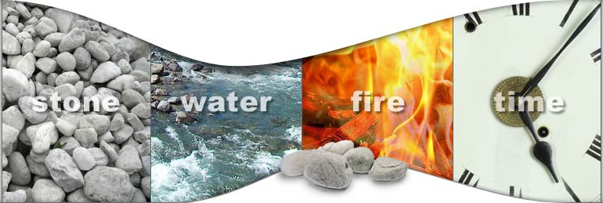
Limestone Cycle

Slide 6
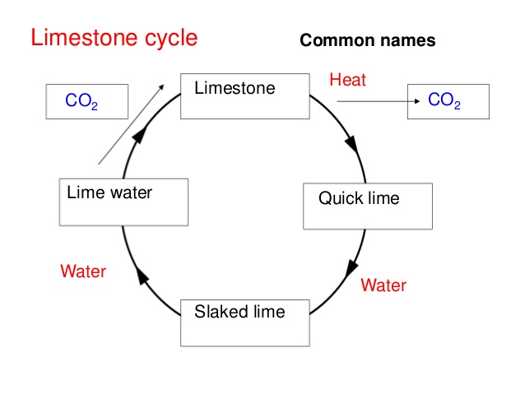
Limestone Cycle

Slide 7
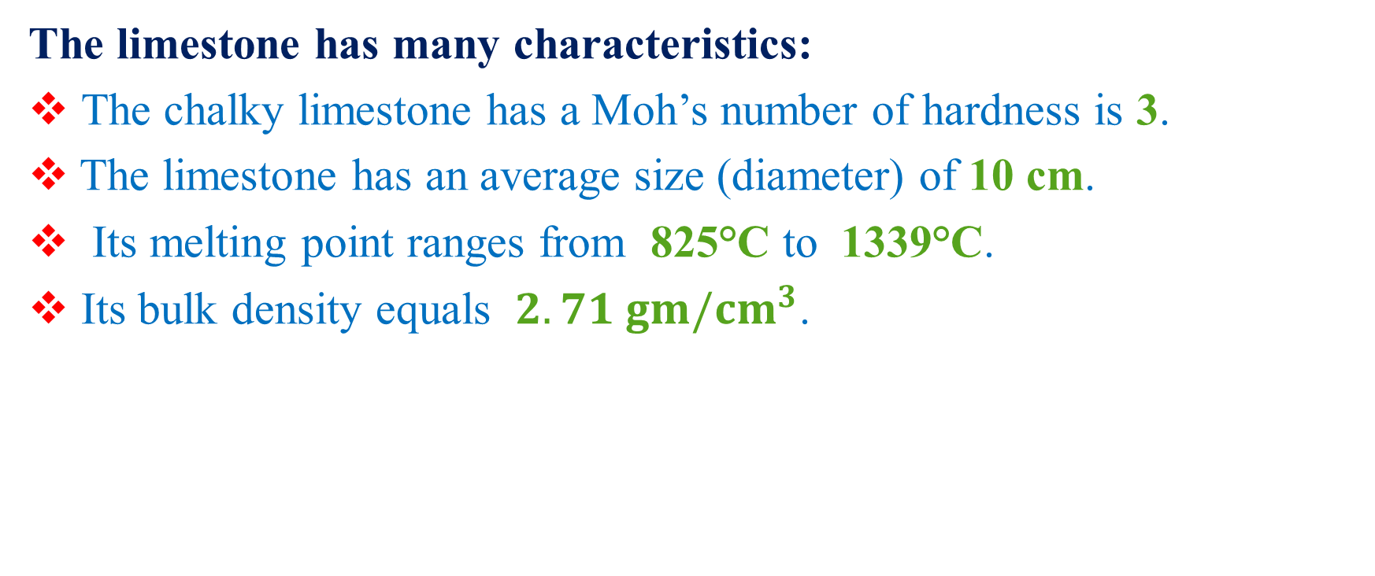
Limestone Characteristics
The limestone has many characteristics:
The chalky limestone has a Moh’s number of hardness is 3.
The limestone has an average size (diameter) of 10 cm.
Its melting point ranges from 825°C to 1339°C.
Its bulk density equals $2.71 gm/{cm}^{3}$.

Slide 8
Limestone Characteristics
Additional characteristics that affect the quality of the limestone produced are:
Porosity.
Density.
Purity.
crystanility.

Slide 9
Amount of the Product
We used a sample of 10 kg of the limestone and the following quantities were produced.
5.6 kg of Quicklime (CaO).
1.8 kg of water was required to produce 7.4 kg of Calcium Hydroxide Ca(OH)2 .

Slide 10
Furnace Design
The furnace was made with the following materials:
Steel Sheets.
Thermal Clay.
Thermal Brick.

Slide 11
Furnace Design

Slide 12
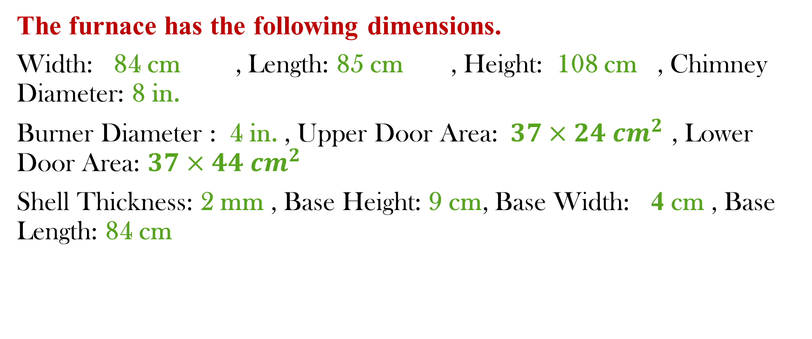
Furnace Design
The furnace has the following dimensions.
Width: 84 cm , Length: 85 cm , Height: 108 cm , Chimney Diameter: 8 in.
Burner Diameter : 4 in. , Upper Door Area:$37×24{ cm}^{2}$ , Lower Door Area: ${37×44 cm}^{2}$
Shell Thickness: 2 mm , Base Height: 9 cm, Base Width: 4 cm , Base Length: 84 cm

Slide 13
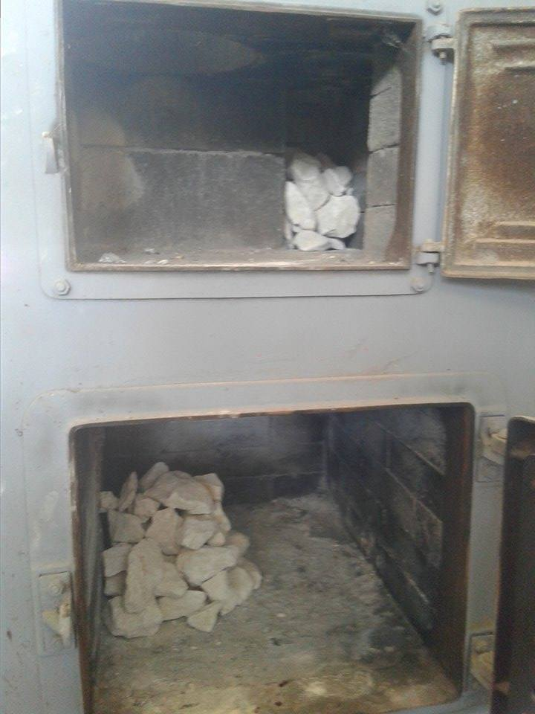
Furnace Design

Slide 14
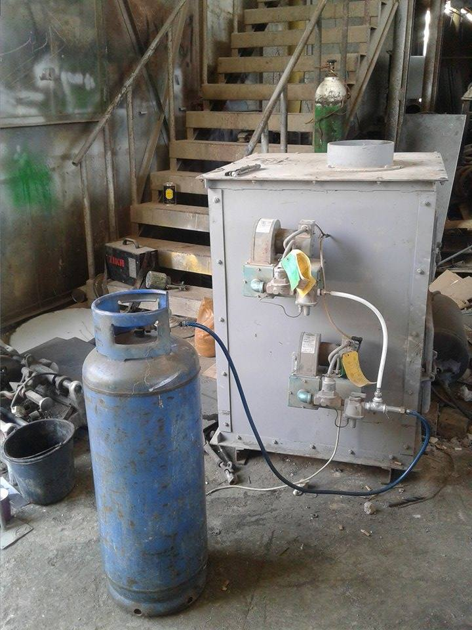
Furnace Design

Slide 15
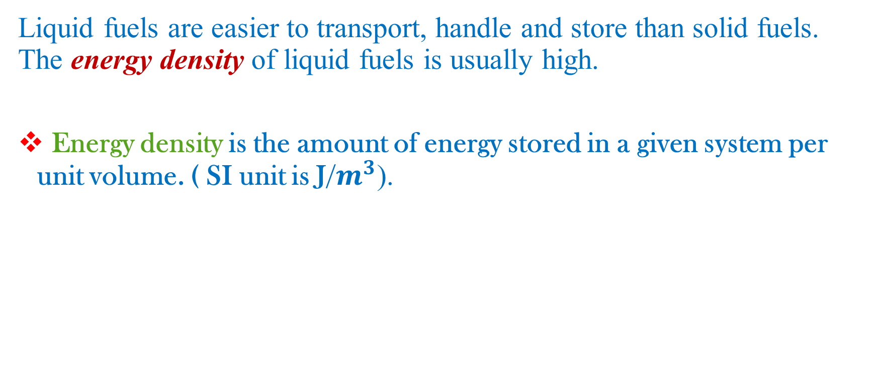
Liquid vs. Solid Fuels
Liquid fuels are easier to transport, handle and store than solid fuels. The energy density of liquid fuels is usually high.
Energy density is the amount of energy stored in a given system per unit volume. ( SI unit is J/$m^{3}$).

Slide 16
Main Results
 | Fuel Type
Comparison | Diesel | Burned Oil
Amount of liter per 10 kg | 1.7 | 1
Amount of kJ per kg | 39 kJ/kg | 42kJ/kg
Cost of ton | 850 NIS | 150 NIS
Price per liter | 5 NIS | 1.5 NIS
Cost of burner | Cheap | Expensive
Density | 0.82 kg/L | 0.907 kg/L
Amount of kJ per liter | 35260 kJ/L | 38094 kJ/L
Maintenance | Difficult | Easy

Slide 17
Thermal Conductivity
Steel Sheet: 43 W/ m°K
Thermal Clay: 1.55 W/ m°K
Fire Brick: 0.32 W/ m°K at 1000 °C

Slide 18
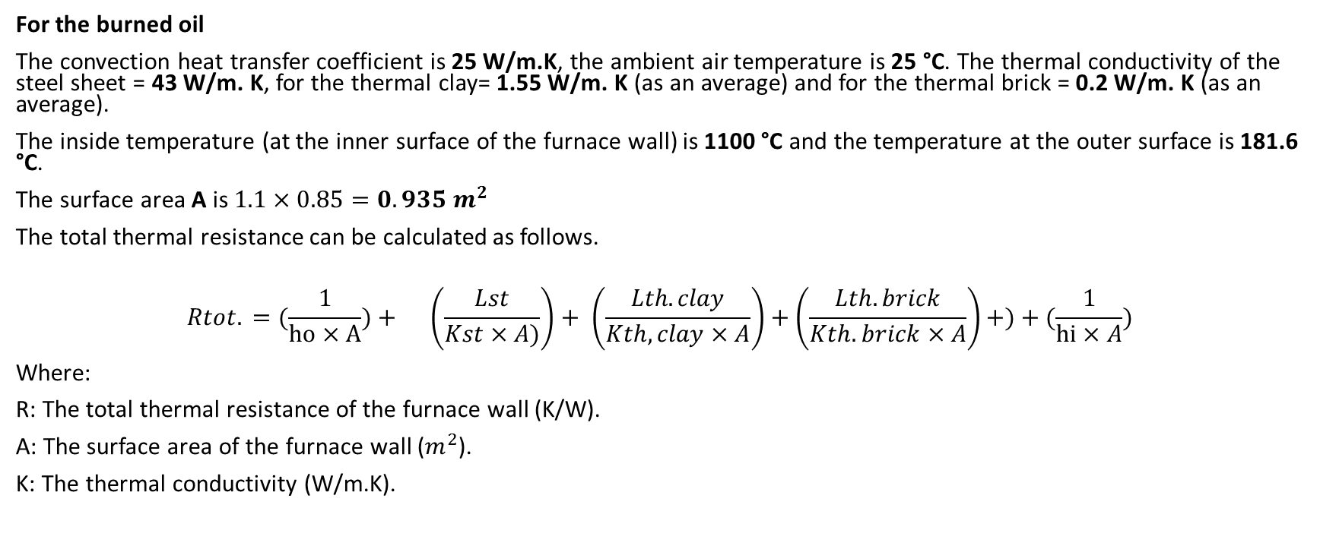
Calculations
For the burned oil
The convection heat transfer coefficient is 25 W/m.K, the ambient air temperature is 25 °C. The thermal conductivity of the steel sheet = 43 W/m. K, for the thermal clay= 1.55 W/m. K (as an average) and for the thermal brick = 0.2 W/m. K (as an average).
The inside temperature (at the inner surface of the furnace wall) is 1100 °C and the temperature at the outer surface is 181.6 °C.
The surface area A is $1.1×0.85=0.935{ m}^{2}$
The total thermal resistance can be calculated as follows.
$$Rtot. =(\frac{1}{ho×A})+ \left(\frac{Lst}{Kst×A)}\right)+ \left(\frac{Lth.clay}{Kth,clay×A}\right)+\left(\frac{Lth.brick}{Kth.brick×A}\right)+)+(\frac{1}{hi×A})$$
Where:
R: The total thermal resistance of the furnace wall (K/W).
A: The surface area of the furnace wall ($m^{2}$).
K: The thermal conductivity (W/m.K).

Slide 19
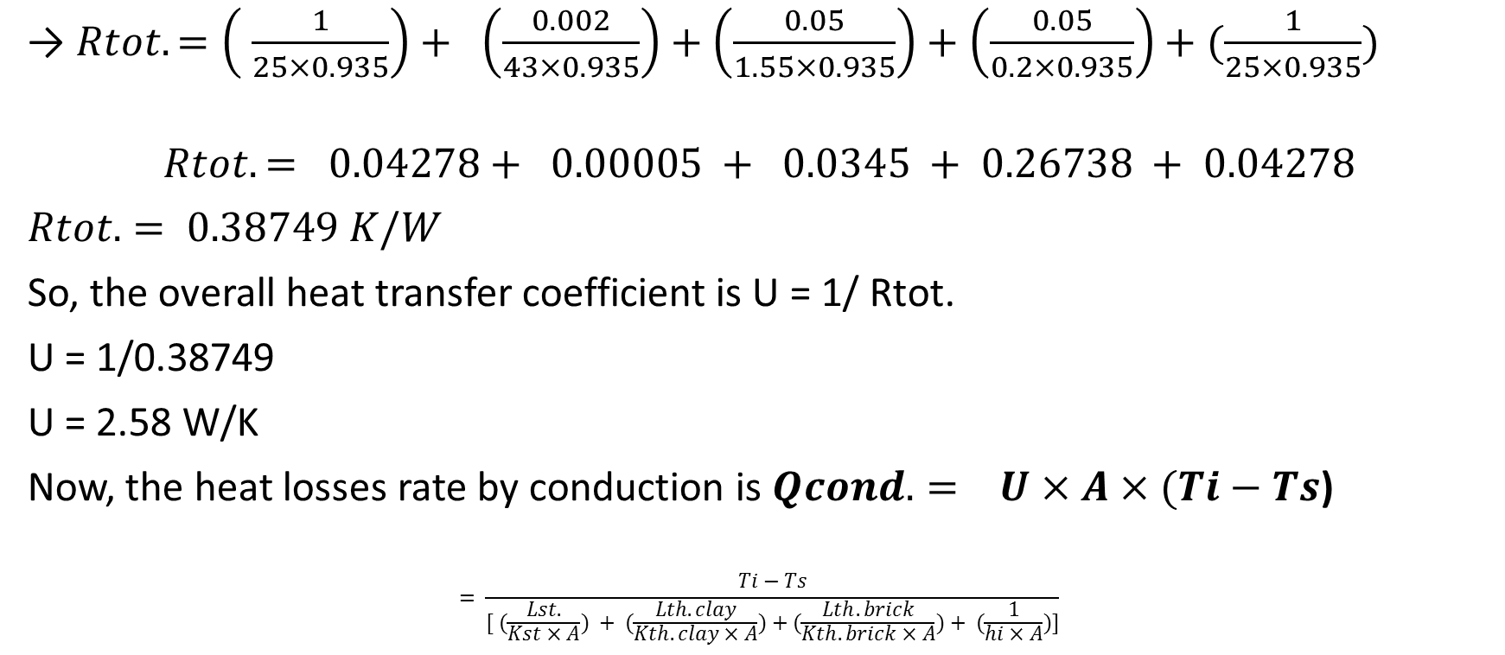
Calculations
→ $Rtot. =\left( \frac{1}{25×0.935}\right)+ \left(\frac{0.002}{43×0.935}\right)+\left(\frac{0.05}{1.55×0.935}\right)+\left(\frac{0.05}{0.2×0.935}\right)+(\frac{1}{25×0.935})$
$$Rtot. = 0.04278+ 0.00005 + 0.0345 + 0.26738 + 0.04278$$
$Rtot. = 0.38749 K/W$
So, the overall heat transfer coefficient is U = 1/ Rtot.
U = 1/0.38749
U = 2.58 W/K
Now, the heat losses rate by conduction is$Qcond. = U×A×(Ti−Ts$)
$$= \frac{Ti−Ts}{[ (\frac{Lst.}{Kst×A}) + (\frac{Lth.clay}{Kth.clay×A})+(\frac{Lth.brick}{Kth.brick×A})+ (\frac{1}{hi×A})]}$$

Slide 20
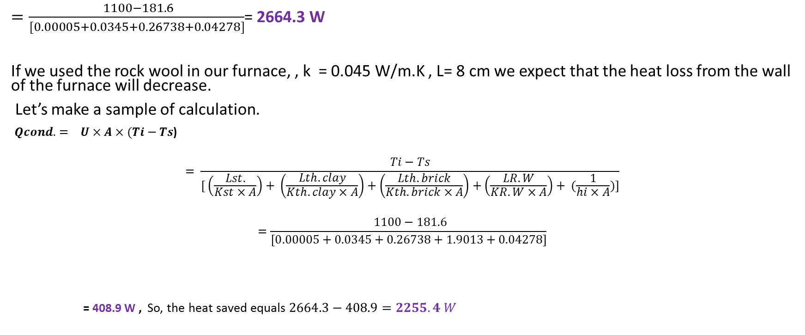
Calculations
$=\frac{ 1100−181.6}{[0.00005+0.0345+0.26738+0.04278]}$= 2664.3 W
If we used the rock wool in our furnace, , k = 0.045 W/m.K , L= 8 cm we expect that the heat loss from the wall of the furnace will decrease.
Let’s make a sample of calculation.
$Qcond. = U×A×(Ti−Ts$)
$$= \frac{Ti−Ts}{[ \left(\frac{Lst.}{Kst×A}\right)+ \left(\frac{Lth.clay}{Kth.clay×A}\right)+\left(\frac{Lth.brick}{Kth.brick×A}\right)+\left(\frac{LR.W}{KR.W×A}\right)+ (\frac{1}{hi×A})]}$$
$$=\frac{ 1100−181.6}{[0.00005+0.0345+0.26738+1.9013+0.04278]}$$
= 408.9 W , So, the heat saved equals $2664.3−408.9=2255.4 W$

Slide 21
Safety Specifications
The Occupational Safety and Health Administration (OSHA) presents the PEL (Permissible Exposure Limit) for both, the quick and slaked lime.
Exposure to calcium oxide dust is regulated. The OSHA PEL (Permissible Exposure Limit) for 8 hour TWA (Time Weighted Average) is 2 mg/m3.
Exposure to calcium hydroxide dust is regulated. The OSHA PEL (Permissible Exposure Limit) for 8 hour TWA (Time Weighted Average) is 5 mg/m3.

Slide 22
Recommendations
Our recommendations to the people who intend to design like this project are
To select the material which has good characteristics of insulation in order to produce a good quality of quicklime.
The fuel issue is very important, there are several specifications which identify the best type of fuel.
The arrangement of the limestone inside the furnace is a good point to ensure an equal heat distribution to all limestones. the heat losses should be minimized in order to reach the limestone to the required temperature without running the burners with unnecessary large amounts of fuel.

Slide 23
Thank You
Special Thanks to Our Project Supervisor
Eng. Ramiz Al-Khaldi

