Slide 1

Students:
Israa Odeh
Jenan Abualrub
Supervisor:
Dr. Anas Toma

Slide 2

Outline
Introduction
Technologies
Target Group
Features
Future Work

Slide 3

Introduction
Palestine is gifted with a generous number of attractions that Embrace its
cultural, historical, and religious significance.
Maintenance and promotion of these sites are crucial for preserving the
tourism sector’s contribution to the Palestinian economy.
Technology should be utilized to bolster the tourism industry.
There does not seem to be enough platforms that showcase Palestinian
sights in a modern way.
Touristine is built to make touring Palestine easy and enjoyable for everyone.

Slide 4







Technologies
Frontend
Backend
Database
Python
Cloud Storage
Image Processing
Cloud Hosting

Slide 5

Target Group
Local Palestinians and Tourists
City Coordinators
Touristine Administrator

Slide 6
Features
For Local Palestinians and Tourists

Slide 7

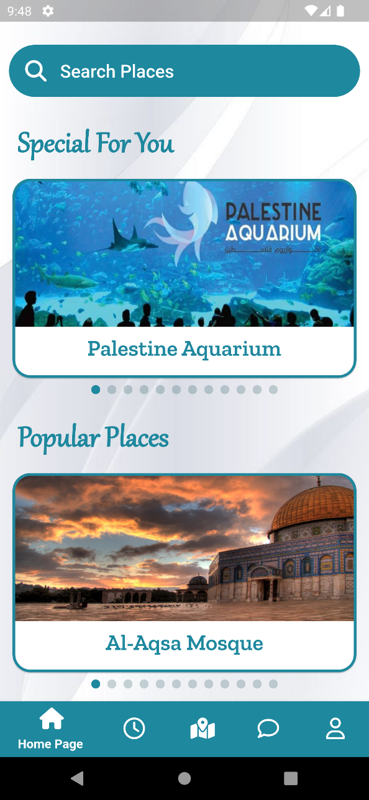
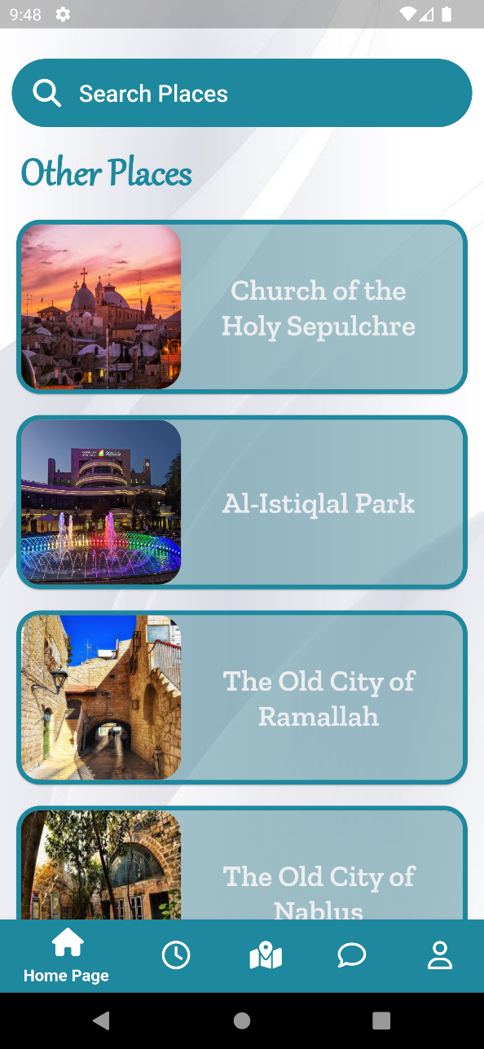
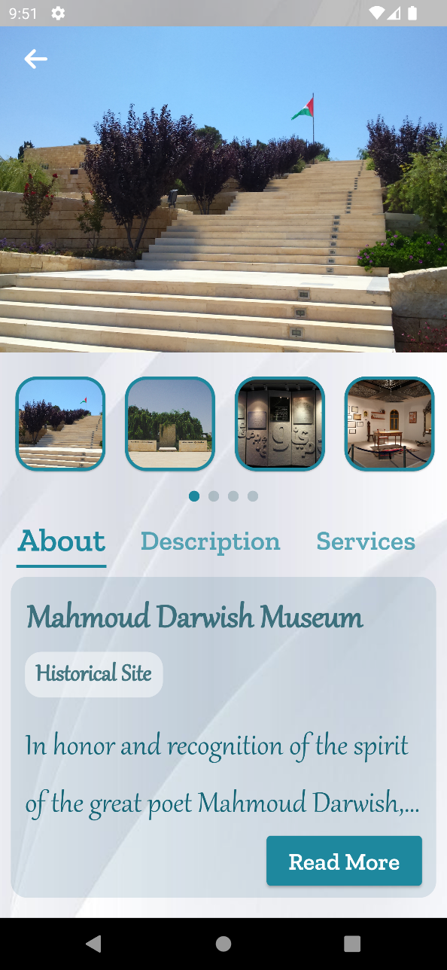
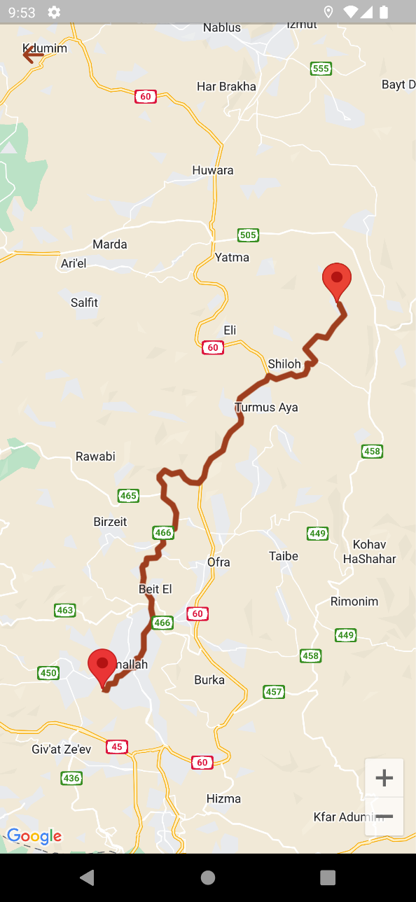
Convenient access to different destinations

Slide 8
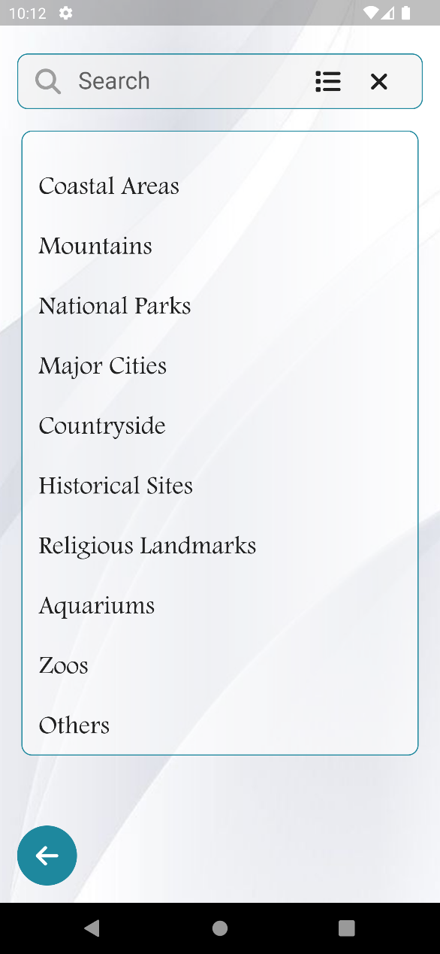
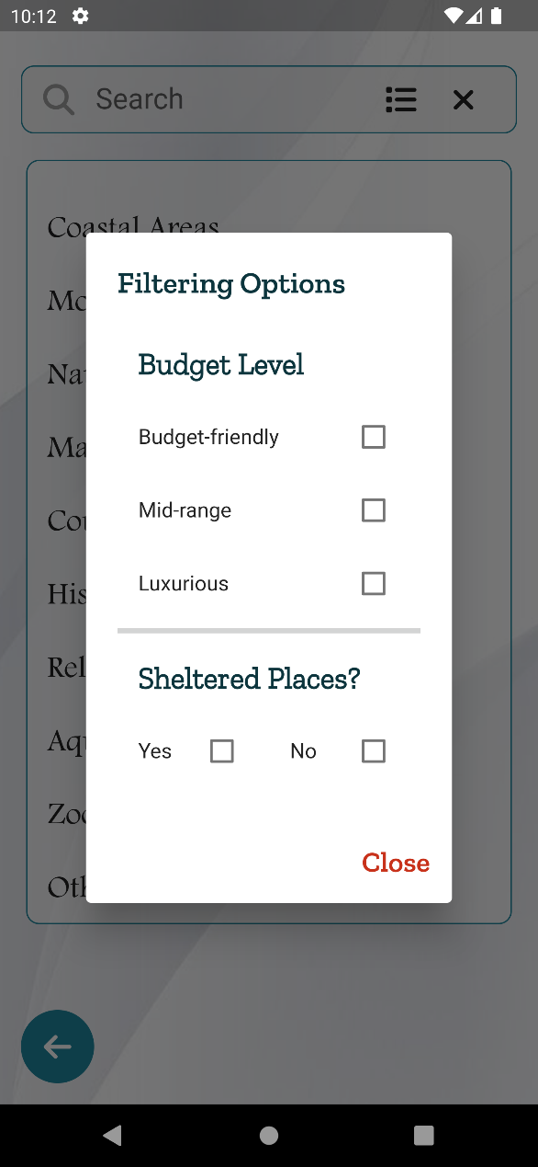
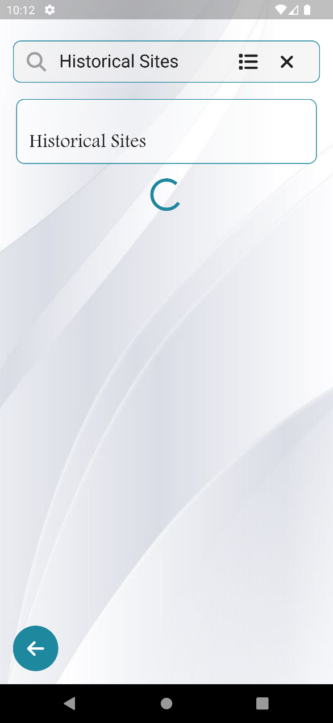
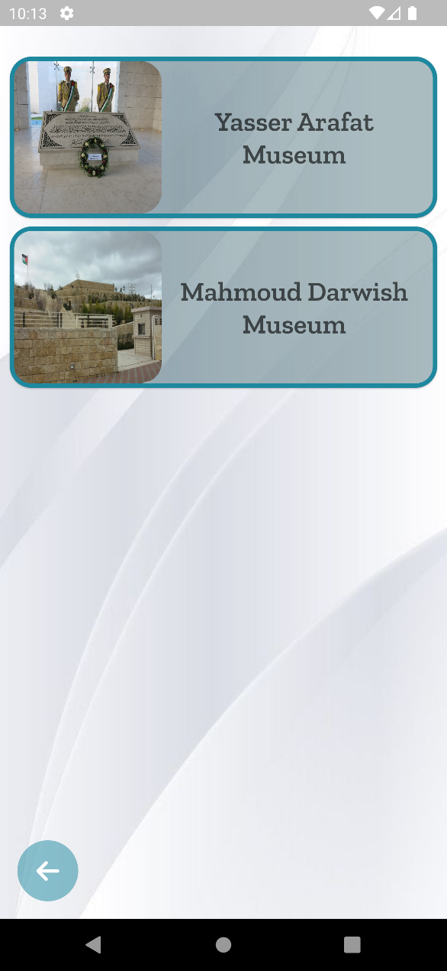
A search service with filtering options

Slide 9
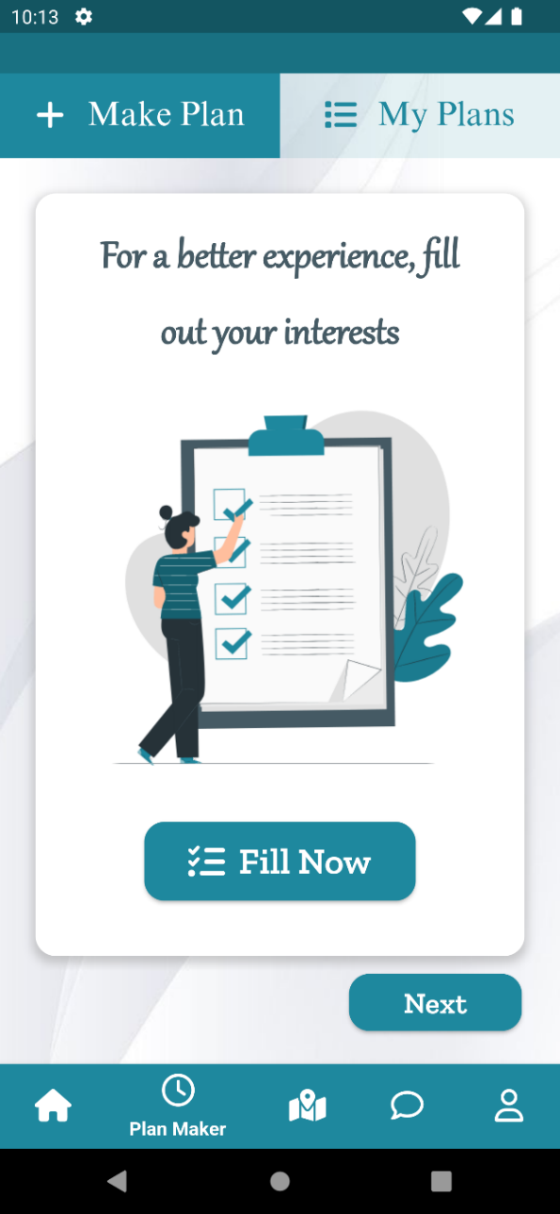
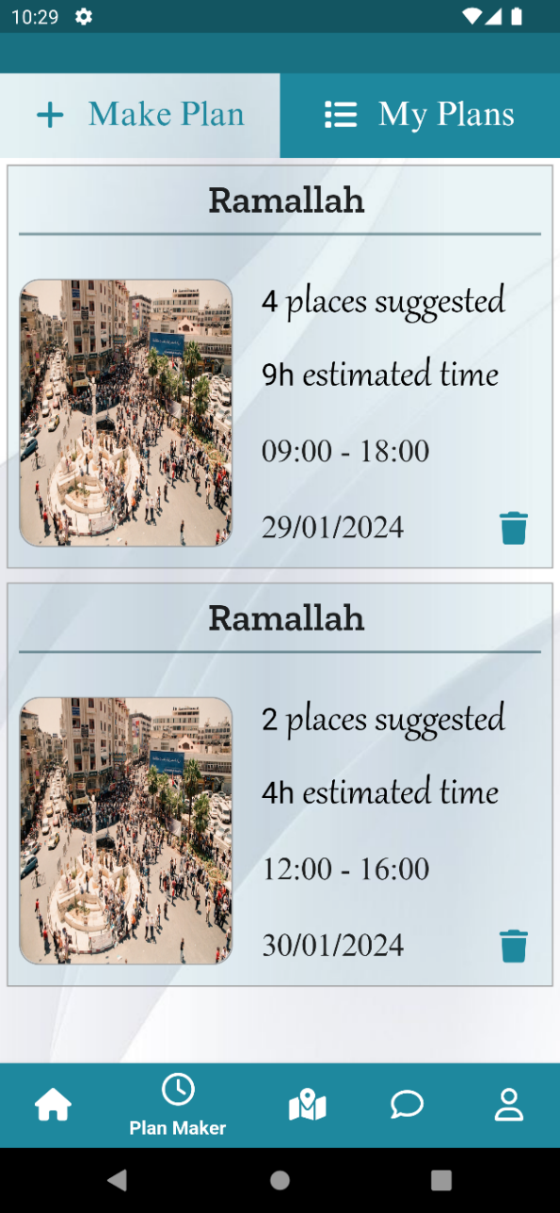
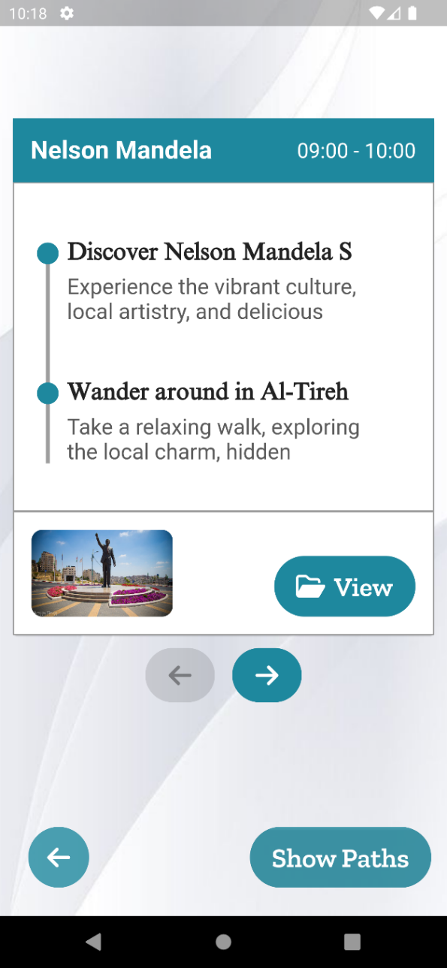
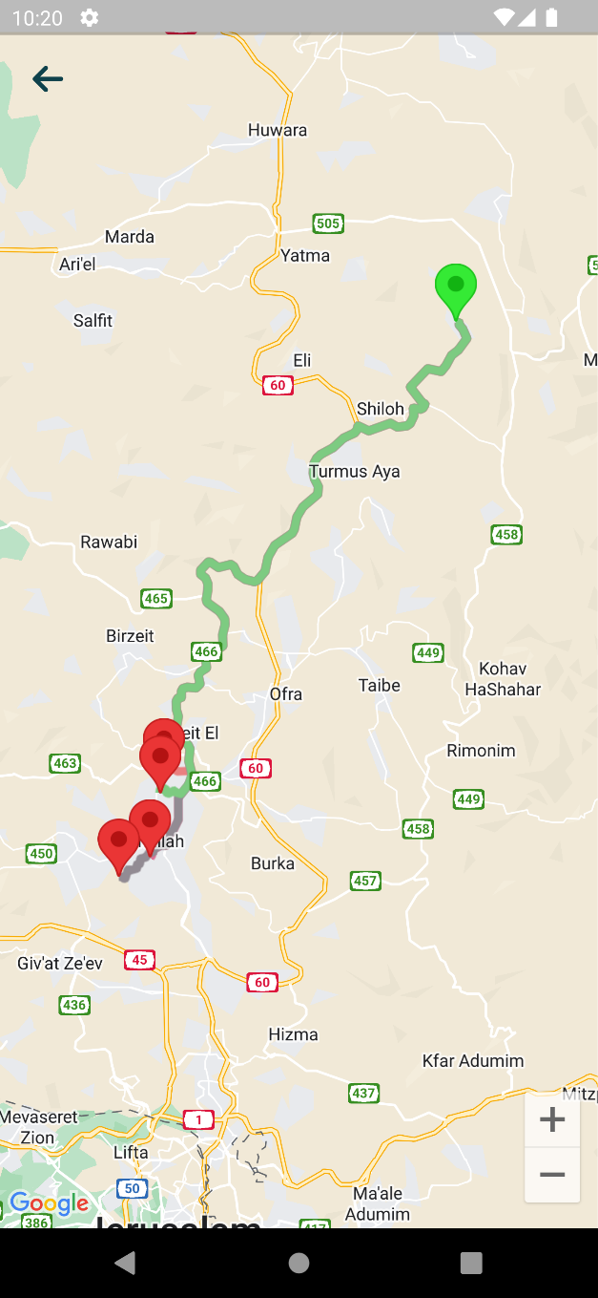
Creating personalized plans

Slide 10
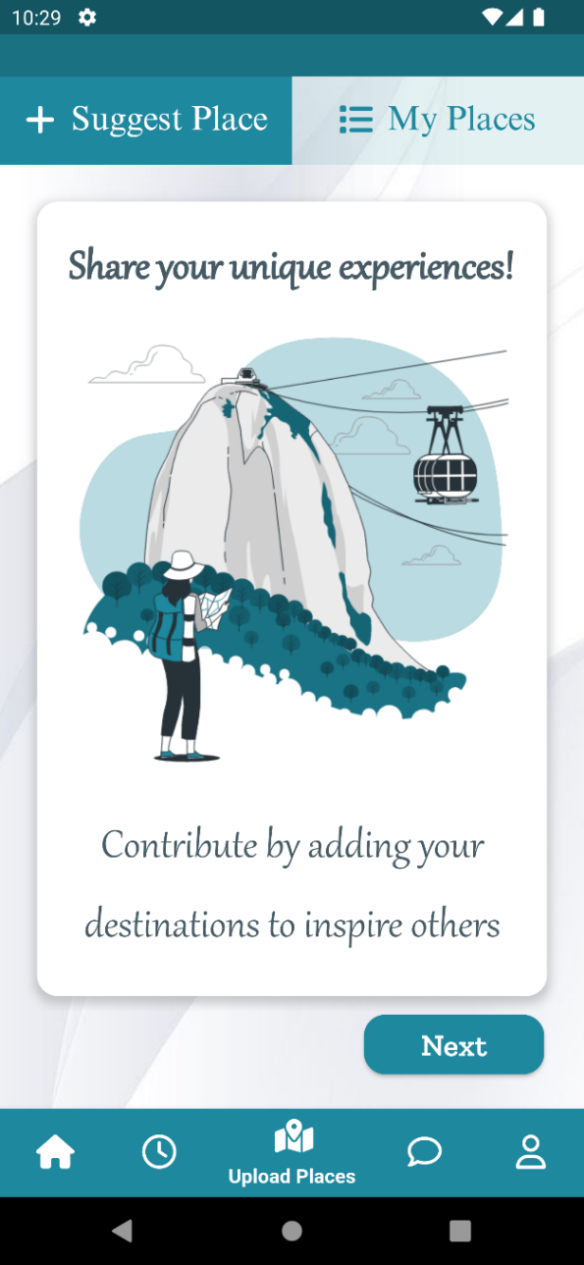
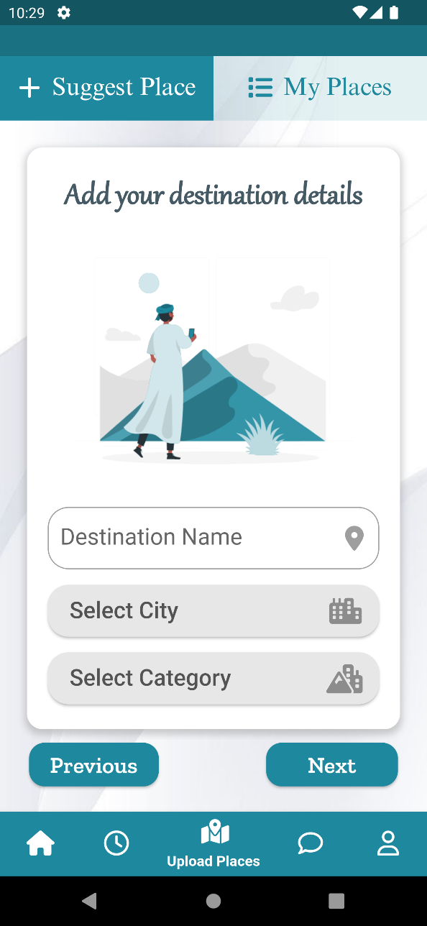
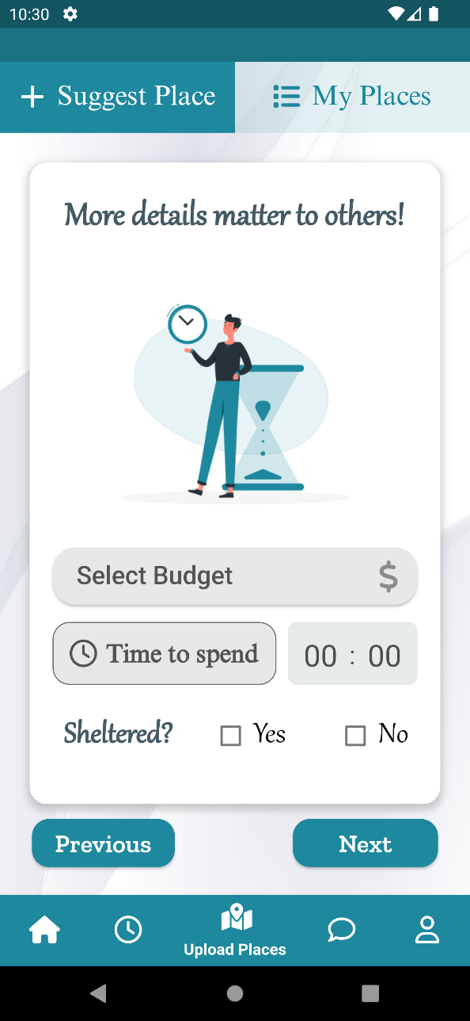
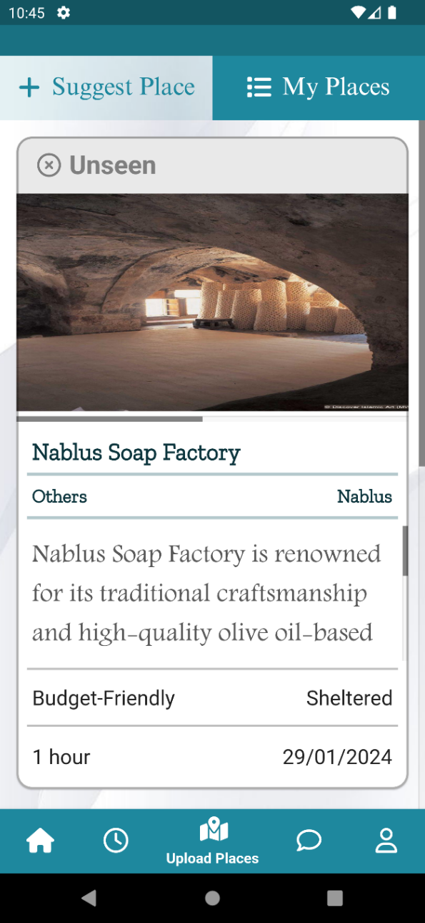
The ability to share and suggest places

Slide 11
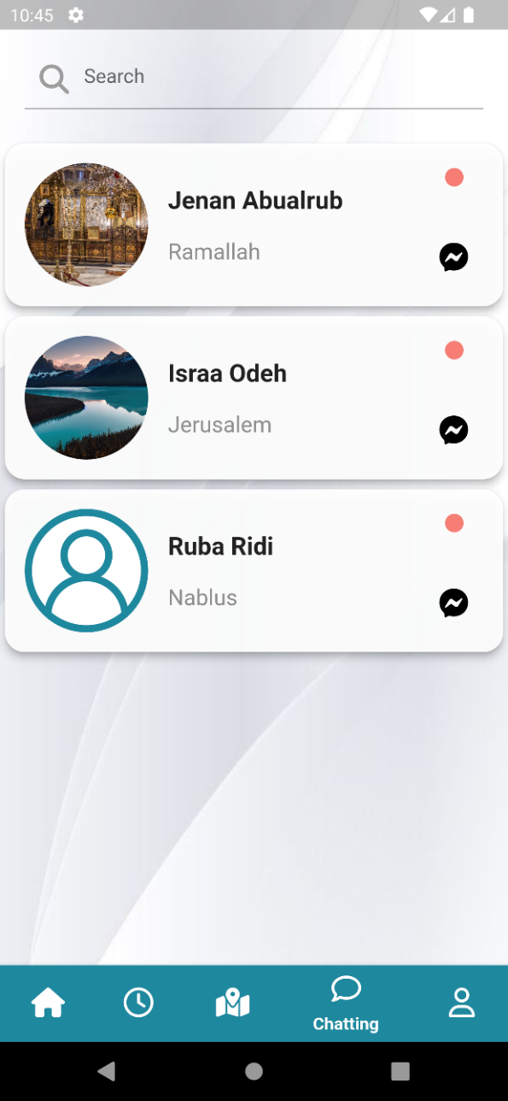
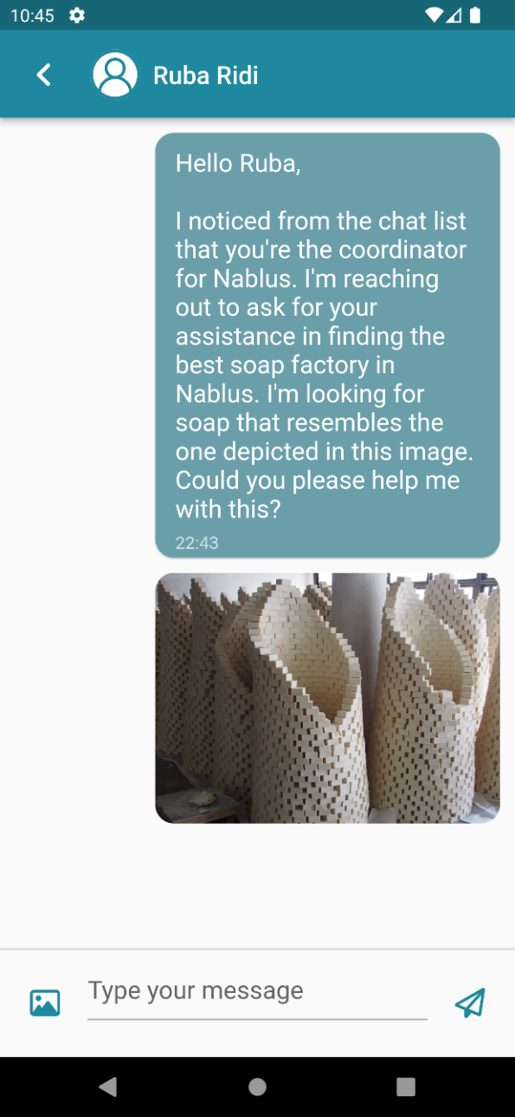
Chatting with different city coordinators

Slide 12
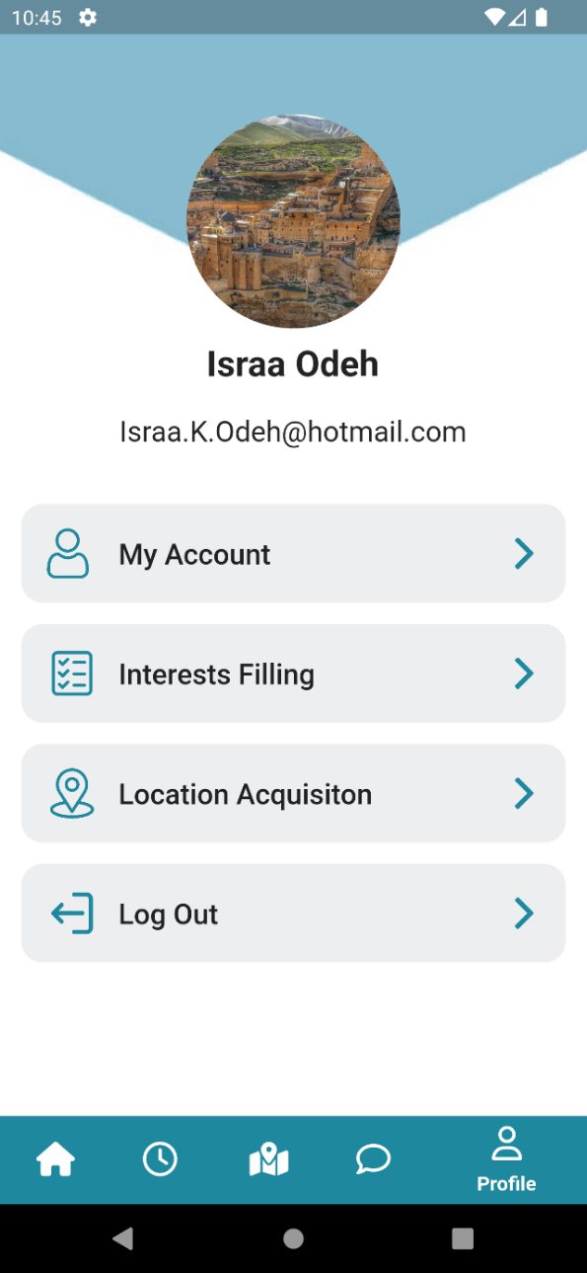
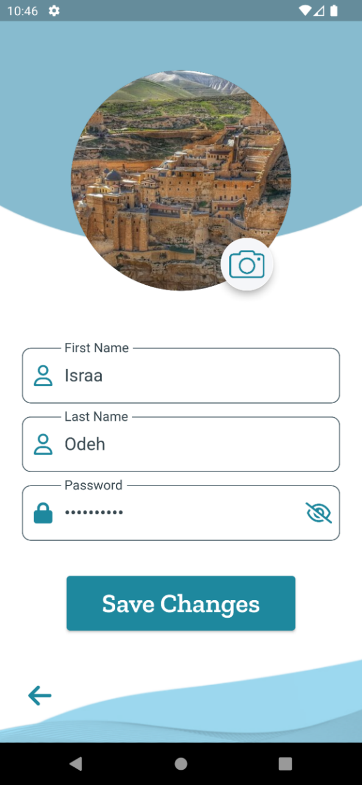
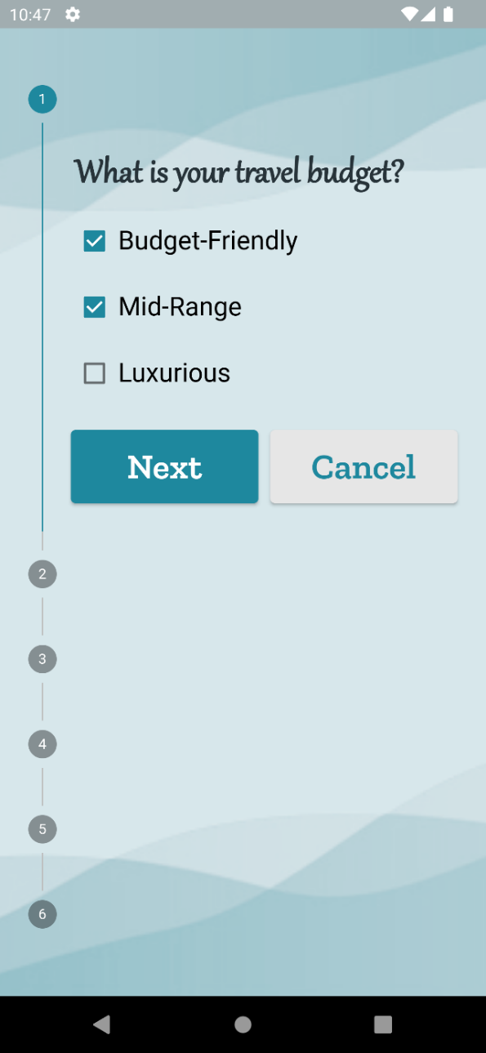
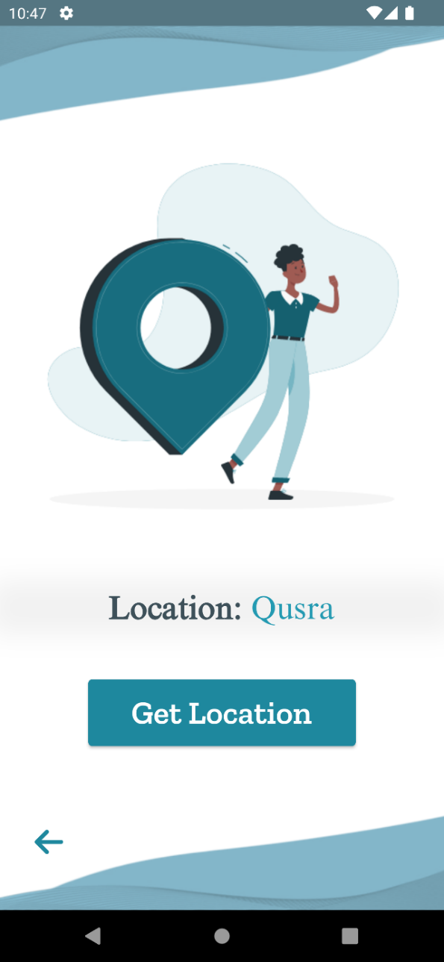
Viewing and managing personal information

Slide 13
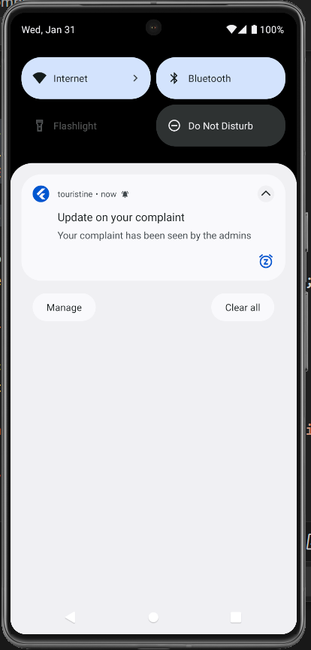
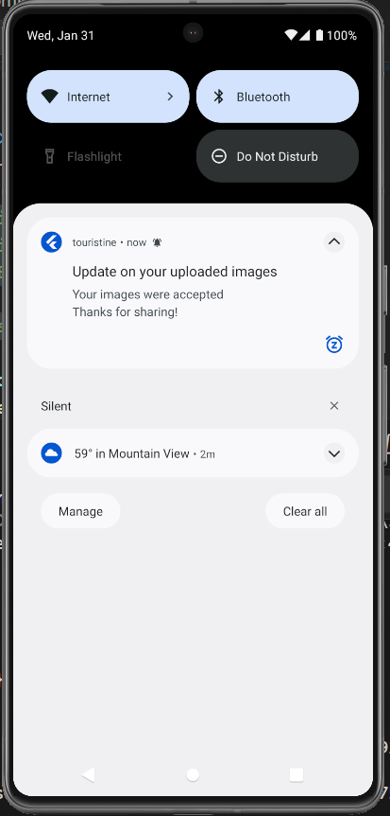
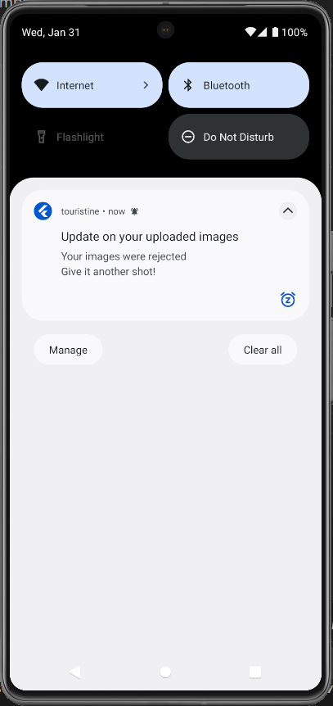
Notifications on Updates

Slide 14

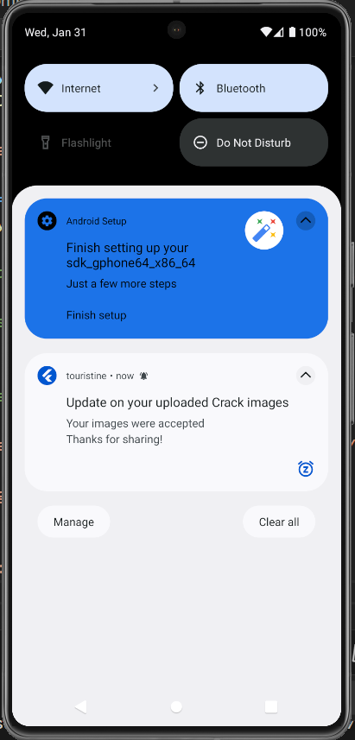


Slide 15
Features
For City Coordinators

Slide 16
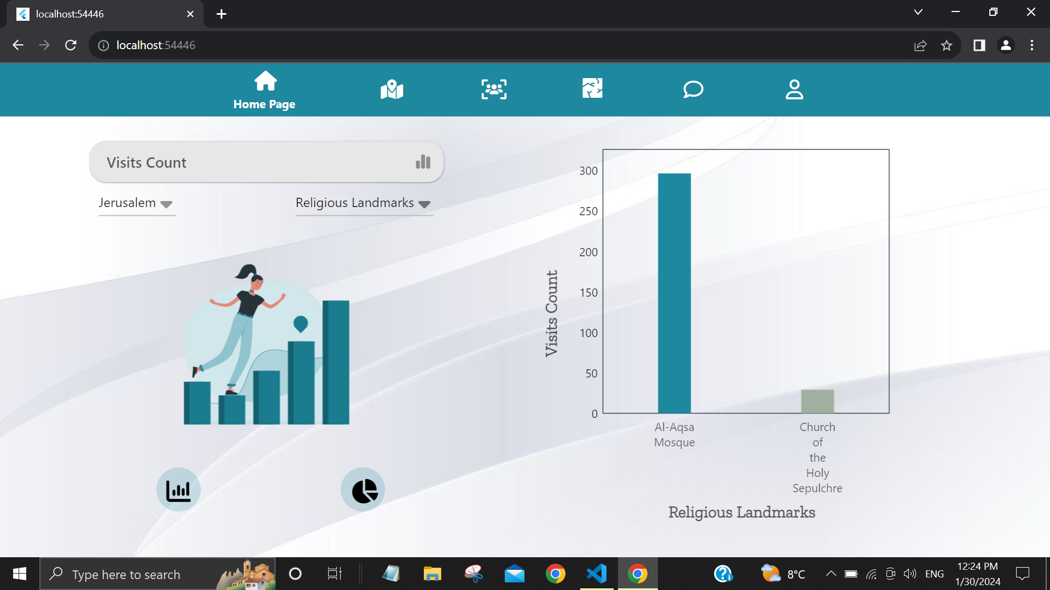
Access to city-specific statistics

Slide 17
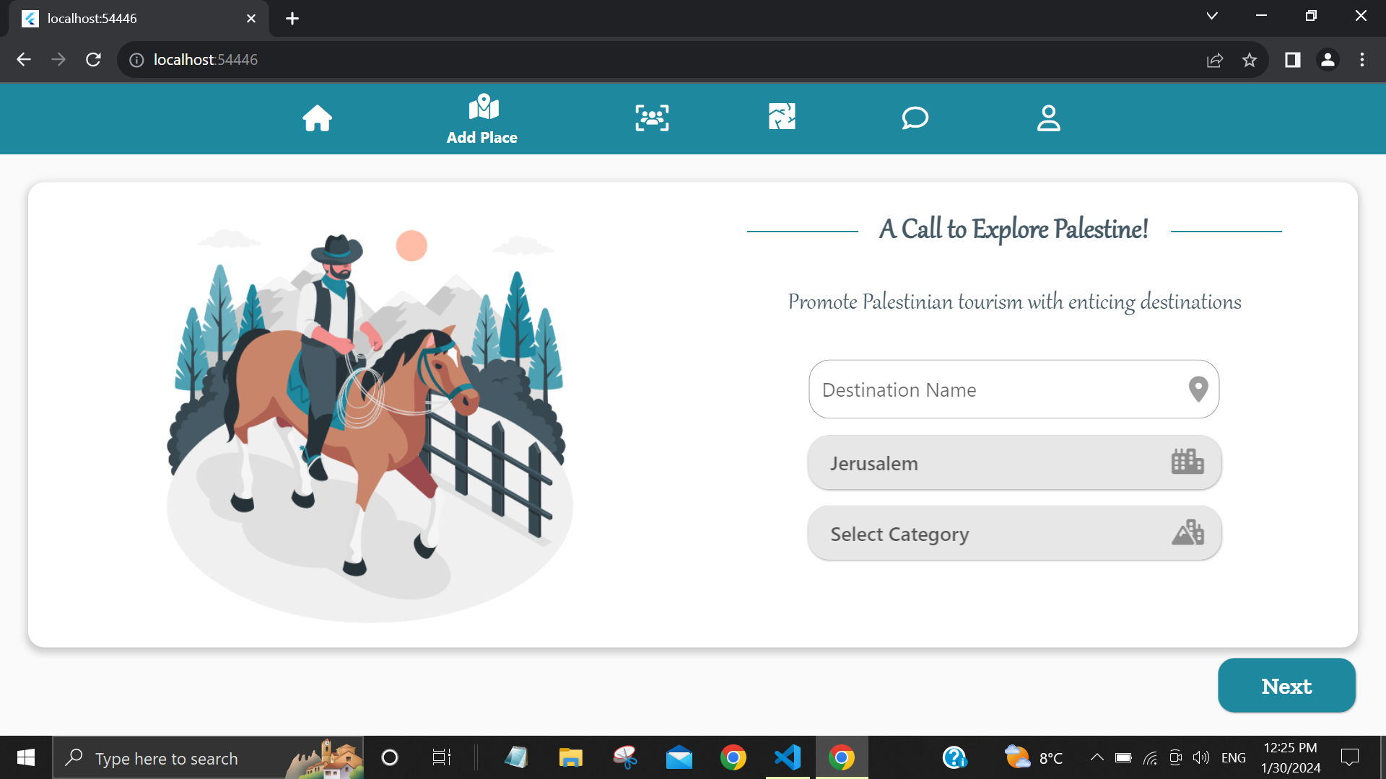
Enrich Touristine with fresh destinations within the coordinator assigned city,
Enriching Touristine with new destinations

Slide 18
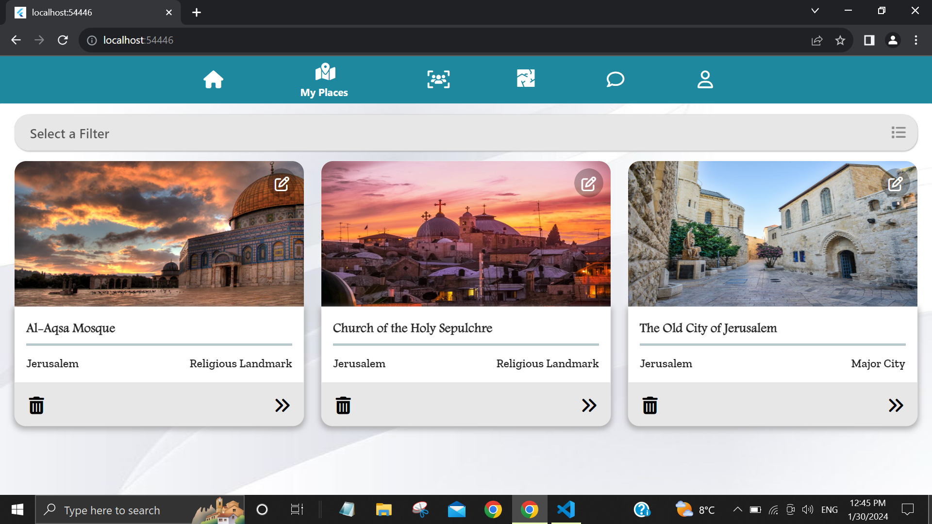
Efficient management of added destinations

Slide 19
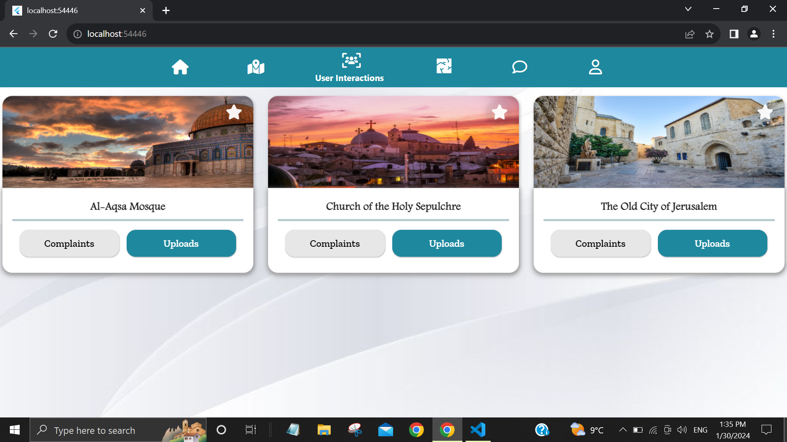
Accessing destinations with user interactions

Slide 20
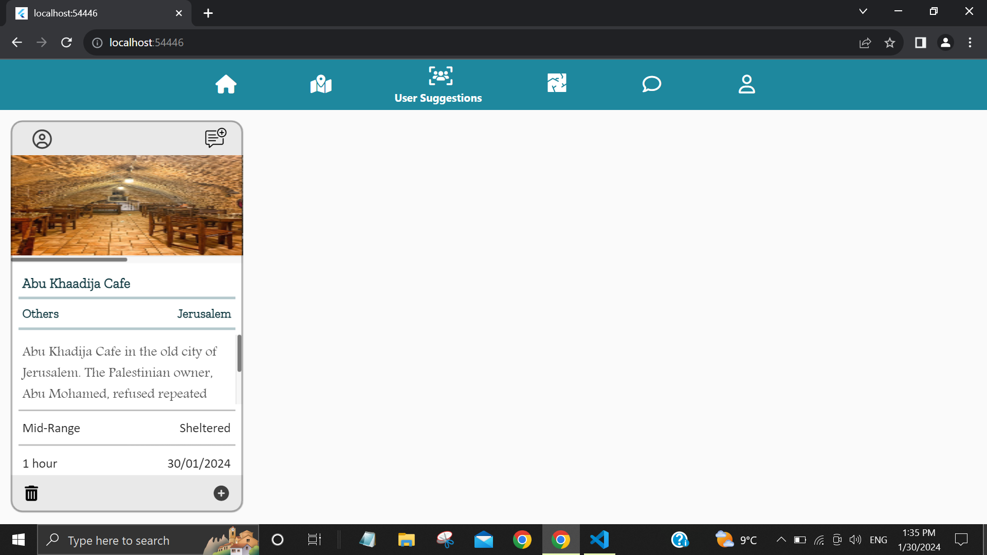
Viewing suggested locations within their assigned city

Slide 21
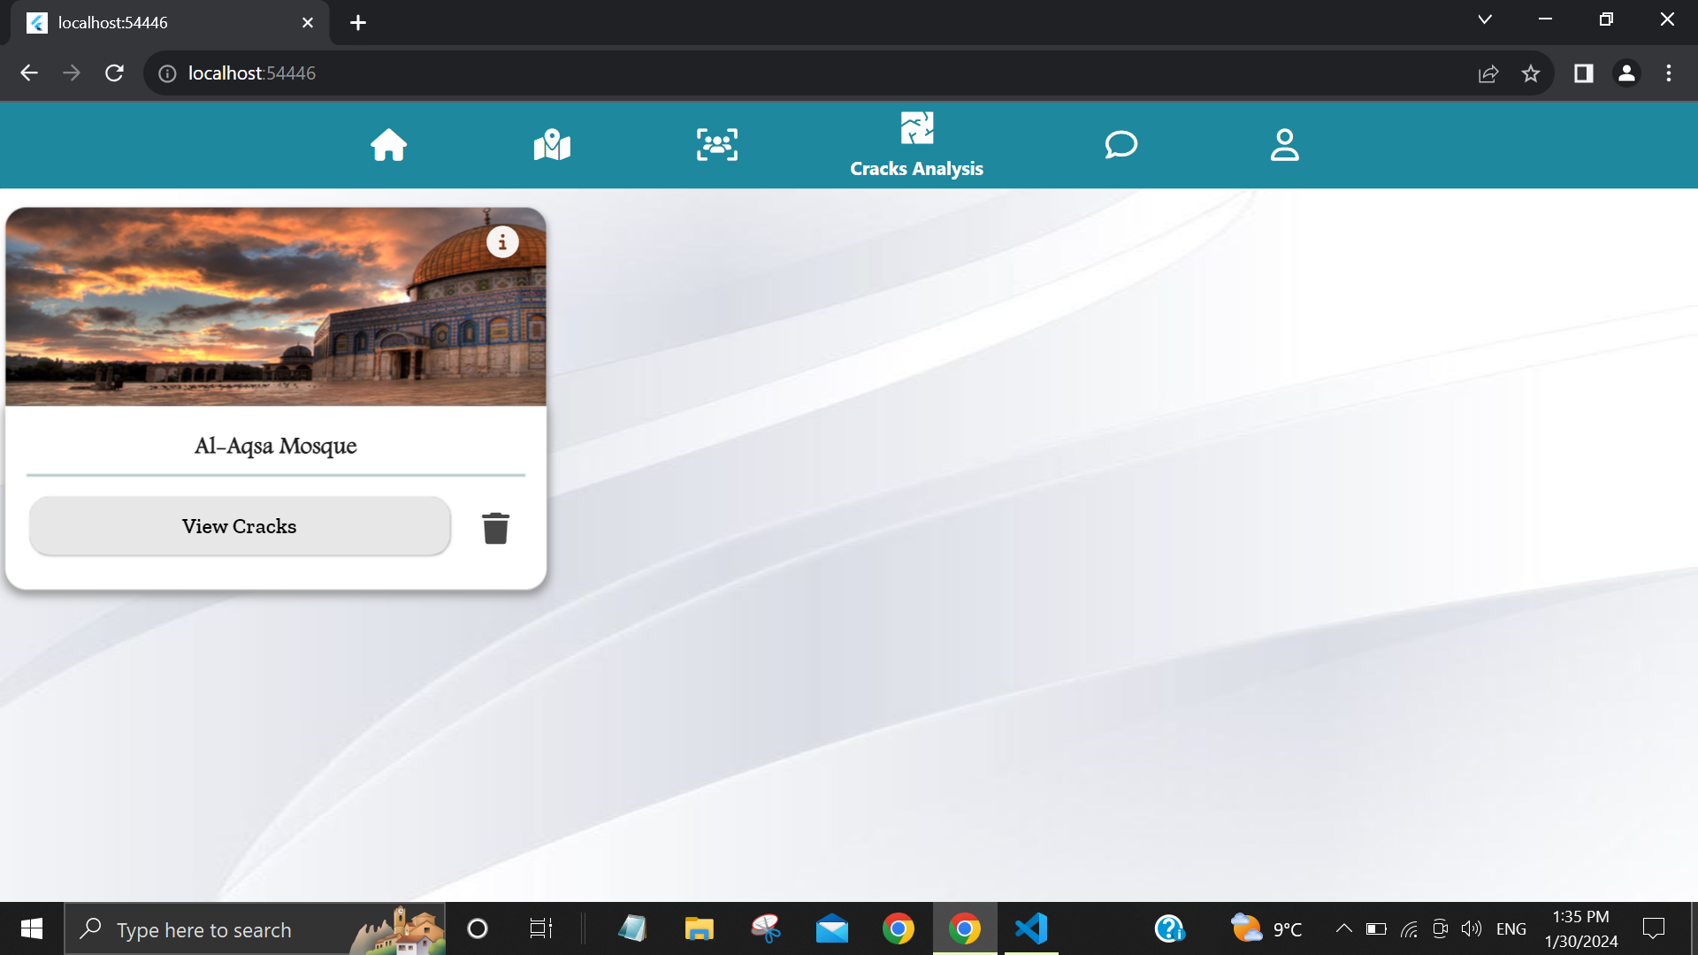
Observing destinations that have uploaded cracks

Slide 22
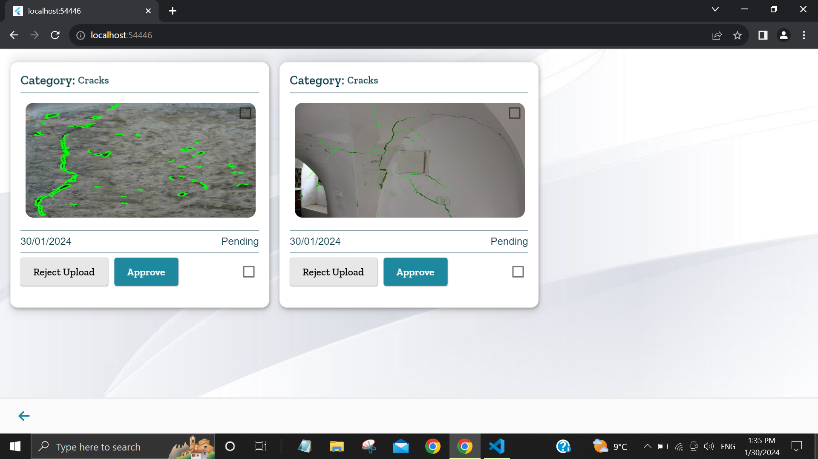
Analyzing wall defects using image processing

Slide 23
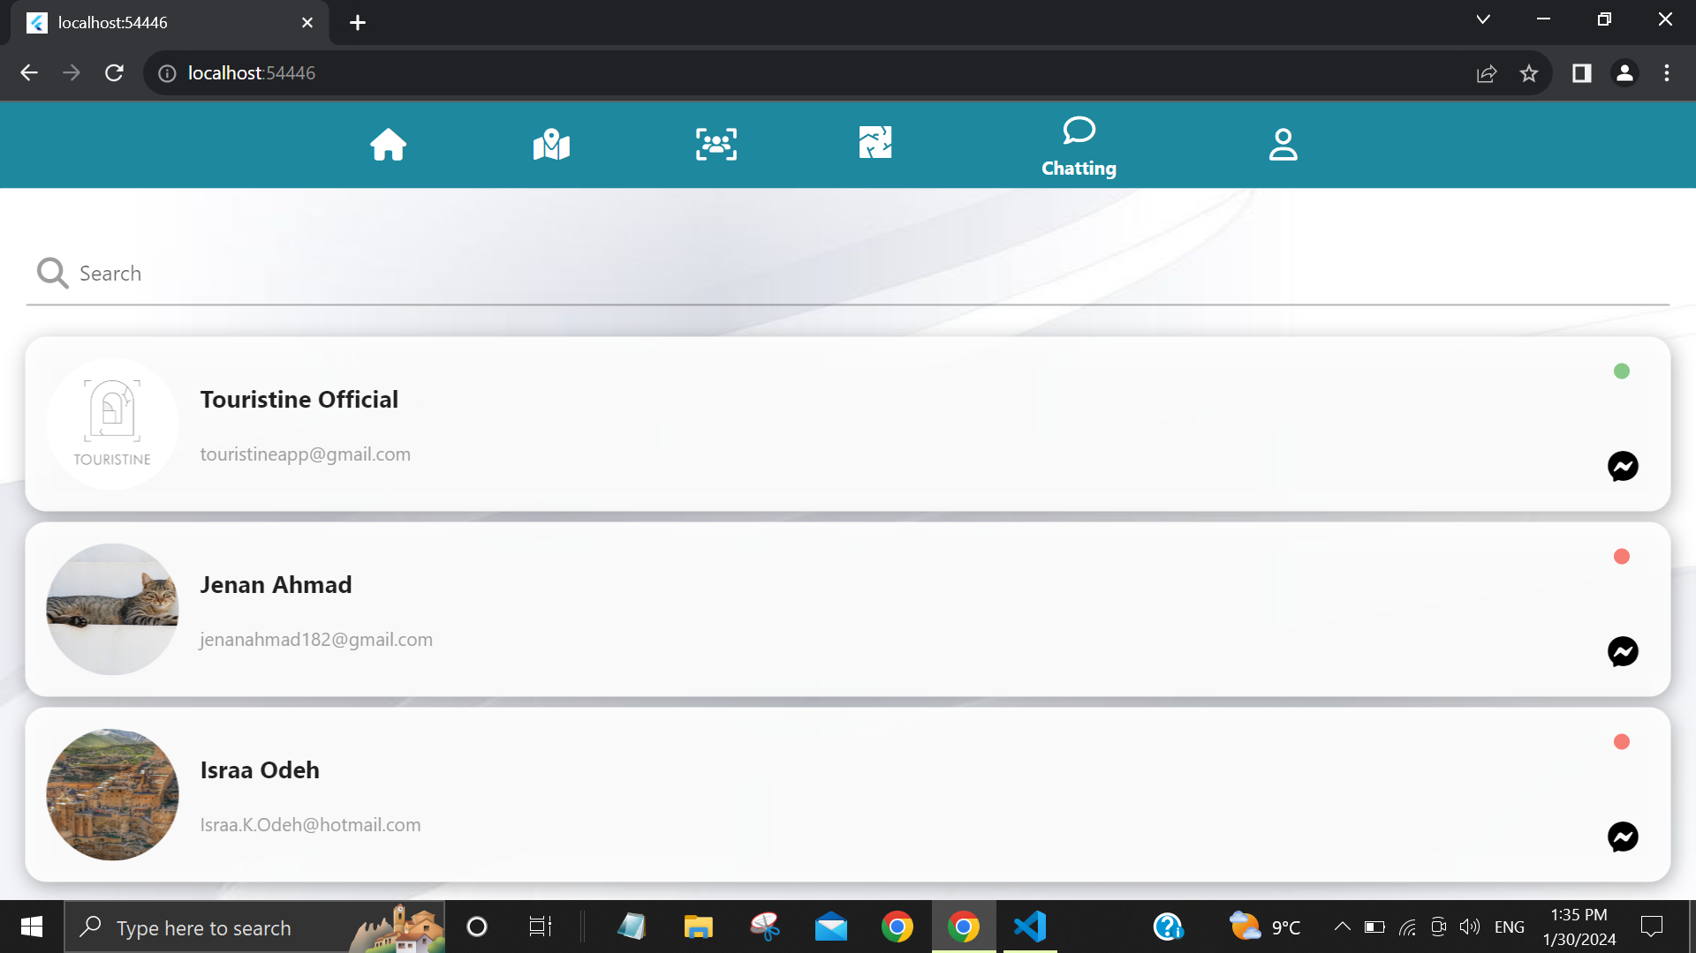
Chatting capability

Slide 24
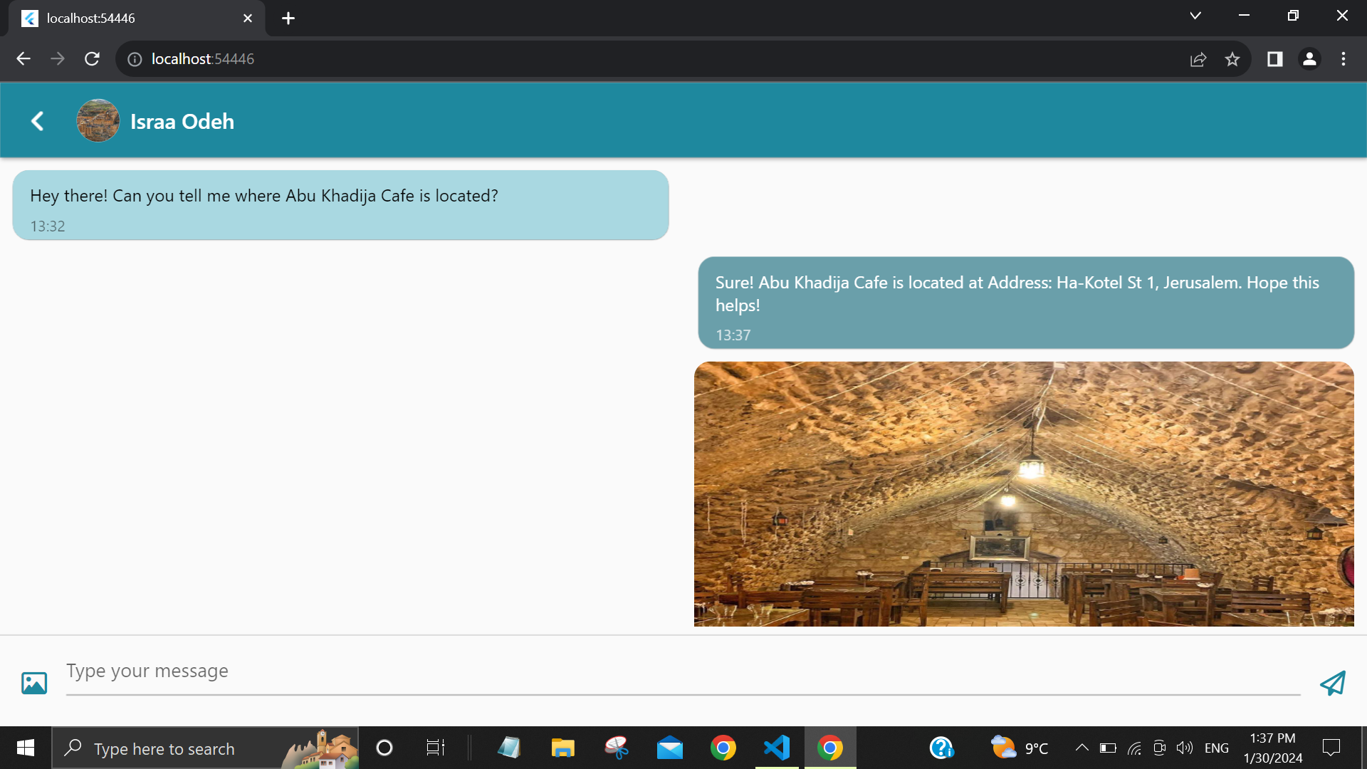

Slide 25
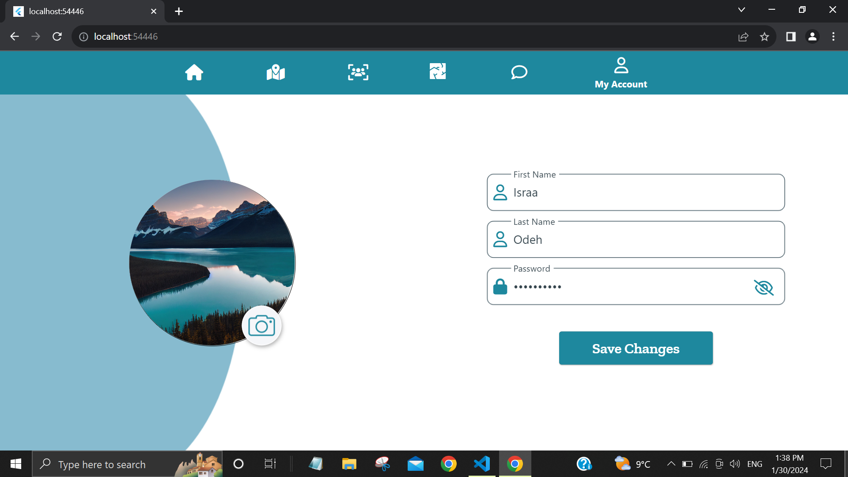
Managing personal information

Slide 26
Features
For Touristine Administrator

Slide 27
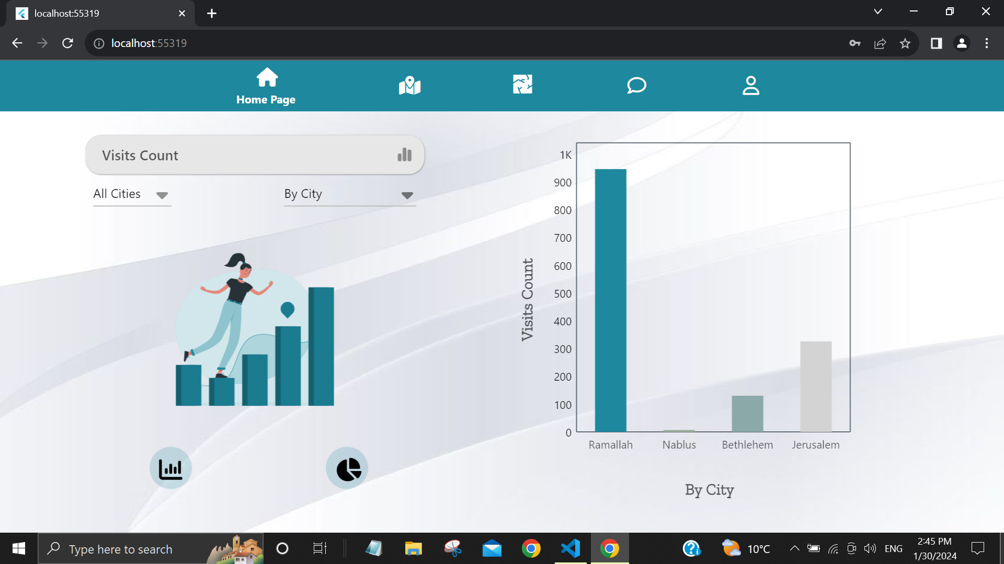
Accessing statistics for all cities available on Touristine

Slide 28
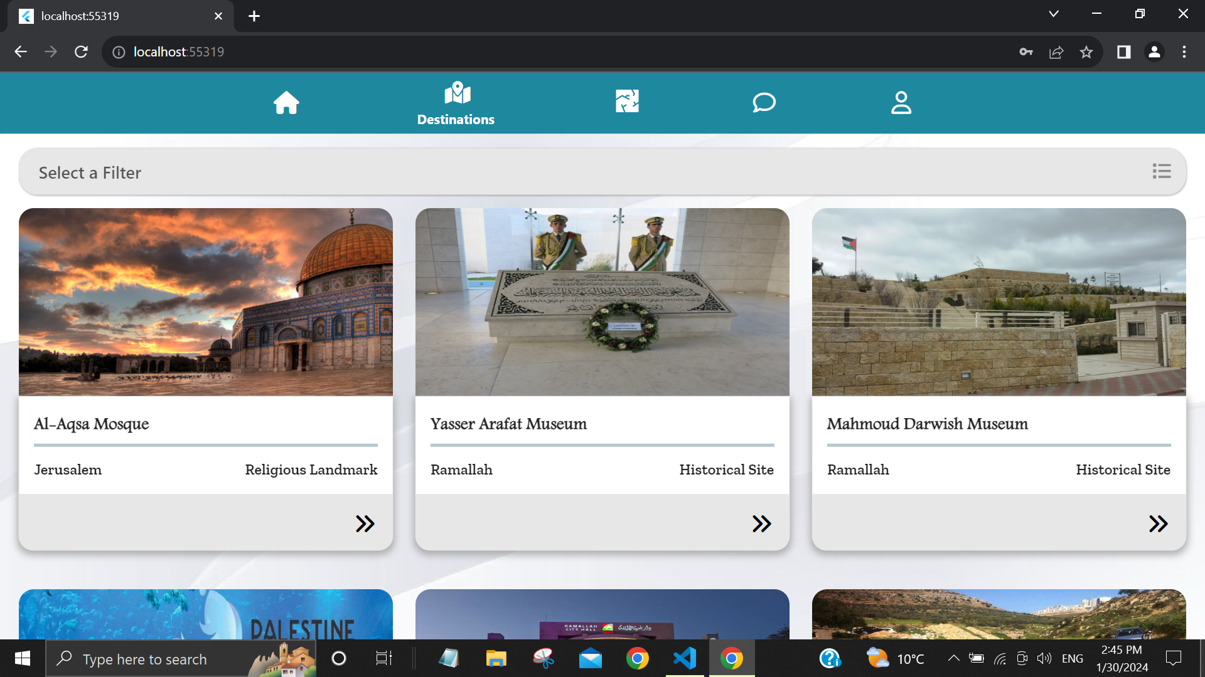
Touristine available destinations

Slide 29
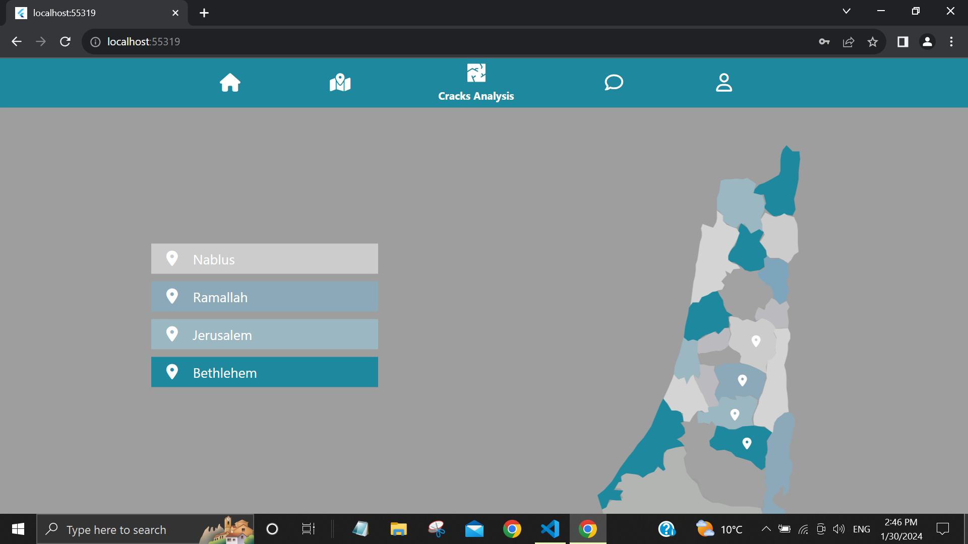
Map View of Cracks Analysis Results

Slide 30
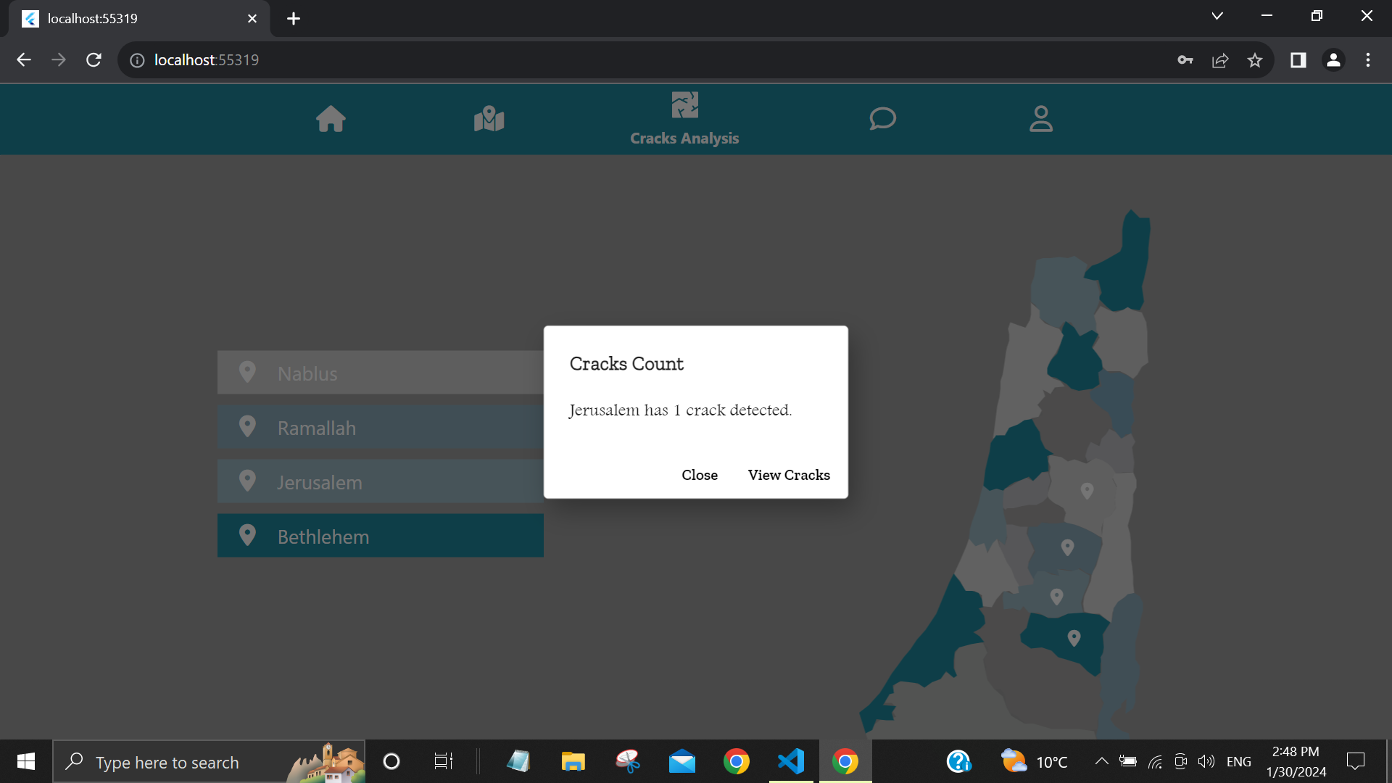

Slide 31
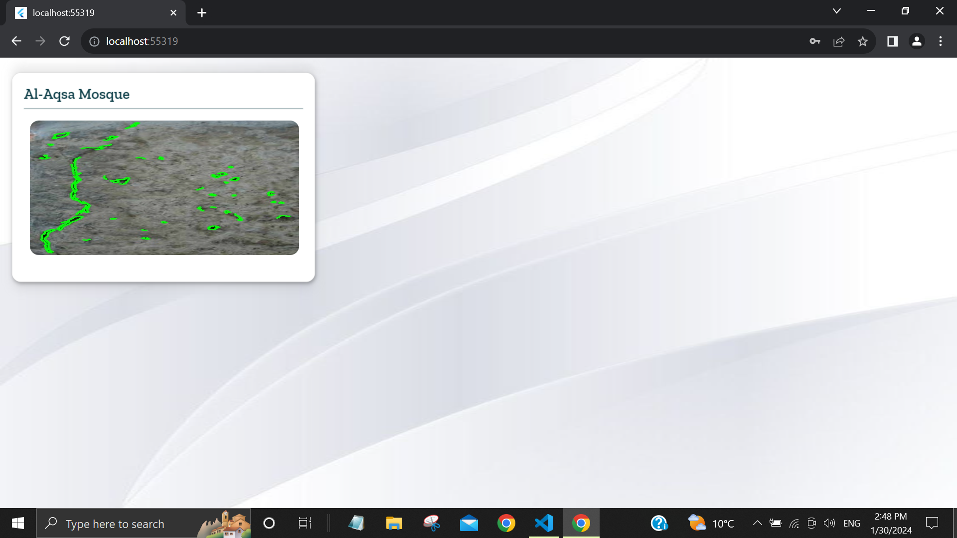

Slide 32
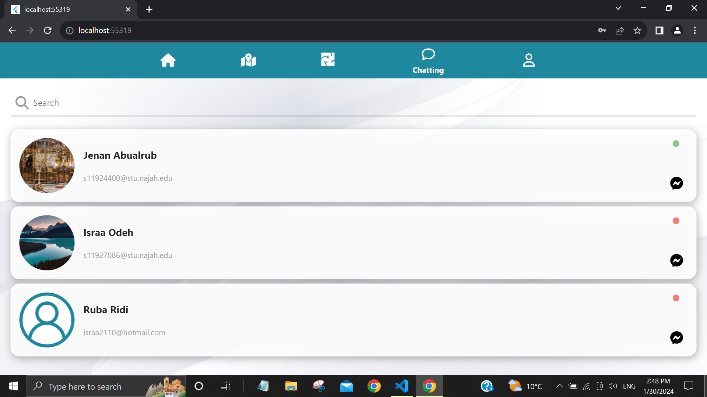
Chatting with city coordinators

Slide 33
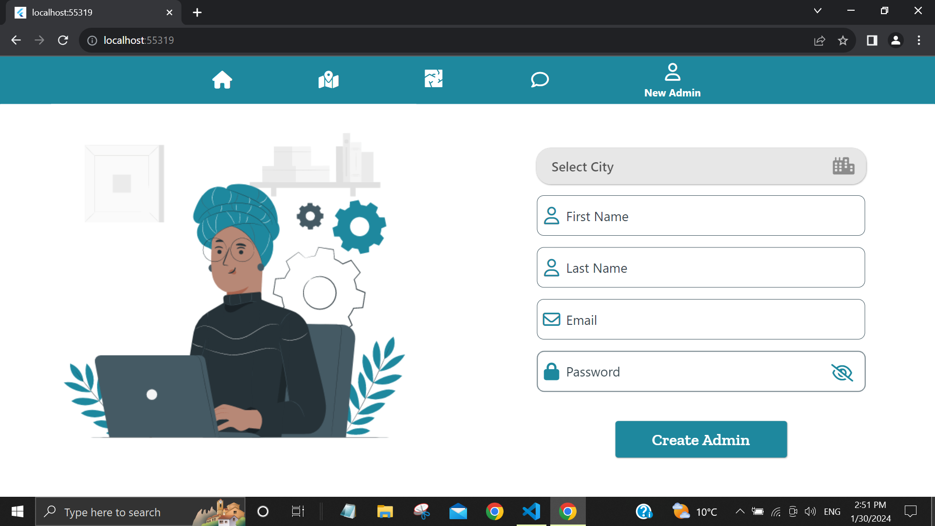
Adding new coordinators

Slide 34
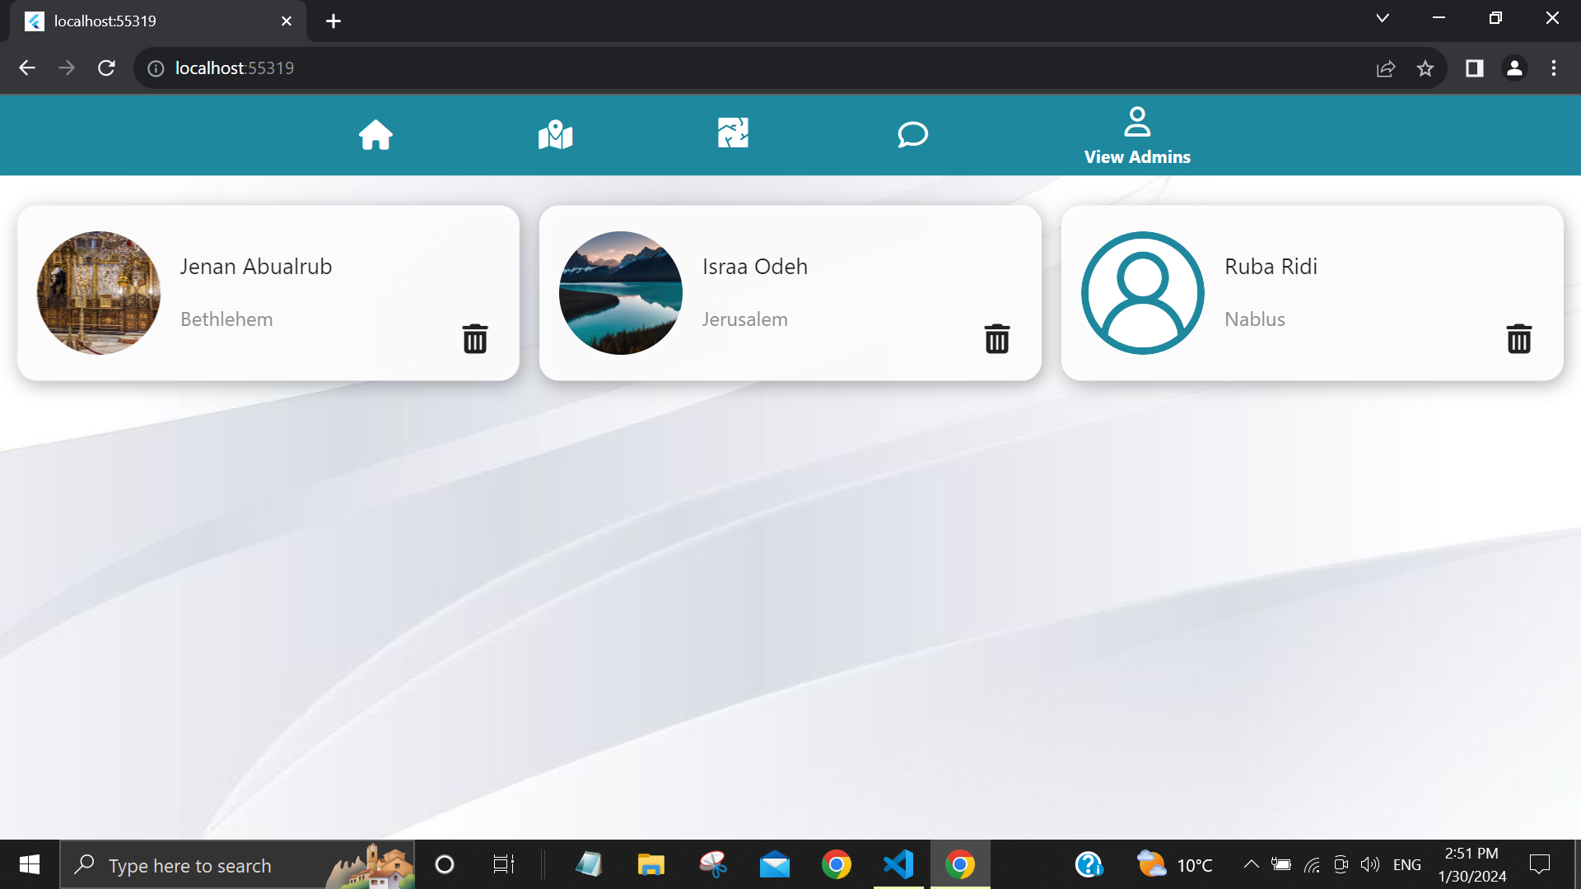
Accessing all of the current coordinators

Slide 35

Future Work
Expand language support for a more diverse user base.
Improve the crack detection technique.
Collaborate with local authorities to obtain real-time data on attractions.
Expand the categories of destinations available for user exploration.
Implement hierarchical layers on the administrators’ side to facilitate periodic
assessments of all attractions.

Slide 36

Does anyone have any questions?

Slide 37

Thanks For Listening!

