Slide 1

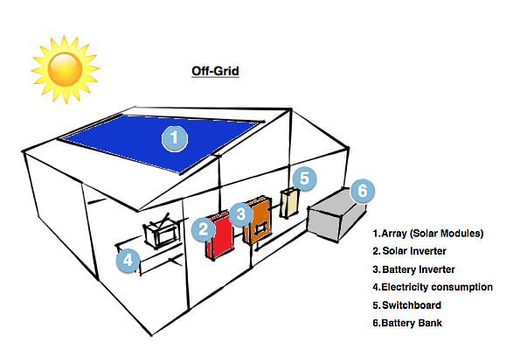
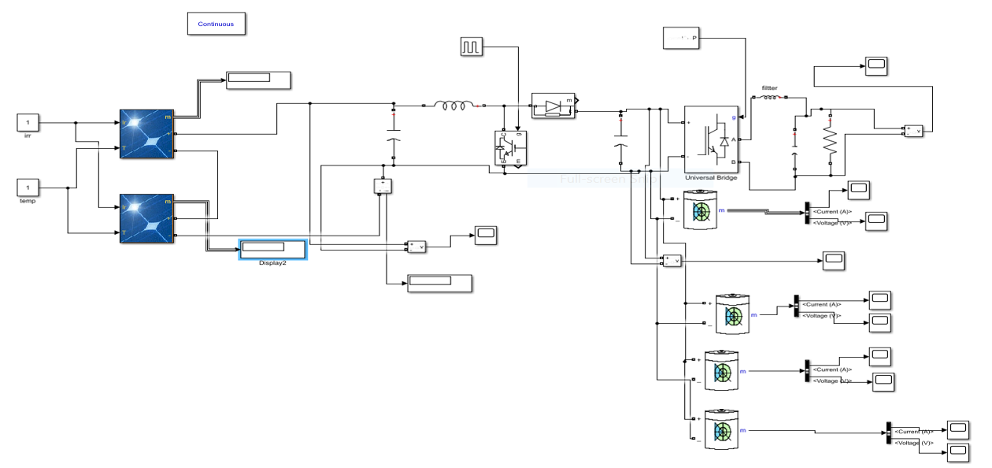
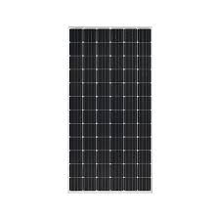
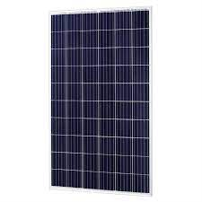
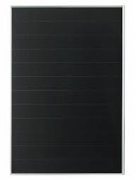
Off-Grid Solar System Design
Adnan Basha
Farah Ghazal
Zaid khayat
Dr.Raed jaber
An-Najah National University
Introduction
battary
The aim of our project is to design an off-grid solar cell system for an area that the electricity company cannot reach and also as an area (C), meaning that it is at the disposal of the Israeli occupation.. Our chosen area is the Al-Tawal area - Atuf village - Tubas city
The residents of this village use diesel generators as a first alternative to producing electricity, despite its high price and its negative impact on the environment, but they have no other choice!
In order to install this system, which relies heavily on converting solar energy into electricity, the geographical location of this region must be studied and is it suitable for this system or not?
Palestine is considered one of the countries producing the most solar energy, as the average solar radiation per day reaches approximately 5.4 kilowatts of solar energy per square meter, which is equivalent to annually Production of 1950 kilowatt-hours of energy. This means more than 300 days of sunshine annually, with 8 hours per day. This indicates the possibility of installing this system for the people of the village without any deterrent reason.
now , the whole system will be explained, including components, installation, prices, and a complete feasibility study will be clarified for it and compared to the diesel transformers currently used.
Definition of the system and the most important components
Being off-grid means you are not connected in any way to your grid's power system or utility company. This is appealing because you are 100% self-sustaining your energy use.
A solar system which has battery storage is called an off grid solar system that generates electricity after power cut or during the night hours. It has the four major components such as
1-solar panels
2-Inverter
3-battery
4-charge controller
: Implementation of the project by MATLAB software
This is a simple software that lays out the way the components of the system are connected to each other:
explain
Solar panels: which in turn absorb sunlight to produce electricity throughout the day and store the surplus inside batteries for night use.
It is a group of solar cells made of silicon mainly. Depending on the manufacturing method, solar panels are classified into:
1- mono crystalline:
(It is our chosen type in the project)
has high efficiency and is the most widespread in the market despite its high price compared to others, because its manufacturing process is complex.
2- pole crystalline :
The method of manufacturing it is easier than the first type, its performance is lower, and its efficiency is lower
3-thin film:
the easiest in terms of manufacturing, comes in the last stage in terms of efficiency and quality
1
Daily consumption schedule for each household
number | Device type | Power(w) | Quantity)q) | Operating hours during the day(h) | Operating hours at night(h) | The amount of energy required during the day(wh) | The amount of energy required at night(wh) | Totel energy during the day and night(wh) | Surge power
1 | Neon lighting | 18 | 2 | 0 | 8 | 0 | 288 | 288 | 36
2 | Light bulb(LED) | 8 | 3 | 0 | 6 | 0 | 144 | 144 | 24
3 | refrigerator | 200 | 1 | 5 | 5 | 1000 | 1000 | 2000 | 600
4 | Washing machine | 800 | 1 | 0.5 | 0 | 400 | 0 | 400 | 2400
5 | TV | 80 | 1 | 2 | 2 | 160 | 160 | 320 | 80
6 | fan | 120 | 1 | 6 | 0 | 720 | 0 | 720 | 120
7 | blender | 500 | 1 | 0.25 | 0 | 125 | 0 | 125 | 500
8 | laptop | 150 | 1 | 1 | 1 | 150 | 150 | 300 | 150
9 | router | 20 | 1 | 12 | 12 | 240 | 240 | 480 | 20
Total |  | W*q=1930w |  |  |  | 2795wh | 1982wh | 4777wh | 3955w
Economic feasibility of the project
2
No. | the Requirements | Qty for each solar system | Qty for all solar systems | U. P/ NIS for each solar system | Total for all solar systems
1 | 2 units of PV Modules 580Wp | 1 | 12 | 0011 | 31200
2 | Off Grid Inverter with built in solar charge controller | 1 | 12 | 0111 | 08111
3 | 4 units of LifePO3 lithium Batteries 24V\100Ah | 1 | 12 | 8000 | 96000
4 | Hot deep Galvanized Structure | 1 | 12 | 600 | 7200
5 | Electricity Cabinet | 1 | 12 | 2300 | 27600
6 | Earth System | 1 | 01 | 511 | 6000
7 | Accessories for installing the system such DC,AC protection, Slive,,,ect | 1 | 01 | 300 | 3600
8 | DC and AC cables to install the unit. | 1 | 11 | 300 | 3600
9 | Main Distribution Board . | 1 | 01 | 200 | 2400
10 | Installation cost including labor work and cost of any needed materials for installation non mention above . | 1 | 11 | 100 | 2400
Total price | 57900 | 853100
properties of the panels:
3
We have two types of solar panels
1-n-type
2-p-type(It is our chosen type in the project)
The two types different from each other in terms of manufacturing methods. The first type adds the boron element to silicon, while the second type adds the phosphorous element during manufacturing to the silicon... There are very slight differences between the two types in terms of efficiency and age. The first type is 22.8% efficient and lasts 20 years. The other is 21.9% and lasts 15 years
1-Bifacial solar panels: feature solar cells on both sides
2-monofacial:Traditional solar panels with solar cells on only one side of the panels. The panels used in our country and relatively cheaper
1- halfcut The cells are divided in half, and therefore the panel is divided into an upper and lower section, meaning that their number is double, and therefore their resistance to the passage of current is low, and therefore their loss of solar energy is less, so they are of high efficiency compared to the full cut.
In this type, the cell columns are connected in parallel with each other (the upper and lower sections) using 2 diodes, meaning that in the event of a defect occurring in a specific part of the board (such as the presence of a shadow, for example), the diode responsible for this part is separated and the rest of the cells complete their work and are not affected by the defect
2- full cut:
We have two types of solar panels
1-Bifacial solar panels: feature solar cells on both sides
2-monofacial:Traditional solar panels with solar cells on only one side of the panels. The panels used in our country and relatively cheaper
calculations
The panels used in our project are:
1- mono crystalline because it is highly efficient
2- The p-type is the most used and available in the country and does not differ much from the other type
3- mono facial
4- The half cut has less energy loss and less resistance
5-topcon
The price for each one project for 1.16 kw = 17900 Nis
Consumption of diesel generators:
The cost of diesel generators producing 1 kilo of electricity is equivalent to the price of 5 Nis.
• daily consumption= (4.777w) * (5 Nis)= 23.885 Nis
• monthly consumption= daily consumption * (30 days)
=23.885*30=716.55 Nis
• Annual consumption=23.88* ( 365 days )=8718 Nis
• Capital recovery period=
(Total project costs=17800 Nis ) / (cost of daily consumption=23.885 Nis) = 745.23
~(745days)
The payback period is 2 years and 15 days
We use this equations to find number of panels required:
panel energy = (Totel energy during the day and night(wh/day) * System efficiency ) / ( solar
radiation hours (kwhp/m^2) )
panel energy = 4.777 kwh *1.3 / 5.56 = 1116.9w
The number of solar panel = panel energy / panel capacity(w)
The number of solar panel = 1116.9w / (580w) =1.925 ~ 2
Solar System Size = num of panels * capacity of panels =2 * 580 =1.16kw
oFF Grid Inverter with Built in Solar Charge Controller:
An inverter (string inverter):is one of the most important pieces of equipment in a solar energy system. It's a device that converts direct current (DC) electricity, which is what a solar panel generates, to alternating current (AC) electricity .
After the panels absorb the solar energy and convert it into DC energy, it is entered into (DC-DC BOOSTE CONVERTER), which in turn raises the value of the continuous current (STEP UP) and then enters the inverter , which performs its main role, which is converted into AC on which the loads work.
As for the charge controller , its main function is to regulate the amount of electricity entering the battery
To find Inverter power
full equipment power * (0.3-1) = 1930w*0.7= 1.35kw= 2kw
conclusion

