Slide 1
The Use of Solid Works in the Evaluation of Different Types of Turbine Wind in Palestine.
Supervisor:
Dr. Salameh Abdull-Fattah
Dr.Raed Jaber
Students:
Taysir Surakji
Mohammad Sayyed
Mosab Abu Haniyeh

Slide 2
TABLE OF CONTENTS
Introduction
Sources and Types of Energy
Types of Wind Turbine
Wind Potential in Palestine
Material Used in Manufacturing
Literature review
Methodology
Results
Conclusion
Reference

Slide 3
Introduction
What is energy?
Energy is the ability to do a certain thing in a certain system.
Multiple types of energy fall under two main categories in terms of source:
Renewable sources
Non-Renewable resources

Slide 4
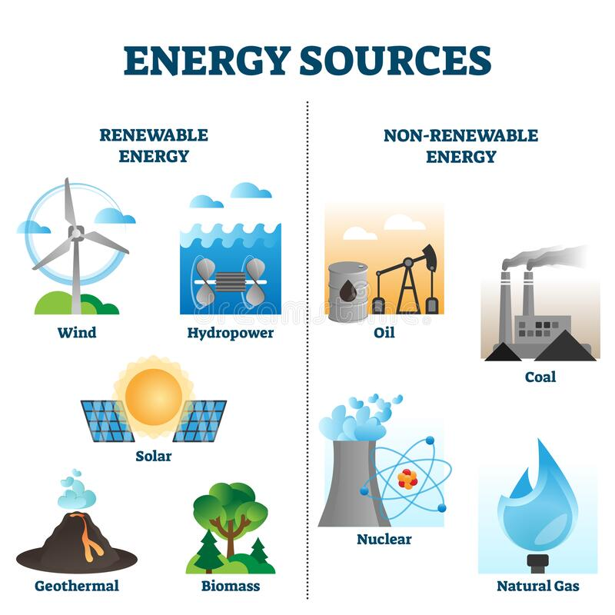
Examples of energy sources

Slide 5
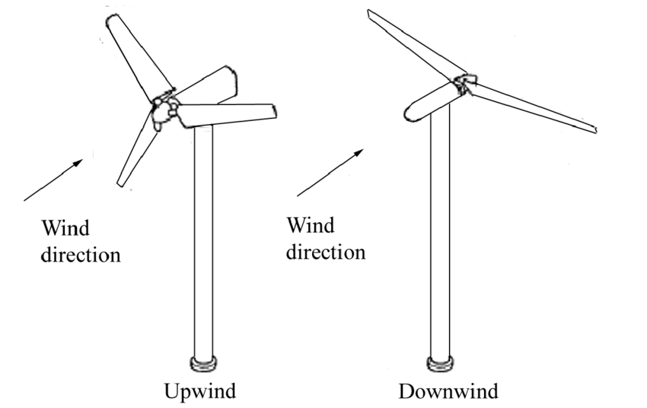
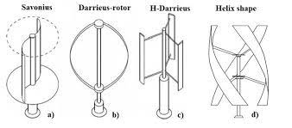
Types of Wind Turbine
Horizontal Axis (HAWT)
Vertical Axis (VAWT)
Figure 1:Types of HAWTs [1]
Figure 2:Types of VAWTs [2-3].

Slide 6
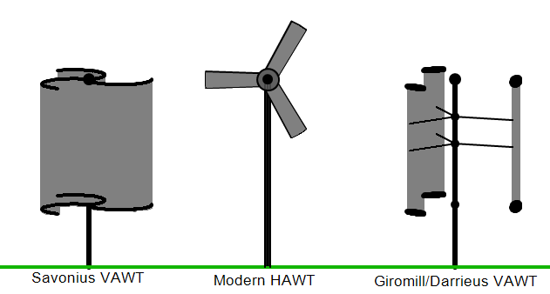
Types of Wind Turbine

Slide 7
Difference between Vertical and Horizontal Wind Turbine
Table 1: Difference between Vertical and Horizontal Wind Turbines [2].
Items | HA-WTS | VA-WTS
Output | Wide range | Narrow range
Starting | Self-starting | Need starting means
Efficiency | Higher | Lower
Cost | Higher | Lower
Maintenance | Difficult | Easy
Generator and gear box | At the top of the tower | At the ground level

Slide 8
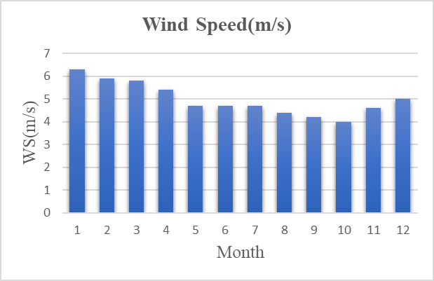
Wind Potential in Palestine
Figure 3:Monthly average wind speed in Hebron [4]

Slide 9
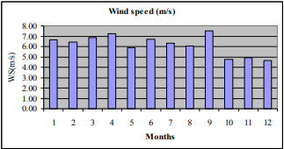
Wind Potential in Palestine
Figure 4: Monthly average wind speed in Hebron [5 -6]

Slide 10
Material Used in Manufacturing
Table 2: Materials percent in blades [7]
components/material (%by weight) |  | steel | Aluminum | Glass fiber reinforced plastic (GFRP) | Carbon fiber reinforced plastic (CFRP)
Rotor | Hub | 95-100 | 0-5 | - | -
 | Balde | 5 | - | 95 | 95
Tower |  | 98 | 2 | - | -

Slide 11
Literature review
Table 3:Summary of studies conducted on wind energy
What did they find ? | What did they do ? | Year / country | Authors
The result of this study is the promising ability of airfoil HAWT and savonius VAWT to generate power at low wind speeds. | This research paper studies and analyzes several designs of horizontal and vertical wind turbines using the Solid Work program. | 2015 / San Diego,californioa | MS.Mayeed A.khalid
It resulted that HAWT turbines are the best type of turbine to be implemented in Malaysia, despite the low wind speed in most parts of Malaysia. | Through this study, a simulation of HAWT & VAWT wind turbines was carried out through the SOLIDWORKS program. | 2020 / Doha,Qatar | A.Khandakar S.Abul kashem
A wind turbine system with a total capacity of 700 kW has been planned, which will reduce the costs of electricity and diesel consumption in the hospital by 30-40%. | This study aims to design a new system for generating wind energy in Al-Ahli hospital buildings | 2011 /Hebron,Palestine | RR.Tahboub I.Braik M.Tamimi

Slide 12
Methodology
Simulation and Measurement
Effect of height
Constraints

Slide 13
Methodology
Simulation
In this research, two different types of wind turbines (H&V) will be simulated in areas in Palestine where the wind speed is appropriate, such as the city of Hebron. and this simulation will be done using the Solid Work program to find out the appropriate type of wind turbine.
Each type of Turbine used will be tested at (0.5 – 4.5) m/s wind speeds.

Slide 14
Methodology
Measurement
For HAWT, Table 4 contains the measurements of the turbines used in this study.
Table 4: Characteristics of the wind turbine components [8]
Blades | Quantity | 3
 | Swept area (m²) | 19.55
 | Length(m) | 2.5
Hub (m) | Outside radius | 0.25
 | Inner radius | 0.05

Slide 15
Methodology
Measurement
For VAWT, Table 5 shows the measurements of a Savonius vertical turbine used in this study.
Table 5: measurements for savonius turbine [9]
Design Parameters | Value
Number of blades | 2
Main shaft diameter | 20 mm
Rotor diameter | 1100 mm
Blade diameter | 600 mm
High blade / blade | 1400 mm
Overlap blade | 50 mm

Slide 16
Methodology
Measurement
Figure 5:Relation between Duration and mid velocity [4]

Slide 17
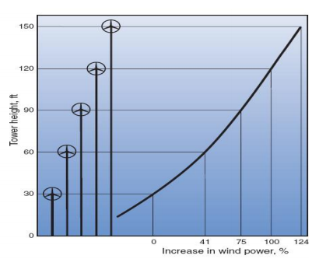
Methodology
Effect of highet:
Figure 6: Relation between height and wind speed [10]

Slide 18
Methodology
Constraints
The lack of any previous reference or practical use of wind turbines in Palestine makes obtaining sufficient information difficult.
It is also difficult to find studies similar to the climate of Palestine and the speed of winds in it.
There were difficulties in working with simulations on SolidWorks and the difficulty of obtaining the necessary parts because they are not available in Palestine, as well as the high cost of importing them.

Slide 19
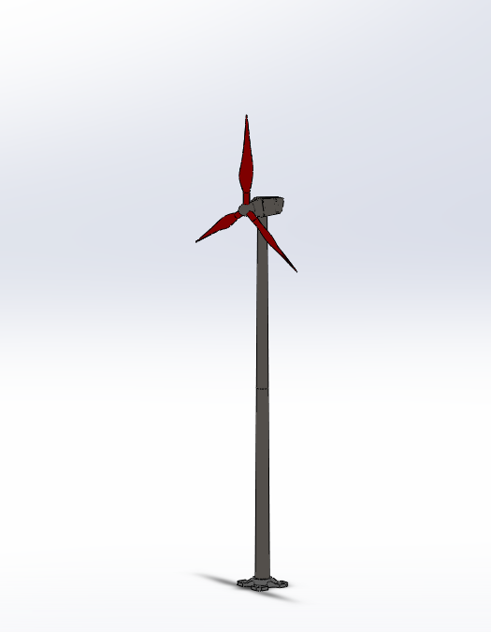
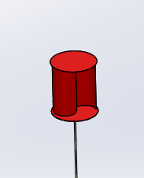
Results
4.1 Designs of (H&V) AWT from Solidworks
Figure 7:Wind Turbines model in solid works

Slide 20
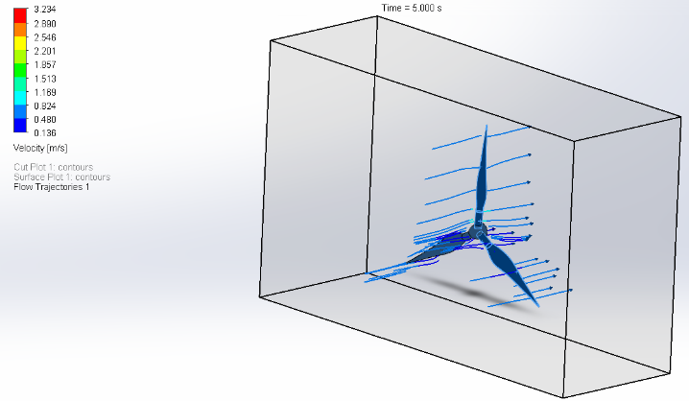
Results
4.2 simulation of the HAWT (3-blades)
Figure 8: air flow on the blades

Slide 21
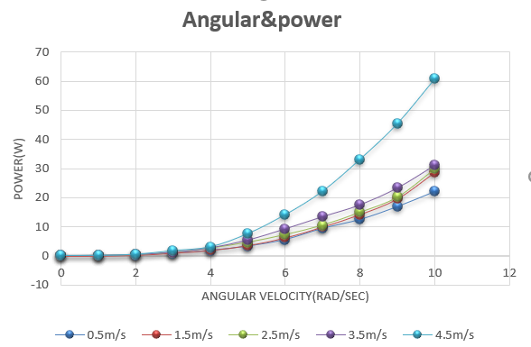
Results
Figure 9:Relation between the Power and Angular velocity at different speeds.

Slide 22
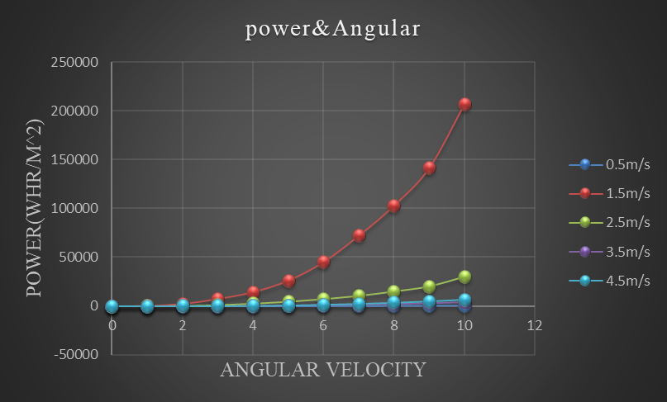
Results
Figure 10:Relation between the Power and Angular velocity at a different speeds

Slide 23
Result
4.3 Study the effect of the number of blades
Figure 11: Relation between the Torque and Rotational speed.

Slide 24
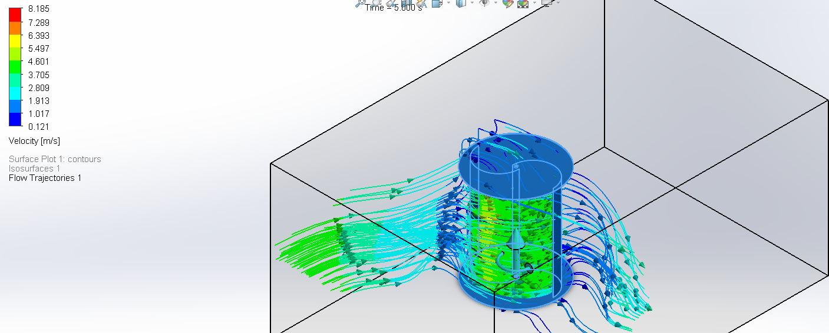
Result
4.4 Simulation of Savonius Wind Turbine
Figure 12:Air flow on the blades

Slide 25
Result
Figure 13: Relation between the Power and Angular velocity at a different speeds

Slide 26
Result
4.5 Compare between Horizontal and Vertical turbines simulation results
Figure 14:Relation between the Torque and Angular velocity at a speed of 4.5m/s

Slide 27
Conclusion
it was found that the best energy yield is at a wind speed of 4.5 m/s.
in HAWT, it is preferable to choose 3 blades as they are most appropriate economically and productively.
After comparing the results of (H&V) AWTs, it was found that Savonius turbines have the greatest ability to generate power at low wind speeds commensurate with the wind speed in the city of Hebron.

Slide 28
Recommendation
It is recommended to experiment with various types of VAWT turbines
Different HAWT blade designs may be tested and compared
It is suggested to conduct a practical experiment of the species given in the research and compare the results with those obtained in the real world and those obtained by performing a simulation.
The types of turbines to be simulated should depend on the wind speed in the chosen area.

Slide 29
Reference
Makhalas, K. A., & Alsehlli, F. (2015). Wind Power.
Aymane, E., Darhmaoui, H., & Sheikh, N. (2017). Savonius Vertical Wind Turbine: Design, Simulation, and Physical Testing. School of Sci. & Eng. Univ. Program.
Óskarsdóttir, M. Ó. (2014). A general description and comparison of horizontal axis wind turbines and vertical axis wind turbines (Doctoral dissertation).
‏Palestinian Meteorological Department, Ministry of transportation. https://www.pmd.ps/. (Accessed 8.14.21).
Tahboub, R., Ibrik, I., & Tamimi, M. (2011). The potential and feasibility of solar and wind energy applications in Al-Ahli Hospital. In A paper presented at the 4th International Energy Conference in Palestine.

Slide 30
Reference
.6Albisher, H., & Alsamamra, H. (2019). An overview of wind energy potentials in Palestine. Journal of Energy and Natural Resources, 8(3), 98.
.7 Ancona, D., & McVeigh, J. (2001). Wind turbine-materials and manufacturing fact sheet. Princeton Energy Resources International, LLC, 19.
.8EV Donnou, H., Boro, D., Noé Fabiyi, J., Tovoeho, M., & B Akpo, A. (2021). Study and Design of a Horizontal Axis Wind Turbine (0.5 kW) Using Software Solid Works.‏
.9Pamungkas, S. F., Wijayanto, D. S., Saputro, H., & Widiastuti, I. (2018). Performance ‘S’type Savonius wind turbine with variation of fin addition on blade. In IOP Conference Series: Materials Science and Engineering (Vol. 288, No. 1, p. 012132). IOP Publishing.

Slide 31
Reference
.10Badawi, A. S. (2013). An analytical study for the establishment of wind farms in Palestine to reach the optimum electrical energy.

Slide 32
Thanks

