Slide 1
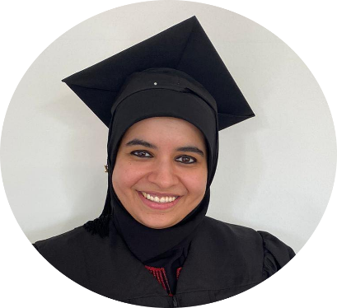



An-Najah National University
Al-Refai
Dr. Safa’a AbuJarour
Engineering and Information Technology Faculty
Management Information Systems Department
2021/2022
Graduation Project
Computerization of the System for
Al-Refai Cars Trading
Supervised By : Dr. Safa’a AbuJarour
Doaa Abu Zahra
Cars Trading
Taqwa Abu Tarboush

Slide 2

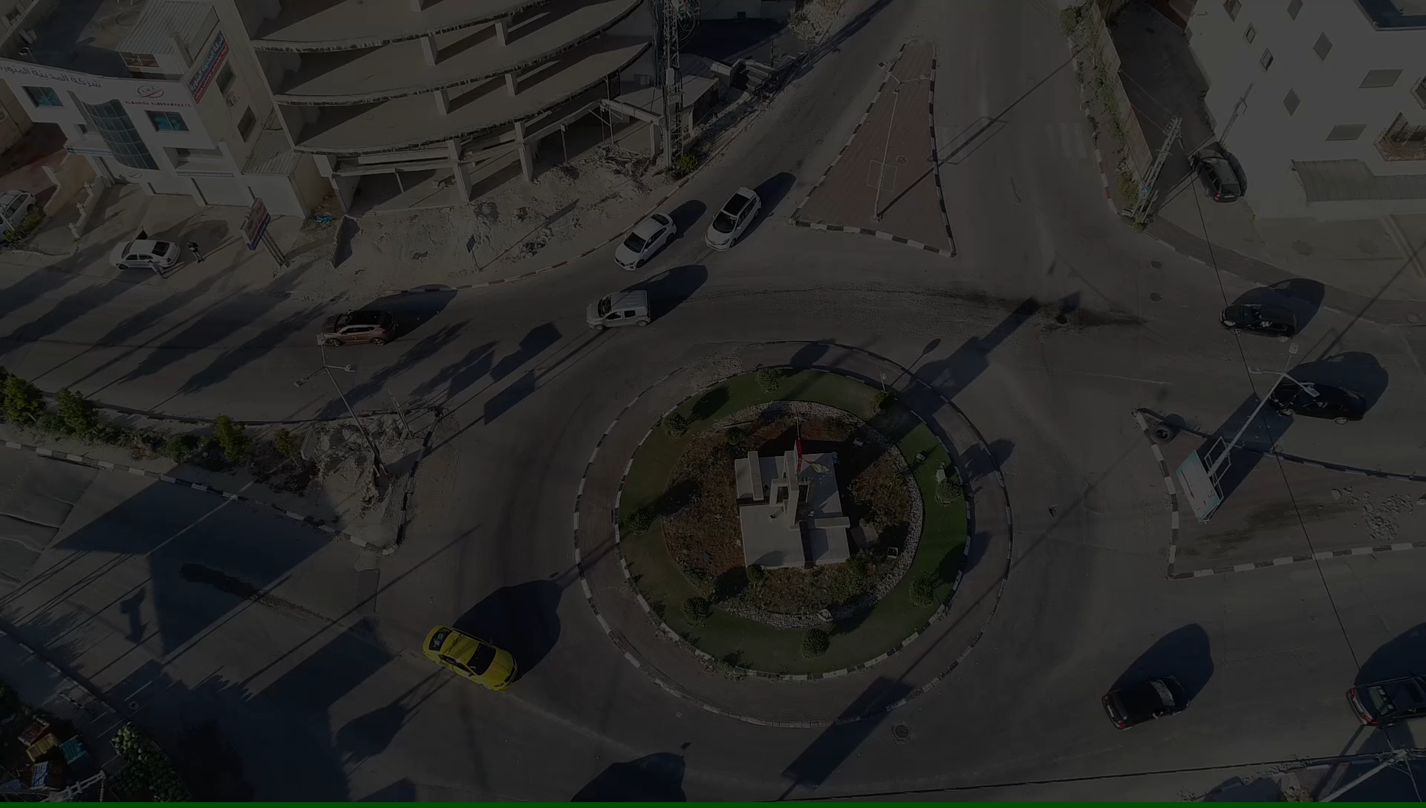
Al – refai cars trading

Slide 3
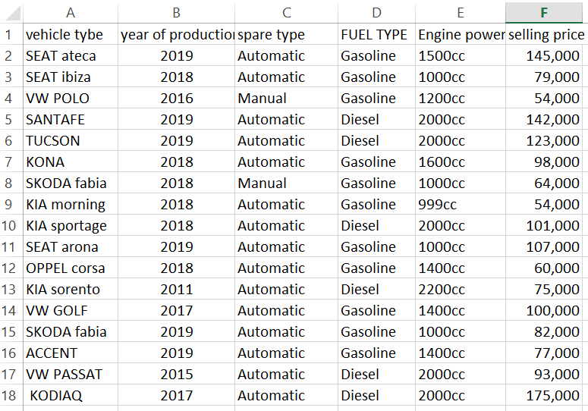
State of the art
After the cars arrive at the store , all cars details are manually recorded on paper .

Slide 4
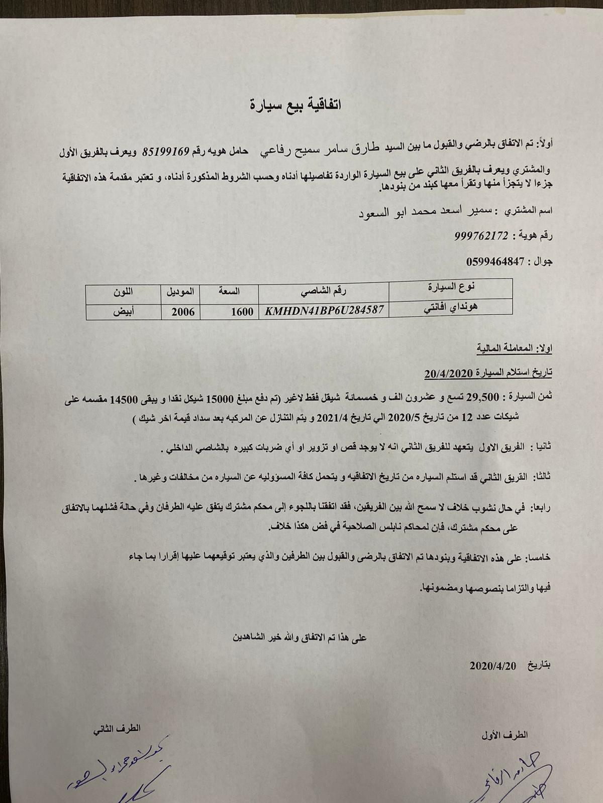
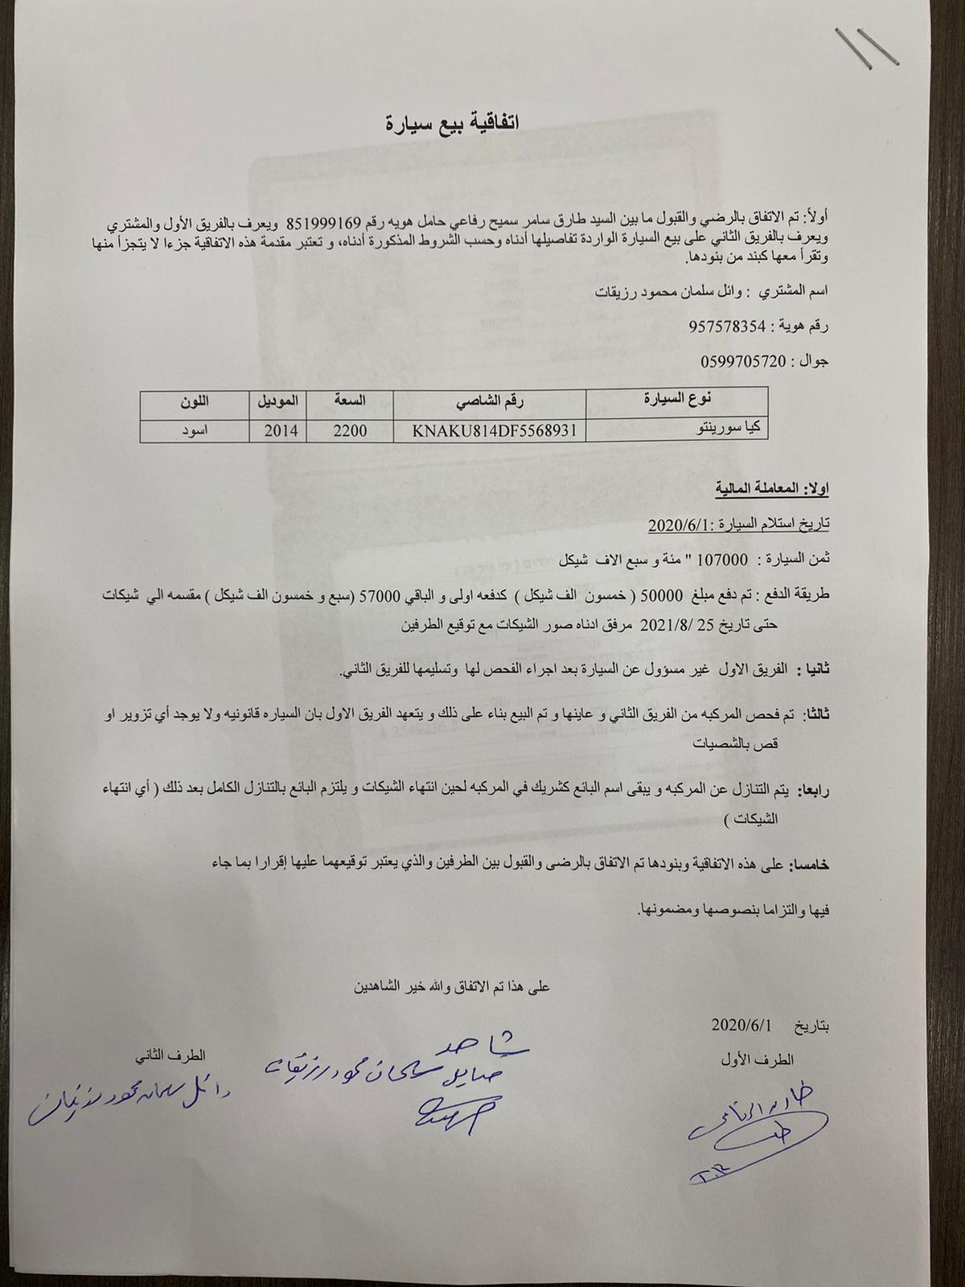

State of the art

Slide 5
State of the art
We study the user needs & requirements and collect data such as :-
The nature of the work .
The way operations work and .
Performance errors in the current system .

Slide 6
Solution
Therefore , we came up with a two folded solution about “Computerizing the Current System” :-
A website that display the cars in a professional way .
A system which contains all commercial operation of the company . )Refaii.com )

Slide 7
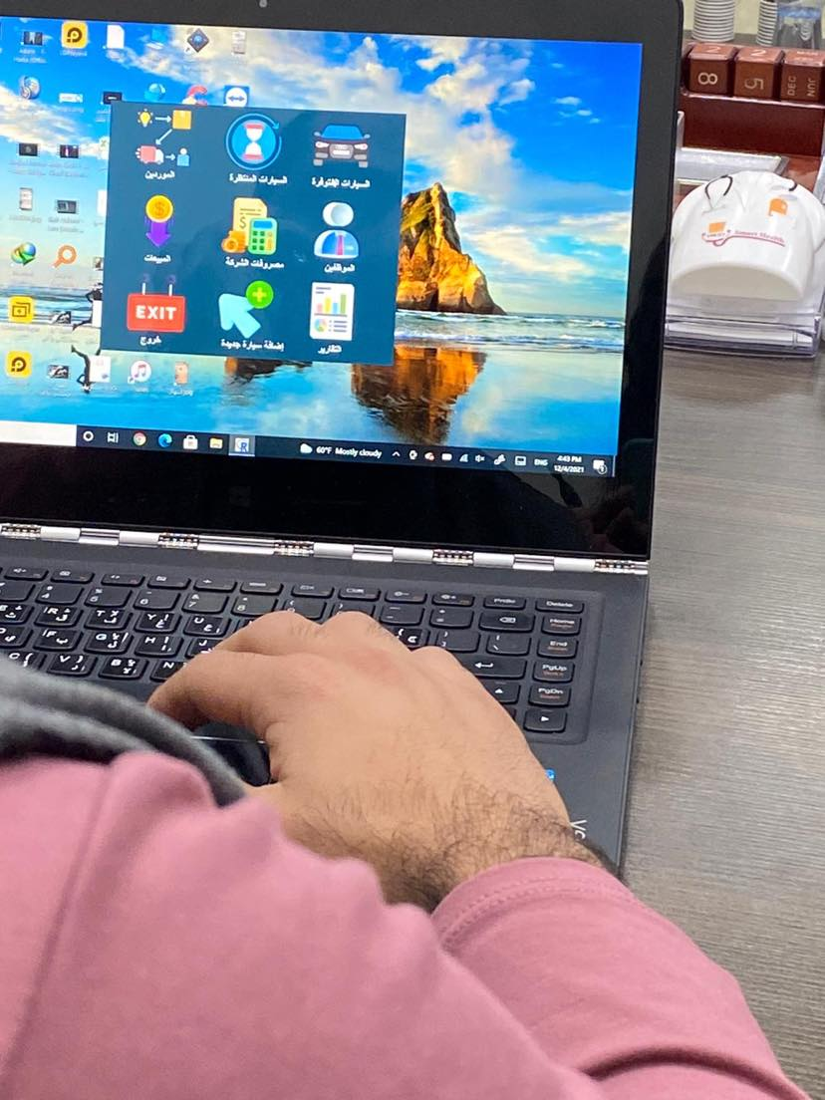
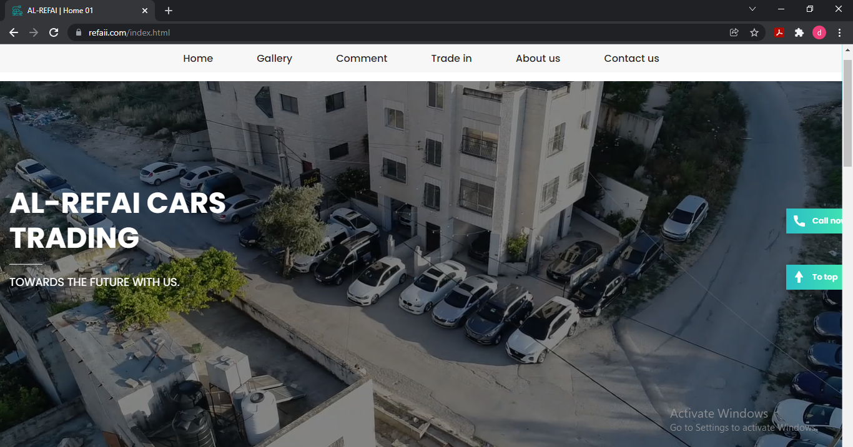
Our outputs

Slide 8
Which courses did we use ?
We would like to mention some of the courses that helped us to accomplish our project during our university journey , such as :-
System Analysis by Dr. Kamal Irshaid .
Visual Studio by Dr. Mohammad Dweikat .
Database by Dr. Najwan Deleq
Operation Management by Dr. Ahmad Shraideh .
Institutional Development and Change Management by Dr. Maher Arafat .
Principles of Scientific Research by Dr. Maher Abu Baker .

Slide 9
Acknowledgement
First and foremost , we would like to thank the chairwomen of our committee Dr. Safa’a for her support , outstanding guidance and encouragement throughout our graduation project .
Our deep thanks go to all of the teaching members of the MIS department , whom we really consider them as our second families .
Thanks for our families , for their encouragement, patience , and assistance over the years . We are forever indebted to who have always kept us in their prayers .
Last but not least , this project was really helpful and efficient because of our partner "Al-Refai Cars Trading Company” . We were really pleased by this cooperation .

Slide 10

Thank you for your attention !
Welcome to your questions ?!

