Slide 1

An-Najah National University
Faculty of Engineering & Information Technology
Building Engineering Department
Group members:
Adnan Arafat
Mohy Darwazeh
Khalil Tanbour
Supervisor name: Eng.Hasan Mathar
Graduation Project 1
“Holy Qur’an Academy Primary School “

Slide 2
Table of Content :
1
Introduction
2
Environmental-Architectural Aspects
3
Structural Aspects
4
Electro-Mechanical Aspects
5
Quantity Surveying and Cost Estimate

Slide 3
Introduction:
The school building is one of the most important basics of the educational process, and the most important factor for success is the educational process.
Studies have shown that the more the school building is equipped with amenities, the greater the educational attainment of students and helps in the proper functioning of the educational process. So the study environment is the place where students receive pedagogical and educational principles and take them to society to develop and build it.

Slide 4
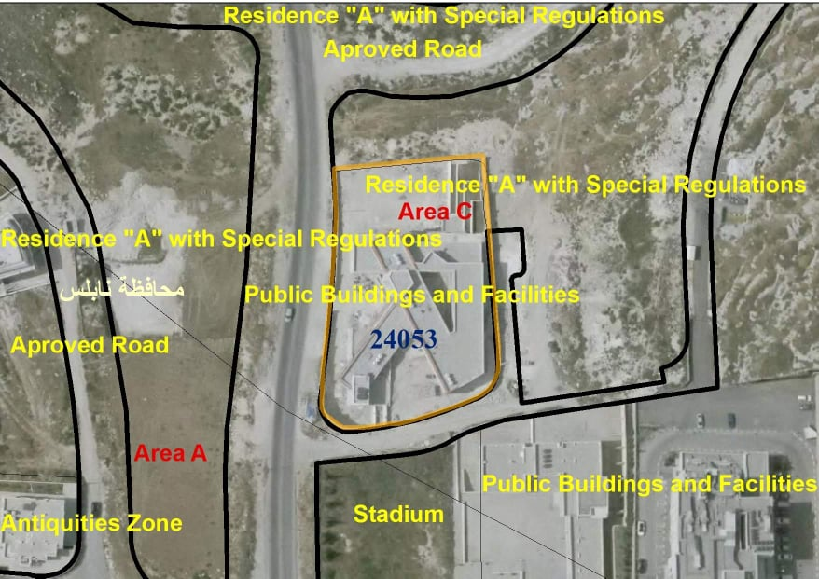
Site Analysis:
Location: It is located in the west north of Nablus city with near of Asira Al-Shamalya village.
Site area: 15030.88 SM.

Slide 5
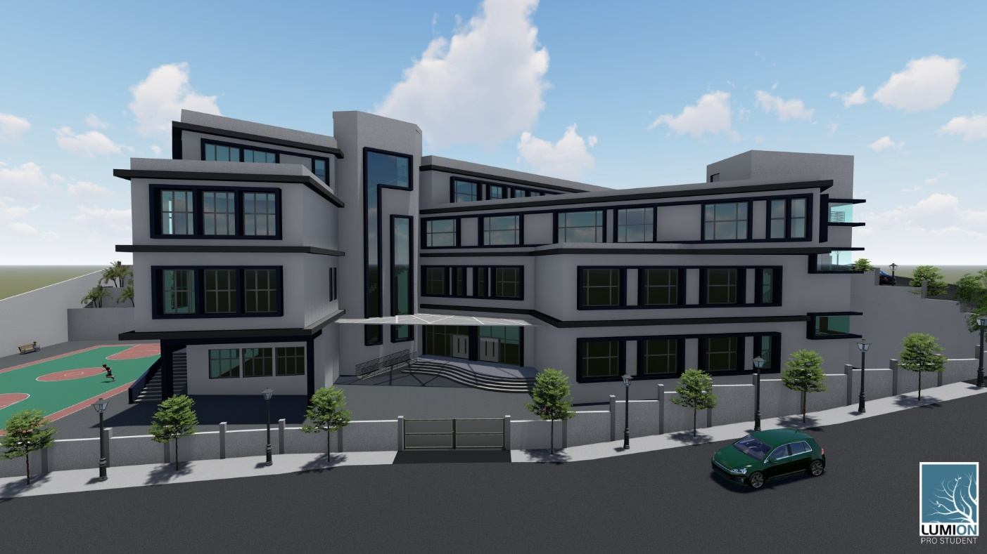
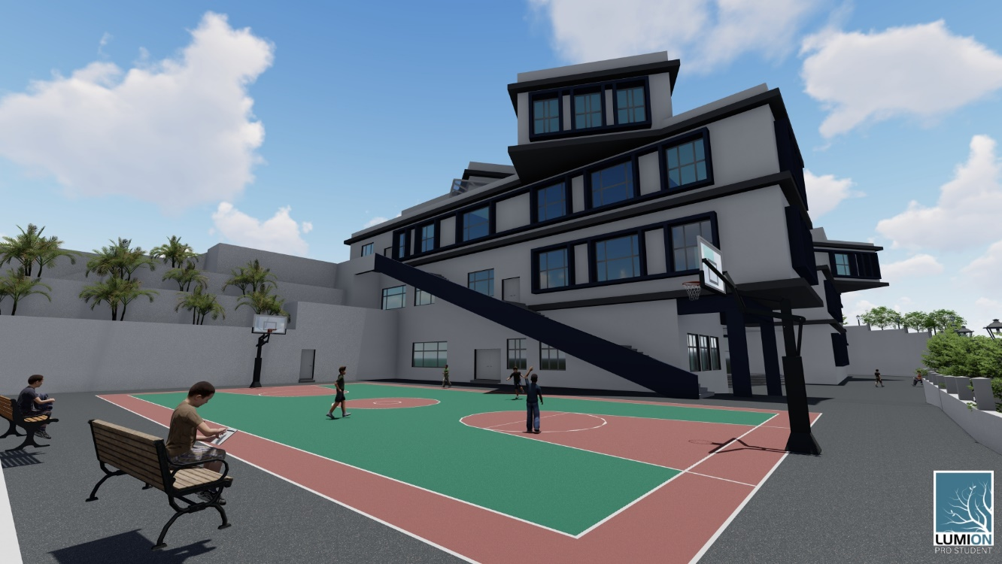
Environmental-Architectural Aspects :

Slide 6
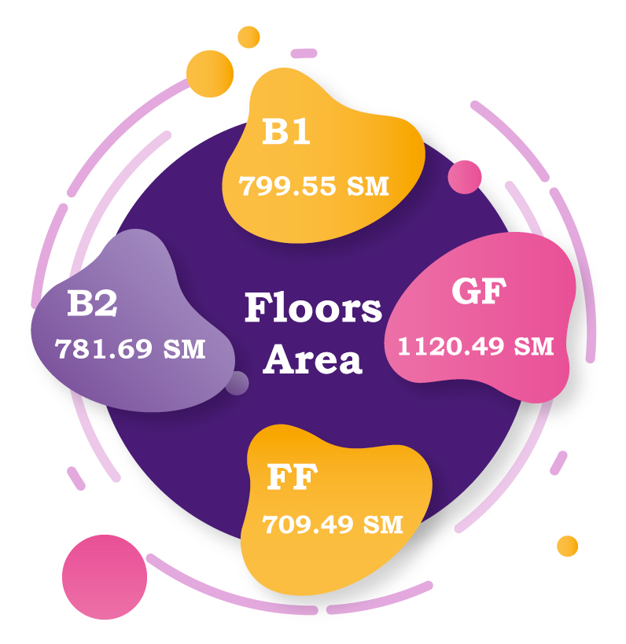
Architectural Aspects :
Project description:
4 Floors including two basements and two floors.
Serve 550 student.
Total area of the building equals to 3411.22 SM

Slide 7
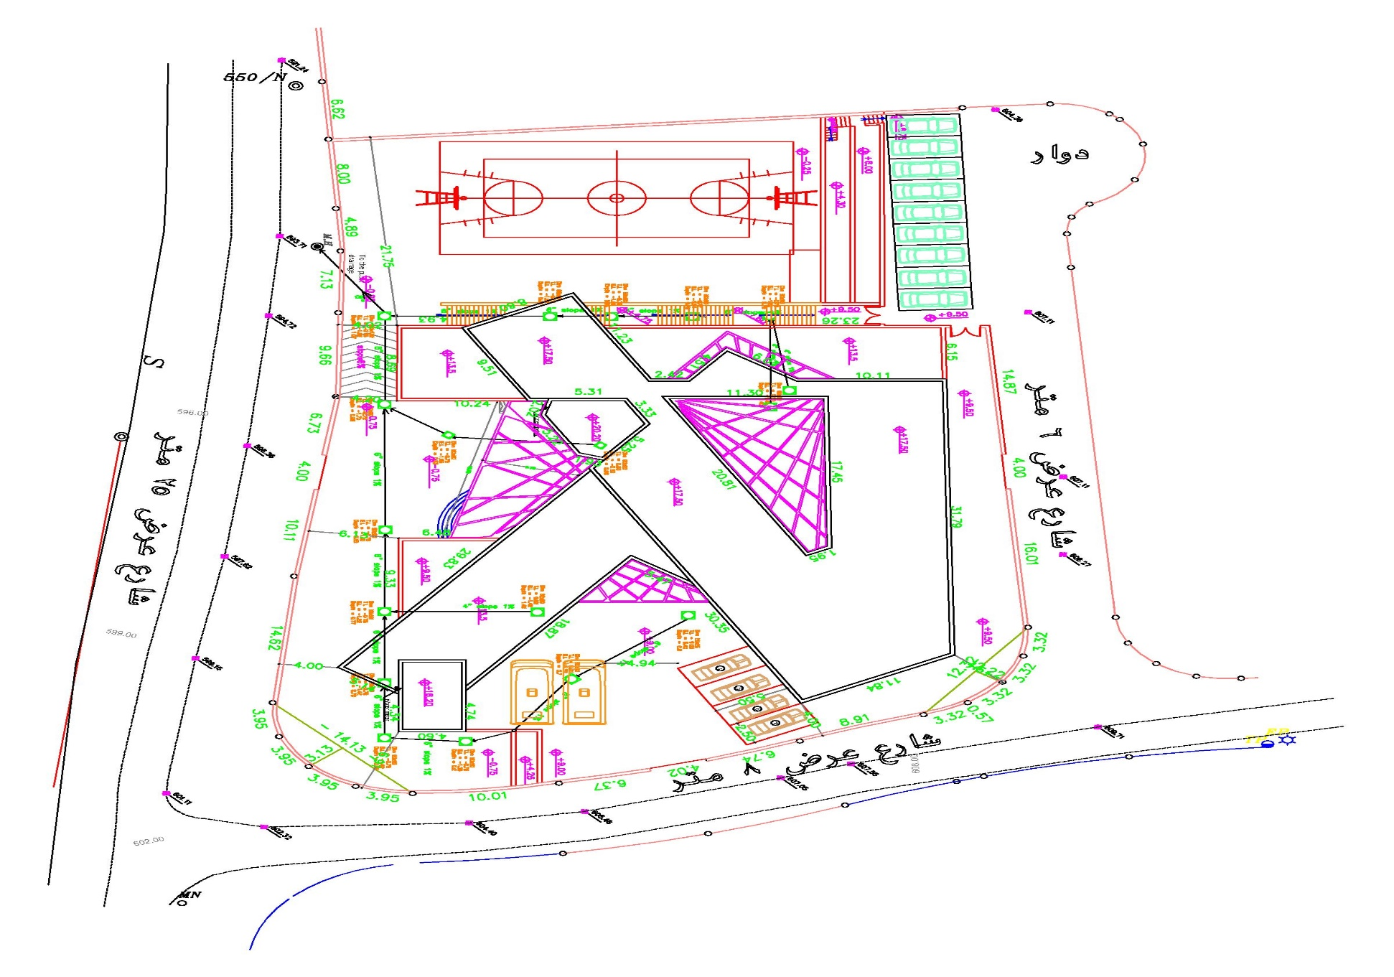
Architectural Aspects :
Project Plans:
Site Plan:

Slide 8
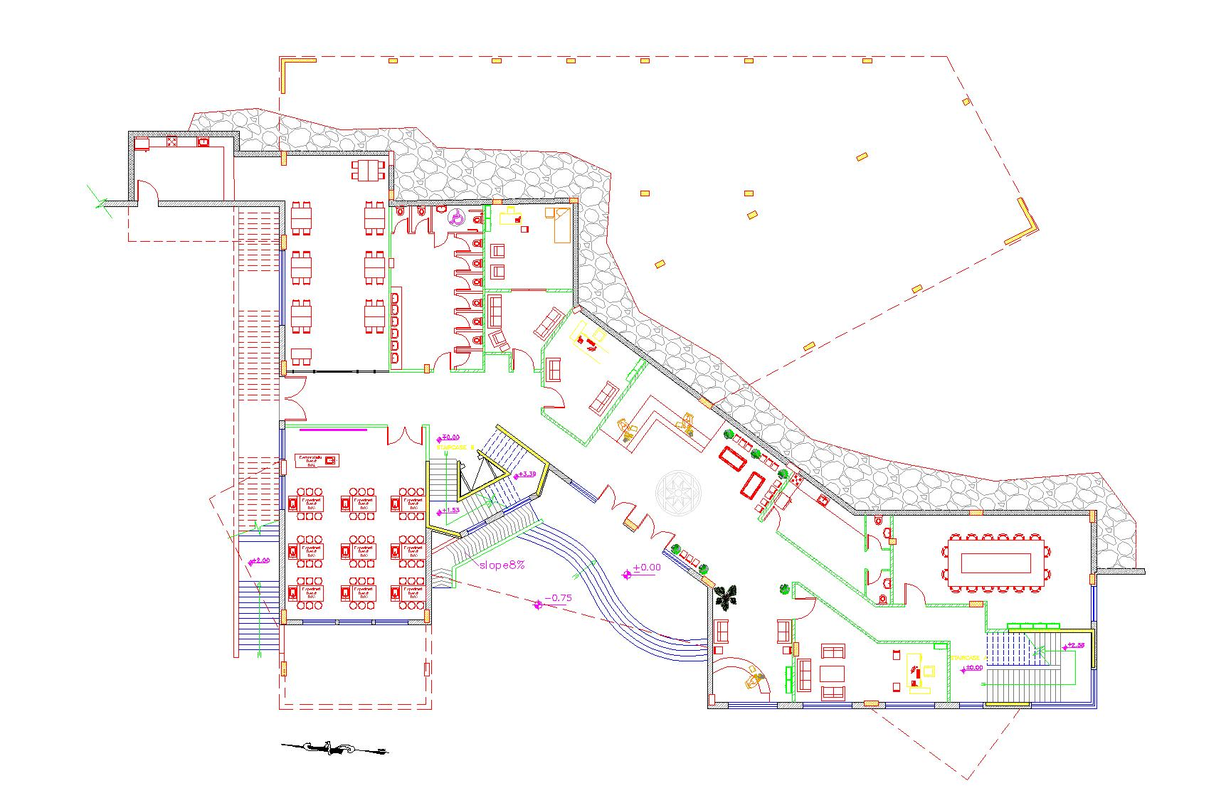
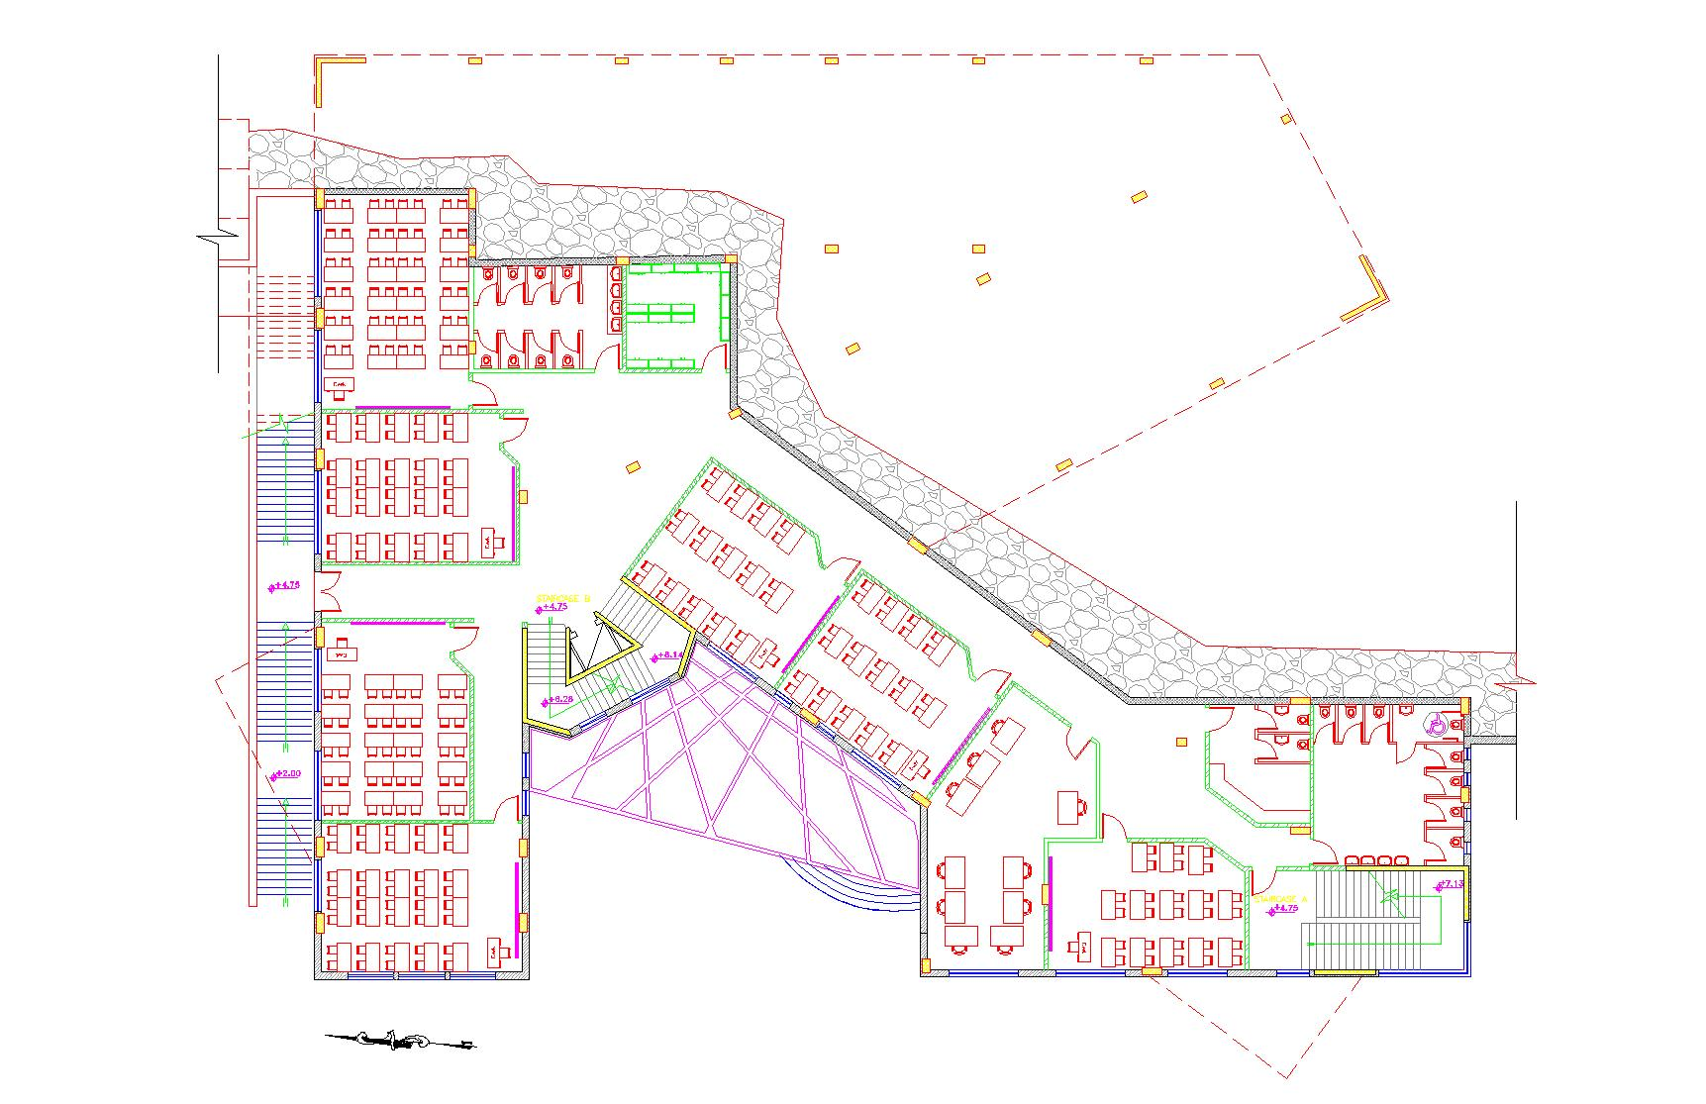
Architectural Aspects :
Project Floor Plans:
B1 floor Plan
B2 floor Plan

Slide 9
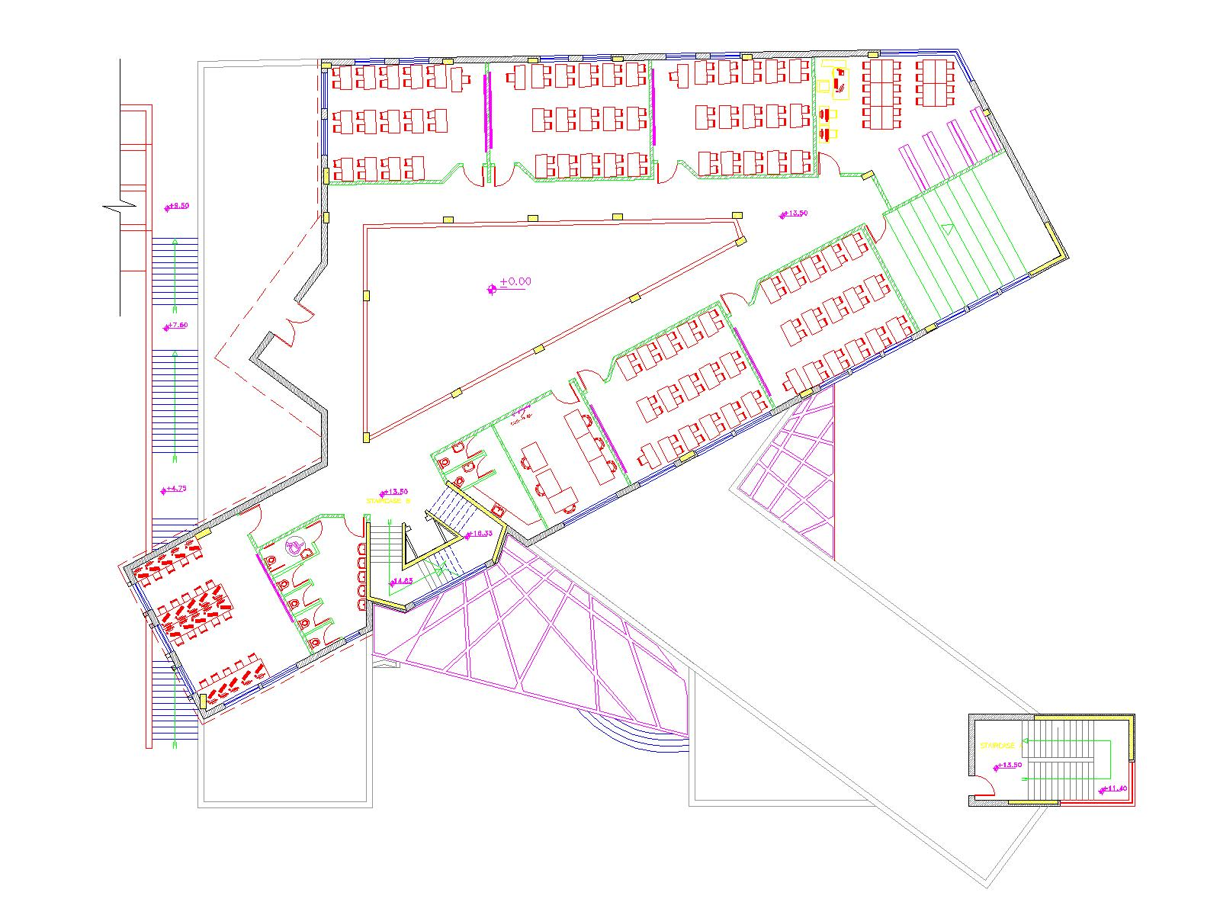
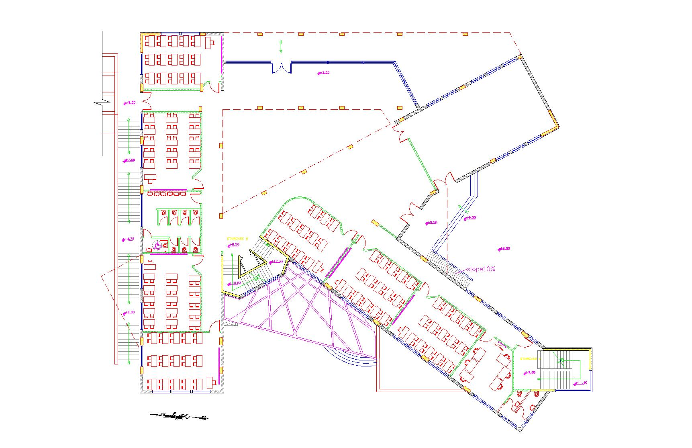
Architectural Aspects :
Project Floor Plans:
First floor Plan
Ground floor Plan

Slide 10
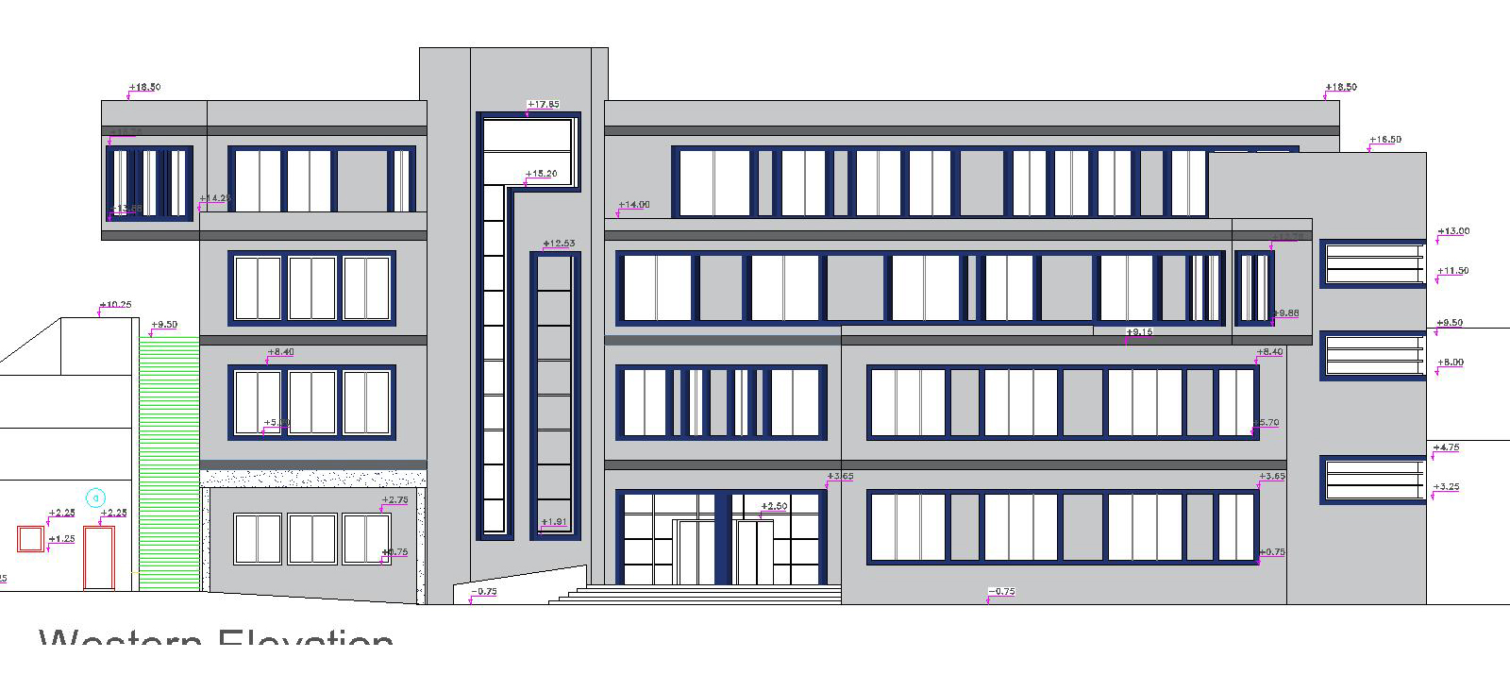
Architectural Aspects :
Project Elevations:
Western elevation

Slide 11
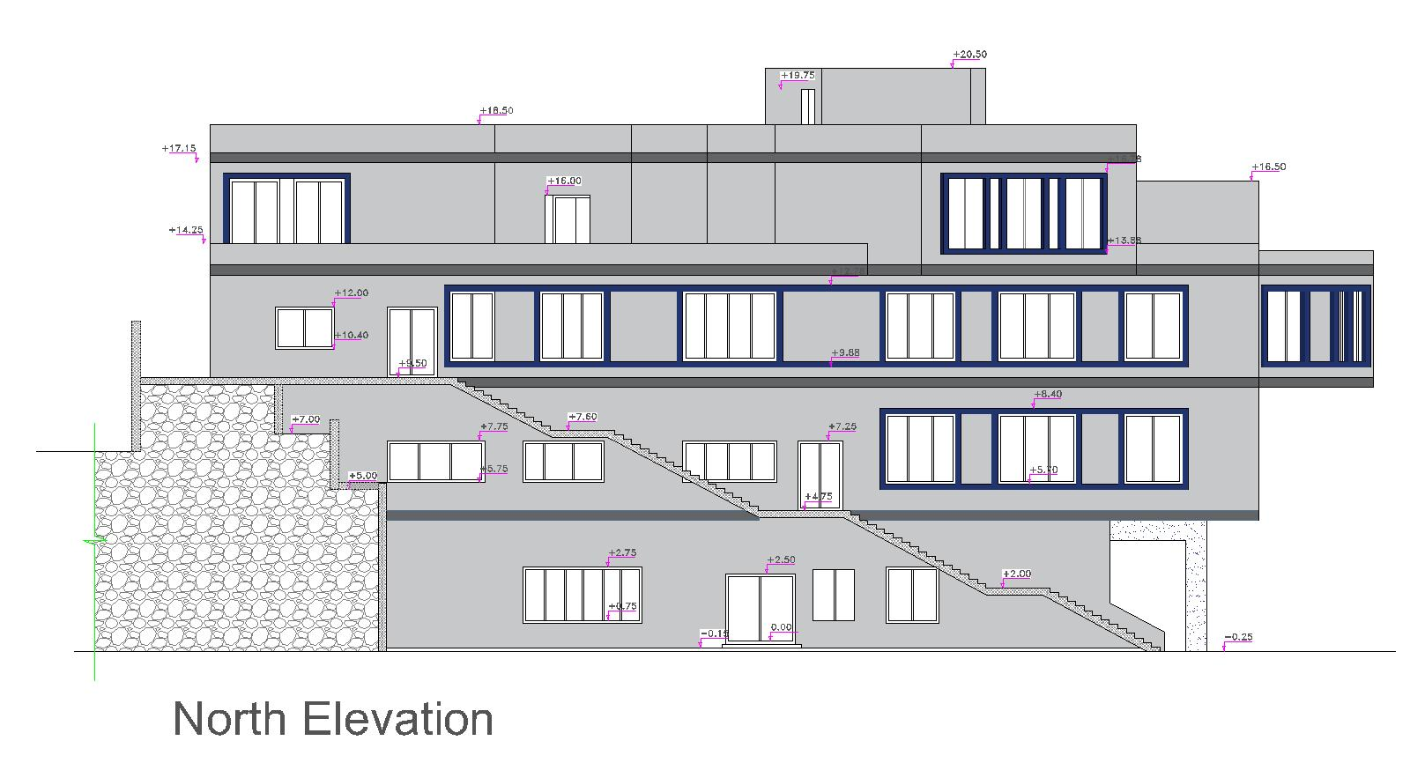
Architectural Aspects :
Project Elevations:

Slide 12
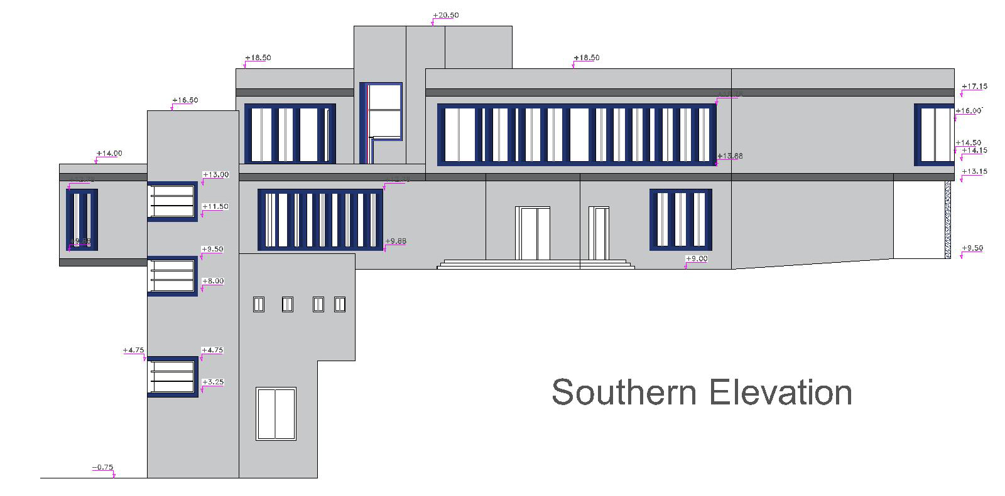
Architectural Aspects :
Project Elevations:

Slide 13
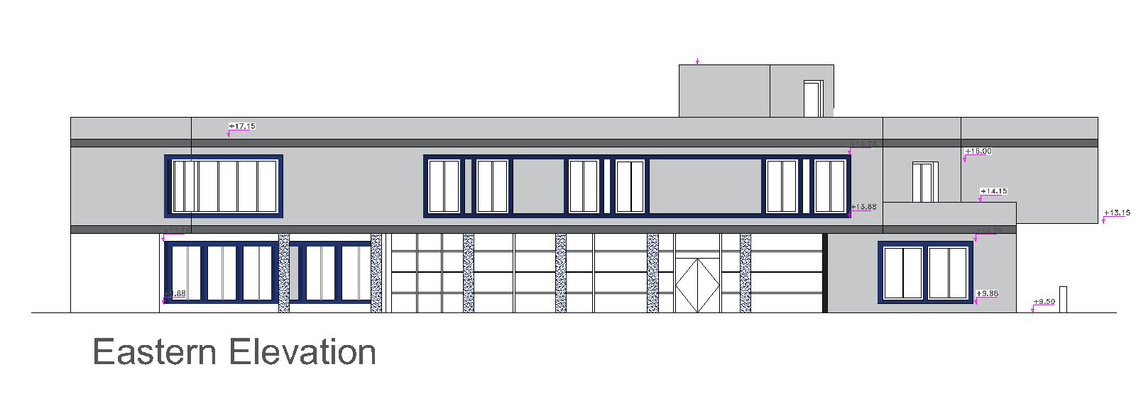
Architectural Aspects :
Project Elevations:

Slide 14
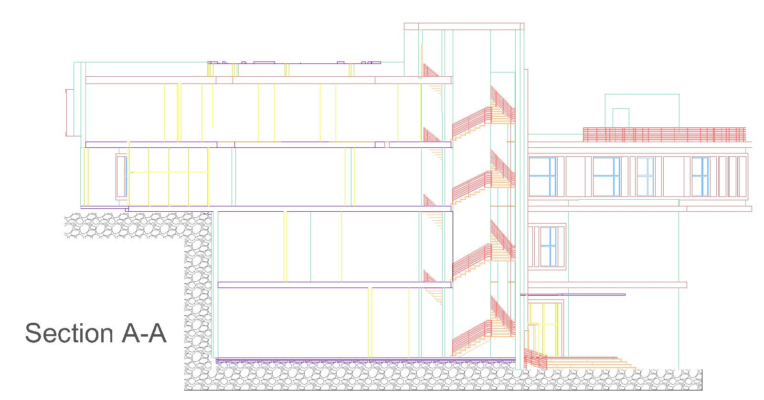
Architectural Aspects :
Project sections:

Slide 15
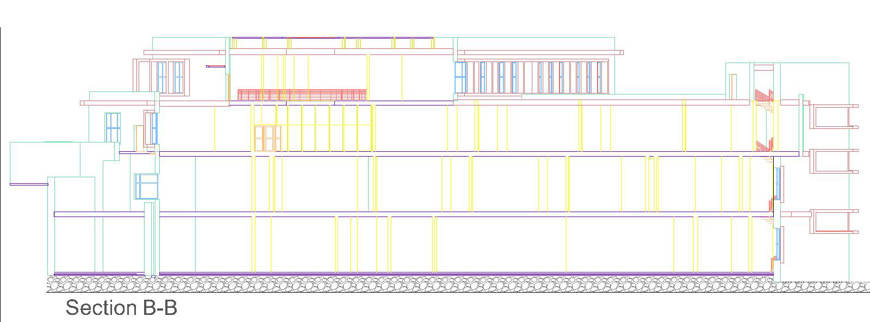
Architectural Aspects :
Project sections:

Slide 16
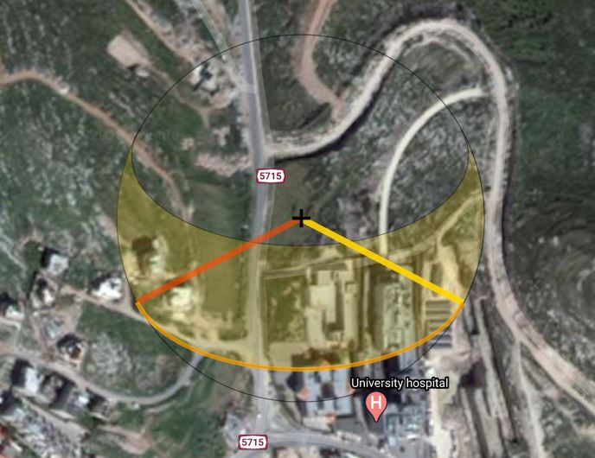
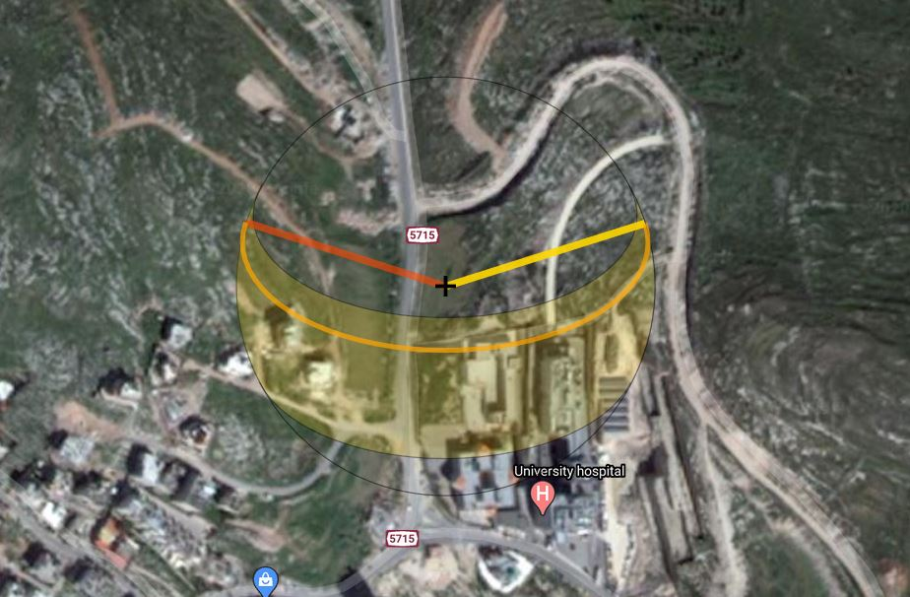
Architectural Aspects :
Sun Path:
Depending on Palestine location so the sun path is wide in summer and narrow in winter with Altitude in summer (21-6) is 81.5 and in winter (21-12) is 34.7 .
Sun path – Winter condition
Sun path – Summer condition

Slide 17
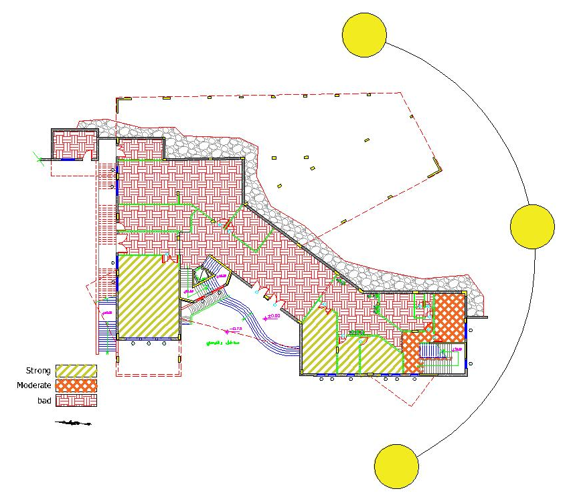
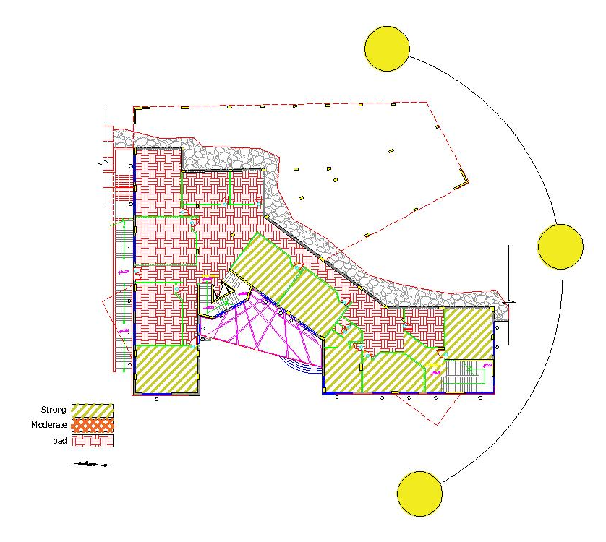
Architectural Aspects :
Sun Path on floors:
B1 floor Plan
B2 floor Plan

Slide 18
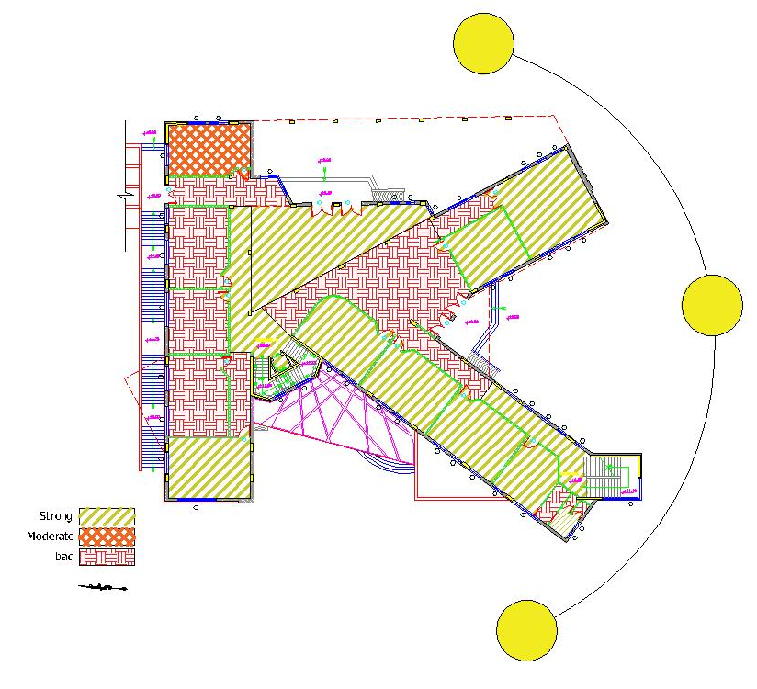
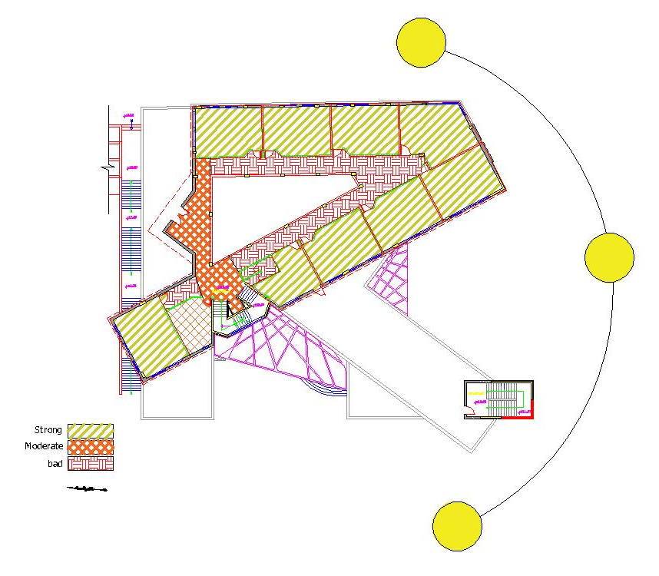
Architectural Aspects :
Sun Path on floors:
First floor Plan
Ground floor Plan

Slide 19
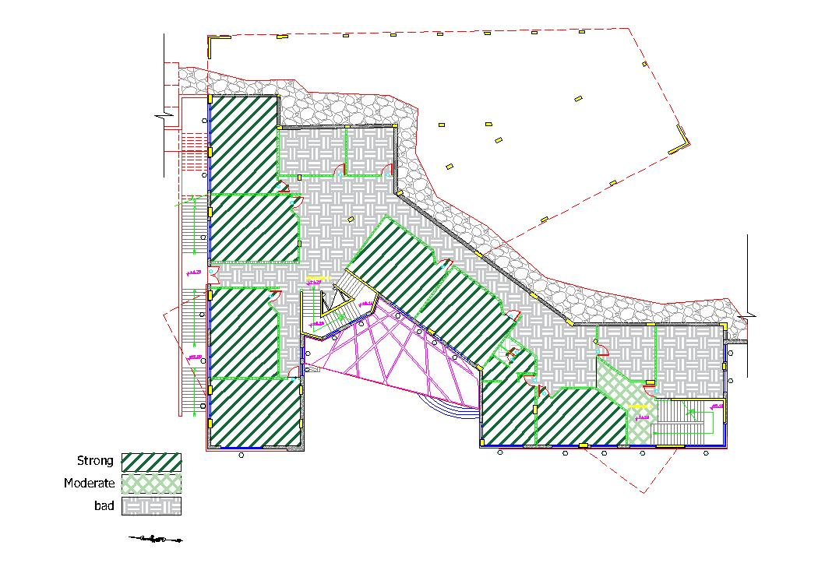
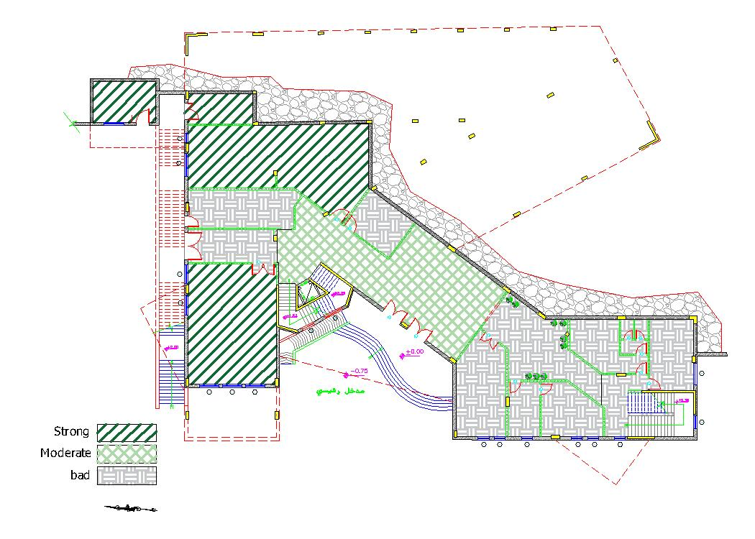
Architectural Aspects :
View analysis on floors:
B1 floor Plan
B2 floor Plan

Slide 20
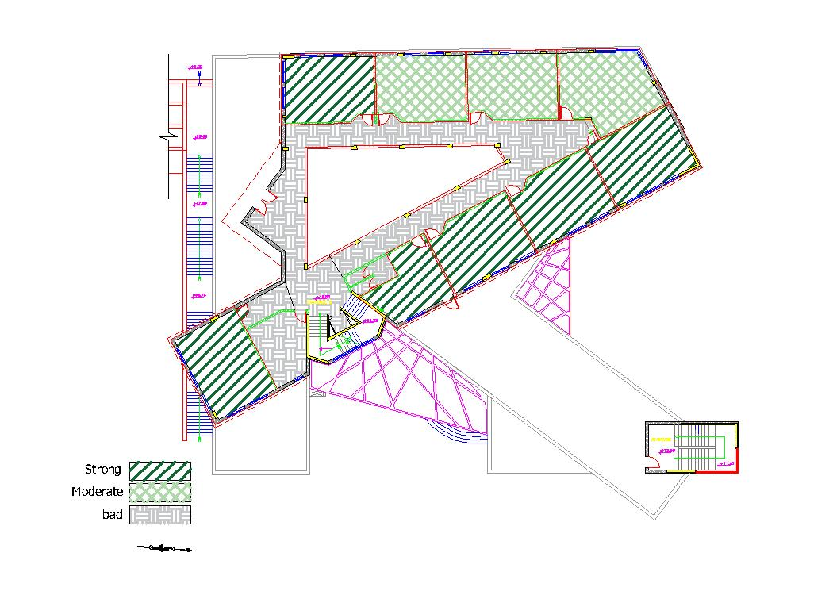
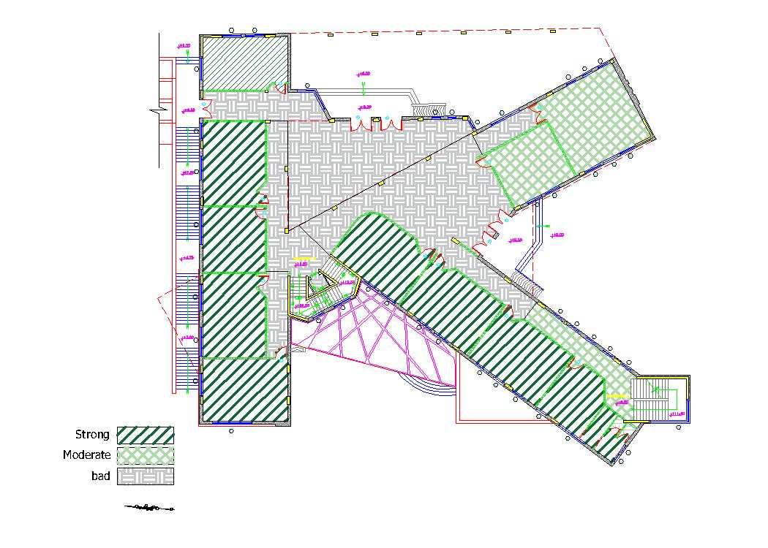
Architectural Aspects :
View analysis on floors:
First floor Plan
Ground floor Plan

Slide 21
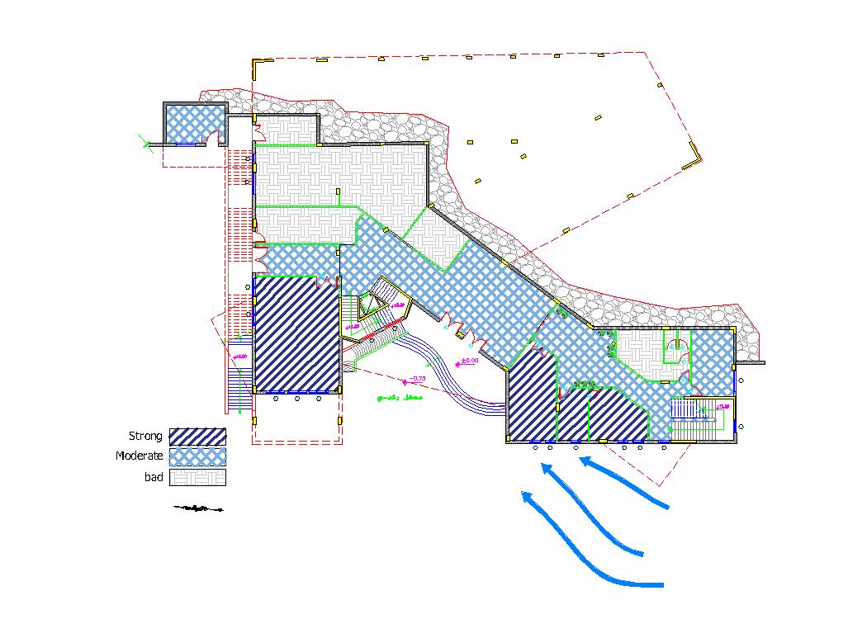
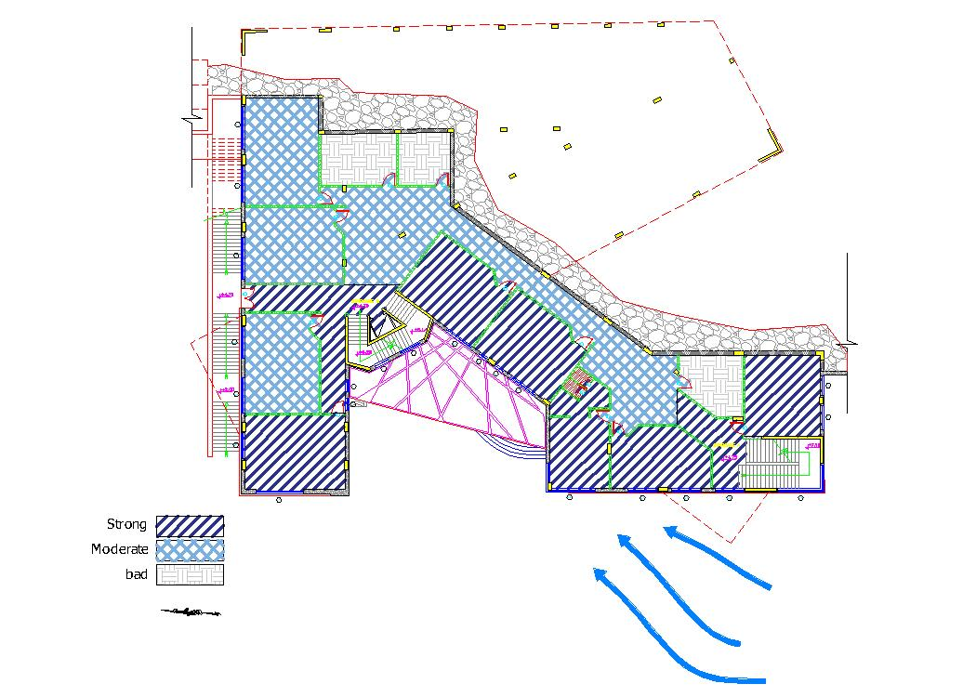
Architectural Aspects :
Wind analysis on floors:
B1 floor Plan
B2 floor Plan

Slide 22
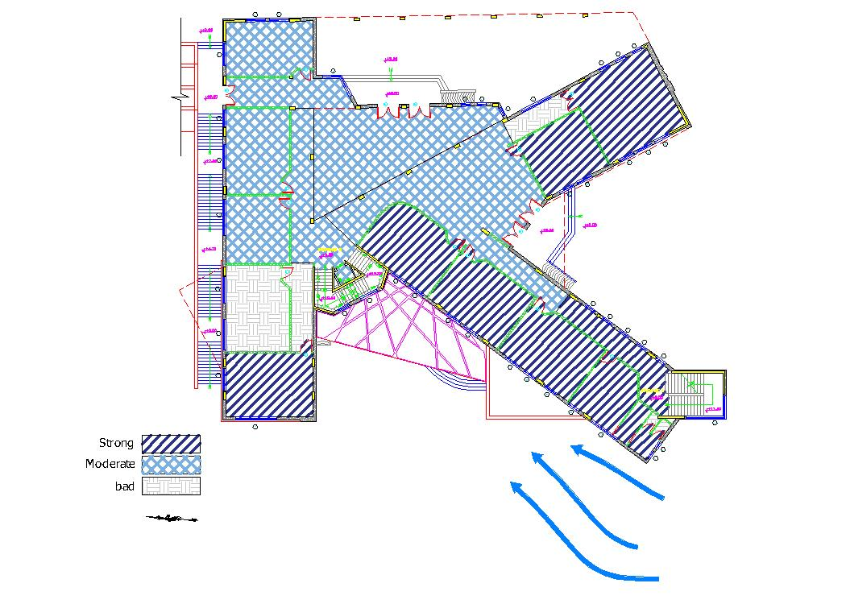
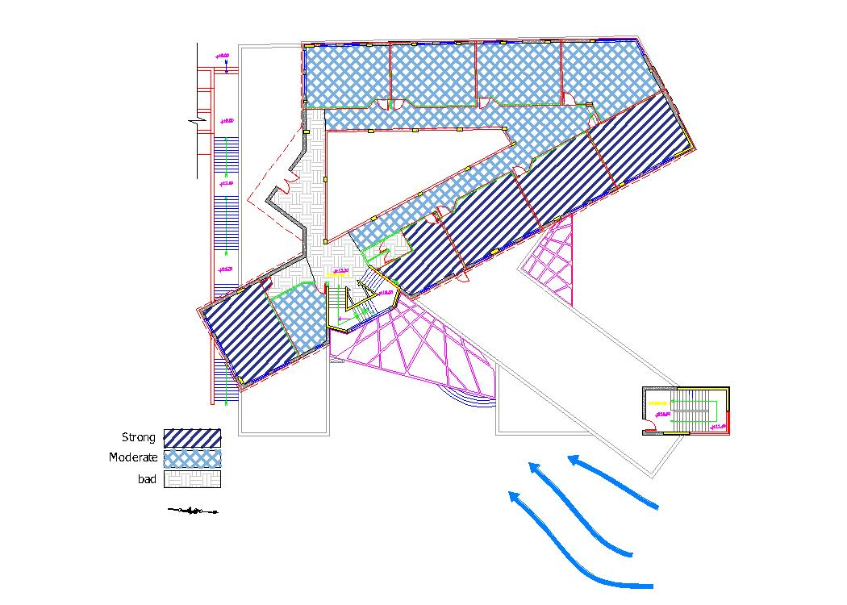
Architectural Aspects :
Wind analysis on floors:
First floor Plan
Ground floor Plan

Slide 23
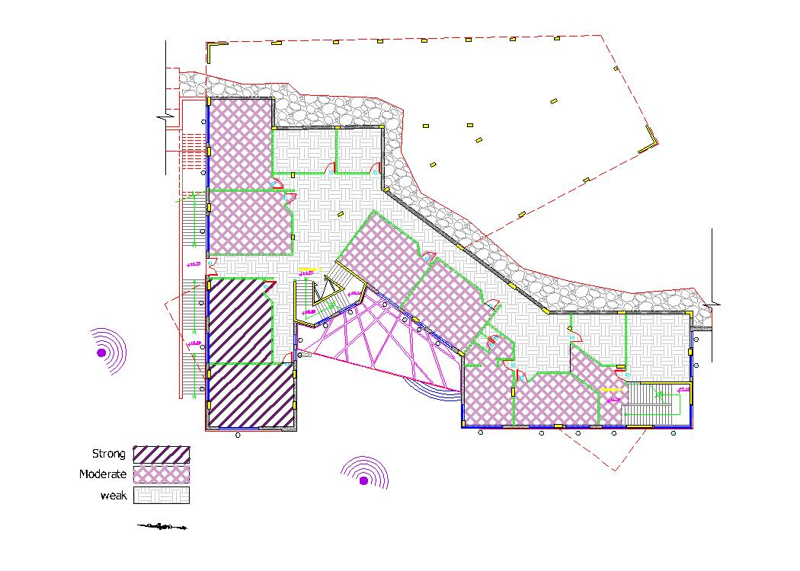
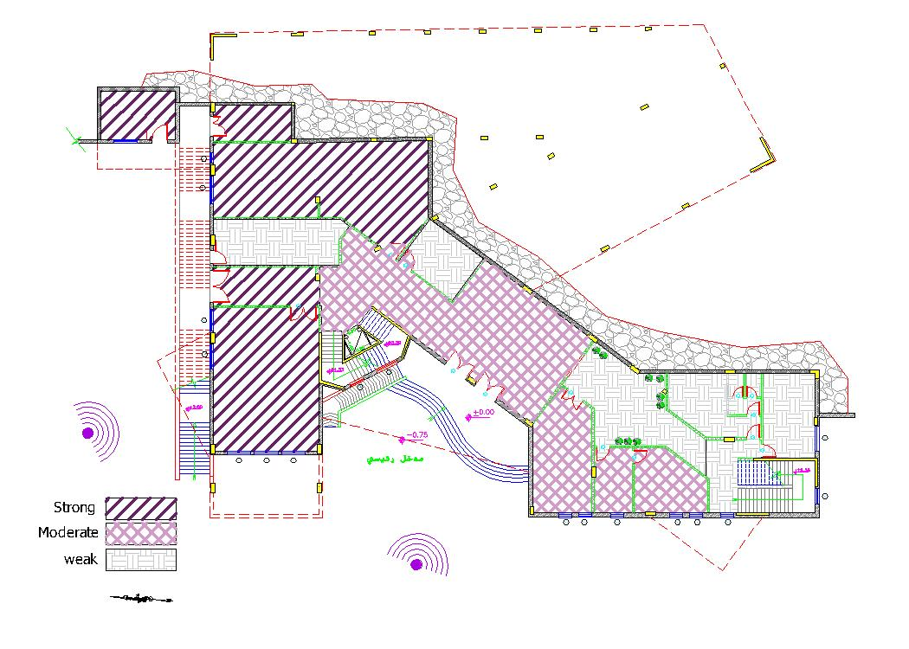
Architectural Aspects :
Noise analysis on floors:
B1 floor Plan
B2 floor Plan

Slide 24
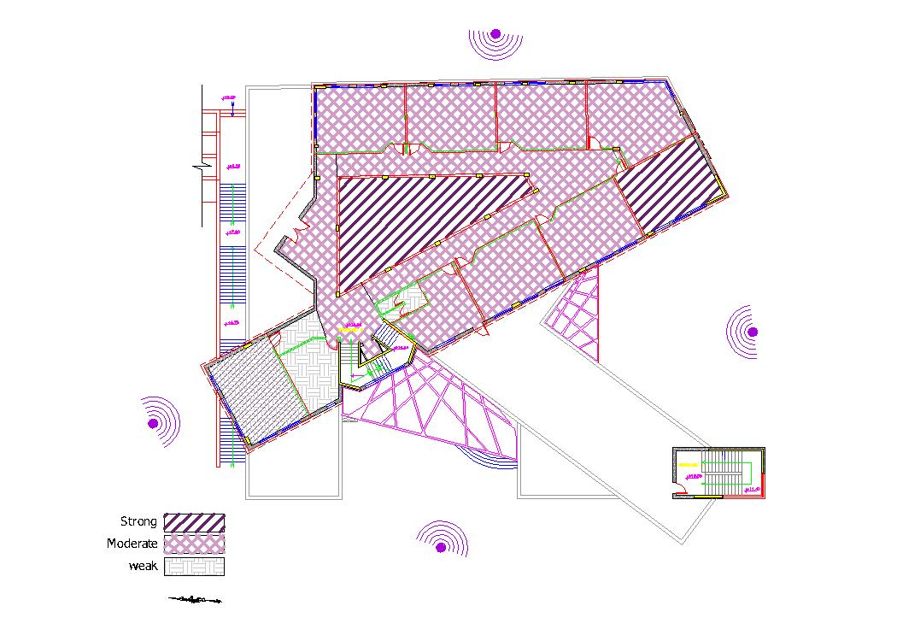
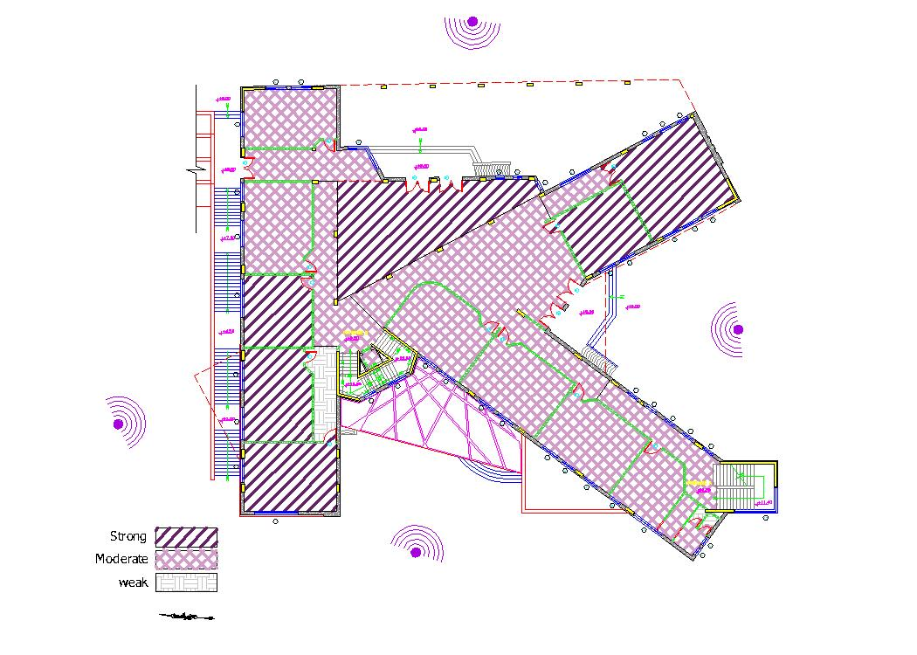
Architectural Aspects :
Noise analysis on floors:
First floor Plan
Ground floor Plan

Slide 25
Architectural Aspects :
Modifications:
Function | Actuel Area (m²) | Standard area (m²) |  | Check
Administrative
Principle office | 24.5 | 20-30 | ok
Secretary | 14.5 | 20-24 | Not ok
meeting room | 39.17 | 80-85 | Not ok
social guidance | 26 | 20 | ok
Services
First Aid | 16.5 | 20 | ok
Reception | 82.5 | 25 | ok
Multipurpose hall | 89.21 | 90 | ok
Canteen | 21.19 | 40-60 | Not ok
Kitchens | 23.5 | *** | ok
Staff W.Cs | 31.9 | 15 | ok
Store | 17.9 | *** | ok
*Student W.Cs | 84.225 | *** | Not ok
Educational Spaces
Classroom 1 | 39.36 | 45 | Not ok
Classroom 2 | 35.88 | 45 | Not ok
Classroom 3 | 42.1 | 45 | ok
Classroom 4 | 42.21 | 45 | ok
Classroom 5 | 48.45 | 45 | ok
Classroom 6 | 46.6 | 45 | ok
Classroom 7 | 46.1 | 45 | ok
Classroom 8 | 51.78 | 45 | ok
Classroom 9 | 45.82 | 45 | ok
Function | Actuel Area (m²) | Standard Area (m²) | Check
Classroom 11 | 44.6 | 45 | ok
Classroom 12 | 38.2 | 45 | Not ok
Classroom 13 | 39.8 | 45 | Not ok
Classroom 14 | 46.1 | 45 | ok
Classroom 15 | 46.25 | 45 | ok
Classroom 16 | 48.2 | 45 | ok
Classroom 17 | 47.3 | 45 | ok
Classroom 18 | 45.82 | 45 | ok
Classroom 19 | 45.8 | 45 | ok
Classroom 20 | 49.1 | 45 | ok
Classroom 21 | 45 | 45 | ok
Classroom 22 | 45.23 | 45 | ok
Classroom 23 | 45.23 | 45 | ok
**Library | 106.16 | 50-70 | Not ok
Science lab | 51.75 | 70-80 | Not ok
Computer lab | 46.6 | 40.5 | ok
Teacher's rooms | 89.22 | 24-50 | ok
Circulation
Staircase A | 24.55 | *** | ok
Staircase B | 23.8 | *** | ok
Area modification:

Slide 26
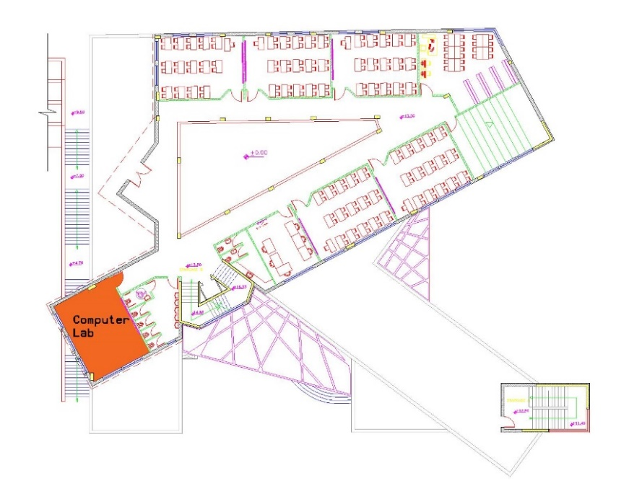
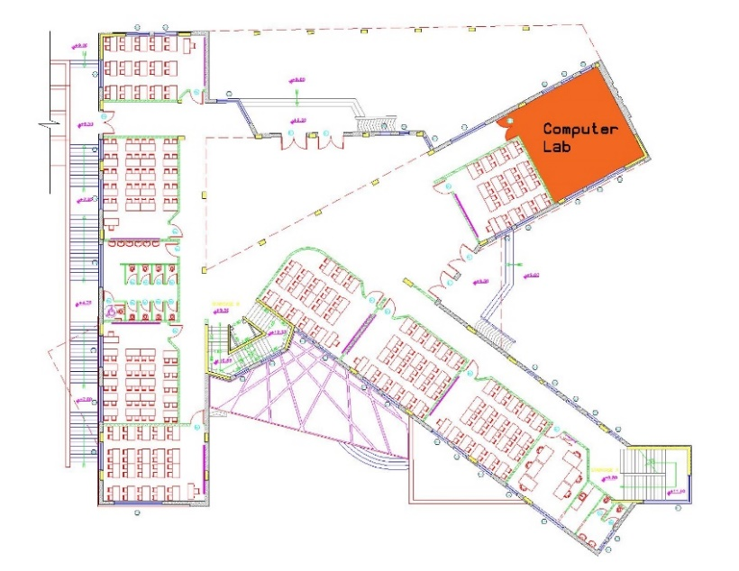
Architectural Aspects :
Modifications:
Room orientation:
The original location of computer lab
The modified location of computer lab

Slide 27
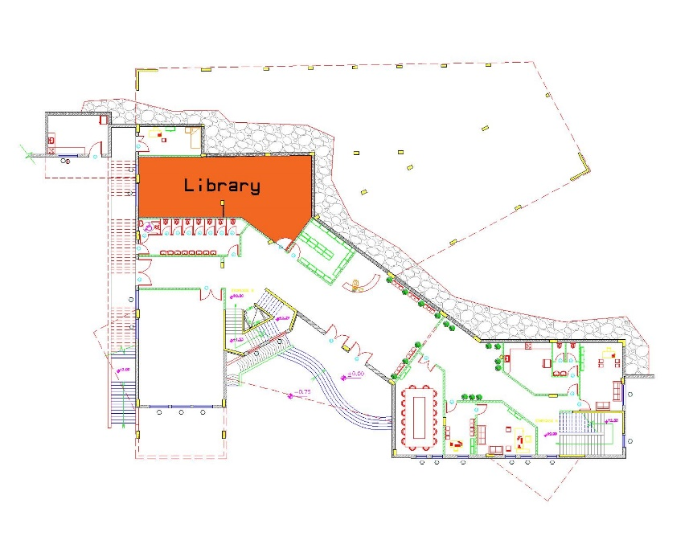
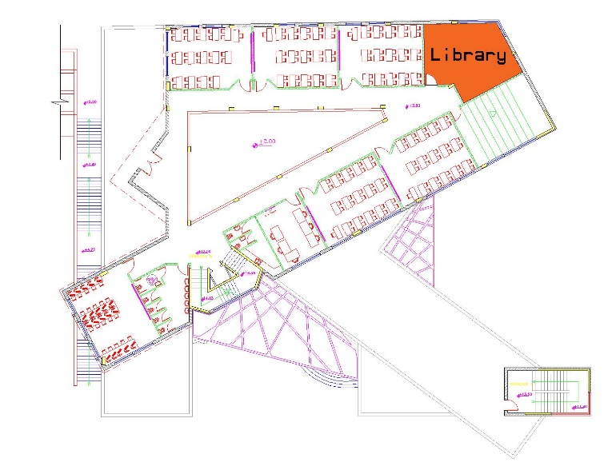
Architectural Aspects :
Modifications:
Room orientation:
The original location of the library
The modified location of the library

Slide 28
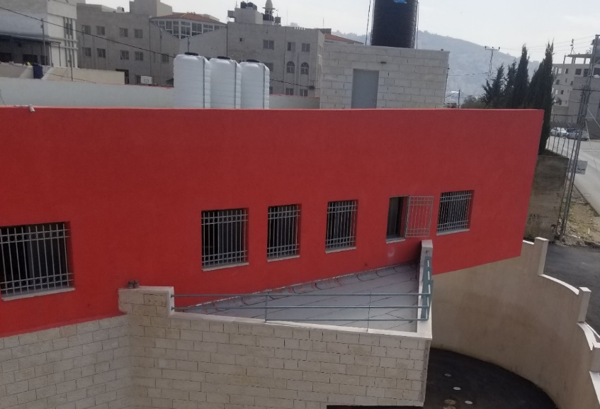
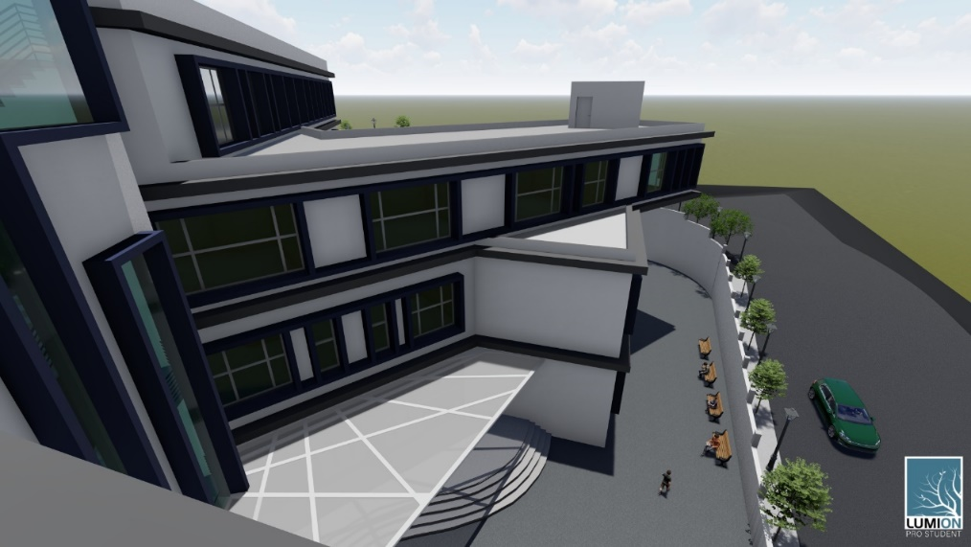
Architectural Aspects :
Modifications:
Glazing Area:
The area of glazing in each classroom should be 20% of classroom area, so the glazing area modified to achieve this requirement.
Glazing area before modification
Glazing area after modification

Slide 29
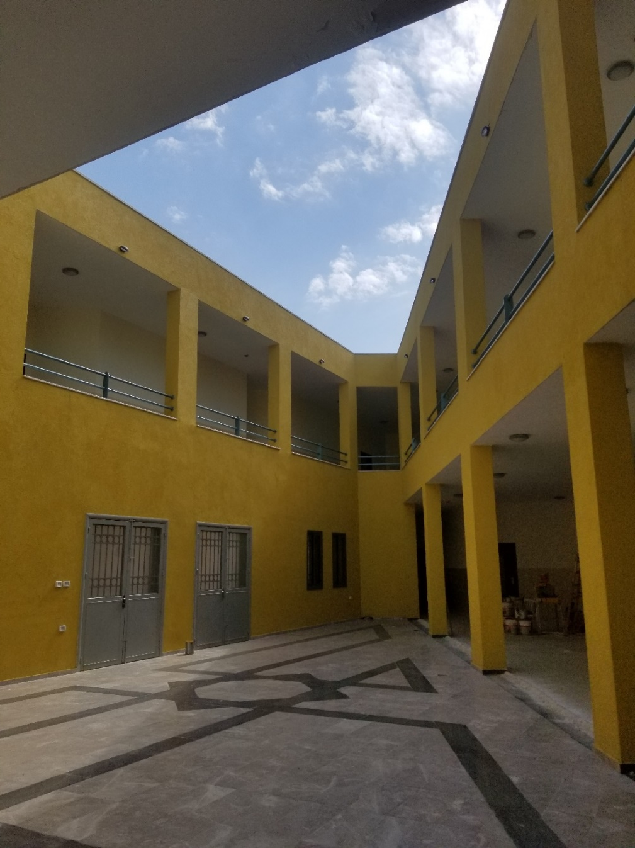
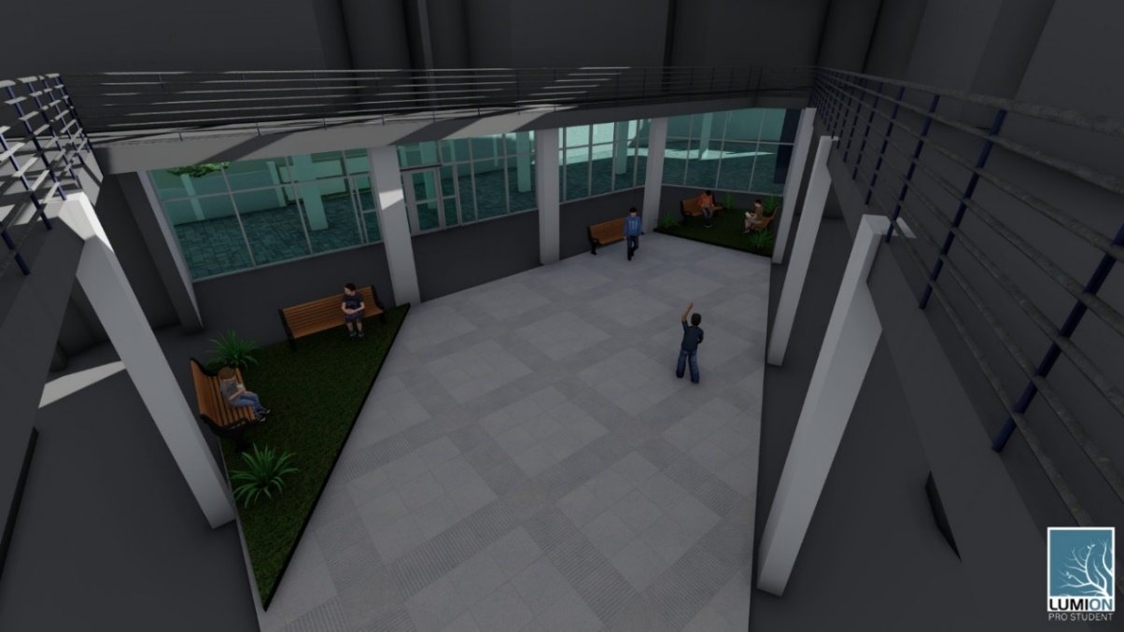
Architectural Aspects :
Modifications:
Green Area:
The modified court
Court before modification - As-built

Slide 30
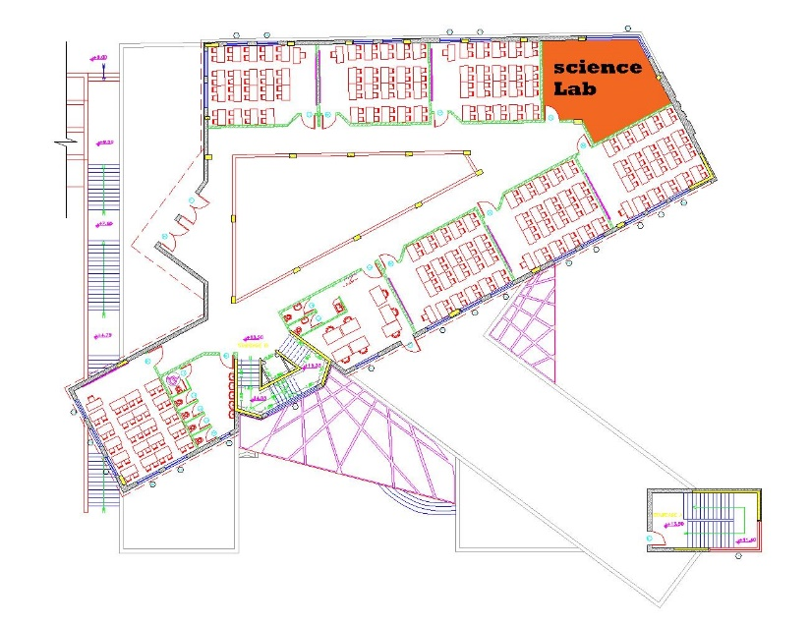
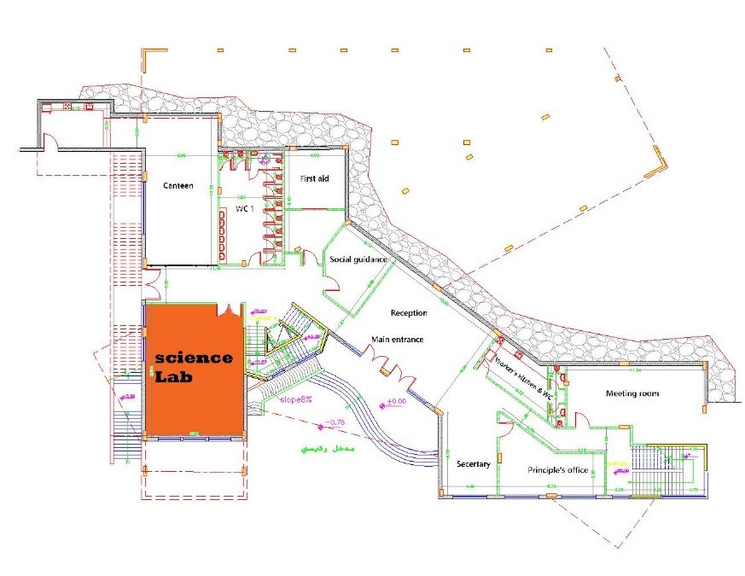
Architectural Aspects :
Modifications:
Safety Modifications:
Science lab is located in the first floor so it moved to second basement to make it near to exits in case any hazard occurred.
The original location of science lab
The modified location of science lab

Slide 31
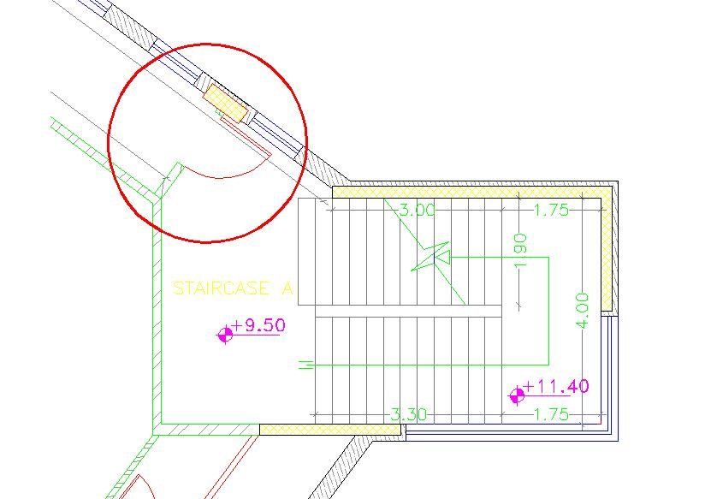
Architectural Aspects :
Modifications:
Safety Modifications:
stair case A modified to work as an emergency staircase by adding insulation to its walls and make emergency doors in each floor.

Slide 32
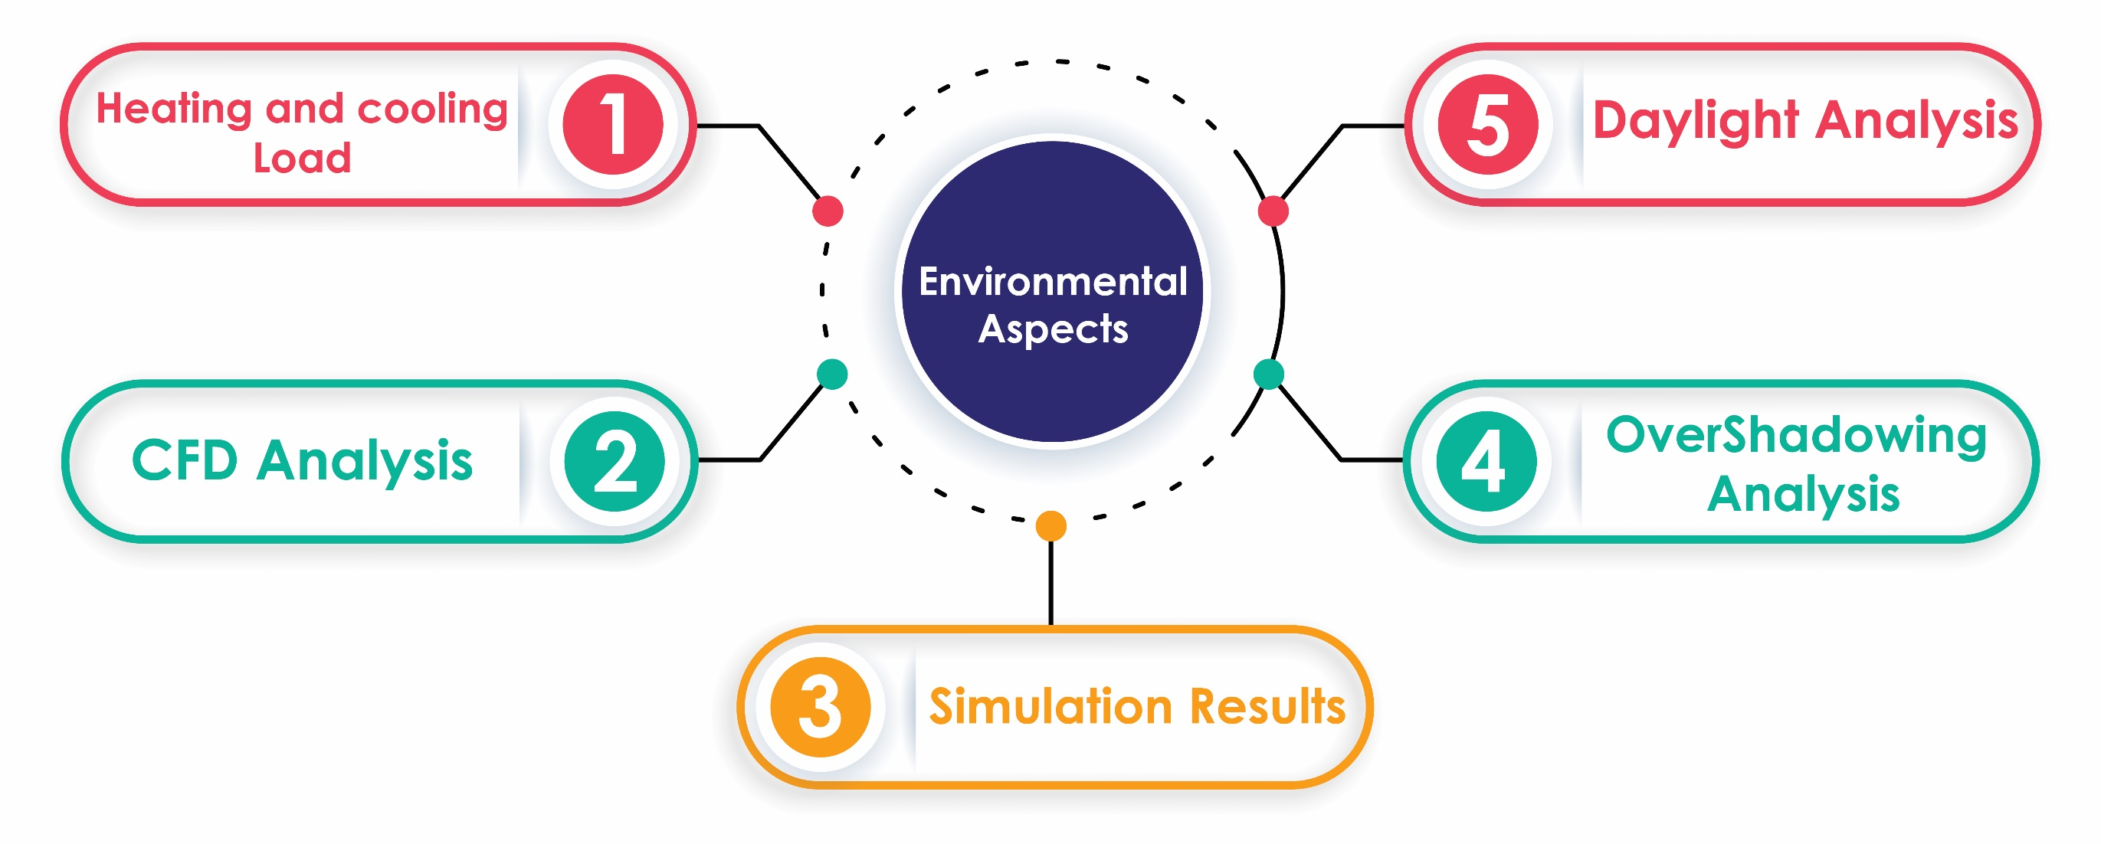
Environmental Aspects :

Slide 33
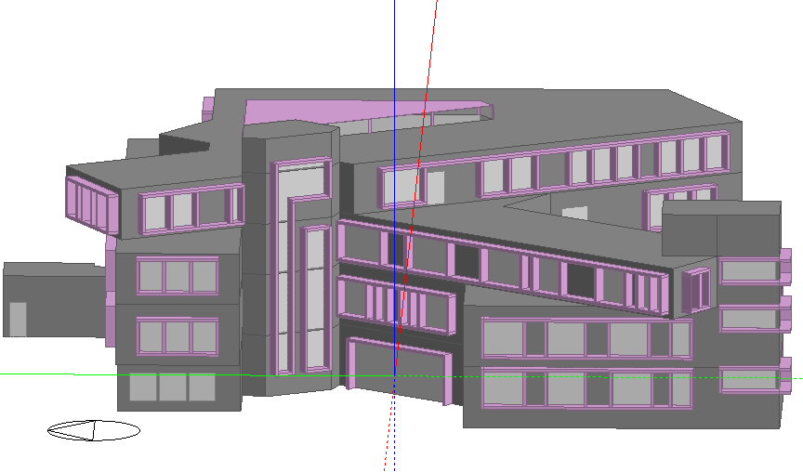
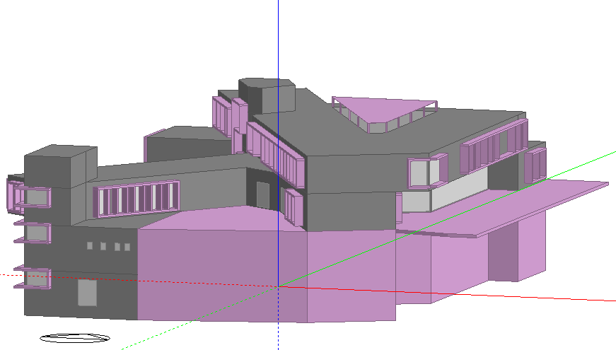
Environmental Aspects :
Design Builder Modeling:

Slide 34
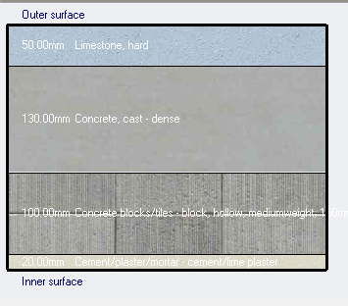
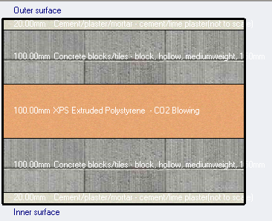
Environmental Aspects :
HVAC System ( Heating and Cooling )
Construction Layers for External Layers:
Some modifications were made to the main layers that formed the external walls and adding some types of insulation materials with certain thicknesses to make the wall energy efficient and to decrease the amount of thermal conductivity.
The U-value is equal 0.287 (W/m2.K) which is less than 0.5 (W/m2.K) so the U-value is efficient.
Wall Layers and U-Value before modification
Wall Layers and U-Value after modification

Slide 35
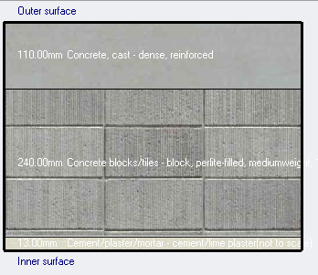

Environmental Aspects :
HVAC System ( Heating and Cooling )
Construction Layers for Flat Roof Layers:
Some modifications were made to the main layers that formed the flat roof and adding some types of insulation materials with certain thicknesses to make the flat roof energy efficient and to decrease the amount of thermal conductivity.
As shown on the figure above, the U-value is equal 0.354 (W/m2.K) which is less than 0.4 (W/m2.K) so the U-value is efficient.
Flat Roof Layers and U-Value before modification
Flat Roof Layers and U-Value after modification

Slide 36


Environmental Aspects :
HVAC System ( Heating and Cooling )
Layers for Glazing Area and Windows :
Some modifications were made to the main layers that formed the glazing area and adding more layers to make the glazing area and window energy efficient and to decrease the amount of thermal conductivity.
Glazing Layers and U-Value before modification
Glazing Layers and U-Value before modification

Slide 37


Environmental Aspects :
HVAC System ( Heating and Cooling )
Lighting System :
Lighting system has an impact on heating and cooling values by the amount of radiant heat which affected by lamp type, luminaire fixation, power density and control system.
To reduce the values of heating and cooling, the type of lamp used is LED with linear control, this type increases the efficiency and reduce the energy consumption.
Lighting system before modification
Lighting system after modification

Slide 38


Environmental Aspects :
HVAC System ( Heating and Cooling )
Shading System:
Shading system affect the amount of solar insolation fallen on spaces, so the heating and cooling load values will change according to shading system design so two techniques used in the building as shown below:
Polycarbonate coverage for the court.
Alcubond cantilever around all sides of the windows, it used to achieve architectural and environmental purposes
Polycarbonate Coverage for court
Alcubond cantilever around windows

Slide 39
Environmental Aspects :
HVAC System ( Heating and Cooling )
Depending on modifications and shading systems, a comparison between heating and cooling load before and after modification as shown in the tables below:

Slide 40


Environmental Aspects :
CFD Analysis:
External CFD Analysis:
External CFD Analysis
CFD analysis for court

Slide 41


Environmental Aspects :
CFD Analysis:
Internal CFD Analysis:
Internal CFD analysis in B2
Internal CFD analysis in B1

Slide 42


Environmental Aspects :
CFD Analysis:
Internal CFD Analysis:
Internal CFD analysis in GF
Internal CFD analysis in FF

Slide 43


Environmental Aspects :
Simulation Results:
After heating and cooling design and all modifications on construction, lighting and HVAC system, a comparison between simulation results before and after modifications as shown :
Energy Per Building Area (kWh/m²) before modification
Energy Per Building Area (kWh/m2) after modification

Slide 44


Environmental Aspects :
Simulation Results:
The total uncomfortable hours before modification from 1-Jan to 31-Dec is = 1082 hrs.
The total uncomfortable hours after modification from 1-Jan to 31-Dec is = 644 hrs, it noticed that a large drop in total uncomfortable hours because multiple modifications were done on the building.
Total uncomfortable hours before modification
Total uncomfortable hours after modification

Slide 45

Environmental Aspects :
Simulation Results:
PMV Analysis:
PMV is a predict mean value of votes to get an indication of the occupancy satisfaction about thermal feeling, the value of PMV should be between -0.5 to 0.5 as shown in the figure:

Slide 46


Environmental Aspects :
Overshadowing analysis:
This analysis done in two specific times at 9:00 am and 12:00 pm for both summer (21-June) and winter (21-Dec) to study the effect of surrounding building and the building itself in terms of entrances and playground.
overshadowing analysis before modifications - 9:00 am - winter case
overshadowing analysis before modifications - 9:00 am - summer case

Slide 47


Environmental Aspects :
Overshadowing analysis:
overshadowing analysis before modifications – 12:00 pm- winter case
overshadowing analysis before modifications - 12:00 pm- summer case

Slide 48


Environmental Aspects :
Overshadowing analysis:
overshadowing analysis after modifications - 9:00 am - winter case
overshadowing analysis after modifications - 9:00 am - summer case

Slide 49


Environmental Aspects :
Overshadowing analysis:
overshadowing analysis after modifications – 12:00 pm- winter case
overshadowing analysis after modifications - 12:00 pm- summer case

Slide 50

Environmental Aspects :
Daylight Factor:
In this section daylight factor analysis has done on all the year ( 1/Jan to 31/ Dec ) to study how much of natural daylight enter to spaces through glazing area so it minimize the consumption of electricity and it also make occupancy feel comfortable in spaces.
Changing eastern entrance to glazing :
Court is located in the middle of the school and it should enter much natural light to illuminate the corridors and open areas ,so to improve it the eastern entrance modified to a glazing area so it allow to get more amount of natural light.

Slide 51


Environmental Aspects :
Daylight Factor:
Daylight for Ground floor - After modification
Daylight on Ground floor - Before modification

Slide 52

Environmental Aspects :
Daylight Factor:
Enlarge windows:
By enlarging windows area, the amount of daylight will increase effectively and light up large area unlike small glazing area, so the modification was to make bigger windows with shading frame to increase lighting and decrease solar radiation.

Slide 53


Environmental Aspects :
Daylight Factor:
Enlarge windows:
Daylight for First floor - After modification
Daylight for First floor - Before modification

Slide 54

Environmental Aspects :
Daylight Factor:
On the other hand, floors underground such as first and second floors are not exposed to direct sun so the amount is few and negligible so artificial light is vital in these floors to illuminate corridors and confined areas

Slide 55

Structural aspects
the structural design system used for this School building is a two way ribbed slab system, And Isolated footing
.

Slide 56
Structural aspects
This structural design is done by using the following codes:
- ACI 318-11 for reinforced concrete structural design
-ASCE 7 2010 for load combinations
- UBC – 97 for earthquake design

Slide 57
Structural aspects
Design data:
Concrete strength for all structural member f’_{c}=28 mpa.
Steel yield strength f_{y}=420 mpa.
Bearing capacity for soil = 400kN/m²

Slide 58
Structural aspects
Loads
Gravity loads
Live Loads
Superimposed loads
Dead loads
Lateral loads

Slide 59
Table 4 : Structural loads
Structural aspects
Live Loads:
School | Load (KN/N) | Concentrated load (KN)
Class room | 1.92 | 4.45
Corridor above first floor | 3.83 | 4.45
First floor corridors | 4.79 | 4.45

Slide 60
Structural aspects
Lateral loads:
The city of structure is Nablus.
The seismic zone factor. Z=0.2.
The soil profile is type SD.
The acceleration seismic coefficient Ca=0.2
The velocity seismic coefficient Cv=0.2
The Seismic importance factor is 1.
The structural design type is intermediate, R=5.5

Slide 61
Structural aspects
Materials
Reinforced concrete
Property | Value
Compressive strength, fc ( MPa ) | 24
Modulus of elasticity, Ec ( GPa ) | 23
Unit weight (kN/m³ ) | 25
Steel reinforcement
Property | Value
Yielding strength, fy ( MPa ) | 420
Modulus of elasticity, Es ( GPa ) | 200

Slide 62
Structural aspects
Materials
Non – structural elements
Material | Ɣ in kN/m³
Blocks | 12
Filling Materials | 18
Tiles | 26
Plaster | 23
Aggregate | 13
Concrete Mortar | 23
Masonry Stone | 30

Slide 63

Structural aspects
Column distributed for Basement 2 and Basement 1

Slide 64

Structural aspects
Column distributed for Ground floor

Slide 65

Structural aspects
Column distributed for First floor

Slide 66

Structural aspects
Beams distributed for Basement 2

Slide 67

Structural aspects
Beams distributed for Basement 1

Slide 68

Structural aspects
Beams distributed for Ground floor

Slide 69

Structural aspects
Beams distributed for First floor

Slide 70

Project modeling
1. Bring the layout of the project from AutoCAD architectural drawing.
2. Define the materials used in the building (concrete and steel).
3. Define element sections of the structure with their suitable modifiers.
4. Define area section (slabs and shear walls) with their suitable modifiers.
5. Define load patterns on the structure, such as Dead, Superimposed and live loads.
6. Define load combinations according to the code for analysis and design.
7. Draw the structural elements (sections) and slabs (area sections).
8. Assign the loads ( except own weight -dead- ) on structural elements and slabs according to the values of superimposed , and live loads.
9. And then make the checks!!

Slide 71
Structural aspects
Stiffness modifiers
Slabs 0.35
Beams 0.35
Columns and shear wall 0.7

Slide 72
Structural aspects
ETABS Model Checks
Compatibility check
Equilibrium check
Stress strain check
Deflection check
Period check
Drift Check
Base shear check

Slide 73

Structural aspects
Compatibility check
The whole structural elements move as one body

Slide 74
Structural aspects
Equilibrium check
This check done for Dead, SID and Live load within difference less than 5 %.
Load | Hand calculation | ETABS | %Difference | < 5%
Live | 15729.15 | 15705.63 | 0.14% | OK!
SID | 18479.81 | 18446.59 | 0.18% | OK!
Dead | 42879.37 | 41739.29 | 2.73% | OK!

Slide 75

Structural aspects
1-stress strain check for column
Axial force | Hand calculation | ETABS | %Difference | < 10%
Slab | 558 | - | - | -
Beams | 412.36 | - | - | -
Column | 108 | - | - | -
Total | 1078.456 | 1029.1384 | 4.81% | OK!

Slide 76

Structural aspects
2-stress strain check for beam
Hand calculation | ETABS | %Difference | < 10%
228.10 | 216.8 | 5.21% | OK!

Slide 77

Structural aspects
3-stress strain check for slab
Hand calculation | ETABS | %Difference | < 10%
76.3154 | 72 | 5.99% | OK!

Slide 78

Structural aspects
Deflection check
From ETABS = 18.75 mm
Max. allowable Deflection =34.16 mm

Slide 79

Structural aspects
Period check
T manual =Ct *(Hn) ^3/4.
Ct=0.0488.
Hn : Building height = 20.5m.
T manual =0.47 sec.
T manual = 1.4 * .47= 0.658sec.
T from ETABS shall be <= 1.4 * T hand calculation.
period time = 0.373second ---- it’s OK!

Slide 80
Structural aspects
Drift Check
The design story drift (Δ) shall not exceed the allowable story drift ( Δa) as obtained from Table 12.12-1 in ASCE 7-10 for any story which is ≤ 0.015hx.

Slide 81
Structural aspects
Drift Check
The displacement of each floor in both direction X and Y has to be less than delta limit. The delta limit
from the table below is less than Standard
Story | Height | Dis-x | Dis-Y | Drift-X | Drift- Y | Delta-X | Delta-Y | Delta Limit | Comment
0 | - | - | - | - | - | - | - | - | -
1 | 4400 | 1.479 | 0.241 | 1.479 | 0.241 | 5.69415 | 0.92785 | 66 | OK!
2 | 4400 | 0.353 | 0.632 | 1.832 | 0.391 | 7.0532 | 1.50535 | 66 | OK!
3 | 3650 | 0.419 | 0.827 | 0.066 | 0.195 | 0.2541 | 0.75075 | 73 | OK!
4 | 3650 | 0.788 | 1.473 | 0.369 | 0.646 | 1.42065 | 2.4871 | 73 | OK!
5 | 3000 | 0.769 | 1.592 | 1.557 | 0.119 | 5.99445 | 0.45815 | 60 | OK!

Slide 82

Structural aspects
Base shear check
Direction | period | V manual | Vetabs | error
X | 0.373 | 4356.35 | 4248.56 | 2.54%
Y | 0.268 | 4356.35 | 4248.56 | 2.54%
Error is less than 5% so its OK!

Slide 83

Structural aspects
Structural elements Design

Slide 84


Structural aspects
Checking design members:
Basement 1
Basement 2

Slide 85


Structural aspects
Checking design members:
Ground floor
First Floor

Slide 86

Structural aspects
Structural elements Design
1. Slabs

Slide 87

Structural aspects
Structural elements Design
1. Slabs

Slide 88


Structural aspects
Structural elements Design
2. Beams
B2 Beams
B1 Beams

Slide 89


Structural aspects
Structural elements Design
2. Beams
GF Beams
F1 Beams

Slide 90


Structural aspects
Structural elements Design
2. Beams

Slide 91

Structural aspects
Structural elements Design
2. Beams

Slide 92

Structural aspects
Structural elements Design
3. Columns

Slide 93

Structural aspects
Structural elements Design
3. Columns

Slide 94


Structural aspects
Structural elements Design
4. Shear walls

Slide 95


Structural aspects
Structural elements Design
5.Footings

Slide 96


Structural aspects
Structural elements Design
6. Stairs

Slide 97

Electro-Mechanical Aspects

Slide 98



Electro-Mechanical Aspects
Artificial Lighting Design:
Meeting Room:
Ambient Light Catalogue
Task Light Catalogue
Accent Light Catalogue

Slide 99



Electro-Mechanical Aspects
Artificial Lighting Design:
Meeting Room:
Meeting Table Result
Accent Light Catalogue
General meeting room result

Slide 100


Electro-Mechanical Aspects
Artificial Lighting Design:
Meeting Room:
UGR Calculation objects plan
UGR Results

Slide 101


Electro-Mechanical Aspects
Artificial Lighting Design:
Meeting Room:

Slide 102


Electro-Mechanical Aspects
Artificial Lighting Design:
Classroom:
Luminaire used in Classroom Catalogue
Classroom Results

Slide 103


Electro-Mechanical Aspects
Artificial Lighting Design:
Classroom:
UGR Calculation objects plan
UGR Result

Slide 104

Electro-Mechanical Aspects
Artificial Lighting Design:
Classroom:

Slide 105





Electro-Mechanical Aspects
Artificial Lighting Design:
Computer Lab:
UGR Calculation objects plan
Computer Lab Results

Slide 106


Electro-Mechanical Aspects
Artificial Lighting Design:
Computer Lab:
UGR Result

Slide 107


Electro-Mechanical Aspects
Artificial Lighting Design:
Luminaires Distribution:
Luminaires Distribution in B2
Luminaires Distribution in B1

Slide 108



Electro-Mechanical Aspects
Artificial Lighting Design:
Luminaires Distribution:
Luminaires Distribution in GF
Luminaires Distribution in FF

Slide 109


Electro-Mechanical Aspects
HVAC System Design:
According to the simulation results on Design builder software the total heating load is equal 74.8 kW and the total cooling load is equal 105.11 kW. The system was designed on cooling load because it’s the higher value.
Outdoor and indoor units Catalogue

Slide 110




Electro-Mechanical Aspects
HVAC System Design:
Slot Diffuser Catalogue
Ventilation Fan catalogue
600x600 Diffuser Catalogue
300x300 Exhaust catalogue

Slide 111


Electro-Mechanical Aspects
HVAC System Design:
HVAC Distribution in B2
HVAC Distribution in B1

Slide 112



Electro-Mechanical Aspects
HVAC System Design:
HVAC Distribution in GF
HVAC Distribution in FF

Slide 113

Electro-Mechanical Aspects
HVAC System Design:

Slide 114


Electro-Mechanical Aspects
Electrical Power Design:
Sockets Distribution:
Socket Distribution in B2
Socket Distribution in B1

Slide 115



Electro-Mechanical Aspects
Electrical Power Design:
Sockets Distribution:
Socket Distribution in GF
Socket Distribution in FF

Slide 116
Electro-Mechanical Aspects
Electrical Power Design:
Drop Voltage:
Voltage Drop for normal power socket
Voltage Drop for special power socket
Resistance for Normal Load
Resistance wire (r) | maximum length (m) | wire area (m^2) | R (Ω)
1.68E-08 | 30 | 0.0000025 | 0.2016
Resistance for Special Load
Resistance wire (r) | maximum length (m) | wire area (m^2) | R (Ω)
1.68E-08 | 30 | 0.0000025 | 0.2016
Current for Normal Load
Power (watt) | Volt (v) | Factor | I load (Amp)
1000 | 220 | 0.9 | 5.1
Current for Special Load
Power (watt) | Volt (v) | Factor | I load (Amp)
1500 | 220 | 0.9 | 7.6
Drop Voltage for Normal Load
I load (Amp) | R (W) | Drop Voltage | Drop Voltage % | Check
5.1 | 0.2016 | 1.0 | 0. 46 | ok
Drop Voltage for Special Load
I load (Amp) | R (W) | Drop Voltage | Drop Voltage % | Check
7.6 | 0.2016 | 1.5 | 0.70 | ok
<5% so its ok

Slide 117

Electro-Mechanical Aspects
Electrical Power Design:
Distribution Boards Design:
DB | No. of sockets | Normal load |  | Special load | Lighting Load | Total power | I load | I C.B | I Cable | C.B | Cable IEC | Cable size | No. of power branches | No. of lighting branches
- | - | Watt | Watt | Watt | Watt | Watt | Amp | Amp | Amp | Amp | Amp | mm^2 | - | -
DBGa | 26 | 250 | 6500 | 1500 | 1414 | 4581.2 | 23.14 | 26.61 | 30.60 | 36 | 36 | 6 | 10 | 6
DBGb | 19 | 250 | 4750 | 1500 | 1239 | 3916.2 | 19.78 | 22.75 | 26.16 | 30 | 36 | 6 | 8 | 5
DBGa-UPS | 0 | 250 | 0 | 0 | 1188 | 950.4 | 4.80 | 5.52 | 6.35 | 10 | 16 | 2.5 | 0 | 8
DBGb-UPS | 0 | 250 | 0 | 0 | 1041 | 832.8 | 4.21 | 4.84 | 5.56 | 10 | 16 | 2.5 | 0 | 7
Distribution Boards Load Calculation for Ground Floor

Slide 118

Electro-Mechanical Aspects
Electrical Power Design:
Distribution Boards Design:
DB | No. of sockets | Normal load |  | Special load | Lighting Load | Total power | I load | I C.B | I Cable | C.B | Cable IEC | Cable size | No. of power branches | No. of lighting branches
- | - | Watt | Watt | Watt | Watt | Watt | Amp | Amp | Amp | Amp | Amp | mm^2 | - | -
DBB2a | 34 | 250 | 8500 | 1500 | 328 | 4312.4 | 21.78 | 25.05 | 28.80 | 30 | 36 | 6 | 12 | 6
DBB2b (3 phase) | 39 | 250 | 9750 | 3000 | 961 | 6693.8 | 33.81 | 38.88 | 44.71 | 50 | 50 | 10 | 14 | 6
DBLAB1 (3 phase) | 57 | 250 | 14250 | 1500 | 228 | 5957.4 | 30.09 | 34.60 | 39.79 | 40 | 50 | 10 | 19 | 6
DBB2a-UPS | 4 | 250 | 1000 | 4500 | 720 | 5376 | 27.15 | 31.22 | 35.91 | 36 | 44 | 10 | 2 | 7
DBB2a-UPS (Elevator C.B) | - | - | - | - | - | 4500 | 20.45 | 23.52 | 27.05 | 32 |  |  | - | -
DBB2b-UPS | 0 | 250 | 0 | 0 | 1070 | 856 | 4.32 | 4.97 | 5.72 | 10 | 16 | 2.5 | 2 | 7
Main Distribution Board
DB | Total power | I load | I C.B | I Cable | C.B | Cable size
- | Watt | Amp | Amp | Amp | Amp | mm^2
MDB ( 3 phase ) | 27695.6 | 76.93 | 88.47 | 101.74 | - | -
each phase | 9231.87 | 46.63 | 53.6194 | 61.662 | 66 | 16
Main distribution and first floor load calculation

Slide 119
Electro-Mechanical Aspects
Electrical Power Design:
Generator selection:
Backup system should work automatically when an electrical cut occurs, so a UPS system installed to feed selected luminaires, sockets and the elevator with enough power to work normally.
The total power that UPS must feed is 14125 watt
Reserve capacity = Total power * 0.25 = 14125 * 0.25 = 3531.25 watt
Generator size = Total power + Reserve capacity = 14125 + 3531.24 = 17656.25 watt
So the selected capacity for the generator is 20 kW 3 Phase

Slide 120


Electro-Mechanical Aspects
Fire alarm and Firefighting system:
Sample for detectors location
Sample for fire hose location

Slide 121


Electro-Mechanical Aspects
Fire alarm and Firefighting system:
Sample for extinguisher location
FM200 Suppression System

Slide 122


Electro-Mechanical Aspects
Fire alarm and Firefighting system:
Evacuation Plans:
Evacuation routes in B2
Evacuation routes in B1

Slide 123


Electro-Mechanical Aspects
Fire alarm and Firefighting system:
Evacuation Plans:
Evacuation routes in GF
Evacuation routes in FF

Slide 124

Electro-Mechanical Aspects
Water Supply System:
Tanks Capacity and Distribution:
Required water per day = 600 student * 18 L/day*student = 10800 L/Day
In Nablus city water pumped by municipality every 3 days, so enough water should save in tanks to serve for 3 days.
The total amount of water for each cycle = required water per day * 3 days = 10800 L/Day * 3 Days = 32400 L
Tanks with 2000 Liter capacity were used.
Total number of tanks needed in the school = 32400 L / 2000 L = 16.2 Tank
So 17 Royal tanks with 2000 L capacity were used

Slide 125

Electro-Mechanical Aspects
Water Supply System:
Tanks Capacity and Distribution:
Tanks Distribution on the Roof

Slide 126

Electro-Mechanical Aspects
Water Supply System:
Pipe Sizing for the whole group branches
Branch | Fixture type | No. of fixture | Load value | WSFU | Total WSFU | Demand gpm | PVC Horizontal Ꝋ | Horizontal Ꝋ | Vertical Ꝋ
T1-FF | Water closet | 7 | 5 | 35 | 55 | 30 | 3/4" | 1.5" | 2"
 | Lavatory | 8 | 2 | 16
 | Sink | 1 | 4 | 4
T1-GF | Water closet | 8 | 5 | 40 | 54 | 29 |  | 1.5"
 | Lavatory | 7 | 2 | 14
T1-B2 | Sink | 10 | 4 | 40 | 40 | 25 | 3/4" | 1.5"
T2-B1 | Water closet | 8 | 5 | 40 | 48 | 28 |  | 1.5" | 2"
 | Lavatory | 4 | 2 | 8
T2-B2 | Water closet | 9 | 5 | 45 | 61 | 33 |  | 1.5"
 | Lavatory | 6 | 2 | 12
 | Sink | 1 | 4 | 4
T3-GF | Water closet | 2 | 5 | 10 | 14 | 10 | 3/4" | 1" | 2"
 | Lavatory | 2 | 2 | 4
T3-B1 | Water closet | 10 | 5 | 50 | 64 | 35 |  | 1.5"
 | Lavatory | 7 | 2 | 14
T3-B2 | Water closet | 2 | 5 | 10 | 18 | 14 |  | 1.25"
 | Lavatory | 2 | 2 | 4
 | Sink | 1 | 4 | 4
Water Supply Pipes Sizing:
Sample for PVC horizontal branches distribution

Slide 127

Electro-Mechanical Aspects
Water Supply System:
Pump Selection:
Branch |  | Pressure without losses (psi) | Losses (psi) | Pressure with Losses (psi) | Check
T1 | B2 | 25.73 | 10.34 | 15.39 | ok
 | GF | 13.23 | 9.22 | 4.01 | not ok
 | FF | 8.05 | 9.36 | -1.31 | not ok
T2 | B2 | 25.73 | 5.06 | 20.67 | ok
 | B1 | 19.485 | 4.61 | 14.875 | ok
T3 | B2 | 20.55 | 2.48 | 18.07 | ok
 | B1 | 15.36 | 2.63 | 12.73 | ok
 | GF | 8.05 | 1.25 | 6.8 | not ok
water pump catalogue for T1 branch

Slide 128


Electro-Mechanical Aspects
Water Supply System:
Pump Selection:
water pump catalogue for T3 branch
water pump catalogue for firefighting system

Slide 129


Electro-Mechanical Aspects
Water Supply System:
Hot Water Design:
The total amount of required hot water = No. of students * Required hot water per day
= 570 Student * 2.3 L/Day*Student = 1311 L / Day.
So use 5 electric boilers with 125 L capacity for students W.C and 6 electric boilers of 50 L capacity for teachers’ rooms
125 L Electric Boiler catalogue
50 L Electric Boiler catalogue

Slide 130

Stack No. | Floor | Type of unit | No pf units | DFU | Total DFU | Horizontal Drains Ꝋ | Stack Ꝋ
Stack 1 | B1 | W.C | 8 | 4 | 32 | 4" 1% | 4"
 |  | Lavatory | 4 | 1 | 4 | 2" 2%
 | B2 | W.C | 9 | 4 | 36 | 4" 1%
 |  | Lavatory | 7 | 1 | 7 | 2" 2%
Sum |  |  |  |  | 79
Stack 2 | GF | W.C | 8 | 4 | 32 | 4" 1% | 4"
 |  | Lavatory | 7 | 1 | 7 | 2" 2%
 |  | Floor trap | 1 | 3 | 3 | 2" 2%
 | B2 | Sink | 10 | 2 | 20 | 2" 2%
Sum |  |  |  |  | 62
Stack 3 | FF | W.C | 5 | 4 | 20 | 4" 1% | 4"
 |  | Lavatory | 6 | 1 | 6 | 2" 2%
 |  | Floor trap | 1 | 3 | 3 | 2" 2%
 | GF | Floor trap | 2 | 3 | 6 | 2" 2%
 | B1 | Floor trap | 2 | 3 | 6 | 2" 2%
Sum |  |  |  |  | 41
Stack 4 | FF | W.C | 2 | 4 | 8 | 4" 1% | 4"
 |  | Lavatory | 2 | 1 | 2 | 2" 2%
 |  | Sink | 1 | 2 | 2 | 2" 2%
Sum |  |  |  |  | 12
Stack 5 | GF | W.C | 2 | 4 | 8 | 4" 1% | 4"
 |  | Lavatory | 2 | 1 | 2 | 2" 2%
Sum |  |  |  |  | 10
Stack 6 | FF | Floor trap | 1 | 3 | 3 | 2" 2% | 4"
 | GF | Floor trap | 1 | 3 | 3 | 2" 2%
 | B1 | W.C | 5 | 4 | 20 | 4" 1%
 |  | Lavatory | 5 | 1 | 5 | 2" 2%
 |  | Floor trap | 1 | 3 | 3 | 2" 2%
 | B2 | Floor trap | 1 | 3 | 3 | 2" 2%
Sum |  |  |  |  | 37
Stack 7 | B1 | W.C | 5 | 4 | 20 | 4" 1% | 4"
 |  | Lavatory | 2 | 1 | 2 | 2" 2%
 | B2 | W.C | 2 | 4 | 8 | 4" 1%
 |  | Lavatory | 2 | 1 | 2 | 2" 2%
Sum |  |  |  |  | 32
Electro-Mechanical Aspects
Drainage and Rain Water System:
Drainage Pipes Design:
Sample for drainage system design

Slide 131

Electro-Mechanical Aspects
Drainage and Rain Water System:

Slide 132

Electro-Mechanical Aspects
Drainage and Rain Water System:
Rain Water System Design:
This system aims to design correct drainage of rain water to avoid problems due to accumulation of the rainwater on roof, water seepage, stains and structural side effects

Slide 133


Electro-Mechanical Aspects
Vertical Transportation:
Elevator Selection:
Standard for Handicapped Elevator
Selected Elevator Catalogue

Slide 134



Electro-Mechanical Aspects
Acoustical Design:
STC for Internal Partition

Slide 135


Electro-Mechanical Aspects
Acoustical Design:
STC for External Walls
Where the outdoor background noise level is between 76 dBA and 80 dBA, then the OITC should be not less than 50

Slide 136


Electro-Mechanical Aspects
Acoustical Design:
IIC for Floor
IIC ratings for floor-ceiling assemblies above core learning spaces should be at least IIC-45 and preferably IIC-50 (measured without carpeting on the floor).

Slide 137

Electro-Mechanical Aspects
Acoustical Design:
RT60 for Classroom
Classroom | 0.6-0.8
FREQ. | TOTAL | SABINE | NOR-ER | MIL-SE
 | ABSPT. | RT(60) | RT(60) | RT(60)
63Hz | 12.602 | 1.25 | 0.78 | 1.19
125Hz | 10.428 | 1.39 | 0.96 | 1.35
250Hz | 12.673 | 0.93 | 0.88 | 0.90
500Hz | 26.449 | 0.62 | 1.01 | 0.46
1kHz | 49.201 | 0.35 | 0.74 | 0.15
2kHz | 50.698 | 0.32 | 0.67 | 0.13
4kHz | 42.957 | 0.36 | 0.67 | 0.21
8kHz | 40.382 | 0.31 | 0.52 | 0.21
16kHz | 38.879 | 0.31 | 0.50 | 0.22

Slide 138

Electro-Mechanical Aspects
Acoustical Design:
RT60 for Library
Recommended RT60 for library = 0.6 to 0.8
FREQ. | TOTAL | SABINE | NOR-ER | MIL-SE
 | ABSPT. | RT(60) | RT(60) | RT(60)
63Hz | 16.653 | 1.43 | 0.99 | 1.36
125Hz | 13.683 | 1.59 | 1.18 | 1.54
250Hz | 15.491 | 1.18 | 1.12 | 1.15
500Hz | 28.776 | 0.76 | 1.26 | 0.61
1kHz | 53.192 | 0.46 | 0.88 | 0.20
2kHz | 54.876 | 0.43 | 0.79 | 0.17
4kHz | 46.744 | 0.45 | 0.75 | 0.28
8kHz | 43.790 | 0.39 | 0.58 | 0.27
16kHz | 42.394 | 0.39 | 0.55 | 0.28

Slide 139


Electro-Mechanical Aspects
Acoustical Design:
Ease Modeling for Cafeteria
SPL

Slide 140


Electro-Mechanical Aspects
Acoustical Design:
Ease Results for Cafeteria
Total Sound pressure level Values on areas
Articulation Values on areas

Slide 141


Electro-Mechanical Aspects
Acoustical Design:
Ease Results for Cafeteria
Direct Sound pressure level Values on areas
Articulation index Values on areas

Slide 142

Integrated System:
B2 Integrated Plan :

Slide 143

Integrated System:
B1 Integrated Plan :

Slide 144

Integrated System:
GF Integrated Plan :

Slide 145

Integrated System:
FF Integrated Plan :

Slide 146

Quantity Surveying and Cost Estimation
The total cost for the school = 4,295,858 Nis, including material, labor and equipment cost. The table below show a brief summary for the main components of the project cost.
Item | Total Cost (NIS)
Earth Work | 114,900
Construction Work | 1,352,904
Finishes Work | 1,649,476
Electrical Work | 442,680
Mechanical Work | 735,898
Total Project Cost | 4,295,858

Slide 147

Thank you

