Slide 1





An-Najah National University
Faculty of Engineering
and Information Technology
Graduation Project 1
We Care

Slide 2
Group Members
Lubna Thaher
Rana Mara’beh
lubnathaher0@gmail.com
ranamaraabeh@gmail.com

Slide 3
CONTENTS
RESEARCH
IDEA
1
2
PROCESS
3
4
GOAL

Slide 4


01
RESEARCH
The reality of the elderly in Palestine and requirements of their care

Slide 5
RESEARCH
Percentage of the elderly
1
12% of elderly in Palestine, 40% suffer from disabilities
Provide needs
2
Great difficulty in accessing basic services
Health care
3
Negligence in the health care , difficult in contact with doctors
4
Physical condition
27% suffer from poverty ,that’s leads to neglect health side.

Slide 6
RESEARCH
Solution
Elderly not have most
needs
Build an app can be a solution
This app provides most needs in most areas

Slide 7
RESEARCH ABOUT SOLUTION
55%
agree
Satisfaction with the idea
23%
maybe
It’s send for the family which contain elderly.
satisfaction
22%
Not agree

Slide 8
02
IDEA
We care application

Slide 9


IDEA
For their needs
For their health
Online shopping page contains clothes , shoes, and other needs.
Doctors page contains number of doctors with a chat system to make any question.
For their events
For their manage
Events page contains a map with their location and a list of free event’s and the road.
Reminder page enable them to determine medicine time with notification system.

Slide 10
Provide needs
Health care
Like clothes ,shoes,
and physical needs.
Economic return
Ask the doctor any question at any time ,reminder and notification
Having shopping online and book an appointment in a doctor .

Slide 11
03
process
Build we care application

Slide 12
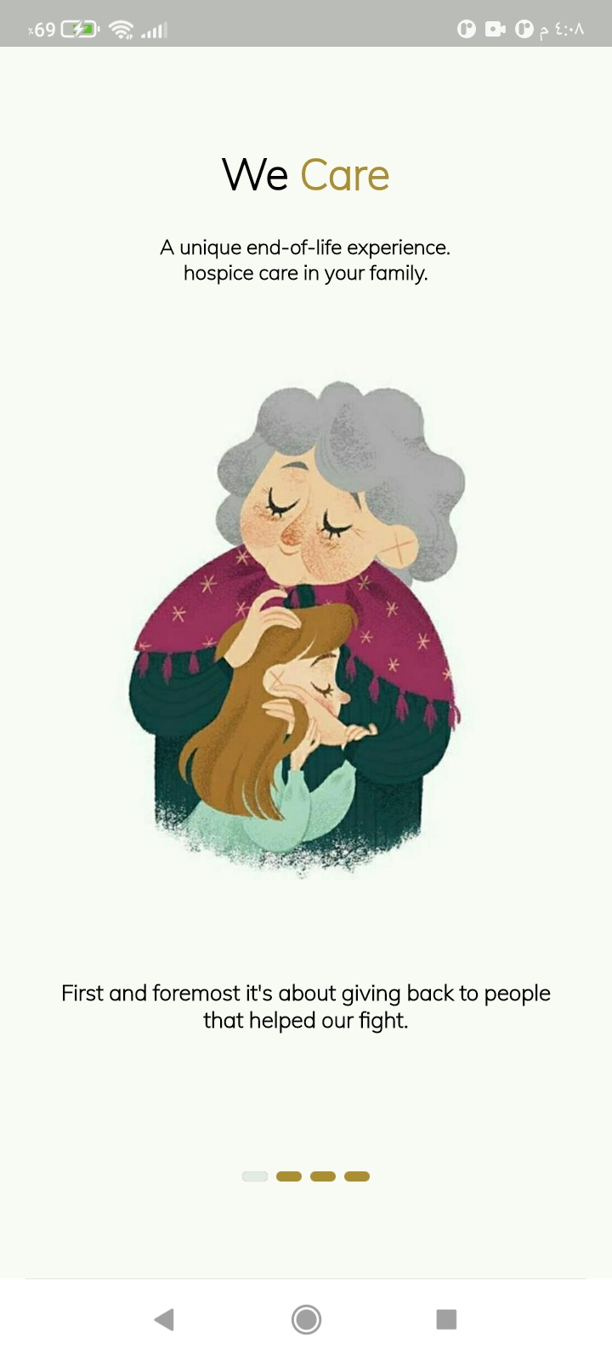
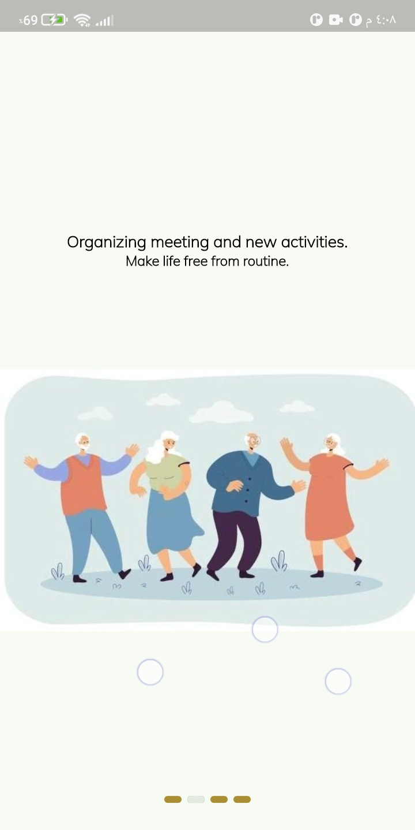
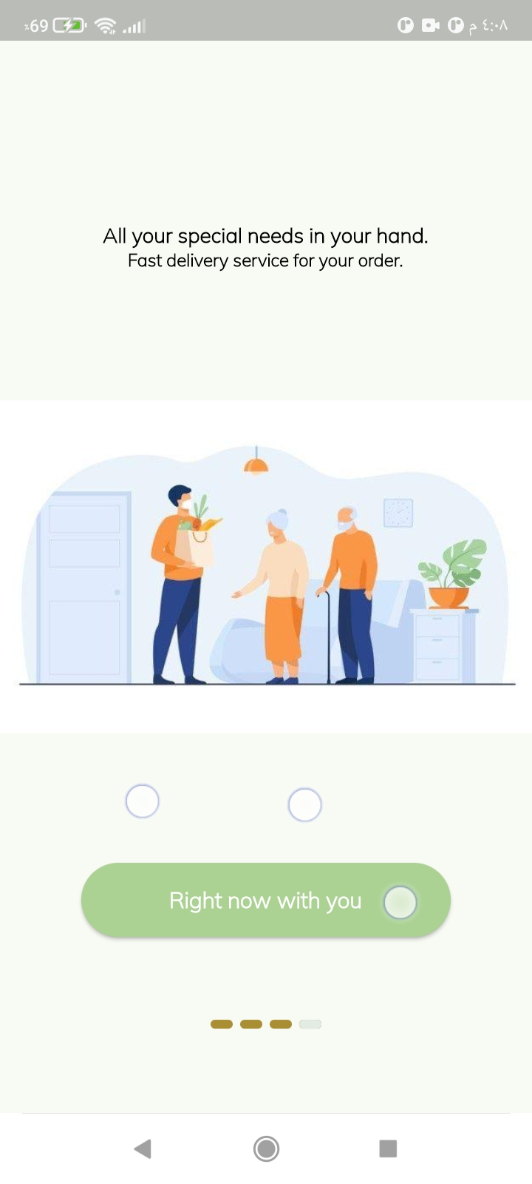
Introductory pages

Slide 13
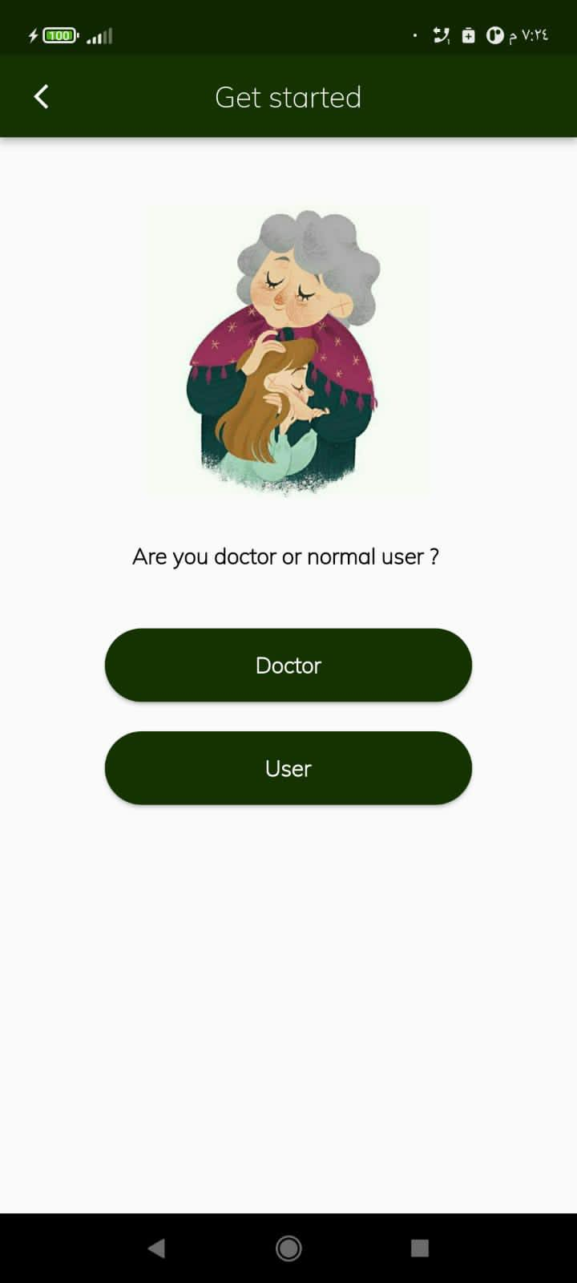
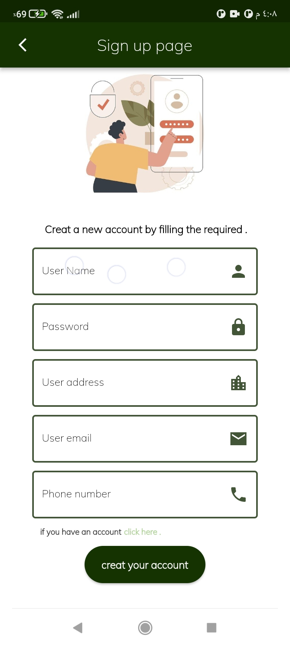

Sign up page
Choose user type.
Firstly we will choose a “user”.
Create new account in the app if the user doesn’t have an account.

Slide 14
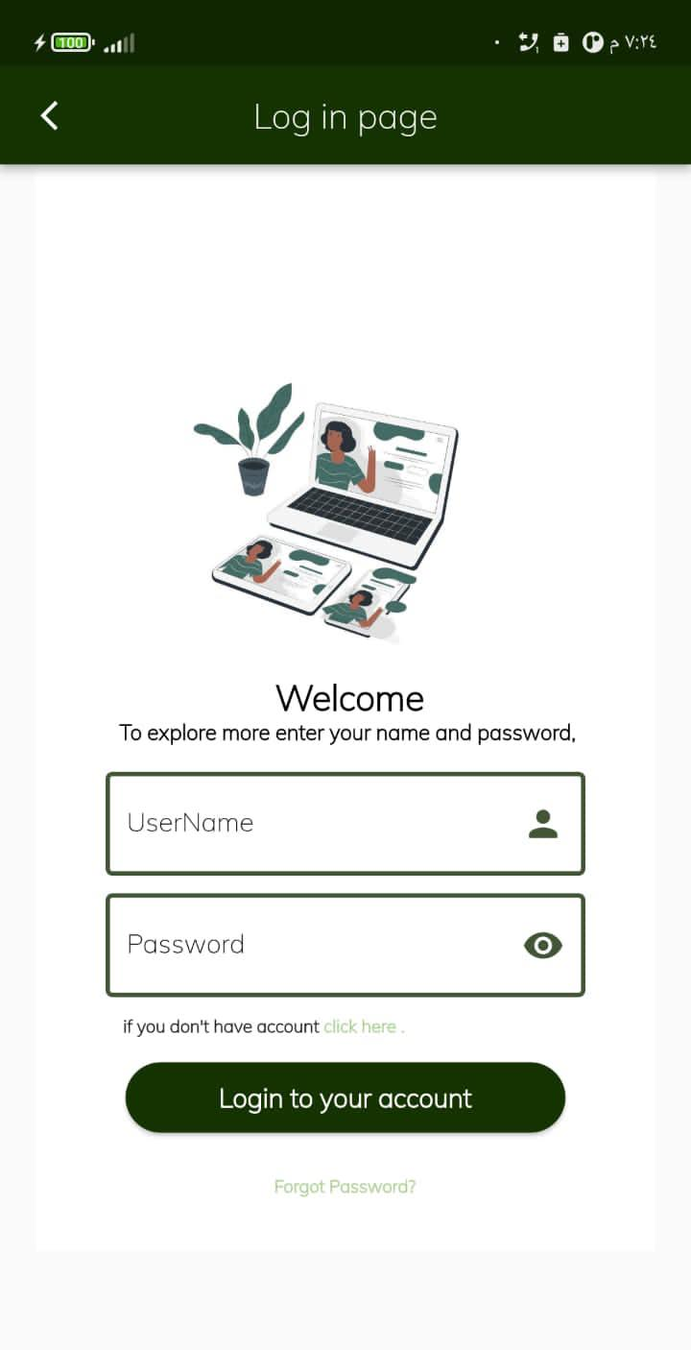
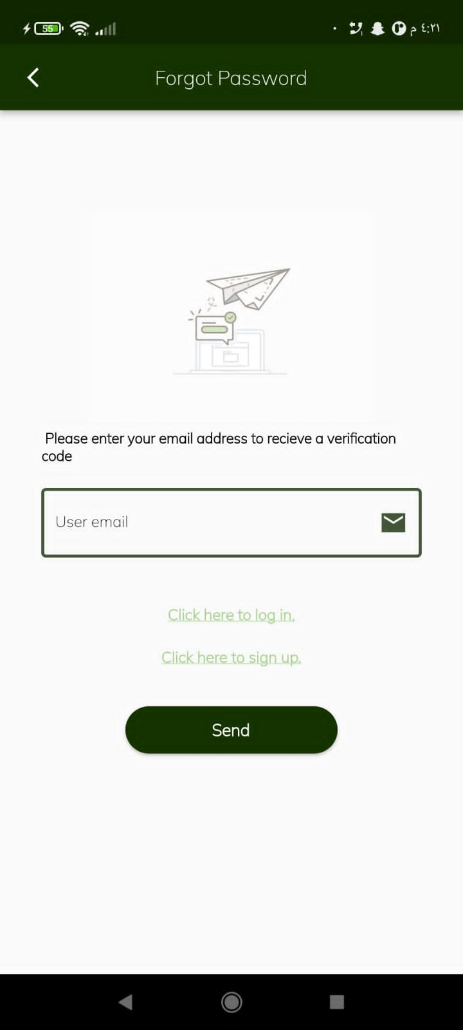

Log in and forgot password pages
If the user has an account, then log in.
Forgot password page
Disappear password
Forgot password

Slide 15
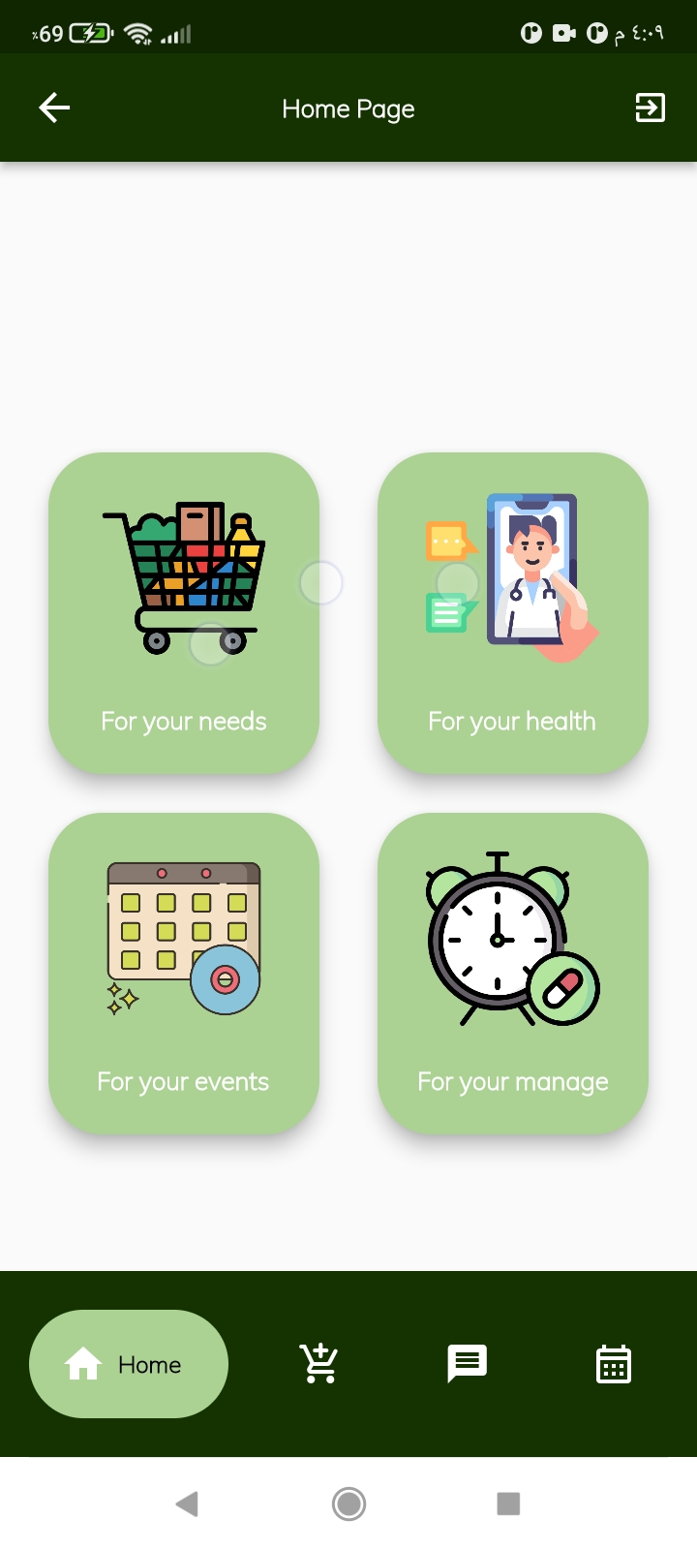



Home page
Log out.
Shopping online
Chatting with doctors
Event’s appointment
Medicine time
Order’s page
Chat’s
Event’s list

Slide 16


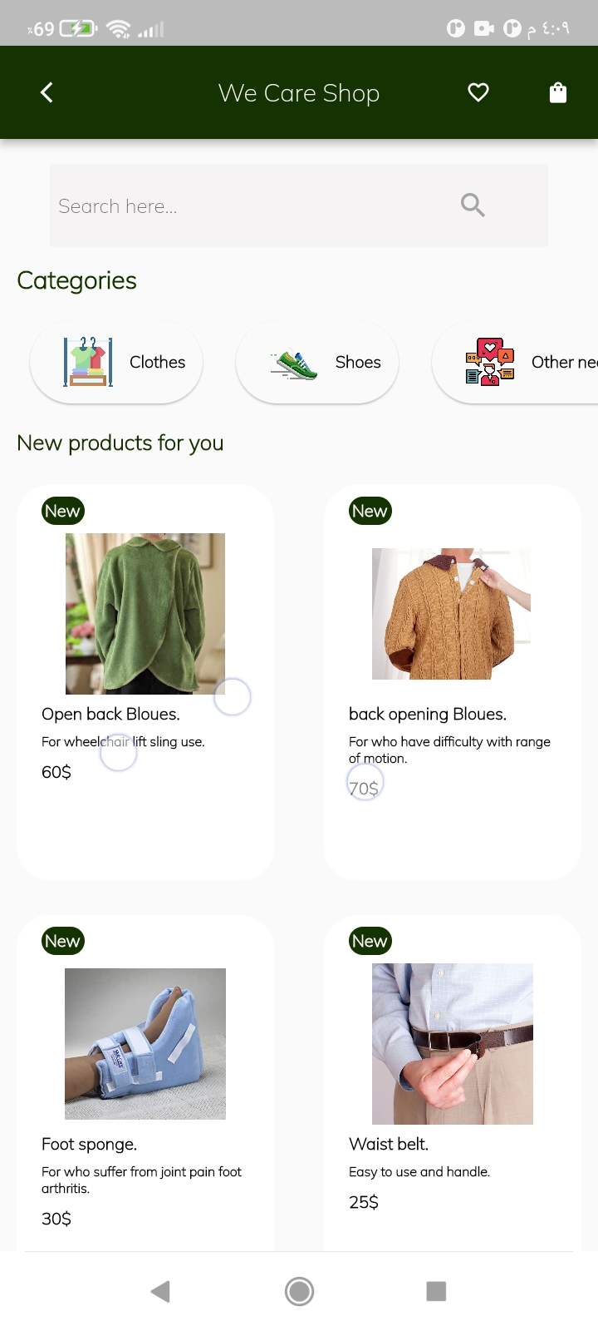
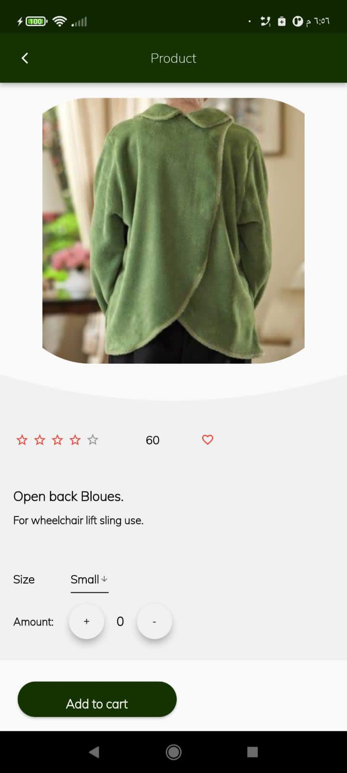


shopping page
Favorite page
Orders page
Search a product
Shoes page
Clothes page
Other needs
Item details page

Slide 17
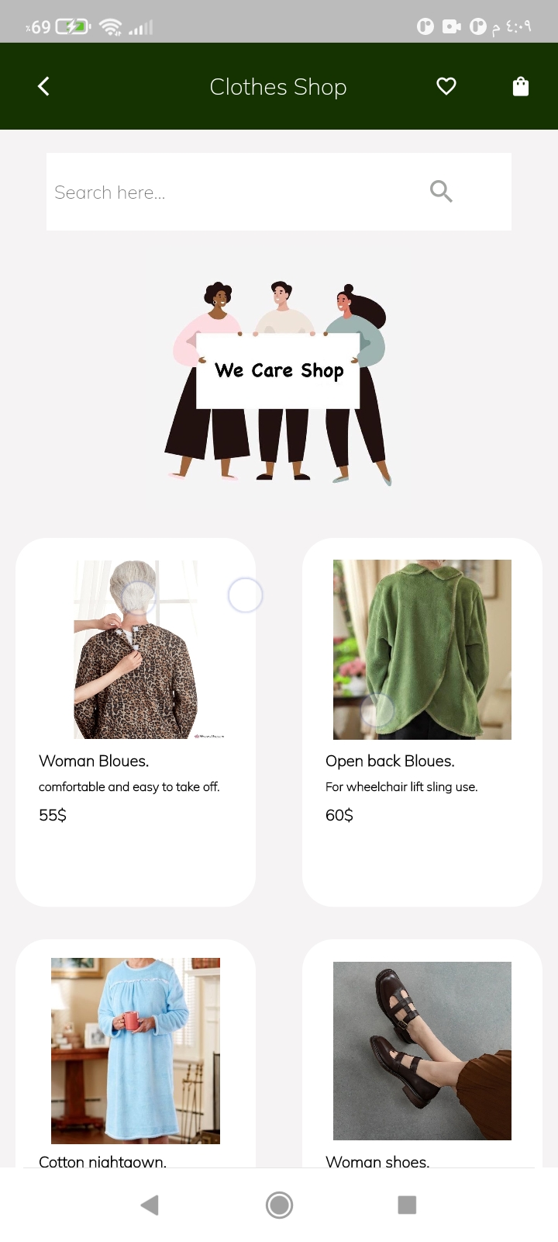
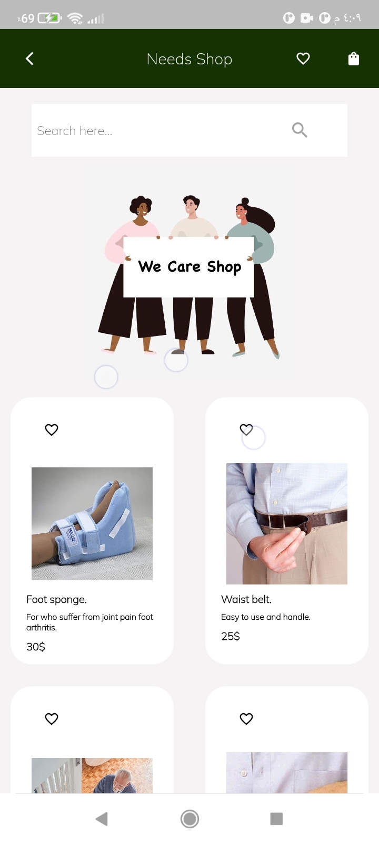
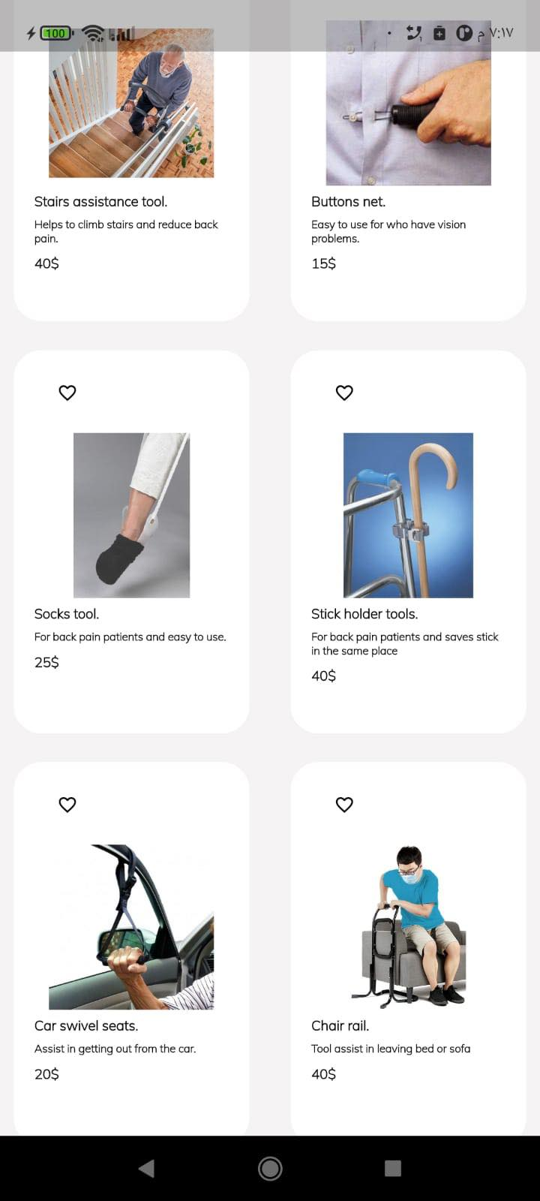
Clothes and needs shop

Slide 18
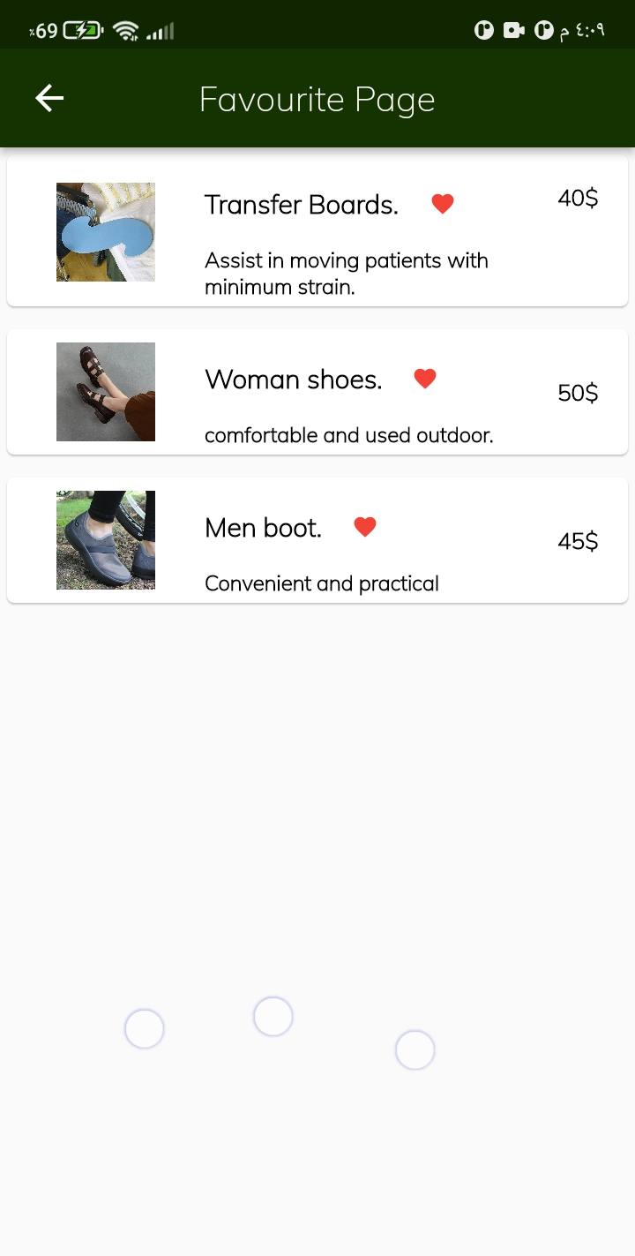
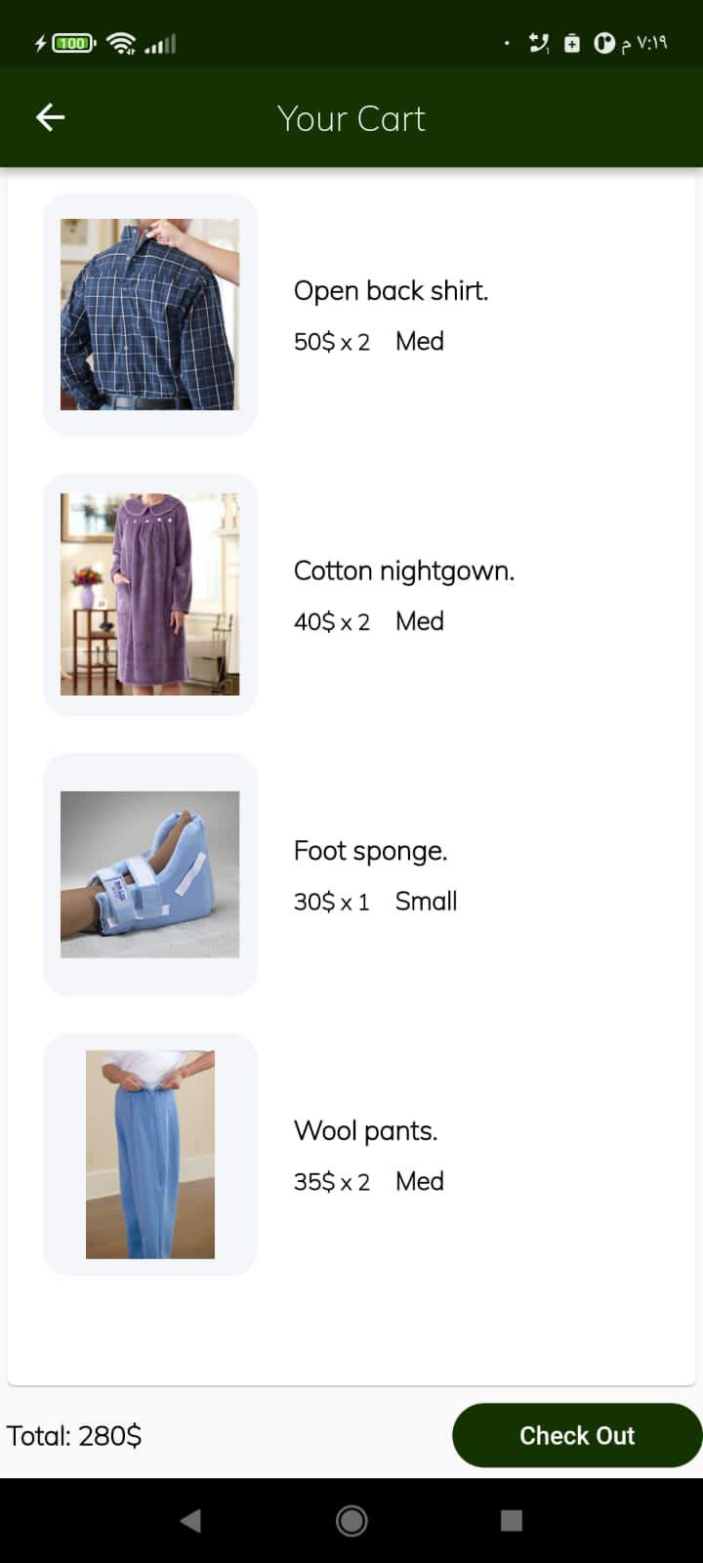


Favorite and Cart page
The product won’t be in the favorite when pressed it.
Make order
Total price

Slide 19
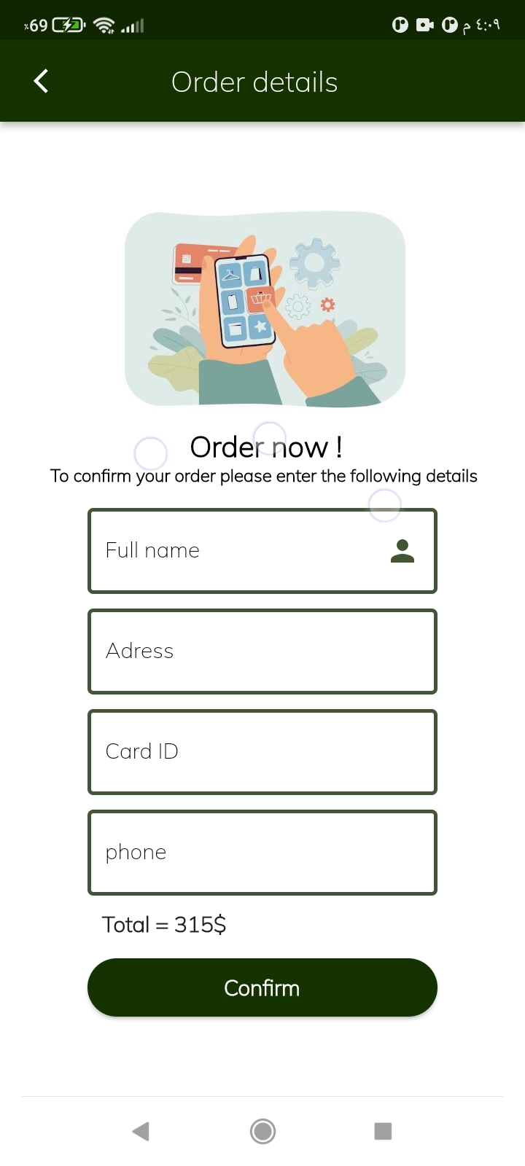
Order details

Slide 20
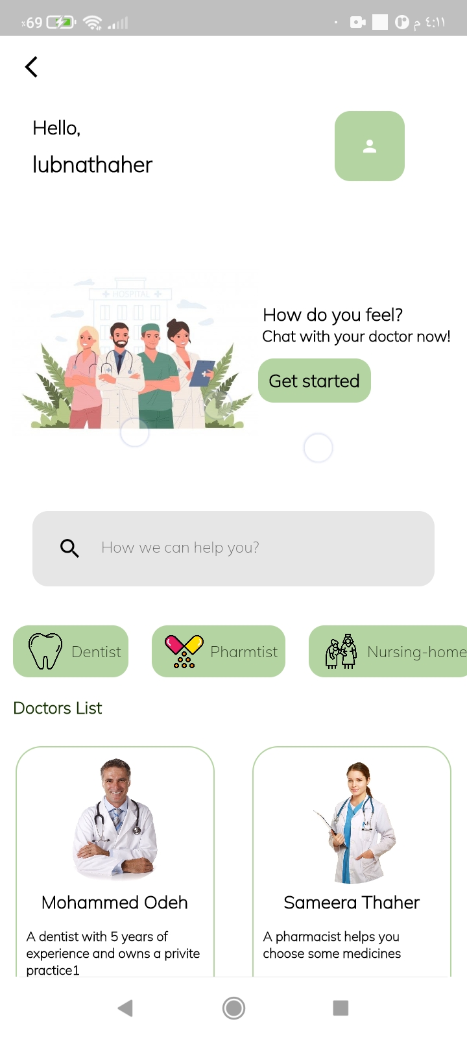
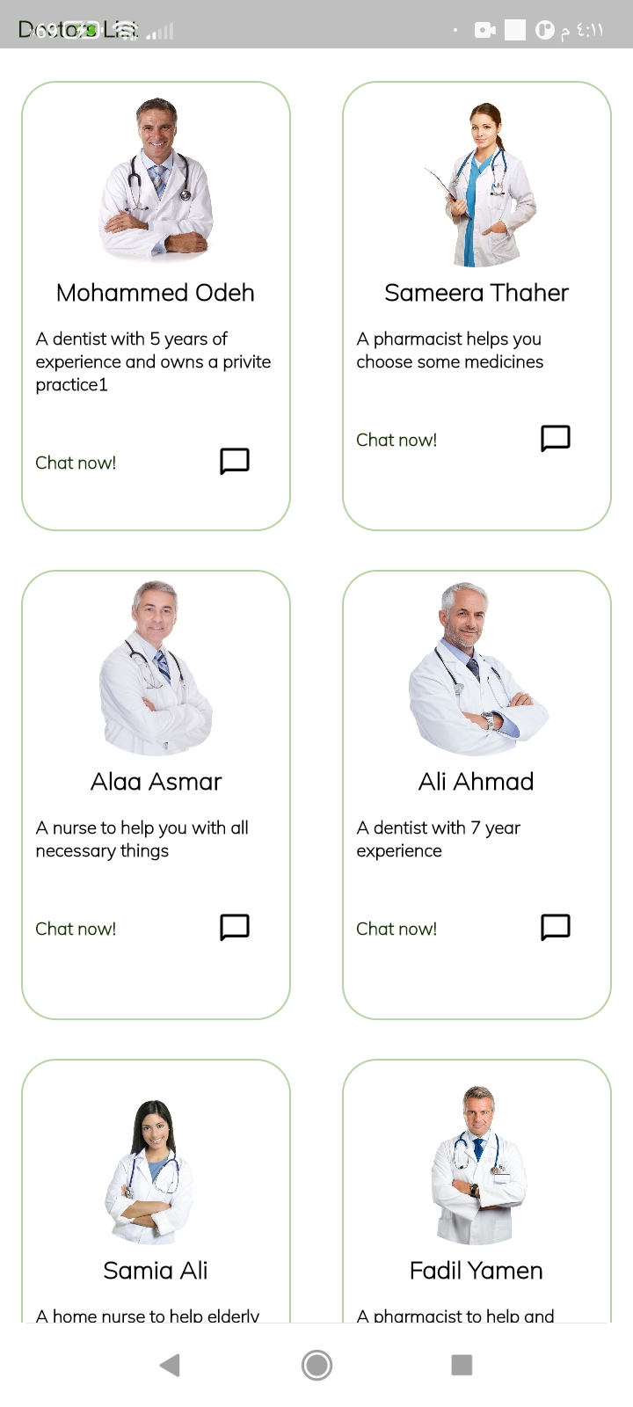
Doctors Page
User name
Chatting with your doctor
Search a doctor

Slide 21
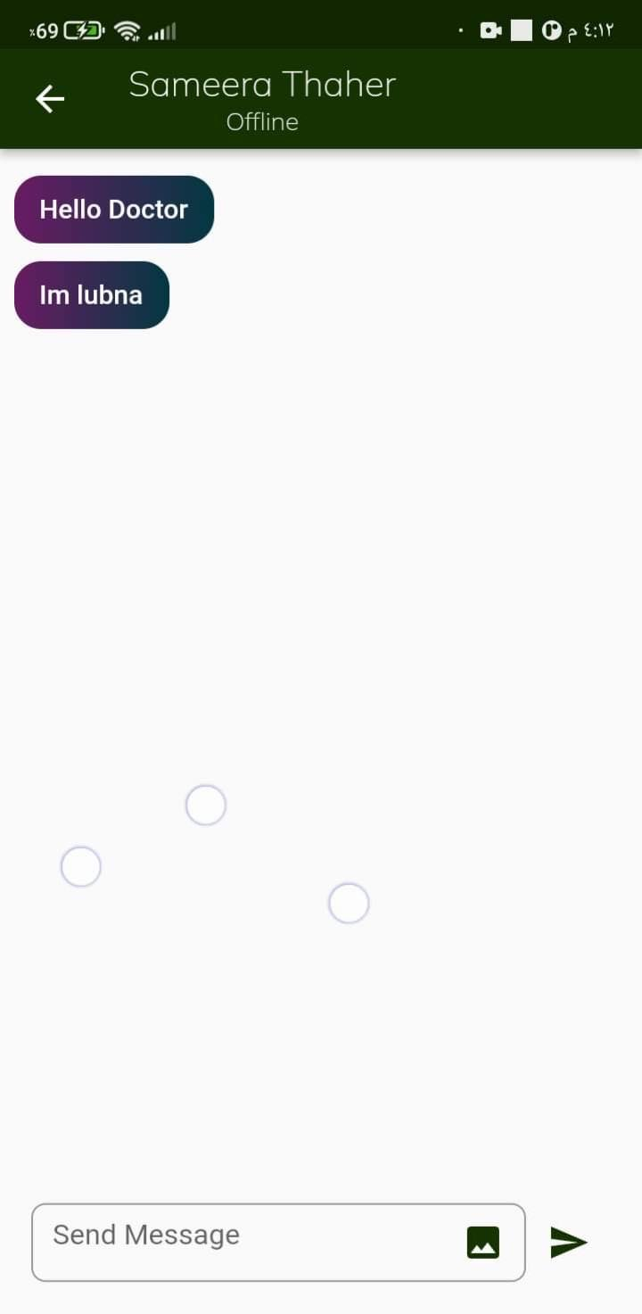
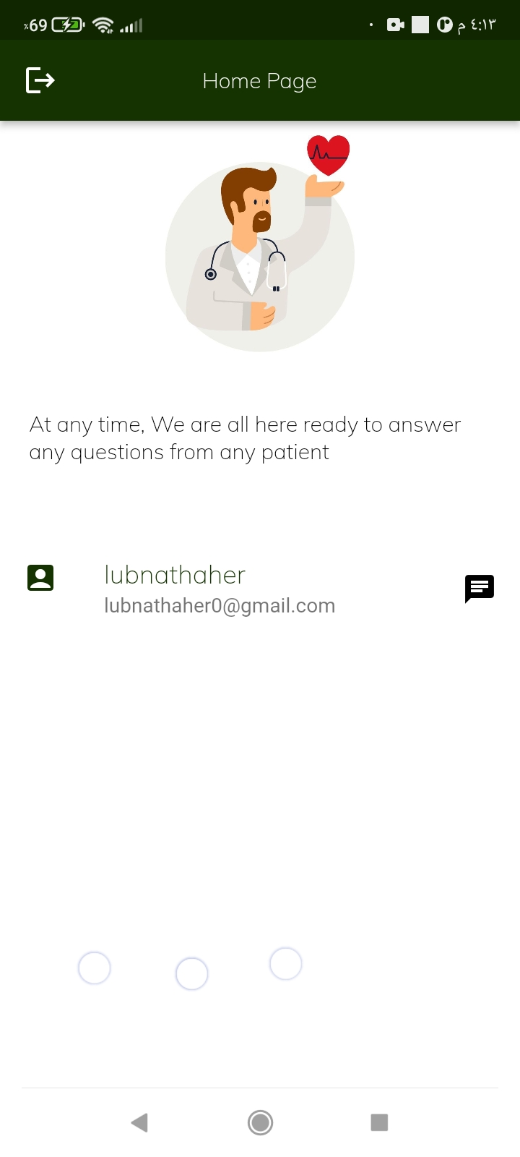
Chatting with doctor from user account
When doctor log in to her account will find this list

Slide 22
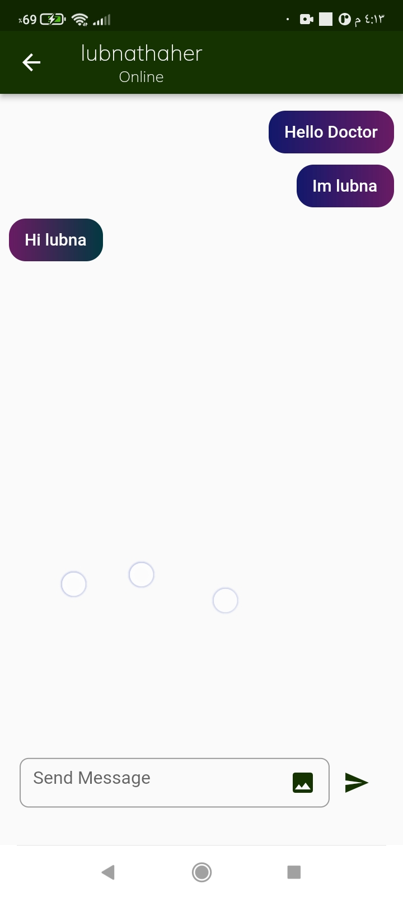
doctor can send a message

Slide 23
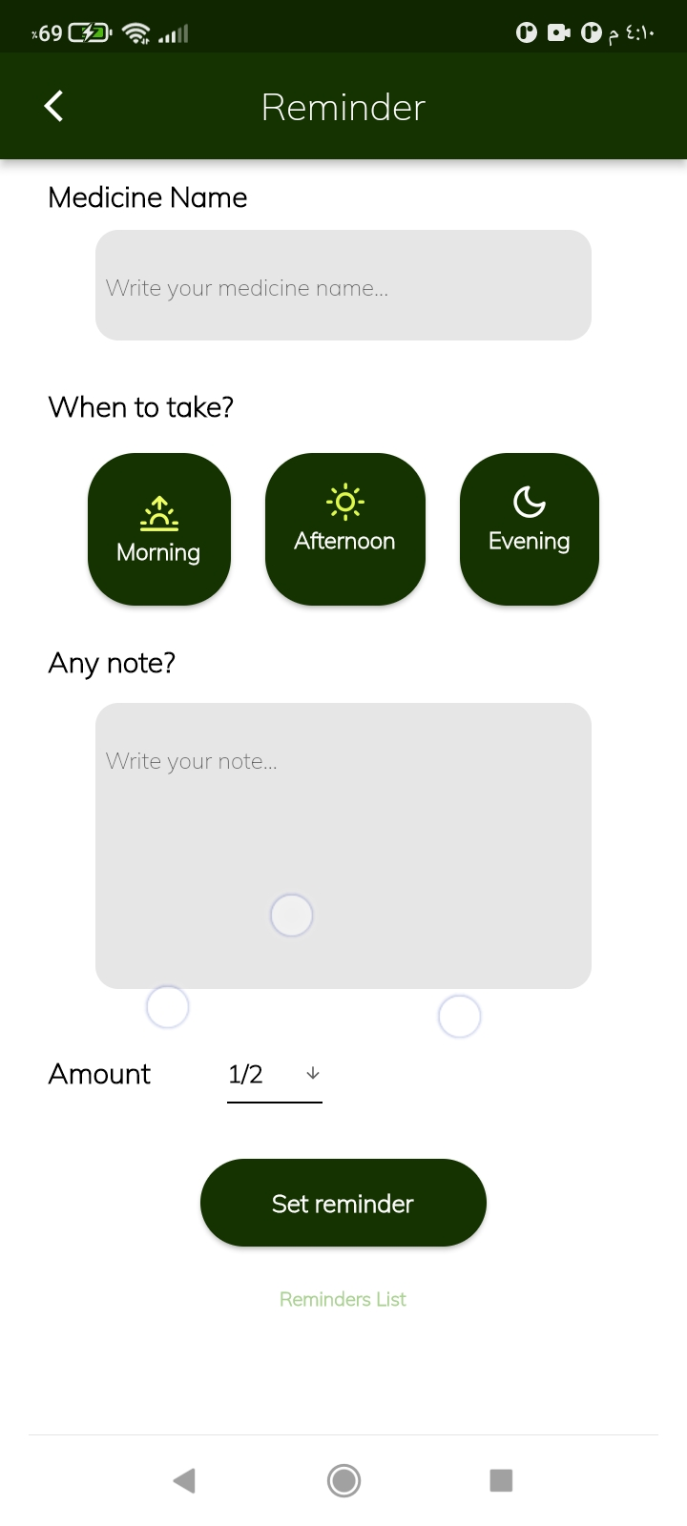
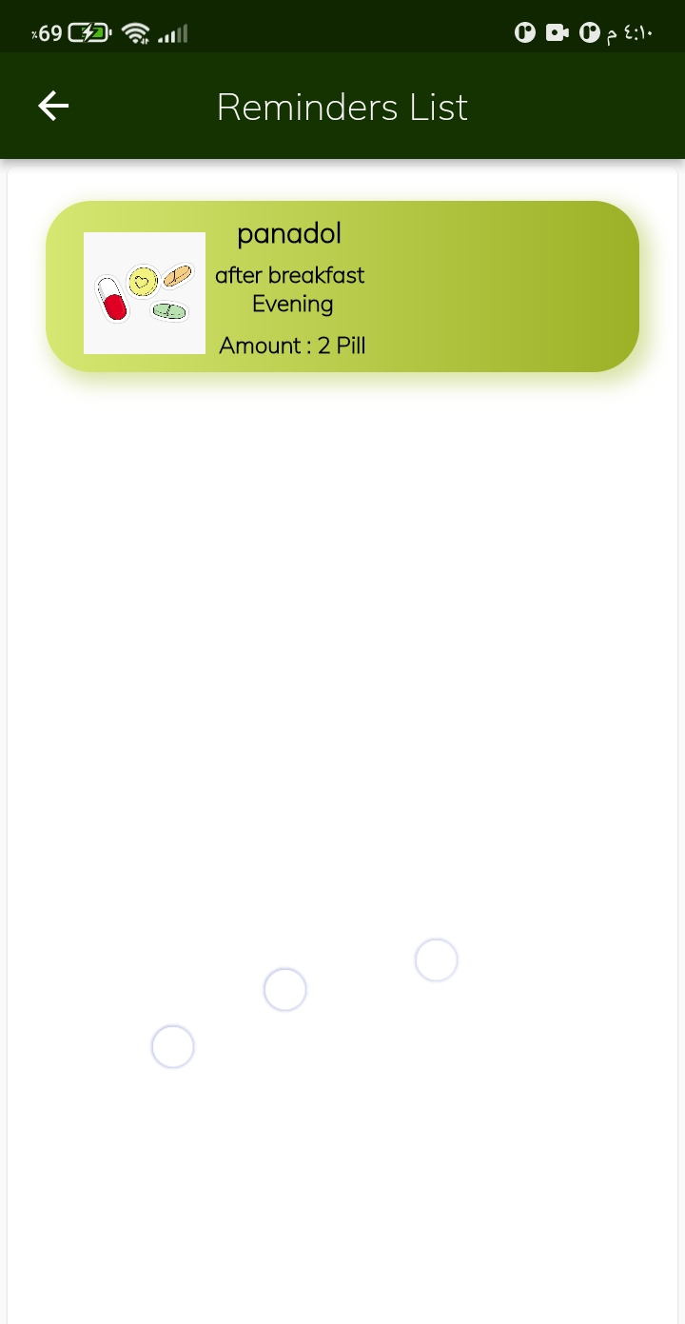
Medicine time
All reminders information's
A list contains your reminders

Slide 24
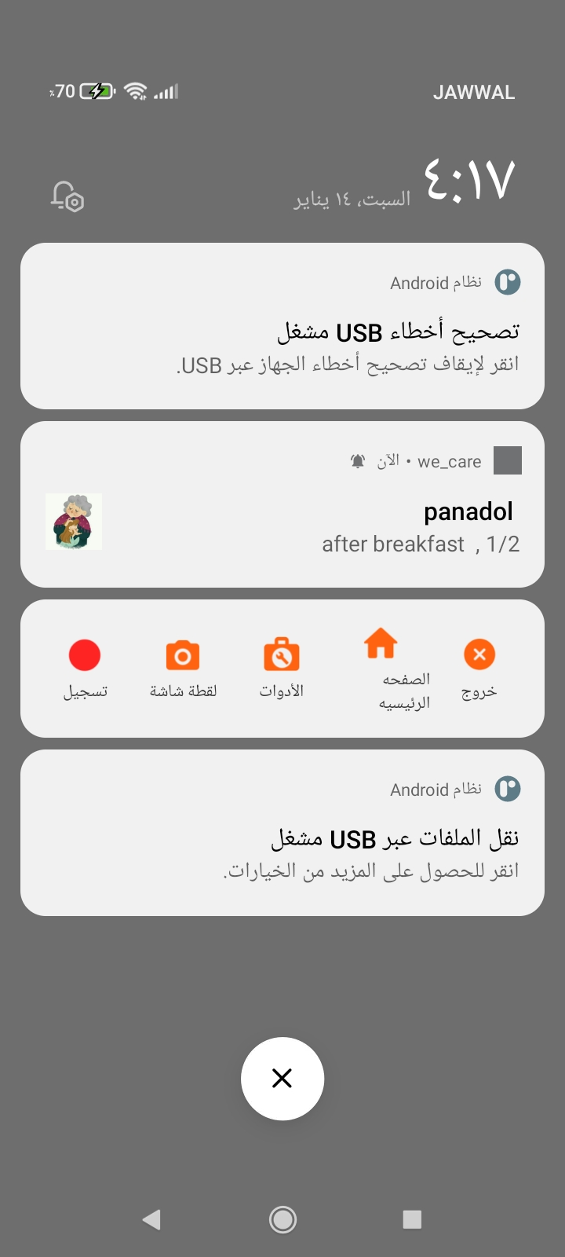
Notification from application contains medicine time information's

Slide 25
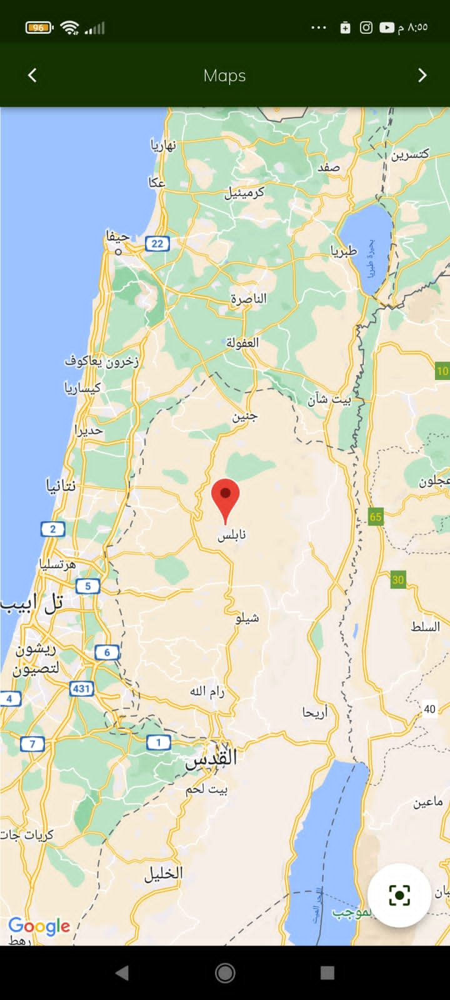
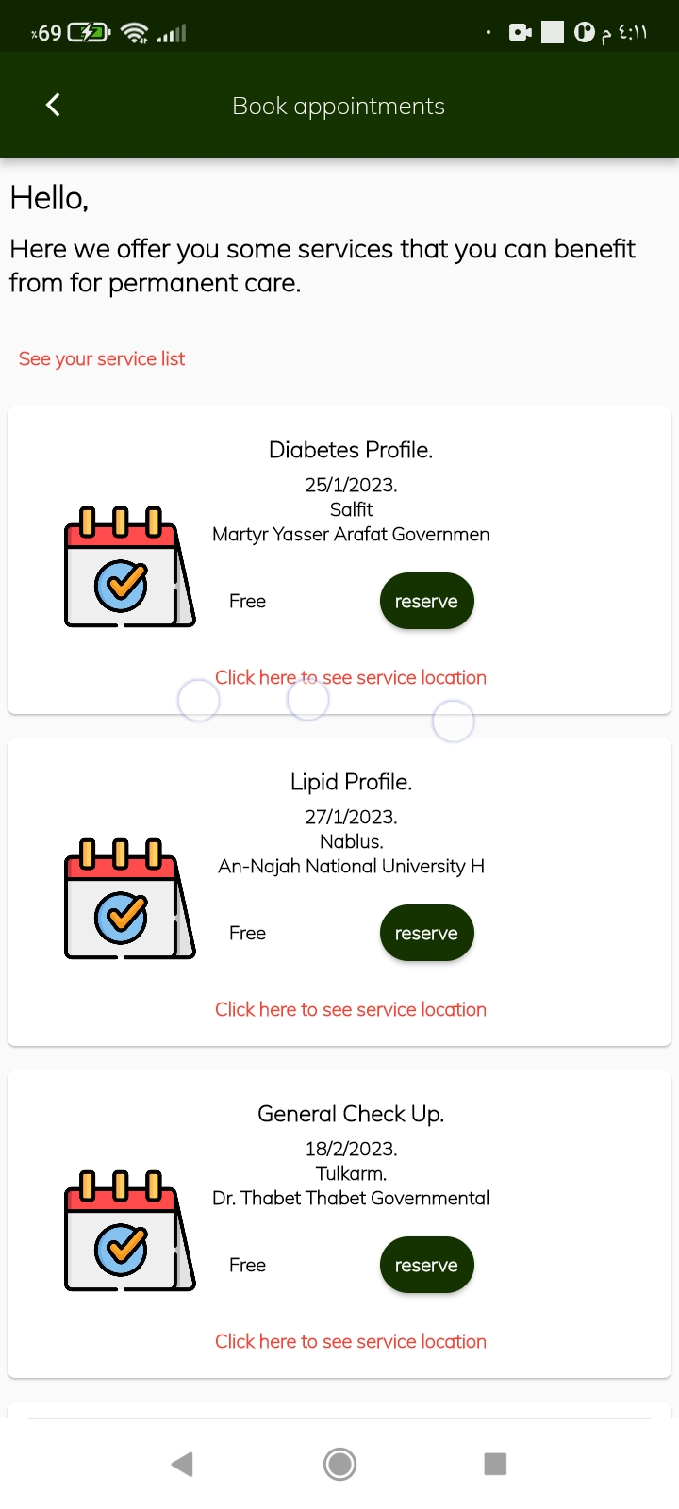
Event’s page
See your event’s list
See event location and the road
User location
Reserve

Slide 26
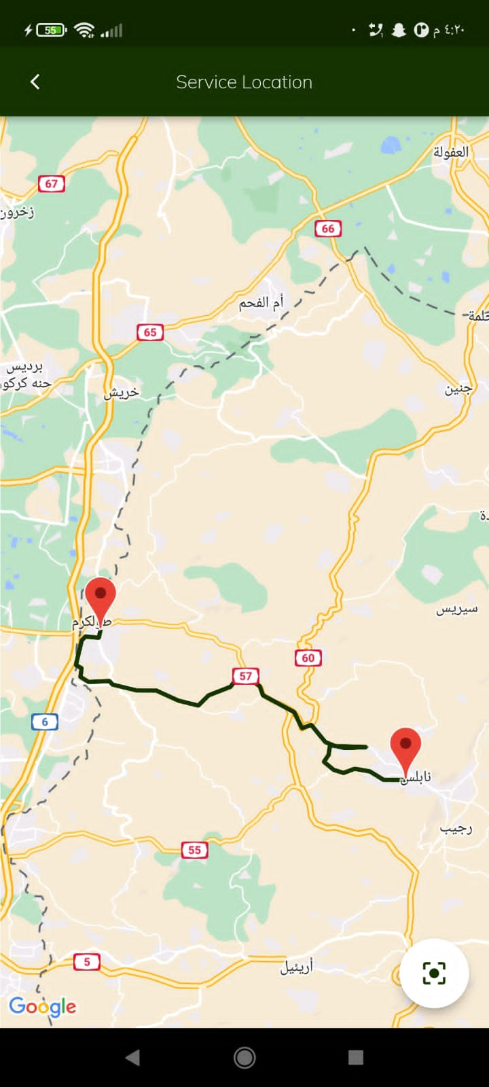
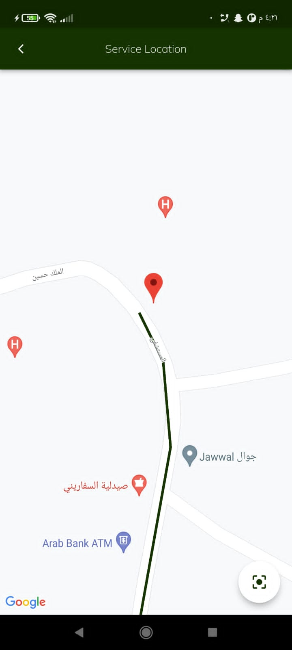
Maps
Event’s address
Hospital
User address
Back to user address

Slide 27
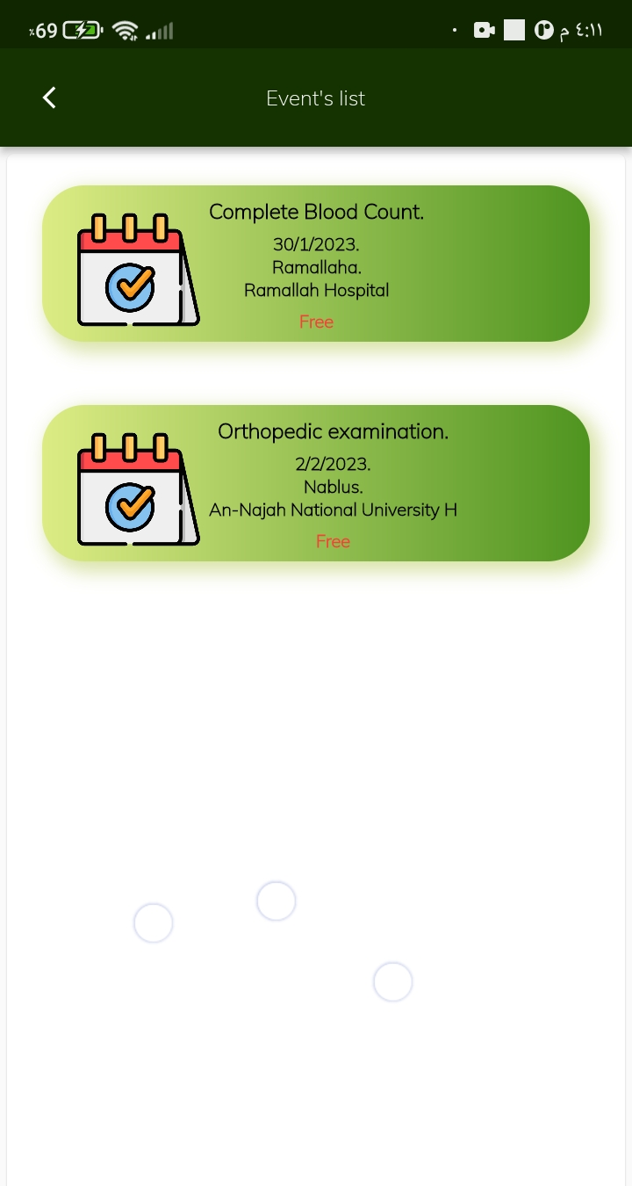
Event’s list
User can delete this event

Slide 28
Admin page
PPT下载 http://www.1ppt.com/xiazai/

Slide 29
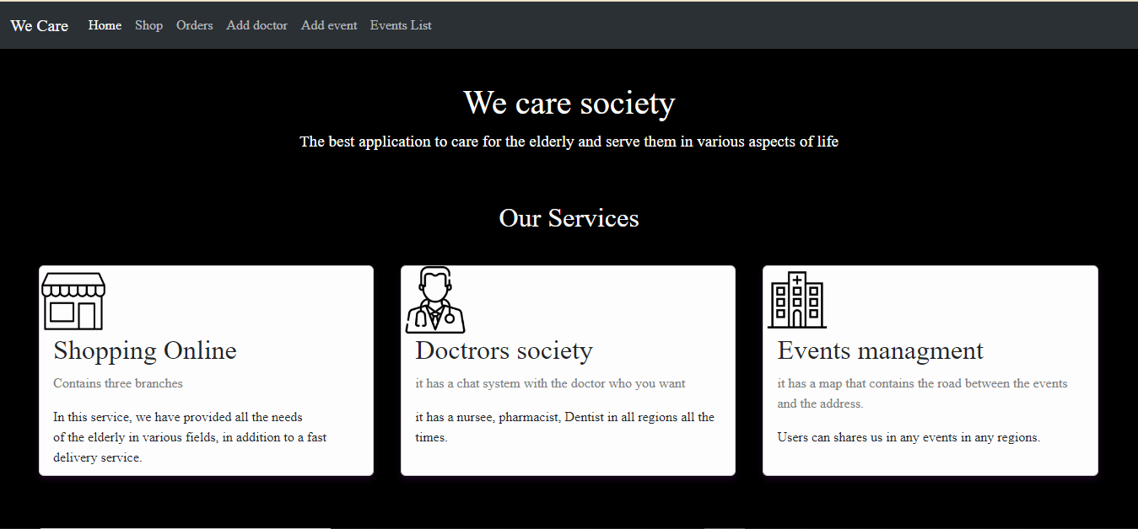
Home page

Slide 30
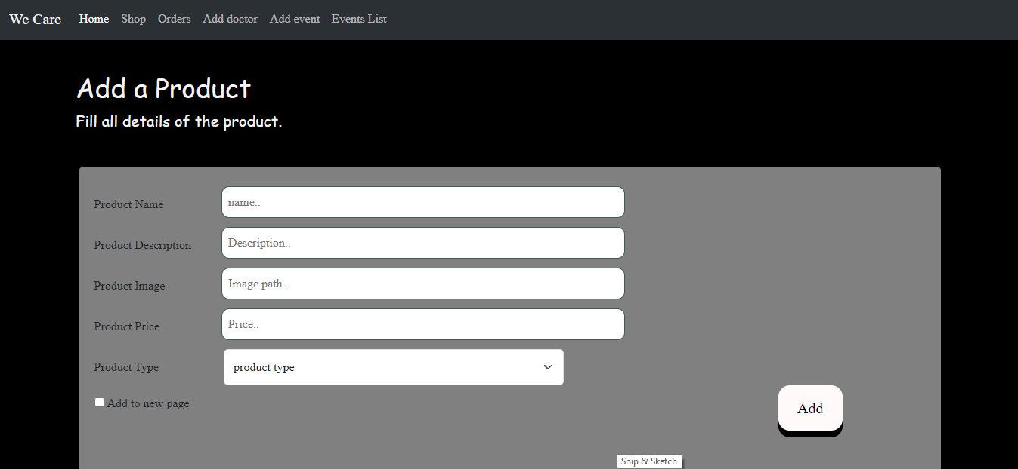
Add a product

Slide 31
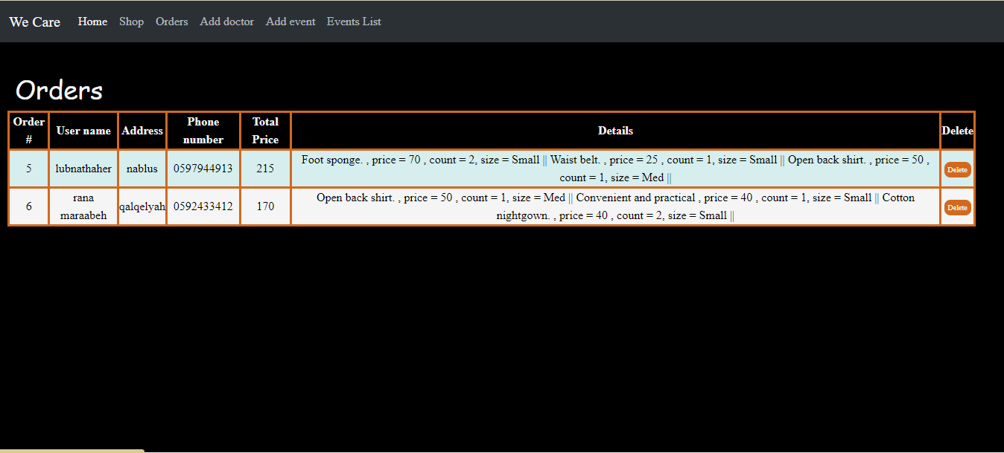
Orders

Slide 32
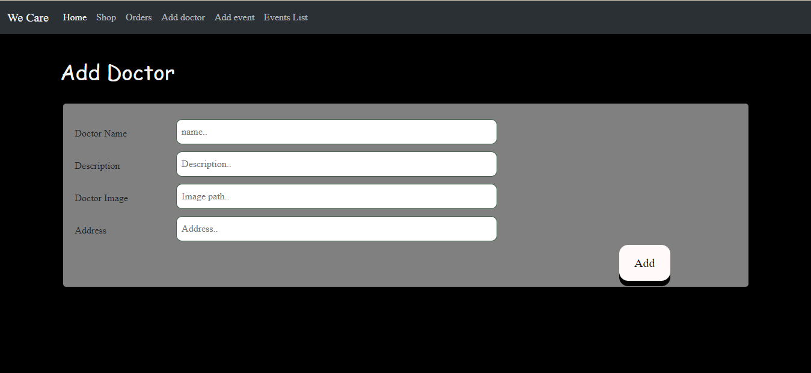
Add doctor

Slide 33
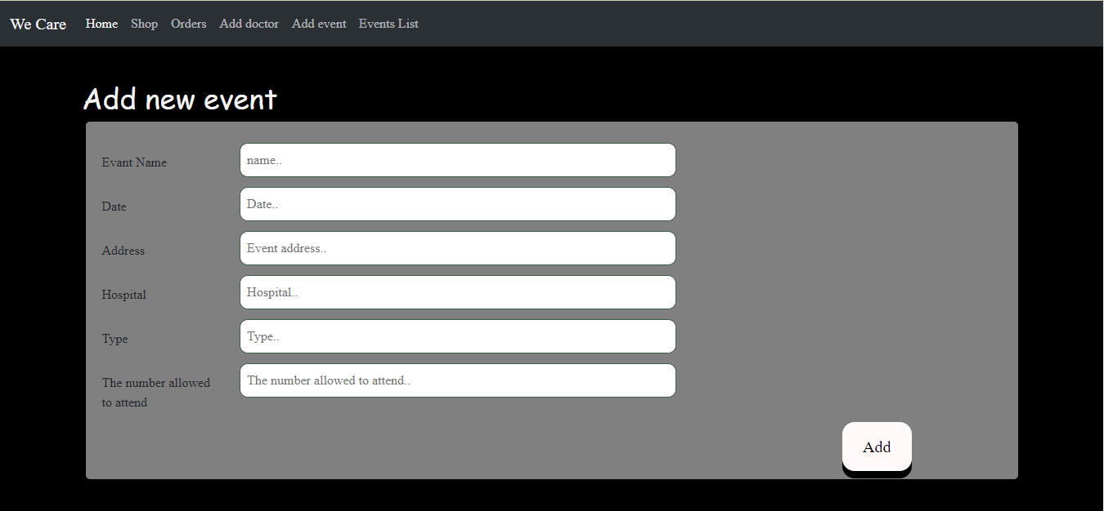
Add Event’s

Slide 34
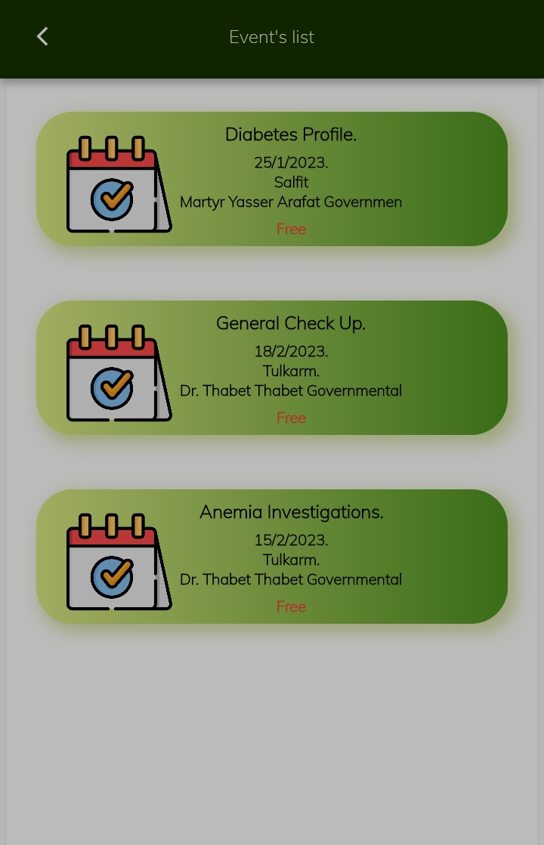
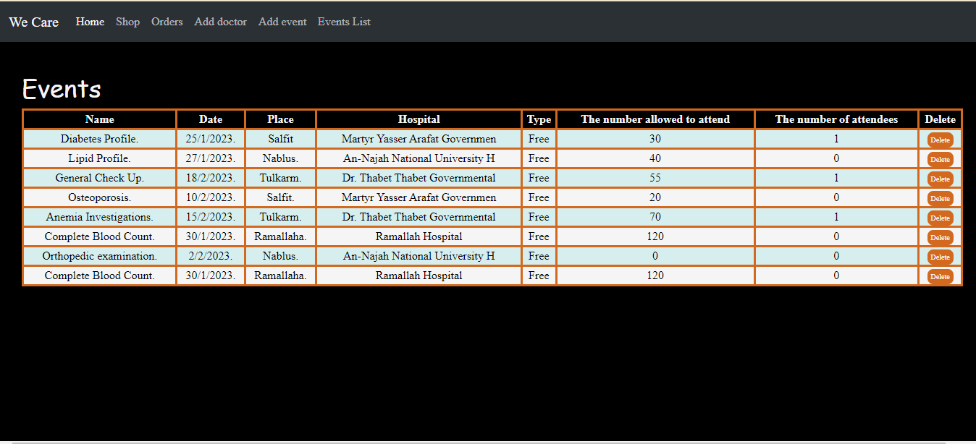
Event’s list

Slide 35
04
Goals
PPT下载 http://www.1ppt.com/xiazai/

Slide 36
Goals
Make business and work opportunity .
Provide elderly needs and help them to manage there life
More events and opportunity to know their health situation

Slide 37
THANK YOU

