Slide 1

An-Najah National University
Faculty of Engineering and
Information Technology
Hydrological Assessment and Hydraulic Design of Culverts along Noor-Shams Camp Street
Prepared by :
Mohammed “M.Muin”Ba’ara
Reg.No: 11523547
Under supervision of:
Dr. Sameer Shadeed

Slide 2

Outline
Project Description
Project Data
Objectives
Design Methodology and Modeling
Results and Conclusion

Slide 3
About The Project
The study area is Tulkarem city, exactly along Noor-Shams camp street – Bal’a square to Kitaba square- such that this area witnesses frequent floods followed by severe consequences. Wade Az-Zimar crosses Nablus-Tulkarem many times, and along the section under my study there exist 4 main culverts. The hydrological assessment for the catchment to determine peak discharge at the culverts will be done using HEC-HMS software and HY8 for hydraulic design of the culverts.

Slide 4
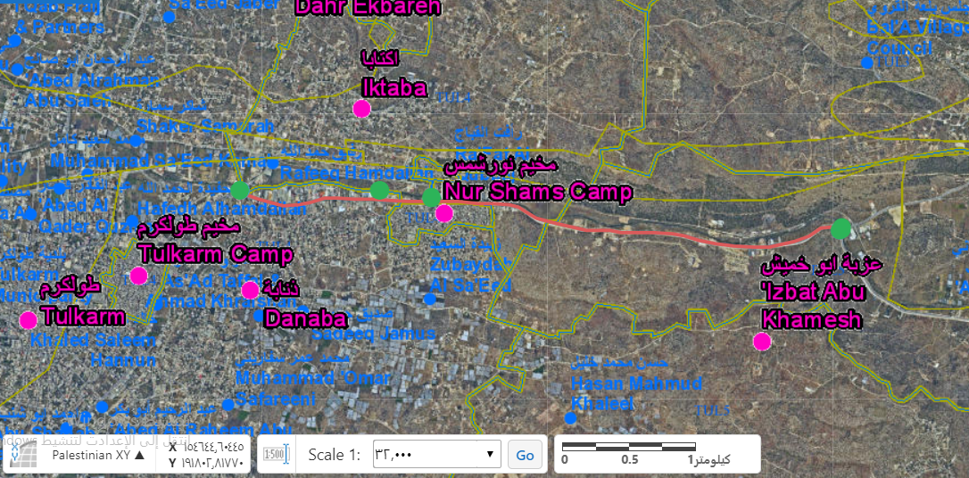
“
Culverts
(green points)

Slide 5
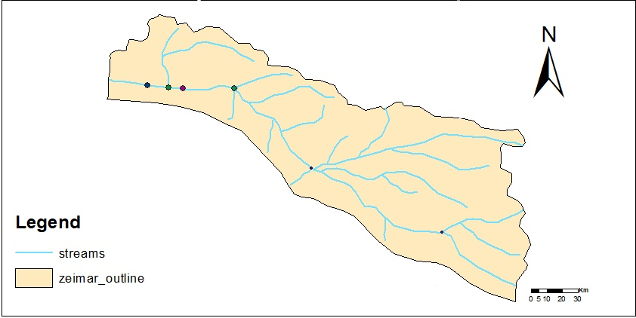
Az-Zimar Catchment

Slide 6
Project Data
Geomolg website is the main source of data for the project, the coordinates of the culverts, soil type, land cover, contour map, buildings, and others. All these data needed in ArcGis software to delineate and analyze the catchment and to obtain all information for HEC-HMS like slope and longest flow path for the outlet, later to find time of concentration and lag time which is needed for HEC-HMS.
Rainfall Data for Nablus is needed too, to determine the maximum annual daily rainfall (MADR), to find the maximum rainfall at Return Period of 50 years. Later to use the data for HEC-HMS.

Slide 7
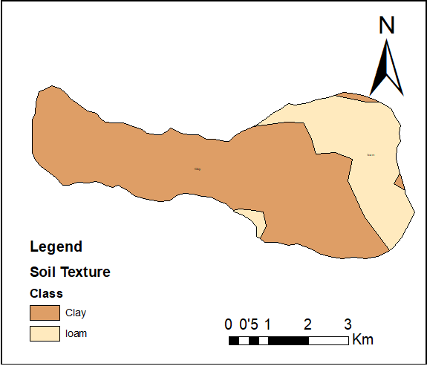
Soil Texture of the catchment around the main culverts

Slide 8
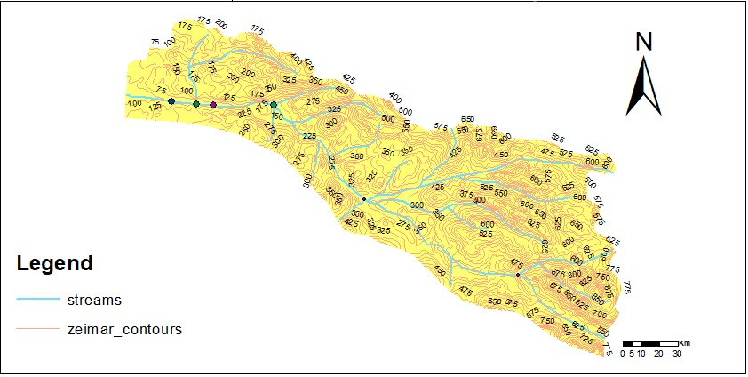
Contour Map of the catchment

Slide 9

Objectives
The main objective of this project is to assess the hydraulic design of the existing culverts, this can be done through:
Determination of sub-basins areas using ArcGIS
Estimate peak flows using HEC-HMS
Hydraulic design of the culverts by HY8
Redesign the insufficient culverts

Slide 10
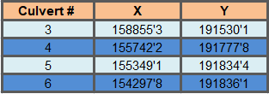

Design Methodology and Modeling
The following steps are followed for modeling:
Watershed Delineation by ArcGIS
I need to delineate Az-Zimar watershed to get sub-basins areas and other data to make the hydrologic model by HEC-HMS, the data required for this mission are pour points and contour map.
ArcGIS

Slide 11
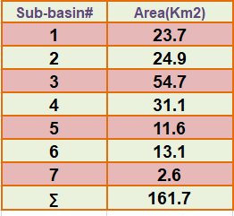
After delineation the catchment,
sub-basins areas are calculated:
Note:
Another data was calculated like slope and length of flow path to use later in modeling in HEC-HMS.

Slide 12
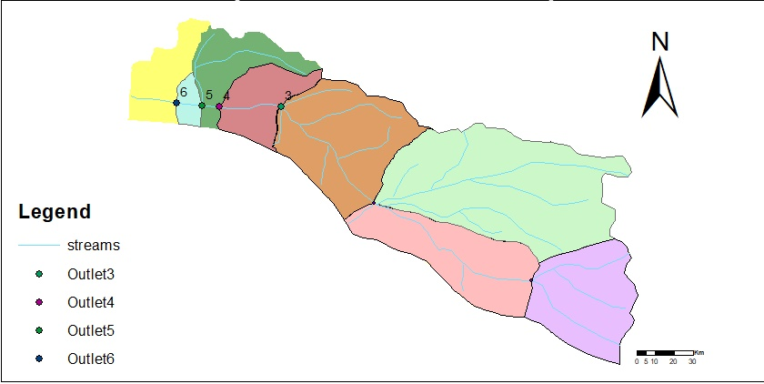
Sub-basins

Slide 13
2. Hydrologic Modeling by HEC_HMS
A hydrologic model for Az-Zimar catchment is to be build, using all data obtained from ArcGIS and from Rainfall Data for Nablus city, the method to be followed is Loss Method(SCS-CN), at last I get the peak discharge at outlets.
The input data for modeling as following:
Sub-basins areas(Km2)
Curve Numbers and Initial Abstraction for each sub-basin
Lag Time

Slide 14
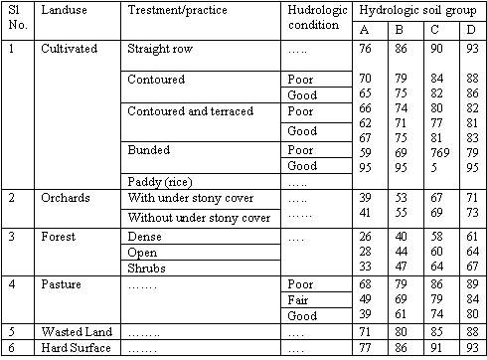
Curve Number(CN) is determined for each sub-basin using the following table:

Slide 15
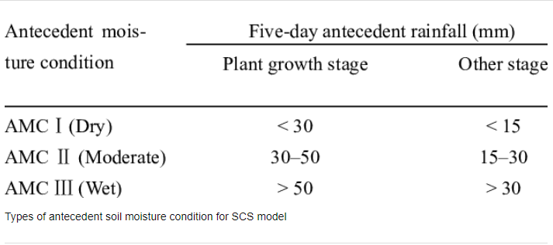
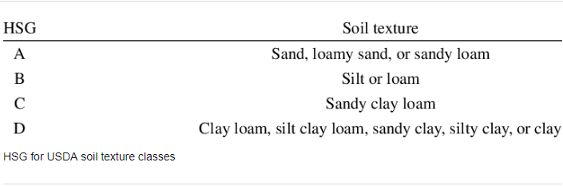
Because of different soil texture and land cover, composite CN is estimated for each sub-basin, the following tables show hydrologic soil group (HSG) and antecedent moisture condition(AMC).

Slide 16
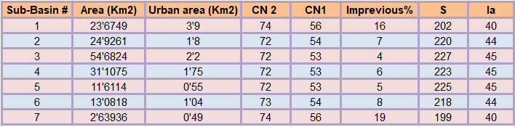
Curve Number, Impervious and Initial abstraction results

Slide 17
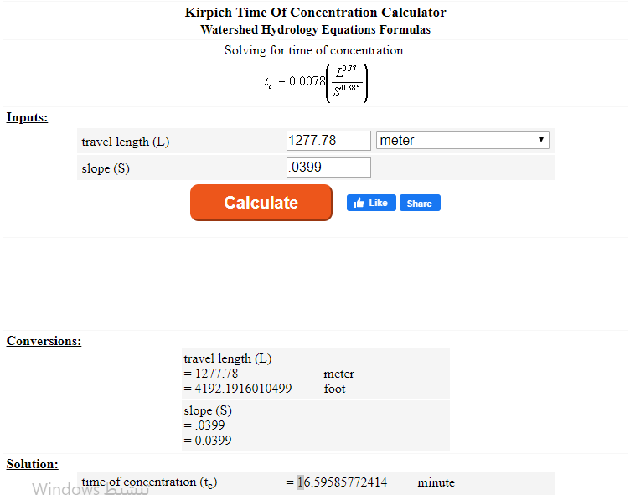
Time of Concentration
It is the time required for runoff to travel for the longest travel time to the catchment. Kirpich Formula is the popularly used.

Slide 18
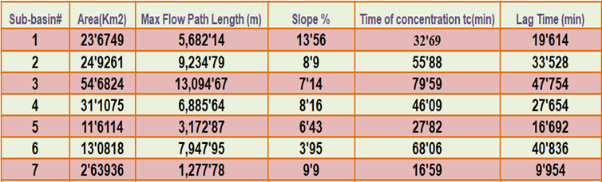
Tc and Lag Time

Slide 19
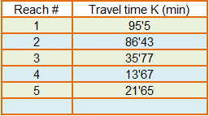
Channel Routing:
Muskingum method: Two parameters needed in this method which are (x) and K.
X parameter is an empirical constant equals 0.2 in general.
K parameter is the flow travel time through reaches.

Slide 20
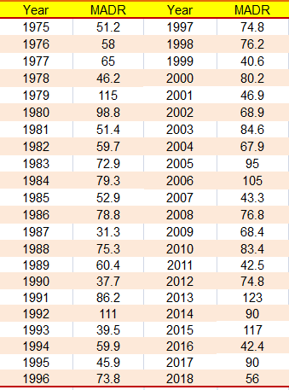
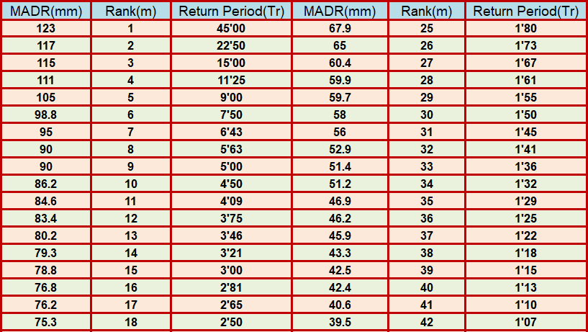
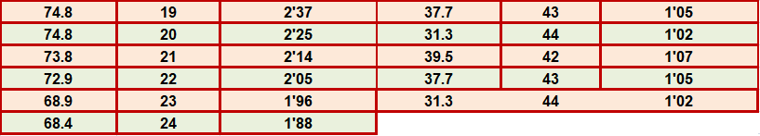
Meteorological Model:
Rainfall data for Nablus is obtained for the last 44 years (from 1975 to 2018)

Slide 21
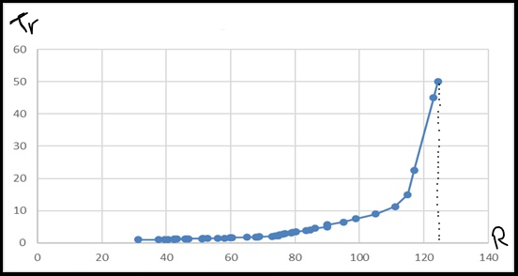
50-year return period is considered in this project. By extrapolation, the design rain storm event of 50-year return period has a rainfall of 124.33mm.

Slide 22
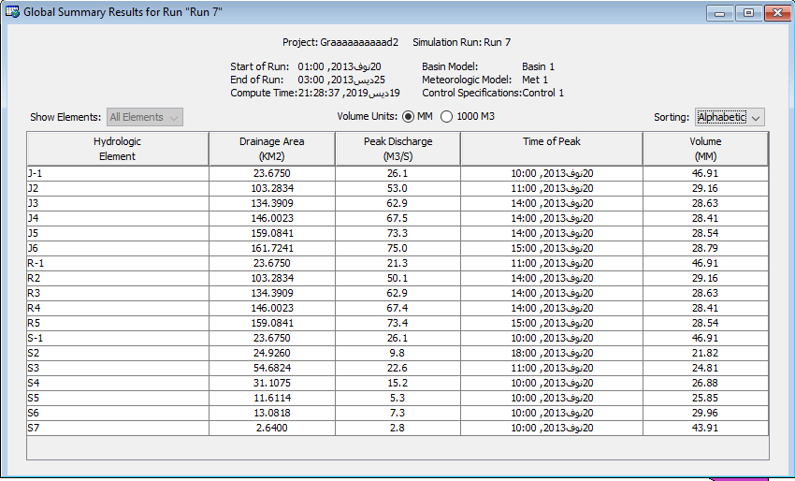
Hydrological Modeling Results

Slide 23
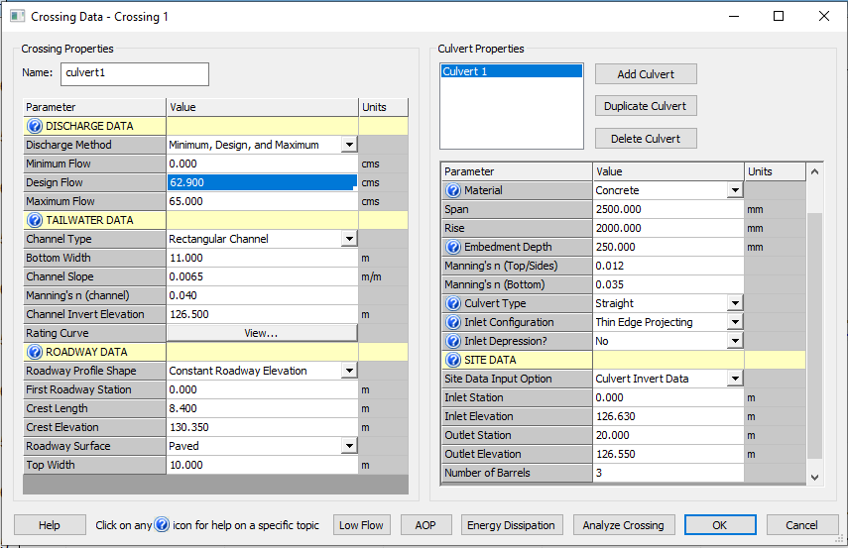
3. Hydraulic design of culverts by HY-8

Slide 24
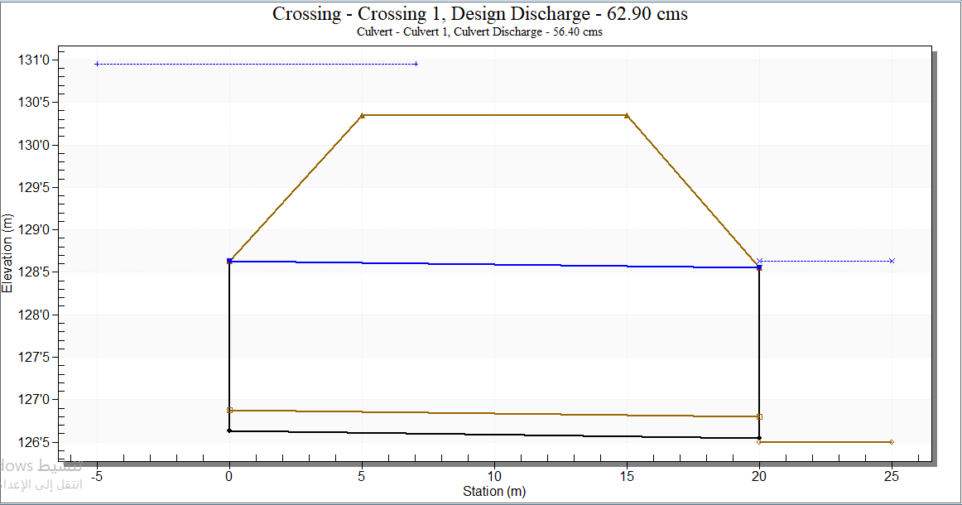

Slide 25
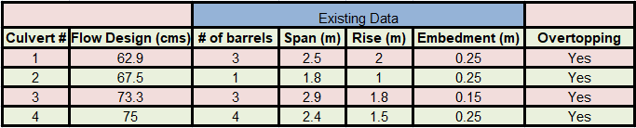
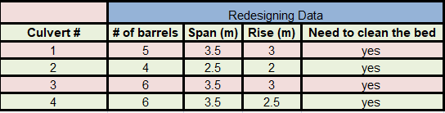
4 . Results

Slide 26
Conclusion and Recommendations
All culverts need redesign to handle the flow.
The municipality of Tulkarem must do a real solution to solve flood problem, as mentioned in the report, or if the budget doesn’t allow it can enlarge culverts and make regular maintenance for them.

Slide 27
Thanks!
Any questions?
Special regards for Dr. Sameer Shadeed (Supervisor)
Dr. Abdulhaleem Khader (Examiner1)
Eng. Yahia Saleh (Examiner2)

