Slide 1
Landside Design of Yasser Arafat
International Airport
By: Huzaifa Ammar Jumaa
Under supervision of: Prof. Sameer Abu-Eisheh

Slide 2
Graduation Project I
Final Result

Slide 3
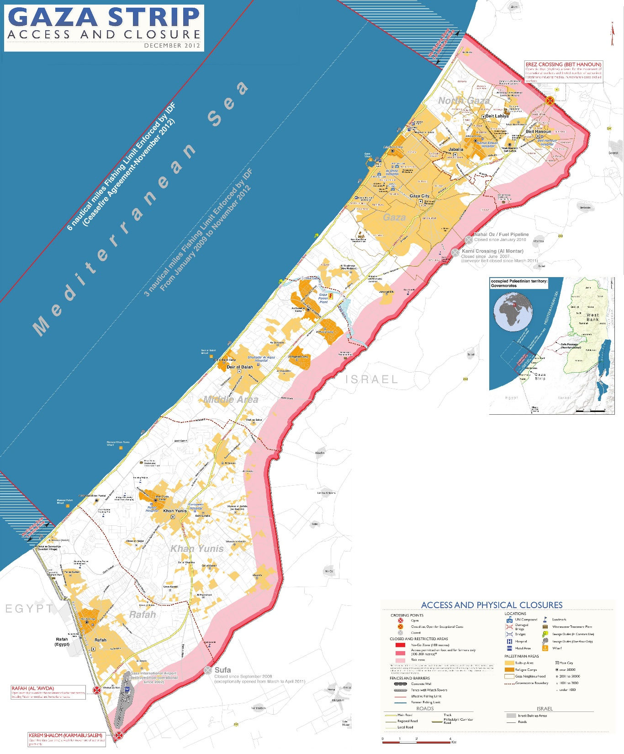

Shawka Al-Soufi village
Rafah
Gaza Strip - Palestine

Slide 4


Running in 2027
2027-2034
2035-2042
2043-2050
3
phases

Slide 5
Number of passengers
West Bank
5,691,391
Gaza Strip
Tourists

Slide 6
Number of Employees per Day
3,595
Employees Peak Hour Vehicle
24

Slide 7
Peak Hour Vehicle for Passengers
 | Bus | Private Car | Taxi
Arrivals | 3 | 577 | 141
Departures | 3 | 561 | 137

Slide 8
Number of Parking Spaces
244
Long-term
68
Taxi Parking
55
Short-term
8
Bus parking
200
Employees parking

Slide 9
Graduation Project 2

Slide 10

Salah Al-Din Road
Peak Hour Volume on 2011 874
Peak Hour Factor 0.9
Peak Hour Volume on 2050 3075

Slide 11
Salah Al-Din Road
Number of Vehicles in the road
3820
With arriving
3800
With departing
Therefore, based on HCS+ output:
Number of lanes = 3
Level of Service = C

Slide 12
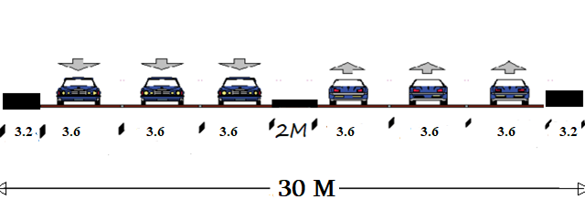
Salah Al-Din Road

Slide 13
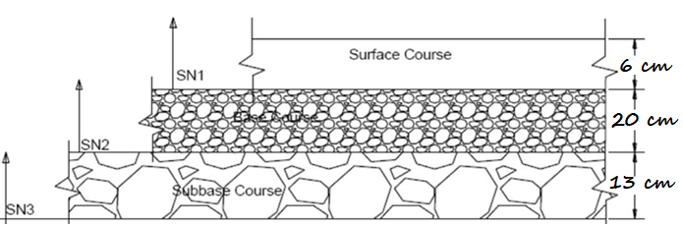
Salah Al-Din Road
Depth of layer

Slide 14
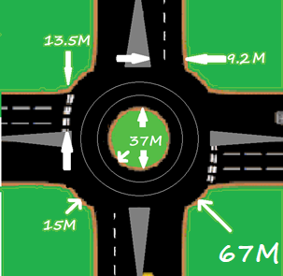
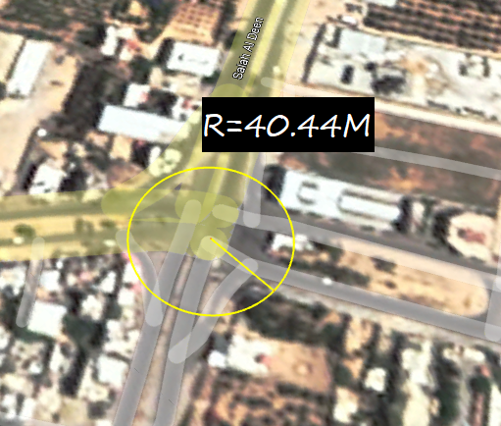
Design of the Roundabout

Slide 15
Airport Street
Number of Vehicles in the road
745
arriving
725
departing
HCS+ output:
Number of lanes = 2
Level of Service = C

Slide 16
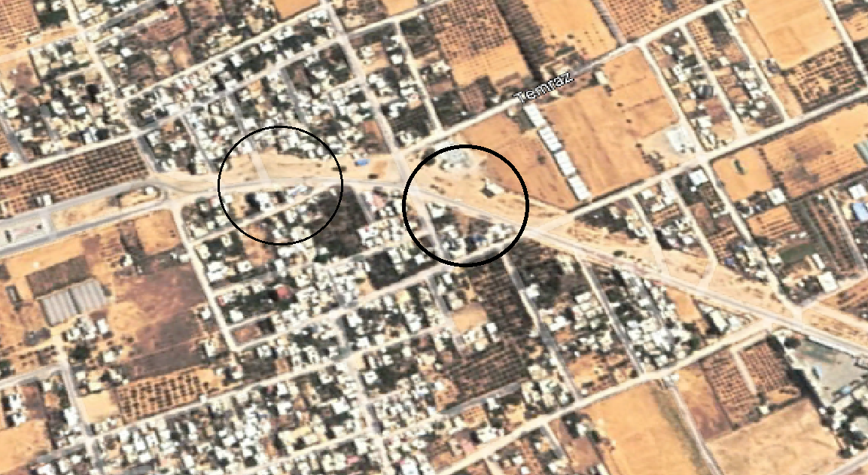
Airport Street
R = 500 M
Case 2 curve design
W = 7.2 M

Slide 17
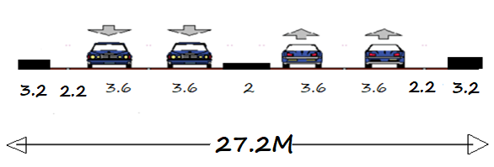
Airport Street

Slide 18
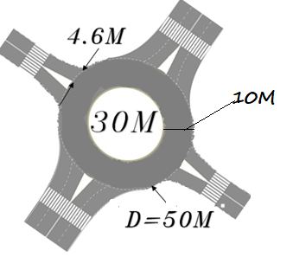
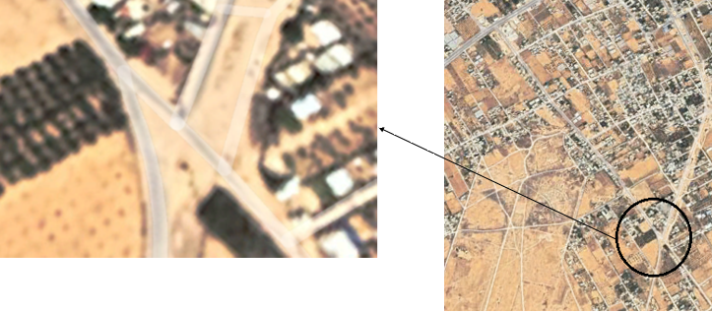
Intersection on Airport Street

Slide 19
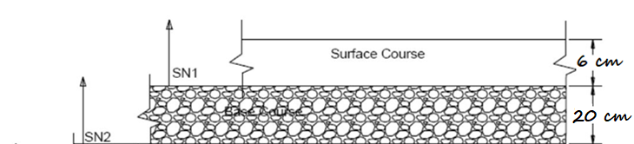
Airport Street
Depth of layer

Slide 20
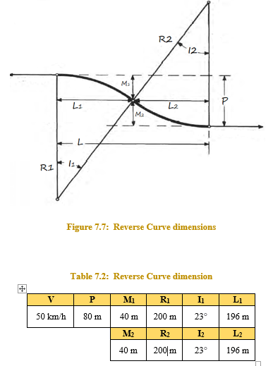
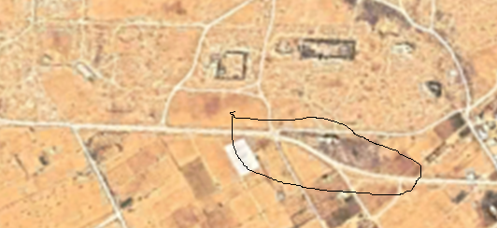
Reverse Curve

Slide 21
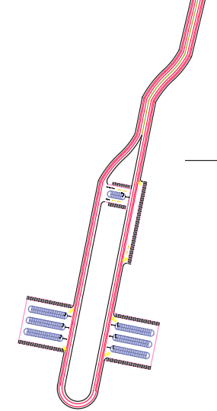
Circular Road
Short-term and employees parking spaces
Taxi’s parking spaces
400m
Reverse Curve
80m
Long-term parking
Bus parking spaces

Slide 22
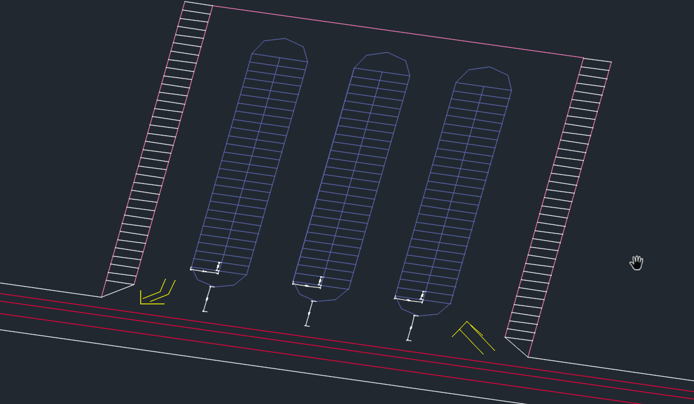
Parking
long-term, short-term & employees parking spaces
255
6928 𝑚2
244
6639 𝑚2

Slide 23
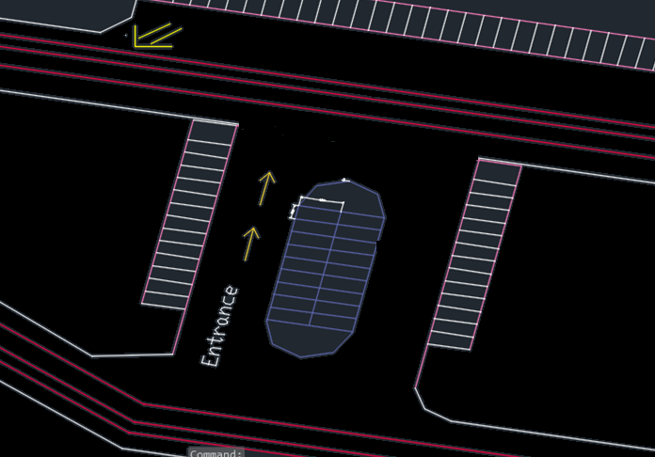
Parking
Taxi parking spaces
68
1902 𝑚2

Slide 24
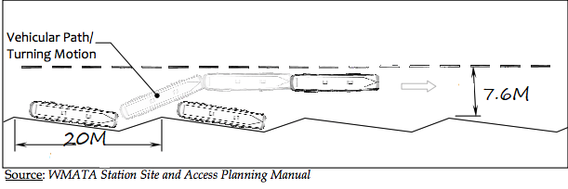
Parking
Bus parking spaces
8
1216 𝑚²

Slide 25
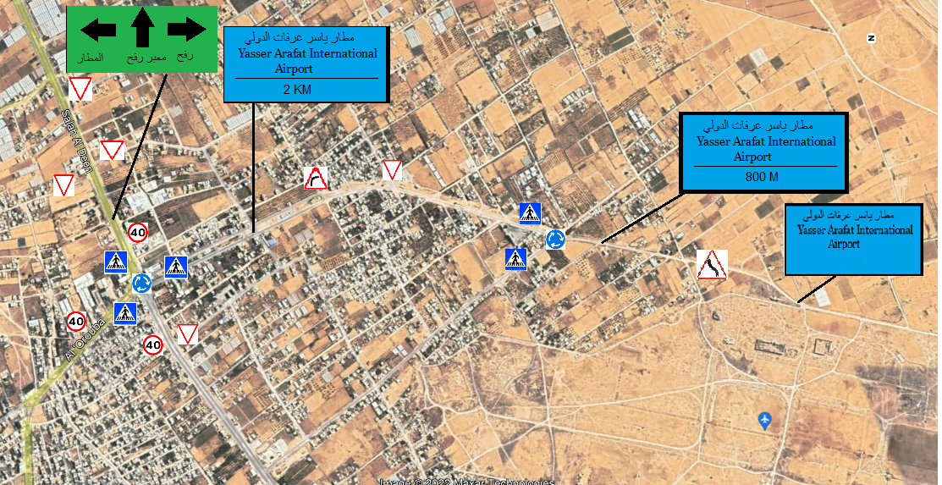
TRAFFIC CONTROL

Slide 26
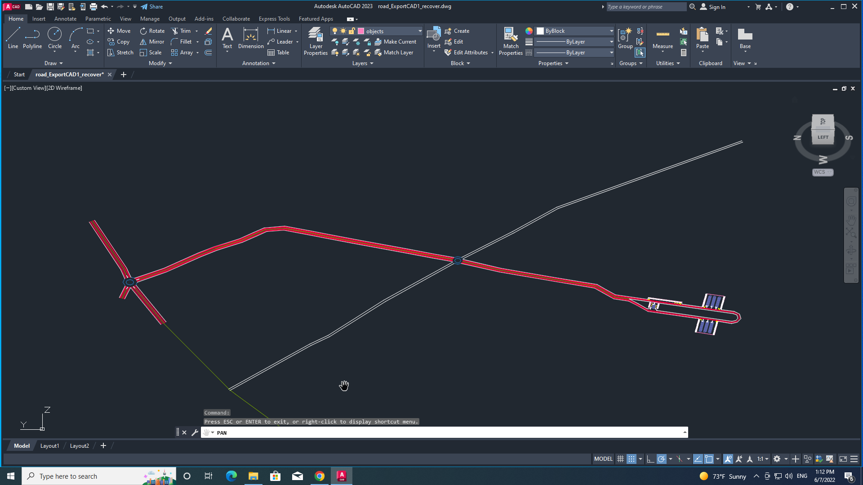

Slide 27
Total Cost
14,190,715 ₪

Slide 28

CONCLUSIONS & RECOMMENDATIONS
This project was completed based on expectations and predictions for the future traffic movement in the sector
And due to the exceptional circumstances in which the Gaza Strip lives, it is impossible to be certain. Therefore, when starting the project, it is necessary to follow up on the changes taking place and the extent of their impact.

Slide 29


