Slide 1

An-Najah National University
College of Engineering and Information Technology Management Information Systems (MIS)
11 May 2022

Slide 2










Enterprise Resource Planning For Gatoh Lebanon Company By Using
Supervised by:
Dr. Safa'a AbuJarour & Dr. Mohammad Dwikat
Prepared By:
Rafah Alfaqeeh & Alaa Odeh Rana Mograbi & Duha Zatar

Slide 3


TABLE OF CONTENT
Introduction
Current state
Needs & Requirements
Solutions & Added value
Business process
Modules
Reports
Future developments

Slide 4






INTRODUCTION
Founded in Nablus in
consists of 4 branches.
1987 .
This store is managed by 5 partners -
Dashon brothers.
Conducting several interviews to
understand their
needs.

Slide 5

Vision
O UR GO AL IS TO
ACHIEVE THE
CO MPANY' S VISIO N WITH THE HIGHEST EFnCIENCY AND
LO WEST CO STS !
To be your nrst and distinguished choice in your happy occasions.

Slide 6



Current state
Paper based system.
Little unincation between point of sales. Traditional ways of accounting.
No reporting.

Slide 7
Direct communication tool between the factory and the point of sale.
01
02
Unined prices between POS.
CUSTOMER NEEDS AND REQUERMENTS
03
Product categorization and easy search.
04
Various and instant reports on various nelds and status.
05 Recording of customer data.

Slide 8
SOLUTIONS
01
Generate customized and ad-hoc reports.
02
Real-Time order management.
05
Build customer database.
03
Reordering system.
0a
Website ordering.
04
Email marketing.

Slide 9


ADDED VALUE
Systematic and automated business operations in sales, point of sale,
01
accounting, inventory and website modules .
Improve business process efnciency.
02
03
Integration of all functions in one place.
04
Register each transaction with the name of the casher.
05
More security is that each session has specify cashers..
0a Website catalog and information inquiry.

Slide 10
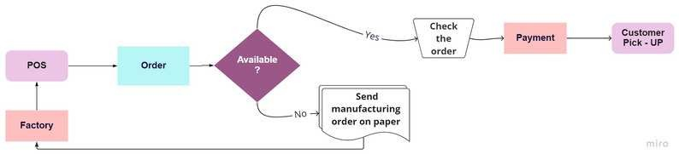
Previous business process

Slide 11
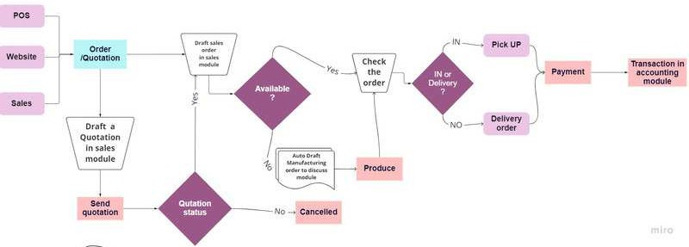
New business process

Slide 12
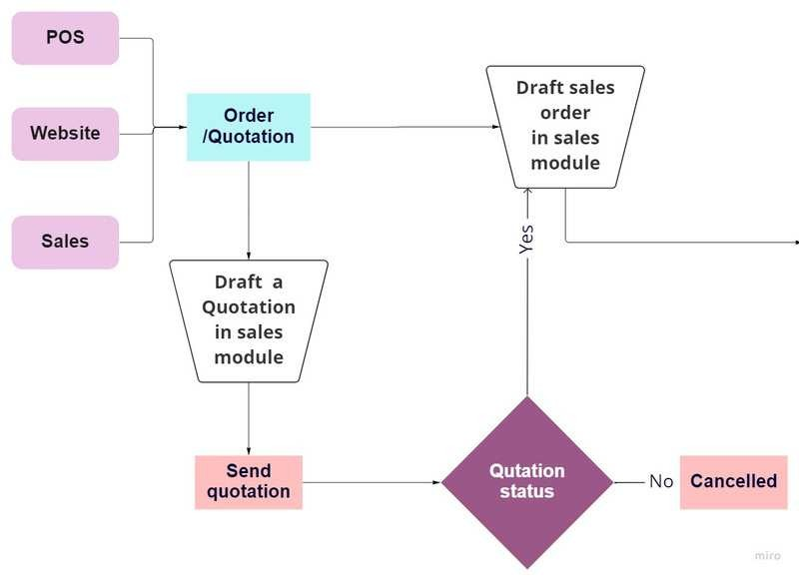

Slide 13
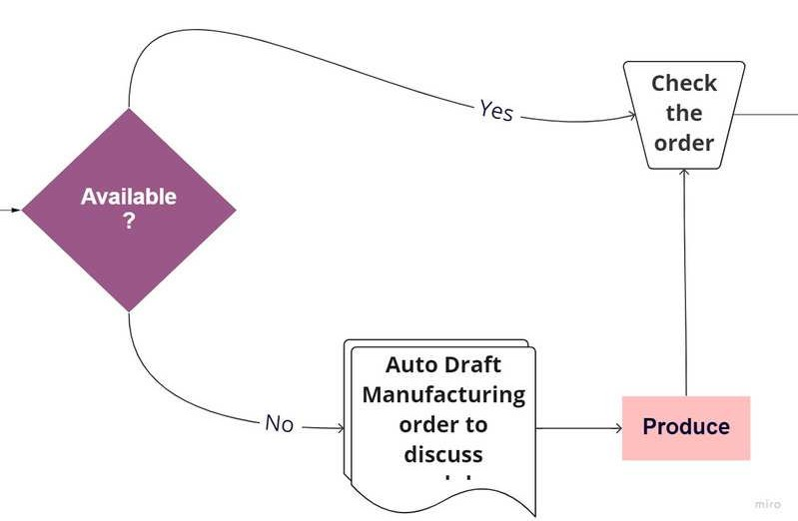

Slide 14
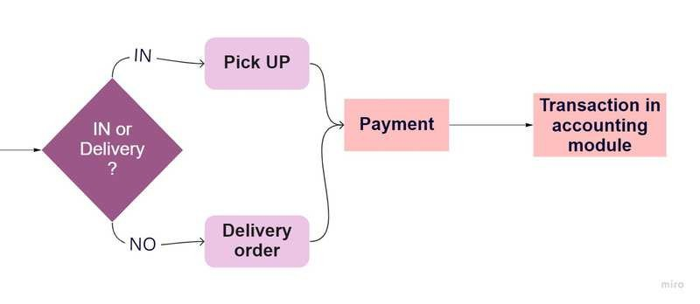

Slide 15

Discuss (communication ).
01
0a
Website.
02
Sales.
Point of sale.
07
Inventory.
Accounting.
MODULES IN
03
08
04 Attendance.
09
Email marketing.
05
Employee.
10
Dashboard.

Slide 16


Let's take a tour of our website!
WEBSITE

Slide 17






Sales
Quotation
Sales order
Deliver
Invoice

Slide 18
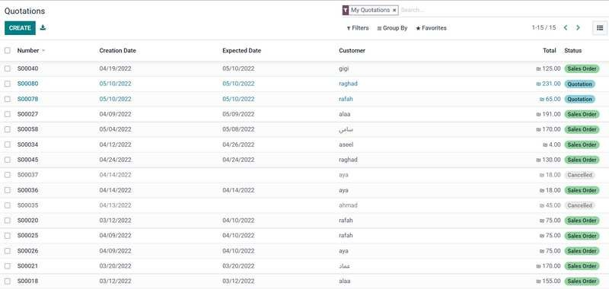
Sales

Slide 19
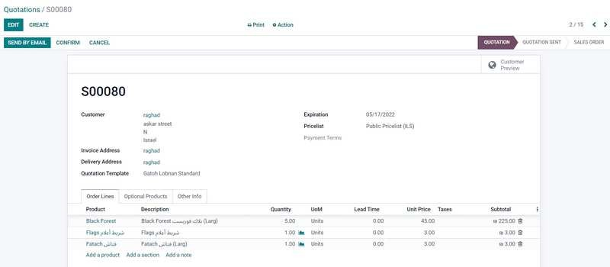
1. Connrm qoutation
Sales

Slide 20
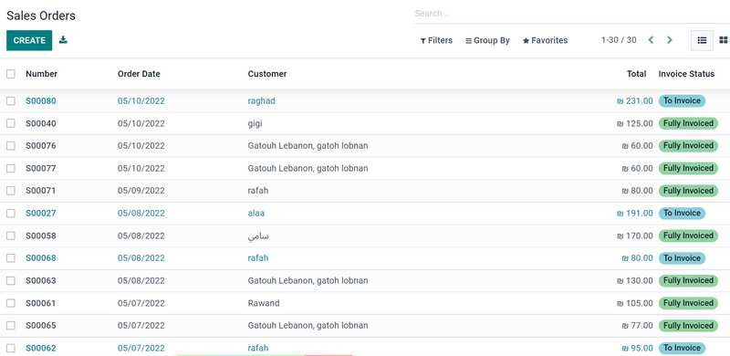
Sales

Slide 21
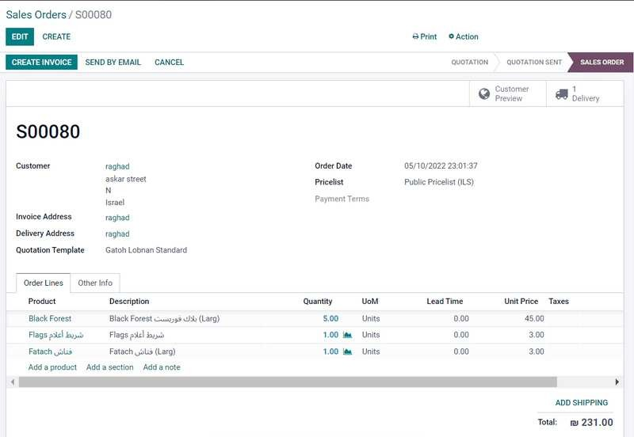


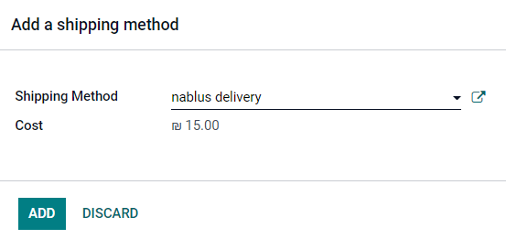
2. Delivery
Sales

Slide 22
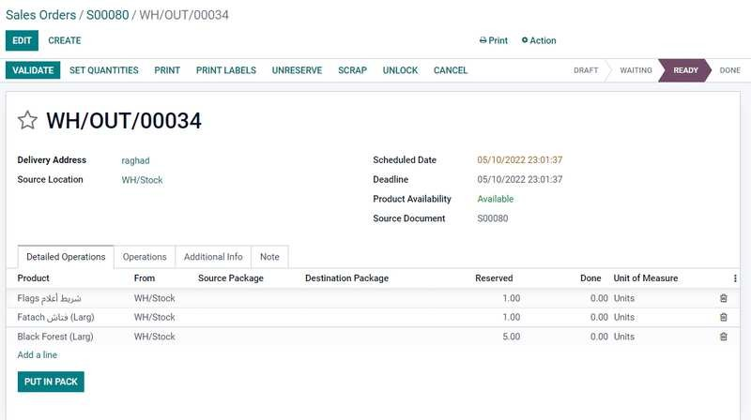
Sales

Slide 23
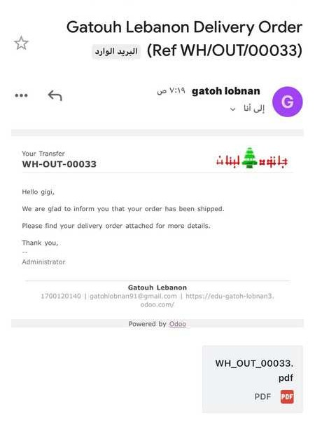

3. Send automatic email
Sales

Slide 24
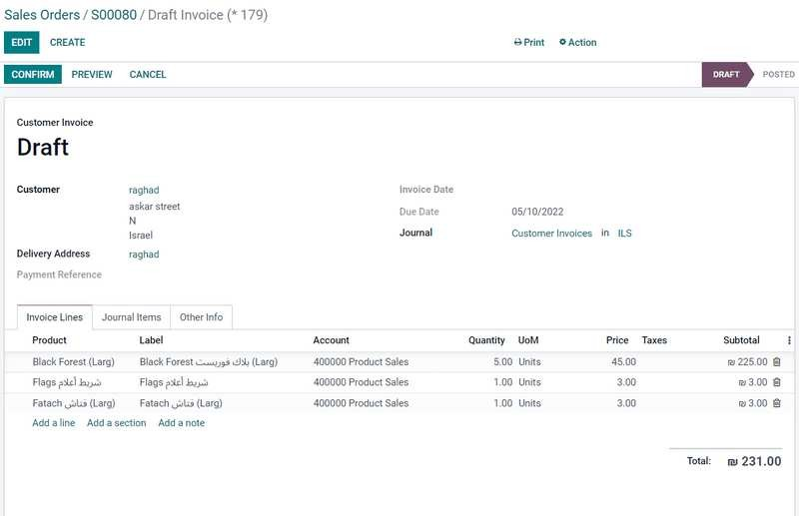
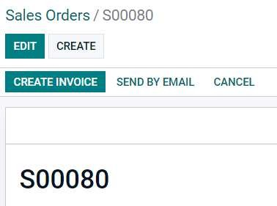
4. Create invoice

Slide 25
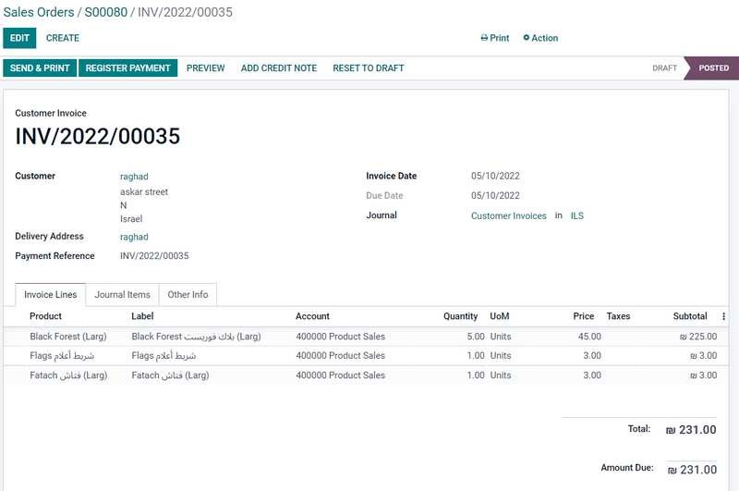
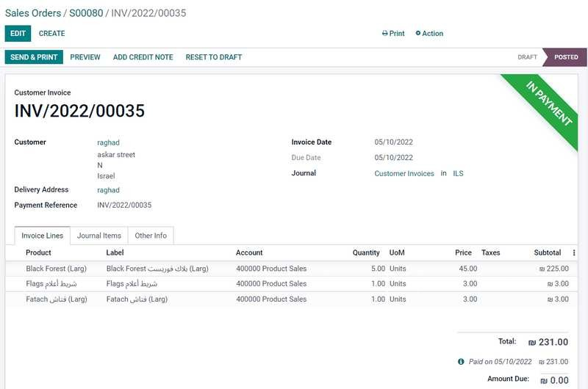

5. Register payment

Slide 26


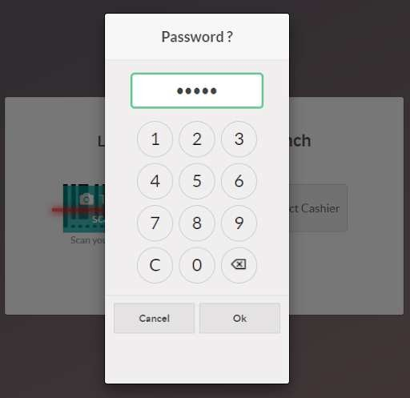

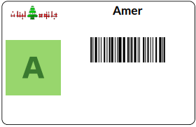
EMPLOYEE
ATTENDENCE

Slide 27
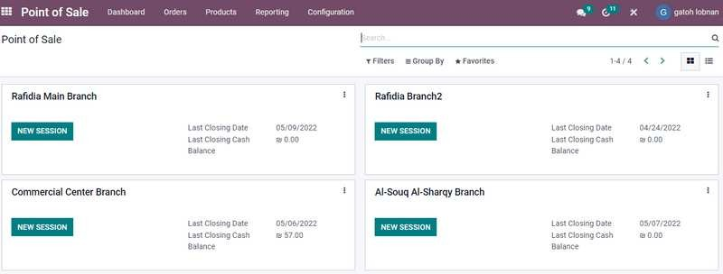

POS

Slide 28
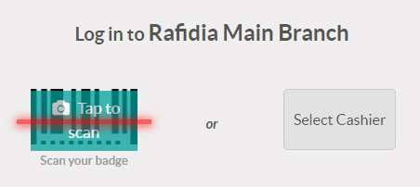
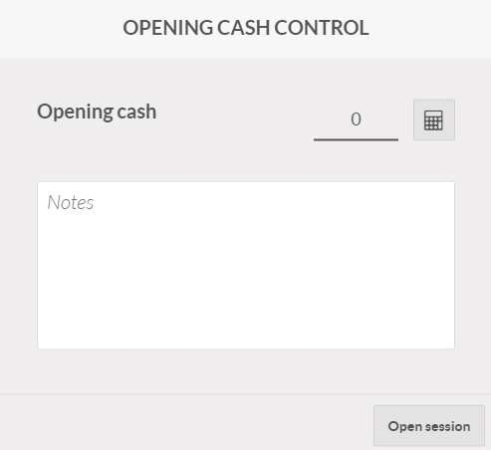
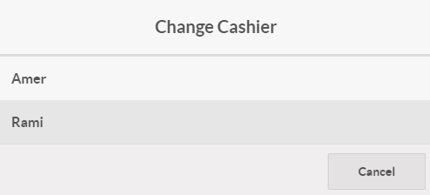
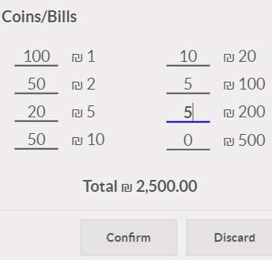
01
03
02

Slide 29

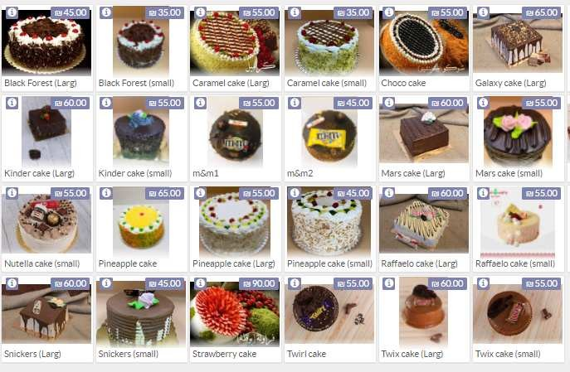
04
05

Slide 30
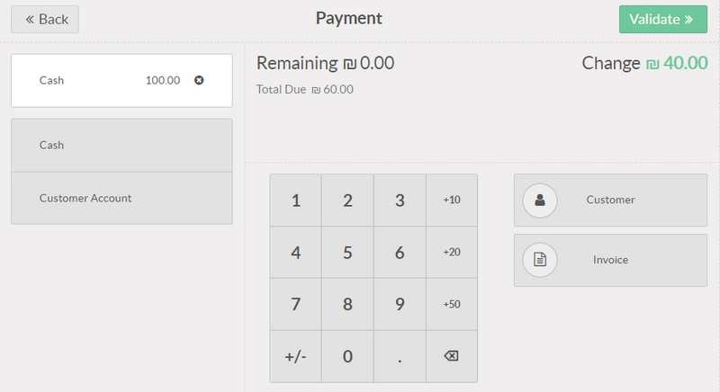

0a

Slide 31
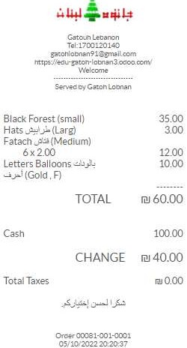


07
08

Slide 32
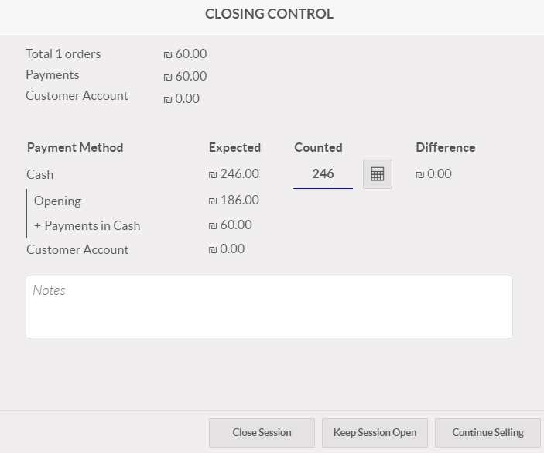

08

Slide 33
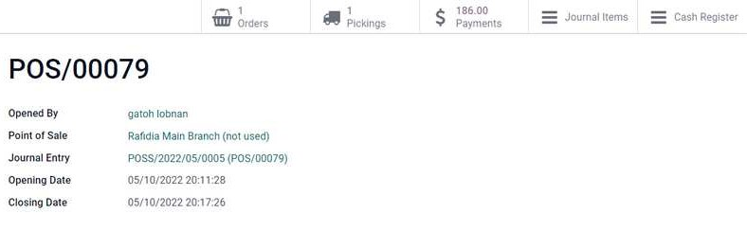
Summary at the of the day.
09

Slide 34
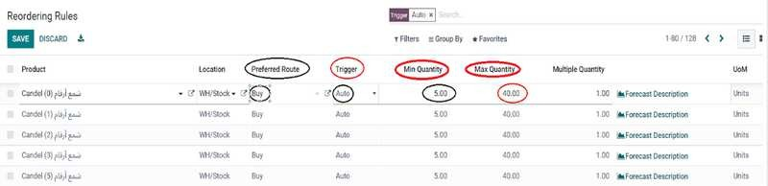

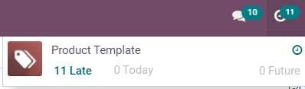
INVENTORY

Slide 35

Integration of all
Insert transactions directly to the
ledger.
ACCOUNTING
modules transactions.
Follow up of invoices and customers.
Reconciliation.

Slide 36
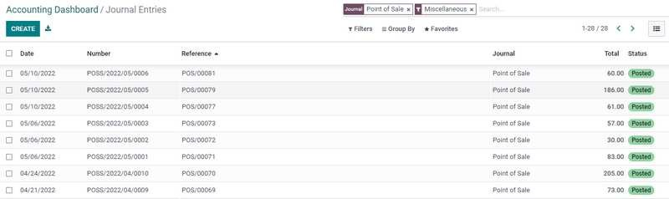
Integration of all modules transactions ( Point of sale ).

Slide 37
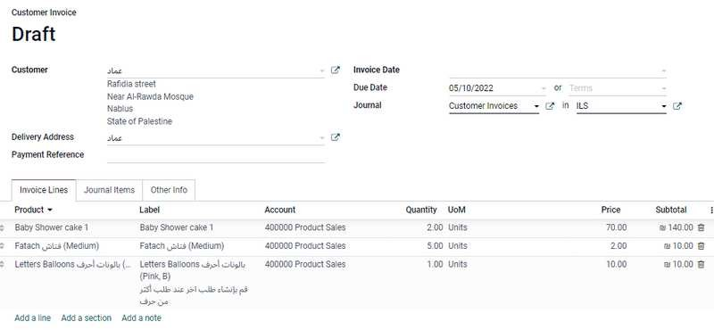
Insert transactions directly to the ledger.

Slide 38
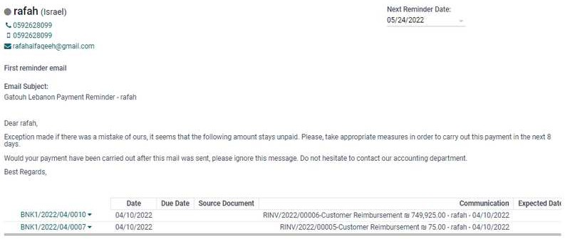
Follow up of invoices and customers.

Slide 39


Follow up of invoices and customers.

Slide 40
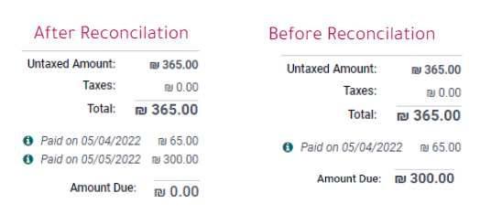
Reconciliation.
Mapping or linking at least two entries to make it clear that they balance each other.

Slide 41
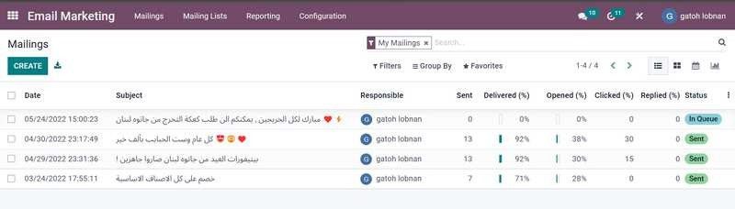

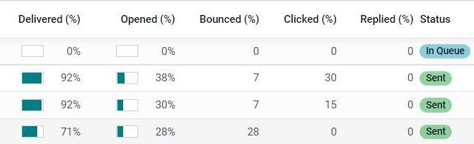
EMAIL MARKETING

Slide 42




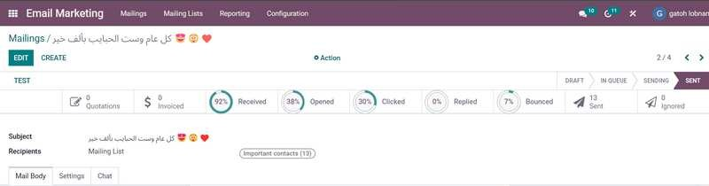




EMAIL MARKETING

Slide 43
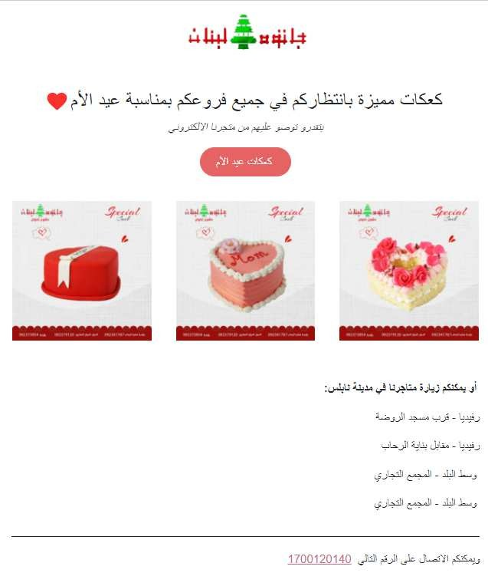
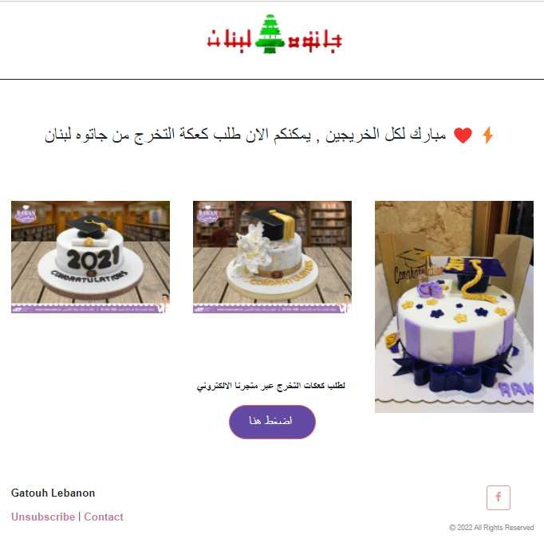
EMAIL MARKETING

Slide 44
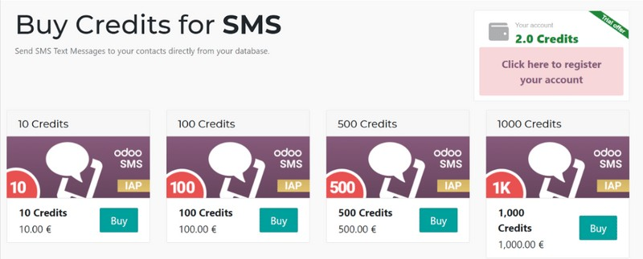

SMS MARKETING

Slide 45
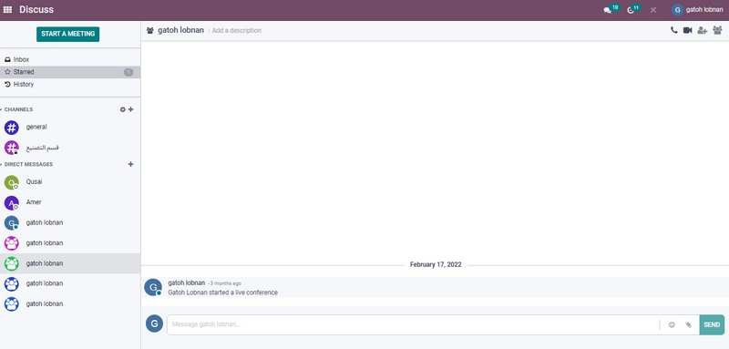

DISCUSS

Slide 46
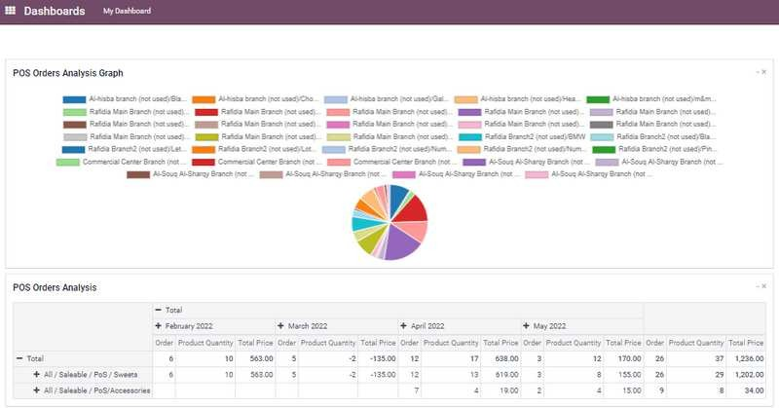

DASHBOARD

Slide 47
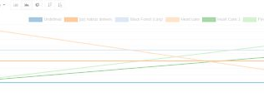
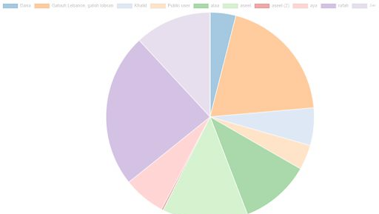
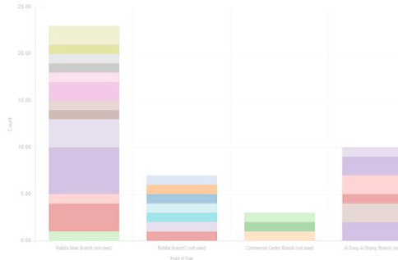

REPORTS
Systematic reports. AD - Hoc reports.
Dashbords.

Slide 48



FUTURE DEVELOPMENTS
Domain publishing & Search engine optimaization.
Raw material
Using modern dashboard Expand delivery scope
CRM

Slide 49







MEET OUR TEAM !
DUHA ZA'TAR
RAFAH FAQEEH
RANA MOGHRABI
ALAA ODEH

Slide 50



THANK YOU!!!
A N Y Q U E S T I O N ?
11 May 2022

