Slide 1
FOOD DELIVERY APP
Lunch Time

Slide 2
01
02
03
04
Problem vs. Solution
All about the Product
System works
Conclusion

Slide 3
Introduction
This study generally aims to implement an application for ordering foods easily from nearby restaurants The Food Ordering app is developed with Flutter, a cross-platform system that uses Android

Slide 4
Aims
Our Aims
design a food ordering app using flutter.
implement an application that will allow users to browse restaurants
lessen the time spent searching for restaurants and ordering food
develop a consolidated platform for restaurants to market their food services
MyDelivery

Slide 5
Problem
As Corona Virus Disease 2019 continues to limit people’s outdoor interactions, there has been an increase in food delivery. Due to the limitations in physical interactions between individuals to reduce the spread of the virus, the pandemic has forced the closure of restaurants

Slide 6
Solution
The main focus is the development process of the Food Ordering App in Flutter. The project is limited only to ordering foods, customizing orders, checking out and other necessary steps needed to complete food orders. This project will bring convenience to the users in ordering foods from their desired restaurants. The application is user-friendly and will allow users to simply select their orders, customize their orders according to their preference and check out. The project will eliminate the need to personally visit nearby restaurants just to order food.

Slide 7
Product Overview
Flutter language
PHP Language
Android studio
Phpmyadmin with xampp
For design the UI of the project
To get data from mysql dynamically

Slide 8
System works
Search meal
Menu of restaurant
Categories of Restaurant
The cart
To search about the restaurant you have in app
Food available in restaurants
List of orders
view a list of categories of restaurants

Slide 9
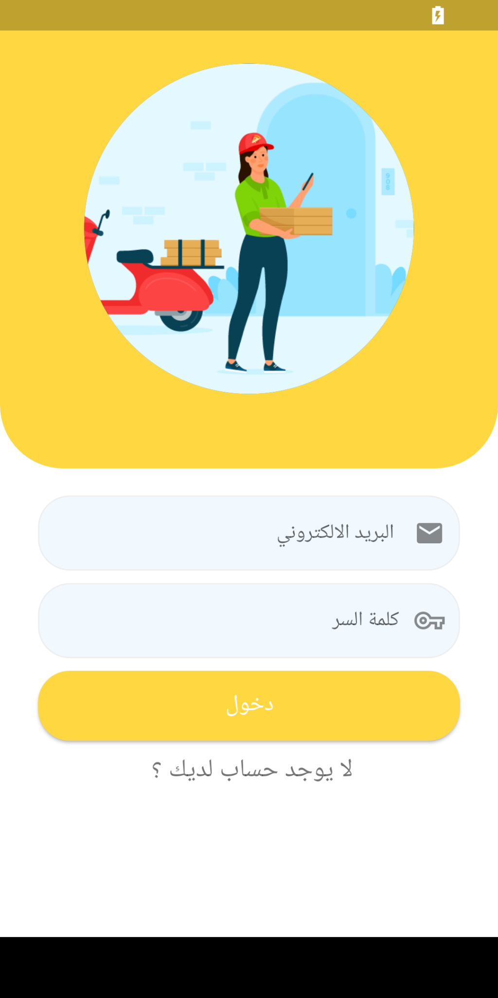
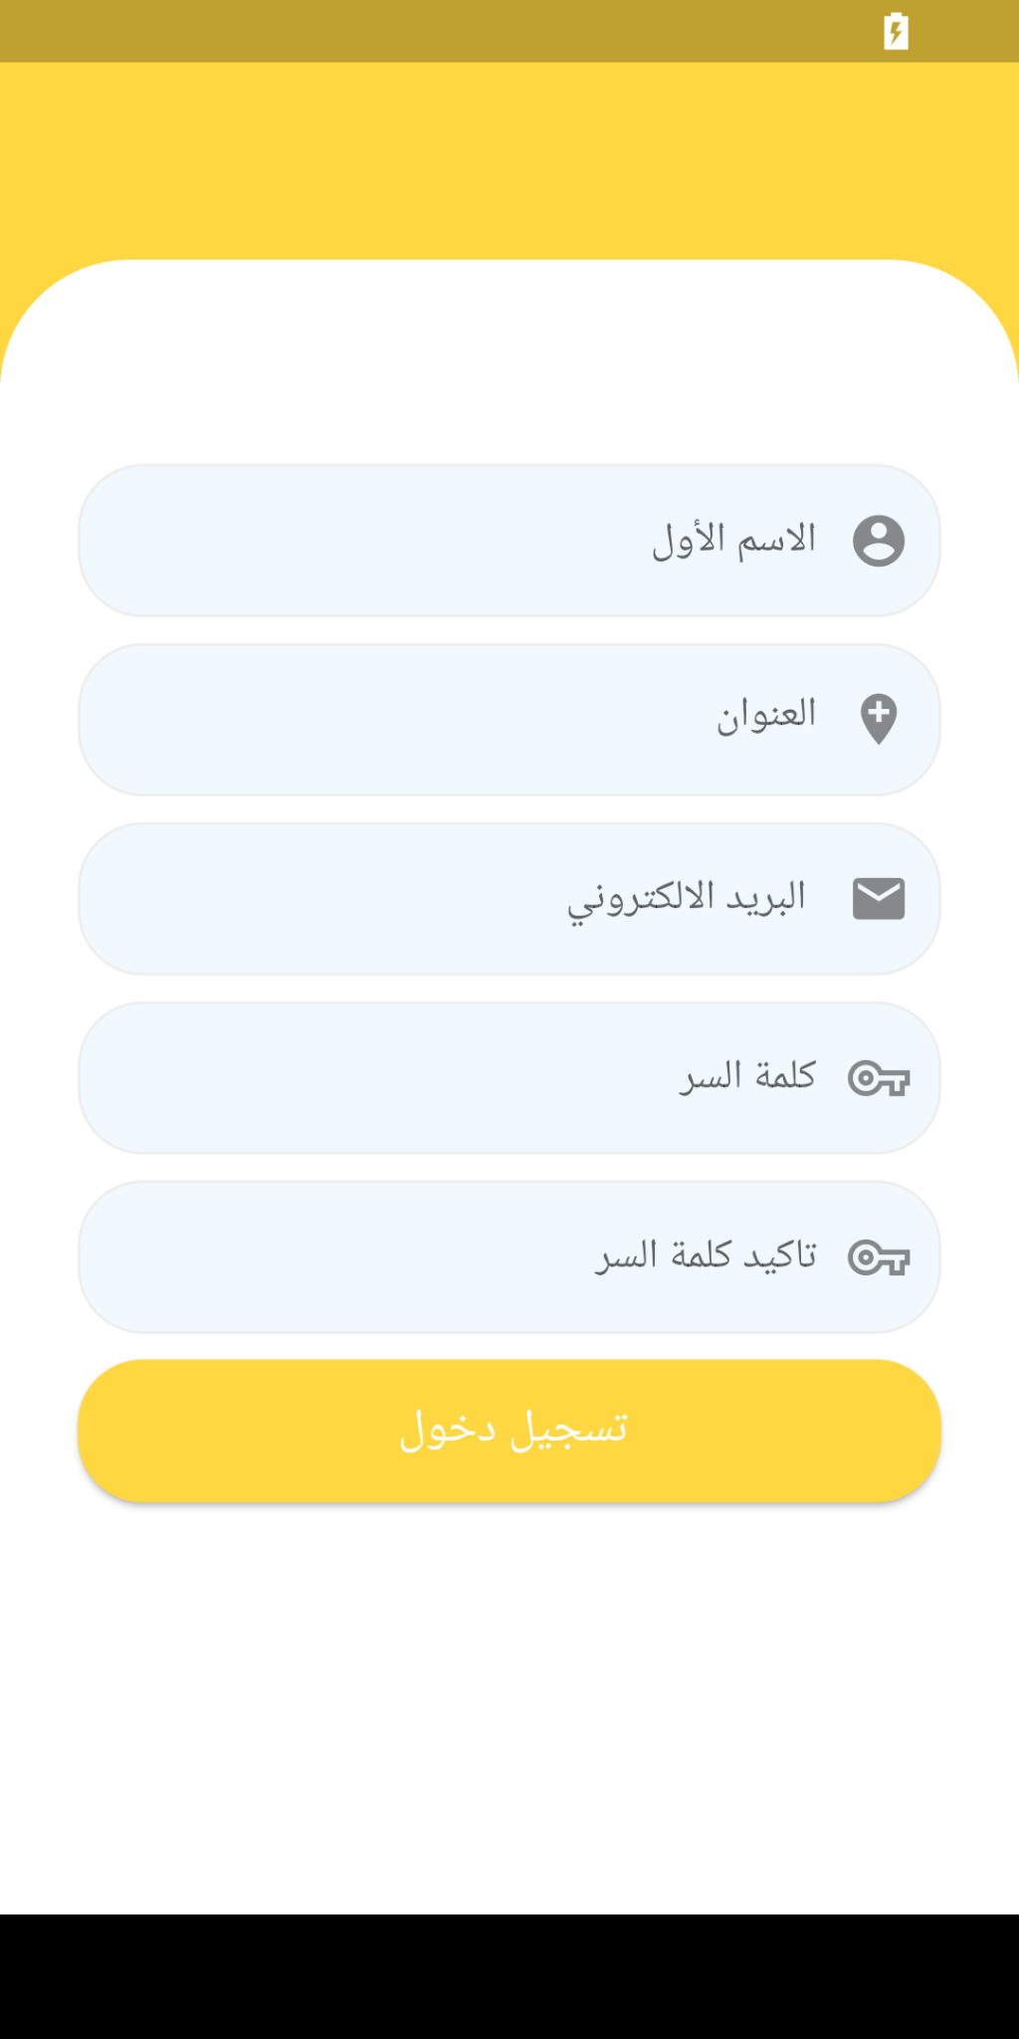
Login & Signup page
The user's information is entered and
stored in the database. The user can
use the application

Slide 10
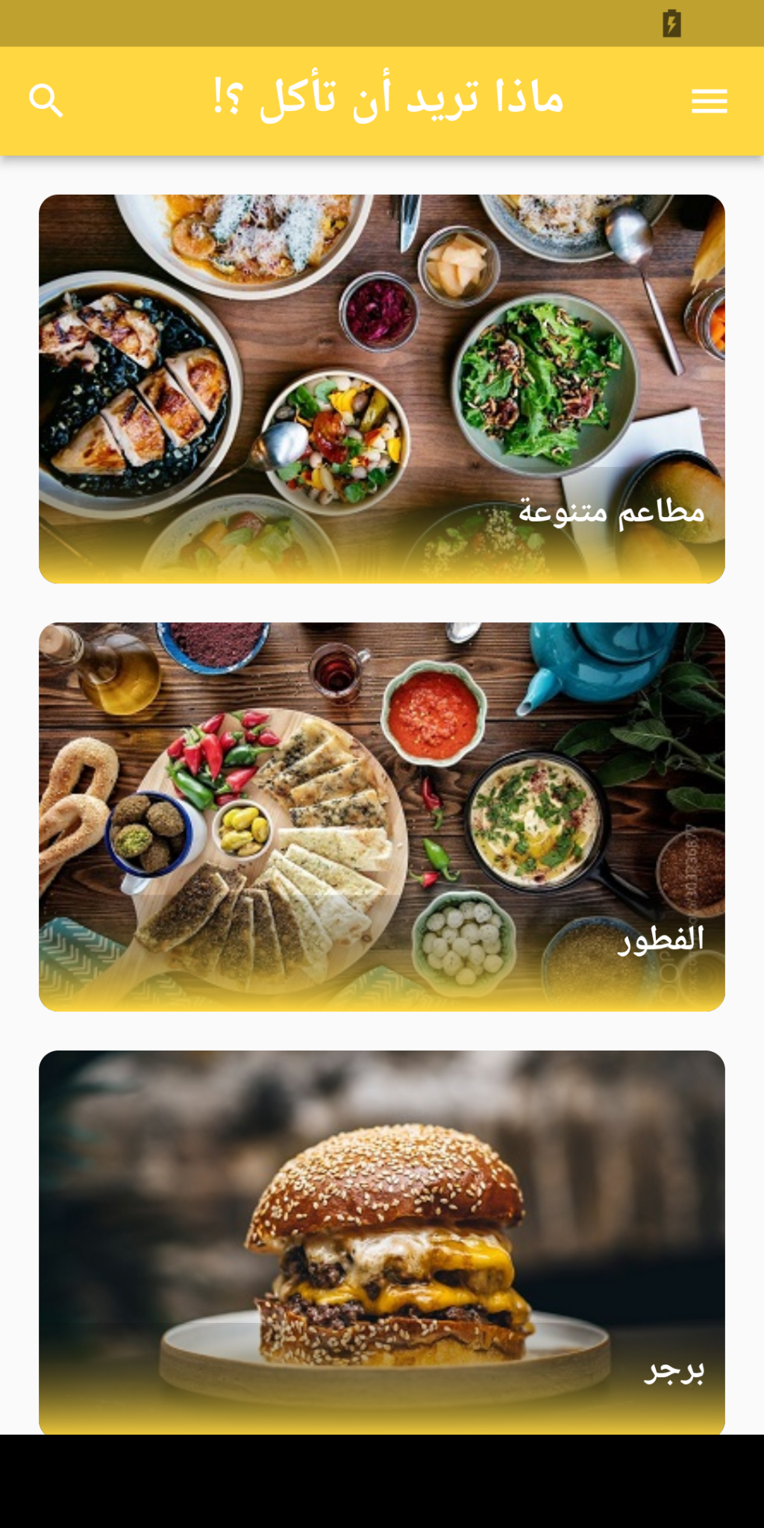

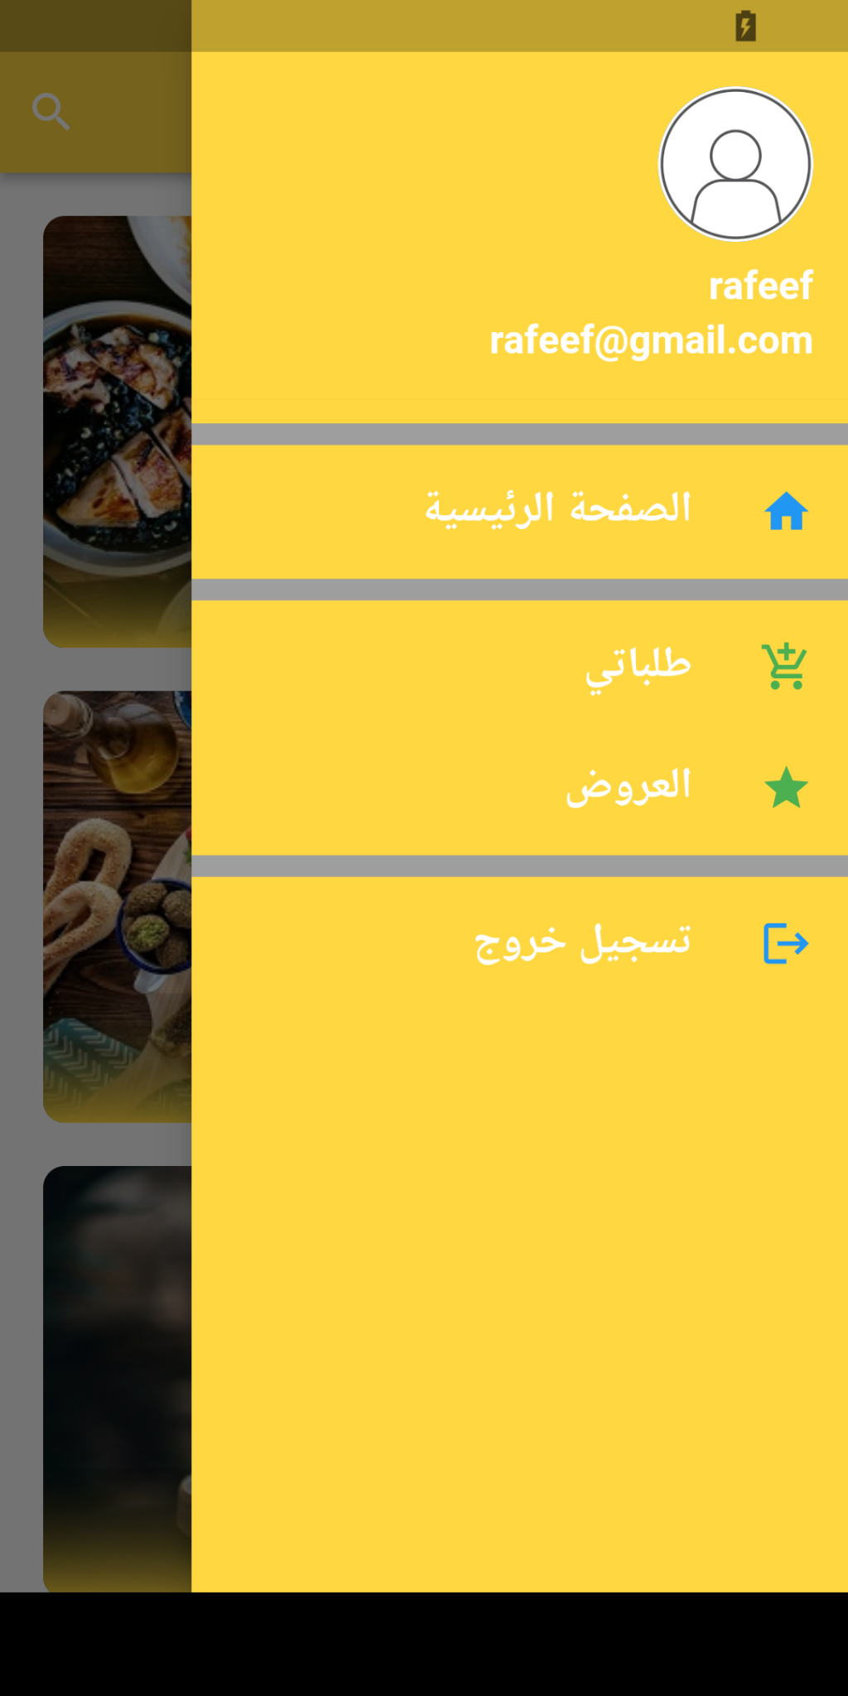
Main page
This page contains a drawer with user information, through which we can navigate between the pages and also contains a search icon to search for existing restaurants and the restaurants have been divided into sections for easy access

Slide 11
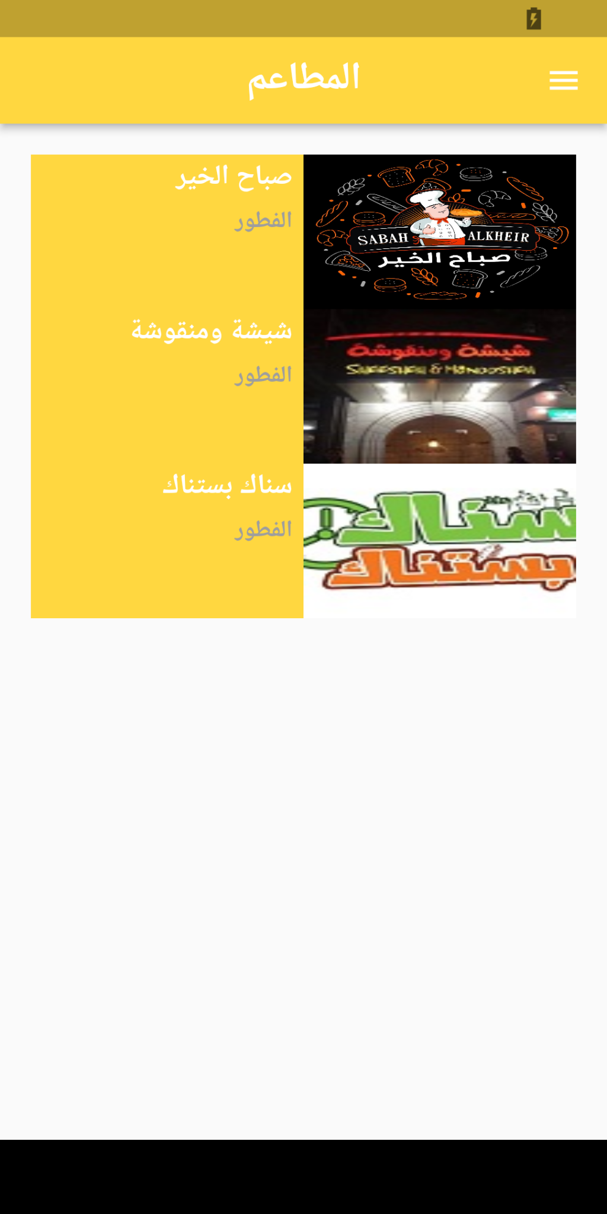
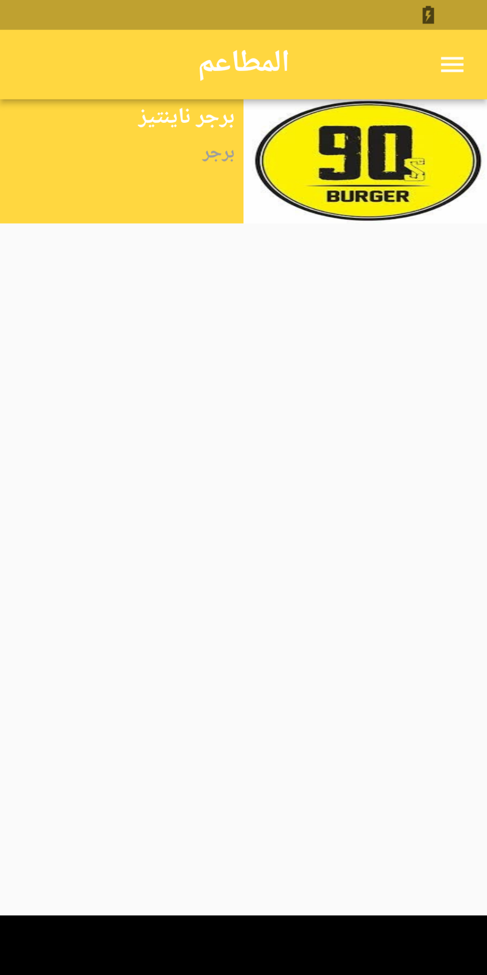
Resturants page
This page contains the restaurants in each section

Slide 12
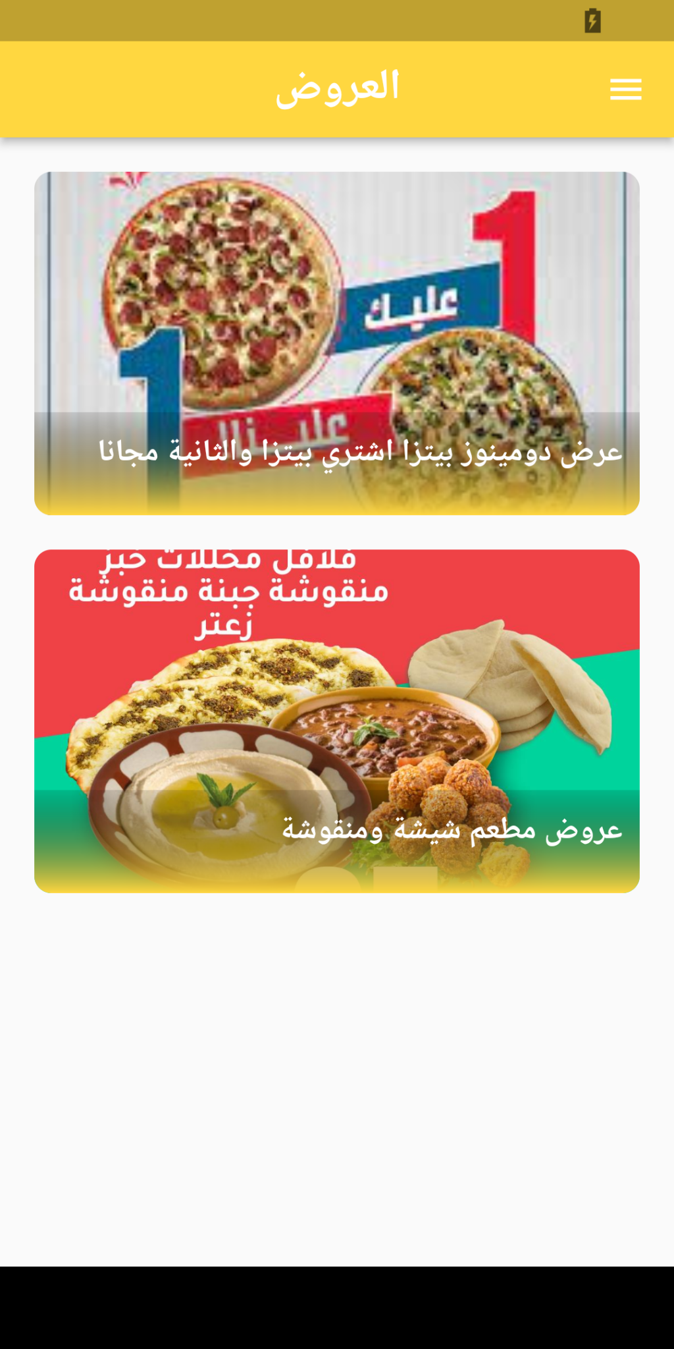
Offers page
This offers page contains all the offers placed by restaurants

Slide 13
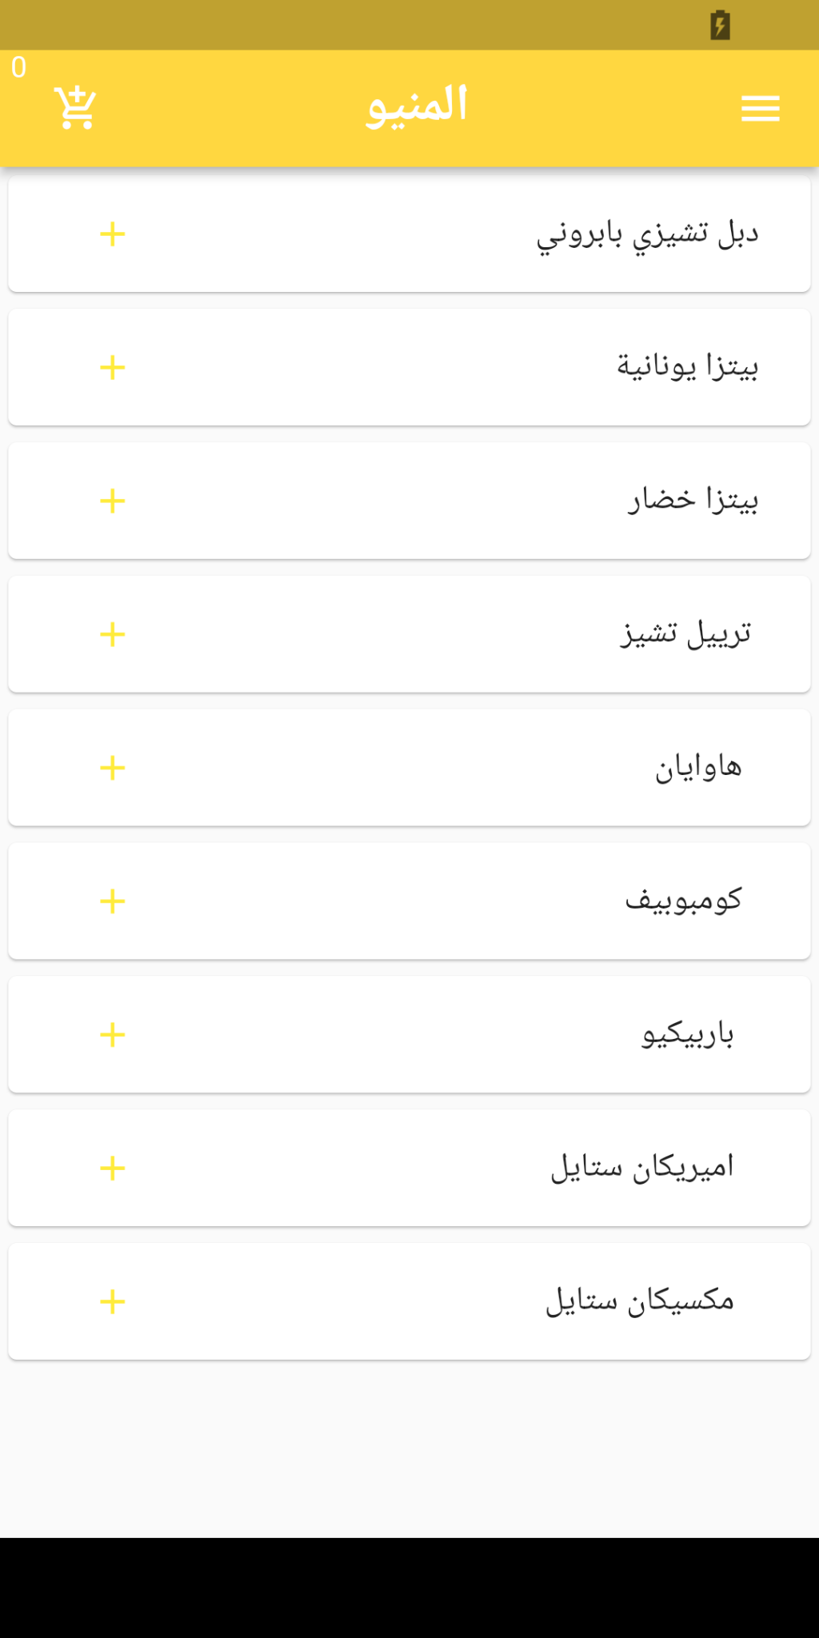
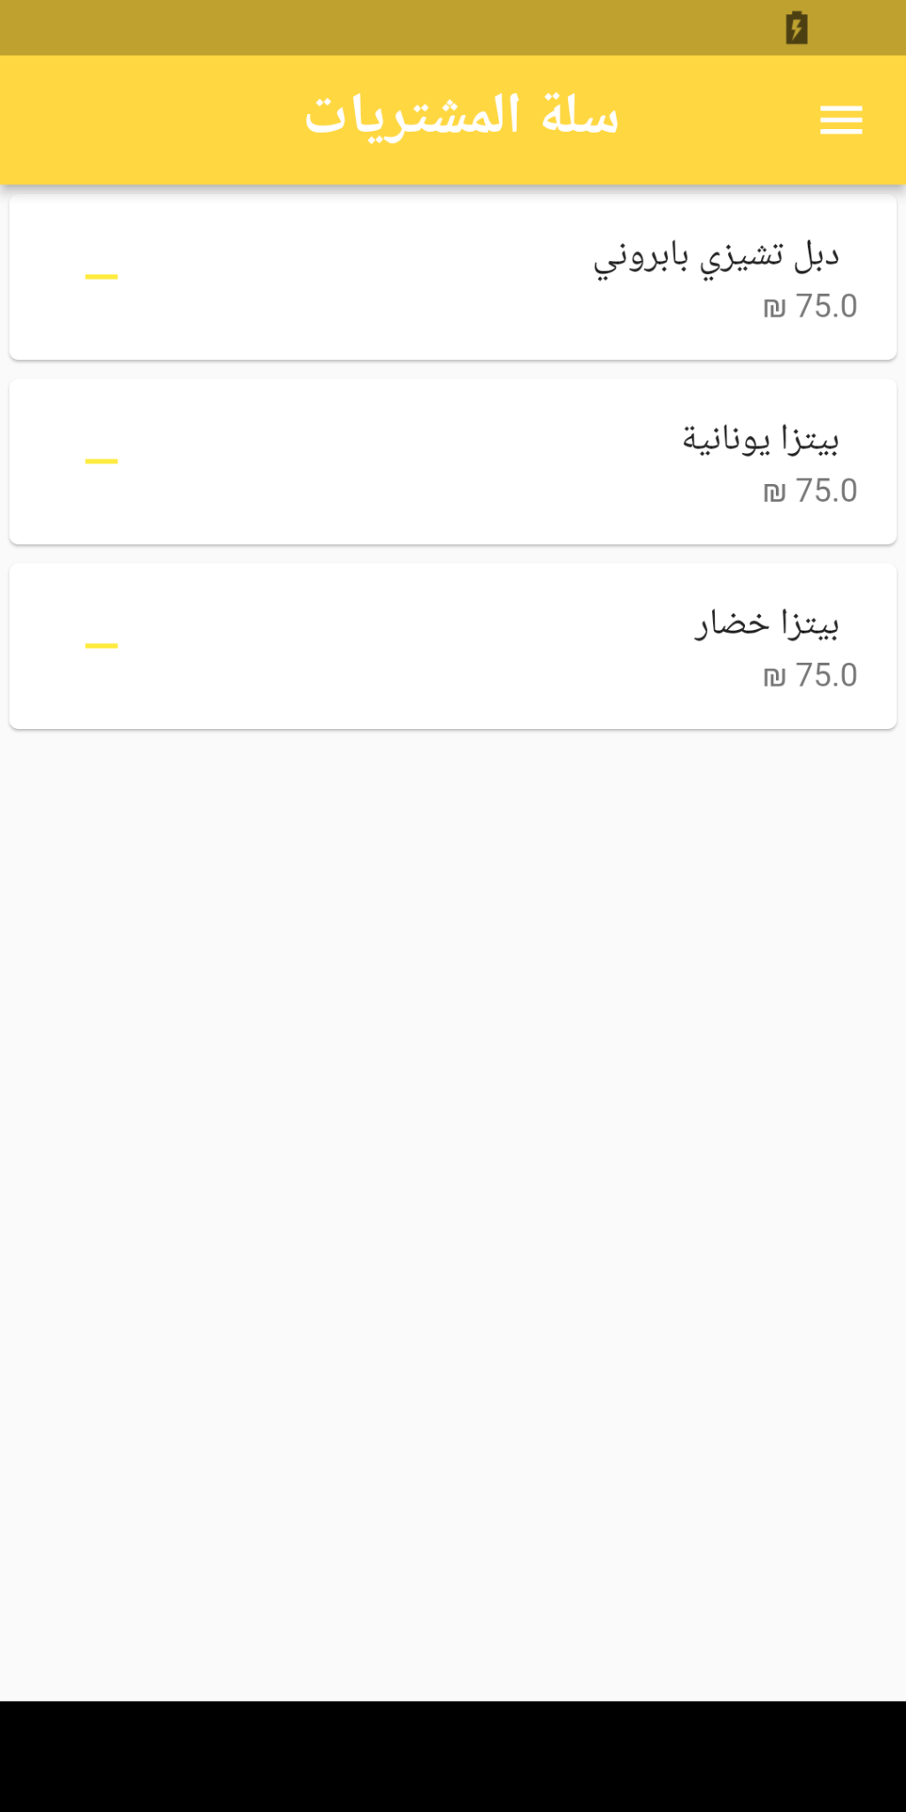
Menu & cart page
Here is the menu page that contains all the foods in each restaurant. Each item you want is added to the cart

Slide 14
Conclusion
The Food Ordering App in Flutter will streamline the process of browsing nearby restaurants, searching for food, and placing orders. The app will serve as a centralized platform for restaurants to continue their business operation.

Slide 15
Our Team
Rafeef Hamdan

Slide 16
Thanks!

