Slide 1
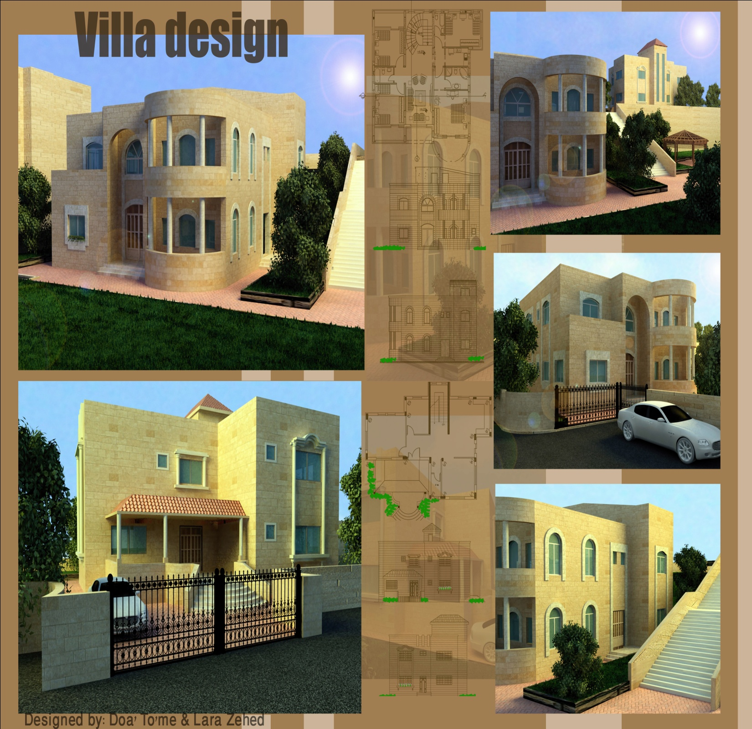
An-Najah National University
Faculty of Engineering
Department Of Building Engineering
Villas of extended Palestinian family
Graduation Project Submitted In Partial Fulfillment Of B.Sc. In Building Engineering
Super visor: Mohammed dwaikat Prepared by:
Lara Kamal Zuhd
Duaa Muhammed Toeme
Sahar Ya’qoub
May - 2011

