Slide 1



An-Najah University
Energy And Environmental Engineering
Graduation Project 2
Nablus Western WWTP Sludge Management Development – Techno – economic Approach
Prepared by:
Esraa Zammar
Mai Saboobah
Supervised by:
Dr. Abd Elrahim Abusafa
Dr. Mohammad Alsayed

Slide 2

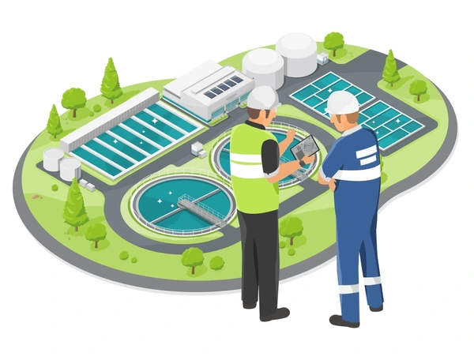
INTRODUCTION
Global Wastewater Challenge: Ineffective wastewater management leads to pollution and health risks, with 45 million dry tons of sludge generated annually worldwide, requiring significant investment in infrastructure.
01
Palestinian Context: 46.1% of the West Bank and 16.4% of Gaza lack sewage net45 million dry tons generated annually worldwide. Works, causing severe environmental and health risks.
02
03
45 million dry tons generated annually worldwide.
45 million dry tons generated annually worldwide.
Need for Effective Sludge Treatment: Developing effective methods for sludge treatment is crucial for environmental and economic sustainability.
04

Slide 3

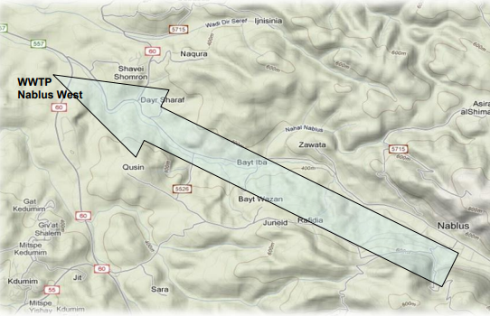
BACKGROUND
The sewage treatment plant is situated to the west of Nablus, approximately 12 kilometers from the city itself, within the territory of the town of Deir Sharaf.
In 2022

Slide 4

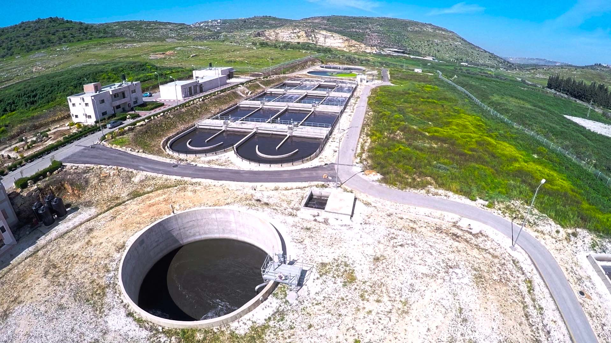


PROBLEM STATEMENT
2. Project Goals: Evaluate "greenhouse solar drying" vs. current methods, focusing on environmental, health, and economic impacts to improve sustainable sludge management.
1.Current Challenges: Western Nablus WWTP struggles with sludge management, needing to dry sludge from 26% to 90% dry solid content for fertilizer or 50% for soil conditioner to reduce landfill strain

Slide 5

OBJECTIVE
01
Evaluate Current System: Assess the Western Nablus WWTP's sludge drying for environmental and health compliance.
02
02
Solar Drying Potential: Explore using greenhouse solar drying to achieve 90% dry solids, considering environmental and economic impacts.
03
03
Feasibility Design: Plan and design greenhouse solar drying for Western Nablus WWTP, ensuring compliance with Palestinian standards and conducting cost-benefit analysis.

Slide 6
METHODOLOGY
Selection of the Optimal Method
Greenhouse Design
Economic Feasibility Assessment
Impact Assessment
Recommendations
Information Gathering

Slide 7
METHODOLOGY
COMPOSTING
PYROLOSIS
Selection of the Optimal Method
Process Design
Economic Feasibility Assessment
Impact Assessment
OPTION ANALYSIS
SOLAR DRYING
N
GASIFICATIN
INCINERATION

Slide 8

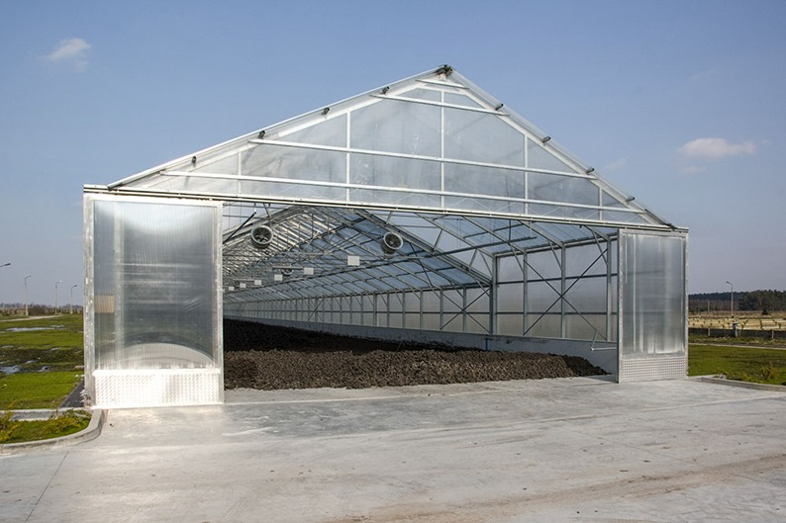
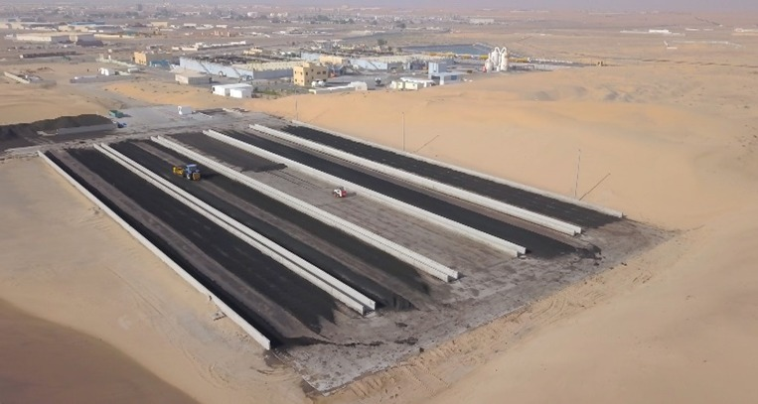
SOLAR DRYING
Greenhouse
Solar bed

Slide 9
DESIGN GREENHOUSE
SOLAR DRYER

Slide 10
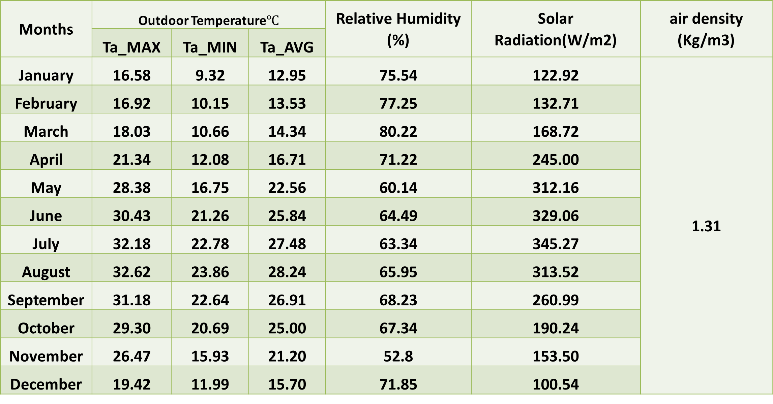
Study Area and Environmental Conditions
Meteorological data
Months | Outdoor Temperature$℃$ |  |  | Relative Humidity (%) | Solar Radiation(W/m2) | air density (Kg/m3)
 | Ta_MAX | Ta_MIN | Ta_AVG
January | 16.58 | 9.32 | 12.95 | 75.54 | 122.92 | 1.31
February | 16.92 | 10.15 | 13.53 | 77.25 | 132.71
March | 18.03 | 10.66 | 14.34 | 80.22 | 168.72
April | 21.34 | 12.08 | 16.71 | 71.22 | 245.00
May | 28.38 | 16.75 | 22.56 | 60.14 | 312.16
June | 30.43 | 21.26 | 25.84 | 64.49 | 329.06
July | 32.18 | 22.78 | 27.48 | 63.34 | 345.27
August | 32.62 | 23.86 | 28.24 | 65.95 | 313.52
September | 31.18 | 22.64 | 26.91 | 68.23 | 260.99
October | 29.30 | 20.69 | 25.00 | 67.34 | 190.24
November | 26.47 | 15.93 | 21.20 | 52.8 | 153.50
December | 19.42 | 11.99 | 15.70 | 71.85 | 100.54

Slide 11
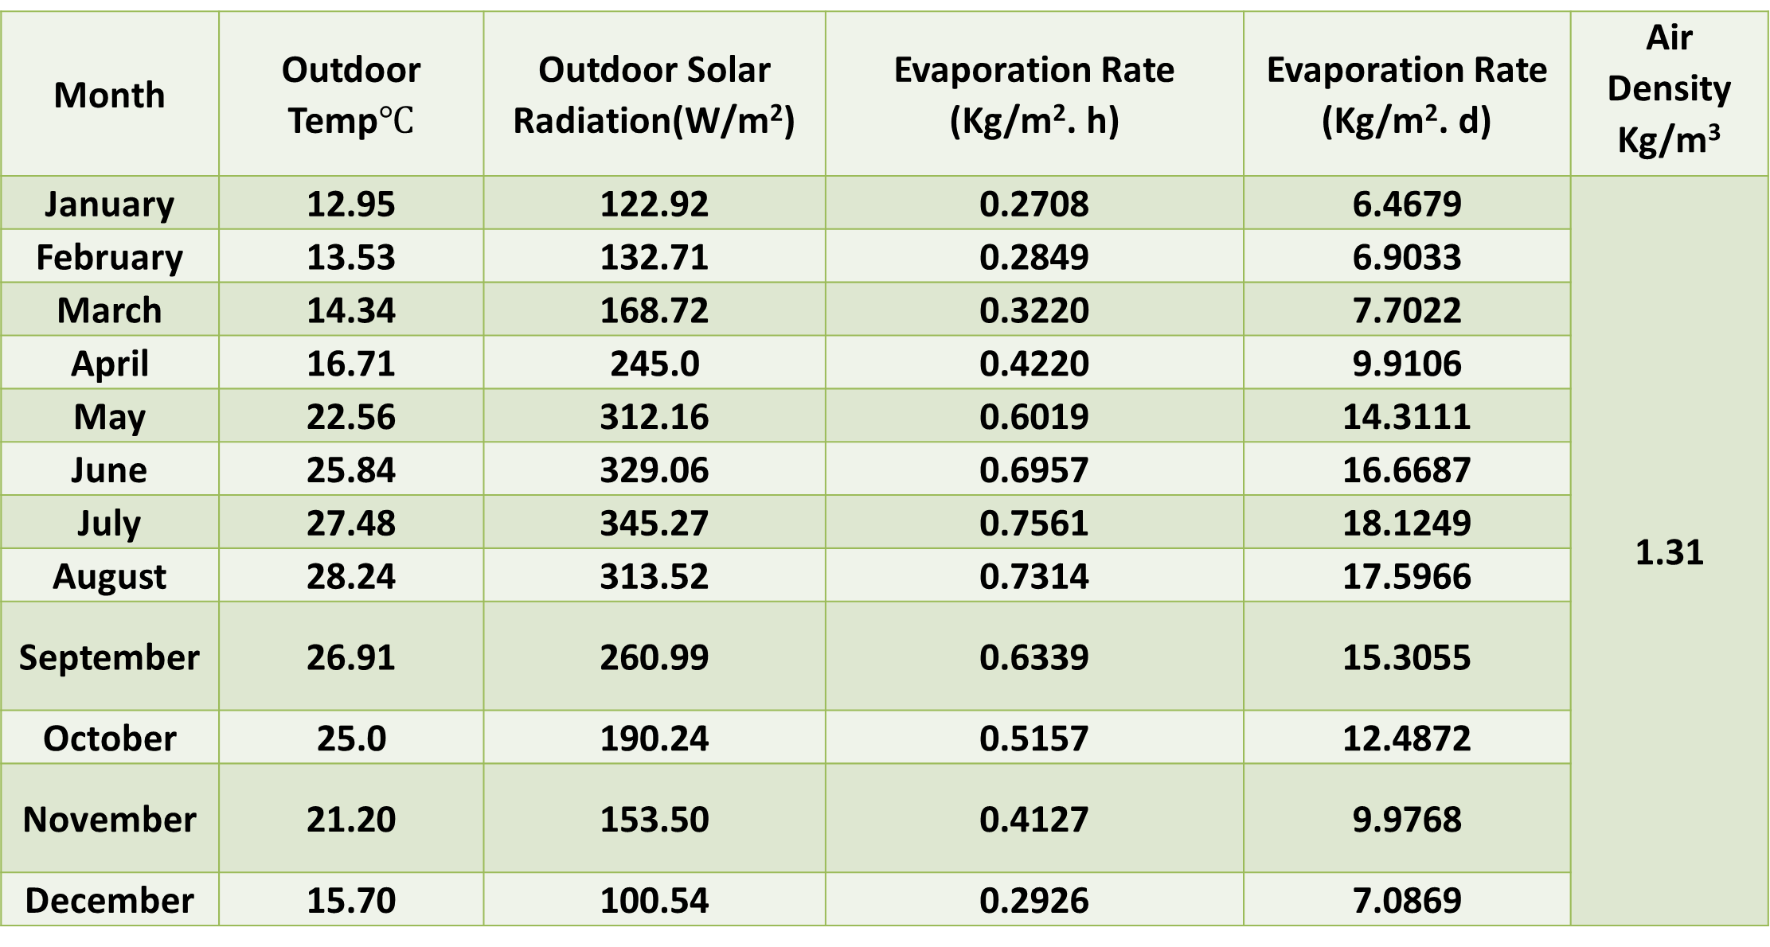
Calculations of Evaporation rate
Month | Outdoor Temp$℃$ | Outdoor Solar Radiation(W/m²) | Evaporation Rate (Kg/m². h) | Evaporation Rate (Kg/m². d) | Air Density Kg/m³
January | 12.95 | 122.92 | 0.2708 | 6.4679 | 1.31
February | 13.53 | 132.71 | 0.2849 | 6.9033
March | 14.34 | 168.72 | 0.3220 | 7.7022
April | 16.71 | 245.0 | 0.4220 | 9.9106
May | 22.56 | 312.16 | 0.6019 | 14.3111
June | 25.84 | 329.06 | 0.6957 | 16.6687
July | 27.48 | 345.27 | 0.7561 | 18.1249
August | 28.24 | 313.52 | 0.7314 | 17.5966
September | 26.91 | 260.99 | 0.6339 | 15.3055
October | 25.0 | 190.24 | 0.5157 | 12.4872
November | 21.20 | 153.50 | 0.4127 | 9.9768
December | 15.70 | 100.54 | 0.2926 | 7.0869

Slide 12
Calculations of Evaporation rate
Month | 19.JAN | 18.JUL
Evaporation Rate(Kg/m2.h) | 0.1831 | 1.7936

Slide 13
Calculations of Evaporation rate

Slide 14
VENTELATION RATE
Qv(m³/m².h) | Evaporation Rate (Kg/m².h)
130 | 0.1831
120 | 0.1770
100 | 0.1639
80 | 0.1491
50 | 0.1222
20 | 0.0830

Slide 15
AIR MIXING RATE
In our study, we used a Qm of 90 m3/m2·h, achieved by installing 30 units with an air mixing rate of 2.9623 m3/m2·h. This configuration effectively maintained the desired air mixing without notable impact on the evaporation rate.

Slide 16
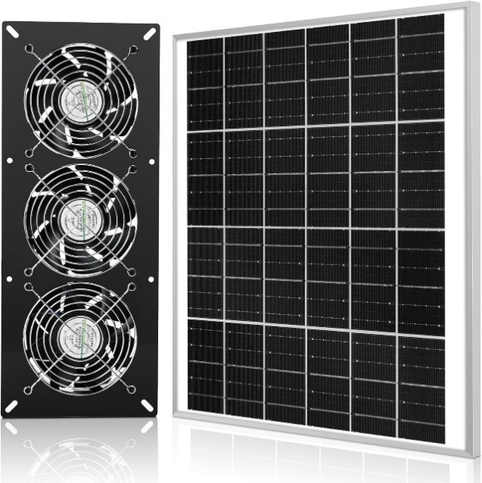
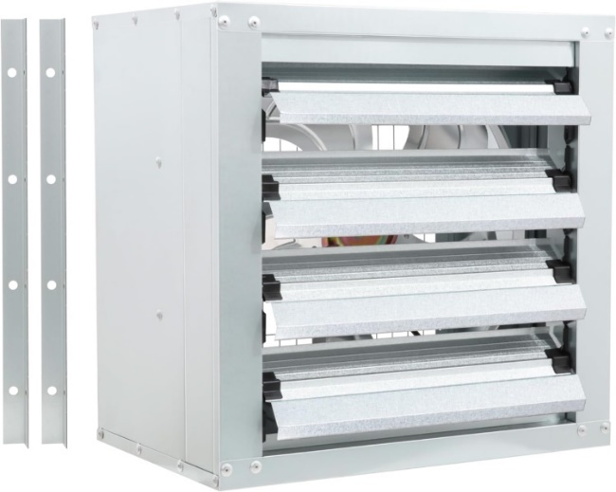
FANS AND EXHAUST FANS
Category | Solar-Powered Fans | Exhaust Fans
Quantity | 30 fans | 37 fans
Power | 25 watts per fan | 250 watts per fan
CFM | 360 CFM | 4900 CFM

Slide 17
CALCULATIONS OF GREENHOUSE AREA
Month | Evaporation Rate (Kg/m2.h) | Daily Sludge mass(t/d) | σ (kg[solids]/ kg[sludge]) | final DS achieved (%) | Area (m2) | construction cost of GSD (ILS)
January | 0.2708 | 15 | 0.28 | 90 | 1801 | 72047.7
February | 0.2849 |  |  |  | 1729 | 69165.8
March | 0.3220 |  |  |  | 1605 | 64211.3
April | 0.4220 |  |  |  | 1340 | 53603.3
May | 0.6019 |  |  |  | 991 | 39659.5
June | 0.6957 |  |  |  | 862 | 34468.1
July | 0.7561 |  |  |  | 806 | 32244.6
August | 0.7314 |  |  |  | 813 | 32512.7
September | 0.6339 |  |  |  | 893 | 35714.3
October | 0.5157 |  |  |  | 1026 | 41037.2
November | 0.4127 |  |  |  | 1225 | 49010.1
December | 0.2926 |  |  |  | 1624 | 64966.5

Slide 18
CALCULATIONS OF GREENHOUSE AREA

Slide 19
CONSTRUCTION COSTS FOR GSD INSTALLATION AND EQUIPMENT
construction cost of GSD (ILS) | 94,060.4
CO2 sensor (ILS) | 1,015.2
temp&humidity sensor (ILS) | 818.9
30 FAN 360CFM (ILS) | 10,152.0
37 exhaust fan (ILS) | 116,548.7
Total (ILS) | 187,258.6

Slide 20
SLUDGE TRANSPORTATION COSTS TO ZAHRET AL-FINJAN LANDFILL
Before Drying
After Drying
120.00 | ILS/ton
15.00 | ton /day
33.48 | Gate fees (ILS/ton)
2,302.20 | ILS/day
840,303.00 | per year
64,461.60 | per month
120.00 | ILS/ton
4.70 | ton /day
33.48 | Gate fees (ILS/ton)
721.36 | ILS/day
263,294.94 | per year
20,197.97 | per month

Slide 21
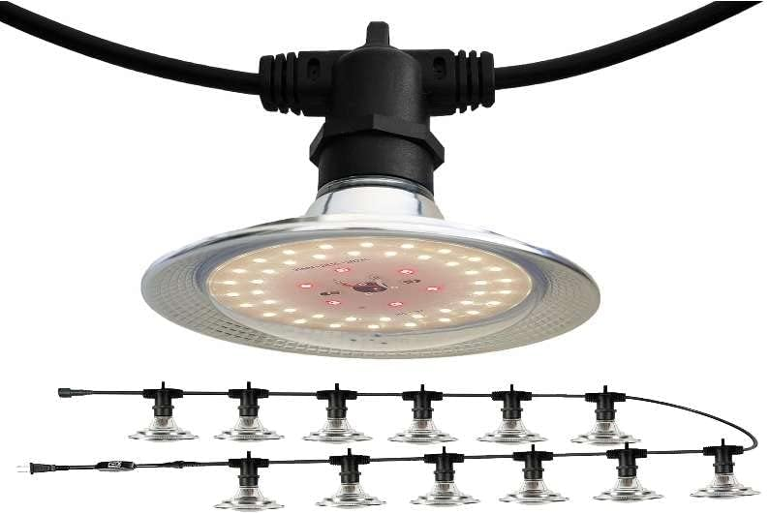
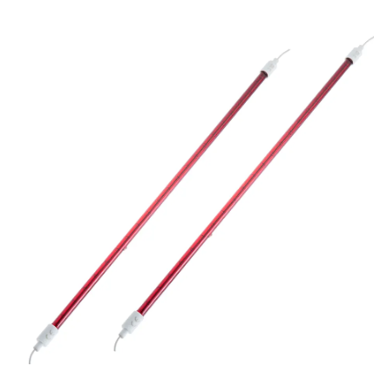
RECOMMENDATION
Cost (ILS) | 5,264
fixed cost for year (ILS) | 47,304
fixed cost per month (ILS) | 3888
LIGHTING
cost (ILS) | 33,539
fixed cost for year (ILS) | 488,370
fixed cost per month (ILS) | 40,140
LIGHTING FOR HEATING

Slide 22
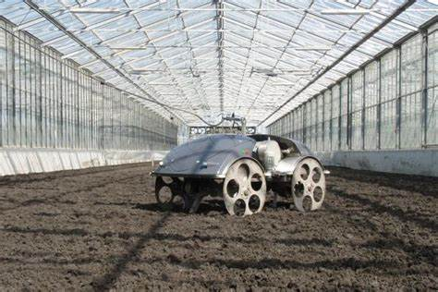
RECOMMENDATION
ELECTRIC MOLE

Slide 23

CONCLUSION
The greenhouse solar dryer at Nablus West Purification Station is a highly effective and economically prudent solution for sludge treatment. By drying 15 tons of sludge to 90% dry solids, reducing its moisture content to 4,700 tons, and achieving a remarkable ROI of 282.17% with a short SPP of 0.354 years, it significantly cuts transportation costs. This approach not only optimizes logistical efficiency but also underscores the dryer's cost-effectiveness and quick recoupment of initial investment.

Slide 24
THANK YOU

