Slide 1

Graduation Project (II)
Redesign of Jenin health care center (L-4)
Prepared by :
Ahmad Hussain
Obaida Owaidat
Mahmoud Ibrahim
Supervisor: Eng. Ameer Aker
14-MAY-2018

Slide 2
Outline
Introduction
Methodology
Site analysis
Architectural design
Environmental design
Structural design
Electrical design
Mechanical design & Safety
Quantity Survey

Slide 3
Introduction
Project Definition
Objectives

Slide 4
Methodology
Data Collection
Codes and Standards
Data Analysis
Obtain Results
Evaluate
Redesign

Slide 5
Site Analysis

Slide 6

Site Analysis

Slide 7
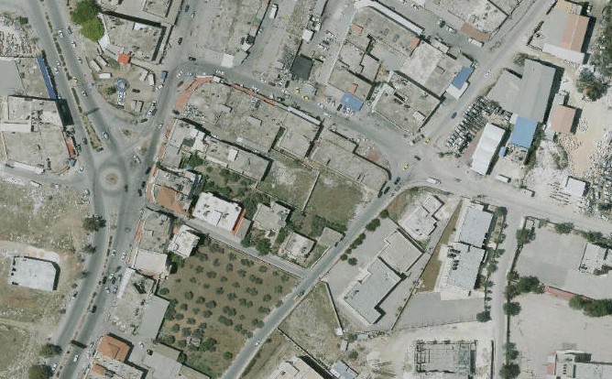
Site Location
N
`

Slide 8
Climate Conditions
Temperature = (11-31) °C
Humidity = 59%
Wind speed = 13 km/hr.

Slide 9
Architectural Design

Slide 10
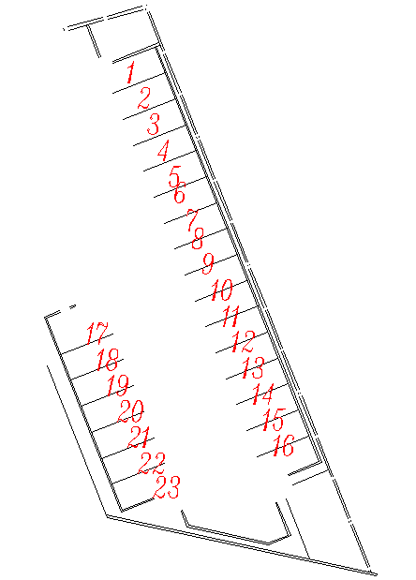
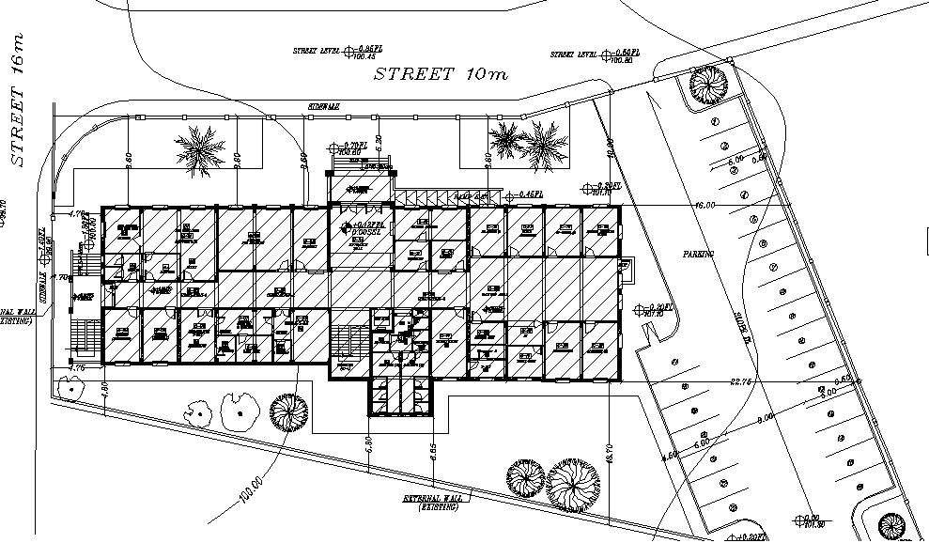
Parking
Previous Parking

Slide 11
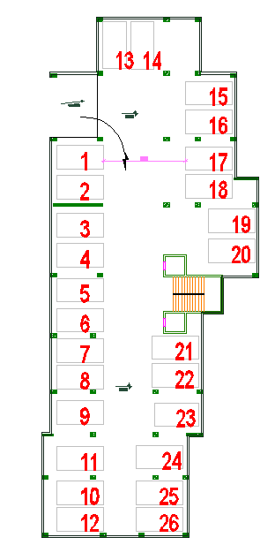
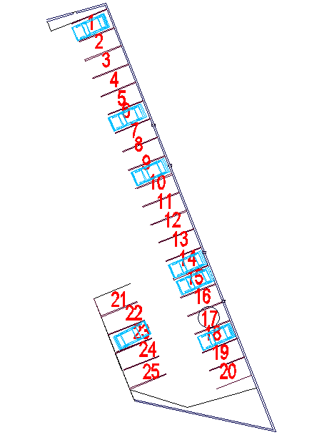
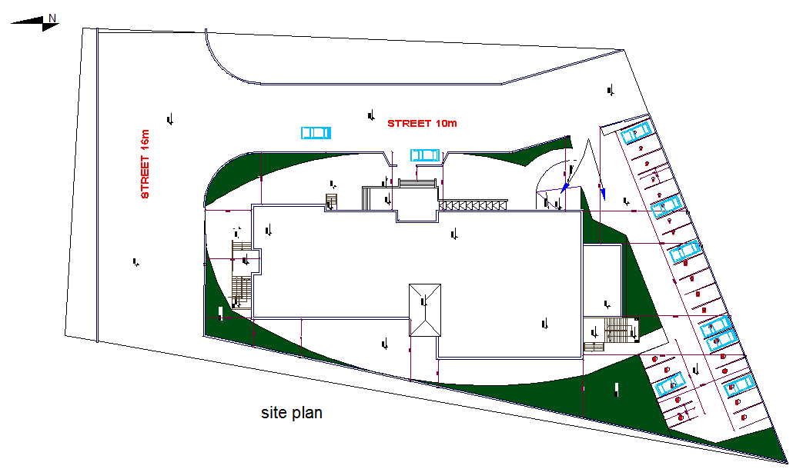
Parking
New Parking

Slide 12
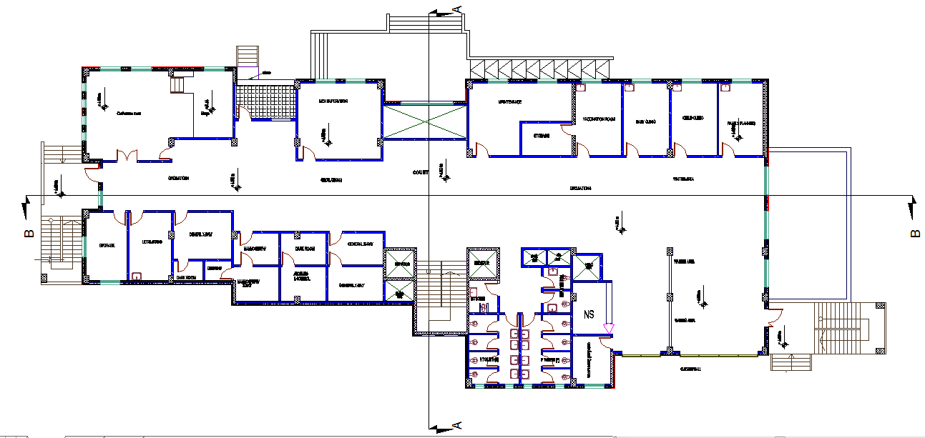
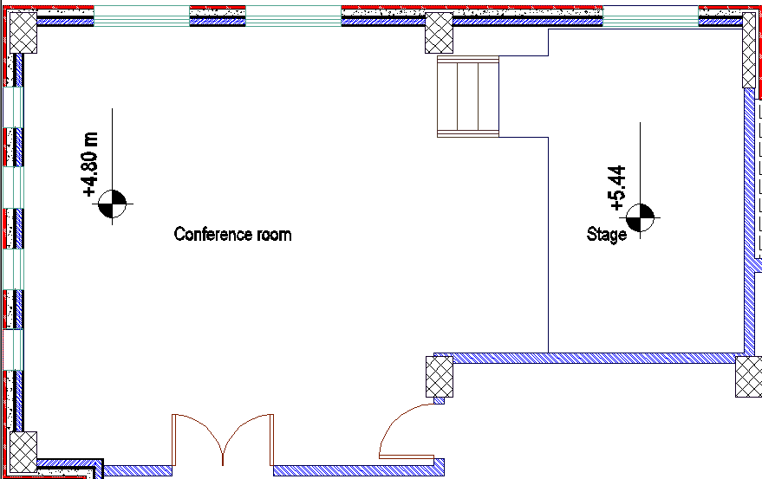
Functions
New function

Slide 13
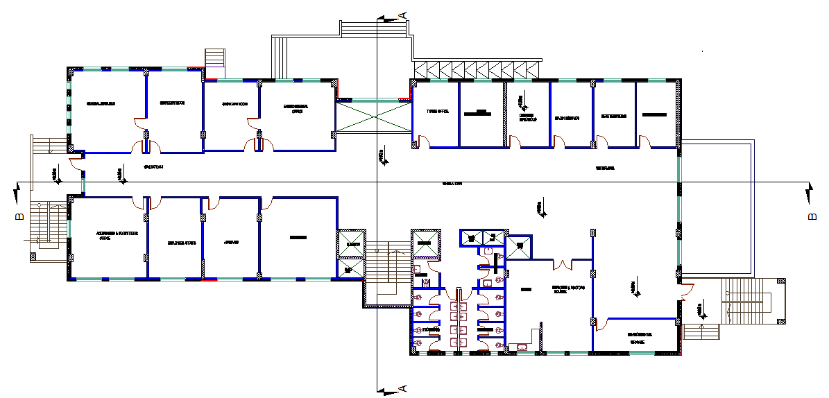
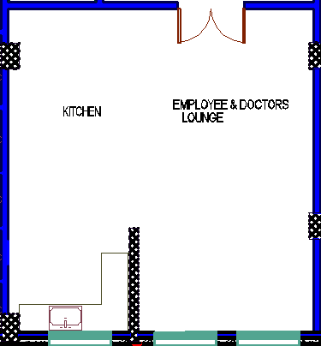
Functions
New function

Slide 14
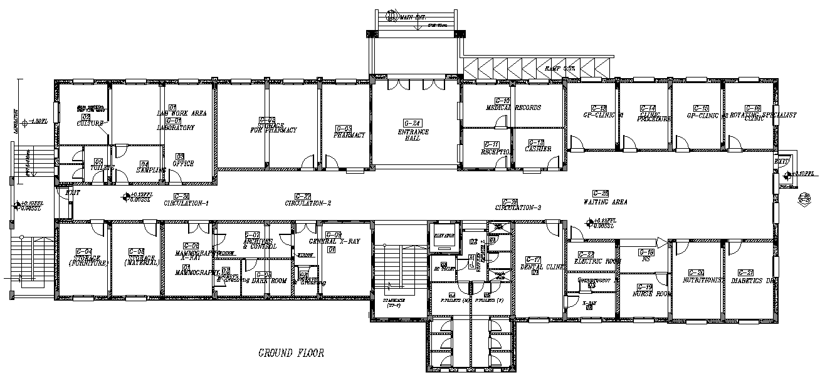
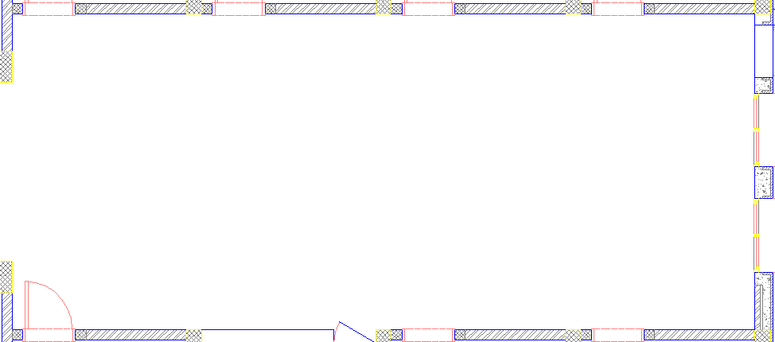
Area of Functions
Previous waiting area

Slide 15
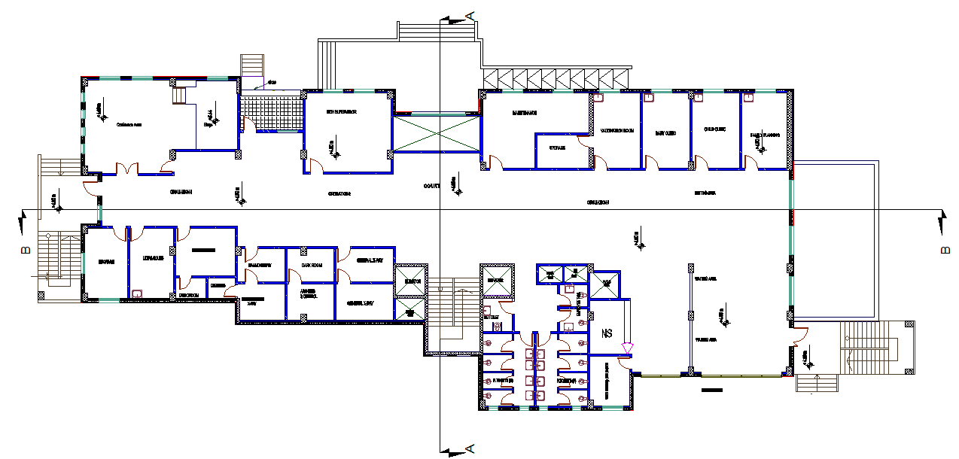
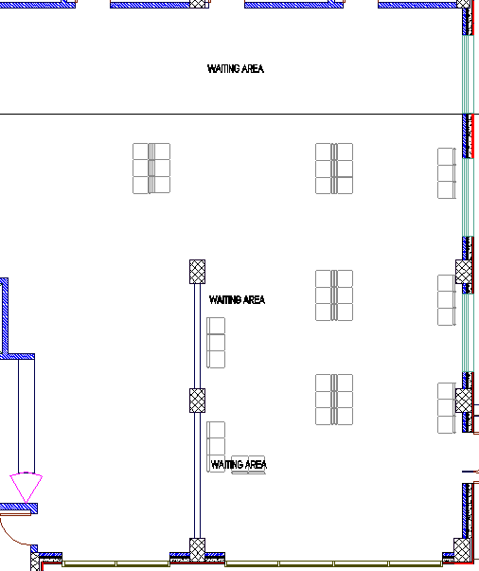
Area of Functions
New waiting area

Slide 16
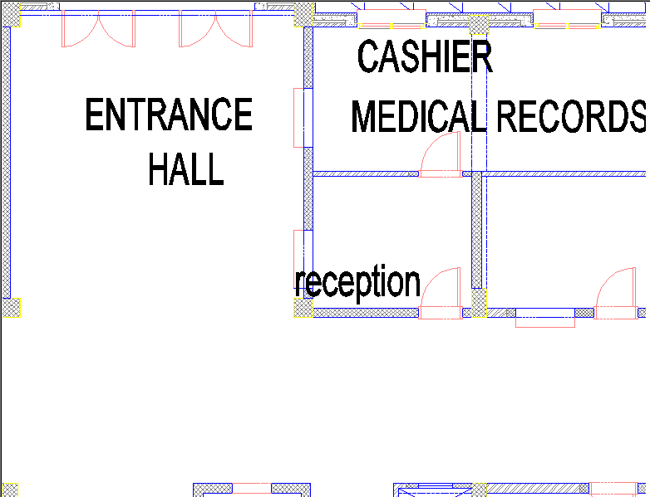
Relationships
Previous Entrance

Slide 17
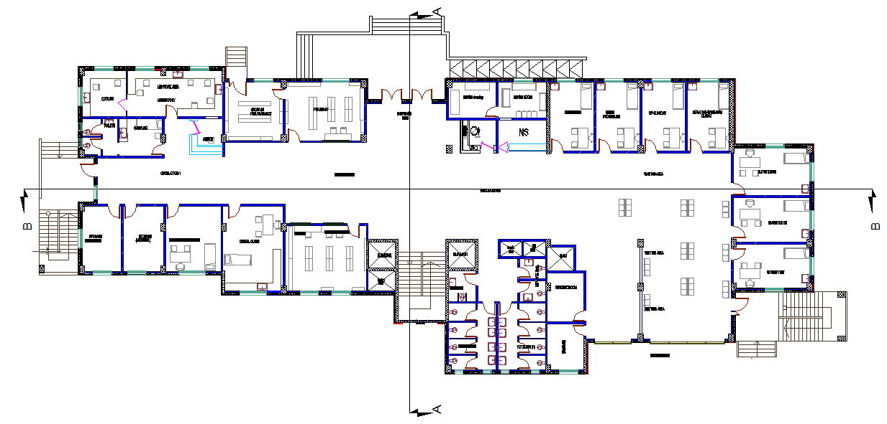
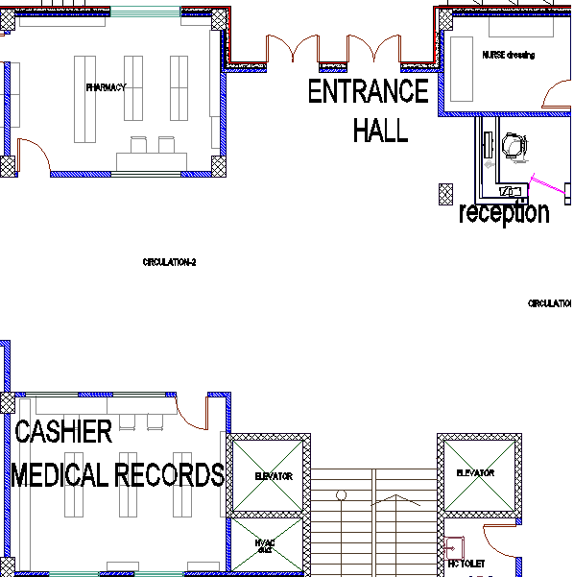
Relationships
New entrance

Slide 18
Site plan
Main entrance
Entrance of parking
Emergency exit

Slide 19
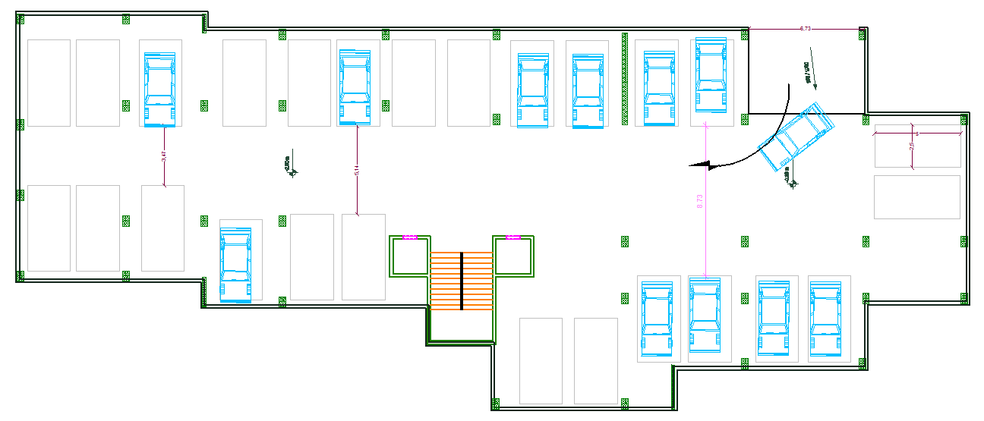
Basement floor

Slide 20
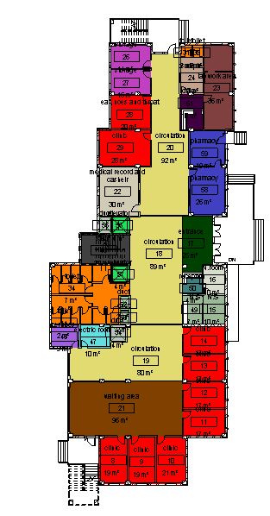
Ground floor
A
B
B
A
A

Slide 21
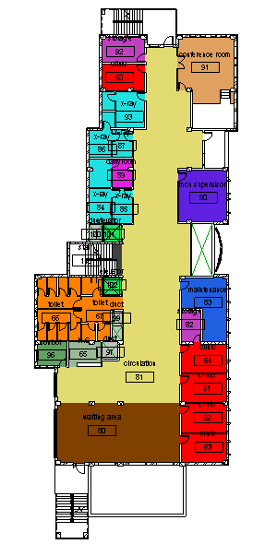
First floor
A
B
B
A

Slide 22
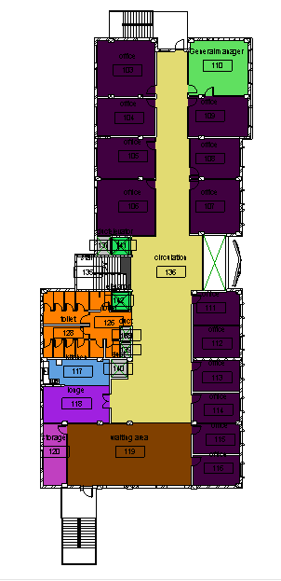
Second floor
A
B
B
A

Slide 23
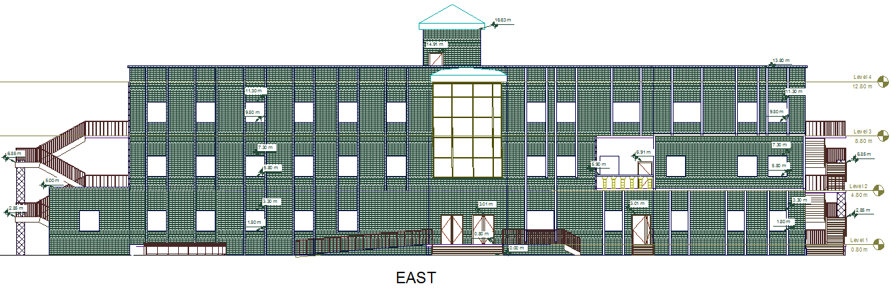
Elevation

Slide 24
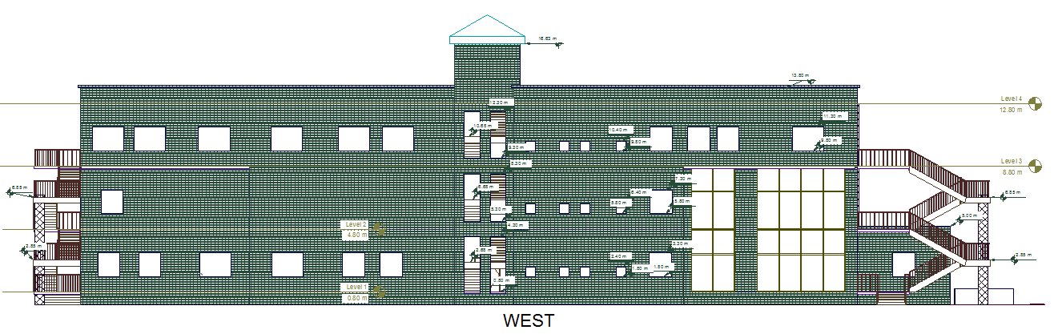
Elevation (cont.)

Slide 25
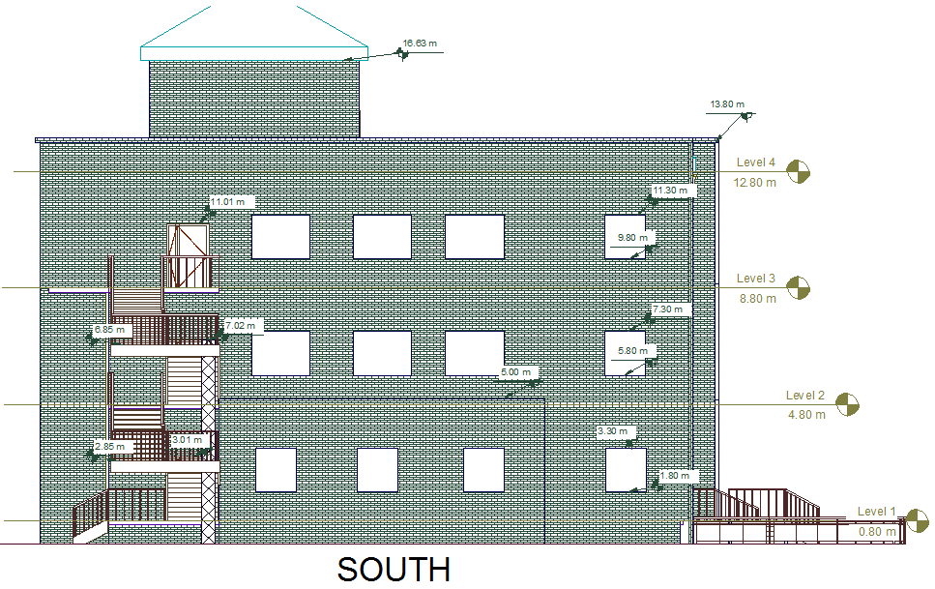
Elevation (cont.)

Slide 26
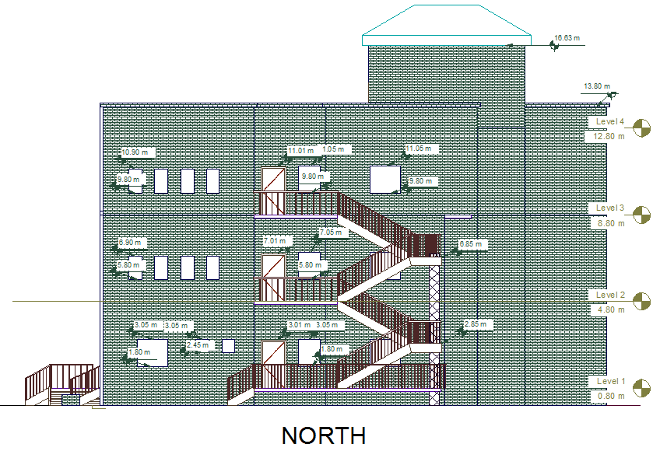
Elevation (cont.)

Slide 27
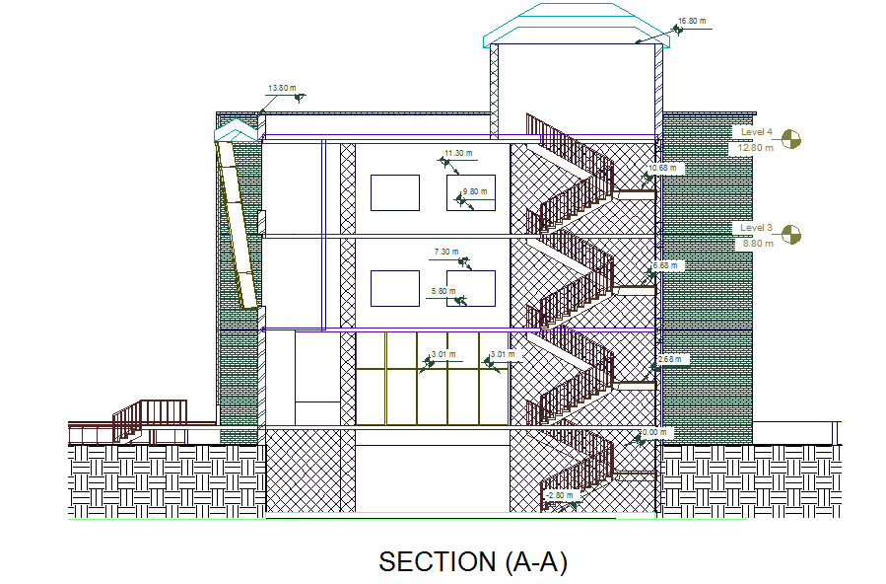
Section

Slide 28
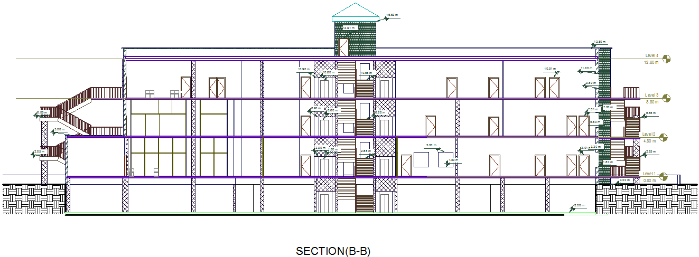
Section ( cont. )

Slide 29
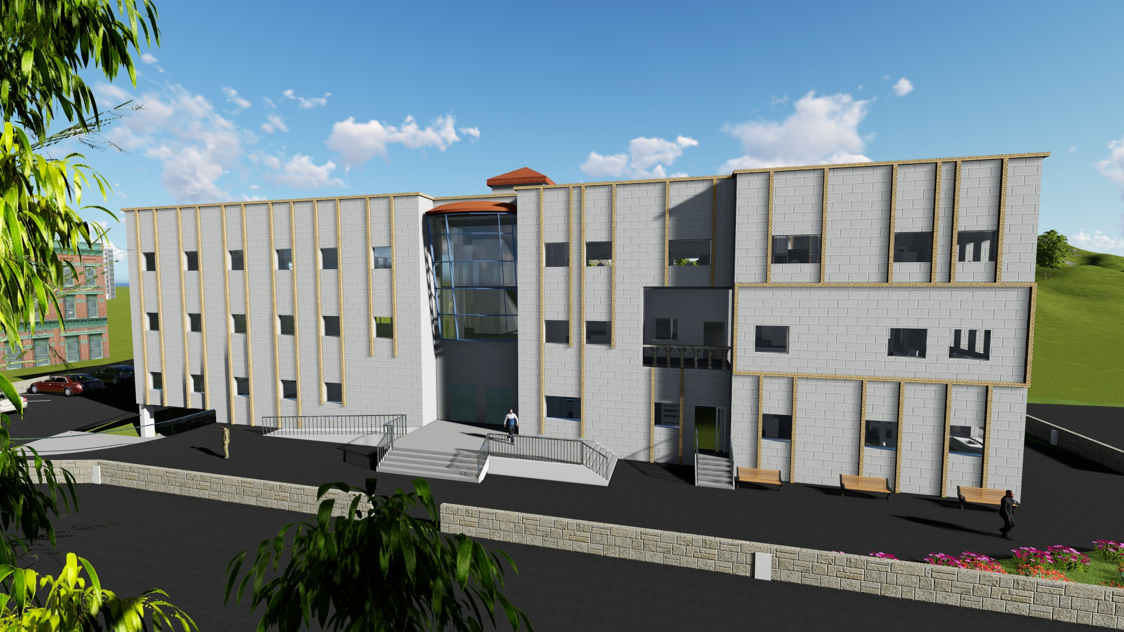
3D- view

Slide 30
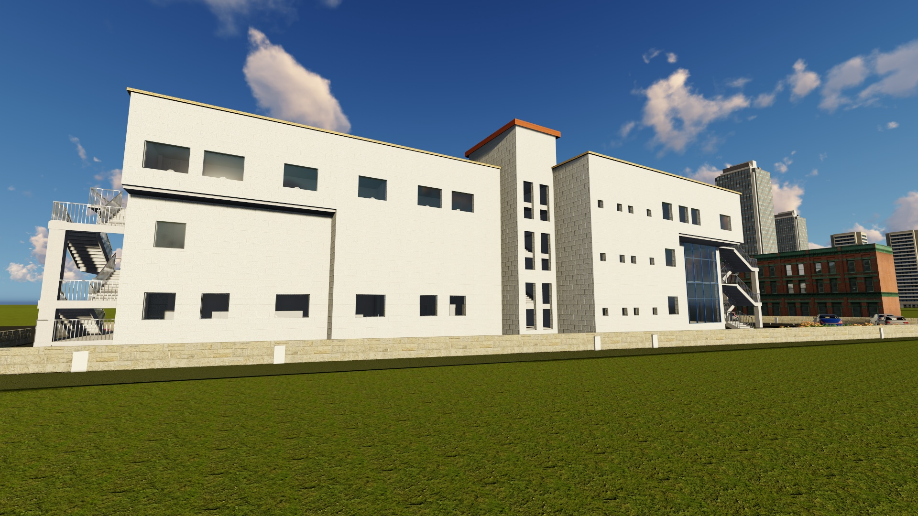
3D- view

Slide 31
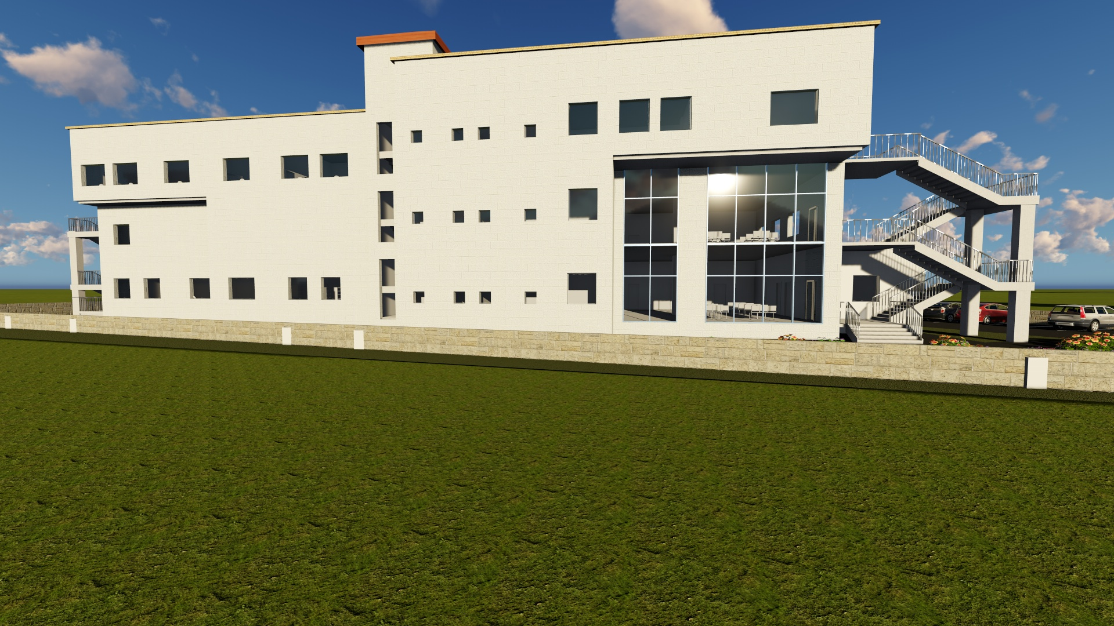
3D- view

Slide 32
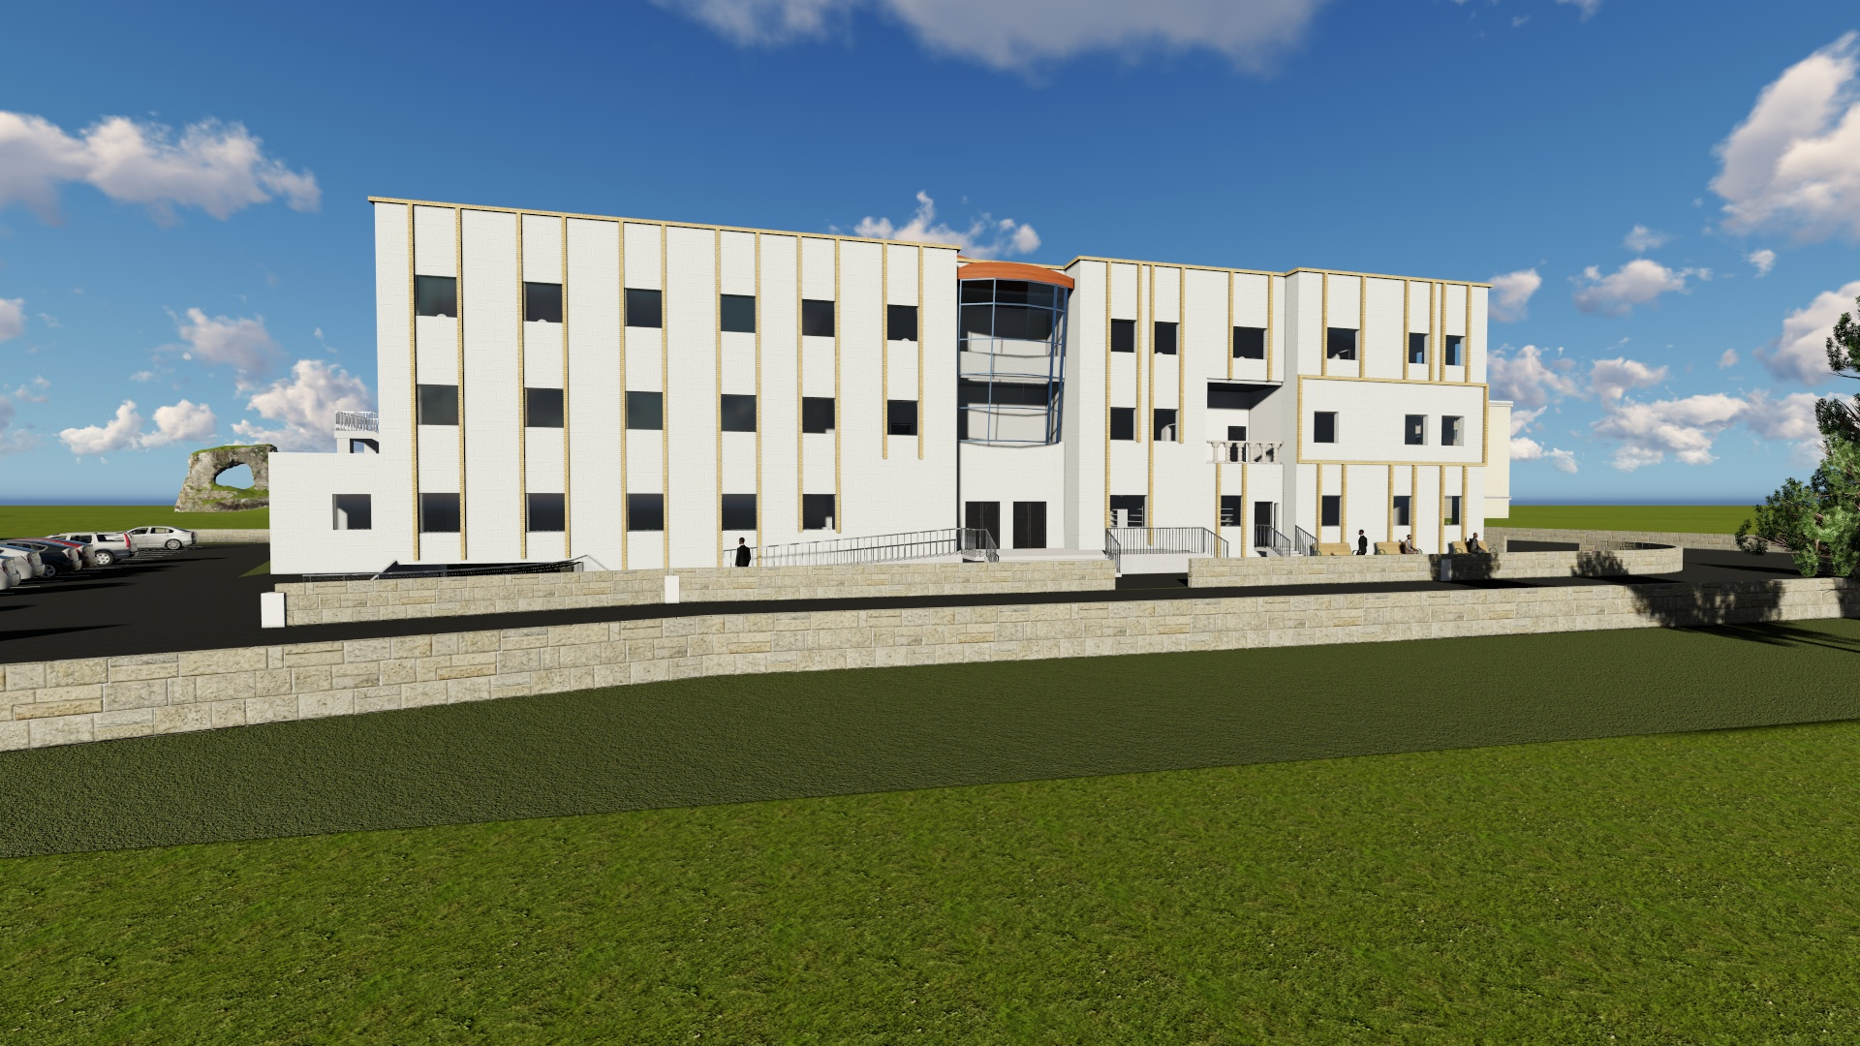
3D- view

Slide 33
3D- view

Slide 34
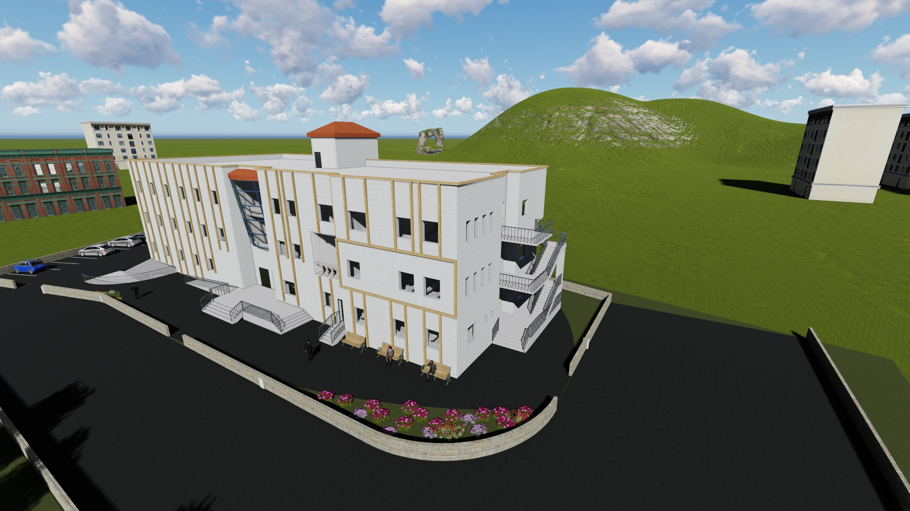
3D- view

Slide 35
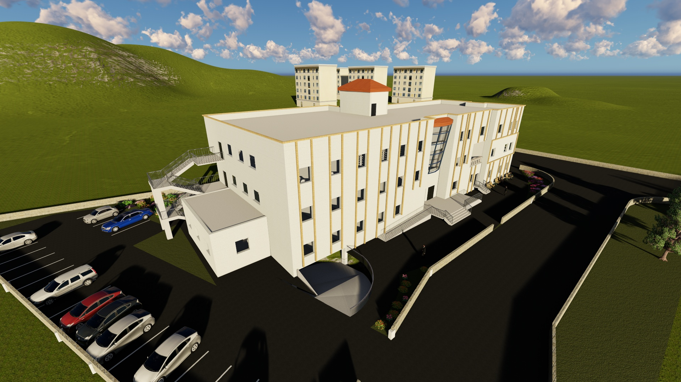
3D- view

Slide 36
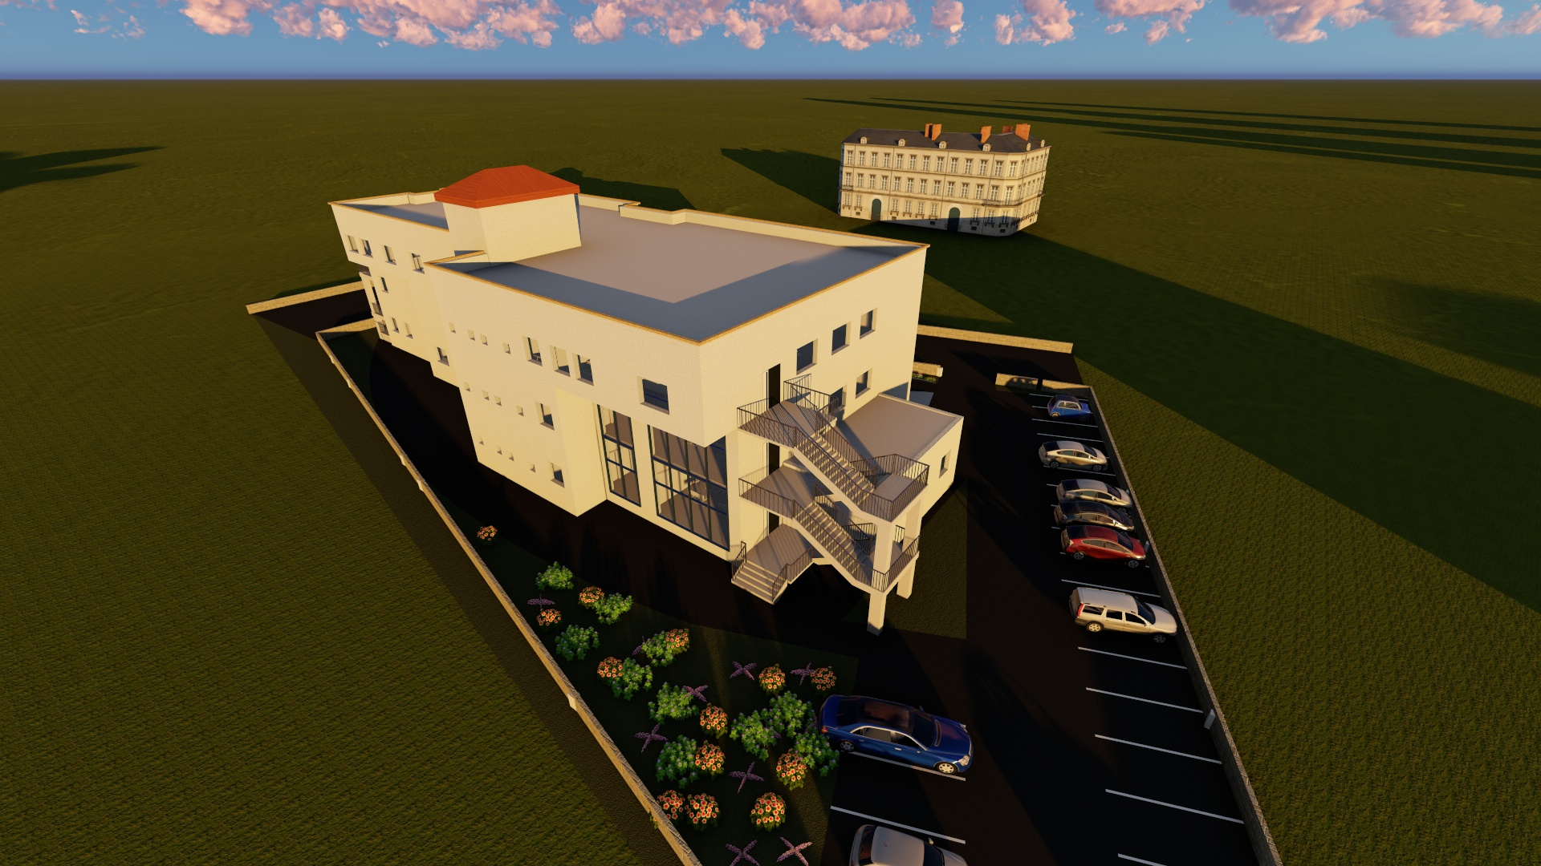
3D- view

Slide 37
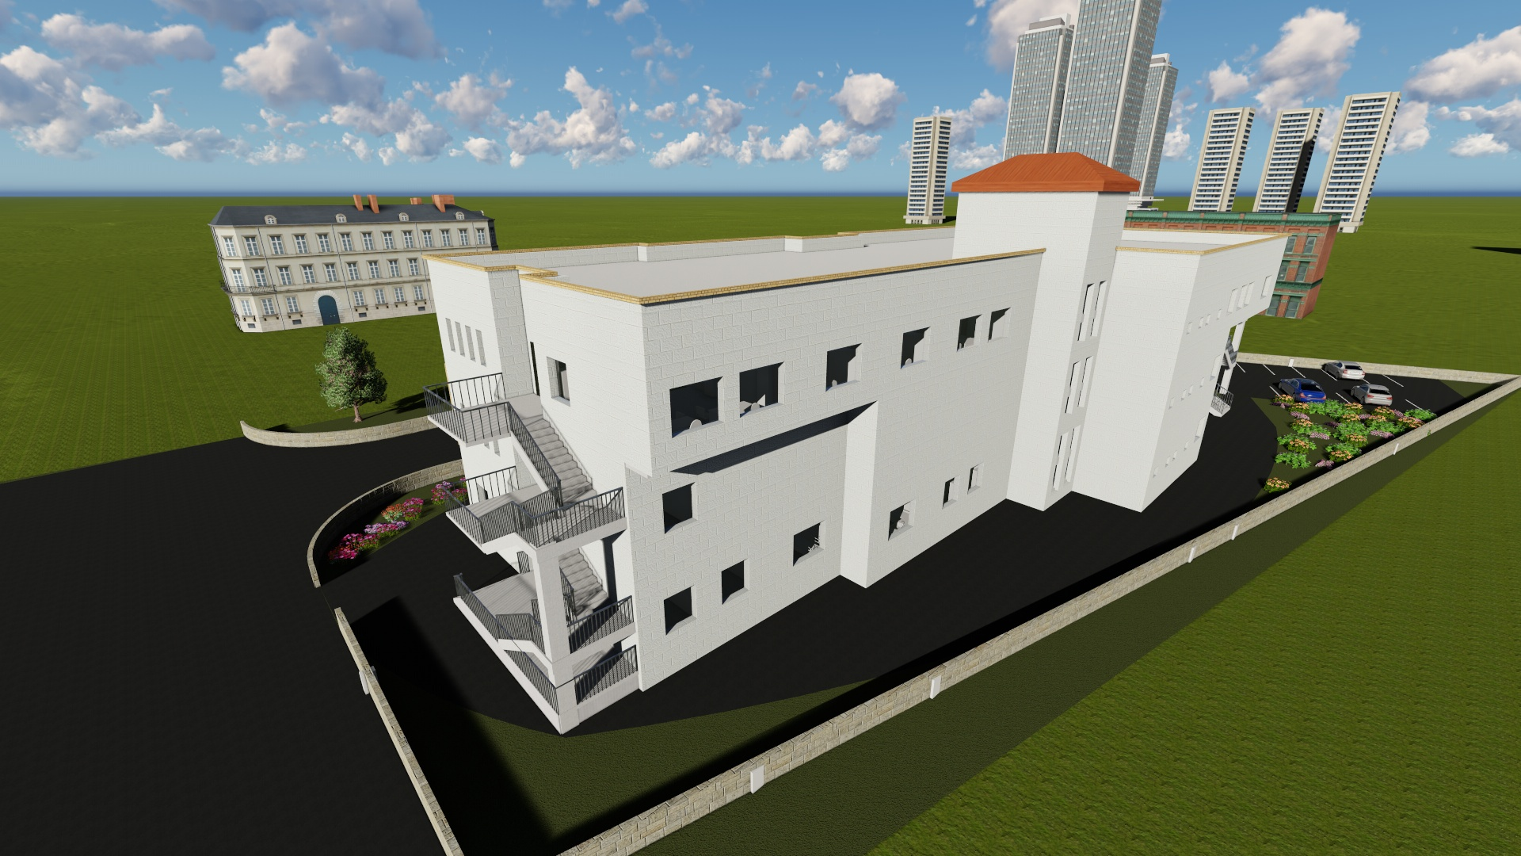
3D- view

Slide 38
Environmental Design

Slide 39
Environmental Design
Material used.
Thermal Design.
Daylight Effect.
Acoustics Design.
Shading Effect Analysis.

Slide 40
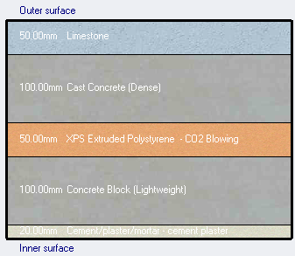
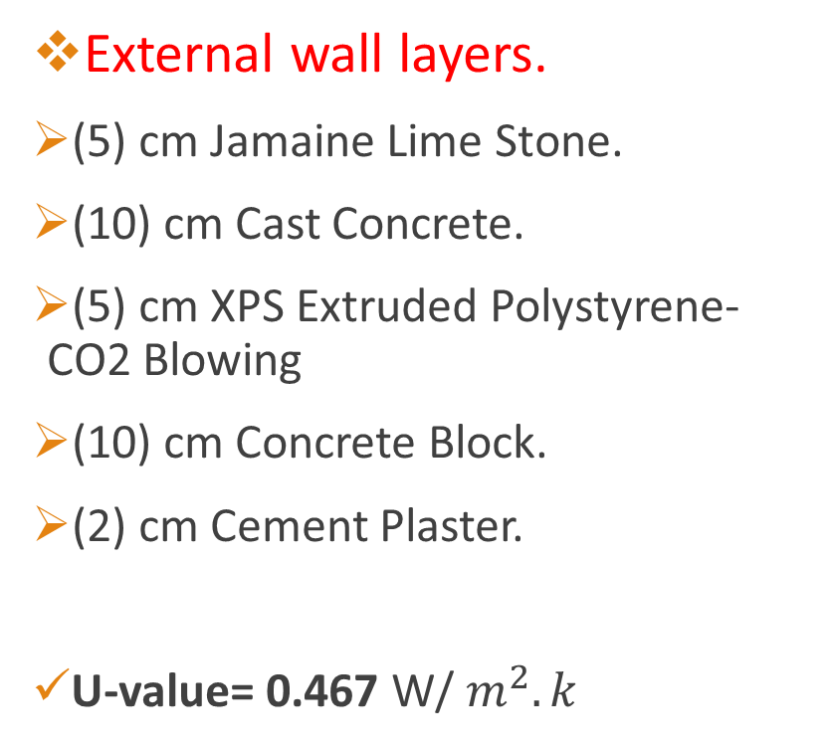
Materials Used
External wall layers.
(5) cm Jamaine Lime Stone.
(10) cm Cast Concrete.
(5) cm XPS Extruded Polystyrene- CO2 Blowing
(10) cm Concrete Block.
(2) cm Cement Plaster.
U-value= 0.467 W/ $m^{2}.k$

Slide 41
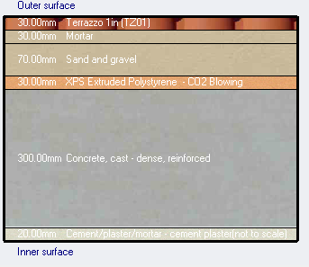
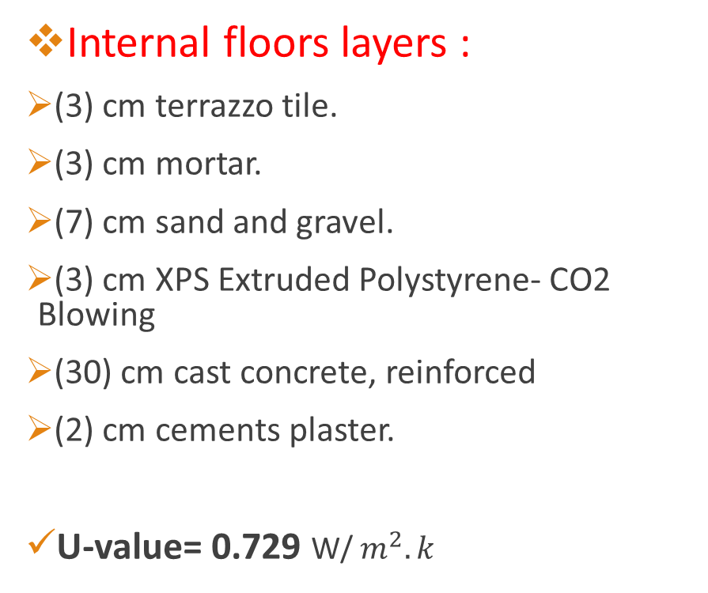
Materials Used
Internal floors layers :
(3) cm terrazzo tile.
(3) cm mortar.
(7) cm sand and gravel.
(3) cm XPS Extruded Polystyrene- CO2 Blowing
(30) cm cast concrete, reinforced
(2) cm cements plaster.
U-value= 0.729 W/ $m^{2}.k$

Slide 42
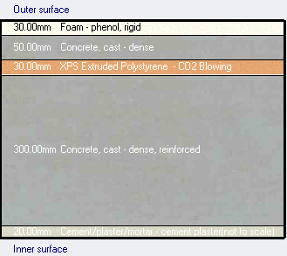
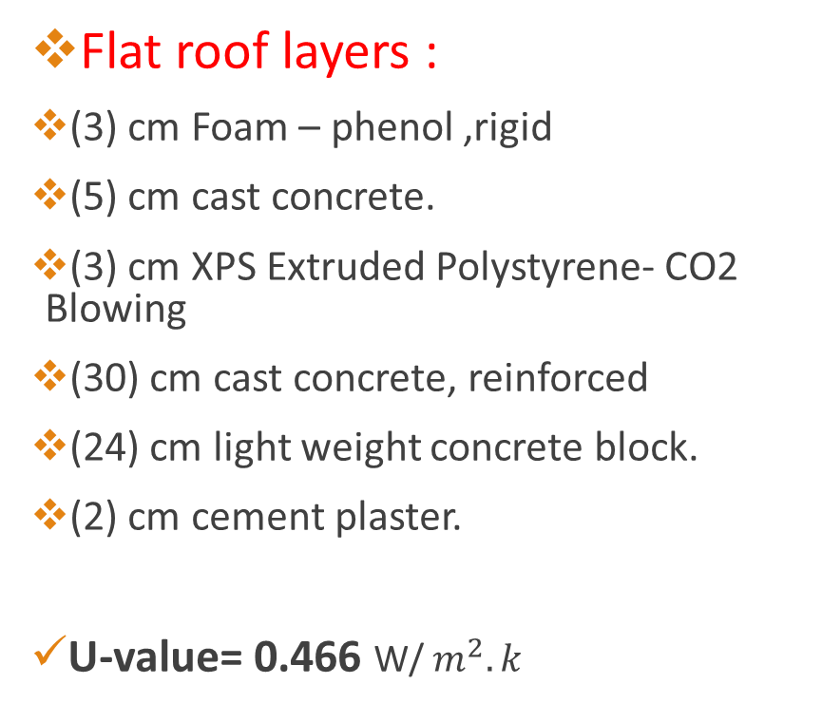
Materials Used
Flat roof layers :
(3) cm Foam – phenol ,rigid
(5) cm cast concrete.
(3) cm XPS Extruded Polystyrene- CO2 Blowing
(30) cm cast concrete, reinforced
(24) cm light weight concrete block.
(2) cm cement plaster.
U-value= 0.466 W/ $m^{2}.k$

Slide 43
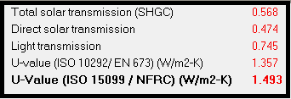
Materials Used
Glass Properties.
Double LoE (e2=0.1) clear glass with 6mm/13 mm Argon gas.

Slide 44
Thermal Design.
Design Builder Parameters:
HAVC System : VRV.
Fuel is Electricity from Grid.
System is used for Heating & Cooling.
Building is used from 8:00 AM to 2:00 PM.

Slide 45
Thermal Design.
Heating and cooling capacity:
Site energy:
Load capacity | Old | New
Heating capacity | 224.7 kW | 117.4 kW
Cooling capacity | 305.67 kW | 269.88 kW
 | Old | New
Total site energy/year | 235.31 kWh/m² | 91.71 kWh/m²

Slide 46
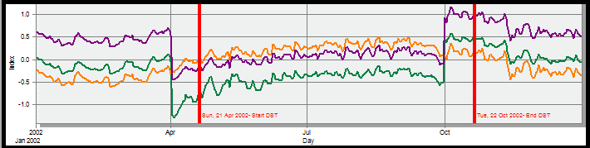
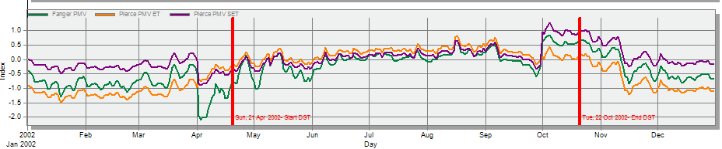
Thermal Design.
Comfort

Slide 47
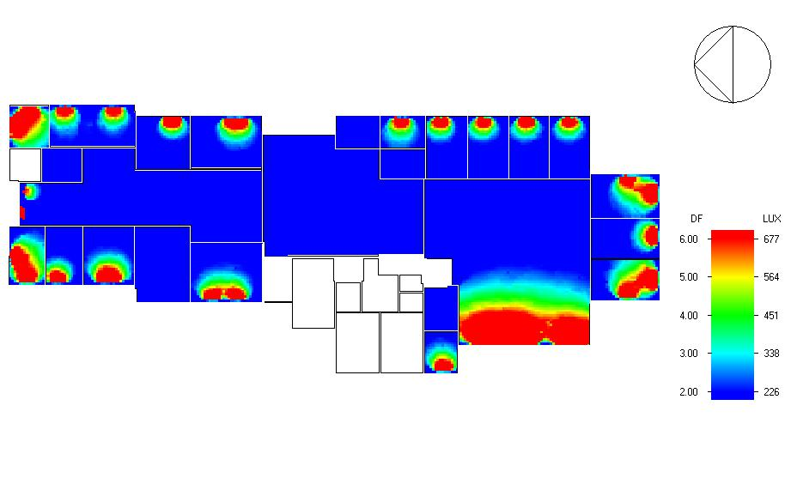
Natural Daylight.
Average daylight factor for ground floor zones

Slide 48
Acoustic Design
Reverberation Time(RT60):
ECOTECT program was used to test and analyze one of the clinics of the building and the conference room .

Slide 49
Reverberation time
For GP- Clinic # 1 Clinic:
RT60 for clinic should be (0.7 - 1.25) sec.
Most Suitable calculation : Sabine calculation
RT60- Full | RT60 – Empty | Freq. (Hz)
0.86 | 0.91 | 63
0.84 | 0.88 | 125
0.83 | 0.97 | 250
0.96 | 1.13 | 500
0.92 | 1.03 | 1K
0.77 | 0.84 | 2K
Old:
Room RT60 at deferent frequency and capacity range between (0.2– 0.75) S
New:
Room RT60 at deferent frequency and capacity range between (0.77– 1.13) S

Slide 50
Reverberation time
For Conference room :
RT60 for conference room should be between ( 0.6 - 1.4) sec
Most Suitable calculation : Millington-Sette calculation
RT60 - Empty | RT60- Full | Freq. (Hz)
0.62 | 0.6 | 63
0.59 | 0.58 | 125
0.72 | 0.64 | 250
0.79 | 0.71 | 500
1.01 | 0.89 | 1K
0.94 | 0.82 | 2K

Slide 51
Acoustic Design
STC for enveloped of clinic:
Description | Value (dB) | Recommended value(dB) | Suitable
IIC for ceiling | 67 | 50 | Yes
STC for external wall | 48 | 45 | Yes
STC for partition of room adjacent room | 45 | 45 | Yes
STC for partition of room adjacent Corridor | 43 | 42 | Yes

Slide 52
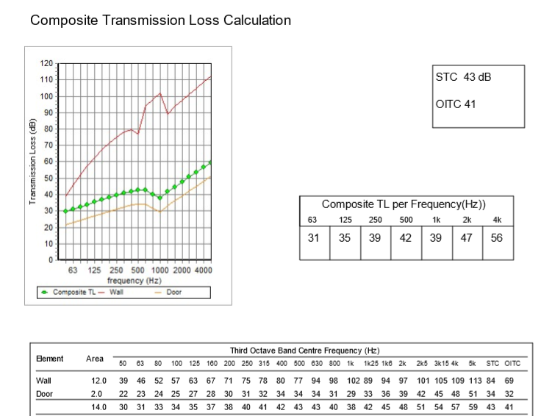
Acoustic Design
STC for Partition of clinic:
The STC for partition must =42 dB.

Slide 53
Acoustic Design
STC for enveloped of Conference room :
Description | Value (dB) | Recommended value(dB) | Suitable
IIC for ceiling | 67 | 50 | Yes
STC for external wall | 42 | 38 | Yes
STC for partition of room adjacent Corridor | 49 | 40 | Yes

Slide 54
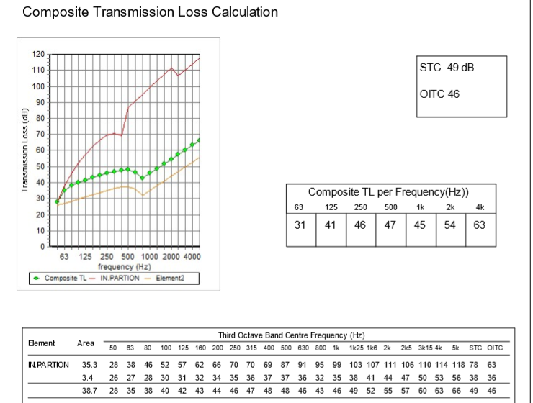
Acoustic Design
STC for Partition of Conference room :
The STC for partition must =40 dB.

Slide 55
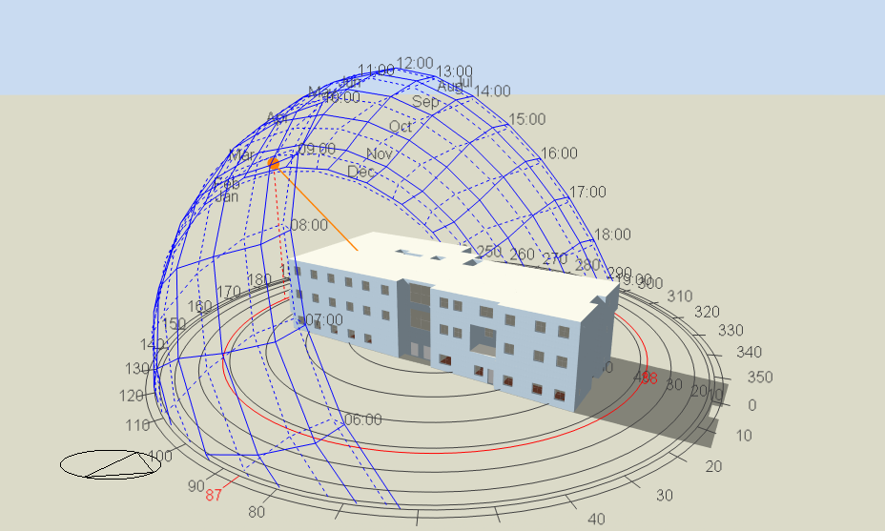
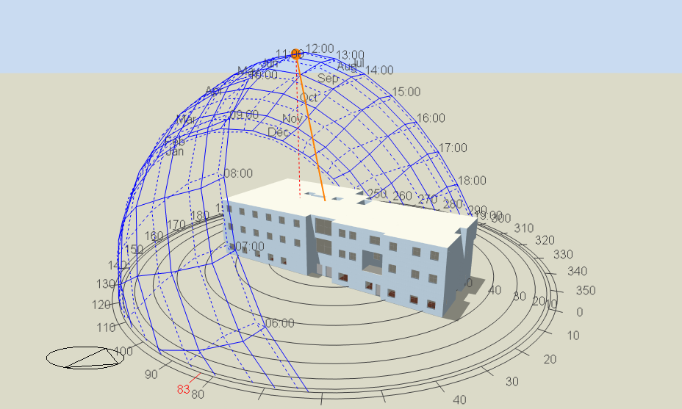
Shading Effect
Building shadow on 21 July at 12:00 pm.
Building shadow on 21 January at 12:00 pm.

Slide 56
Structural Analysis & Comparison

Slide 57
Main Problems in Structural System (First Phase Project)
Many beams failed the design process due to seismic loads.
Many areas of the slab were under reinforced.
The period was too high, which means that the building is too soft.
There was a big eccentricity problem which caused the building to rotate.
No Structural Joint.

Slide 58
Structural Redesign (Phase 2)
Codes and Standards:
ACI 318-14 (American Concrete Institution)
ASCE-2010 (American Society of Civil Engineers)
UBC97 (Uniform Building Code)
For the design of the structure and its elements ETABS , Safe, SAP2000 were used.

Slide 59
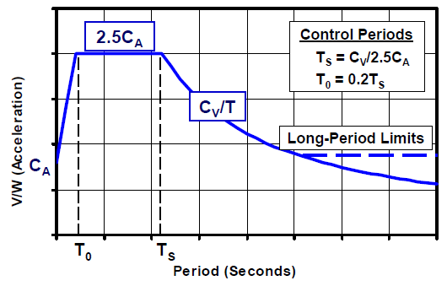
Loads
SID = 4 kN / m²
Live = 5 kN / m²
Lateral Loads are obtained by service and ultimate design combinations and using response spectrum curve.

Slide 60

Structural & Seismic Design Parameters
Fy = 420 MPa.
f’c = 28 MPa (B350).
Bearing Capacity = 1.9 kg/cm².
1 Basement & 3 Floors.
Floor height = 4.00 m.
Basement height = 2.8 m.
Soil profile = SD
Z = 0.15
Ca = 0.22
Cv = 0.32
R = 5.5
I = 1.5

Slide 61
Structural Sections Dimensions
Structural Element | Dimensions
Ribbed Slab | 30 cm Thickness.
Solid Slab | 20 cm Thickness.
Beams | 40 x 60 cm, 50 x 30 cm
Columns | 40 x 60 cm

Slide 62

Building Blocks (Seismic Separator)

Slide 63

Ribbed Slab Reinforcement

Slide 64

Solid Slab Reinforcement

Slide 65

Beam Reinforcement
Beam ID | Span Length [m] | Section Size (Width x Depth) [cm] | Longitudinal Bars |  |  | Stirrups |  | Diameter
 |  |  | Top |  | Bottom | C | D
 |  |  | A | B
B3 | 3.75 | 40 x 60 | 8 | 8 | 8 | 1Ø10/200mm | 1Ø10/250mm | 20
B4 | 2.95
B17 | 2.75
B27 | 6.85
B28 | 3.6
B30 | 5
B32 | 5
B37 | 3.8
B38 | 3.6
B5 | 7.95 |  | 8 | 2 | 5 | 1Ø10/200mm | 1Ø10/250mm | 16
B6 | 7.15
B8 | 7.75
B9 | 7.75
B16 | 6.15 |  | 8 | 8 | 8 | 1Ø10/200mm | 1Ø10/250mm | 25
B18 | 7.15
B29 | 7.15
B34 | 7.15
B21 | 7.25 |  | 6 | 2 | 5 | 1Ø10/200mm | 1Ø10/250mm | 16
B23 | 7.25
B26 | 7.1
B33 | 7
B35 | 7
B36 | 7
B39 | 2.5
B40 | 7
B41 | 4.5
B43 | 2
B1 | 6.65 |  | 7 | 2 | 5 | 1Ø10/200mm | 1Ø10/250mm | 16
B14 | 7.7
B19 | 7.25
B20 | 7.25
B31 | 7
B2 | 6.65 |  | 4 | 2 | 3 | 1Ø10/200mm | 1Ø10/250mm | 16
B7 | 9
B13 | 3.75
B15 | 3.1
B24 | 5.1
B25 | 4.5
B42 | 2.4
B10 | 5.7 | 50 x 30 | 4 | 2 | 3 | 1Ø10/200mm | 1Ø10/250mm | 16
B11 | 1.75 |  | 3 |  | 2
B12 | 5.7
B22 | 3.6

Slide 66

Column Reinforcement and Dimensions

Slide 67

Staircase Reinforcement

Slide 68

Footing Layout

Slide 69

Footing Reinforcement (F1)

Slide 70

Footing Reinforcement (F2)

Slide 71
Electrical Design.

Slide 72
Artificial Lighting
Space | Ēm (lux)
Laboratory | 500
Storage | 300
Pharmacy | 500
X-Ray | 300
Archive | 200
Lockers | 200
Reception/cashier | 300
Examination clinic | 500
General clinic | 500
Staff room | 300
Office | 500
Circulation | 200
Toilet | 200
Waiting room | 200
Kitchen | 500
Maintenance room | 500
Recommended illumination.
Reflection factor.
surface | Reflection factor
Ceiling | 80 %
Walls | 70%
Floors | 30%

Slide 73

Artificial Lighting
Clinics(Family planning)
 | OLD | NEW
E (lux) | 408 | 533
U (Uniformity) | 0.42 | 0.65
UGR | 19.3 | 18.3

Slide 74

Artificial Lighting
Offices (General manager).
 | OLD | NEW
E (lux) | 408 | 513
U (Uniformity) | 0.1 | 0.79
UGR | 17.5 | 17

Slide 75

Artificial Lighting
Clinics and offices selected luminaires.

Slide 76

Artificial Lighting
Waiting area.
 | OLD | NEW
E (lux) | 215 | 249
U (Uniformity) | 0.2 | 0.41

Slide 77

Artificial Lighting
Pharmacy.
 | NEW
E (lux) | 570
U (Uniformity) | 0.79
UGR | <10

Slide 78

Artificial Lighting
Waiting area and pharmacy selected luminaires.

Slide 79


Artificial Lighting
Lighting arrangement in ground floor.

Slide 80


Sockets arrangement for ground floor

Slide 81
Mechanical Design.

Slide 82
Water supply
 | Diameter of pipes
Vertical | 3``
Horizontal | 2.5``
Branch | 3/4``

Slide 83

Water supply (cont.)
Ground floor

Slide 84

Water supply (cont.)
First floor

Slide 85

Water supply (cont.)
second floor

Slide 86

Drainage system ( previous design )
Ground floor

Slide 87

Drainage system ( New design )
Ground floor

Slide 88


Elevator and toilets ( previous design )

Slide 89


Elevator and toilets ( New design )

Slide 90
Drainage system
The sewers for lavatory which reach to the main drainage = 2"
The sewers for kitchen sink which reach to the main drainage =2"
The sewers for W.C which reach to the main drainage = 4”.
From tables the pipe reaching from riser to the manhole = 6”.
The distance between manhole less than 15 meter
ventilation stakes 4’’

Slide 91
HVAC System.
System used are :
VRV
This building was divided into several zones.
Main components of VRV system are :
Air handing units( out door units for cooling and heating).
Chiller.
Ducts.
Controller
Diffusers.
Return diffusers units

Slide 92


HVAC System.
Out door unit(AHU).

Slide 93

HVAC System.
Chiller

Slide 94


HVAC System.
Controller

Slide 95


HVAC System.
Diffusers.

Slide 96


HVAC System.
HVAC diffusers distribution in ground floor :

Slide 97

Reflected Ceiling.

Slide 98
Safety Design.

Slide 99






Safety
Sprinklers
Smoke detectors
Fire extinguisher
Fire alarm
Safety signs
Emergency lighting

Slide 100

Safety
Exit Routes:

Slide 101
Quantity Surveying
Total Cost of The Project | 3,027,594.19 NIS
The Unit Cost Of the Project | 1190 NIS/m2

Slide 102


