Slide 1







Supervisor: Dr. Asmaa Afeefi
Students:
Abbas Dweikat
Mohamed Wahba

Slide 2

OUTLINE
INTRODUCTION AND OBJECTIVE
TARGET
AUDIENE
TOOS
FEATURS
FUTURE
WORK

Slide 3


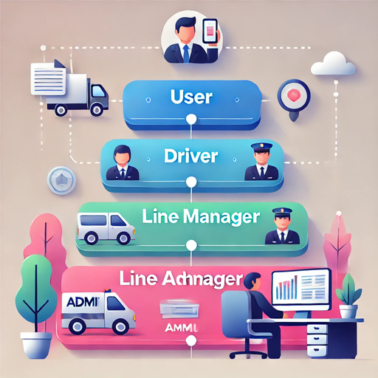

Introduction
Our app features four levels: User, Driver, Line Manager, and Admin. Each level is designed with a user-friendly interface to ensure smooth and efficient interactions tailored to their specific roles.

Slide 4











TOOLS
01
03
02
Flutter
MY SQL
04
NODE JS
GOOGLE MAP
FRONT END
DATABASE
BACK END
FOR MAPS

Slide 5




Project`s Features

Slide 6

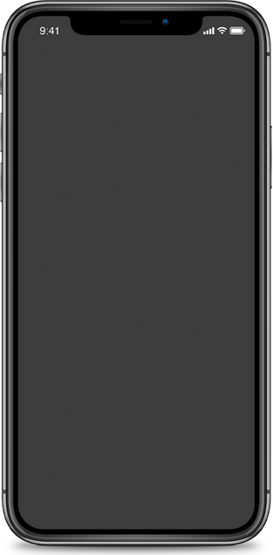
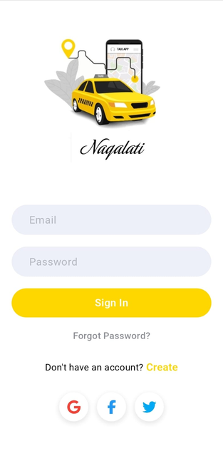
Sign In Page
02
03
01

Slide 7

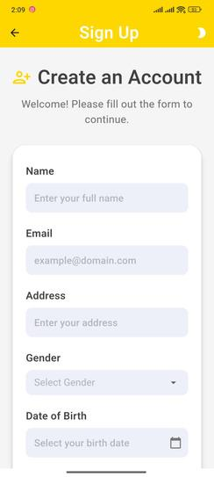
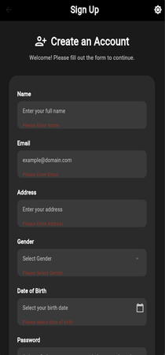
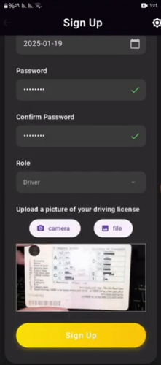

Sign Up Page

Slide 8
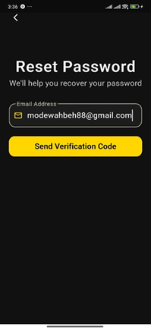
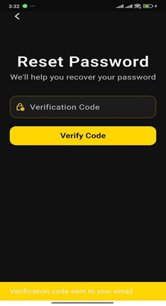
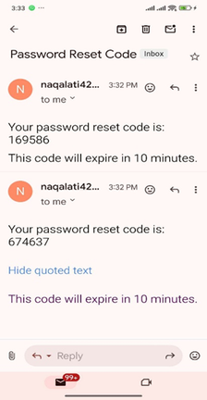
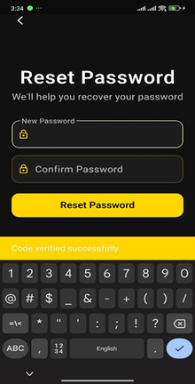




Forget Password Process
Forget Password
Verification Code
Email Reset Code
Confirm Pasword Page

Slide 9
User App

Slide 10

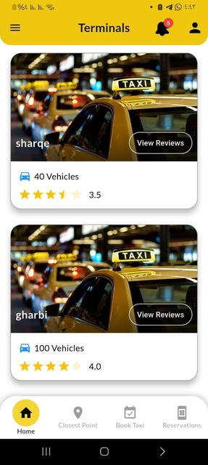
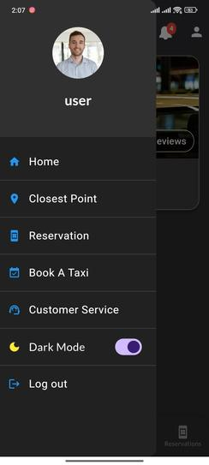
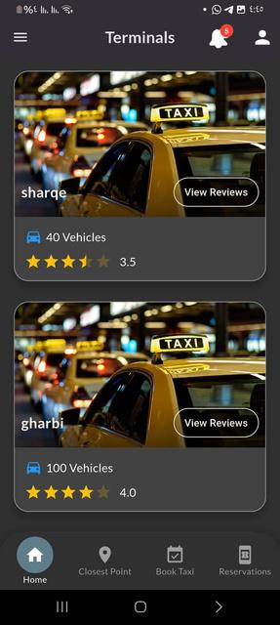
User Pages

Slide 11
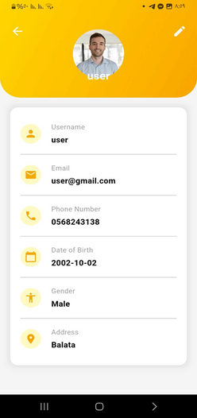
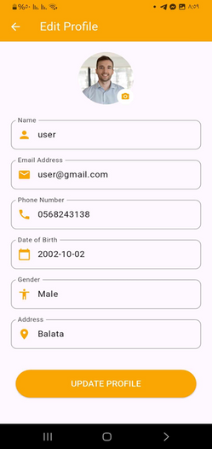
User Pages

Slide 12
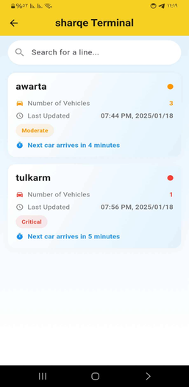
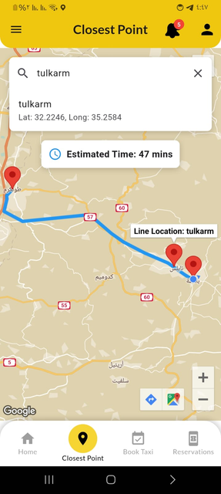
User Pages
01

Slide 13
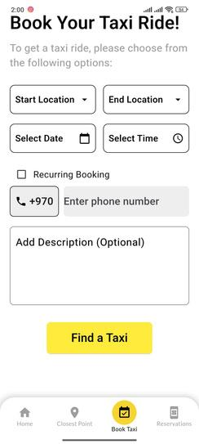
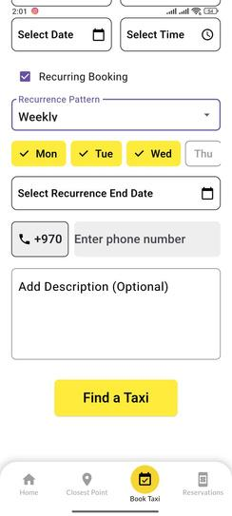
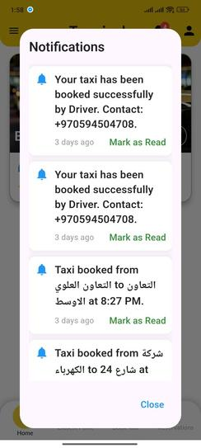
User Pages

Slide 14
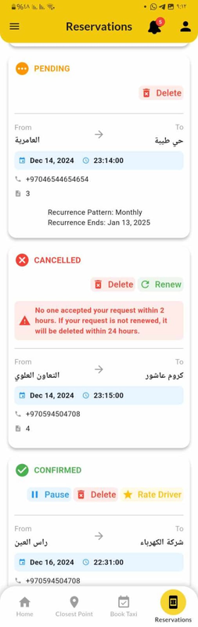
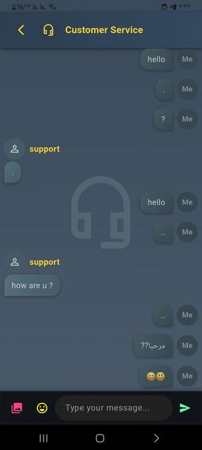
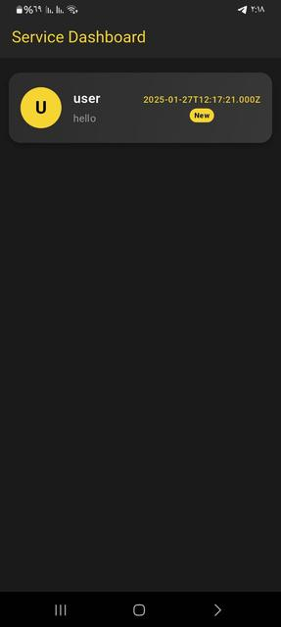
User Pages

Slide 15
Driver App

Slide 16
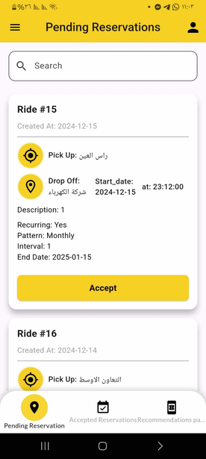
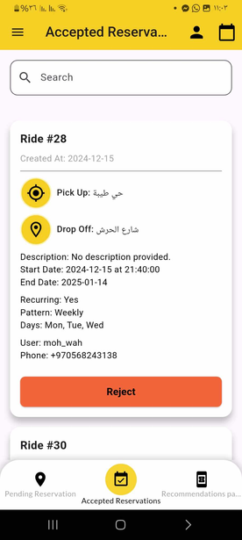
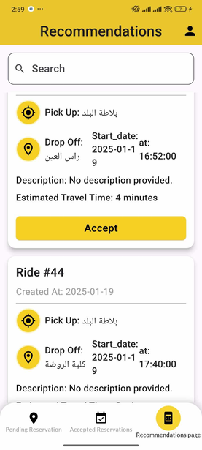
Driver Pages

Slide 17
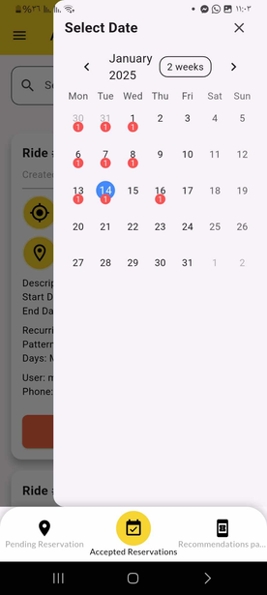
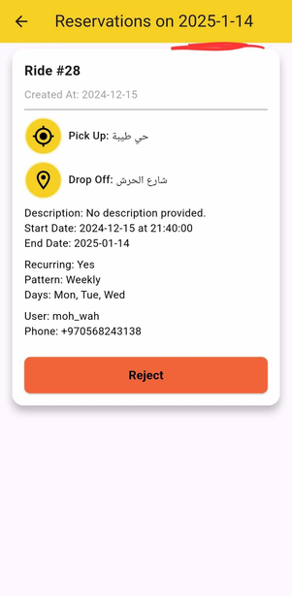
Driver Pages

Slide 18
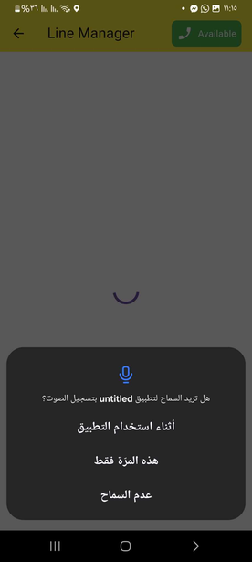
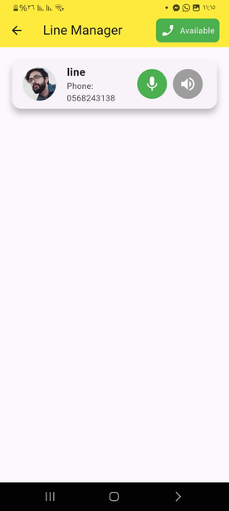
Driver Pages

Slide 19
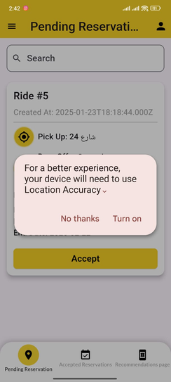
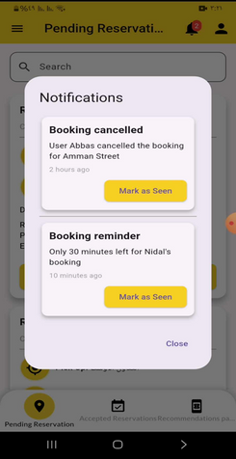
Driver Pages

Slide 20
Line Manger App

Slide 21
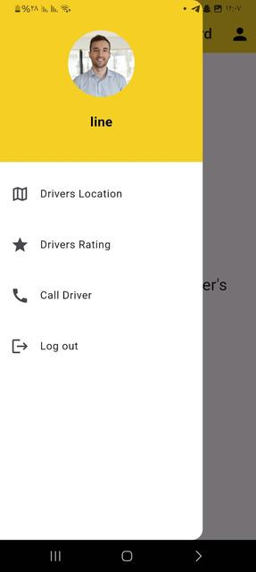
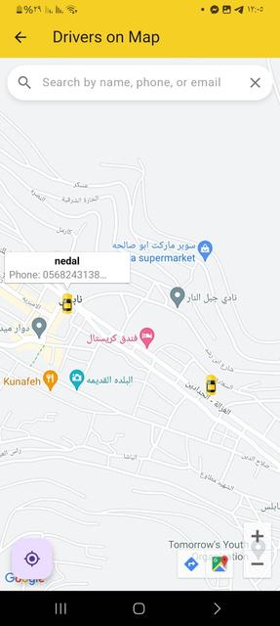
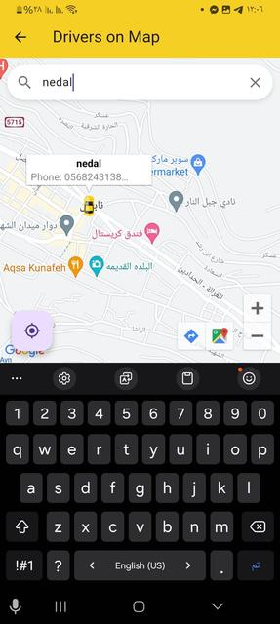
Line Manger Pages

Slide 22
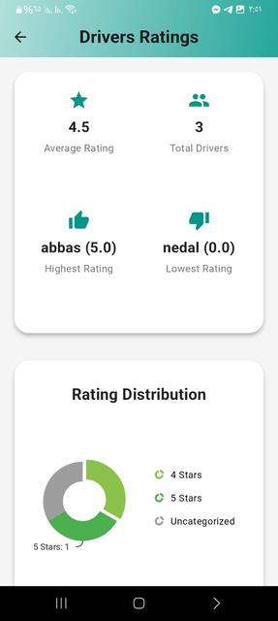
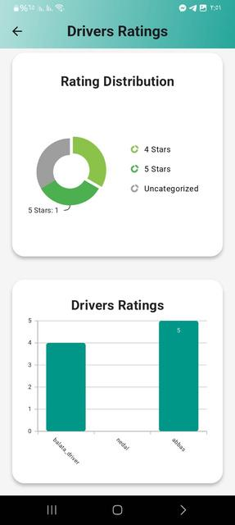
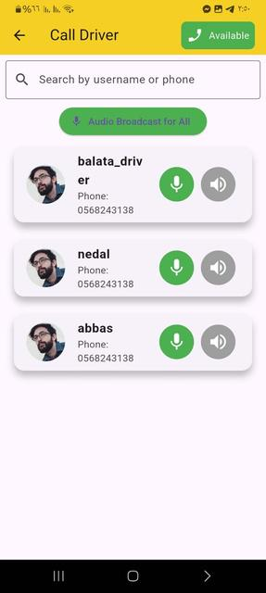
Line Manger Pages

Slide 23

Admin App or website

Slide 24
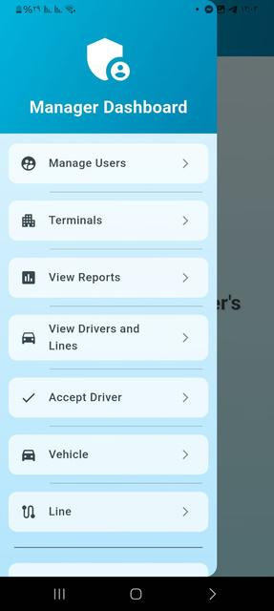
Admin Pages

Slide 25
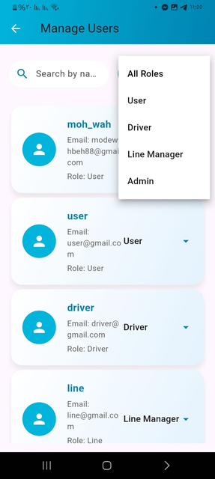

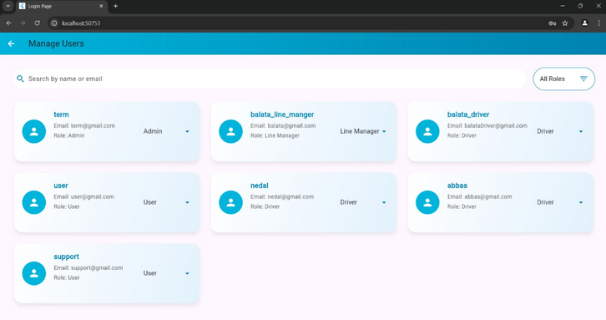
Admin Pages

Slide 26
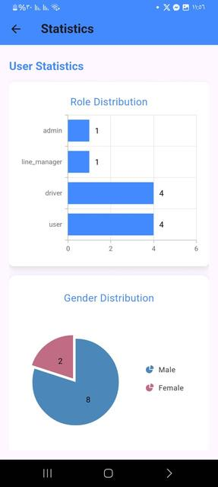
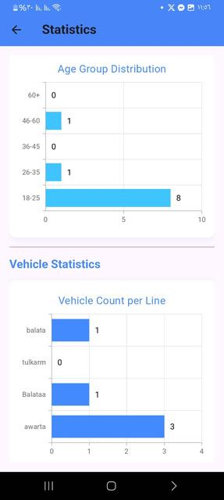
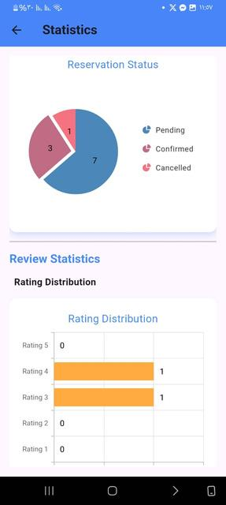
Admin Pages

Slide 27
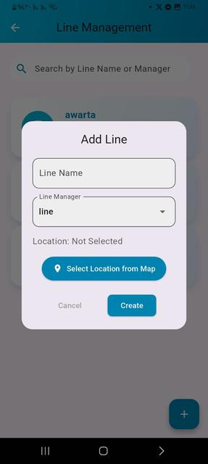
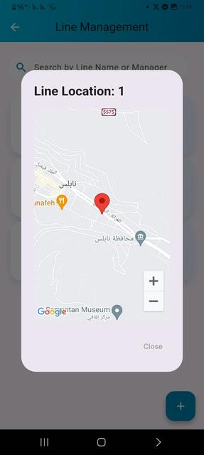
Admin Pages

Slide 28
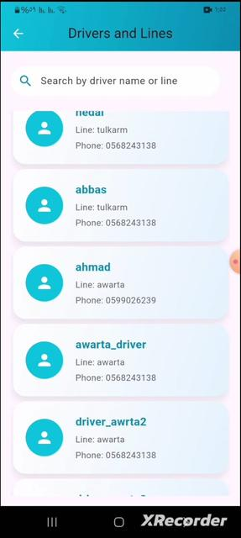
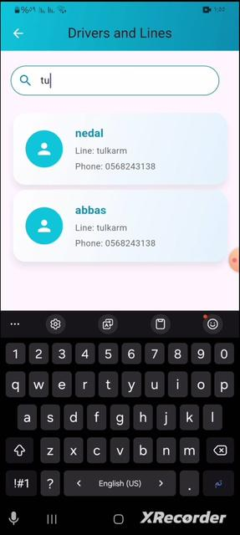
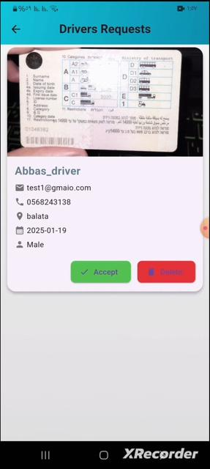
Admin Pages

Slide 29


Future Work
1 2 3
Automatically check license number :
We will link the person's ID number from the license number to verify the validity of the license and its holder information.
Predictive and Recommendation System:
This system relies on weather and traffic forecasts to provide recommendations to leave early due to an expected traffic jam or bad weather.
Accidents and Violations System :
.
Violations and accidents tracking system with electronic payment system

Slide 30




