Slide 1

Design of a Wastewater Collection Network for the New Nablus Area (B)
By
Hatem Abu Asbeh
Mohammad Qamhiya
Sayel At-Torman
Supervisor
Dr. Mohammad N. Almasri
December 2012

Slide 2
OUTLINE
INTRODUCTION
OBJECTIVES
STUDY AREA
METHODOLOGY
RESULTS
COST
CONCLUSIONS

Slide 3
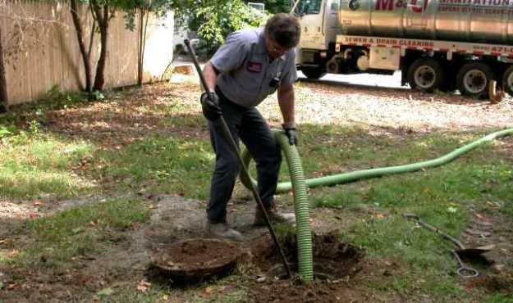
INTRODUCTION

Slide 4
OBJECTIVES
DESIGN THE SEWER NETWORK USING SEWERCAD
ESTIMATE
THE WASTEWATER
GENERATION (LOAD)
ESTIMATE THE OVERALL COST USING ARCGIS

Slide 5
BACKGROUND
ENGINEERING CONCEPTS
GOOD DESIGN
EFFICIENT SOFTWARE
Effective WASTEWATER COLLECTION NETWORK

Slide 6
STUDY AREA
LOCATION
LAND USE
TOPOGRAPHY

Slide 7
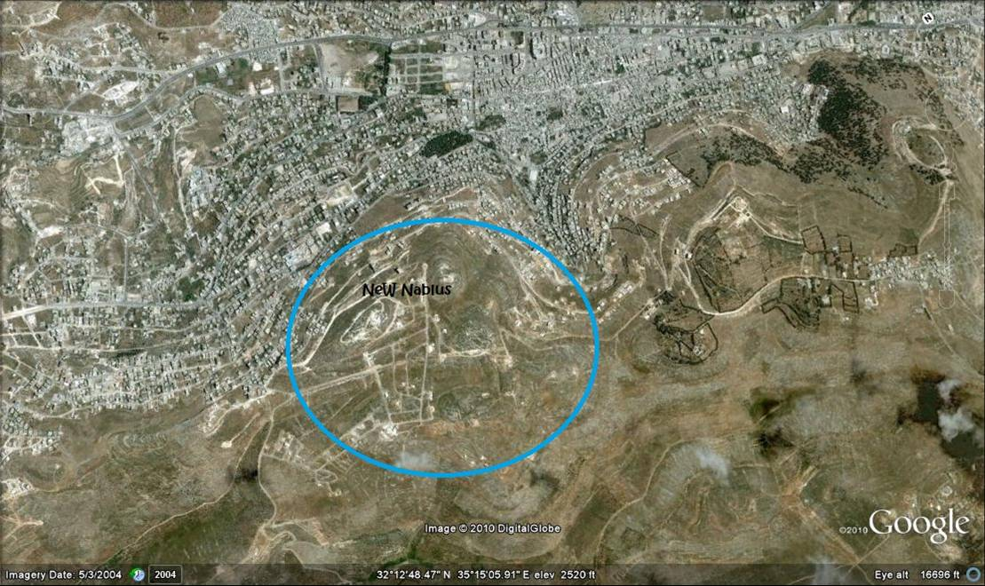
LOCATION
camp

Slide 8
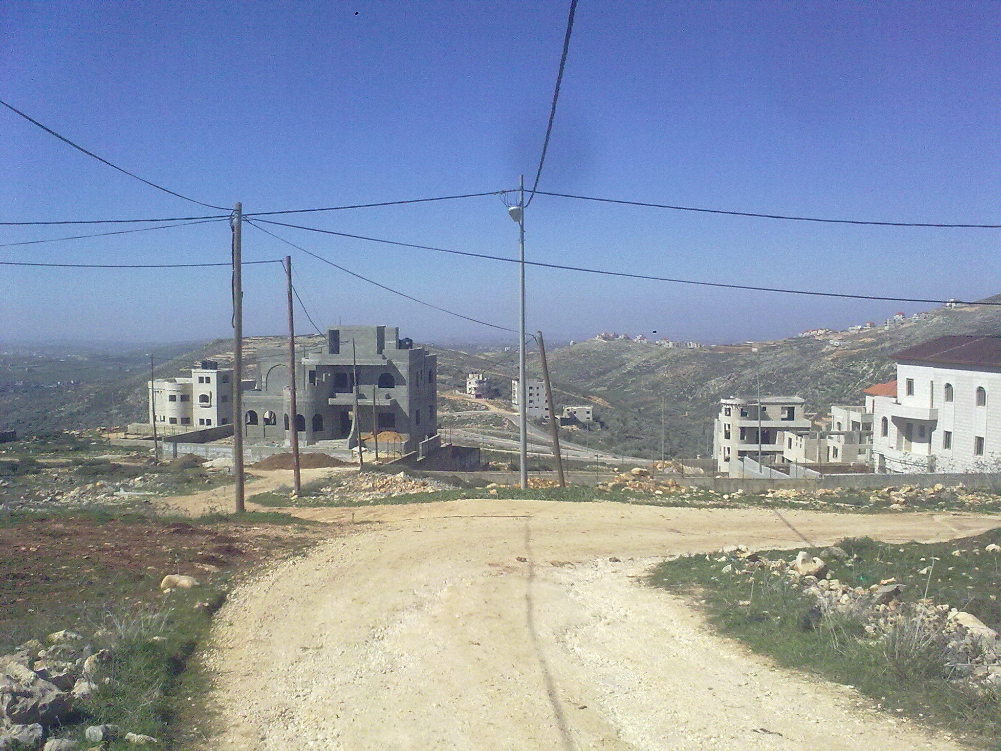
LAND USE
It luxurious . residential buildings

Slide 9
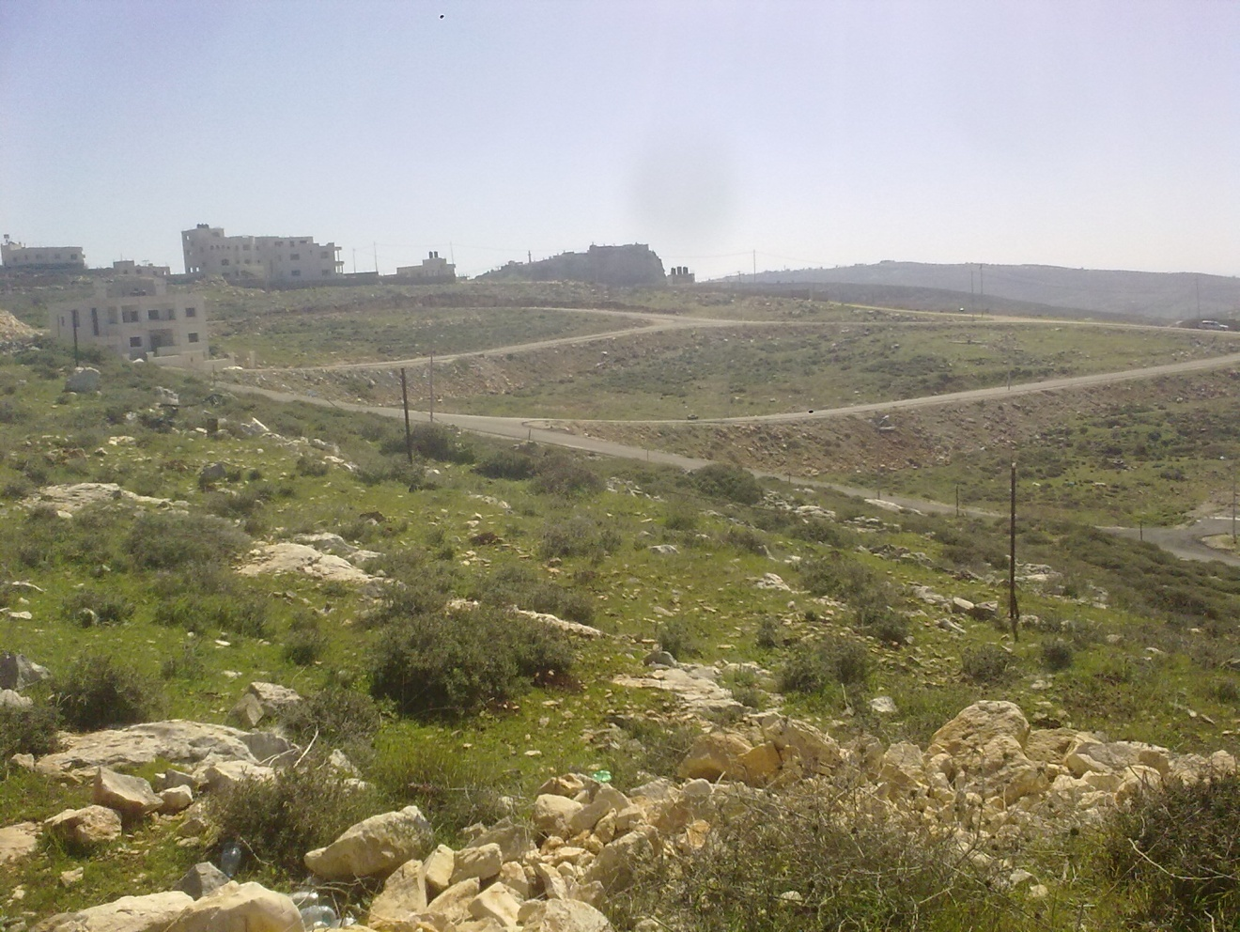
TOPOGRAPHY

Slide 10
METHODOLOGY

Slide 11
SELECTION OF STUDY AREA
We selected an area
  Not served
  Located in Nablus
  Priority for Nablus Municipality
  Availability of data
Facts about our study area
1- one-third of the area is sparsely built
2- The area is hilly with high range slopes

Slide 12
DATA COLLECTION
Information from Nablus Municipality about the study area
Street plan
Contour map
Parcels and buildings distribution plan
Items cost
Site investigation

Slide 13
WASTEWATER GENERATION
WASTEWATER GENERATION
FAMILY PER BUILDING
2
FAMILY SIZE
6
DAILY
WATER CONSUMPTION
100 L/c/d
INFILTRATION
10 %
(WW/W) FACTOR
0.8
HOURLY PEAK FACTOR
4

Slide 14
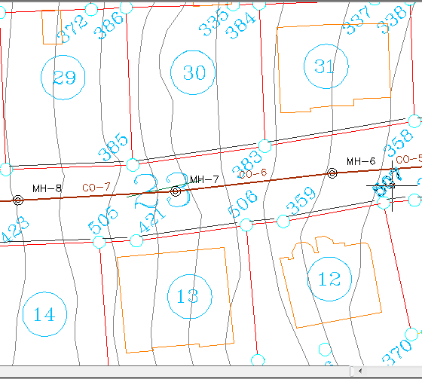
MANHOLE No.
7
PARCELS SERVED
2
Each Parcel Contains One Building
BUILDINGS
2
Two Families per Building
FAMILIES
4
PERSONNEL NUMBER
24
Each Family of 6 Personnel
Water Consumption 100 L/c/d

Slide 15
TOTAL WATER CONSUMPTION
2400
WasteWater Factor is 0.8
AVE. WW GENERATION
1920
Peak Factor is 4
MAX. WW GENERATION
7680
Infiltration 10 %
INFILTRATION
192
DESIGN WW
VOLUME
8448
DESIGN WASTEWATER VOLUME
7872 L/d

Slide 16

Design and analysis using SewerCAD
Designing a Sewer system by using SewerCAD is
More efficient .
Provides the output in a short duration .

Slide 17
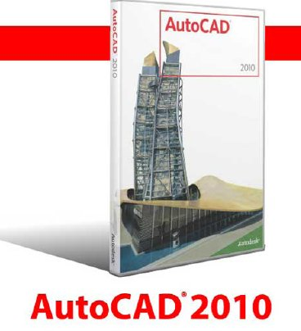
DATA COLLECTED
A) Maps: (all in AutoCAD format)
1- Contour map for the area
2- Road network
3- Parcels
B) Wastewater related data
C) Design constraints

Slide 18
Development of the network
Drawing the network using AutoCAD

Slide 19
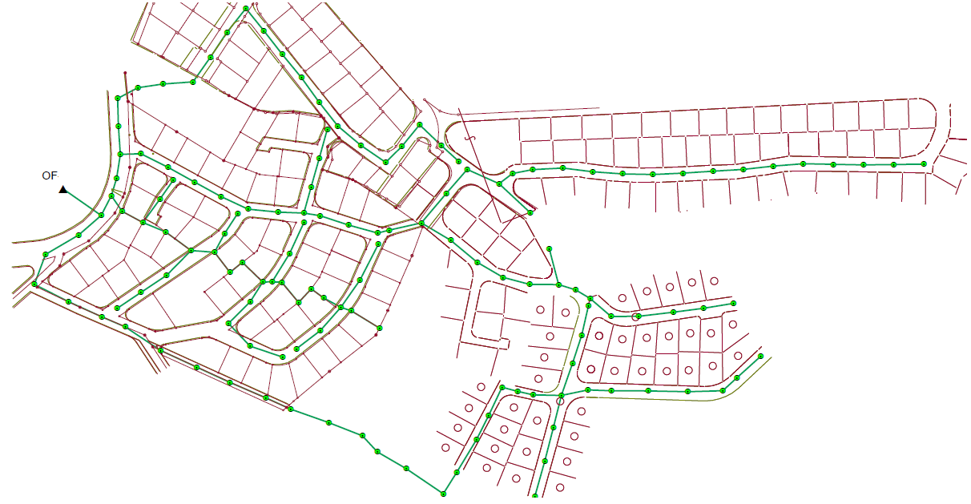
PLAN

Slide 20
PROCEDURES
Assign manholes loads and extract elevations
Define design constraints
Initial run
Solving warning messages
Final design

Slide 21
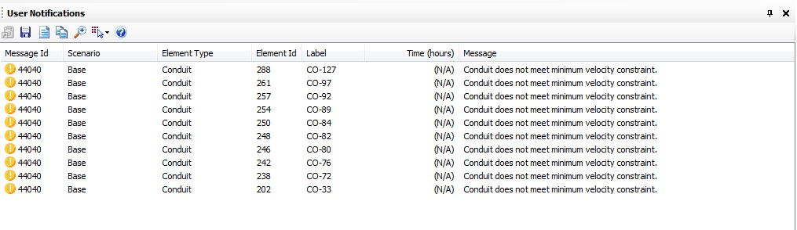
Warning messages

Slide 22
RESULTS
Diameters
Velocity
Cover

Slide 23

DIAMETERS
8 inch

Slide 24
VELOCITY

Slide 25
COVER

Slide 26
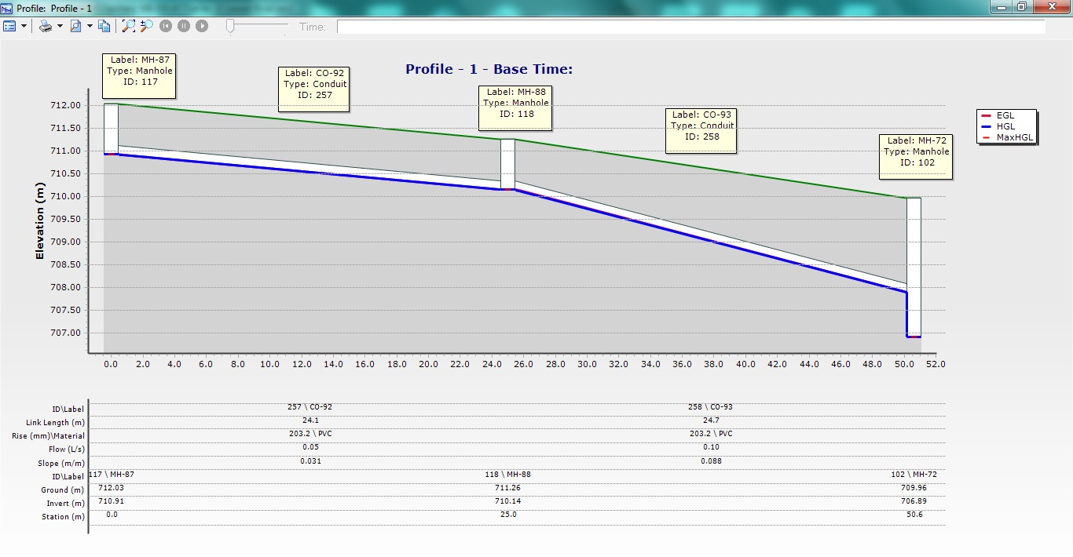
PROFILES

Slide 27
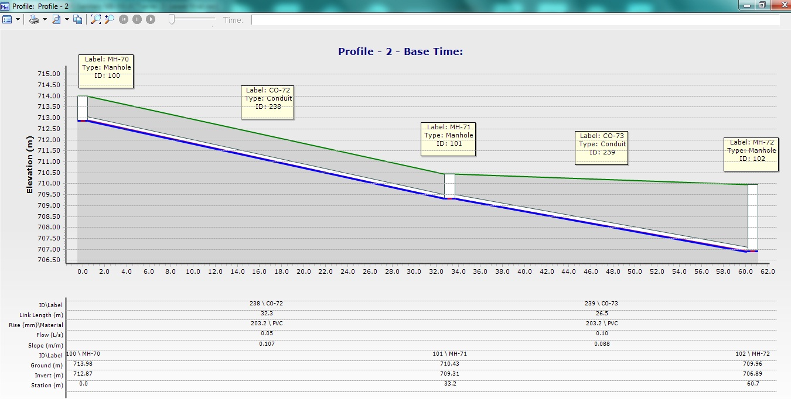
PROFILES

Slide 28
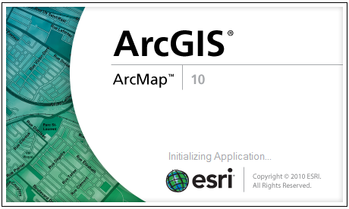
COST
Quantity identification using ArcGIS
Cost calculation

Slide 29
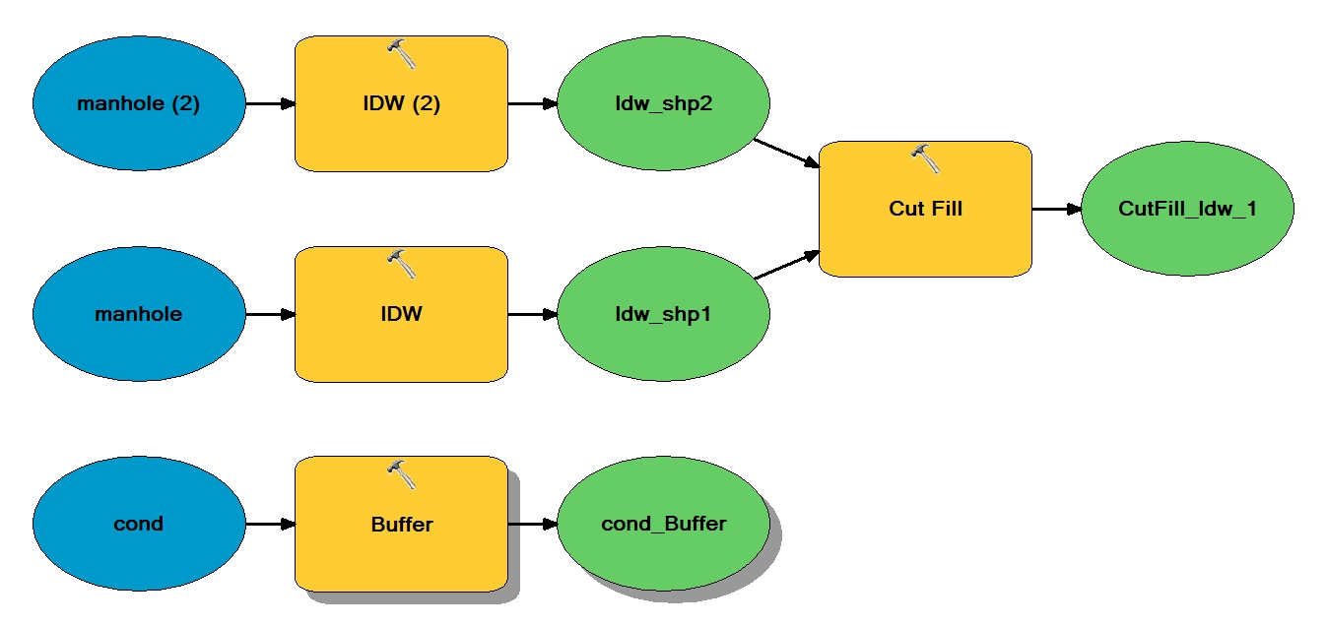
Quantity identification using ArcGIS

Slide 30
Cost calculation
Cost ($) | Unit Cost | Quantity | Item
37872 | 7.9 ($/m³) | 4800 (m3) | Excavation
95535 | 29 ($/m) | 3300 (m) | Sewer line
45724 | 329 ($/manhole) | 140 | Manhole (No.)
24874 | 179 ($/cover) | 140 | Manhole cover (No.)
27786 | 21 ($/m³) | 1320 (m3) | Backfill
69465 | 21 ($/m) | 3300 (m) | Asphalt
301256 |  |  | Total
Cost per kilometer is~ $ 90,000

Slide 31

Conclusions
Only 8-inch diameter sewer lines were used
SewerCAD and ArcGIS are important and efficient to use.
Teamwork is critical .

Slide 32
Recommendations
WWTP
ENTIRE AREA
SITE INVESTIGATIONS

Slide 33

Thank you

