Slide 1

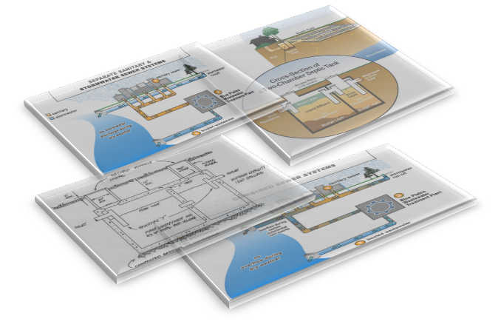
Design of a Wastewater Collection
Network for Kifl Hares Village along with cost estimate and assessment of potential location for a proposed Wastewater Treatment Plant
Prepared by
Ghada Emad Hammad
Rand Saleem Jadallah
Supervisor
Dr. Mohammad N. Almasri

Slide 2
Outline
Introduction
Objectives
Study area
Methodology
Modeling and design
Results
Conclusions and Recommendations
Cost estimate of WWCN
The proposed location of WWTP

Slide 3


Slide 4

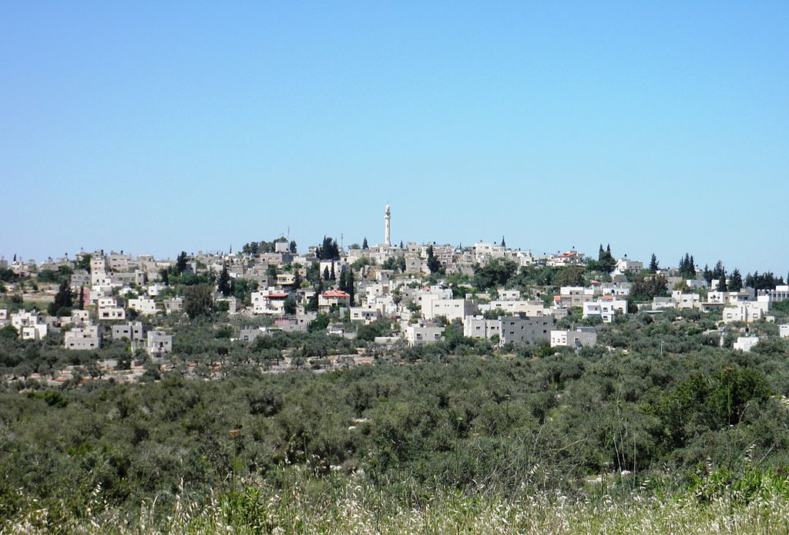
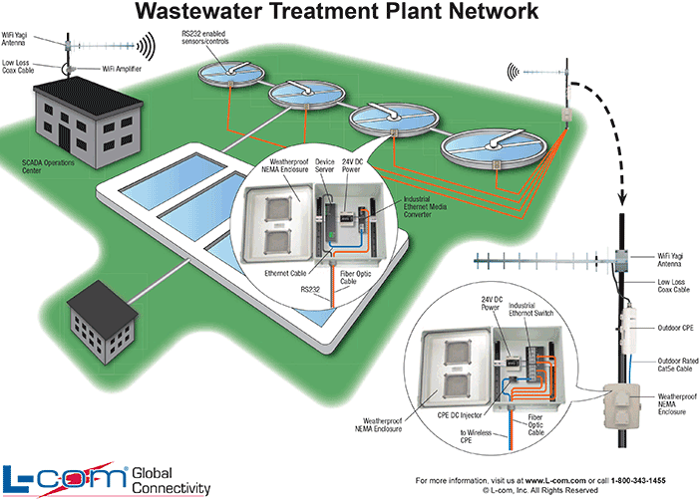


Objectives
-Design a wastewater collection network for Kifl Hares Village using SewerCAD.
- Calculate the cost.
-Location of proposed Wastewater Treatment Plant.

Slide 5
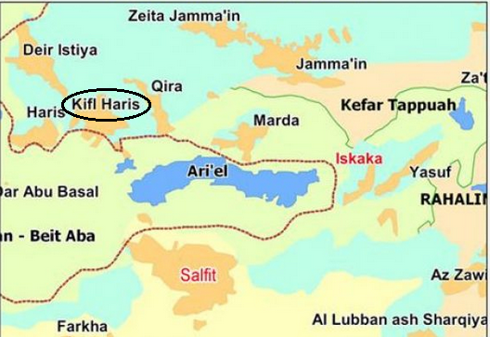
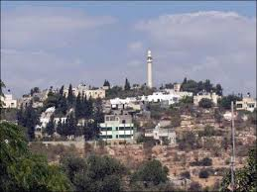
Study Area
Study Area
r= 3.3%
515 m
410 m

Slide 6
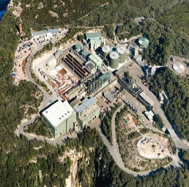






Methodology
Determine problem
Selection of study area
Data collection
Loads determination
Design Wastewater Collection Network
Calculate the cost of a network
Location of WWTP

Slide 7
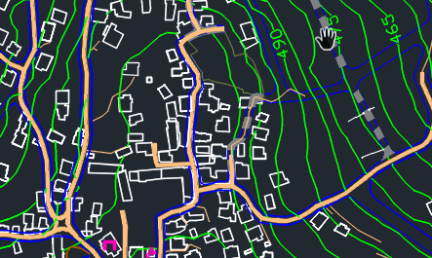

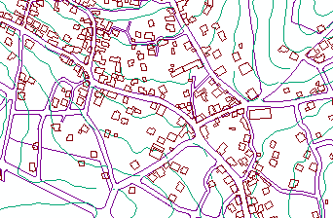


Data collection
Data
AutoCAD
Village Council
Communities
GIS
Dr
Settlements
GIS
Dr
Population
word
PCBS

Slide 8
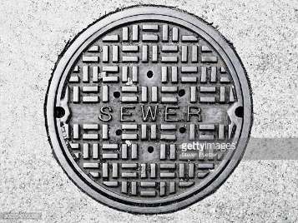
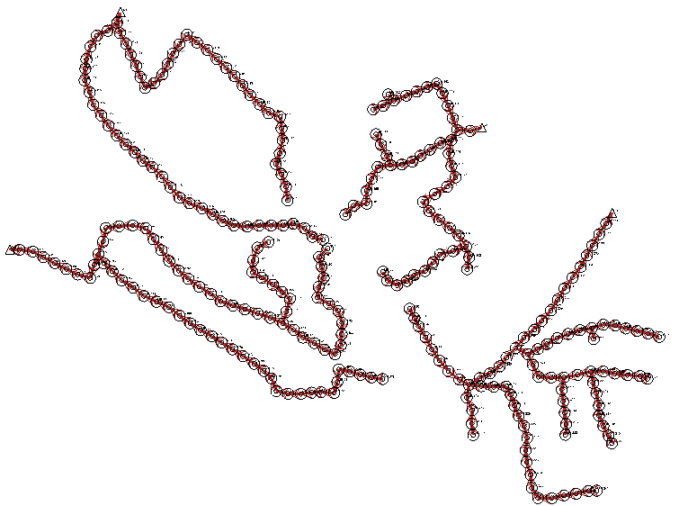
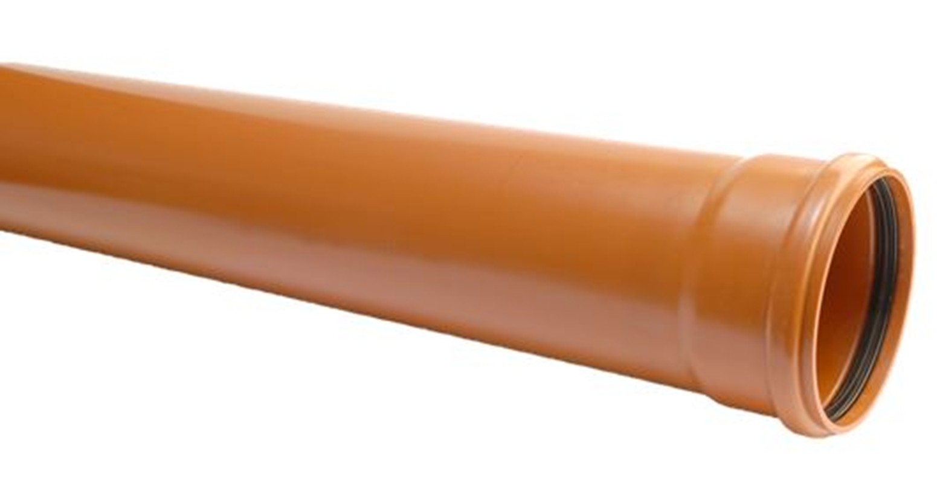
Network
278
278

Slide 9
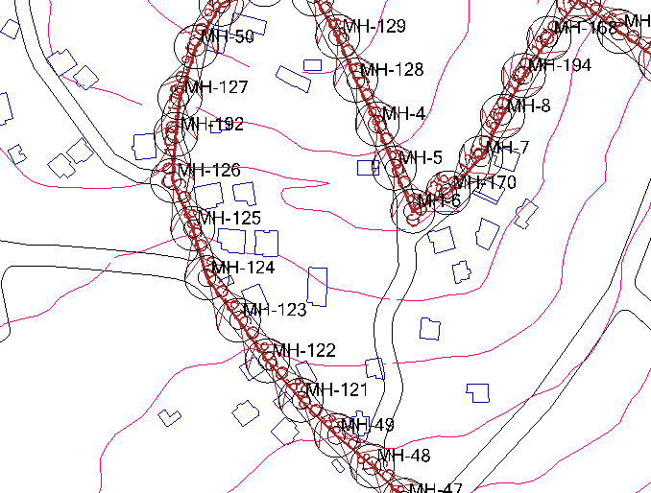
Load calculations

Slide 10
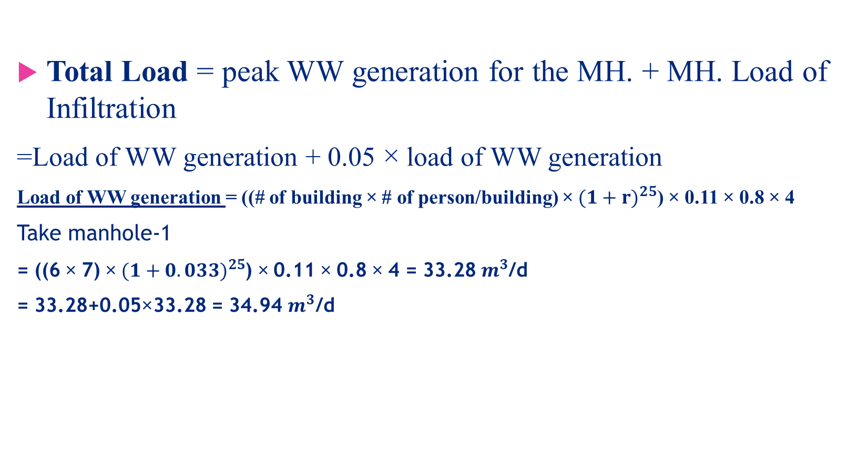
Load calculations
Total Load = peak WW generation for the MH. + MH. Load of Infiltration
=Load of WW generation + 0.05 × load of WW generation
Load of WW generation = ((# of building × # of person/building) ×${(1+r)}^{25}$) × 0.11 × 0.8 × 4
Take manhole-1
= ((6 × 7) × ${(1+0.033)}^{25}$) × 0.11 × 0.8 × 4 = 33.28${ m}^{3}$/d
= 33.28+0.05×33.28 = 34.94 $m^{3}$/d
# of person/building = 7
Design period = 25
Growth rate =0.033
Water consumption=0.110

Slide 11
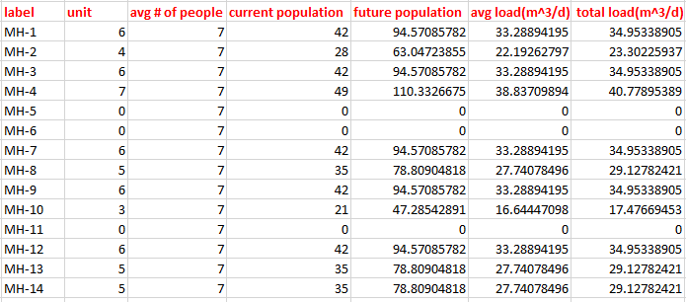


Slide 12
Design constraints
Velocity
Cover
Slope
0.6-3m/s
1-5m
1-12%
80%
Partial flow

Slide 13
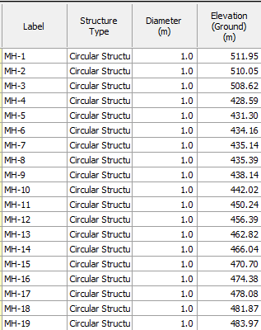
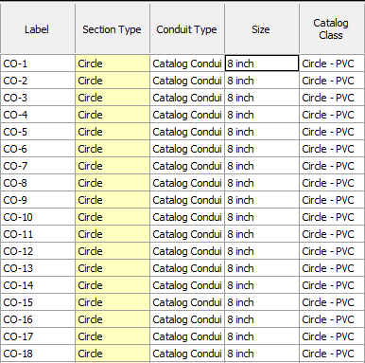
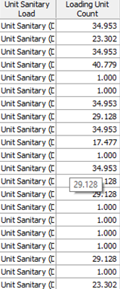
Manholes and conduits information

Slide 14



Slide 15
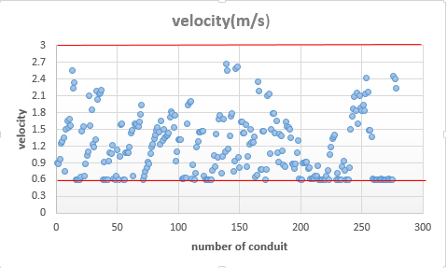

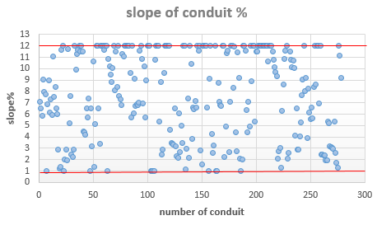

Slide 16
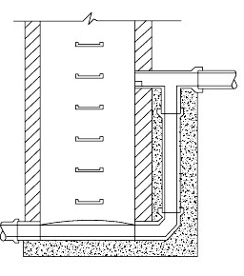
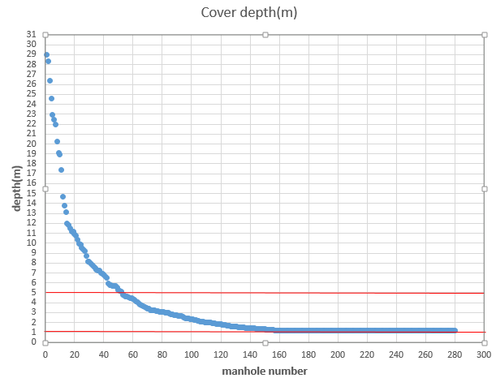
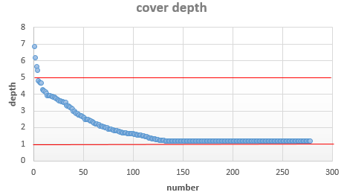

Before
After use Drop manholes

Slide 17
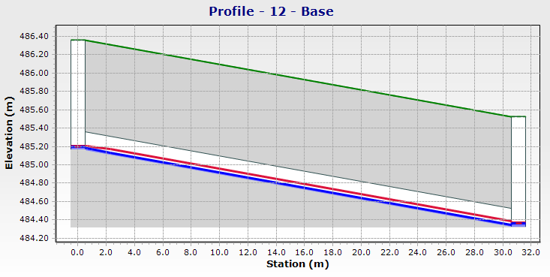

Data profile
Ground surface
Total Energy Line
Hydraulic Grade Line

Slide 18

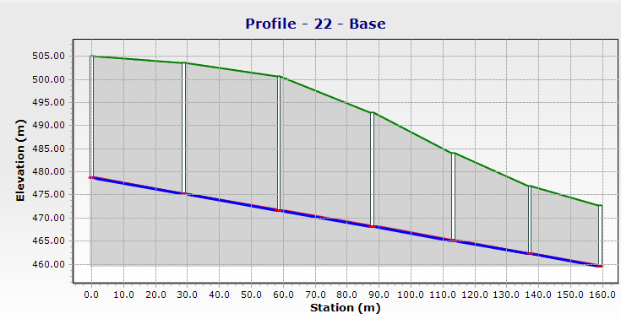
Data profile

Slide 19

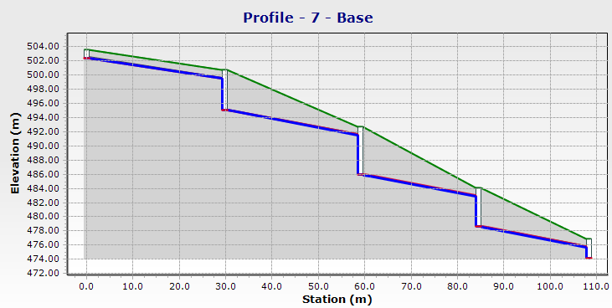
Data profile

Slide 20
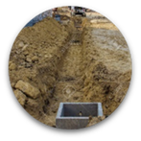
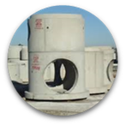

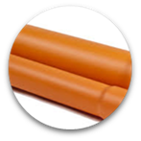
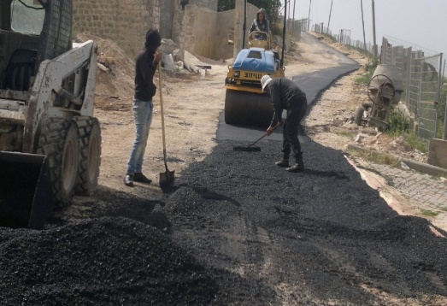

Estimation of Potential Cost
Network Elements
Excavation
Manholes
Conduits
Re-paving
Others

Slide 21
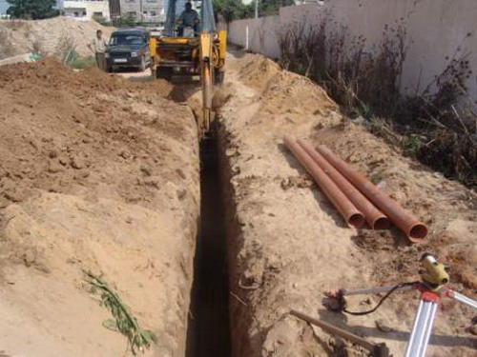

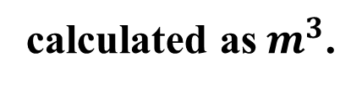
Excavation
1 m³ excavation for 8in conduit = 12 $.
calculated as${ m}^{3}$.
width
length
depth
25cm+D+25cm
Distance between two manholes
Avg cover+D+20cm
117,763 $

Slide 22
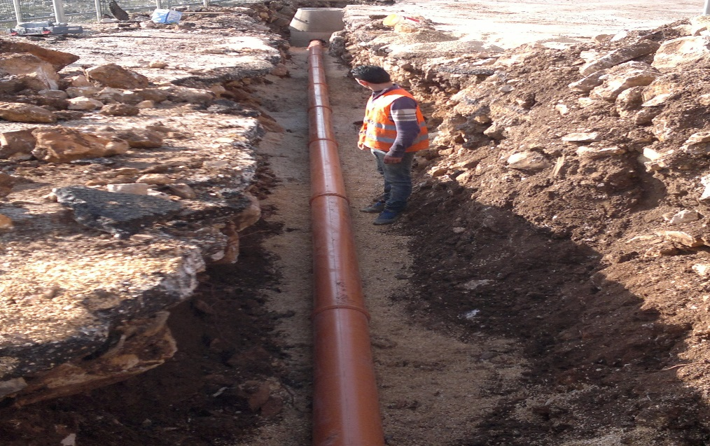
Conduits
Calculated in linear meter
Depends on:
Length
Dimeter
Material
1 m of 8in diameter PVC conduit = 13 $
98,046 $

Slide 23
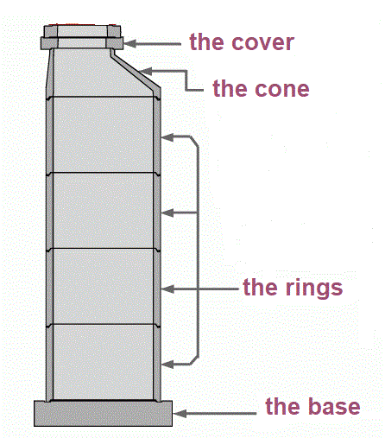
Manholes
MH element | Dimensions | Cost
Base | 100×60 | $99
 | 100×80 | $115
Cone | 100×75 | $99
Cover | 100×20 | $61
Ring | 100×30 | $54
 | 100×40 | $56
 | 100×50 | $57
50,018 $

Slide 24

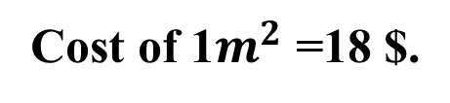
Re-paving
Cost of 1$m^{2}$ =18 $.
length
Length of the network =7542 m
width
0.7 m
95,029 $

Slide 25
Other cost
Labor
Insurance
Transportation
Engineer salary
Installing manholes
108,820 $

Slide 26
Cost percentage of Network Elements ($)

Slide 27
Item | Cost ($) | Percentage (%)
Excavation | 117,763 | 25%
Conduits | 98,046 | 21%
Manholes | 50,018 | 11%
Asphalt | 95,029 | 20%
Others | 108,820 | 23%
Total cost | 469,676 | 100%
Cost/m | 62 | -
Cost/person | 52 | -

Slide 28
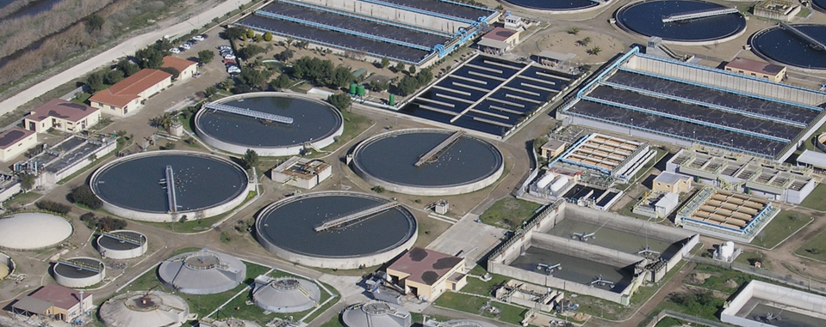
Proposed location for potential Wastewater Treatment Plant

Slide 29

Selection criteria for the WWTP location.
15
Geopolitical area
8
Type of the soil.
14
Population served.
7
Land acquisition.
13
Remoteness from residential areas.
6
Topography.
12
The zones to be served.
5
The susceptibility of the site to flooding.
11
Prevailing wind directions.
4
Traffic and dust pollution.
10
The public opinion.
3
Remoteness from areas recharge of the Groundwater.
9
Access by an existing road.
2
Geotechnical stability.
1
Noise and lighting

Slide 31

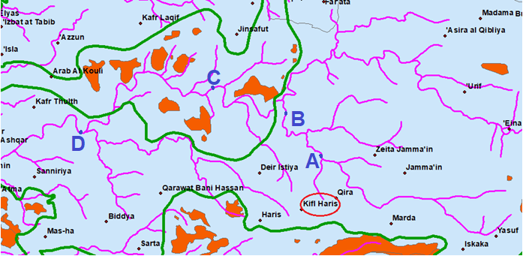
Distribution of the settlements in the area.

Slide 32
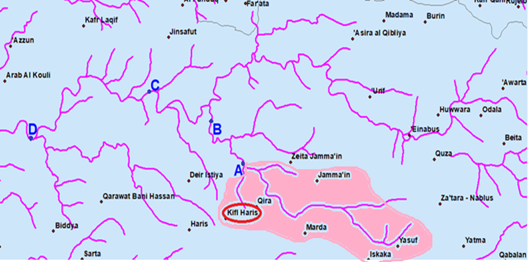

Slide 33
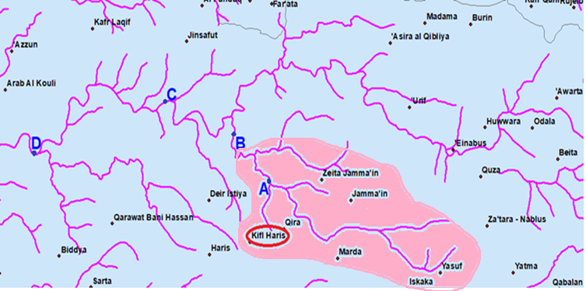

Slide 34
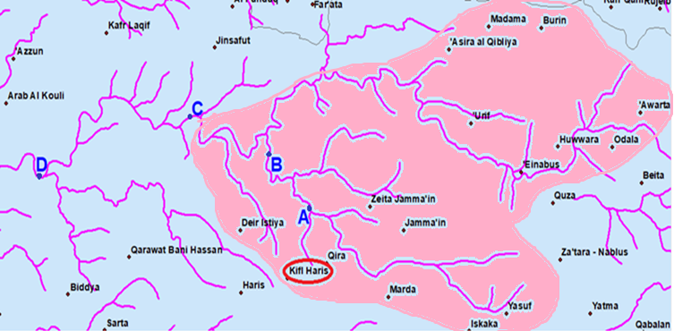

Slide 35
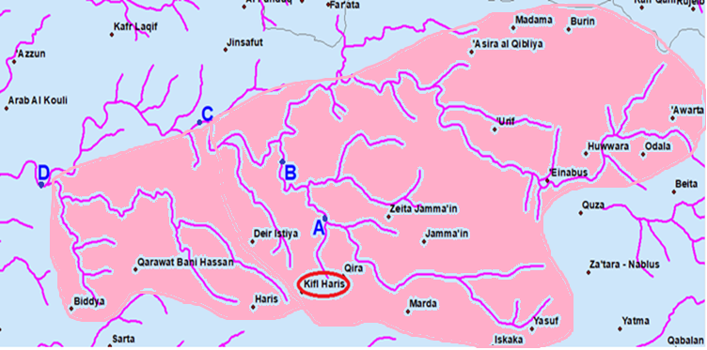

Slide 36
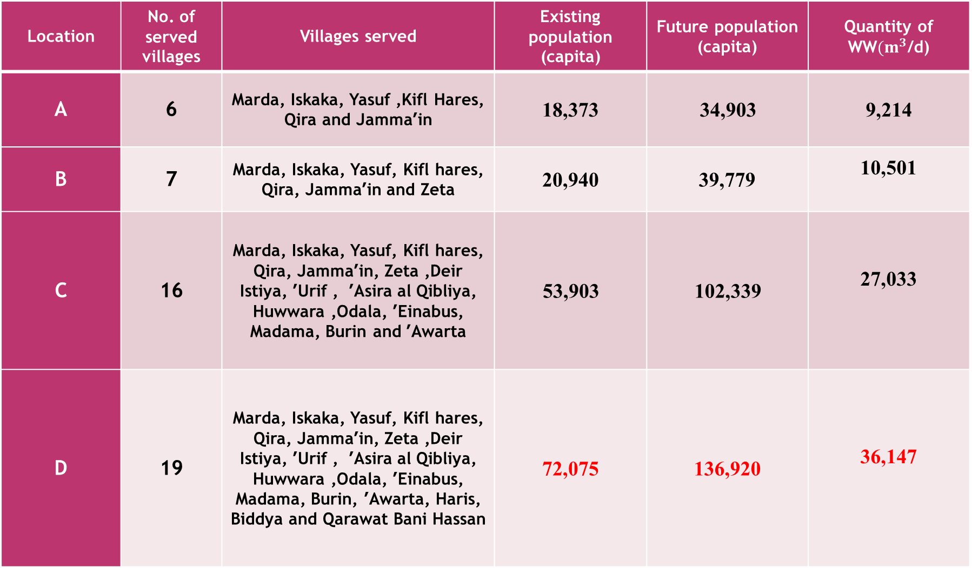
Location | No. of served villages | Villages served | Existing population (capita) | Future population (capita) | Quantity of WW$(m^{3}$/d)
A | 6 | Marda, Iskaka, Yasuf ,Kifl Hares, Qira and Jamma’in | 18,373 | 34,903 | 9,214
B | 7 | Marda, Iskaka, Yasuf, Kifl hares, Qira, Jamma’in and Zeta | 20,940 | 39,779 | 10,501
C | 16 | Marda, Iskaka, Yasuf, Kifl hares, Qira, Jamma’in, Zeta ,Deir Istiya, ’Urif , ’Asira al Qibliya, Huwwara ,Odala, ’Einabus, Madama, Burin and ’Awarta | 53,903 | 102,339 | 27,033
D | 19 | Marda, Iskaka, Yasuf, Kifl hares, Qira, Jamma’in, Zeta ,Deir Istiya, ’Urif , ’Asira al Qibliya, Huwwara ,Odala, ’Einabus, Madama, Burin, ’Awarta, Haris, Biddya and Qarawat Bani Hassan | 72,075 | 136,920 | 36,147

Slide 37
 | Weights (W) | Location A | Location B | Location C | Location D
Population served. | 14 | Bad | Good | Very good | Excellent
Remoteness from residential areas | 13 | Bad | Good | Very good | Very good
The zones to be served. | 12 | Excellent | Excellent | Excellent | Excellent
Access by an existing road | 9 | Excellent | Very good | Excellent | Very good
Remoteness from flooding zone | 5 | Very good | Very good | Very good | Very good
Land acquisition. | 7 | Bad | Bad | Bad | Bad
Noise and lighting | 1 | Excellent | Excellent | Excellent | Excellent
Traffic and dust pollution | 4 | Bad | Good | Bad | Good
Topography | 6 | Good | Bad | Bad | Bad
Geotechnical stability | 2 | Good | Good | Good | Good
Winds direction. | 11 | Good | Good | Good | Good
Geopolitical area | 15 | Good | Bad | Bad | Bad
Type of the soil | 8 | Bad | Good | Good | Good
Areas recharge of the ground water | 3 | Good | Good | Good | Good
The public opinion | 10 | Bad | Bad | Bad | Bad
Excellent = 10
Very good = 7
Good = 4
Bad = 2

Slide 38
 | Weights )W) | Location A (W*M) | Location B (W*M) | Location C (W*M) | Location D (W*M)
Population served. | 14 | 28 | 56 | 98 | 140
Remoteness from residential areas | 13 | 26 | 52 | 91 | 91
The zones to be served. | 12 | 120 | 120 | 120 | 120
Access by an existing road | 9 | 90 | 63 | 90 | 63
Remoteness from flooding zone | 5 | 35 | 35 | 35 | 35
Land acquisition. | 7 | 14 | 14 | 14 | 14
Noise and lighting | 1 | 10 | 10 | 10 | 10
Traffic and dust pollution | 4 | 8 | 16 | 8 | 16
Topography | 6 | 24 | 12 | 12 | 12
Geotechnical stability | 2 | 8 | 8 | 8 | 8
Winds direction. | 11 | 44 | 44 | 44 | 44
Geopolitical area | 15 | 60 | 30 | 30 | 30
Type of the soil | 8 | 16 | 32 | 32 | 32
Areas recharge of the ground water | 3 | 12 | 12 | 12 | 12
The public opinion | 10 | 20 | 20 | 20 | 20
Sum | - | 483 | 492 | 592 | 615

Slide 39
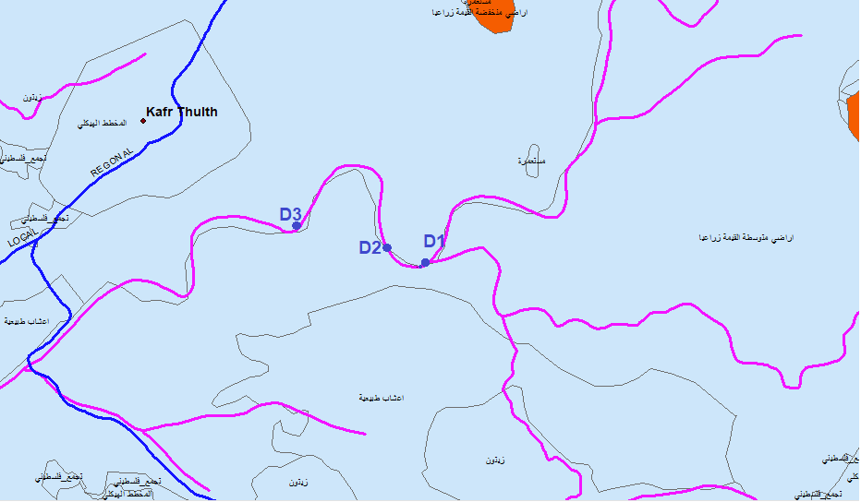

Slide 40
Conclusions
# of manholes | 278
# of conduits | 278
# of outfalls | 4
Diameters | 8 in
Cover depth | (1.20-6.84)m
Velocity | (0.6-2.67)m/s
Slope | (1-12)%
Cost/m | 62 $/m
Cost/person | 52 $/person

Slide 41




Slide 42



