Slide 1

Electronic Clinic System
Prepared By: Salsabeel Ahmad AL-Taha and Maram Fathi Balatia
Supervisor : Dr.Aladdin Masri

Slide 2
Outline
Introduction
Motivation
Features
For Whom
Main Goals
Languages and Tools
Website
Android Application
Conclusion

Slide 3

Introduction
Our project offers a variety of secure, online services for both patients and doctors through Medical Website and mobile application .

Slide 4

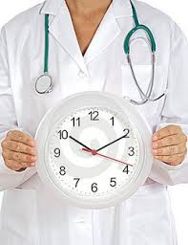
Motivation
Most people have been watching the minutes slowly tick by,
  waiting waiting waiting for their names to be called.

Slide 5
Our project consist of:
Web Site
Mobile Application

Slide 6
For Whom??
Patients
Doctors
Administrators

Slide 7
Main Goals
Attractive make users to conduct medical operations in a modern, advance approach.
Flexibility for the patients.
Simplicity: user Friendly.
Simulates social media.

Slide 8


Languages and Tools
Server ( XamppServer2.0c).
Database ( MySQL).
Dreamweaver.
PHP, JavaScript, AJAX , and HTML as programming languages .
Java for android
Artisteer (we use it to design our project temp)

Slide 9
Website : Doctor activities
Add, update, and delete the news
Update personal data
Make prescription
Send and receive a message.
View Patient data.
View weekly schedule.

Slide 10
Website :Administrator Activities
Add, update, and delete the news
Update personal data
Add doctor
Send and receive a message.
Add/delete/update hospital, pharmacy
Search for any doctor , hospital and pharmacy.

Slide 11
Website : Patient activities
Update personal data.
Reserve appointment at any doctor.
Send and receive a message.
View all news.
Choose favorite doctors.
Search for any doctor.
Search for any hospital.
Search for any pharmacy.

Slide 12
Android Application
Our mobile application offers many services for doctors and patients :
Notification for appointment before it’s time for doctors and patients using GCM services .
Notification for unread messages on time.

Slide 13
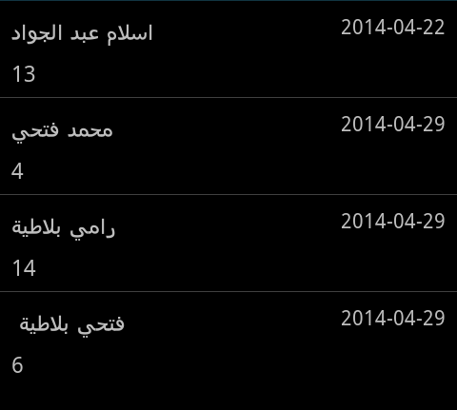
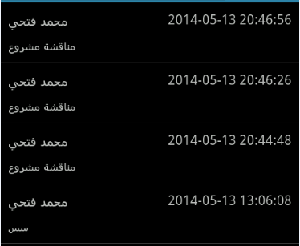
Android Application
View your future appointments
View all unread messages.

Slide 14
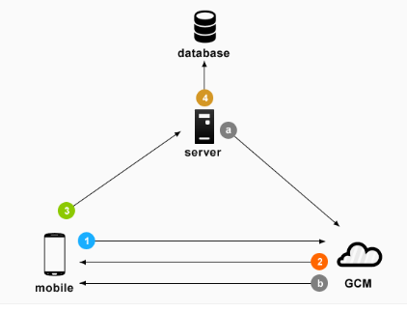
Google Cloud Messaging(GCM)
It is a service that helps developers send data from servers to their Android applications on Android devices whenever new data is available instead of making requests to server in timely fashion.

Slide 15
Future Work:
Add more features to mobile version.
Determine the nearest hospital , pharmacy and doctor’s clinic using GPS.
Add billing system with our system.

Slide 16
Conclusion
Our system is a type of Medical systems that gives the opportunity for patients to allows:
the interaction between patient and there doctor's through the appointments, messages, news, notifications .
And also between the doctors and the administrators .

Slide 17
THANK YOU!

