Slide 1

Graduation Project 2
The “Smart” Diaper Moisture Detection System
Prepared by: Rana Haj Ali .
Supervisor : Dr. Falah Mohammad.

Slide 2



Outline
Introduction
System Component
Project Description
Methodology
Strengths and Weaknesses
Conclusion

Slide 3
Introduction
One of the main problems facing parents with their baby is diaper dermatitis ,prolonged exposure to urine and stool in a diaper weakens skin and increased skin pH . Parents of excessive interest often check to see if the diaper is soiled too often, causing them to throw away diapers unnecessarily.
Smart diaper System connects Parents and nurses with their children and their patients .Our design reduce this problem by providing real-time notifications to a caregiver when a diaper is wet through an embedded wireless moisture sensing system.

Slide 4
HC-05 Bluetooth
module
Application
Smart phone
System Component
Soil Moisture
sensor
Arduino

Slide 5
Hardware component
1.Soil Moisture sensor:
is used to measure the volumetric water content .
2.HC-05 Bluetooth module:
is an easy to use Bluetooth SPP module, designed for transparent wireless serial connection setup.
3.Arduino
Arduino consists of both a physical programmable circuit board and a piece of software, or IDE .

Slide 6
Project Description
Design smart diaper using Bluetooth module . The sensor is placed in the area most vulnerable to moisture. The wetting of the diaper decreases the resistance between two terminals, which are connected with conductors. As a result, terminals resistance fall down below the predefine resistance value and Bluetooth module send the data reading from sensor to the Smartphone application .

Slide 7
Flowchart
Block Diagram
Methodology
Results
Design & Implementation

Slide 8
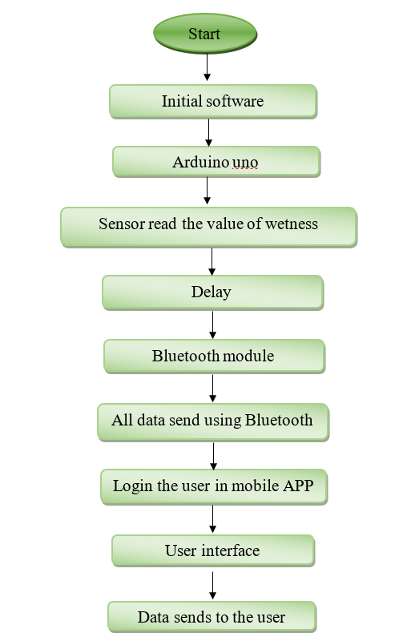
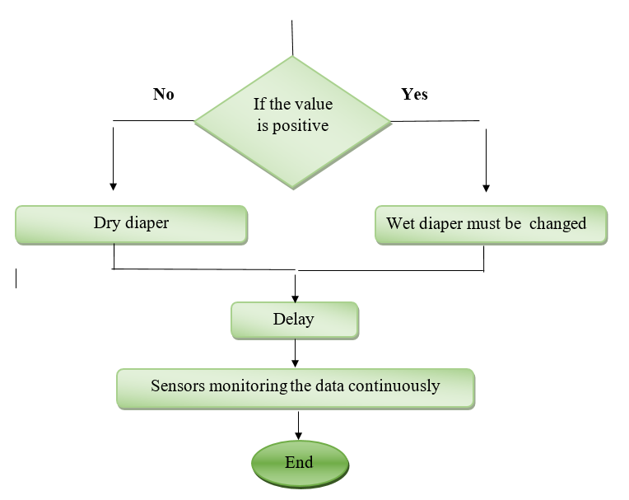
Flowchart

Slide 9
Block Diagram Of System
Diaper Moisture sensor
Arduino Uno
Blutooth Module
Application on smart phone

Slide 10
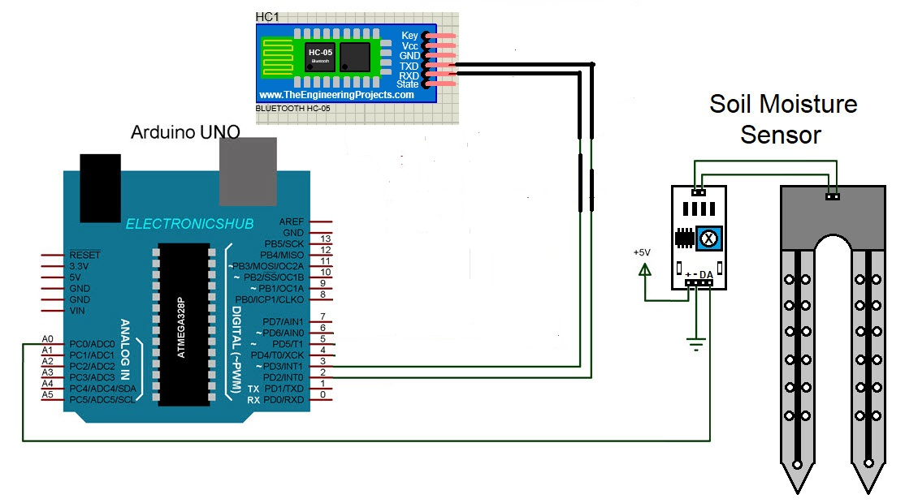
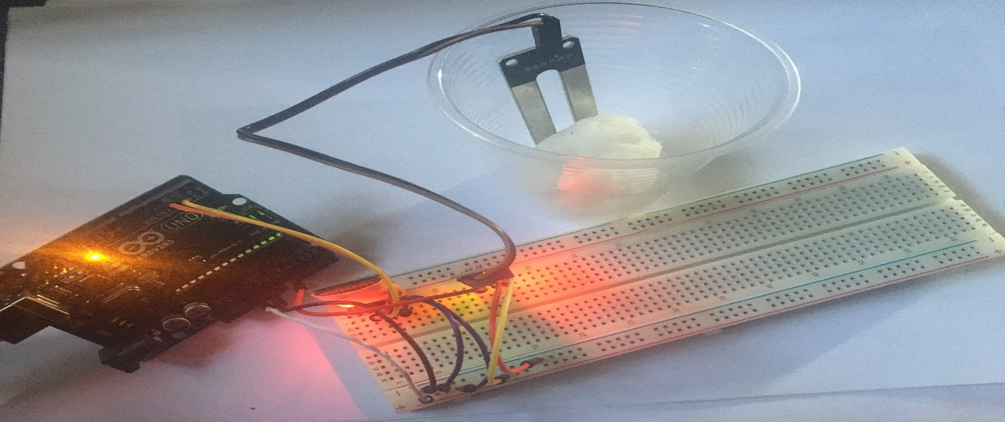
Design and Implementation
Proteus Simulation
Circuit implementation

Slide 11
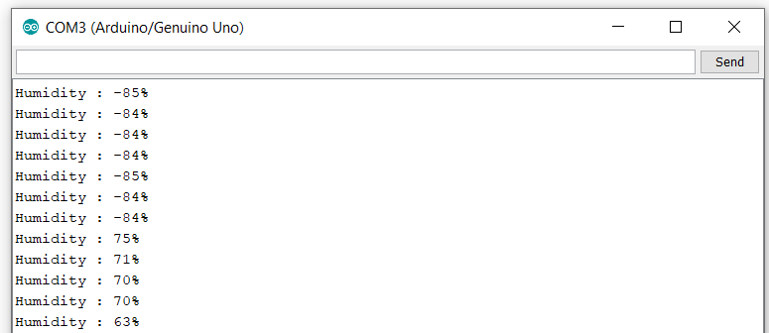
Results
Results in Arduino Uno Serial Monitor

Slide 12
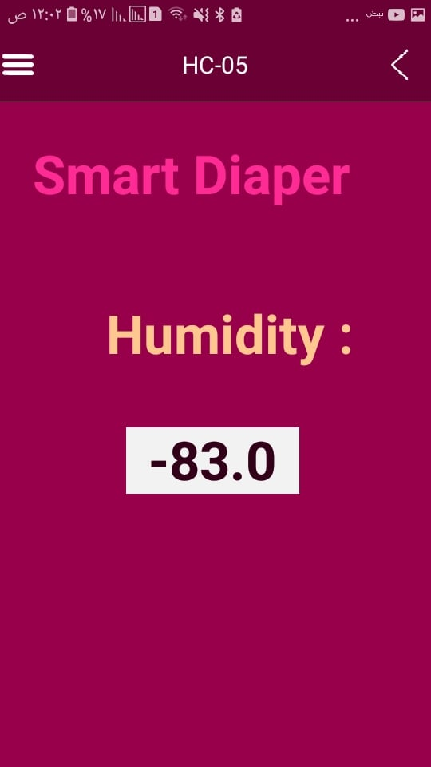
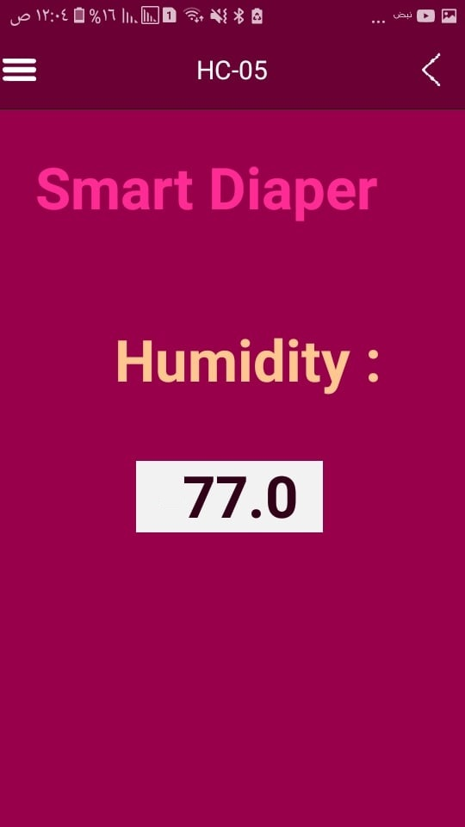
Results in Application on smartphone
Humidity measurement
Dry diaper . Wetness diaper.

Slide 13

Strengths and Weaknesses
Strengths
Weaknesses
Opportunities
Threats
Reliable for parents and nurses.
Maintaining healthy skin
Available smart technologies.
Saving time and effort.
Bluetooth coverage area is limited.
We can added more sensors not only moisture sensor.
There are other project applied may be competitive to our project due performance and cost.

Slide 14
Conclusion
Diaper rash is a nightmare for the wearer of diapers and the people who are responsible for such wearers. In this project proposed a wet diaper detector based on smart phone. Above experimental results shows that proposed method is very suitable to detect wetness of the diaper. Our system gives a value of humidity using a smart phone. In these days, smart phone is inexpensive and everybody has their own smart phone. Proposed sensor are very cheap compared to other wet detectors. Our system is appropriate for all kinds of user who is able to use Smartphone.

Slide 15

Thank
You
2021-1-3

