Slide 1
An- Najah National University
Assessment and Redesign Al-Ledawi Building
prepared by:
Malak Sholi
Raya Hassoun
Laiale Samer
Under the supervision:
Eng.Alaa Shaheen

Slide 2
1
2
3
CONTENT
4
5
6

Slide 3
1
Introduction
2
Site Analysis
3
Architectural Aspect
4
Structural Aspect
5
Electro-Mechanical Aspect
6
Quantity surveying

Slide 4
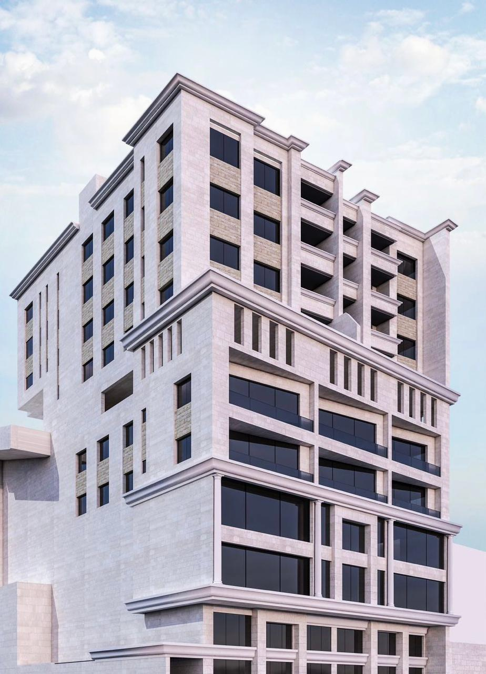
Introduction
This project represents an integrated design for a commercial and residential classification building in Rafidia in Nablus, to be a very good model in design for similar projects.

Slide 5
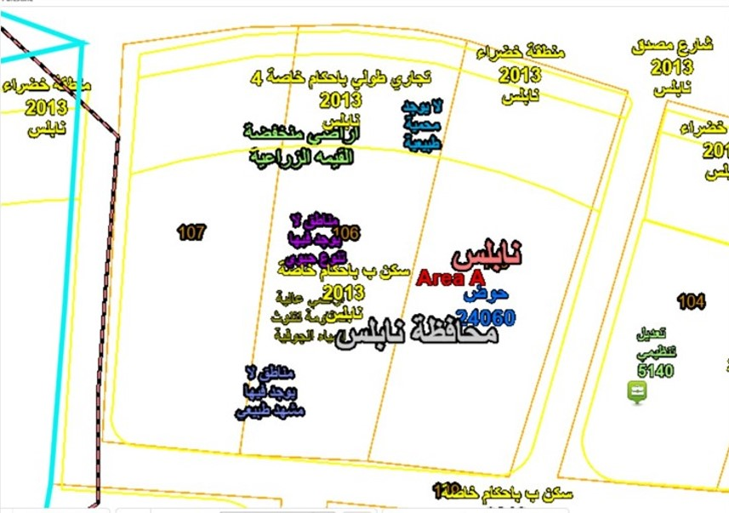
Site Analysis
Land location in Nablus
The building is located in Nablus, the Rafidia area specifically, on an area of 2240.00 m2

Slide 6
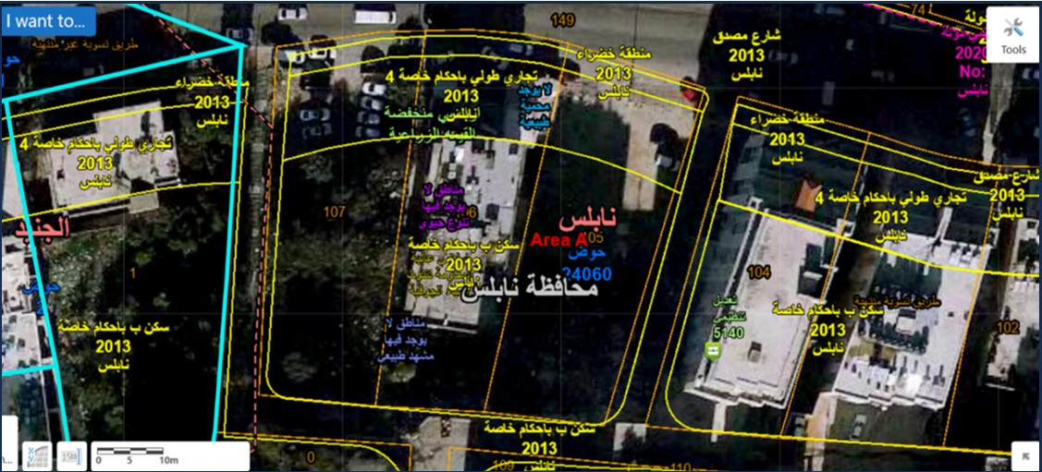
Site Analysis
SURROUNDING
BUILDINGS
IN THE PROJECT

Slide 7
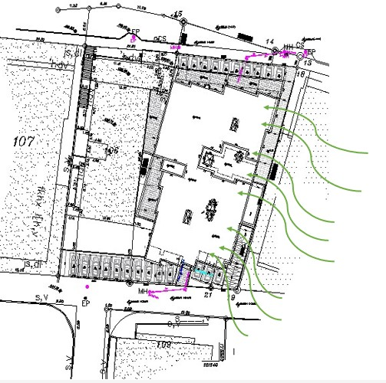
Site Analysis
WIND DIRECTION
AND SPEED
The wind direction at the site is Southwest and the wind speed is 10 km / h.

Slide 8
Architectural Aspects

Slide 9
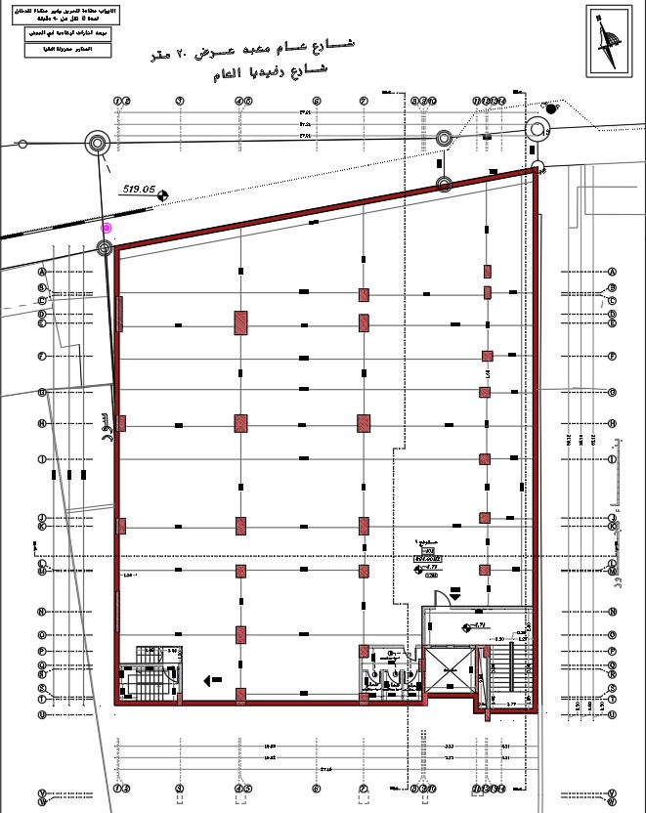
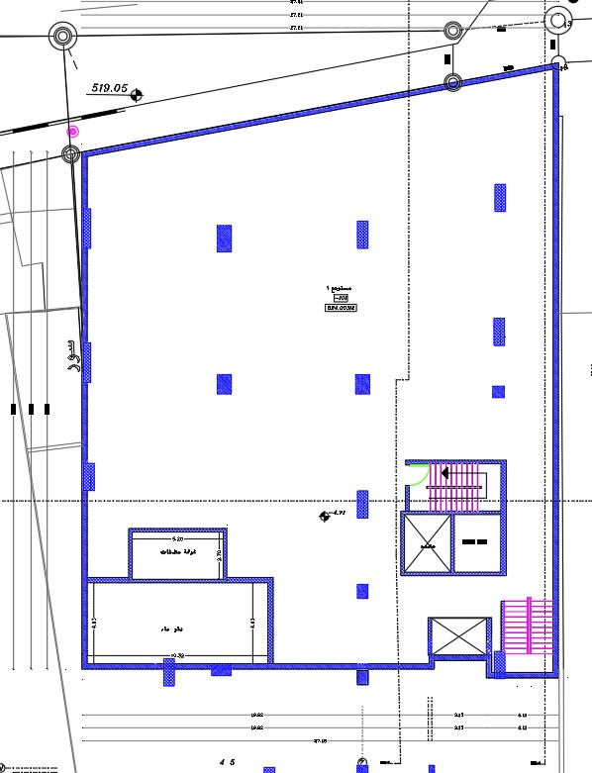
First basement floor
before& after modification

Slide 10
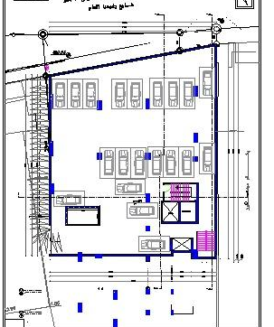
Second basement floor
This floor was added after modification

Slide 11
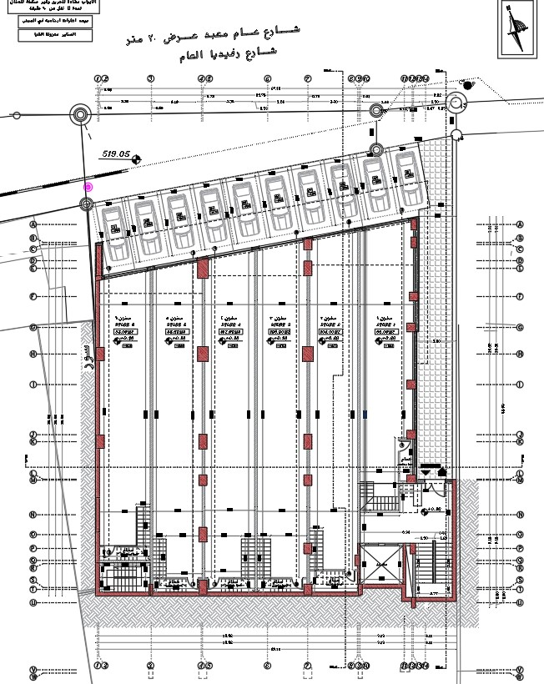
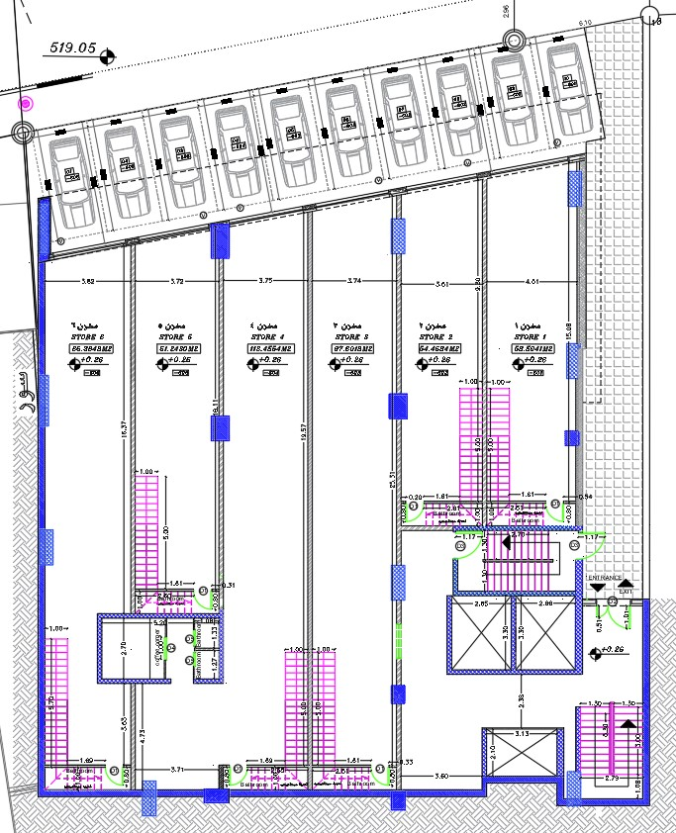
Ground floor
before& after modification

Slide 12
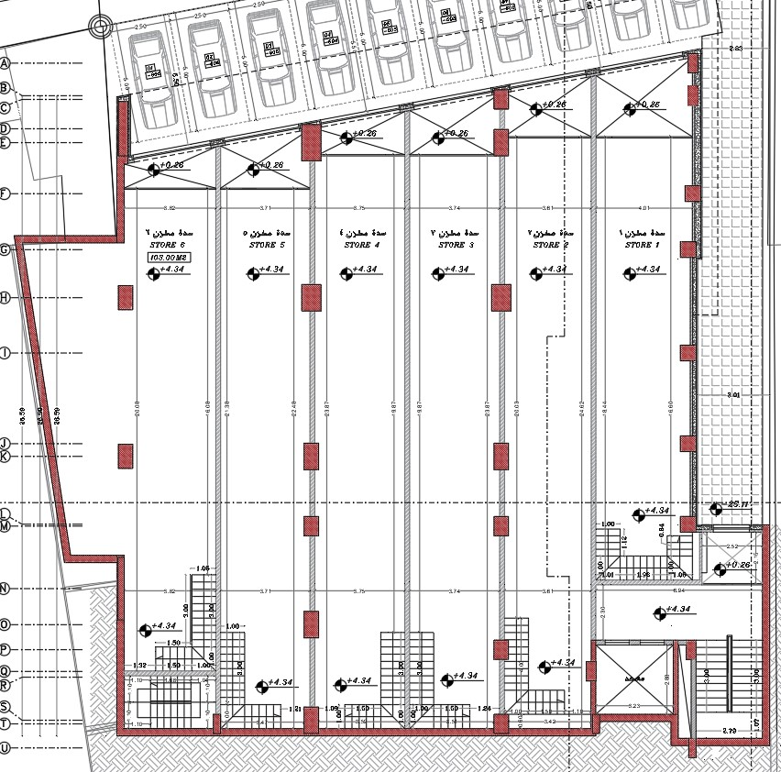
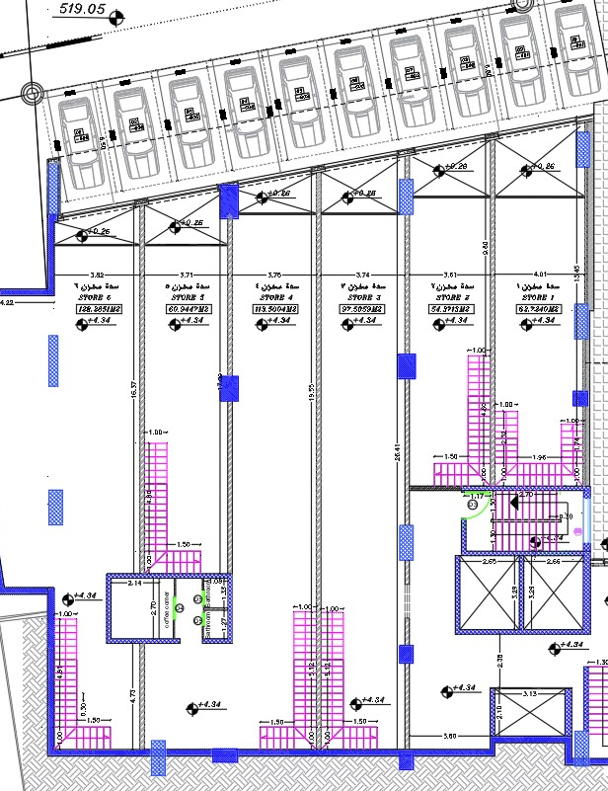
Ground floor block
before& after modification

Slide 13
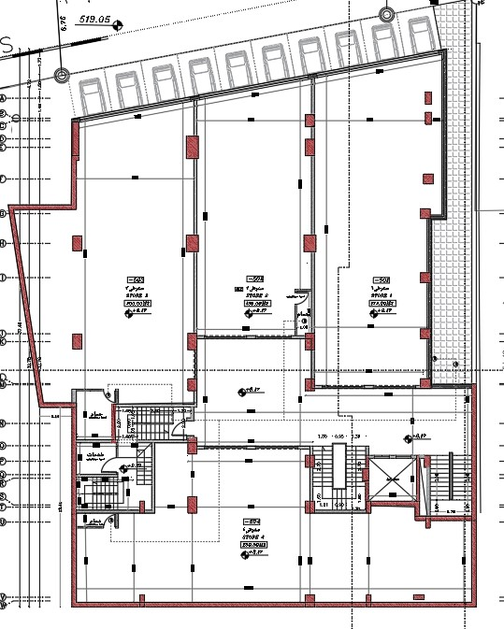
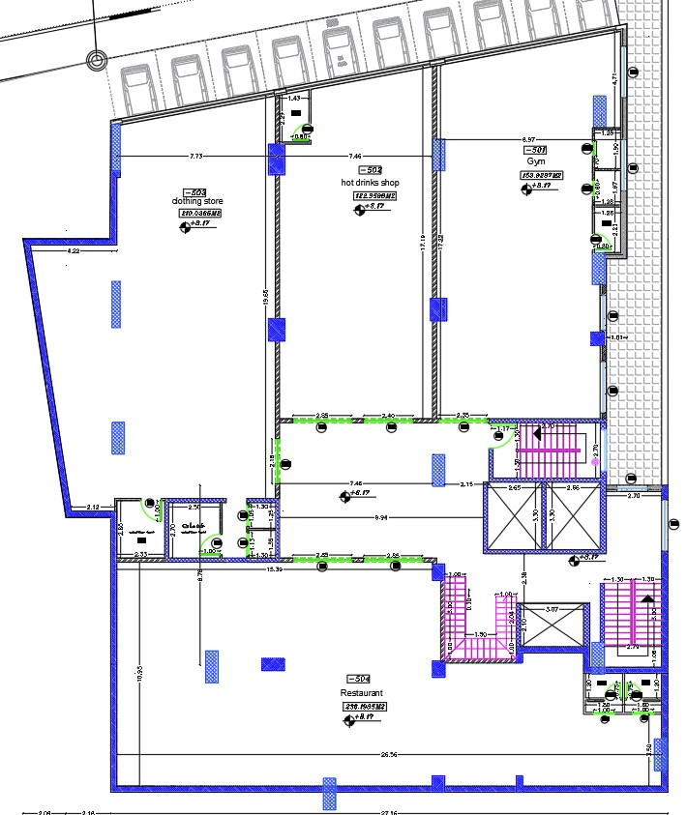
First& second floor
before& after modification

Slide 14
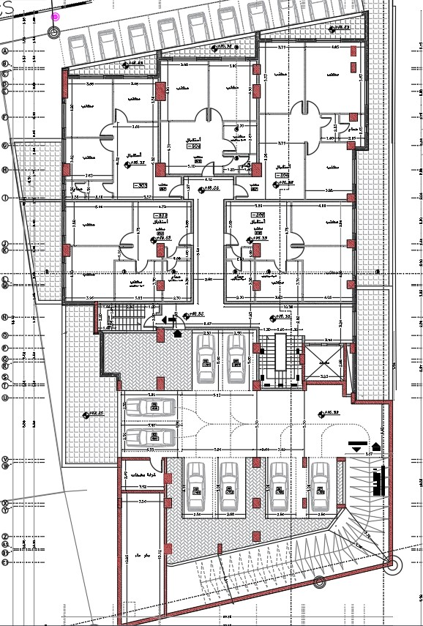
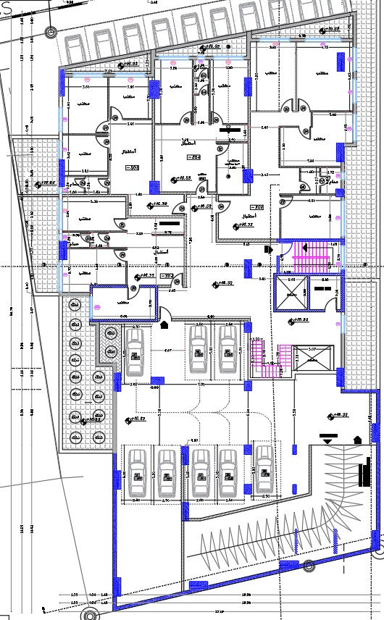
Third& Fourth floor
before& after modification

Slide 15
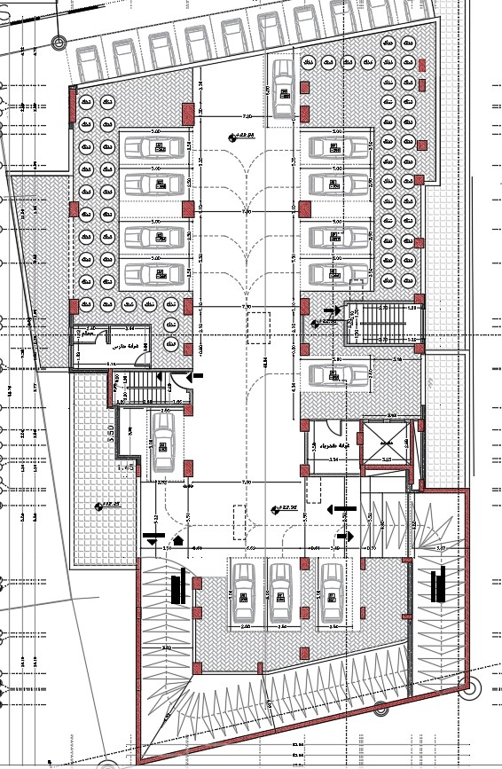
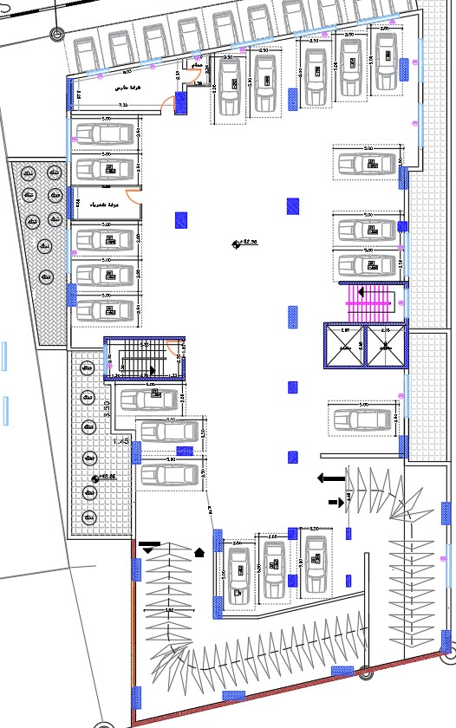
Fifth floor
before& after modification

Slide 16
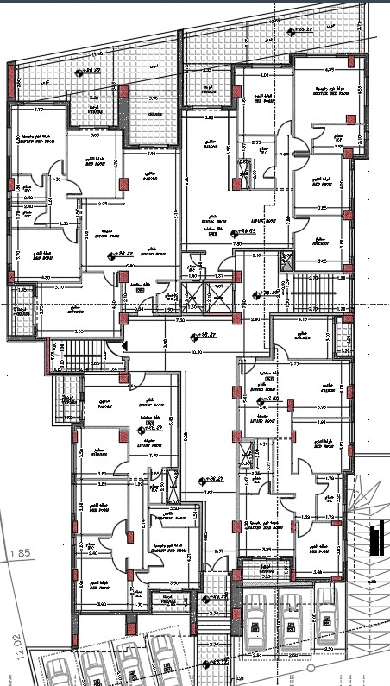
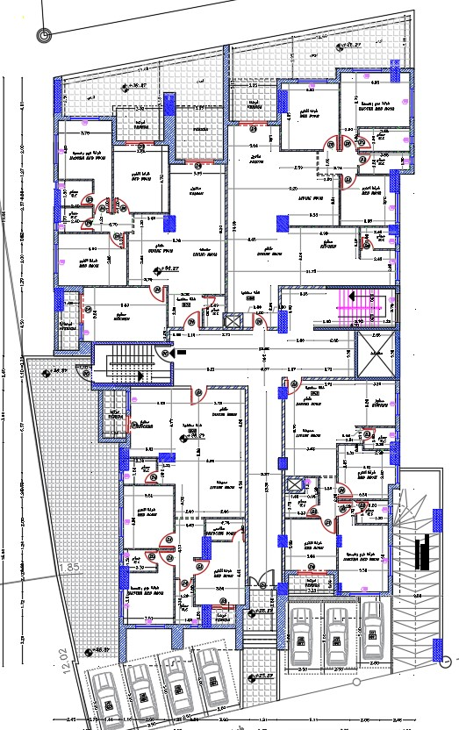
Sixth floor
before& after modification

Slide 17
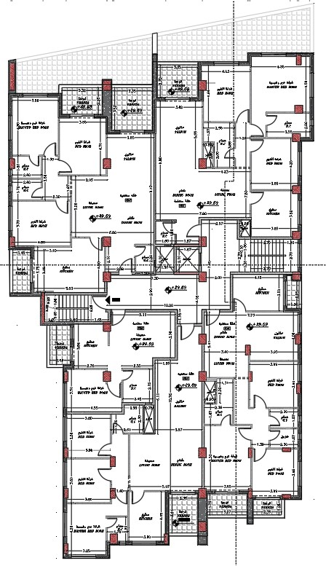
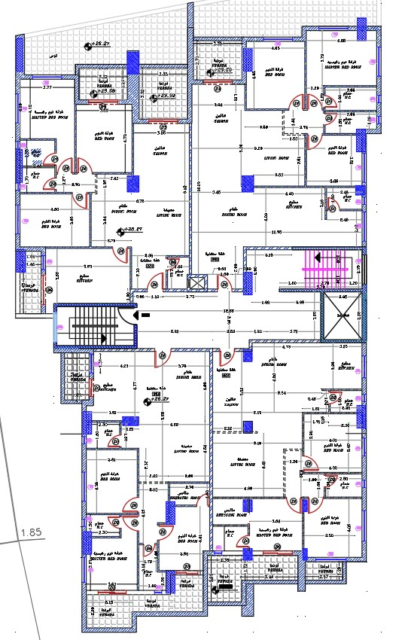
Seventh, eighth and ninth floor
before& after modification

Slide 18
Structural Aspect

Slide 19
Assumption:
loads:
Live load =4.79KN/m²
Live load of parking =6 KN/m2
Superimposed load =2 KN/m2
Wall load =18 KN/m2
Capacity load =220 KN/m2

Slide 20
Materials :
steel: fy=420 Mpa.
Concrete : B350 kg/cm2 (f'c=28 Mpa).

Slide 21
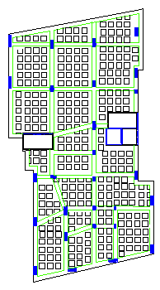
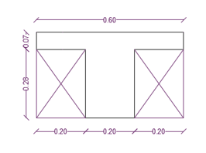
Structure System:
Slab system
Two way ribbed thickness =350mm

Slide 22
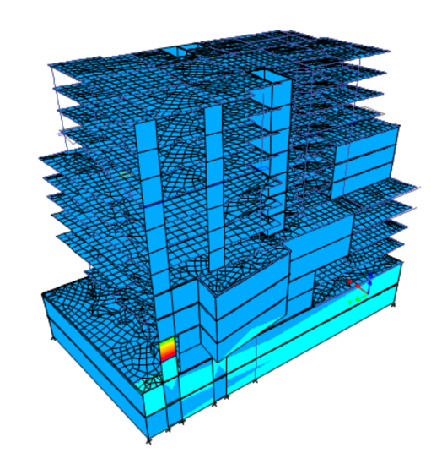
ETABS check
Compatibility check
Equilibrium check
Load | Etabs (KN) | MANUAL (KN) | % error
Dead | 385530.58 | 393295.49 | 2%
Superimposed with wall | 173009.35 | 170478.5 | 2%
Live | 114388.17 | 121878 | 6%

Slide 23
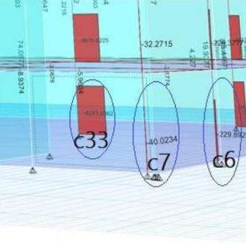
Internal Force Check:
Columns:
Live Load | Hand Calculation | ETABS | Errors %
Corner columns | 43.72 | 40.0234 | 8.46%
Edge columns | 242.2 | 229.892 | 5.08%
Internal columns | 6762 | 6241 | 8.35%

Slide 24
Seismic checks:
Period check
Direction | ETABS (PERIOD) (SEC) | Manual (sec) | 1.4 Manual | check
X | 1.07 | 0.93 | 1.3 | ok

Slide 25
Drift Check:
Story height | Dis-X (Ux) (from ETABs) | Dis-Y (Uy) (from ETABs) | Drift Delta x - (ΔSX) | Drift Delta y - (ΔSY) | Inelastic drift x - (ΔMX) | Inelastic drift y - (ΔMy) | Delta Limit (ΔMAll) | Check Status
0 | 0 | 0 | 0 | 0 | 0 | 0 | 0 | ----
3.5 | 0.019 | 0.225 | 0.019 | 0.225 | 0.072 | 0.866 | 70 | OK
3.5 | 0.070 | 0.806 | 0.051 | 0.581 | 0.196 | 2.237 | 70 | OK
3.5 | 0.232 | 5.185 | 0.162 | 4.380 | 0.625 | 16.862 | 70 | OK
3.5 | 0.170 | 12.739 | 0.402 | 7.553 | 1.549 | 29.080 | 70 | OK
3.5 | 0.423 | 22.456 | 0.252 | 9.718 | 0.971 | 37.413 | 70 | OK
3.5 | 0.333 | 32.873 | 0.756 | 10.416 | 2.911 | 40.103 | 70 | OK
3.5 | 1.252 | 40.685 | 0.919 | 7.812 | 3.536 | 30.078 | 70 | OK
3.5 | 0.206 | 47.124 | 1.458 | 6.439 | 5.612 | 24.791 | 70 | OK
3.5 | 1.099 | 50.744 | 0.893 | 3.620 | 3.437 | 13.937 | 70 | OK
3.5 | 2.600 | 55.600 | 1.501 | 4.856 | 5.781 | 18.694 | 70 | OK
3.5 | 1.600 | 63.000 | 4.200 | 7.400 | 16.170 | 28.490 | 70 | OK
3.5 | 1.800 | 68.000 | 0.200 | 5.000 | 0.770 | 19.250 | 70 | OK
All ∆m in X, Y direction less than (∆story), so check is OK

Slide 26
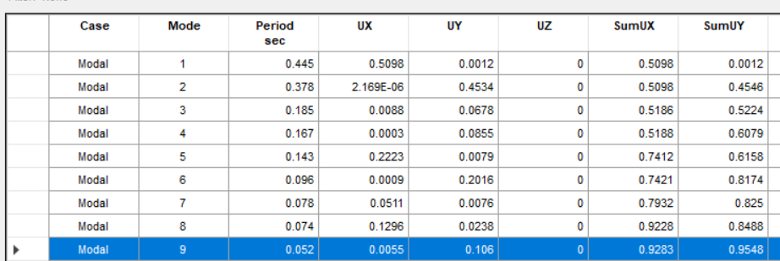
Seismic checks:
modal participation mass ratio

Slide 27
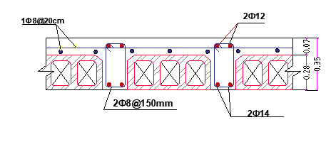
Details
Slab:

Slide 28
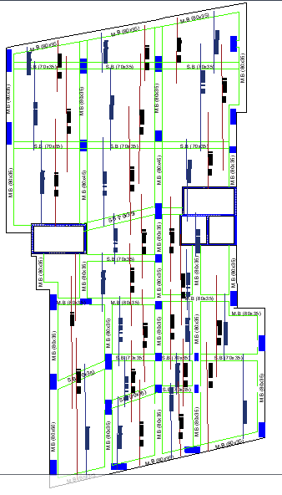
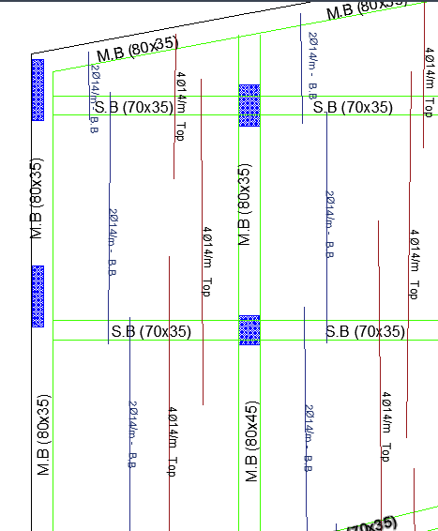
Slab:

Slide 29
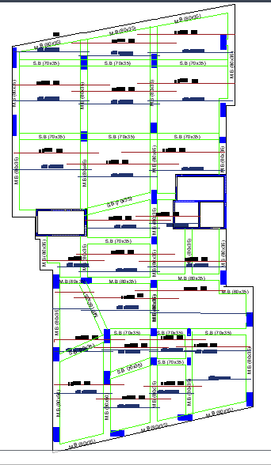
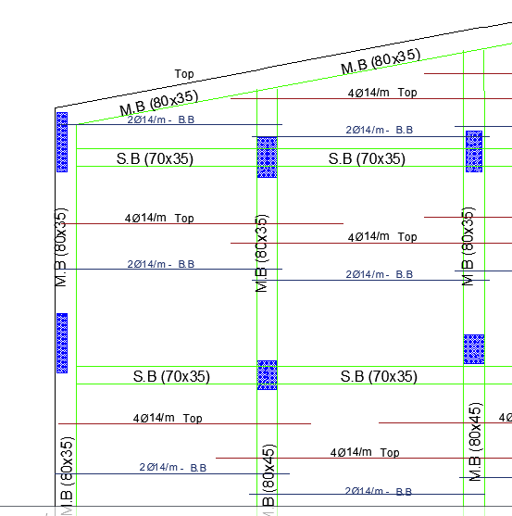
Slab:

Slide 30
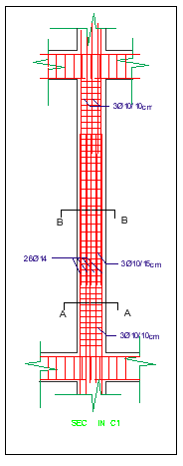
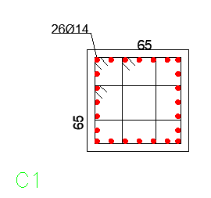
Columns:
cm

Slide 31
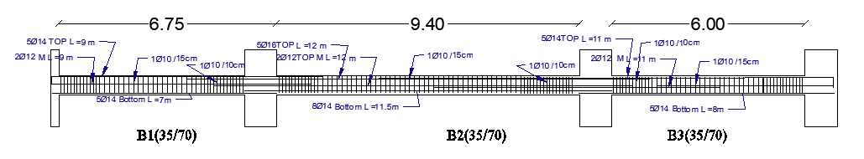
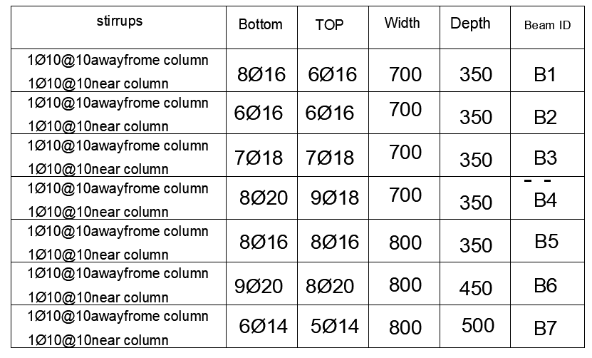
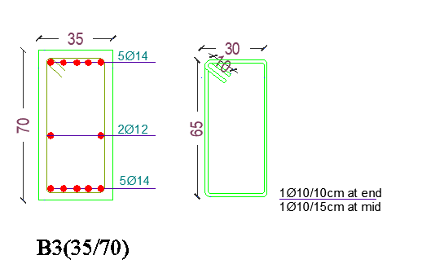
Beam:

Slide 32
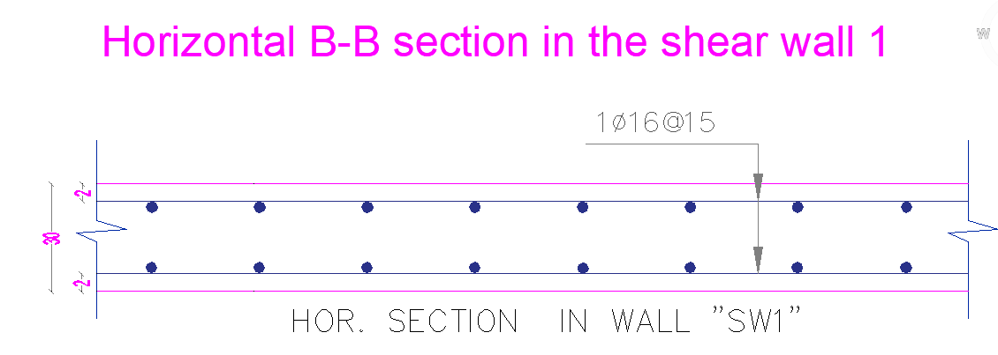
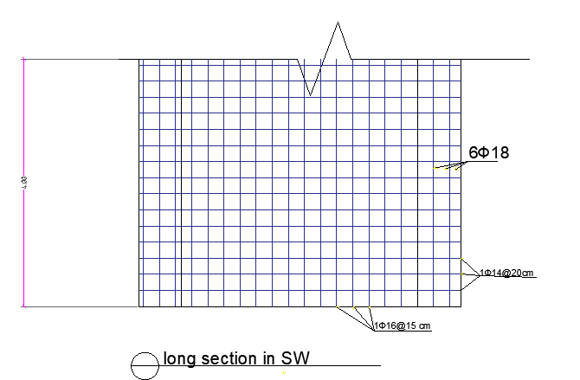
Shear wall:

Slide 33
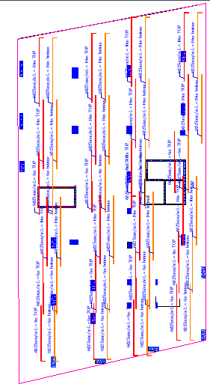
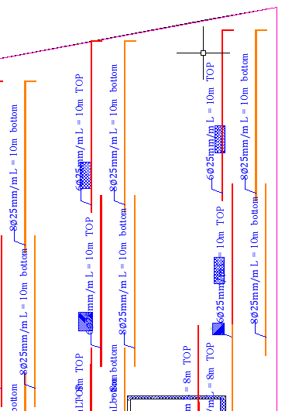
Foundation
Raft footing

Slide 34
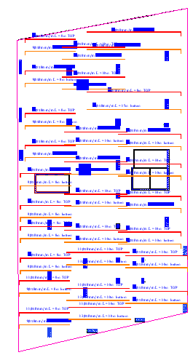
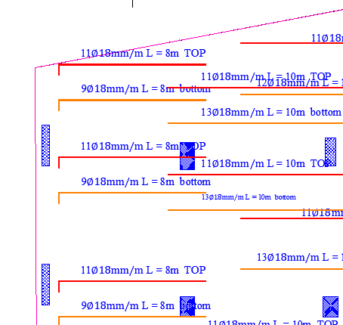
Foundation
Raft footing

Slide 35
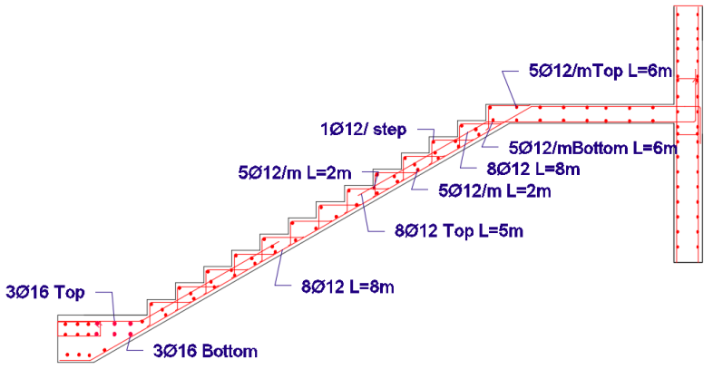
Stair

Slide 36
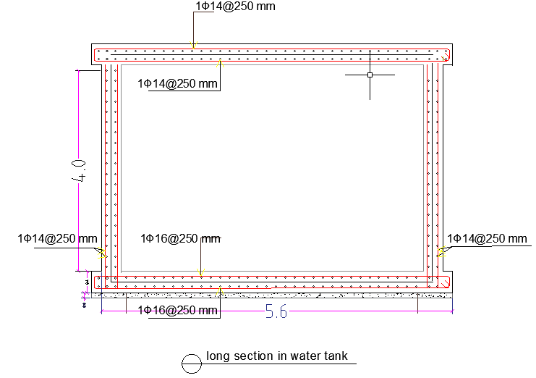
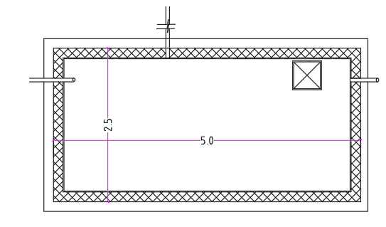
Water tank :
View of the top tank

Slide 37
1
2
3
Electro-Mechanical
Aspect
4
5
6

Slide 38
1
Acoustics
2
Lighting and power
3
Thermal analysis and comfort
4
HVAC and drainage
5
Water supply
6
Fire fighting

Slide 39
Acoustics

Slide 40
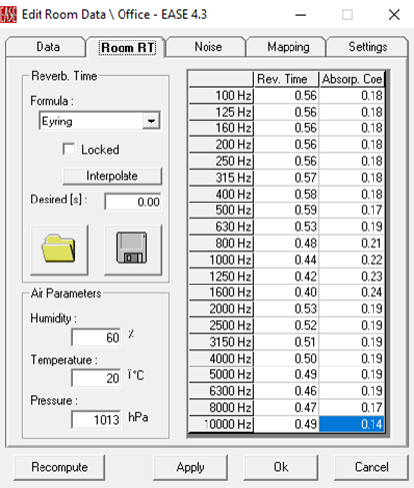
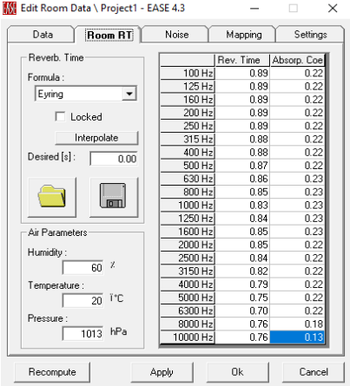
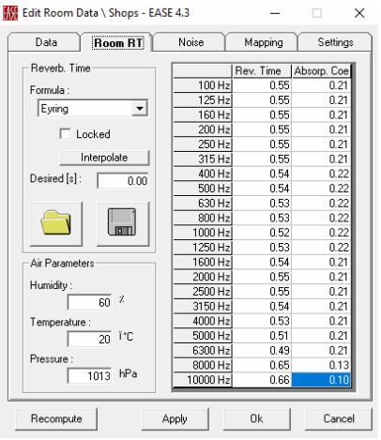
Acoustics
Acoustic design
Reverberation time for Office
Reverberation time for Restaurant
Reverberation time for Clothing Shop

Slide 41
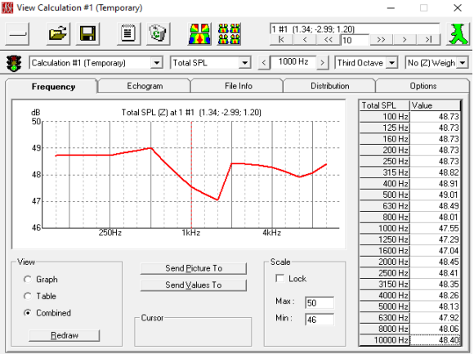
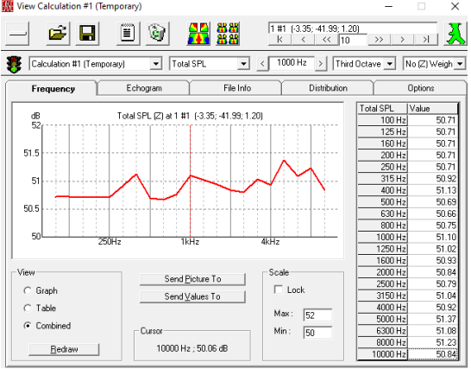

Acoustics
Acoustic design
Total SPL Value for Office
Total SPL Value for Restaurant
Total SPL Value for Clothing Shop

Slide 42




Acoustics
Acoustic design -Sound insulation

Slide 43
Lighting And Power

Slide 44



Lighting And Power
Artificial Lighting Design
Example Type of used Luminaires:

Slide 45



Lighting and power
Artificial Lighting Design
Residential Floor :
Bed Room :
Kitchen & Dining Room :
Bathroom:

Slide 46



Lighting and power
Artificial Lighting Design
Office Floor :
Office:
Reception:
Inner Corridor:

Slide 47


Lighting and power
Artificial Lighting Design
Barking Floor :

Slide 48



Lighting and power
Artificial Lighting Design
Exhibition Floor :
Gym :
Drink Shop:
Restaurant:

Slide 49



Lighting and power
Artificial Lighting Design
Stores Floor & Basement Floor:
Stores Floor :
Corridor:
Basement Floor :

Slide 50


Artificial Lighting Design – plan for Office floor & Residential floor

Slide 51


Artificial Lighting Design – plan for Barking floor & Opposed floor

Slide 52


Artificial Lighting Design – plan for Store floor & Warehouse floor

Slide 53


Artificial Lighting Design – plan for Basement floor & Barking floor

Slide 54


Power design – plan for Residential floor

Slide 55


Power design – plan for Office & Barking floor

Slide 56


Power design – plan for Opposed & Store floor

Slide 57


Power design – plan for Basement & Barking floor

Slide 58
Thermal Analysis and Comfort

Slide 59

Thermal Analysis and Comfort
Building in the Design Builder program
3D Design Building

Slide 60

Thermal Analysis and Comfort
Design Builder Baseline Comparison
Baseline = 52.18 %

Slide 61


Thermal Analysis and Comfort
Roof with insulation material
Wall with insulation material
U-Value = 0.499 (w/m^2.k)
U-Value = 0.933 (w/m^2.k)

Slide 62

Thermal Analysis and Comfort
External glazing with
insulation material
U-Value = 1.345 (w/m^2.k)

Slide 63




Thermal Analysis and Comfort
Daylight Factor After Modification
)Eighth& Ninth Floor )
) Fifth Floor )
) Fourth Floor )

Slide 64



Thermal Analysis and Comfort
Daylight Factor After Modification
) Second Floor )
) First Floor )
) Fourth Floor )

Slide 65
Thermal Analysis and Comfort
Heating and Cooling Load
Total Heating Loads | 3212.08 KW
Total Cooling Loads | 1163.86 KW
Total Consumption | 133.59 KWh/m^2

Slide 66
HVAC design

Slide 67


HVAC design
The system used for HVAC design is (VRF system)
Outdoor unit:
The Air stage company Catalog was used for
VRF .

Slide 68


Indoor unit :
Split unit:
Air stage company Catalog was used.
Cassette unit:
Air stage company Catalog was used.

Slide 69


Commercial
occupations

Slide 70


Office occupations

Slide 71

Office occupations

Slide 72


Residential occupations

Slide 73

Residential occupations

Slide 74
Drainage Design

Slide 75


Drainage Design
Drainage Design for basement-2 floor

Slide 76

Drainage Design
Drainage Design for
Rainwater drainag

Slide 77


Drainage Design
Drainage Design for ground floor

Slide 78


Drainage Design
Drainage Design for
Commercial occupations

Slide 79


Drainage Design
Drainage Design for
Office occupations

Slide 80

Drainage Design
Drainage Design for
parking

Slide 81


Drainage Design
Drainage Design for
Residential occupations

Slide 82

Drainage Design
Drainage Design for
Roof slope plan

Slide 83
Water Supply Design:

Slide 84

Water Supply Design:
The maximum number of people may exist inside the building at the
same time, equals 96 person.
The average consumption of water for each person daily in such this building equals 135 L/day for each person.
In the city of Nablus, water is cut off 3 days a week
The volume based on the number of people and their
consumption of water 96 x 135 x3 = 38880 liters/day ≈ 39 m3

Slide 85



Water Supply Design:
Diameters of the used pipes for vertical feeder 1 .
Diameters of the used pipes for Horizontal 1.1

Slide 86

Water Supply Design:
Water Supply Design:
for ground floor

Slide 87

Water Supply Design:
Water Supply Design:
for first & second floor

Slide 88

Water Supply Design:
Water Supply Design:
for Third & fourth floor

Slide 89

Water Supply Design:
Water Supply Design:
for Third & fourth floor

Slide 90


parking

Slide 91


Residential occupations

Slide 92

Water Supply Design:
Water Supply Design:
for Roof floor plan

Slide 93
Fire safety design

Slide 94


basement floors
)Evacuation ways(

Slide 95


Commercial
Occupations
)Evacuation ways(

Slide 96


Commercial
Occupations
)Evacuation ways(

Slide 97


Office Occupations
)Evacuation ways(

Slide 98

parking

Slide 99


Residential Occupations
)Evacuation ways(

Slide 100




Fire safety design:
The symbols of suppression system
Fire Hose
Extinguishers
Emergency signs and light

Slide 101


basement floors

Slide 102


Commercial
Occupations

Slide 103


Commercial
Occupations

Slide 104


Office Occupations

Slide 105

parking

Slide 106


Residential Occupations

Slide 107
Quantity Surveying

Slide 108
The Total Project Cost = 28,769,347.95 ILS
The Unit Cost = 2435 ILS/m^2
Cost summery
Earthworks | 2,058,870.00 ILS
Structural | 19,000,000 ILS
Finishing | 6,997,000.63 ILS

