Slide 1
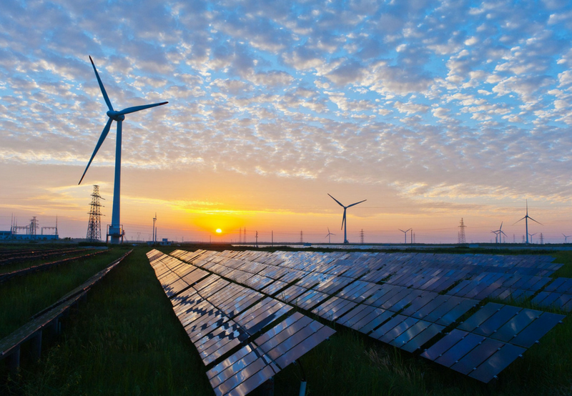
Design Hybrid Renewable Energy System in Palestine

Slide 2
Prepared By:
Omar Shakhsheer
Abdul Rahman Jnaajreh
Ahmad Refai
Mahmoud Qadi
Supervisor Name: Dr. Mahmoud Assad
This project was submitted as a part of the requirements for bachelor degree in Mechanical Engineering
2017\2018

Slide 3
Conant's:
Review for project 1
What is project?
What are the obstacles facing Palestine in the development of the energy sector?
Design solar energy to school (Al-Carml).
Design wind energy.
Selecting elements of project.
Feasibility study of the project.

Slide 4
What is project?
The idea of the project is designing system of a renewable energy combine between solar energy and wind energy to reach high efficiency and it doesn't depend on power from generators coming from companies of electricity.
So we will designing a building AL-Carmel elementary school for girl, within projects which carried out by the ministry of a higher education to develop schools in Nablus. The school is located in the center of Nablus.

Slide 5
Electricity is an essential element in people's lives. It is a central element in the operation of sectors of life such as industry, agriculture, health, etc.
the situation of the electricity sector in Palestine is different from the rest of the world, where 92% Electricity from the Israeli side within the price that is imposed without any role for the Palestinian side to determine this price.
The West Bank and the Gaza Strip consume electricity of about 1,300 MW, distributed between 500 MW for the Gaza Strip and 800 MW in the West Bank.
The energy sector situation in Palestine is highly different compared toot her countries in the Middle East due to many reasons: non-availability of natural resources, unstable political conditions, financial crisis and high density population.

Slide 6
Can we benefit from renewable energy in Palestine?
Palestine is located at 30 degrees north of the equator, which means that the solar energy falling on each square meter is estimated at 3000 kilowatt-hours, and this is very high in the positive sense. In addition Palestine has more than 300 sunny days per year, making it one of the best areas for solar and wind exploitation, making investment in this area feasible and economically feasible.
Palestine elevation ranges from 300m below sea level in the Jordan Valley, to sea level along the Gaza Strip seashore, reaching 1000m above sea level in some locations in the West Bank. The total population is about 4.4 mil-lion (census 2016, Palestinian Central Bureau of Statistics) of which2.47 million live in the West Bank and about 1.7 million in the Gaza Strip. The population growth rate is about 3.0% and the average household size is about 5 to 6 persons.

Slide 7
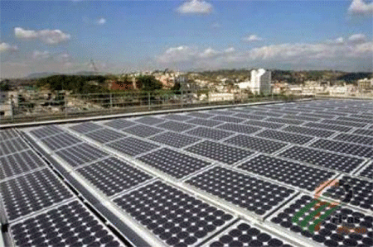
Atouf project

Slide 8
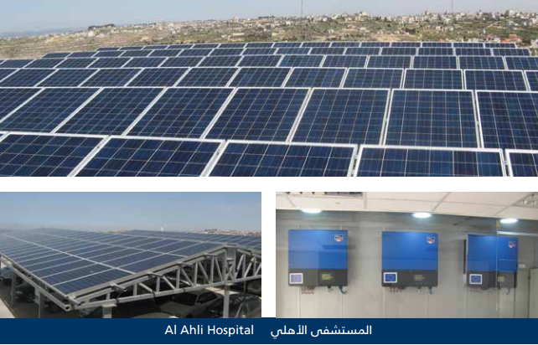
Al-Ahli Hospital

Slide 9
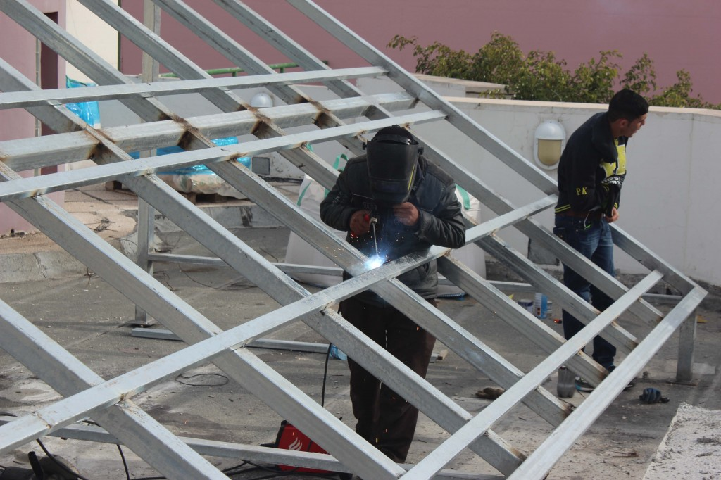
Nablus Cultural Center (Hamdi Menko)

Slide 10
In order to design hybrid renewable energy system we must study:
The project site.
Calculate the energy consumption of the project.
The feasibility study of the project.
The necessary equipment we have to building of project.
Market study and project acceptance.
Solar radiation and wind speed.

Slide 11
Design solar energy to school (Al-Carml).
First: Consumption of school monthly (Kilowatt per hour).

Slide 12
month | Consumption KWH
Jan | 700
Feb | 822
Mar | 648
Apr | 749
May | 619
June | 300
July | 221
Aug | 277
Sep | 259
Oct | 535
Nov | 600
Dec | 799
Total | 6529

Slide 13
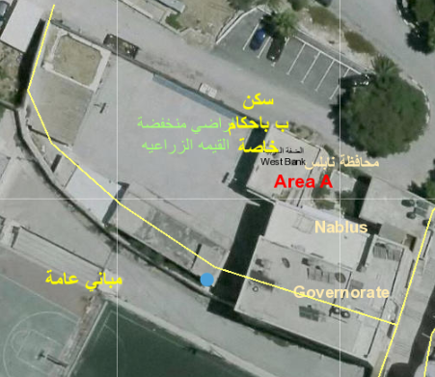
Site of school:

Slide 14
Irradiation on horizontal plane (Wh/m2/day)

Slide 15


Capacity of solar project:
$Capacity of solar project=\frac{The amount of annual electricity consumed by the subscriber}{1500}$
$No. of pv panels =\frac{SYSTEM KWP }{(pv modules power )}$
Capacity of solar project | 4.5 kwp
$$No. of pv panels$$ | 14

Slide 16
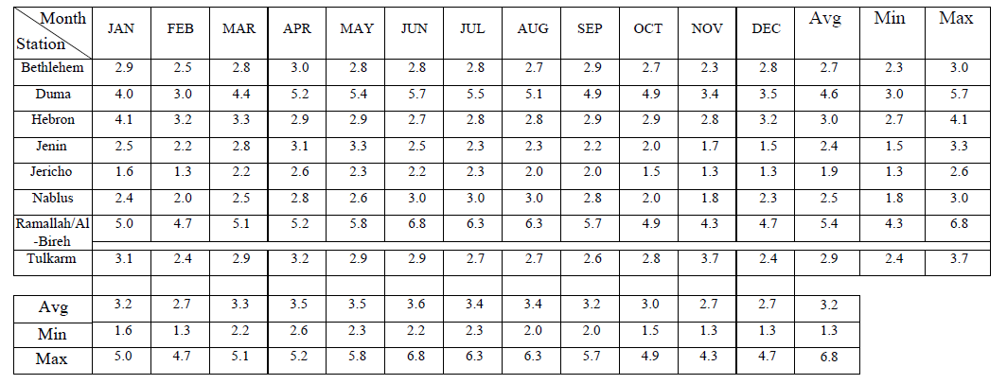
Design wind energy:
Wind speed in many cities in Palestine:

Slide 17
Chart of wind speed in Nablus:

Slide 18
Calculations of wind design:
Power(kilowatt) At month (10hrs/daily) | Power(watt) At 1 hour | Wind speed(m/s) | Month
14.880 | 49.6 | 2.4 | Jan
8.036 | 28.7 | 2 | Feb
16.830 | 56.1 | 2.5 | Mar
23.640 | 78.8 | 2.8 | Apr
18.930 | 63.1 | 2.6 | May
29.070 | 96.9 | 3 | Jun
29.070 | 96.9 | 3 | Jul
29.070 | 96.9 | 3 | Aug
23.640 | 78.8 | 2.8 | Sep
8.036 | 28.7 | 2 | Oct
6.282 | 20.94 | 1.8 | Nov
13.110 | 43.7 | 2.3 | Dec
220.594 | Total.

Slide 20
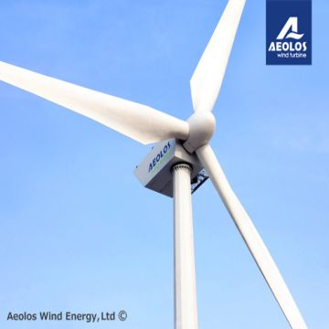
From the above we can observe that the mean wind speed at Nablus (where our project site) is 9km/h (2.5m/s) and this number leads us to design wind turbine for project. To get one megawatt we used five turbines from Aeolos-H 500W wind turbine.

Slide 21
Characteristics of Aeolos-H 500W wind turbine
Characteristics
Power rated | 500W
Output voltage | 24V
Blade quantity | 3 Glass Fiber Blades
Rotor diameter | 2.7m
Start speed | 2 m/s
Rated speed | 3.3
Generator efficiency | 0.96
Turbine weight | 28Kg
Noise | 25 db(A) @ 5m/s
Warranty | Standard 5 Years
Design Lifetime | 20 year

Slide 22
Selecting of solar panels:
Solar panel on market in Palestine:
THE TALLMAX MODULE TSM-PD14 from company Train solar (315 watt).
Q.POWER L-G5 315-335 from company Hanwha SolarOne (315 watt).

Slide 23
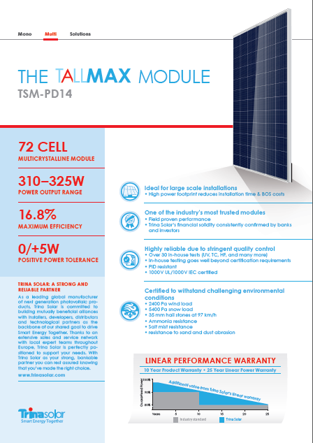
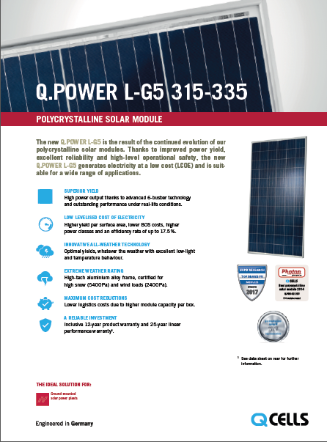

Slide 24
What is factors depends on select solar panel?
Production power tolerance
Warranty
Certifications
NOCT (Nominal Operating Cell Temperature):
Solar panel temperature coefficients:

Slide 25
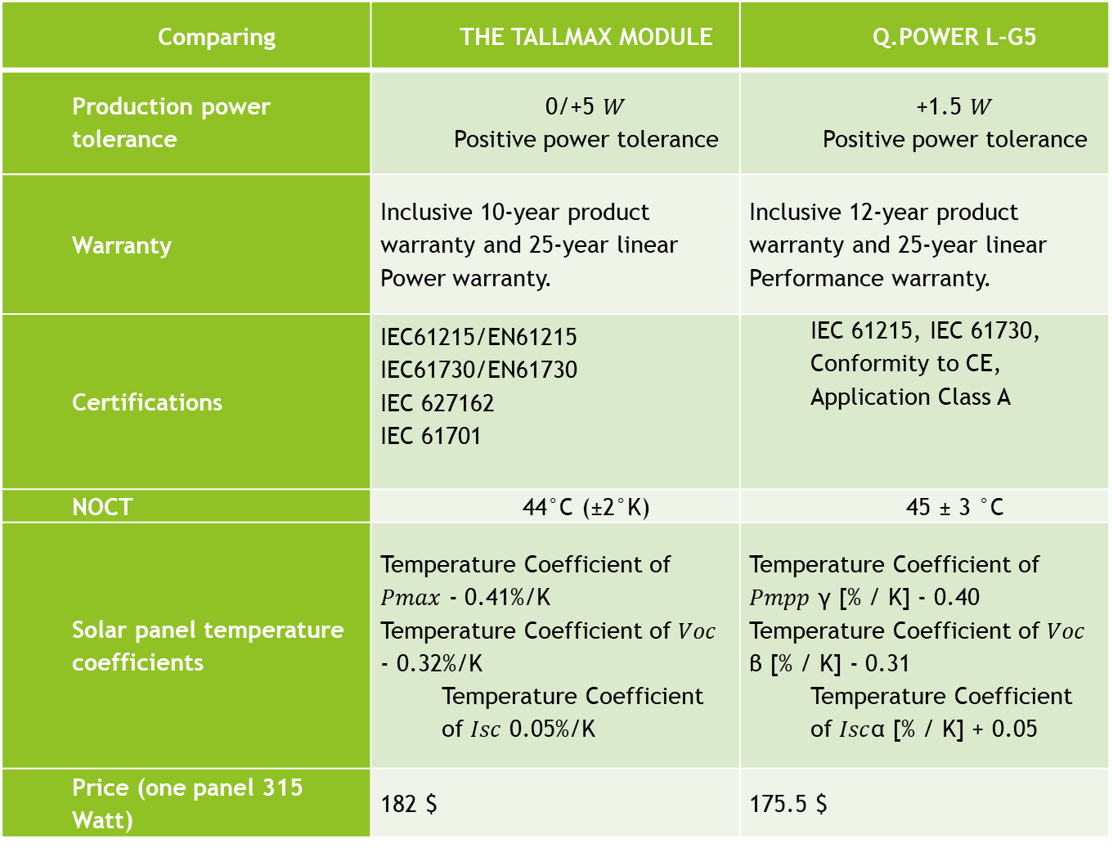
Comparing | THE TALLMAX MODULE | Q.POWER L-G5
Production power tolerance | 0/+5 $W$ Positive power tolerance | +1.5 $W$ Positive power tolerance
Warranty | Inclusive 10-year product warranty and 25-year linear Power warranty. | Inclusive 12-year product warranty and 25-year linear Performance warranty.
Certifications | IEC61215/EN61215 IEC61730/EN61730 IEC 627162 IEC 61701 | IEC 61215, IEC 61730, Conformity to CE, Application Class A
NOCT | 44°C (±2°K) | 45 ± 3 °C
Solar panel temperature coefficients | Temperature Coefficient of $Pmax$ - 0.41%/K Temperature Coefficient of $Voc$ - 0.32%/K Temperature Coefficient of $Isc$ 0.05%/K | Temperature Coefficient of $Pmpp$ γ [% / K] - 0.40 Temperature Coefficient of $Voc$ β [% / K] - 0.31 Temperature Coefficient of $Isc$α [% / K] + 0.05
Price (one panel 315 Watt) | 182 $ | 175.5 $

Slide 26
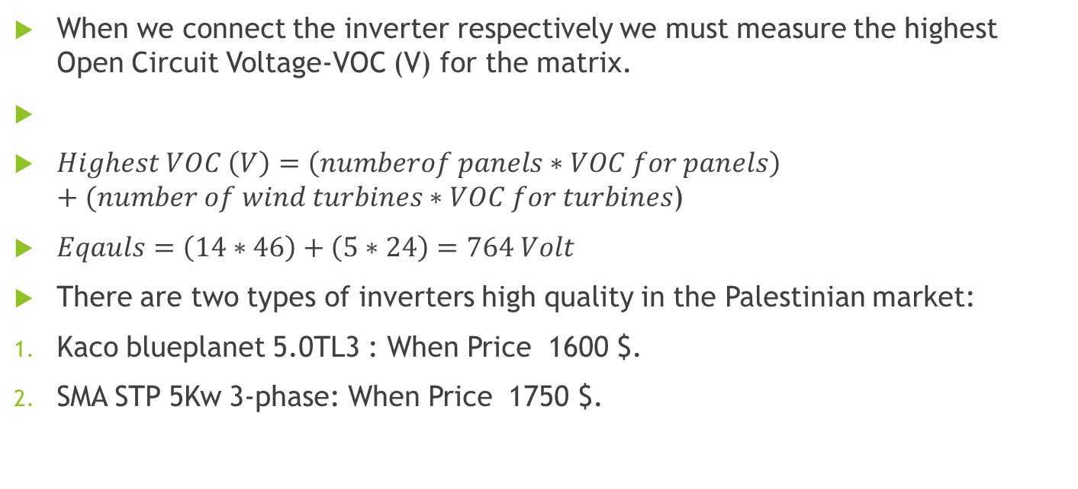
The selection of the inverter:
When we connect the inverter respectively we must measure the highest Open Circuit Voltage-VOC (V) for the matrix.
$Highest VOC \left(V\right)=\left(numberof panels∗VOC for panels\right)+(number of wind turbines∗VOC for turbines$)
$Eqauls=\left(14∗46\right)+\left(5∗24\right)=764 Volt$
There are two types of inverters high quality in the Palestinian market:
Kaco blueplanet 5.0TL3 : When Price 1600 $.
SMA STP 5Kw 3-phase: When Price 1750 $.

Slide 27
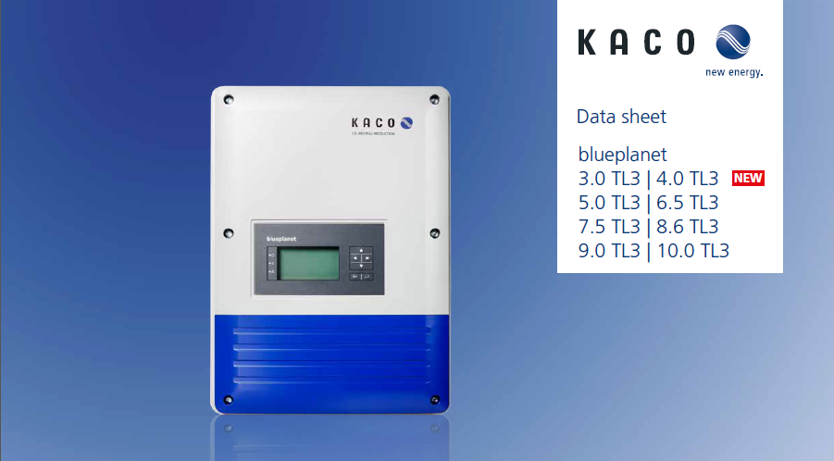
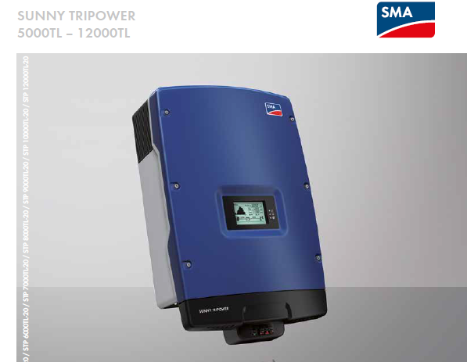

Slide 28
Unit | Number | Description
Pv module 315 watt | 14 | Q.POWER L-G5
Wind turbines 500 Watt | 5 | Aeolos-H 500W
Inverter | 1 | inverter Kaco blueplanet 5.0TL3 VOC (Volt) between (200-950) volt

Slide 29
Feasibility study of the project:
Initial cost of project:
Unit | Number of unit | Price ($) | Number*$
PV Panels | 14 | 175.5 | 2457
Wind turbines | 5 | 1000 | 5000
inverters | 1 | 1600 | 1600
Operational costs | - | - | 3000
equipment’s | - | - | 2000
 |  | Total | 14,057

Slide 30
School pays per year equals 2000$
Maintenance for project per school 500$
Financial return 200$
Payback period equal 5 years

Slide 31
Thank you for listing
Any Question's

