Slide 1

Biodiesel Production From Used Soybean oil: Effect Of Methanol to Oil Ratio On Biodiesel Yield and Properties
Presented by:
Hamzah Arar
Jamal Abu Snenih
Razan Amireh
Worood Ghannam
Supervisor: Prof. Amer El-Hamouz

Slide 2
Layout
Biodiesel Definition, Advantages and disadvantages.
Experimental work.
Results and Discussion.
Conclusion.

Slide 3
Biodiesel
Definition
Why Biodiesel?
Recap of first semester

Slide 4
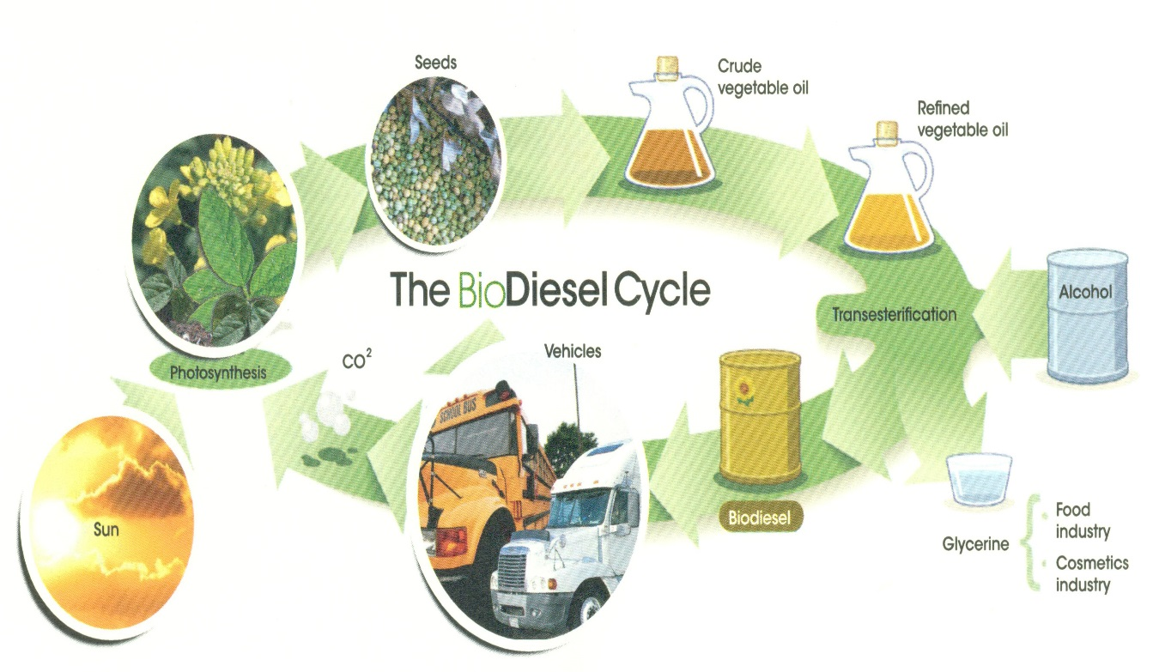
Methodology & Experimental Work
Problem statement
Oil type and source selection
Production method selection
Primary procedure
Final procedure

Slide 5
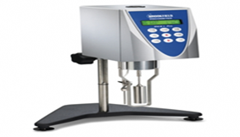

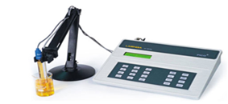
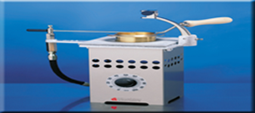

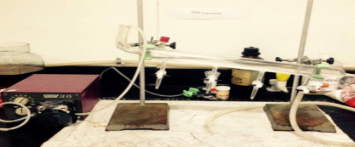
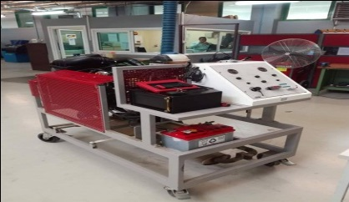
Result and Discussion
Viscosity
Density
pH
Flash point
Yield
blending
Diesel engine
The following parameters are found to effect the transesterification process yield and properties:
Temperature.
Stirring time.
Mixing speed.
Catalyst type.
Methanol to oil ratio.

Slide 6
Discussion points:
How did the produced biodiesel stand to the standards?
Comparison between biodiesel and its blends.
Biodiesel and its blends performance in diesel engine.

Slide 7
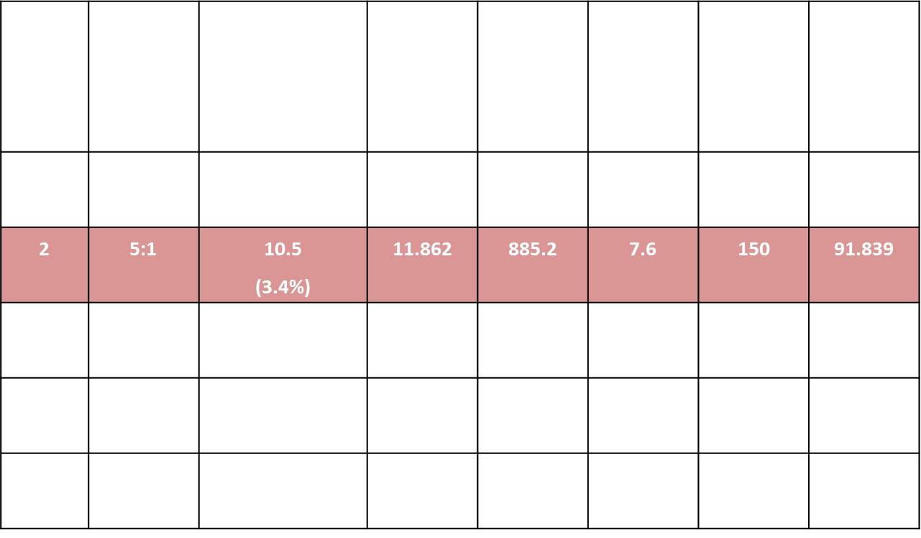
The effect of molar ratio of methanol to oil on biodiesel yield and properties

Slide 8
Biodiesel Blends

Slide 9
Biodiesel engine test
Group | Property | Diesel | B100 | B80 | B50 | B20 | B20,M10 | B20,M5 | B5 | B2
Group 1 | Engine speed (rpm) | 2058 | 2184 | 2142 | 2184 | 2016 | 2058 | 2121 | 2100 | 2058
 | Injected quantity (mg/str) | 5 | 5.8 | 5.2 | 5.6 | 5.4 | 6 | 5.4 | 5.6 | 5.4
Group 2 | Engine speed (rpm) | 2058 | 2184 | 2142 | 2184 | 1974 | 2058 | 2121 | 2079 | 2058
Group 3 | Engine speed (rpm) | 2058 | 2121 | 1974 | 2184 | 2100 | 2079 | 2121 | 2100 | 2058
Group 4 | Engine speed (rpm) | 2058 | 2121 | 2016 | 2184 | 2100 | 2079 | 2121 | 2100 | 2058
Group 5 | Engine speed (rpm) | 2058 | 2121 | 1995 | 2184 | 2100 | 2079 | 2121 | 2100 | 2058
Group 8 | Engine speed (rpm) | 2058 | 2142 | 2163 | 2205 | 2100 | 2100 | 2121 | 2100 | 2058
Group 9 | Engine speed (rpm) | 2058 | 2121 | 2184 | 2205 | 2016 | 2121 | 2121 | 2100 | 2058
Others | Smoke | No cloud | Cloudy | Cloudy | Cloudy | Less cloudy | Less cloudy | Little cloud | No cloud | No cloud
 | Sound | High | Low | Low | Low | Low | Lowest | Lowest | Medium | Medium

Slide 10
Project Outcomes
Project report structure.
How to deal with difficulties and perform under stress.
Working as a team.
How to appropriately analysis the data ,discuss the result and make a good recommendation.

Slide 11
Difficulties
Time shortage
Poor material support
Poor equipment quality

Slide 12
Recommendation
Tripled
Cold weather starting
Load test
Visibility study
Environmental effect

