Slide 1
Contents :
Introduction
Why this project?
Abstract
Features
Problems
Implementation
Recommendations
Demo

Slide 2
Introduction
Our project is an exploratory robot which has a shape of tank that is controlled remotely by a mobile phone that is connected to the network .
The robot is controlled manually through controller person or can detect threads and automatically go away from the risk.

Slide 3

Why this project ??
Developing a system that can be controlled remotely away from the risk.
Increasing the safety by making it capable to be controlled from far distance.
Making it capable to act as an exploratory robot by supplying it with sensors and cameras.

Slide 4
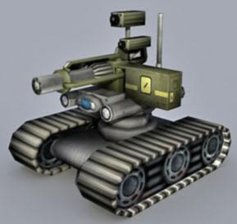
Abstract…
We designed and construct a “Remotely controlled Exploratory” robot to be used as an exploratory tool by one local network.
We built the model from the zero using available components and tools.

Slide 5
Features:
The robot can walk on straight forward or zigzag way.
The robot can walk on all directions
The robot can detect color
Can be controlled remotely
Can carry up to 50 KG

Slide 6
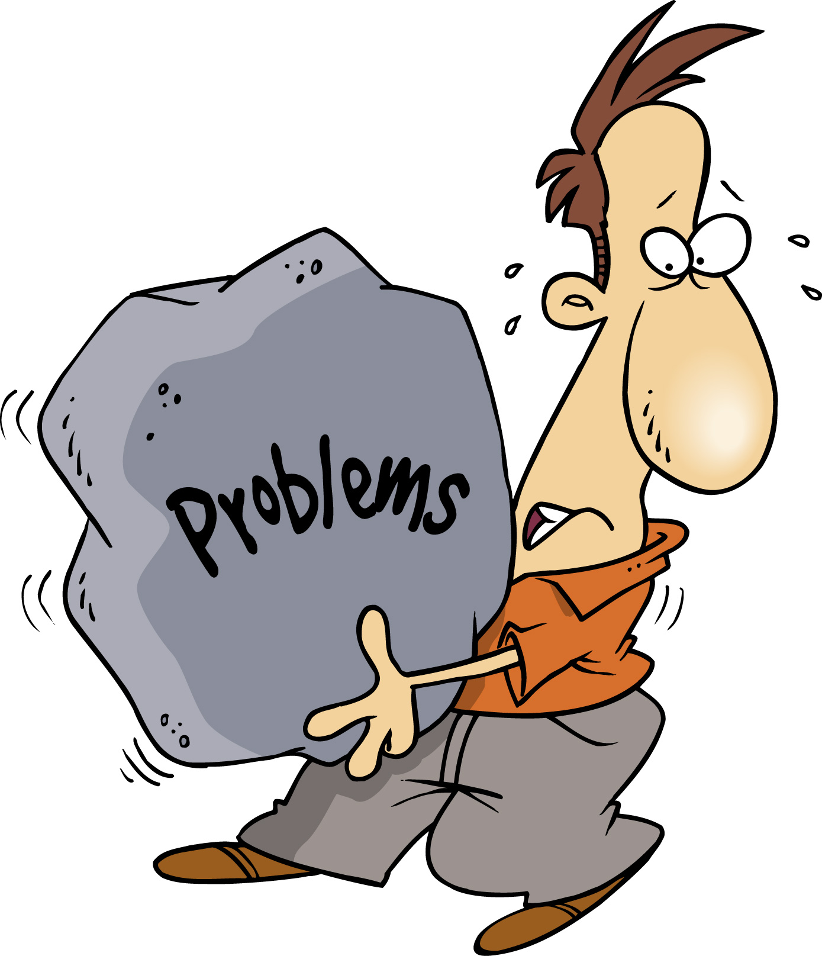
Challenges:
Finding a stabile motors for the model.
We face some challenges in control circuit.
Some times we didn’t find the wanted component in the market.

Slide 7
Implementation:
Model:
-We build the model from scratch
with available components.

Slide 8
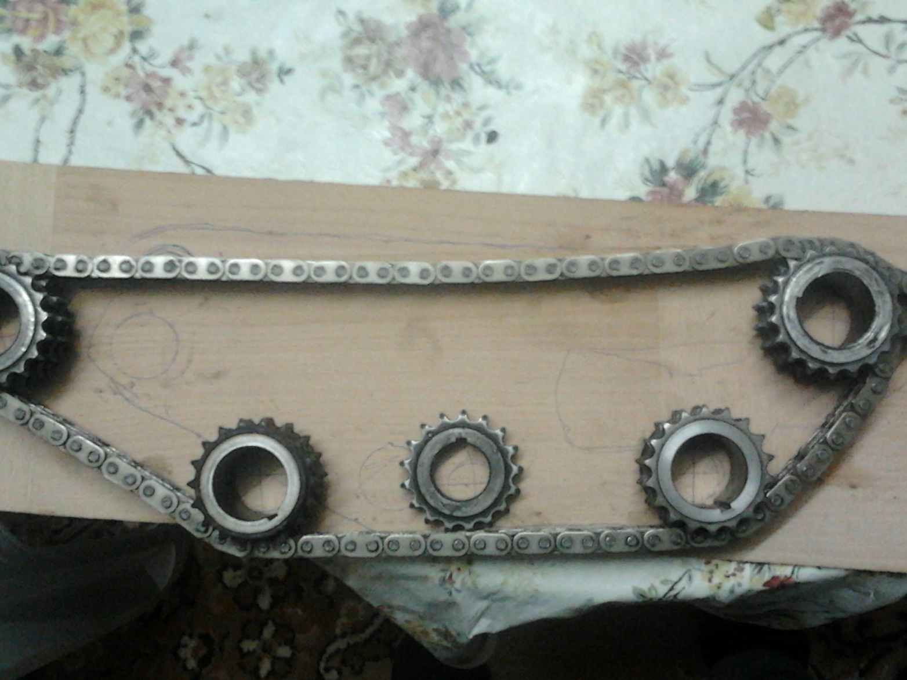
Model count…

Slide 9
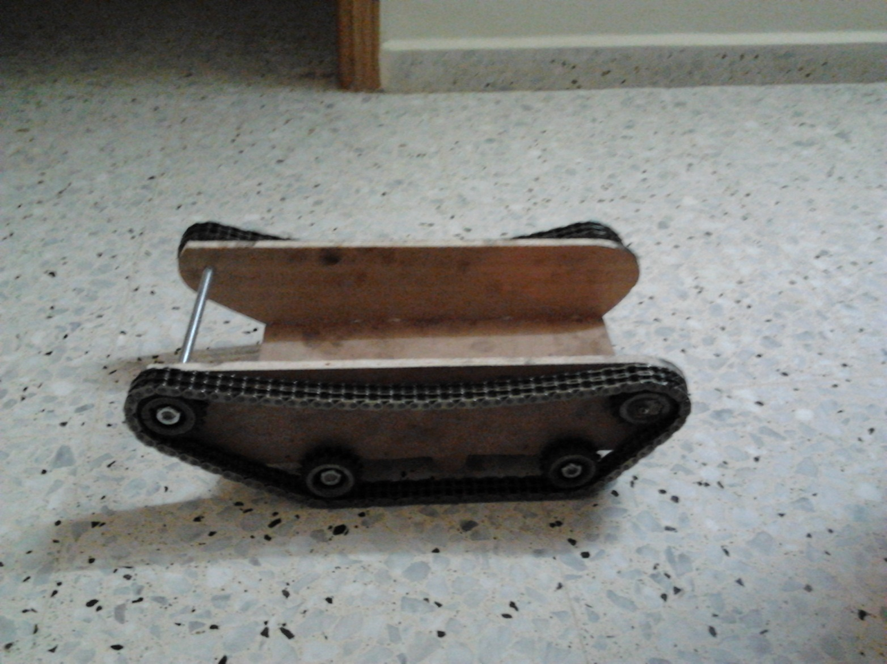
Model count…

Slide 10
Control circuit:
we built the control circuit using two relays with two power transistors to make H-bridg, because the H-bridg ICs available in the market don’t bear five amp’s that we need, so we have to build it because it’s not available in the market.

Slide 11
Control circuit count…

Slide 12
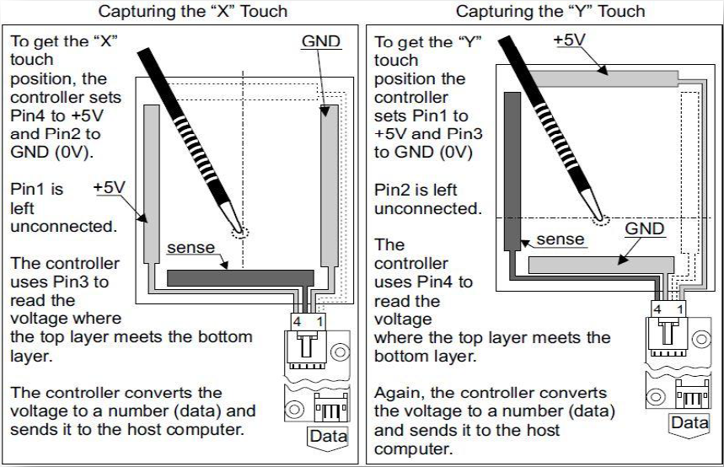
Touch screen:

Slide 13
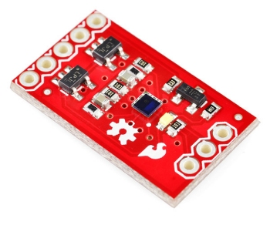
Color sensor

Slide 14
communication
In our project we have used some components for the communication
We have used the Xbee for sending data from the PC to microcontroller.
The communication between the mobile and the pc is GPRS communication using TCP protocol
Also we used GSM modem between the pc and the mobile

Slide 15

Recommendations:
Before using any component make sure that is available and suitable for your project.

Slide 16
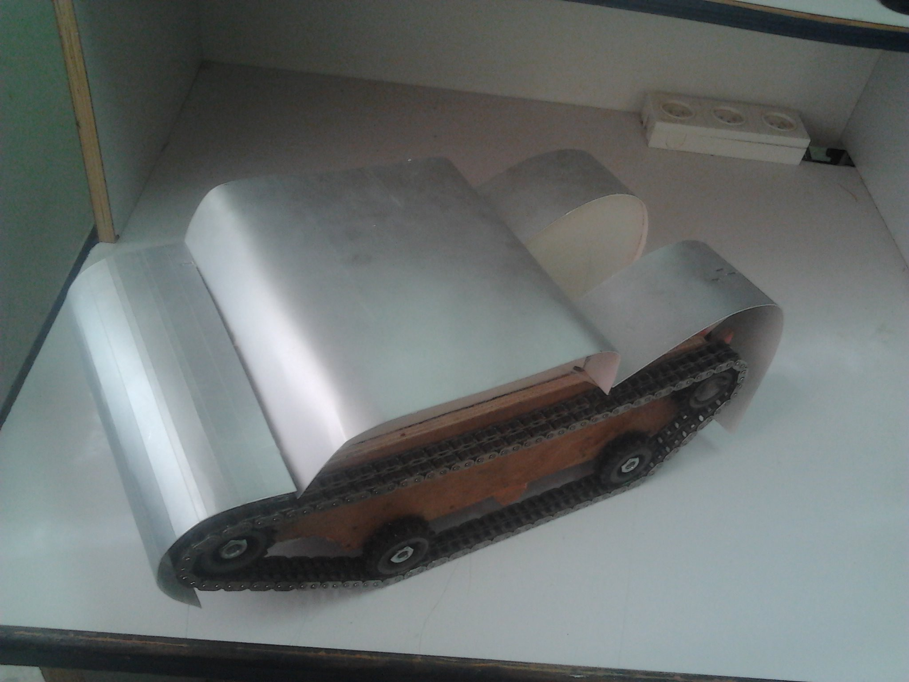
Demo:

Slide 17

Thank you for your attention :)

