Slide 1

Graduation project (II)
Compressive Strengths and Water Absorption of Recycled Plastic – Based Concrete
Prepared by:
Ahmad Ayyash
Ameer Al-Fuqaha
Ragheed Qabaha
Submitted to:
Dr. Majd Eshtaya

Slide 2
Outline
Objectives
Introduction
Methodology
Results
Conclusion
Recommendations

Slide 3
Objectives
Study the effect of PET on concrete properties.
Knowing the changes that occur on compressive forces and water absorption when adding PET in different proportions.
Trying to get the best properties of concrete and plastic mixture.
Comparison of concrete properties before and after adding PET.

Slide 4
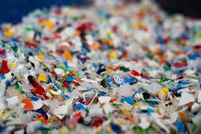
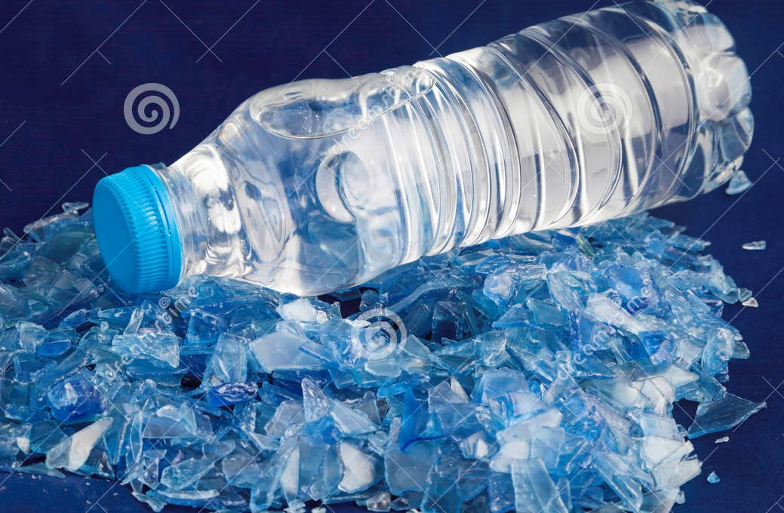
Introduction
Polymers

Slide 5
Introduction
Concrete

Slide 6
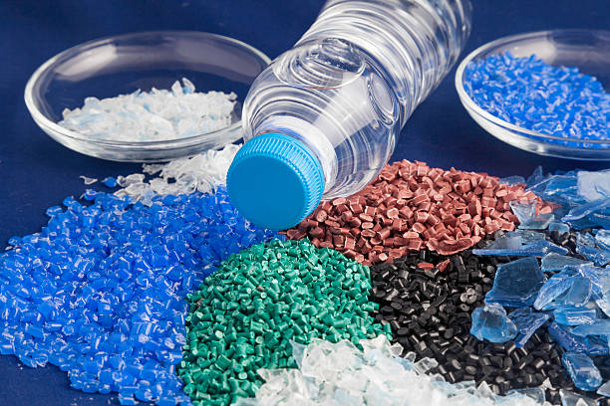
Why Polyethylene Terephthalate?
One of the most widely used types of plastic, and therefore easy availability as recycled.
Ease of shaping and cutting for desired use.
most research says that it improves concrete properties significantly and positively.

Slide 7
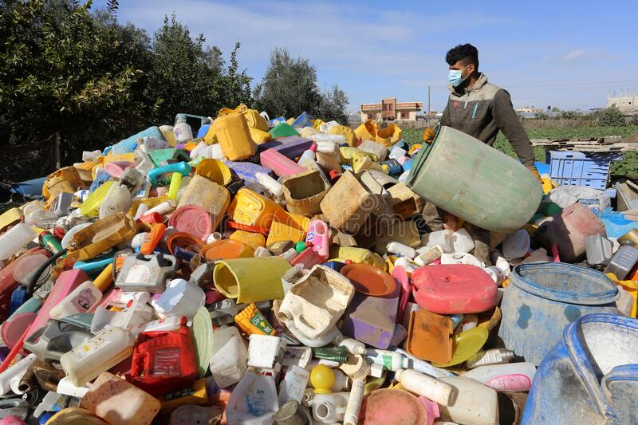
Waste in Palestine
Waste in Palestine is not treated in a proper way.
plastic waste is not completely separated.
not enough factories to recycle plastic.

Slide 8
Waste in Palestine

Slide 10
  Methodology

Slide 11

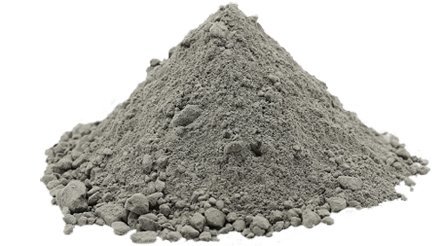
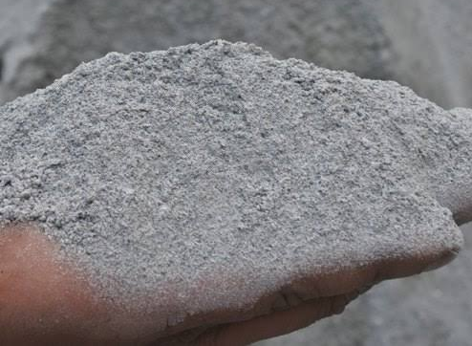

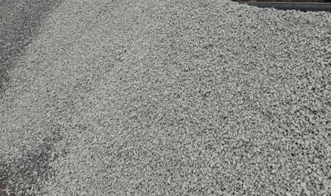
Materials
Water
Cement
Fine aggregates (Sand)
Coarse aggregate
Plastic waste (PET)

Slide 12
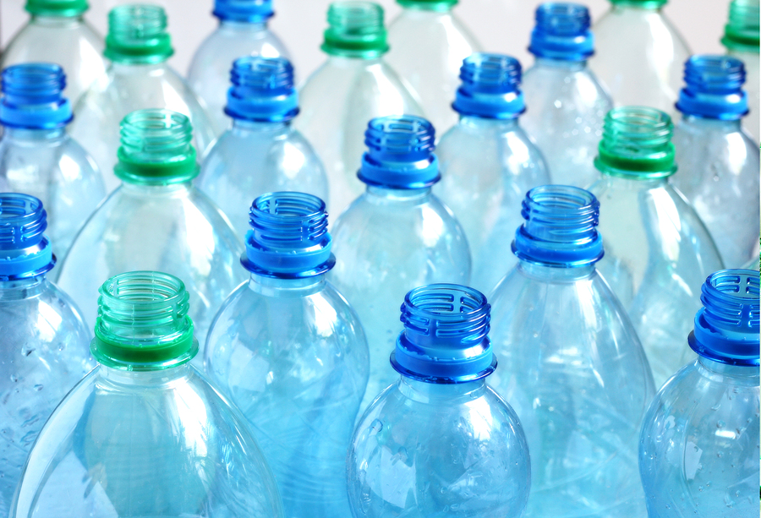
Plastic waste
Type:
The plastic used in preparing the concrete samples was a PET plastic type, which was obtained from used water bottles.

Slide 13
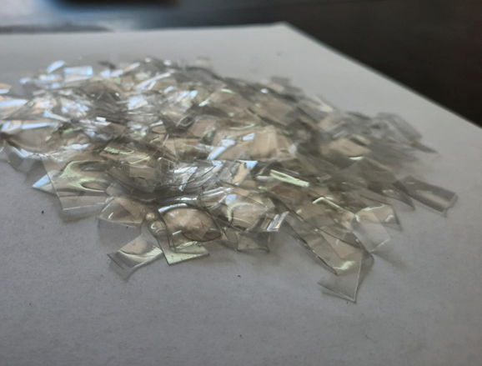
Plastic waste
Amount:
2 kg of plastic waste was needed in the preparation of the twenty-eight sample of plastic waste-passed concrete (around 150 bottles).
Forming:
The method used to obtain the desired form of plastic was (manual cutting)

Slide 14
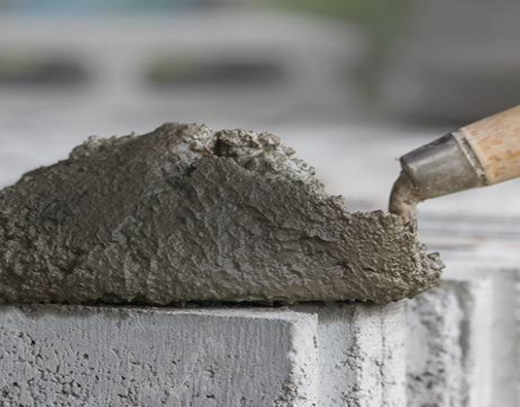
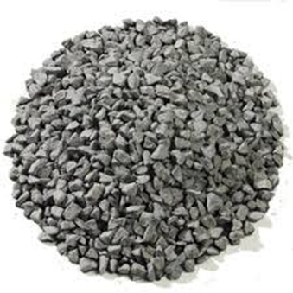
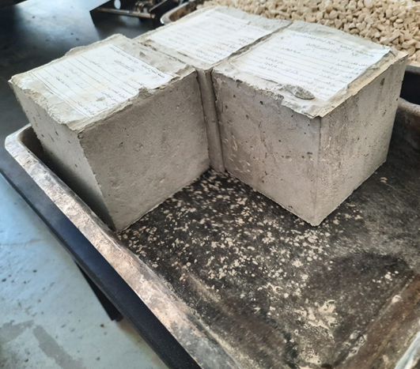
Concrete
Concrete with a ratio of 1:1:2 for (fine aggregate, cement, and coarse aggregate respectively) was used for the tests.
All concrete components were obtained from the local stores.

Slide 15
Experimental Procedure
Mixing
Slump
Molds
Curing
Drying
Compression test

Slide 16
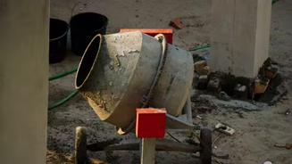
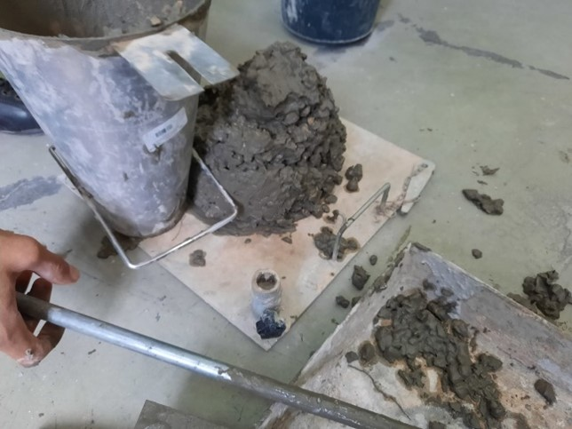
Experimental Procedure
Mixing
Slump

Slide 17
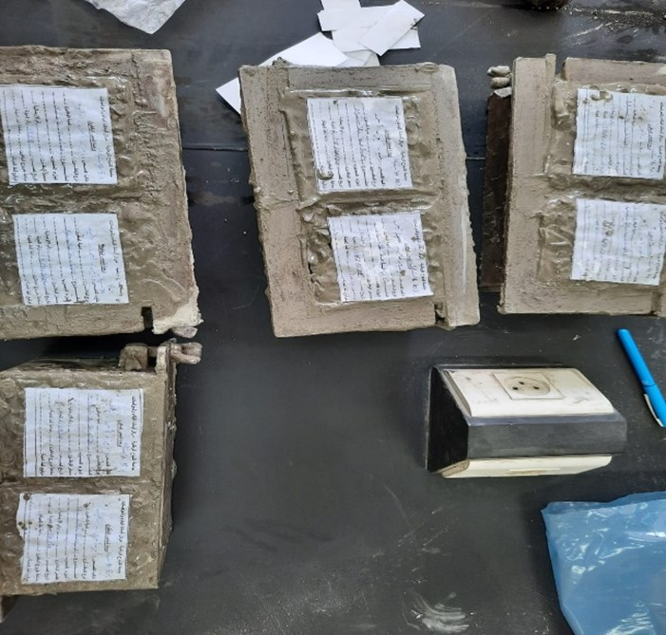
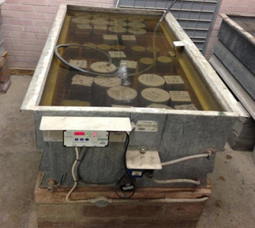
Experimental Procedure
Molds
Curing

Slide 18
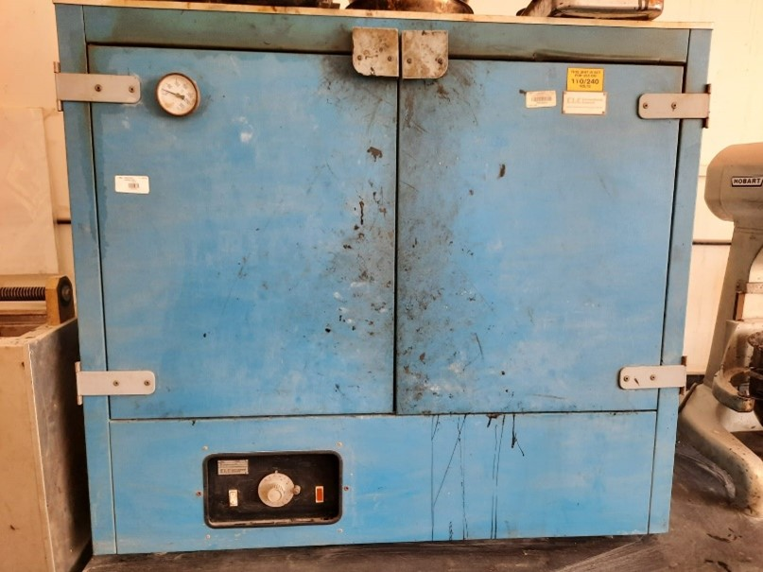
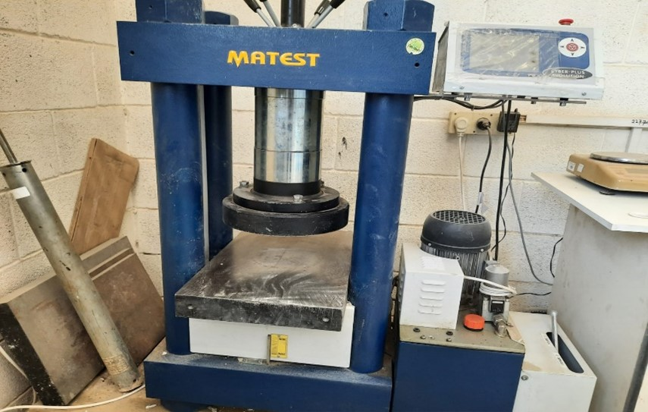
Experimental Procedure
Drying
Compression test

Slide 19
Results

Slide 20
No | wt% | Compressive (kg/cm2) | Tensile strength (M Pa ) | Absorption rate (%) | Density (ρ) (g/cm3) | Slump
0 | 0 | 253±2.1 | 2.48±0.02 | 6.0±0.15 | 2.33±0.005 | True slump
1 | 1 | 260±3.8 | 2.55±0.03 | 6.4±0.11 | 2.31±0.011 | True slump
2 | 2 | 271±5.1 | 2.65±0.05 | 7.2±0.36 | 2.303±0.005 | True slump
3 | 3 | 279±1 | 2.73±0.01 | 7.6±0.74 | 2.301±0.028 | True slump
4 | 4 | 266±0.1 | 2.61±0.007 | 7.8±0.007 | 2.29±0.007 | True slump
5 | 5 | 252.±6.1 | 2.47±0.06 | 9.18±0.003 | 2.27±0.0035 | True slump
6 | 10 | 123±5.5 | 1.20±0.477 | 9.81±0.49 | 2.12±0.034 | True slump
7 | 15 | 48±6.95 | 0.47±0.32 | 11.29±0.6 | 2.074±0.018 | True slump

Slide 21
Compressive Strength

Slide 22
Compressive Strength

Slide 23
Absorption rate

Slide 24
Density

Slide 25
Tensile strength & slump
The tensile strength is related to the compressive strength
Slump were in the normal range (True slump)

Slide 26
Conclusion:
When using PET at below than 5 wt %instead of aggregate, the results were gotten better than the plain concrete.
when using PET at Above 5wt% instead of aggregate. the results were gotten less than the plain concrete.
The water absorption increased
When adding PET instead of aggregate, the density of the samples decreased.
All samples had true slump

Slide 27
Recommendations
To use plasticizer before adding the plastic to the concrete mixture to enhance the water absorptivity.
To try different volumes of PET pieces, like the size of sand or fiber.
To substitute components with plastic other than coarse aggregate.
To pretreat the plastic waste before adding it to the concrete mixture ,such as injection molding, extrusion, thermoforming.

Slide 28


