Slide 1
Standalone Photovoltaic System Sizing Based On Different Approaches
AN-NAJAH NATIONAL UNIVERSITY
FACULTY OF ENGINEERING AND INFORMATION TECHNOLOGY
ELECTRICAL ENGINEERING DEPARTMENT
Obada Abu-Eideh
Motaz Hanbali
Aref Masri
Supervised by: Dr. Moien Omar

Slide 2
Outline
Problem statement
Earlier work
Introduction
Standalone PV system
Loss of Load Probability approach
Performance study
Economical Study
Software Simulation
Results
Conclusion

Slide 3
Problem Statement
Initial cost of PV systems is high.
Most expensive components are PV Array and Battery Block.
That’s why it’s important to determine the accurate size of the system which achieve the load needs.
Sizing PV system can be done by different approaches, here we focus on Traditional & LLP approaches.

Slide 4
Earlier Work
Graduation Project 1:
Renewable Energy and its potential in Palestine.
Standalone PV system and its components.
PV system sizing approaches.
Sizing PV system using Traditional Approach.
Software Simulation.
Performance Study.
Economical Study.

Slide 5
Introduction
Using Traditional Approach may conclude in oversized or undersized PV system.
It does not take into account solar radiation, temperature and other important factors.
This will affect the initial cost and performance of the system.
LLP gives more accurate size of the PV system.

Slide 6
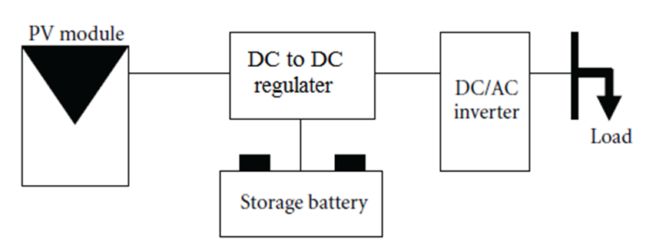
System components
Standalone PV system is a system that generates power needed by the load connected to it using only PV cells.
Standalone PV system components

Slide 7
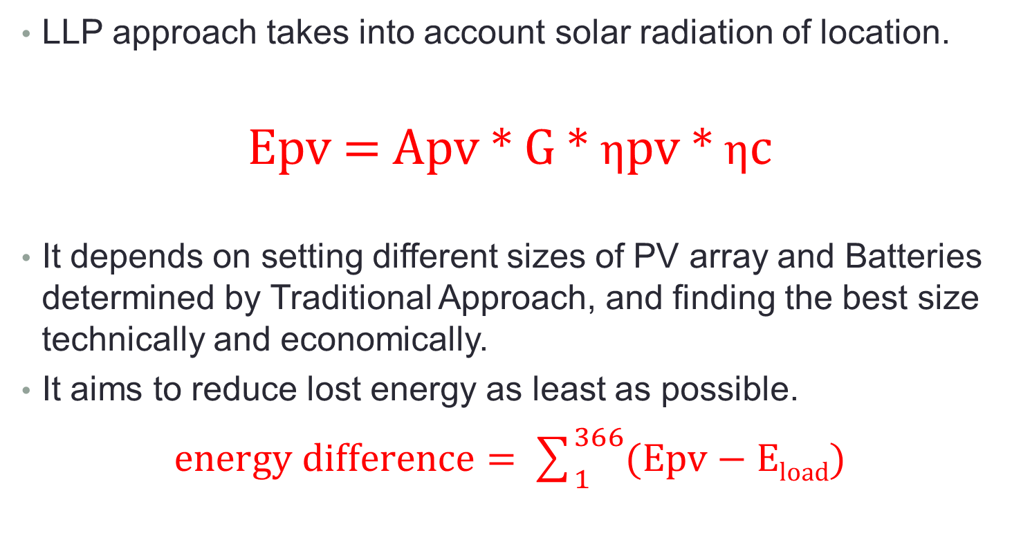
Loss of Load Probability
LLP approach takes into account solar radiation of location.
Epv = Apv * G * ηpv * ηc
It depends on setting different sizes of PV array and Batteries determined by Traditional Approach, and finding the best size technically and economically.
It aims to reduce lost energy as least as possible.
$energy difference=\sum_{1}^{366}{(Epv−Eload)}$

Slide 8
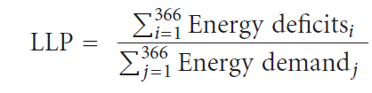
Set Eload
Get Esun matrix
Sizing PV system using traditional approach
Area of PV = [ 80% 90% 100% 110% 120% ]*PV
Battery size = [ 60% 70% 80% 90% 100%]*B
if EPV < Eload
charging
discharging
Yes
No
Energy deficit
e
Energy demand
No
Yes
EPV + E batteries < Eload
Economical study for chosen size

Slide 9
System Sizing
LLP approach concluded 90% PV & 90% Battery
 | Traditional Approach | LLP Approach
PV Size | 24592 W | 22132 W
Battery Block Size | 1137 Ah | 1023 Ah
PV Energy (yearly) | 40493 KWh | 36403 KWh
Lost Energy (yearly) | 5282 KWh | 1338 KWh
Loss of Load Probability | 15.1% | 3.8%

Slide 10
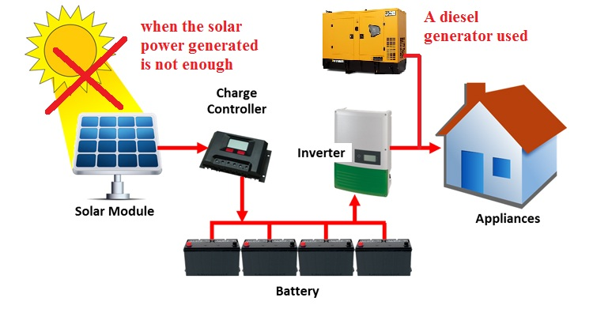
Performance Study
Traditional Approach has more energy excess comparing to LLP.
Both approaches suffer from deficit energy during some days among the year, especially in December, that needs to covered.

Slide 11
Performance Study
Diesel generators have a relatively low initial cost compared to their running cost. It will be needed for short interval, so it provides a good solution.
The highest deficit energy among the year is:
-Traditional Approach : 55 KWh/daily
-LLP Approach : 59 KWh/daily
So, an estimated diesel generator rated at 5 KW would solve the problem.

Slide 12
Economical Study
Component | Quantity | Unit Price (NIS) | Total Price (NIS)
PV-Module | 24592 Wp | 18 | 442,656
Battery Cells | 110 | 1534 | 168,740
Total Cost |  | 611396
initial cost using Traditional approach

Slide 13
Economical Study
Component | Quantity | Unit Price (NIS) | Total Price (NIS)
PV-Module | 22133 Wp | 18 | 398,390
Battery Cells | 99 | 1534 | 151,866
Total Cost |  | 550256
initial cost using Loss of Load Probability approach

Slide 14
Economical Study
The previous two tables show the initial cost of the two approaches.
It’s shown that the Traditional Approach gives an oversized PV system.
LLP Approach gives more accurate PV system size.
LLP approach saves up to 61,000 NIS of initial cost.

Slide 15
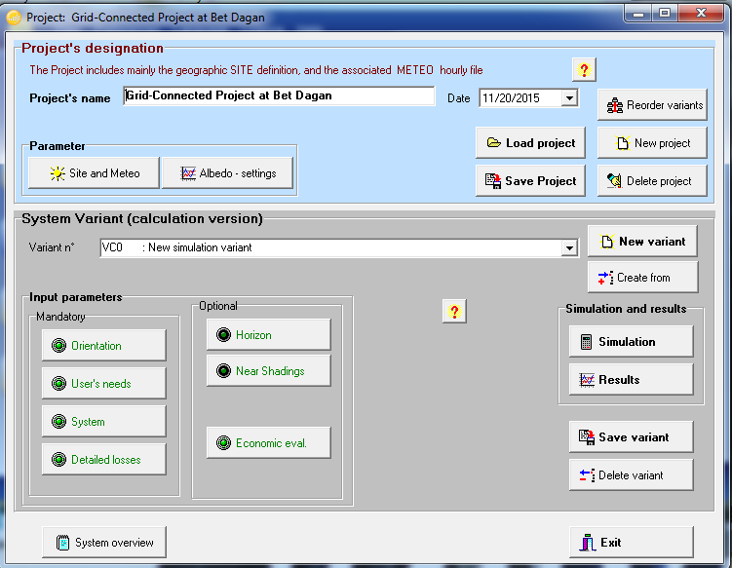
Software Simulation
We used PVsyst software to make a simulation for the system.
It helped in studying the performance of the system.

Slide 16
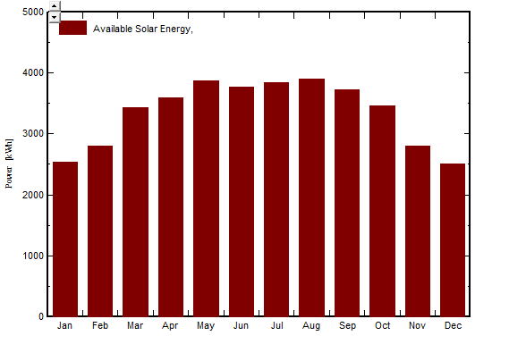
Software Simulation
Available solar energy

Slide 17
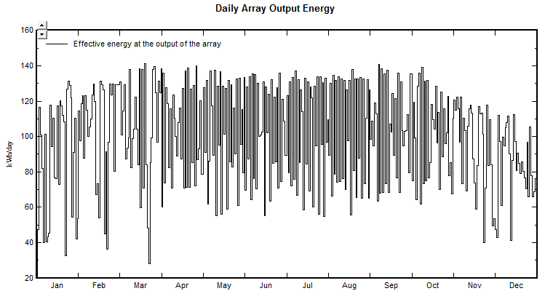
Software Simulation
Daily output energy generated by PV array

Slide 18
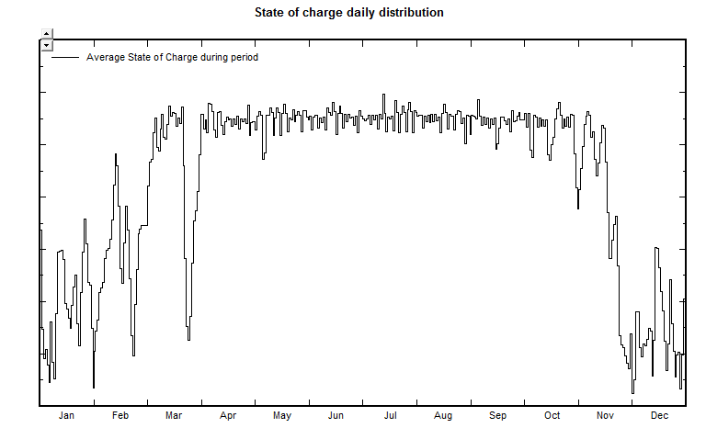
Software Simulation
State of charge among the year

Slide 19
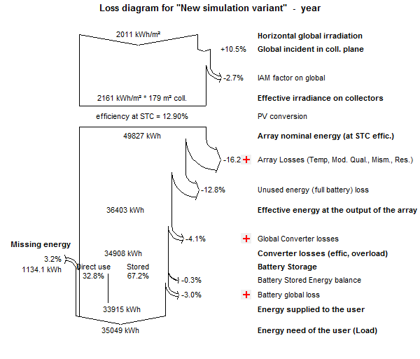
Software Simulation
Energy losses

Slide 20
Results
 | Traditional Approach | LLP Approach
PV Array | more | less
Battery Block | more | less
Generated energy | more | less
Energy losses | more | less
cost | more | less
Back-up Generator | recommended | recommended

Slide 21
Conclusion
Traditional Approach gives an oversized PV system, while LLP is more accurate.
Using LLP reduces the initial cost, energy losses.
Both approaches suffer from energy deficit during some days in winter.
Back-up diesel generator is needed in both generators to solve the energy deficit problem.

Slide 22


