Slide 1
Graduation project 2
Improvement on Bissan factory
Bissan air conditioner factory
Made by :
1.Lara Barakat
2.Wardah Shawabkeh
3.Heba Barham

Slide 2
Outline:
Introduction
Inventory Management
Quality Management
Safety Management
Conclusion

Slide 3
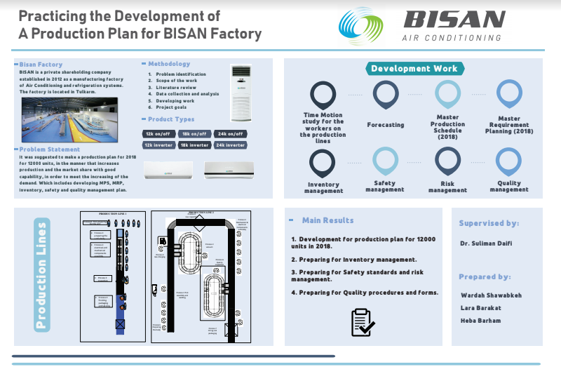
Introduction:

Slide 4
Inventory management
1. Finished Product
limit of store (3000) units
A project plan could suggest for building an umbrella for temporary store for the raw materials

Slide 5
Minimum Stock Level
Minimum Level = Re-order level -(Normal consumption x Normal Re-order Point)
(Case A) for the months from April to August
(Case B) from September to March

Slide 6
2. Raw Materials
inventory cost
Ordering Cost | Cost NIS
Inspection and internal transportation | 1300
Storage cost | 1000
insurance, licensing, and taxes | 300
Carrying Cost | Cost in NIS
Capital cost | 6000
Obsolescence | 1000
Damage cost | 3700
Storage cost | 53091

Slide 7
Economic order quantity
Economic-Order Quantity Formula

Slide 8
The given data
Q= 1000 units
H =1.078 NIS
D =9000 units
S = 2900 NIS

Slide 10
3. Classification for Spare parts Inventory

Slide 12
Safety Management :
Every job is dangerous in some way.
Millions of people who work in factories. They may suffer because of bad ventilation, dangerous chemicals or noise pollution.

Slide 13
General check list about the safety in the factory:

Slide 14
Installation site:
Ensure that the ceiling or the wall is solid enough to carry the weight of the system which will be mounted on it.

Slide 15
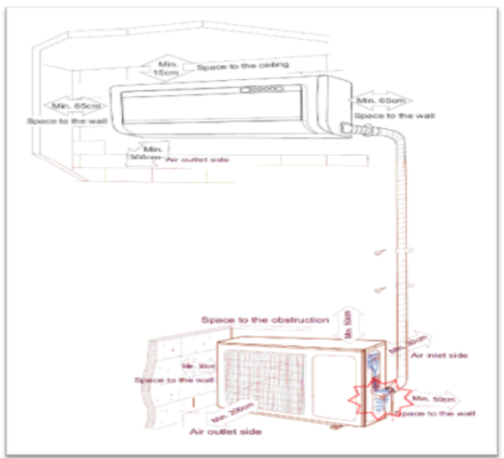

Slide 16
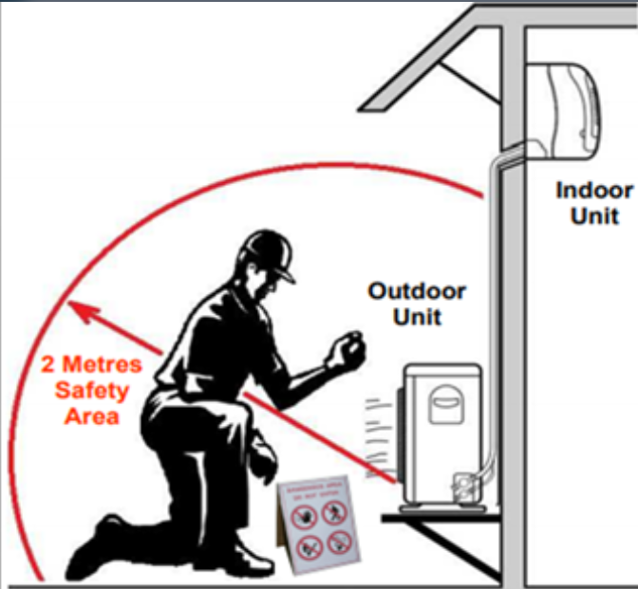

Slide 17
Installation site-outdoor unit :
1. Choose the installation location in a way that don't make noise from the system or outgoing.
2. Installation the unit out of the reach of children.

Slide 18
Installation site-indoor unit:
1. Make sure that the installation position of the indoor unit can handle the weight of the unit and the associated vibration.
2. There should be a minimum distance about 1 m from TV or any other electric appliances.

Slide 19
Check list for the installation

Slide 20
Maintenance check list:

Slide 21
The plant risk assessment:

Slide 24
Risk Identification:
Risk Priority Number equal S*O*D
Fail in wire connecting = 4*4* = 64
Malfunction in packing machine = 4*4*3 = 48
Worker is injured by burning = 7*5*5 = 175

Slide 25
Quality management:
Quality Overview
Quality Forms

Slide 26
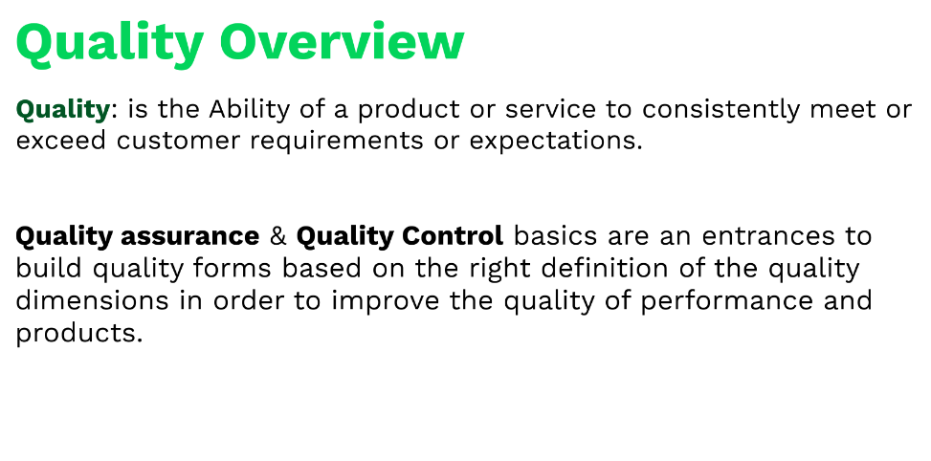

Slide 27
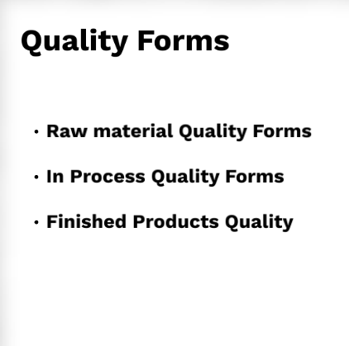

Slide 28
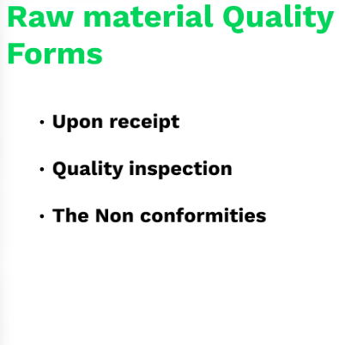

Slide 29
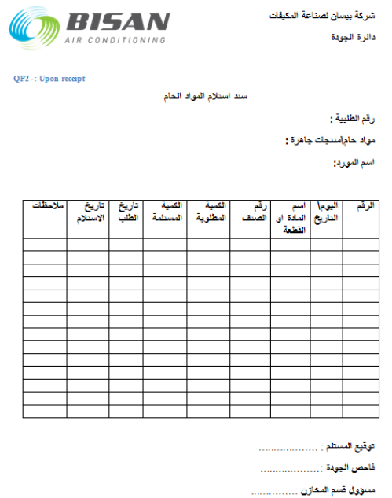
Upon Receipt :

Slide 30
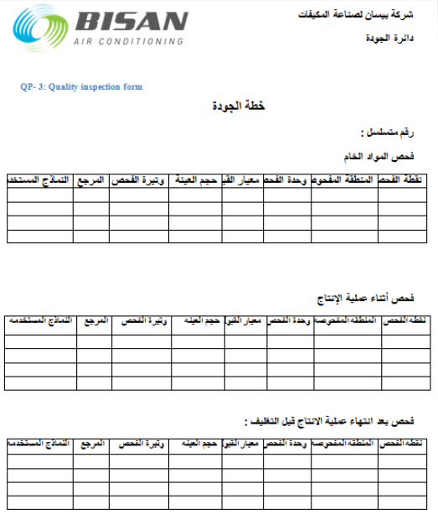
Quality Inspection:

Slide 31
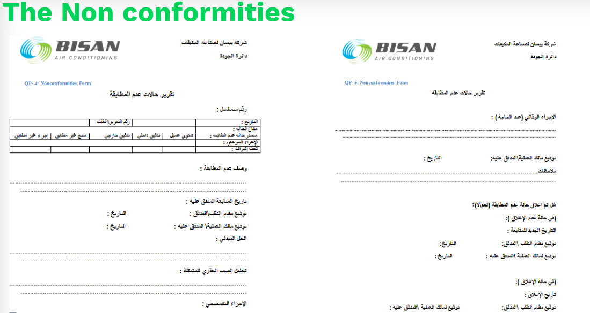

Slide 32
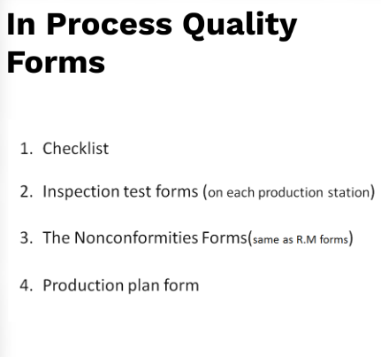

Slide 33
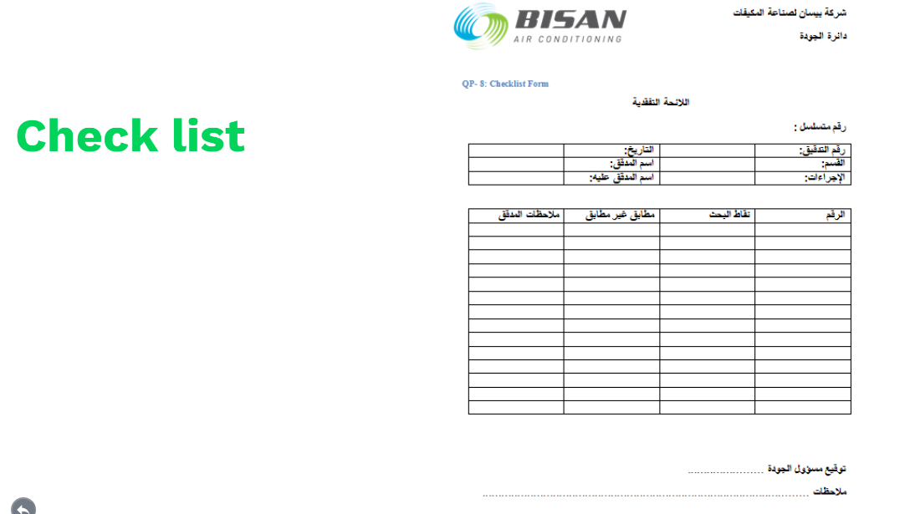

Slide 34
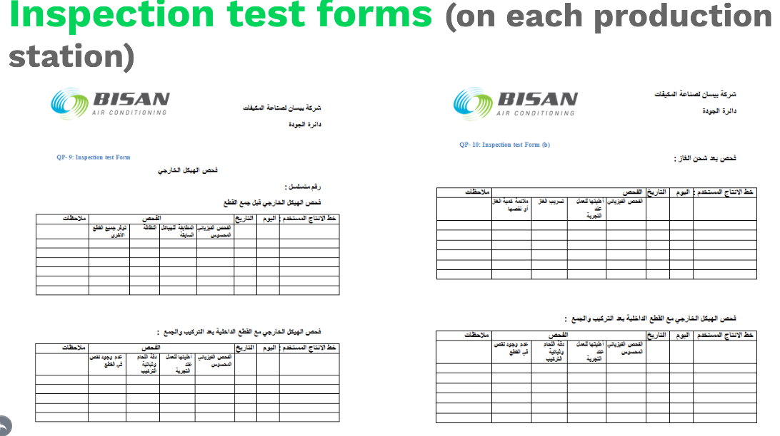

Slide 35
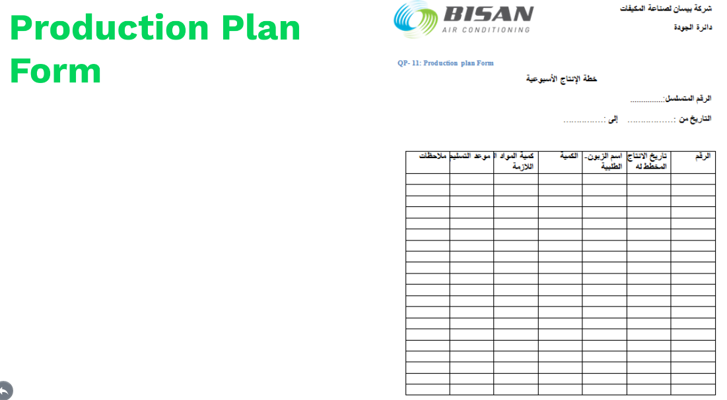

Slide 36
