Slide 1

Prepared By:
Sama’a Hajeer
Manar Haji
Supervised by:
Dr. Hanal Abuzanit

Slide 2
Outline:
Motivation
What STEPS is
Components
Future work
Demo

Slide 3
Motivation
Babies are born ready to learn, and their brains develop through use. So your child needs a stimulating environment with lots of different activities that give him plenty of ways to play and learn. He also needs lots of chances to practice what he’s learning.
Children spontaneously learns and memorizes more effectively when they are having fun ,so the educational games become the best way to teach the children.

Slide 4
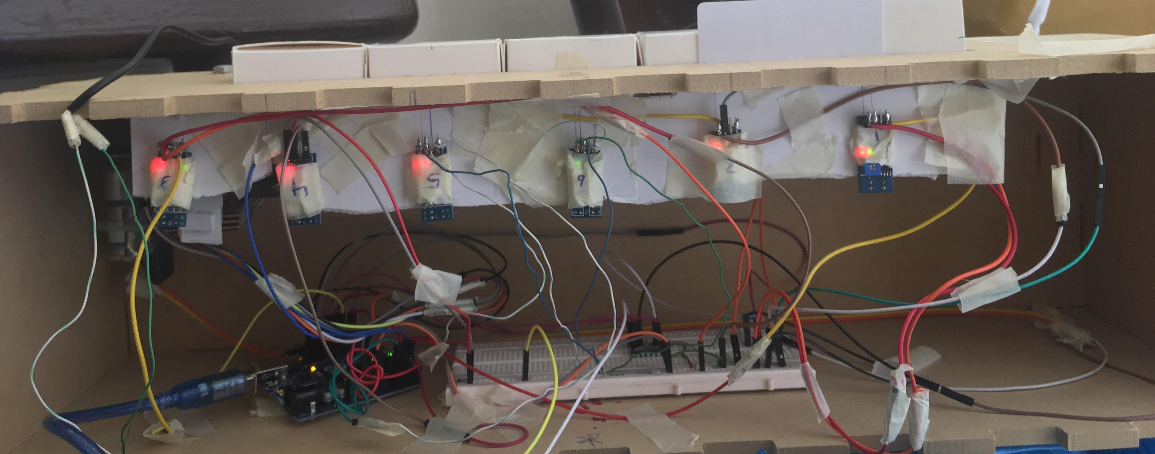
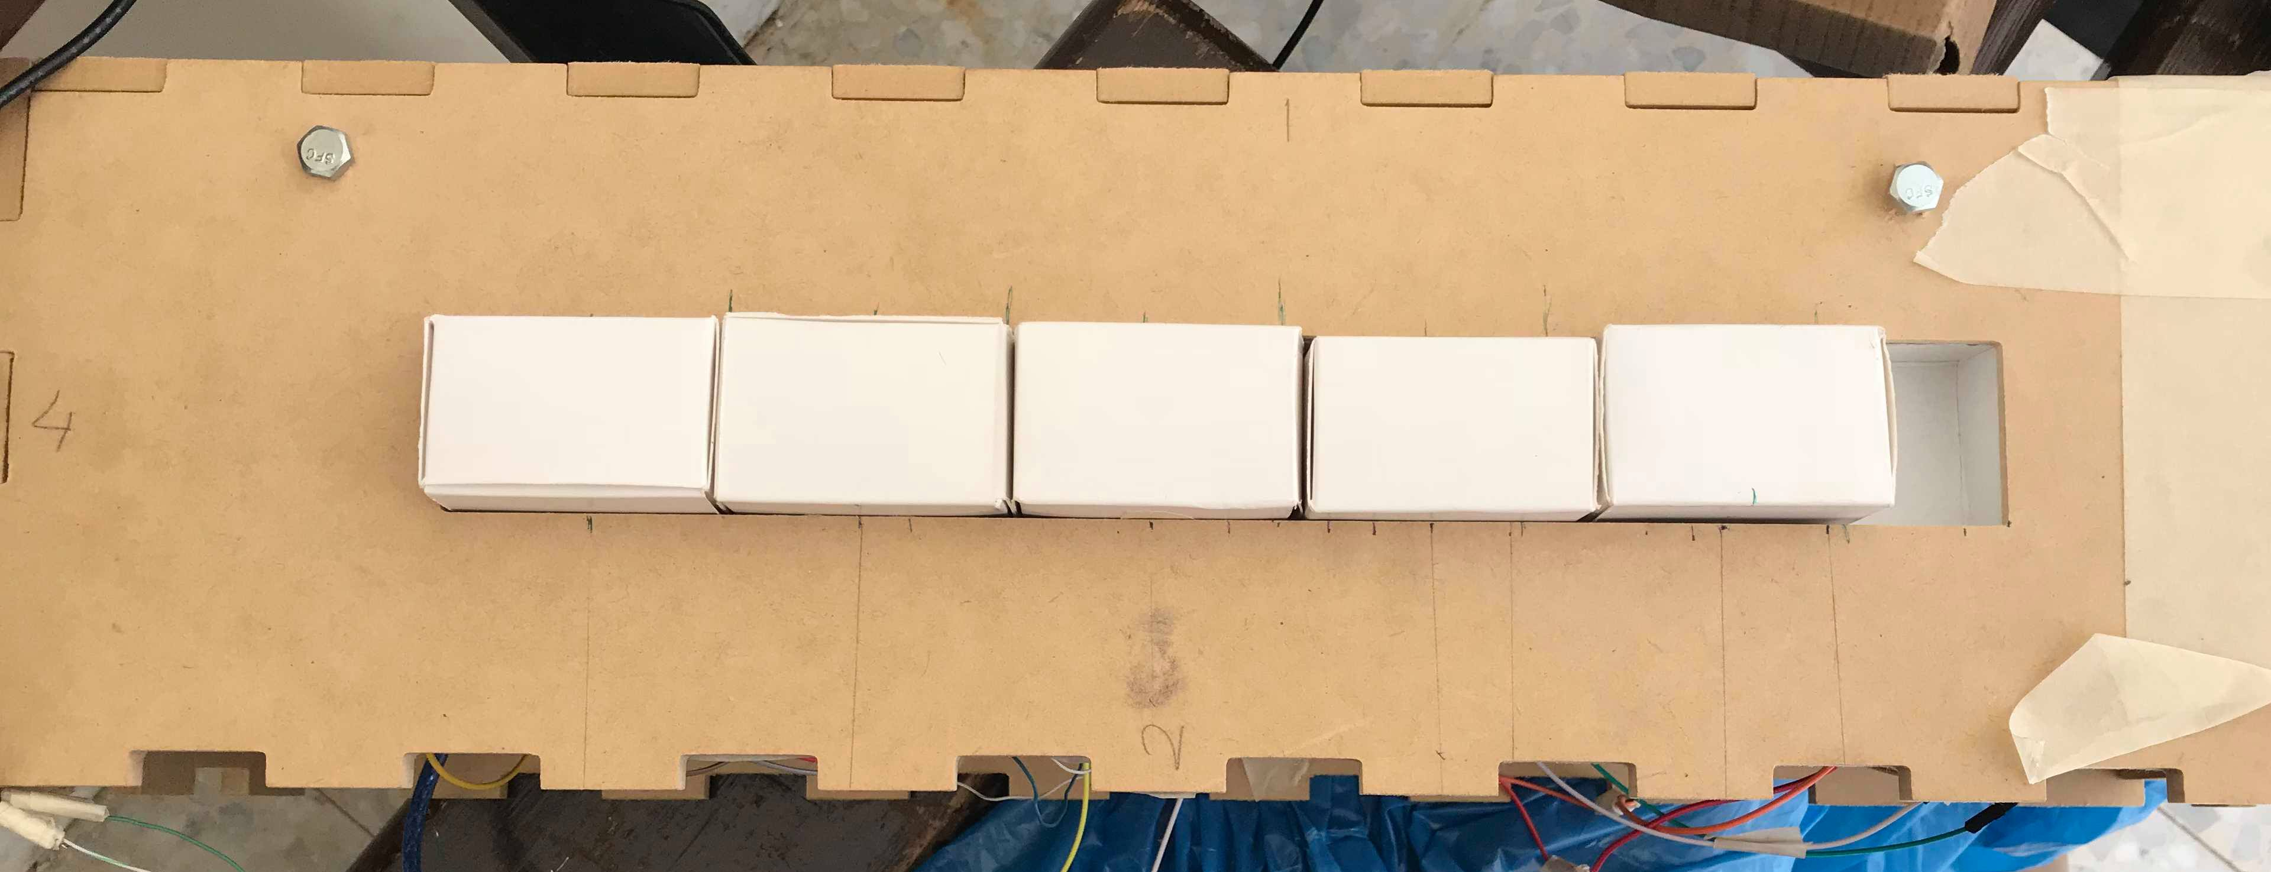
What STEPS is
Educational game that focuses on learning the basic ABC's and numbers in a funny and interactive way .
The game consist of :
The answer box. Each answer represented by a sequance of cube so that the child required to put it in the correct format .

Slide 5
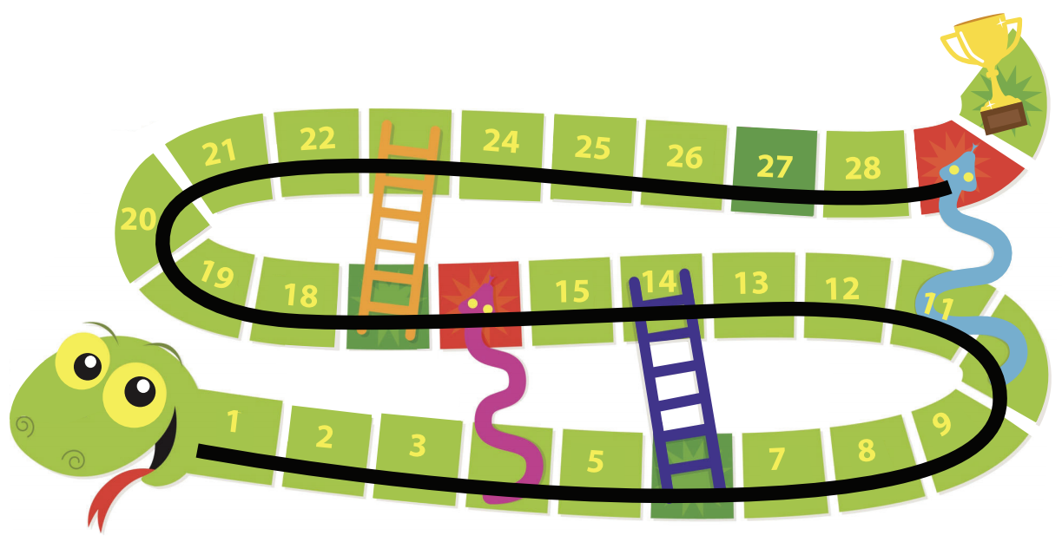
What STEPS is
The map (the snake and the ladder)

Slide 6
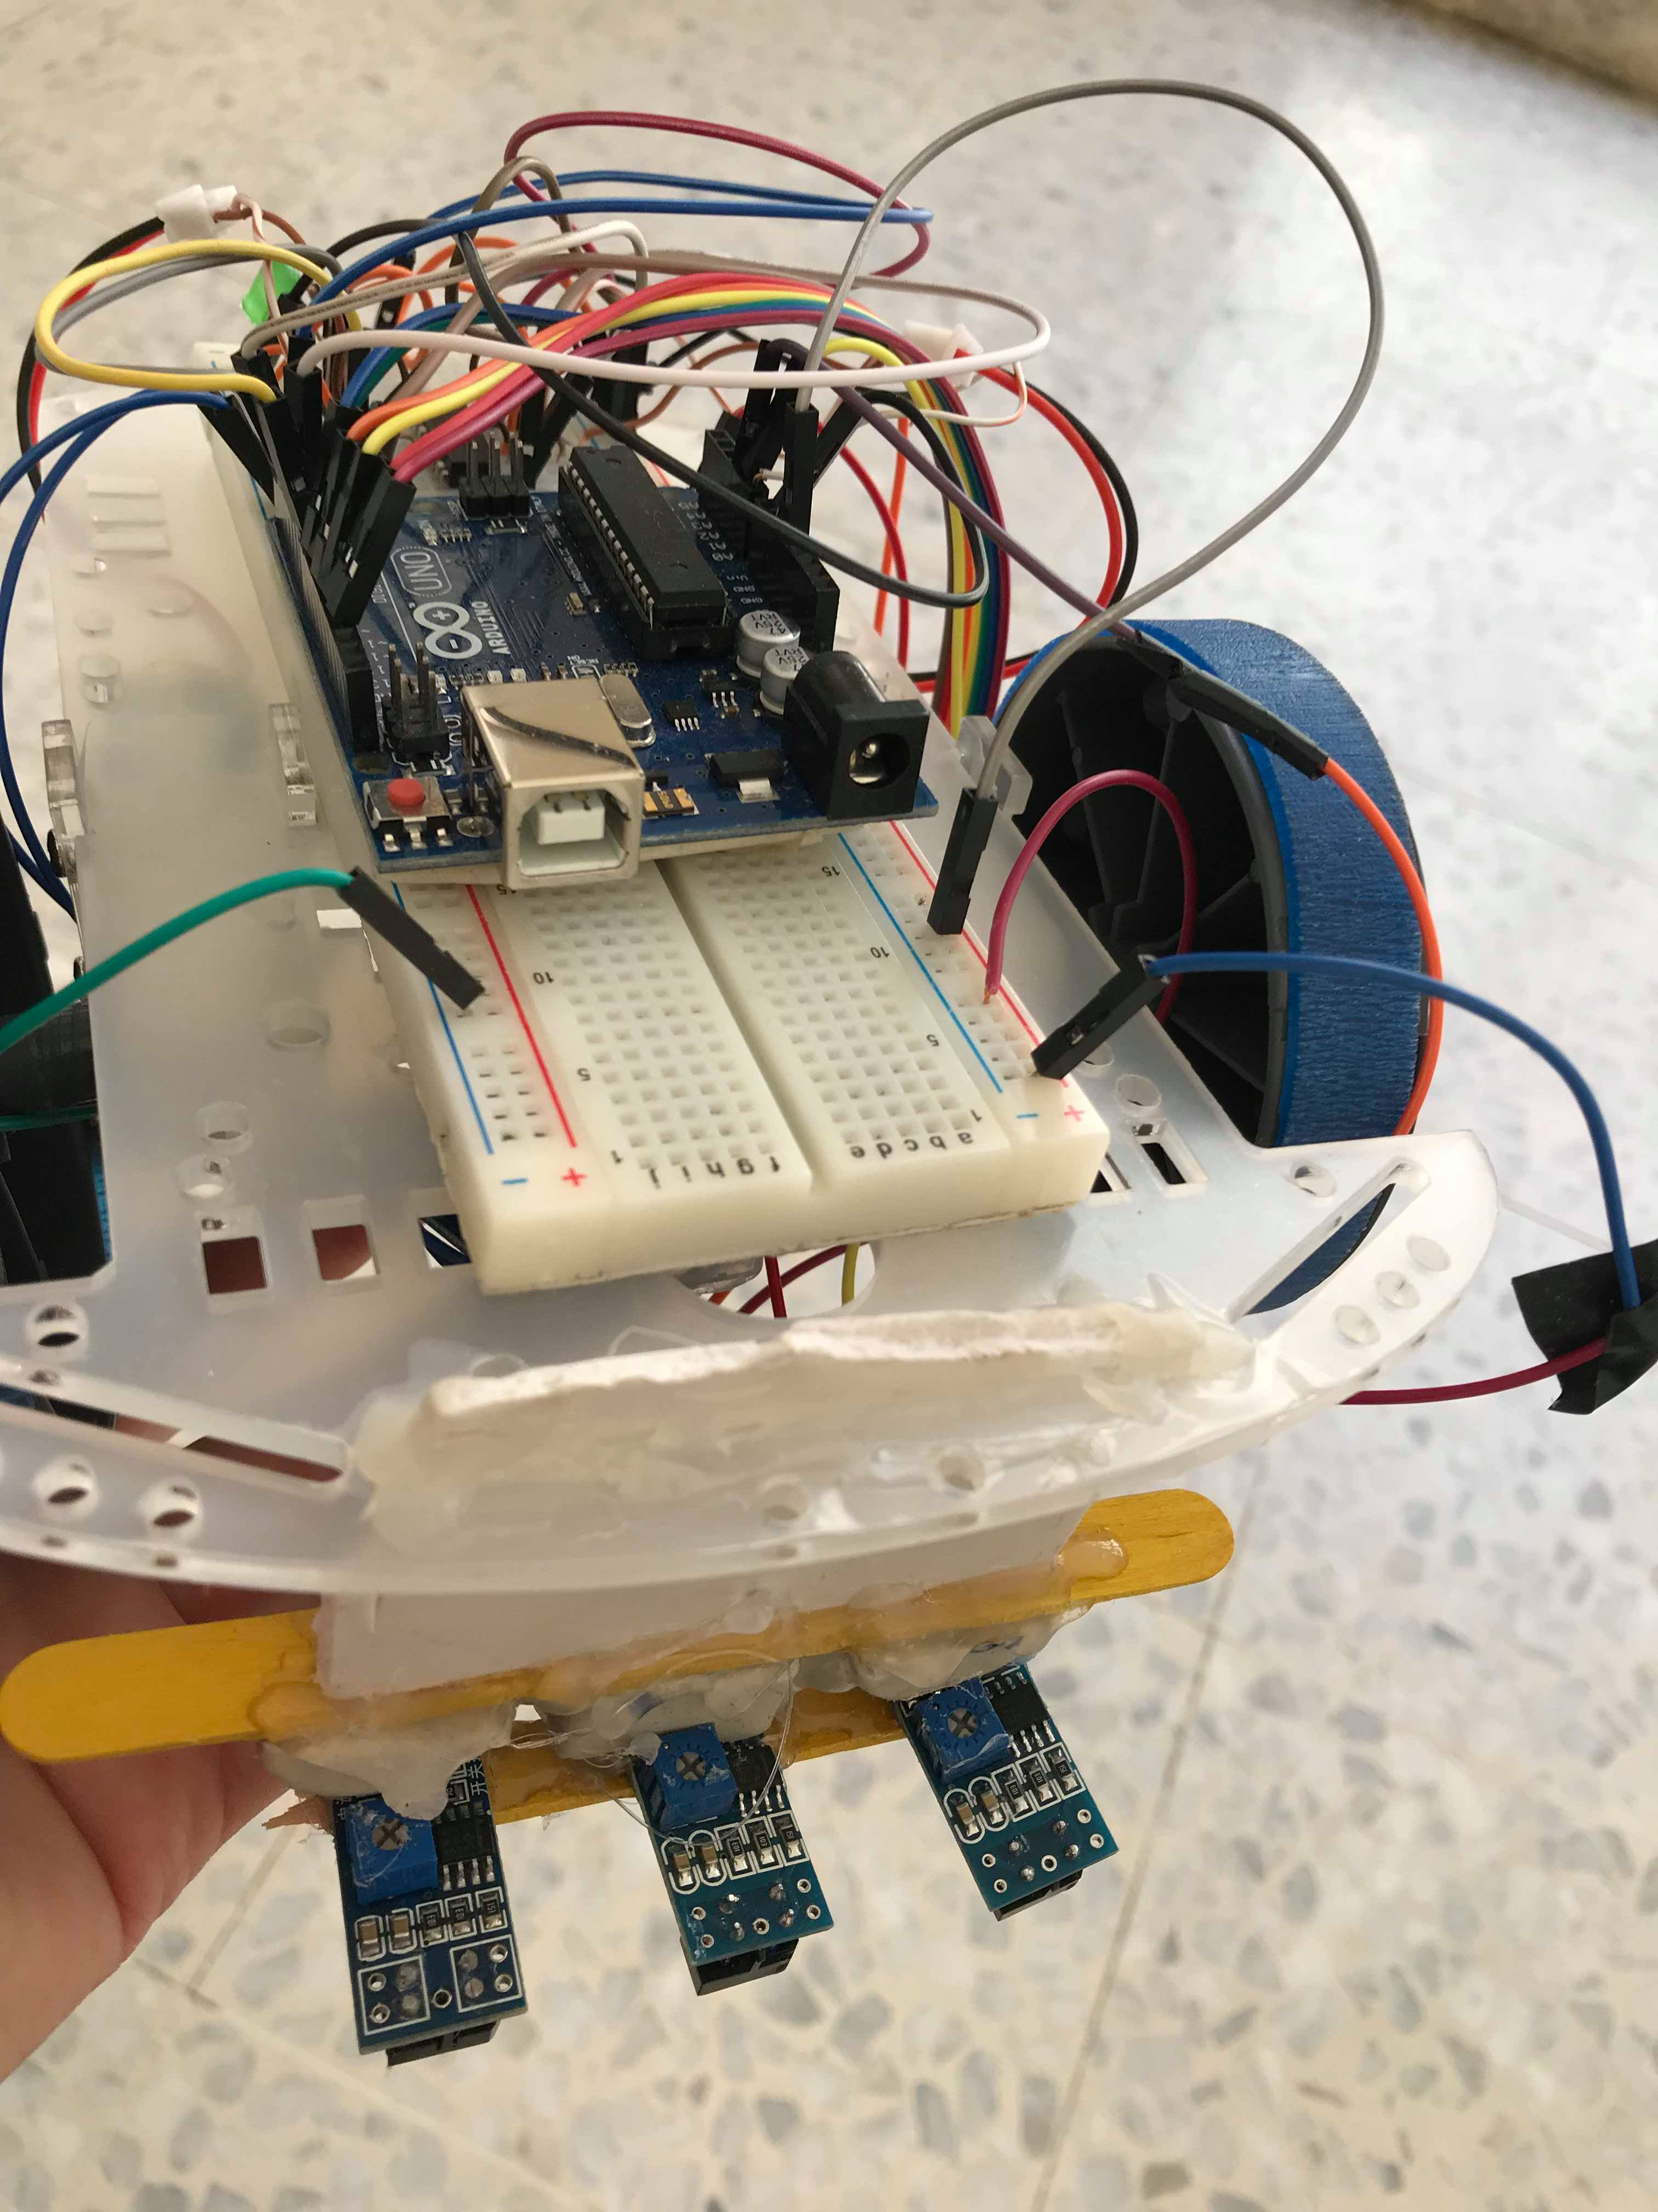
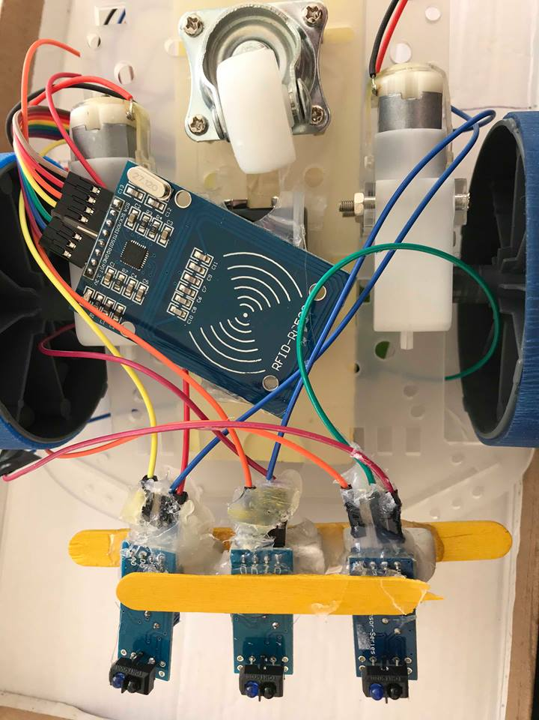
What STEPS is
The car moved depending on the child’s answer with random steps

Slide 7
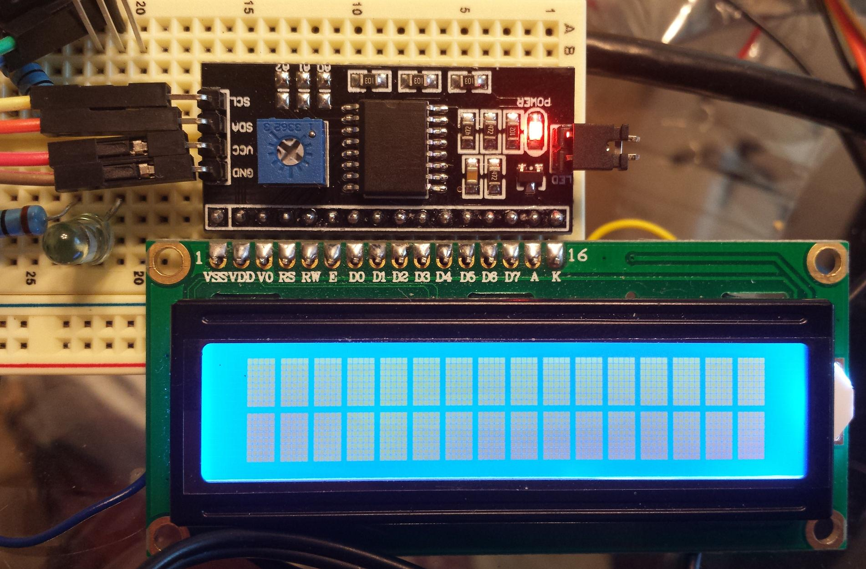
What STEPS is
LCD for showing questions and number of steps

Slide 8
Components
Answer box:
DC motor (scanning) Motor driver
FRID(reader,tags) IR sensors (for each slot ,to check the sequence)
Aruino uno
Bluetooth(communicate with robotic car)
LCD(displaying the questions and randomly steps)

Slide 9
Components
Robotic car and the map:
Dc motor (wheels) Motor driver
IR sensors(direction of the car)
FRID(location)
Aruino uno
Bluetooth(receive from the answer box )

Slide 10
Future work
Making the game for more than one player .
Increasing the difficulty level of the questions each time the child win the game .

Slide 11

Demo

Slide 12
Demo

Slide 13
THAKS FOR LESTINING

