Slide 1
Economic & Environmental Impact assessment for porous asphalt applications in Nablus, Palestine

Slide 2
Outline
Chapter 1: Introduction.
Chapter 2: Literature Review.
Chapter 3: Methodology.
Chapter 4: Data Collection.
Chapter 5: Pavement Design.
Chapter 6: Economic and Environmental Impact Assessment.
Chapter 7: Conclusion and Recommendations.
Chapter 8: Appendices.

Slide 3
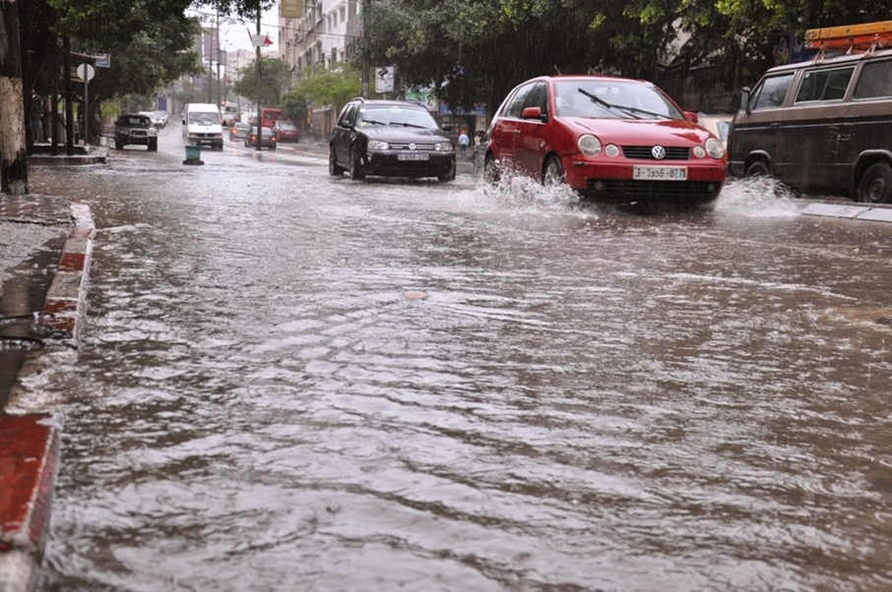
Introduction
General Background:
Nablus City:
Located in the northern of West bank, its area is 28.6 Km2, with an approximated population of 157,000 citizens as of 2017.
Located between two mountains, and on top of three aquifers.
Problem of bad rain drainage.

Slide 4
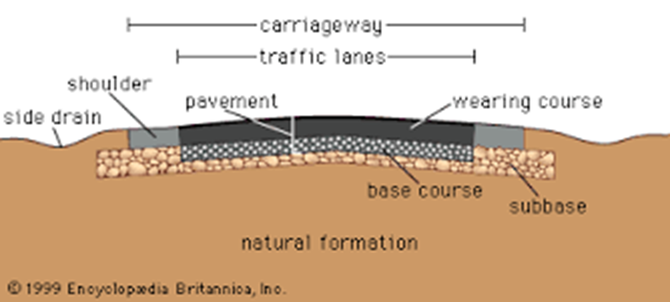
Conventional pavement

Slide 5
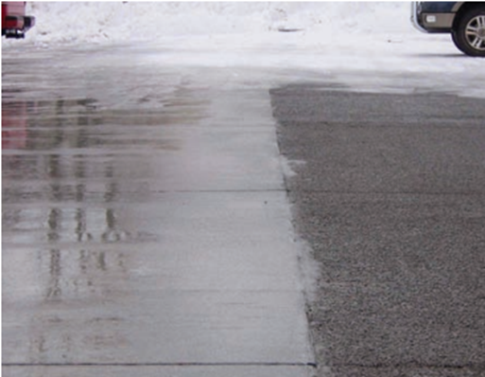
Permeable Pavement contributes to solve the problem of bad drainage.

Slide 6
Significance of the work and objectives
The importance of this study is both economic and environmental, it will explore how much money can be saved by using porous asphalt for water costs and construction costs, in addition to determine how much water can be added to the natural reservoir by using porous asphalt, thus hopefully improving the cost and improving the lives of Palestinians.

Slide 7
Approach
Porous asphalt can be used in local streets, parking, and sidewalks.
The local streets in Nablus city with speed limit up to 50 km/h, low traffic volume, and a grade of less than 5% will be selected.
Economic and environmental implications of using the new pavement system will be determined.

Slide 8
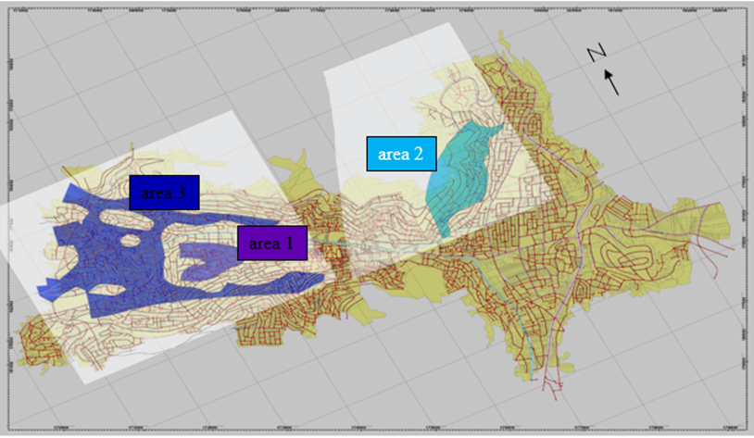
Study area

Slide 9
Review of literature
Both global studies and local studies were taken into consideration when the literature review was done, these studies talked about porous asphalt physical properties and draining capabilities and other factors that might affect the porous asphalt like additives.

Slide 10
3. METHODOLOGY
Methodology
Sources of data
Literature Review.
The Permeable Pavements Task Committee book published by The American Society of Civil Engineers.
Geotechnical Map for Nablus city.
GIS files, AutoCAD files.
Geomolg.
Names, layers and thicknesses of the streets.

Slide 11
Design alternatives
Conventional Pavement design based on AASHTO method (The American Association of State Highway and Transportation Officials).
The design alternative is the permeable paving system chosen to be porous asphalt.
Setting criteria and standards
Good permeable soil subgrade.
Local street (speed limit under 50 Km/hr and low traffic volume).
slope within (0-5) % range.

Slide 12
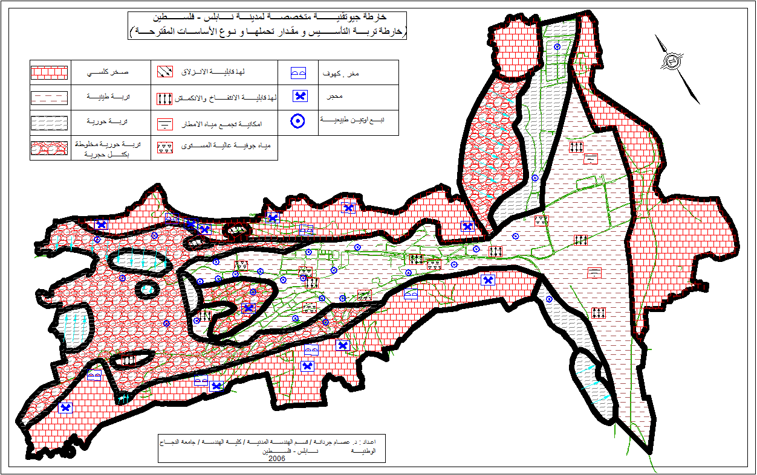
4.1 Existing record and maps
Data collection

Slide 13

Street selection
Based on the design criteria (soil type, slope, traffic volume, and speed), among the1352 local streets of Nablus, 61 local streets were selected in this study from three different areas as shown in the following Figure.

Slide 14
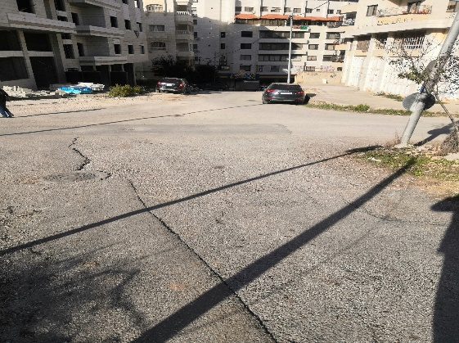
Area 1

Slide 15
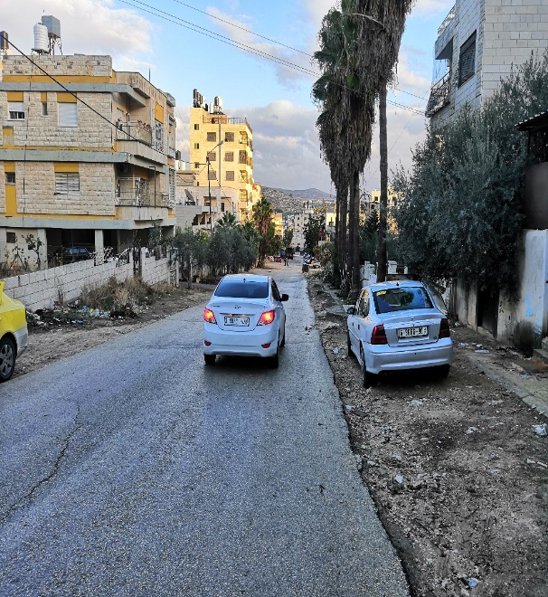
Area 2

Slide 16
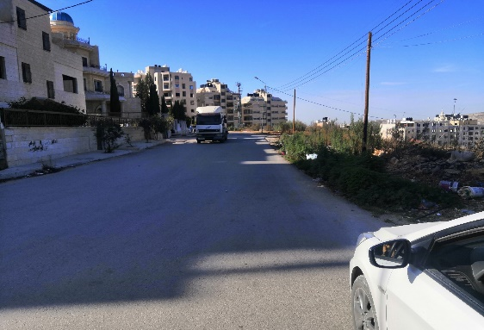
Area 3

Slide 17
Pavement design
5.1
Conventional pavement design
5.2
Permeable Pavement

Slide 18
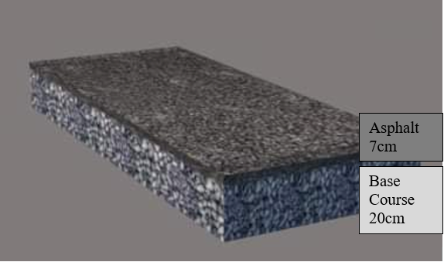
Conventional pavement design
Designed based on AASHTO method (The American Association of State Highway and Transportation Officials).

Slide 19
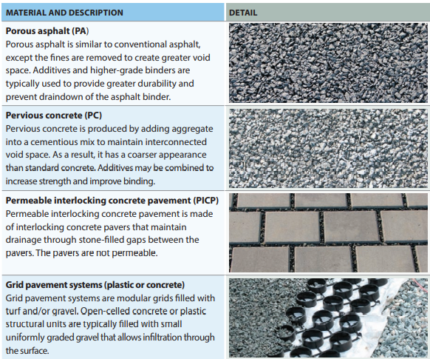
Permeable pavement types

Slide 20
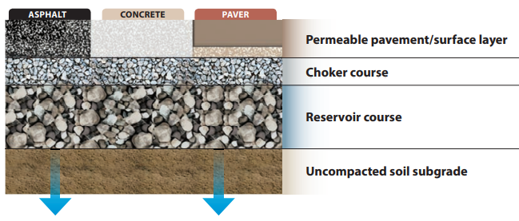
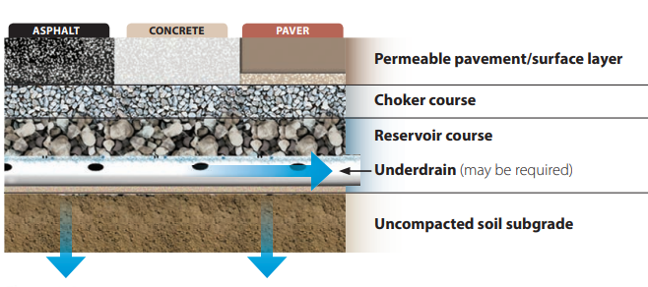
Infiltration types
Full-infiltration design—No underdrain Partial-infiltration design—Underdrain, no liner

Slide 21
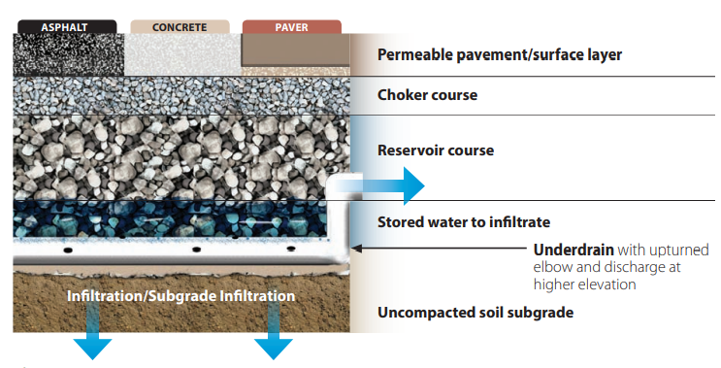
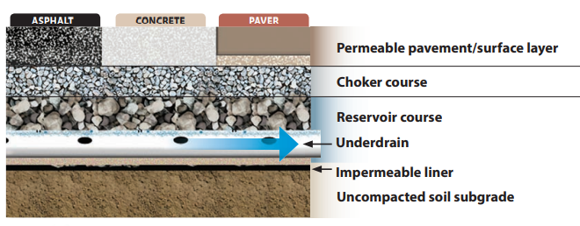
Infiltration types
Partial-infiltration with inverted underdrain No-infiltration design—Underdrain and impermeable liner

Slide 22
5.2 Permeable Pavement
Permeable pavement advantages
Reducing the total runoff volume
Increasing the recharge rate of ground water
Filtering the storm water and thus improving its quality
Reduces the cost of the infiltration systems

Slide 23
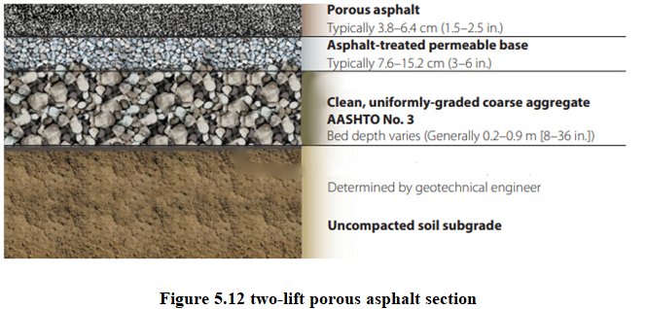
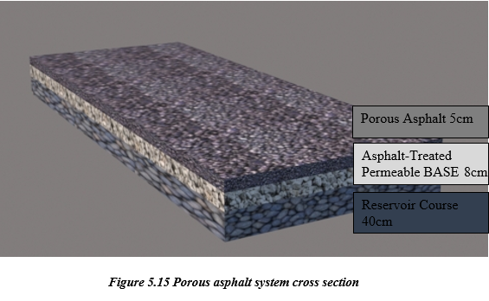
Permeable asphalt layers
Porous Asphalt
Asphalt-Treated Permeable BASE (ATPB)
Reservoir Course
The uncompacted soil subgrade

Slide 24
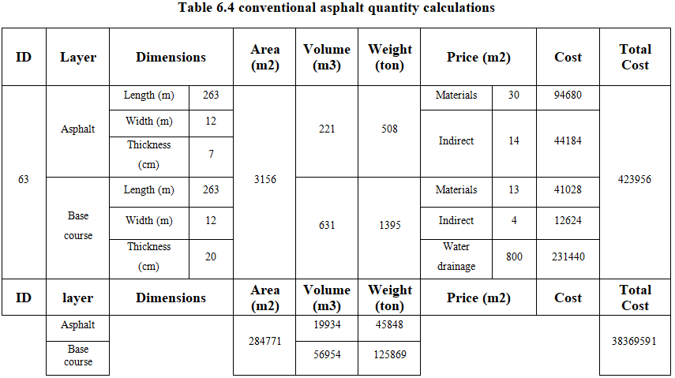
6.1 Economic impact assessment

Slide 25
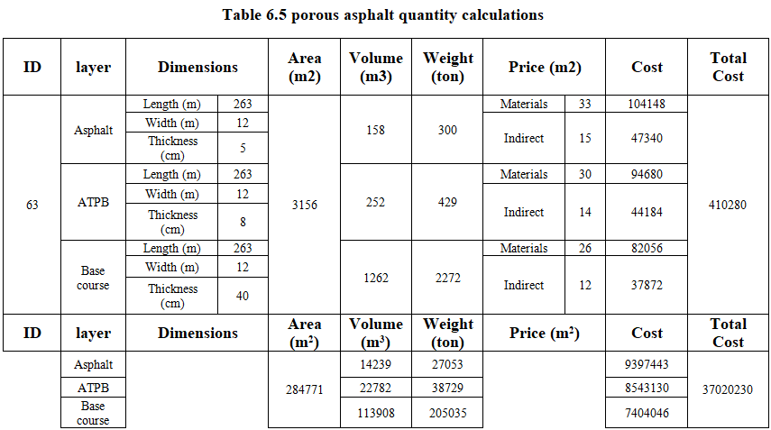

Slide 26
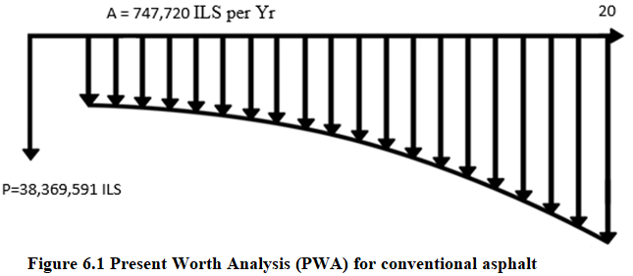
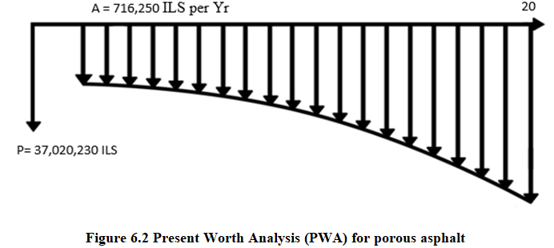
Initial construction cost and maintenance cost
g = 1%, i =2%

Slide 27
Environmental impact assessment
Runoff flow quantity
CIA method
Environmental Implications
Advantages and disadvantages
Feasibility calculations

Slide 28
CIA method
Q = CIA
Where Q is the runoff (m³/sec), C is the runoff coefficient for the city of Nablus, I is the intensity of rain for a selected frequency and duration equal to at least the overland flow time (time of concentration t_{c}) for the City of Nablus (mm/hr), and A is the area of the catchment (hectares [ha])
Time restriction
More complex calculations need an individual project

Slide 29
Area | 1 | 2 | 3
Runoff (m³/sec) | 0.92 | 1.62 | 4.60
Runoff sum (m³/sec) | 7.14

Slide 30
Environmental implications
(Advantages)
Improving the water quality by filtering and decreasing pollutants.
Reduce the water runoff causing a reduction of thermal pollution compared to conventional asphalt.
Contribute to solving the flooding problem in Nablus.
Contribute to reducing the accidents rate in winter.
Filtering the rainwater leads to reduce the cost and work load imposed upon water filtering plants in the winter.

Slide 31
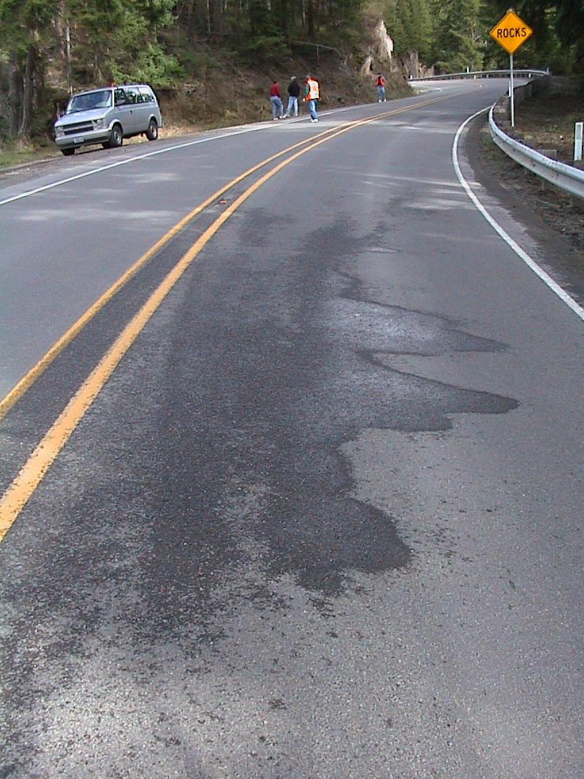
Environmental implications (Disadvantages)
It has a substantially higher percentage of bitumen compared to conventional asphalt, and bitumen is considered as a source of pollution for the environment.
This asphalt system can’t be used in high heat areas because high heat will cause the asphalt to bleed.
It takes more resources to be completed than its conventional asphalt counterpart.

Slide 32
Environmental implications
Feasibility calculations were done to find out the ground water recharge rate, and the amount of money that could be saved for the government per year; two assumptions were taken into consideration:
Only 50% of rainwater gets to the streets, the rest ends up on roofs or other areas.
Porous asphalt had an average rainfall water reduction of 96.7%
The Environmental impact assessment study concluded that the groundwater is recharged at a rate of 107,404.7 m³/year. This amount of water can satisfy the capita needs in Nablus city for 7 days while generating upwards of 37,023,350 ILS per year for the government.

Slide 33
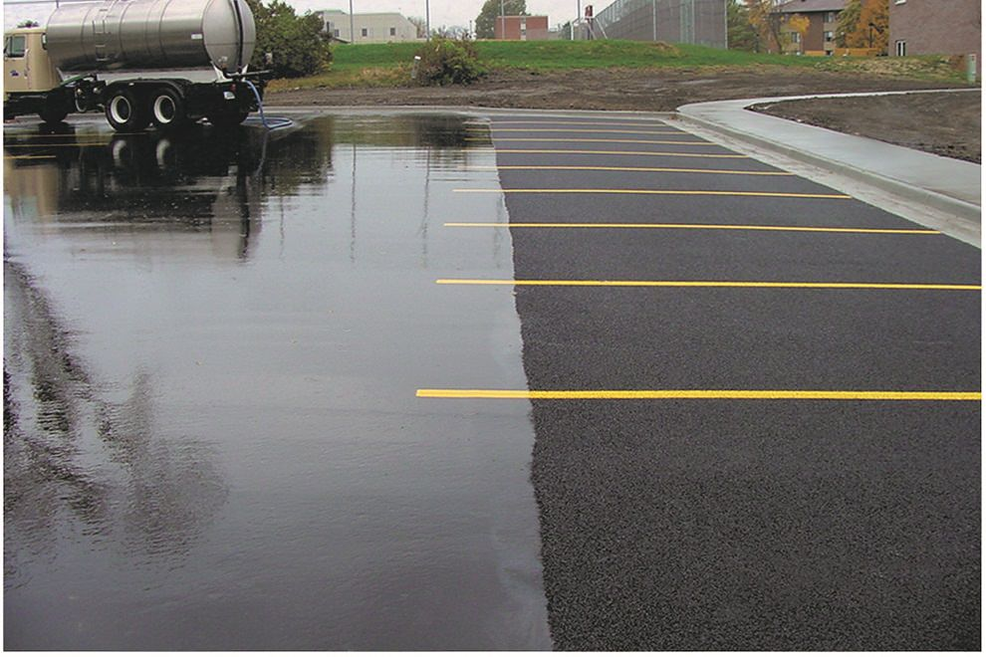
Conclusion and recommendations
The study introduced a new and important scientific contribution, since it is the first time in Palestine that the implementation of porous asphalt was investigated.

Slide 34
Conclusion
The study concluded that the most suitable permeable pavement type to be implemented is the full-infiltration porous asphalt design.
Porous asphalt has many environmental benefits as mentioned above.
Porous asphalt is applicable in the city of Nablus, especially in areas where:
The soil type has to be marl soil with stones.
The streets have to be classified as local streets with speed limit up to 50 km/hr, and have a low traffic volume.
The streets have to have a grade less than 5%.

Slide 35
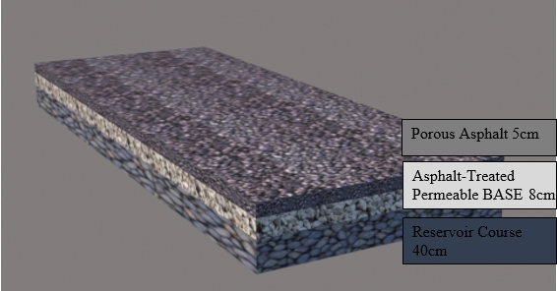
Conclusion
The best suitable design for porous asphalt layers was as follows (choker course layer, filter course layer and geotextiles were not used)

Slide 36
Conclusion
The application of porous asphalt saves the cost of construction and maintenance of the water drainage system, since it allows stormwater runoff to filter through the voids. However, porous asphalt must be vacuumed periodically twice a year to keep the pours opened, this leads to an increase in the maintenance cost.
The application of porous asphalt in the selected streets in the city of Nablus as an alternative to conventional asphalt has important economic benefits, as it saves about of 1,912,000 ILS for the return period of the study which is 20 years.
The results from the Environmental impact assessment concluded that the groundwater is recharged at a rate of 107,404.7 m³/year. This amount of water can satisfy that daily quota for capita needs in Nablus city for 7 days while generating upwards of 37,023,350 ILS per year for the government.

Slide 37
Recommendations
In future studies for Nablus, porous asphalt can be applied to areas outside this study’s area (with different soil types), using different methods such as partial infiltration, and using different designs for layers and thicknesses.
In the future, a more comprehensive study can be conducted to address the process and methods that can be used to make good use of the groundwater that is saved using porous asphalt.
In future studies, porous asphalt designs for high sloping streets can be explored in addition to a way to drain the runoff into a specific drainage system.
In future studies, economic feasibility of using a water drainage system in porous asphalt can be calculated, as it is possible that the cost of the saved collected water can cover the cost of establishing the drainage network.

