Slide 1
Assessment of AL-Hag Qasim School in Tulkarm
(Quantity Survey and Cost Estimate)
Prepared by :
Mo'men Harashi
Mohammad Khader
Laith Daqa
Under supervision of: Eng. Reema Nassar

Slide 2
Title and Content Layout with List
What is project management system
Project life cycle
Methodology
Quantity survey
Delivery system
Contracts
Project introduction
Quantities Surveying Using Revit Software
BOQ
Time Schedule Using Primavera Software

Slide 3

What is Project Management System

Slide 4

Project life Cycle
The basic faces of scheduling are :
Planning
Scheduling
Monitoring

Slide 5
Methodology
Quantity survey using Revit software
Time schedule using Primavera software

Slide 6

Quantity Survey

Slide 7

Quantity Survey
Importance of quantity survey

Slide 8
Delivery System
Design-Bid-Build.
Design-Build.
Self Performance.
Professional Construction Management.

Slide 9

Contracts
Types of Contracts:
Lump Sum Contract.
Unit Price Contract.
Cost-Plus Contract.

Slide 10
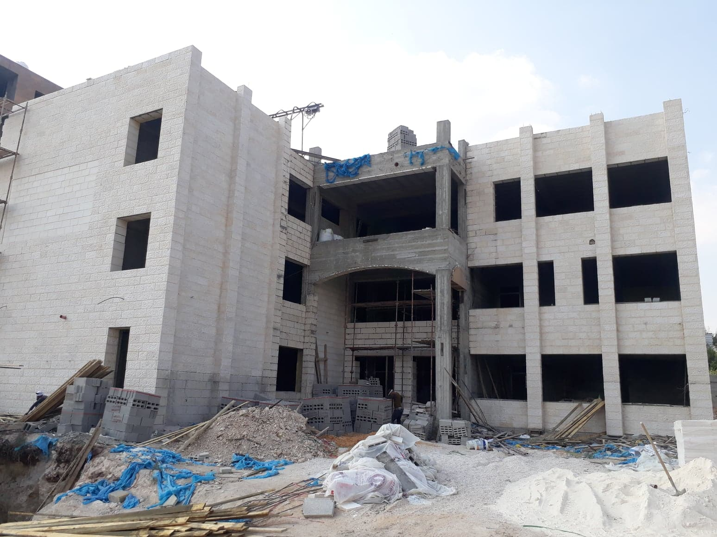
Project Introduction
Project delivery system:-
Design-Bid-Build.
Project contract:-
Unit price.

Slide 11

Quantities Surveying Using Revit Software

Slide 12
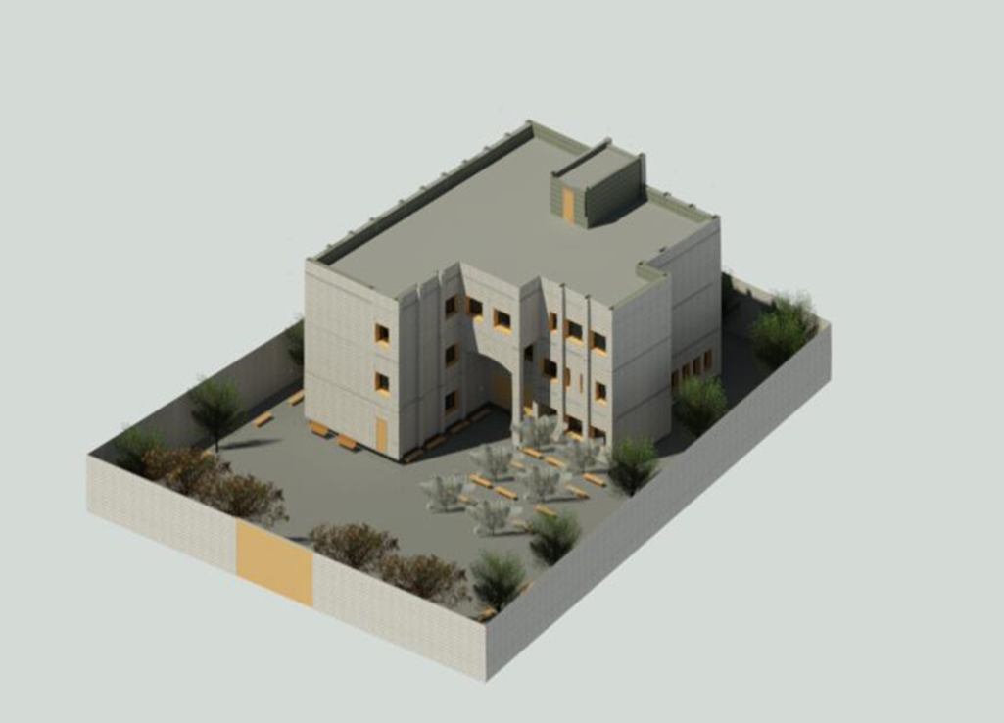
Architectural Model

Slide 13
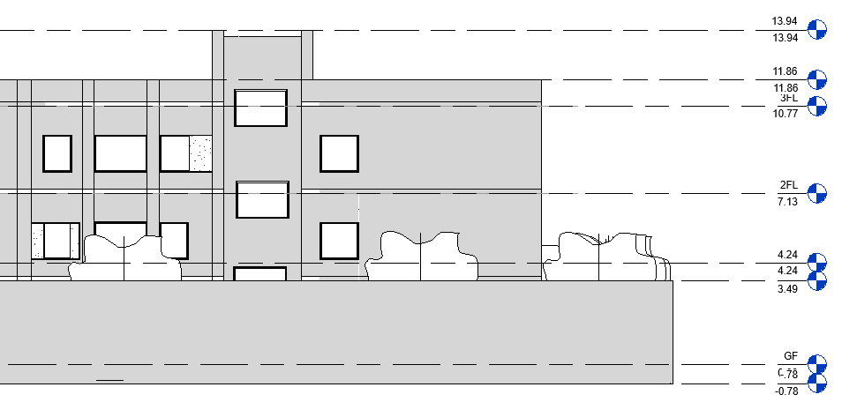
Levels

Slide 14
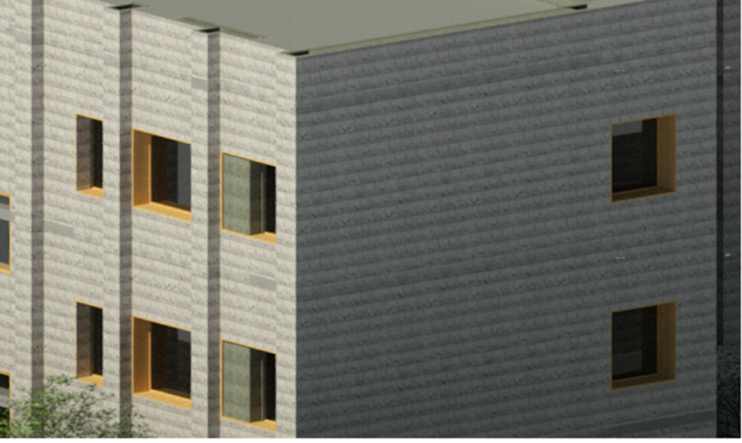
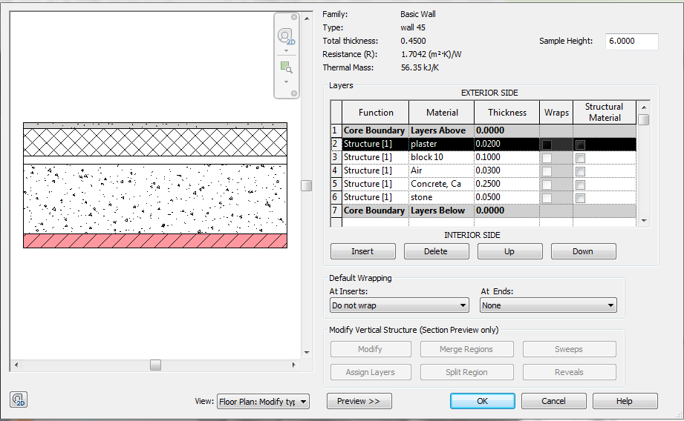
Walls
Exterior Walls

Slide 15
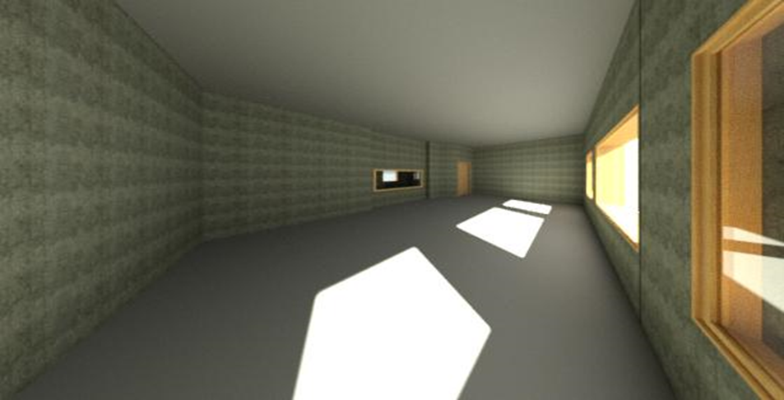
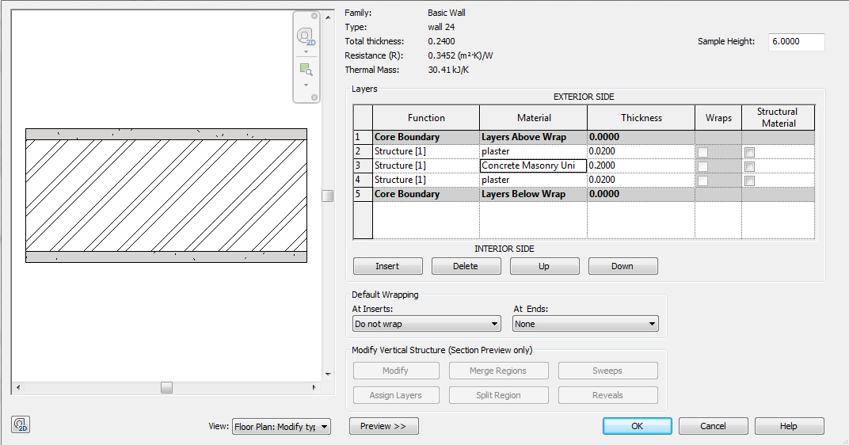
Walls
Interior Walls

Slide 16
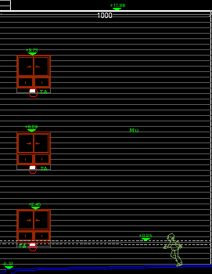
Sample calculation for stone quantity :
12.1 * 10 = 121 m^2
121 + 3( 1.6*1.56)= 113.5m^2

Slide 17
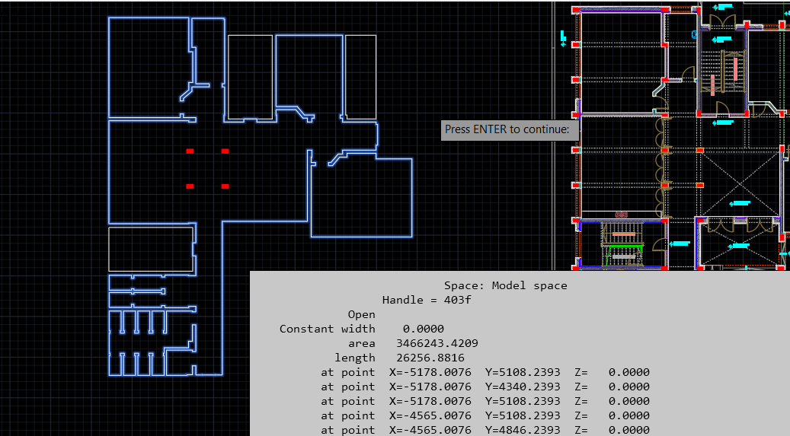
Sample calculation for tiles quantity :
346.6 + 262.5*0.1 = 372.85 m^2

Slide 18
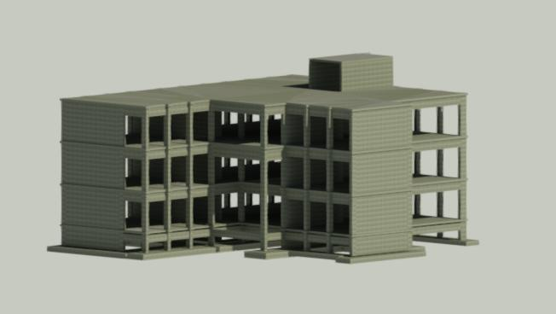
Structural Model

Slide 19
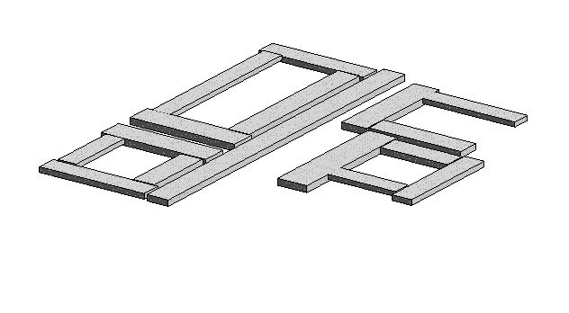
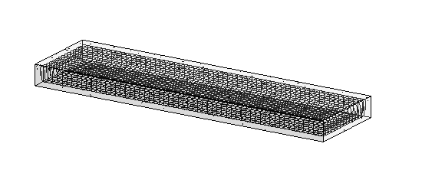
Footing

Slide 20
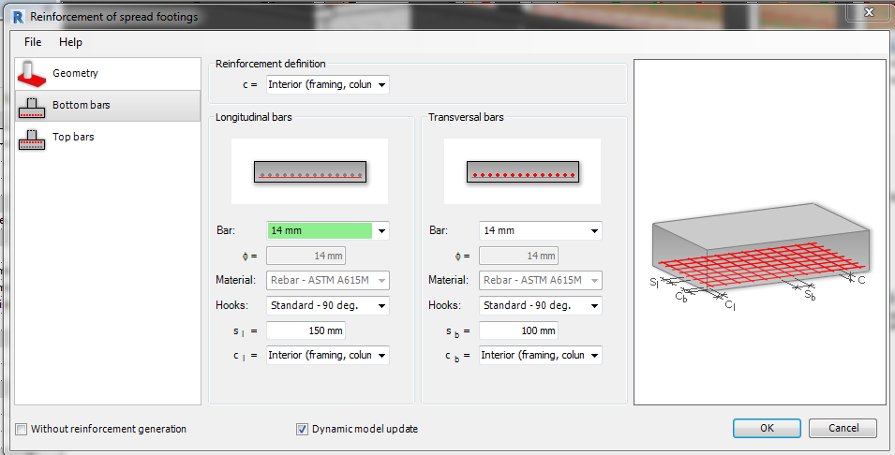

Slide 21
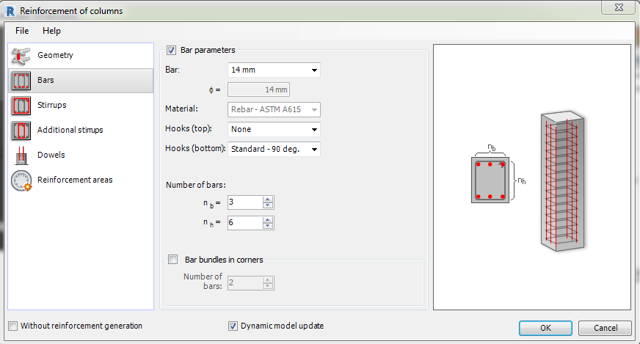
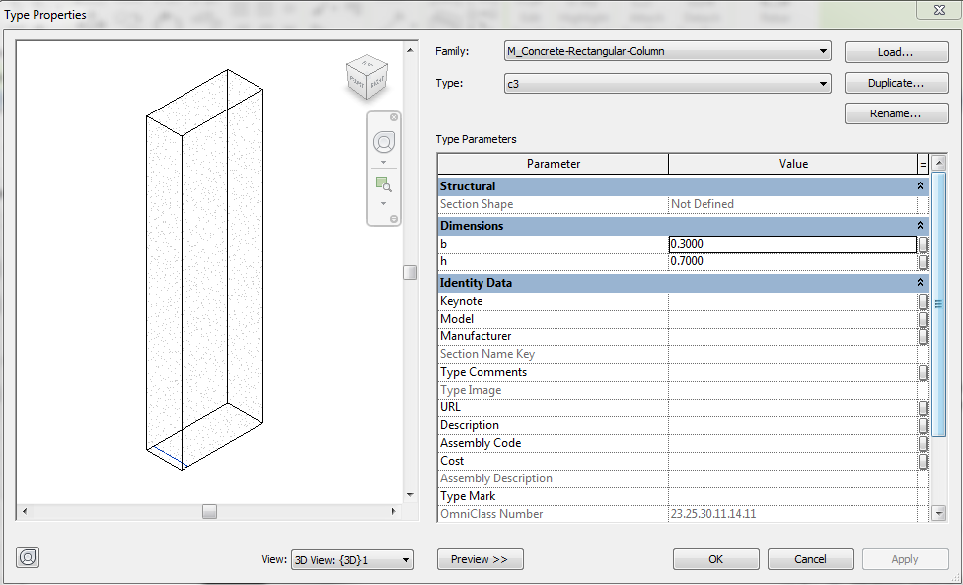
Columns

Slide 22
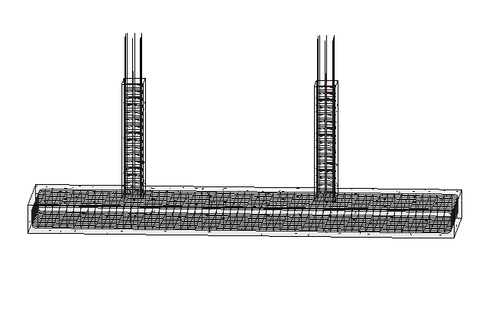
Column neck

Slide 23
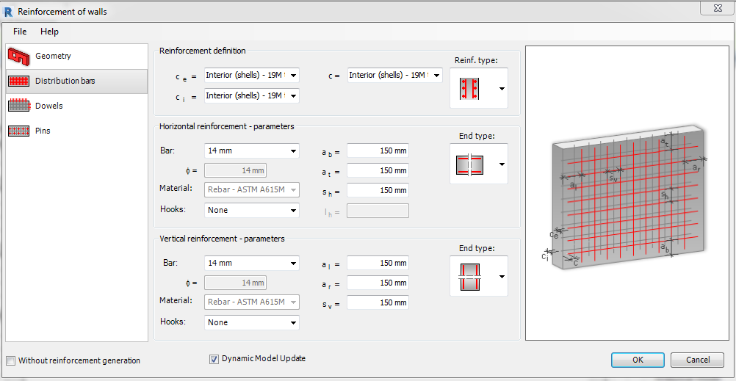
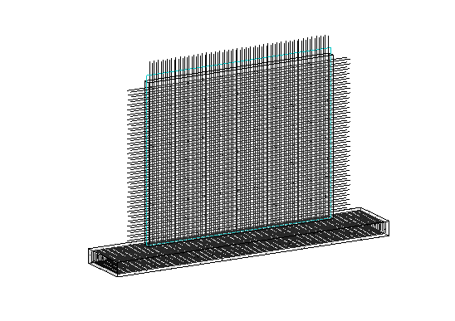
Shear walls

Slide 24
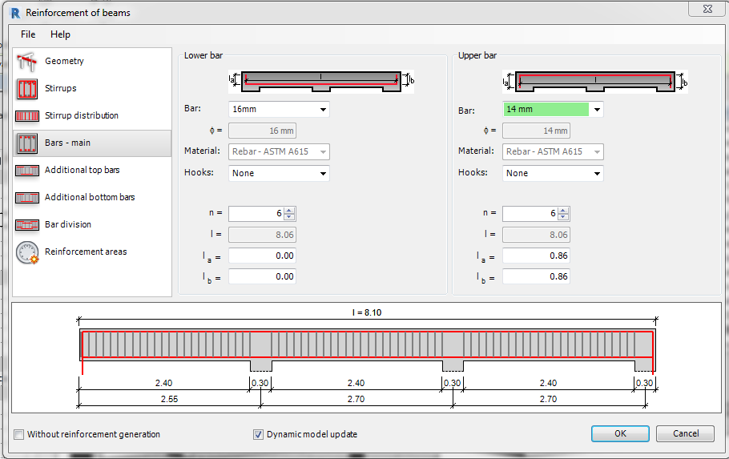
Beams

Slide 25
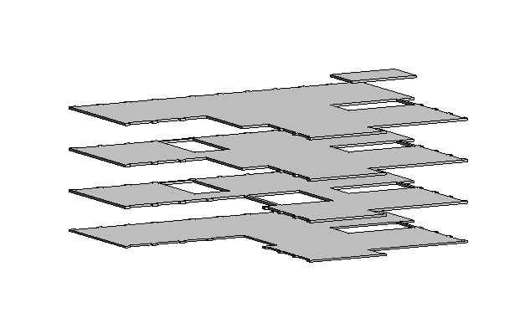
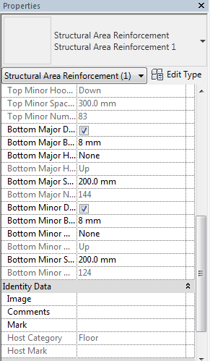
Slabs

Slide 26
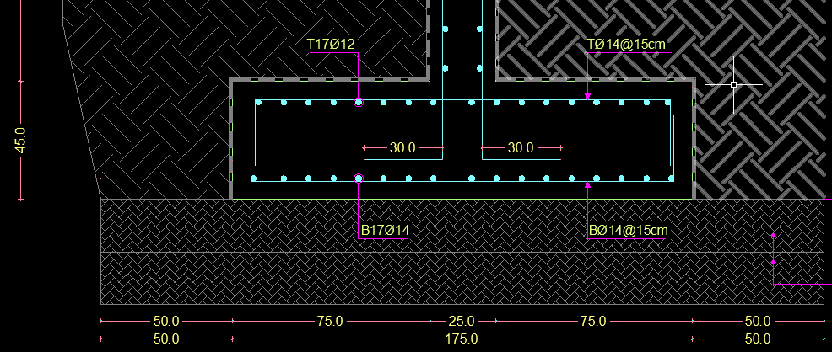
Sample calculation for footing :
Volume of concrete = 9.3*1.75* 0.45 = 7.35 m^3
D | # | L | D2/162 | W (Kg)
ꬾ14 | 17 | 9.3 | 1.2 | 191.3
ꬾ14 | 62 | 2.35 | 1.2 | 176.3
ꬾ12 | 17 | 9.35 | 0.889 | 140.5
ꬾ14 | 62 | 2.35 | 1.2 | 175
Total | 683.1kg

Slide 27
Total Result
Name | Quantity
Stone (m²) | 1250
Concrete (m³) | 1030
Steel (ton) | 97
Block 7cm (M.S) | 32
Block 10cm (M.S) | 851
Block 15cm (M.S) | 4
Block 20cm (M.S) | 327
Tiles(M.S) | 1265
Plaster (m²) | 3679
Paint (m²) | 3679
Ceramic | 230

Slide 28
BOQ
ITEM | DESCRIPTION | UNIT | QUANTITY | RATE | AMOUNT
NO. |  |  |  | US$ | US$
 | Excavation, & Back filling
1.01 | Excavation for foundations. | M.C | 1265 | 10 | 12650
1.02 | Supply and Well Compact Base Coarse. | M.S | 500 | 10 | 5000
 | TOTAL |  |  |  | 17650

Slide 29
ITEM | DESCRIPTION | UNIT | QUANTITY | RATE | AMOUNT
NO. |  |  |  | US$ | US$
 | SKELETON WORKS. CONCRETE WORKS.
 | Supply and Cast Plain Concrete;
2.01 | Supply and Cast Reinforced Concrete Grade 'B 300' Foundations and Wall Footings. | M.C | 157 | 211 | 33127
2.02 | Supply and Cast Reinforced Concrete Grade 'B 300'.
 | Tie Beams. | M.C | 56 | 275 | 15400
2.03 | Supply and Cast Reinforced Concrete Grade 'B 300' for:
 | a). Stairs. | M.C | 22 | 292 | 6424
 | b). Reinforced Shear . | M.C | 316 | 240 | 39120
2.04 | Supply and Cast Reinforced Concrete Grade 'B 300' for the Columns. | M.C | 78 | 258 | 22446
2.05 | Supply and Cast Reinforced Concrete Grade 'B 300' for the ground floor | M.S | 463 | 75 | 34725
2.06 | Supply and Cast Reinforced Concrete Grade 'B 300' for the first floor | M.S | 410 | 75 | 30750
2.07 | Supply and Cast Reinforced Concrete Grade 'B 300' for the second floor | M.S | 464 | 75 | 34800
2.08 | Supply and Cast Reinforced Concrete Grade 'B 300' for the third floor | M.S | 486 | 75 | 36450
2.09 | Supply and Cast Reinforced Concrete Grade 'B 300' for the stair | M.S | 25 | 75 | 1875
 | TOTAL |  |  |  | 256216
 | TOTAL CARRIED TO SUMMARY |  |  |  | 273866

Slide 30
Sample calculation for stone works:
{(110*1248)+(75*1248) +(0.23*290*1248)}*1.15 = 103584 $
ITEM NO. | DESCRIPTION | UNIT | QUANTITY | RATE | AMOUNT
 |  |  |  | US$ | US$
3 | SKELETON WORKS. STONE WORKS. | M.S | 1248 | 83 | 103584
 | TOTAL CARRIED TO SUMMARY |  |  |  | 376202

Slide 31
Summary
Item | Discription | Total (Us$)
Bill no.1 | Excavation, Back filling | 17650
Bill no.2 | CONCRETE WORKS. | 256216
Bill no.3 | STONE WORKS. | 103584
Bill no.4 | CONCRETE BLOCK WORKS. | 31297
Bill no.5 | PLASTERING. | 36790
Bill no.6 | TILING WORKS | 45550
Bill no.7 | CARPENTRY AND JOINERY WORKS | 27410
Bill no.8 | STEEL AND ALUMINUM WORKS | 47600
Bill no.9 | PAINTING WORKS | 22074
Total price |  | 588171$

Slide 32

Time Schedule Using Primavera Software

Slide 33
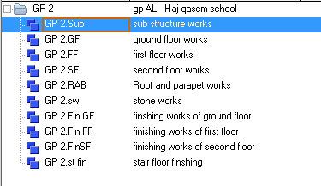
Work Breakdown Structure (WBS)

Slide 34
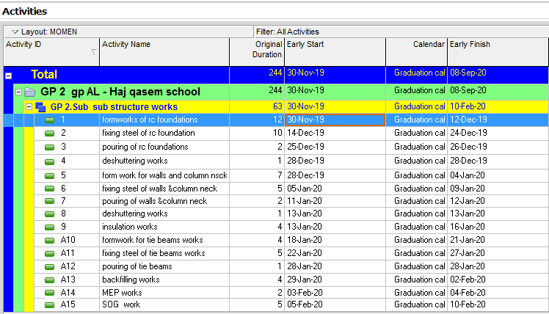
Activities

Slide 35
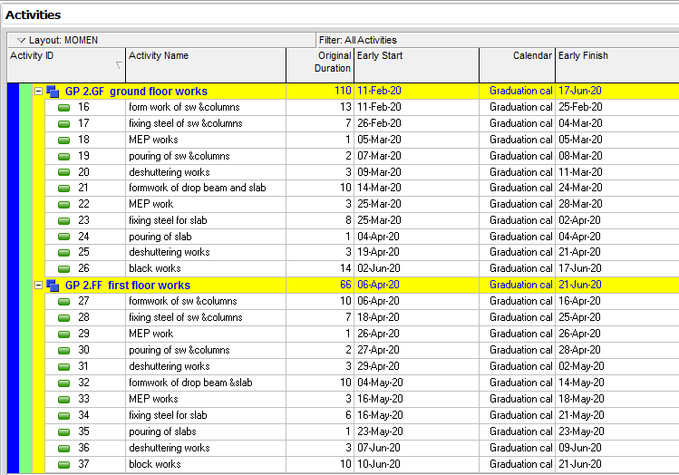

Slide 36
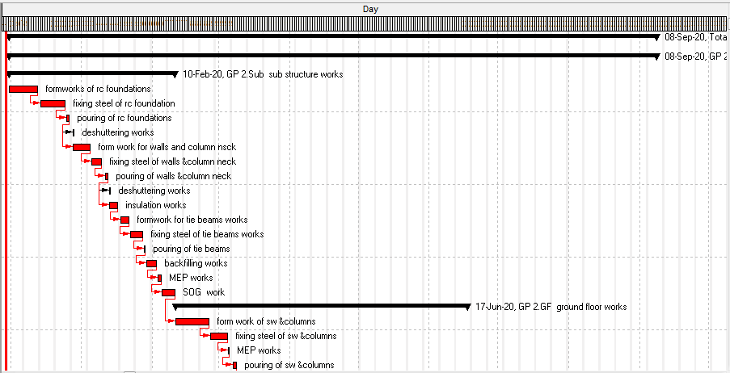
Time Schedule (Bar chart)

Slide 37
Summary
After contacting with contractors who implement the structure, the total price was 588171$
during 244 calendar day.

Slide 38


