Slide 1
AN-Najah National University
faculty of Engineering
Mechanical Engineering Departement
Geothermal process
in Mechanical Building system
Supervisor :
Dr. Iyad Assaf
Mohammed Itmazeh
Omar Rizq-Allah Salem
Rafat Basheer
Osaid M. Assaf

Slide 2
Objective
Comparison between traditional system(Chiller Boiler system) and geothermal system

Slide 3
Outline
Building description
Heating and cooling system
Geothermal system
Geothermal design
Plumping and fire fighting system
Cost analysis

Slide 4
Building description
The tower is located in the suburb of basil in the city of Ramallah
which rises from the sea 874 meters above sea level
within longitude 35.20 east and 31.902 north latitude and wind speed reaches 18.5 meters per second

Slide 5
Building description cont.
Inside and Outside Design condition:
Parameters | T_{in} | T_{out} | Φ_{in} | Φ_{out} | w_{in} | w_{out} | T_{un} | T_{ground}
Winter | 23 | 4.7 | 50% | 68% | 9 | 3.8 | 13.85 | 10.7
Summer | 25 | 30 | 50% | 60% | 10 | 13 | 28.33 | 35

Slide 6
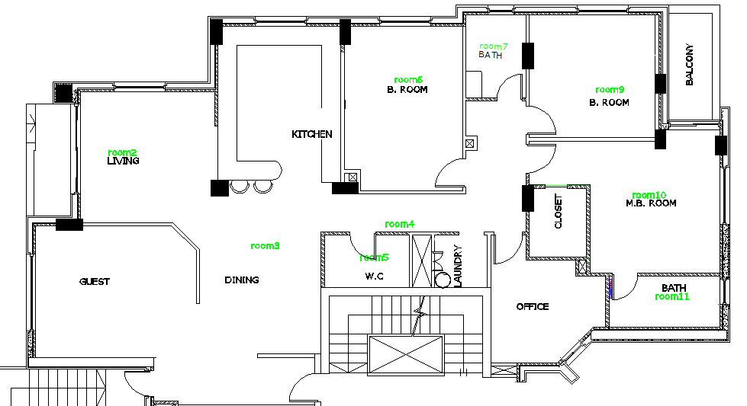
Building description cont.

Slide 7

Overall heat transfer coefficient U_{overall.}
According to equations
R _{total} = R_{i}+ R+ R_{o}
R= ∑ $\frac{x}{k}$
U= $\frac{1}{Rtot}$

Slide 8
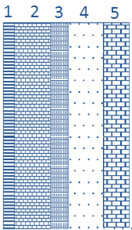
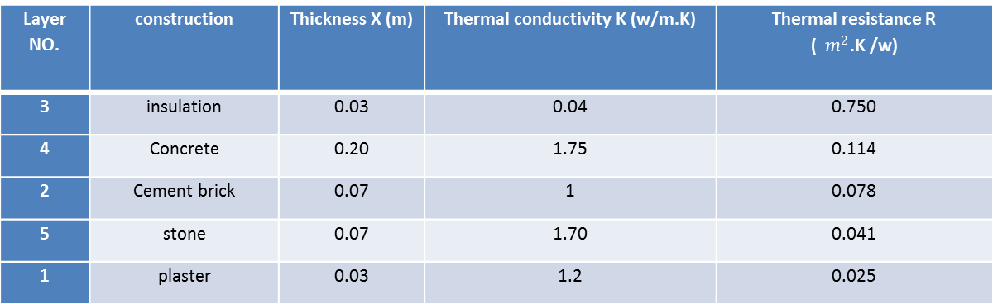
For external wall
R_{o}= 0.03 m². Cº/W
R_{i}= 0.12 m­².Cº/W
U=0.8692 W/m².k
Layer NO. | construction | Thickness X (m) | Thermal conductivity K (w/m.K) | Thermal resistance R ( $m^{2}$.K /w)
3 | insulation | 0.03 | 0.04 | 0.750
4 | Concrete | 0.20 | 1.75 | 0.114
2 | Cement brick | 0.07 | 1 | 0.078
5 | stone | 0.07 | 1.70 | 0.041
1 | plaster | 0.03 | 1.2 | 0.025

Slide 9
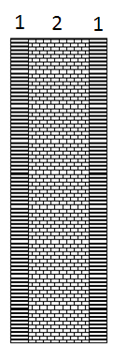
For internal wall
R_{o}= R_{i} = 0.12 m­².Cº/W
U=2.05 W/m².k
 | Construction | Thickness[m] | Thermal conductivity k[w/m.k)
1 | Plaster | 0.02 | 1.2
2 | Cement brick | 0.2 | 0.95

Slide 10
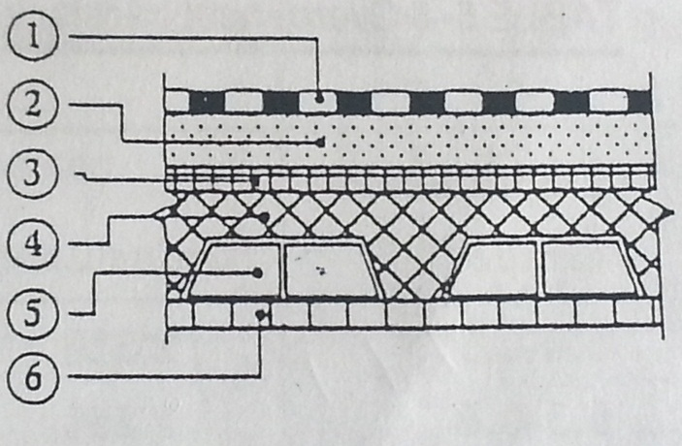
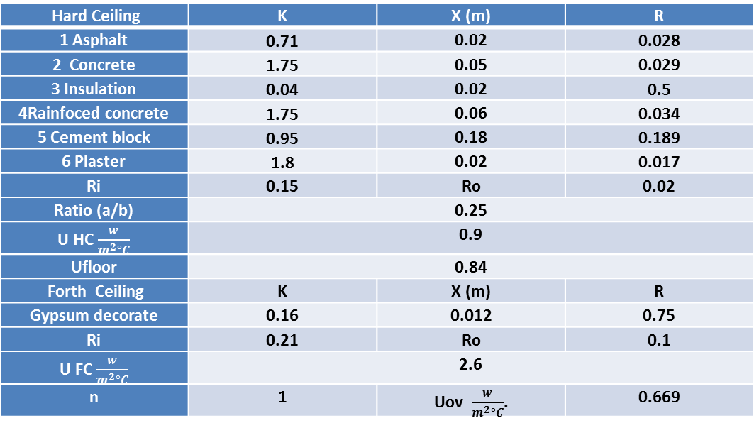
Ceiling and floor
Hard Ceiling | K | X (m) | R
1 Asphalt | 0.71 | 0.02 | 0.028
2 Concrete | 1.75 | 0.05 | 0.029
3 Insulation | 0.04 | 0.02 | 0.5
4Rainfoced concrete | 1.75 | 0.06 | 0.034
5 Cement block | 0.95 | 0.18 | 0.189
6 Plaster | 1.8 | 0.02 | 0.017
Ri | 0.15 | Ro | 0.02
Ratio (a/b) | 0.25
U HC $\frac{w}{m^{2}°C}$ | 0.9
Ufloor | 0.84
Forth Ceiling | K | X (m) | R
Gypsum decorate | 0.16 | 0.012 | 0.75
Ri | 0.21 | Ro | 0.1
U FC $\frac{w}{m^{2}°C}$ | 2.6
n | 1 | Uov $\frac{w}{m^{2}°C}$. | 0.669

Slide 11
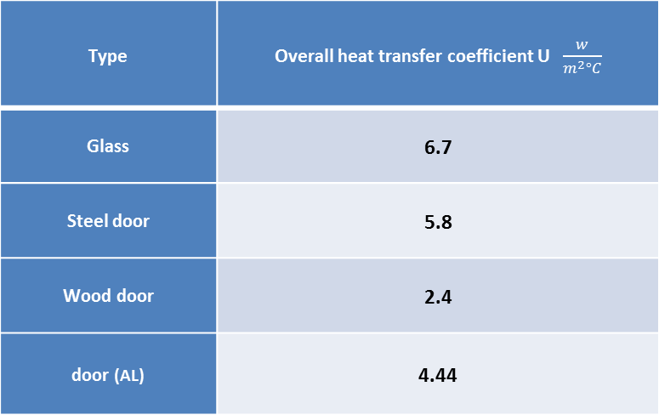
Windows And Doors
Type | Overall heat transfer coefficient U $\frac{w}{m^{2}°C}$
Glass | 6.7
Steel door | 5.8
Wood door | 2.4
door (AL) | 4.44

Slide 12
Heating load calculation Source
The heating load calculation begins with the determination of heat loss through a variety of building for components and situations.
Walls
Windows
Doors
Ceiling & Floors
Infiltration Ventilation

Slide 13
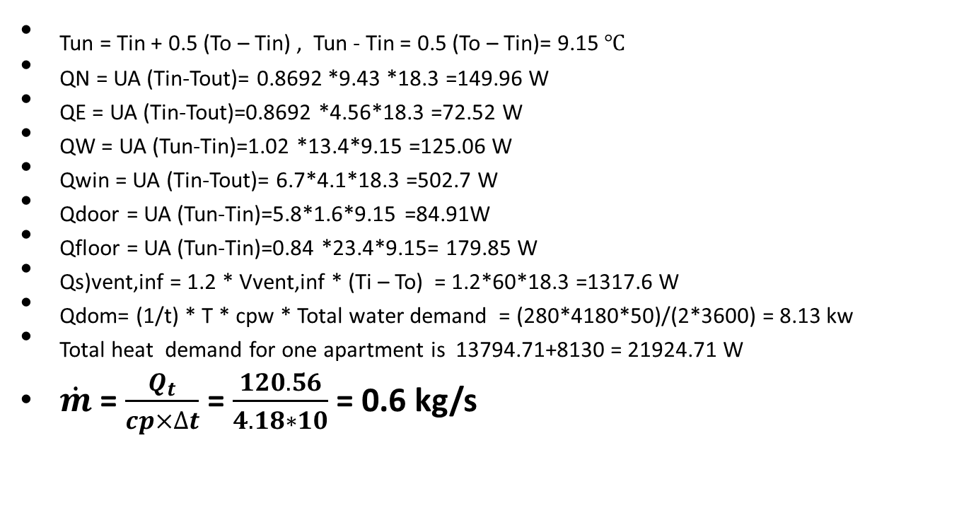
The Heat load Equation
Sample calculation for room 1

Slide 14
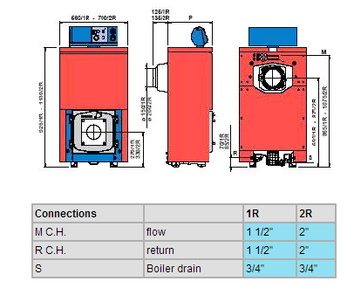
Boiler selection
Total heat demand for one apartment is 13794 +8130 = 21924.7 W
So the building is Residential Building (4 floor application-2 apartments for each level)
Qboiler =1.1(Qapt*4*2)
= 1.1*(21924.7*4*2)= 177.84 KW
The boiler was selected from The sime company ,Boiler model no# 2R10 (180 KW)

Slide 15
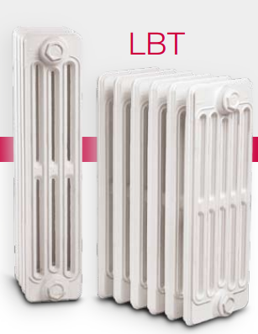
Radiators selection
LBT radaitors were selected according to effective cost, heating demand, availability
Model No# LBT 6/680
Output /section
192 W

Slide 16
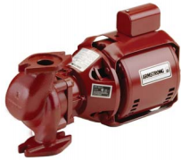

Pump selection
The total heating demond is 177.84 KW
flowrate =$\dot{m}= \frac{\sum{Q}}{cp∗ ∆T }$ =$\frac{177.84}{4.18∗10}=4.25 L/s$
the pump expected was S55 24.9 Kpa
Leqv =$L∗1.5$ = 50*1.5 = 75 m
Pump head = P = $\frac{pressure}{length}= \frac{25K}{75}$ = 333.3 Pa/m

Slide 17
Cooling load Source
Heat transfer (gain) through the building skin by conduction, as a result of the outdoor – indoor temperature difference.
Solar heat gain (radiation) through glass or other transparent materials.
Heat gains from Ventilation air and/or infiltration
Internal heat gain by occupants, light, appliances, and machinery.

Slide 18
Cooling Load equation :
For ceiling & walls :
Q=U*A*(CLTD)_{corr}
(CLTD)_{corr} = (CLTD + LM) K + (25.5 – Ti )+ (To – 29.4)
K=1 dark color
K=0.83 medium color
K=0.5 light color
For glass :
Q=A*(SHG)*(SC)*(CLF)
For people :
Q_{s}=q_{s}*n*CLF
q_{L}=q_{L}*n
For lighting :
Q_{s}=W*CLF
For equipments :
Q_{s}=q_{s}*CLF
Q_{L}=q_{L}

Slide 19
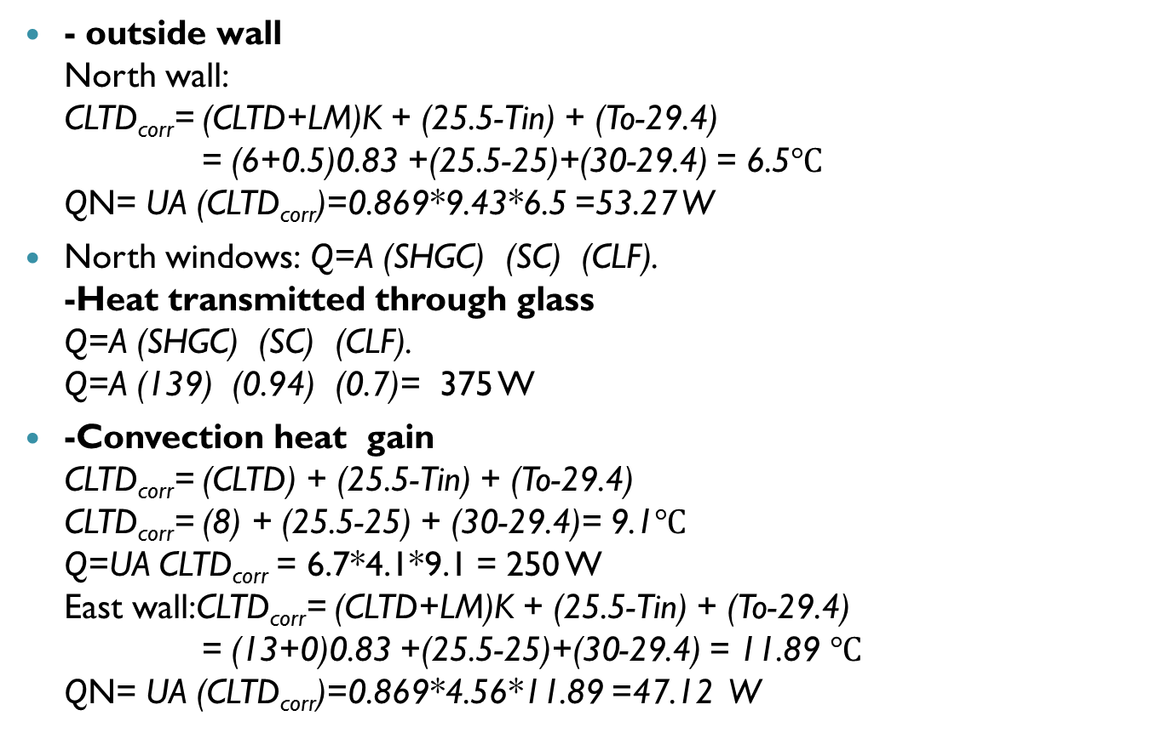
Cooling calculation sample calculation for room 1
- outside wall
North wall:
CLTD_{corr}= (CLTD+LM)K + (25.5-Tin) + (To-29.4)
= (6+0.5)0.83 +(25.5-25)+(30-29.4) = 6.5$℃$
QN= UA (CLTD_{corr})=0.869*9.43*6.5 =53.27 W
North windows: Q=A (SHGC) (SC) (CLF).
-Heat transmitted through glass
Q=A (SHGC) (SC) (CLF).
Q=A (139) (0.94) (0.7)= 375 W
-Convection heat gain
CLTD_{corr}= (CLTD) + (25.5-Tin) + (To-29.4)
CLTD_{corr}= (8) + (25.5-25) + (30-29.4)= 9.1$℃$
Q=UA CLTD_{corr} = 6.7*4.1*9.1 = 250 W
East wall:CLTD_{corr}= (CLTD+LM)K + (25.5-Tin) + (To-29.4)
= (13+0)0.83 +(25.5-25)+(30-29.4) = 11.89 $℃$
QN= UA (CLTD_{corr})=0.869*4.56*11.89 =47.12 W

Slide 20
Cooling calculation cont.
Inside wall
West wall
QW= UA (T_{un}-T_{in})=1.05 *13.4*3.33 =46.85 W
West door
QW= UA (T_{un}-T_{in})=5.8 *1.6*3.33=30.9 W
Ventilation and Infiltration Calculation.
V_{inf} = 16.1 L/s
V_{vent} = 60 L/s
Qs)_{vent,inf} = 1.2 * V_{vent,inf} * (T_{i} – T_{o}) = 1.2*60*5 = 270 W
QL)_{vent,inf} = 3 * V_{vent,inf} * (w_{i} – w_{o}) = 3*60*3 = 540 W
People
QL= n q = 10*30 =300 W
Qs= n q (CLF)=10*70*0.33= 532 W
Equipment(TV, Laptops)
Qs= n q (CLF)=2*100*0.65= 130 W
Qs= n q (CLF)=1*150*0.65=97.5W
Lighting
Qs= n q (CLF)=4*35*0.77=107.8
Total cooling load for room1 is 2804.17 W

Slide 21
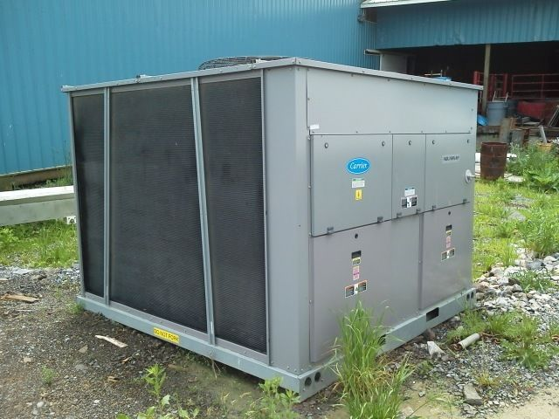
Chiller selection
Total cooling load is 131.05 KW
➔ chiller capacity = 131.05*1.1 =144.11Kw = 41.17 T.R
The Chiller was selected from Carrier company
Model No. 30RAP AQUASNAP unit 050
with capacity of 43.1 T.R

Slide 22

Pump selection
The total cooling load is 131.05 KW
flowrate =$\dot{m}= \frac{\sum{Q}}{cp∗ ∆T }$ = $\frac{144}{6∗4.18}= 5.22 L/s$
Leqv =$L∗1.5$ = 51*1.5 = 76.5 m
Pump was selected as S55 19.1 KPa ( as shown in Chapter 7)
Pump head = P = $\frac{pressure}{length}= \frac{19.1}{76.5}$ = 249.7 Pa/m
Armstrong company Model No. S55

Slide 23
Geothermal system

Slide 24
Introduction:
Heat from the earth can be used as an energy source in many ways form large and complex power station to small and relatively simple pumping system .This heat energy known as geothermal energy, Then thermal energy is generated and stored in the Earth and determines the temperature that converted to an energy that used for cooling and heating.

Slide 25
Type of Geothermal Exchange Systems:
Open loop Geothermal Exchange System.
Closed loop Geothermal Exchange System.

Slide 26
Open loop Geothermal Exchange System:
An open loop system is quite uncommon due to the fact that it relies on a nearby body of water.
The water from the body of water flows (underground) to the heat exchanger in the heat pump and then back out again.
More efficient than a closed loop system.

Slide 27
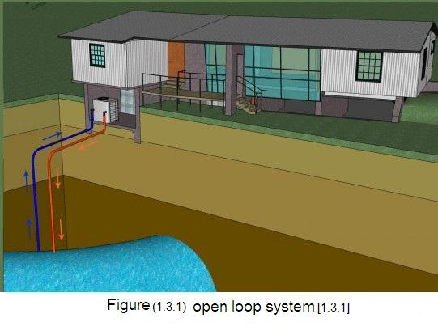

Slide 28
Closed loop Geothermal Exchange System:
A closed loop system is the most common type of geothermal exchange system simply because it does not require a nearby body of water to pull from.
Has two different types.

Slide 29
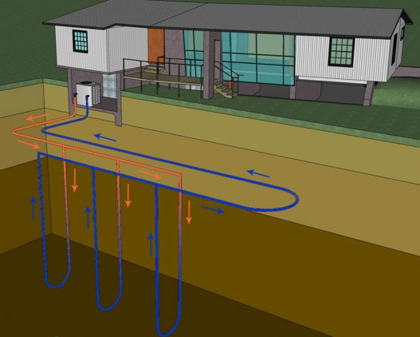
1. Vertical loop system:
This type is ideal for area is limited and the depth of drilled holes between 46 to 138 m.
More expensive than the horizontal type, due to more depth of the well holes.

Slide 30
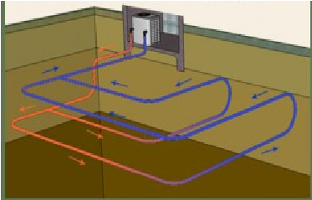
2. Horizontal loop system:
This type is the most Popular and most cost effective Of all geothermal exchange System, and require the Depth at least 2.5m.

Slide 31
Geothermal in heating and cooling
Using the geothermal in heating and cooling is more possible to implement due to the low cost, in comparison with using it in producing energy.
The cooling and heating geothermal system does not need very high temperature so that the wells is not as deep as the depth in the producing energy(about 150m underground).

Slide 32
Geothermal design

Slide 33
Steps GSHP design
1- Building load:
heating load = 104 KW
cooling load = 131 KW
2- GSHP system:
The available land for this project will be considered to suit the vertical system only (because is not enough for the horizontal system).

Slide 34
3- Selection Pump:
The selection of heat pump needs the following parameter:
1- Type of the system(open, close, etc)
2- Building load
3- The required of a Coefficient of Performance(COP)
4- Pump characteristics(water to air, water to water)
In this project, we select water to air heat pump.

Slide 35
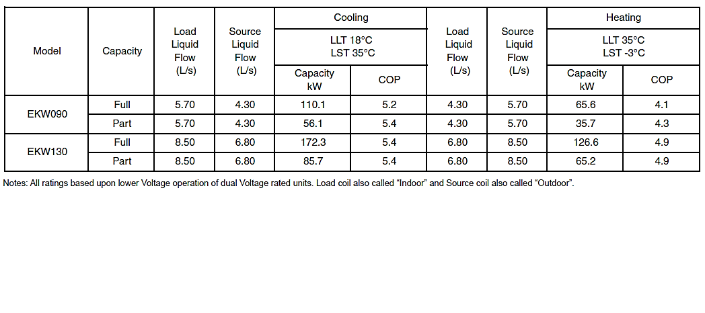
For our building (131KW cooling & 104KW heating)
EKW130 is enough to cover the building

Slide 36
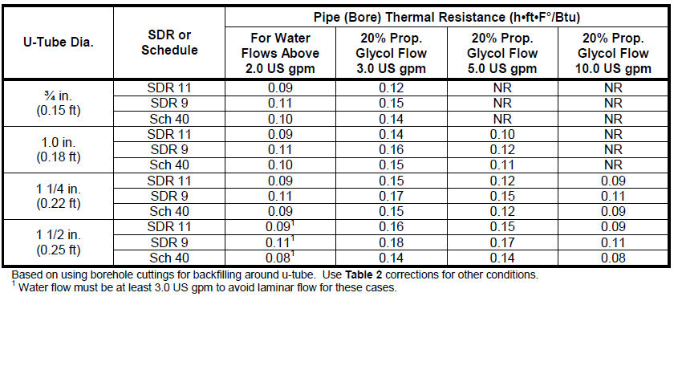
4- pipe properties:
Equivalent Diameters and Thermal Resistances for Polyethylene U-Tubes
this table show the thermal resistance and pipe size
the flow rate should be at least 2.0 gpm for ¾” through 1 ¼” pipe, and at least 3.0 gpm pipe.

Slide 37

5- Estimation of pipe length:
We have two methods to estimate pipe length:
Method 1:
The required GHX length based on heating requirements, L_{h} is:
Wehre q_{heat} : the load liquid flow for the heating
COP_{h}: the design heating coefficient of performance (COP)
of the heat pump system.
R_{p}: the pipe thermal resistance.
R_{s}: the soil/field thermal resistance.
F_{h}: the GHX part load factor for heating.
T_{g,min}: the minimum undisturbed ground temperature.
T_{ewt,min}: the minimum design entering water temperature
(EWT) at the heat pump.

Slide 38

The required GHX length based on cooling requirements, L_{c} is:
Where q_{cool} : the load liquid flow for the cooling
COP_{c}: the design cooling coefficient of performance (COP) of the heat pump system.
R_{p}: the pipe thermal resistance.
R_{s}: the soil/field thermal resistance.
F_{c}: the part load factor for cooling.
T_{g,min}: the maximum undisturbed ground temperature.
T_{ewt,min}: the maximum design entering water temperature at the heat pump

Slide 39
Method 2:
For horizontal and vertical systems given the following:
Vertical, all configurations:
L= 21m/KW (73m/ton)
Horizontal, all configuration:
L= 37m/KW(130m/ton)

Slide 40
Results:
Tg = 19ºC (on the depth of hole is 110m)
T_{ewt,min} = -6.7 ºC
T_{ewt,max} = 92.2 ºC
R_{p} = 0.4 m².ºC/W
Rs = 1 m².ºC/W
From the heat pump catalogue we have :
For heating
COP = 4.9
Flow rate = 6.8 L/s
For cooling
COP = 5.4
Flow rate = 8.5 L/s

Slide 41
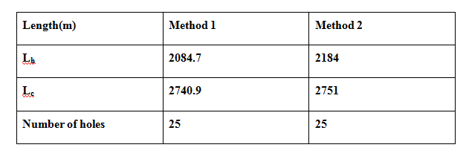
This table show the results of the two method:
6- land required:
Each borehole needs to be 2 meters away from the other, This distance will be enough to diffuse the heat from the ground.
Area = 2(m)* number of hole =2*25=50m²

Slide 42
Duct Design and Fan-coil unit system

Slide 43

Sample of calculation for number of diffusers:
For the room 1

Slide 44

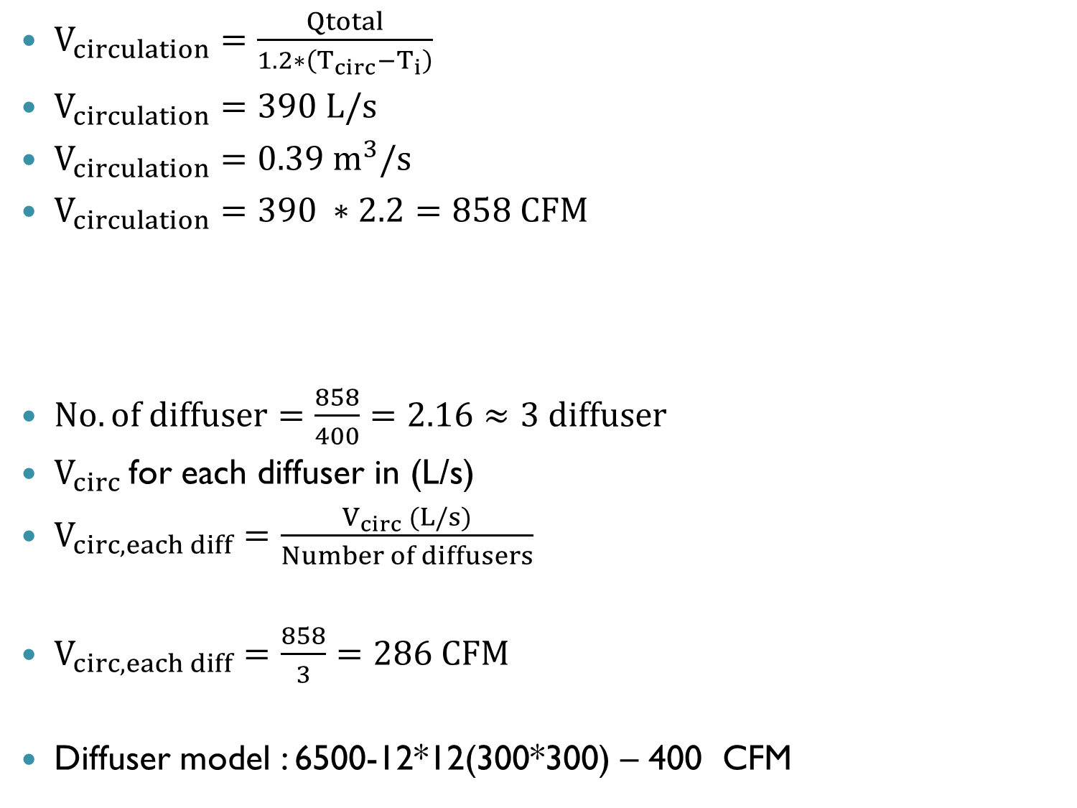
$V_{circulation}=\frac{Qtotal}{1.2∗\left(T_{circ}−T_{i}\right)}$
$V_{circulation}=390 L/s$
$V_{circulation}=0.39 m^{3}/s$
$V_{circulation}=390 ∗2.2=858 CFM$
$No.of diffuser=\frac{858}{400}=2.16≈3 diffuser$
$V_{circ}$for each diffuser in (L/s)
$V_{circ,each diff}=\frac{V_{circ} (L/s)}{Number of diffusers}$
$V_{circ,each diff}=\frac{858}{3}=286 CFM$
Diffuser model : 6500-12*12(300*300) – 400 CFM
$$Number of diffuser=\frac{V_{circ}\left(CFM\right)}{400}$$

Slide 45

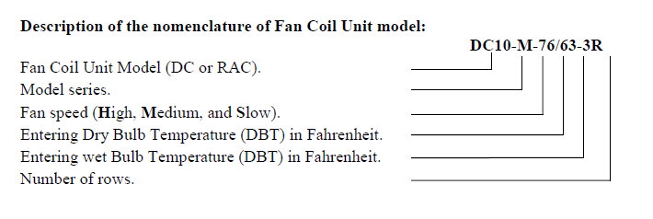
Fan coil unit selection.
For multipurpose room (Room 1) in the ground floor:

Slide 46
Table (5.2): The equal pressure method for sizing
Room 1 | Duct | v' m³/s) | v(m/s) | A(m²) | D (m) | p/L(pa/m) | H (mm) | W (mm)
 | AB | 0.39 | 5 | 0.096 | 0.35 | 0.9 | 200 | 280
 | BC | 0.13 | 4 | 0.049 | 0.25 | 0.9 | 200 | 280
 | BE | 0.13 | 4 | 0.049 | 0.25 | 0.9 | 200 | 280
 | BD | 0.13 | 4 | 0.049 | 0.25 | 0.9 | 200 | 280

Slide 47
Bath rooms duct dsign
For bath room1
Table (5.9): The equal pressure method for sizing
Bath 1 | Duct | v' m³/s) | v | A(m²) | D (m) | p/L(pa/m) | H (mm) | W (mm)
 | AB | 0.166 | 5 | 0.0314 | 0.20 | 1.7 | 200 | 219
 | BC | 0.0833 | 4.5 | 0.020 | 0.16 | 1.7 | 150 | 170
 | BD | 0.0833 | 4.5 | 0.020 | 0.16 | 1.7 | 150 | 170

Slide 48
Bath rooms and kitchen Exhaust fan selection.
Table (5.15): Exhaust fan electrical and mechanical data.
1 SPEED
TYPE= Centrifugal | CFM = 162 – 406 | VOLTAGE = 115
WEIGHT (lbs) = 30 | SONES @ ½ SP = 2.2 - 10.4 | MAX BHp =.95
HP = 100 WATT | SIZE = 6 | RPM =1250-2700
PHASE = 1 | MOTOR = TE | RPM RANGE =
DRIVE = Direct Drive | dB(A) = - | WARRANTY = 1 Year Motor
Exhaust Fan model
SP-SQD601AS

Slide 49
Plumping & Fire fighting System.
1 - potable water system
Plumbing also refers to a system of pipes and fixtures installed in a building for the distribution of potable water and the removal of waterborne wastes.
In our project the design of the pipes based on the flash tank type.
PVC were used for cold water services pipes in the building, and CPVC were used for hot water services pipes.

Slide 50
Sample of calculation :
Supply hot water pipes design:
Branch name | Fixture unit | Flow(l/s) | ΔP/L(pa/m) | Diameter(in)
A-B | 8.5 | 0.84 | 900 | ¾”
B-C | 4.75 | 0.57 | 450 | ¾”
C-D | 3.25 | 0.44 | 800 | ½”

Slide 51
Supply hot water stack design:
Branch name | Fixture unit | Flow(l/s) | Δp(pa/m) | Diameter(in)
1-2 | 68 | 2.2 | 550 | 1 ¼”
2-3 | 34 | 1.55 | 150 | 1 ¼”
3-4 | 25.5 | 1.36 | 300 | 1”
4-5 | 17 | 1.16 | 320 | 1”
5-A | 8.5 | 0.84 | 700 | ¾”
2-6 | 34 | 1.55 | 150 | 1 ¼”
6-7 | 25.5 | 1.36 | 300 | 1”
7-8 | 17 | 1.16 | 320 | 1”
8-A | 8.5 | 0.84 | 700 | ¾”

Slide 52
pump calculation.
for hot water .
(ΔP)pump = (ΔP)head + (ΔP) friction ,fitting + (ΔP) flow
(ΔP)head = 15*9.81 = 147.15 Kpa.
(ΔP) flow = 5 psi * 6.89 = 34.45 Kpa.
(ΔP) friction = ∑ (ΔP/L)*L = 77* 0.350 = 26.95 Kpa.
(ΔP) friction ,fitting = 26.95 *1.8 = 48.5 Kpa .
(ΔP)pump = (ΔP)head + (ΔP) friction ,fitting + (ΔP) flow
(ΔP)pump = 147.15 + 48.5 + 34.45 = 230 Kpa.
(ΔP)pump = (230/101.125) *14.7 = 33.5 psi.
Q pump = 2.2 (L/s)

Slide 53
Hot water pump selections:

Slide 54
for cold water .
(ΔP)pump = (ΔP)head + (ΔP) friction ,fitting + (ΔP) flow
(ΔP)pump = -39.24 + 28.8 + 34.45 = 24 Kpa.
(ΔP)pump = (24/101.125) *14.7 = 3.5 psi.
Q pump = 3.7 (L/s)
The size of the cold water tank = 3.7 * 30 min,*60 = 6660 = 6.66 m³. litre for a one day.
But tank size for a three days = 6.66 * 3 = 19.98 m³ , so select 20 m³.

Slide 55
for return hot water .
(ΔP)pump = (ΔP)head + (ΔP) friction ,fitting + (ΔP) flow
(ΔP)pump = 0 + 22+ 0 = 22 Kpa.
(ΔP)pump = (22/101.125) *14.7 = 3.2 psi.
Q pump = 1.32 (L/s).

Slide 56
2- Sanitary Drainage system.
Sanitary Drainage system is that system in which waste and soil are transferred to main sewer line or other sewage system.
Used fixture.
Bathtub
Lavatory
Water closet (wc).
Kitchen sink.

Slide 57
Drainage pipe sizing.
To determine drainage pipe size tow factor govern the size.
1-Number of fixture unit.
2-Self clean velocity.
Table (6.7): kitchen.
Used fixture | Equivalent Fixture unit | Branch line to floor drain (in) | Floor drain to stack (in) | Vent size (in) | Stack size (in)
Kitchen sink | 2 | 2” | 4” | 4” | 4”
Dish washer | 2 | 2”
floor drain | 6 | -

Slide 58
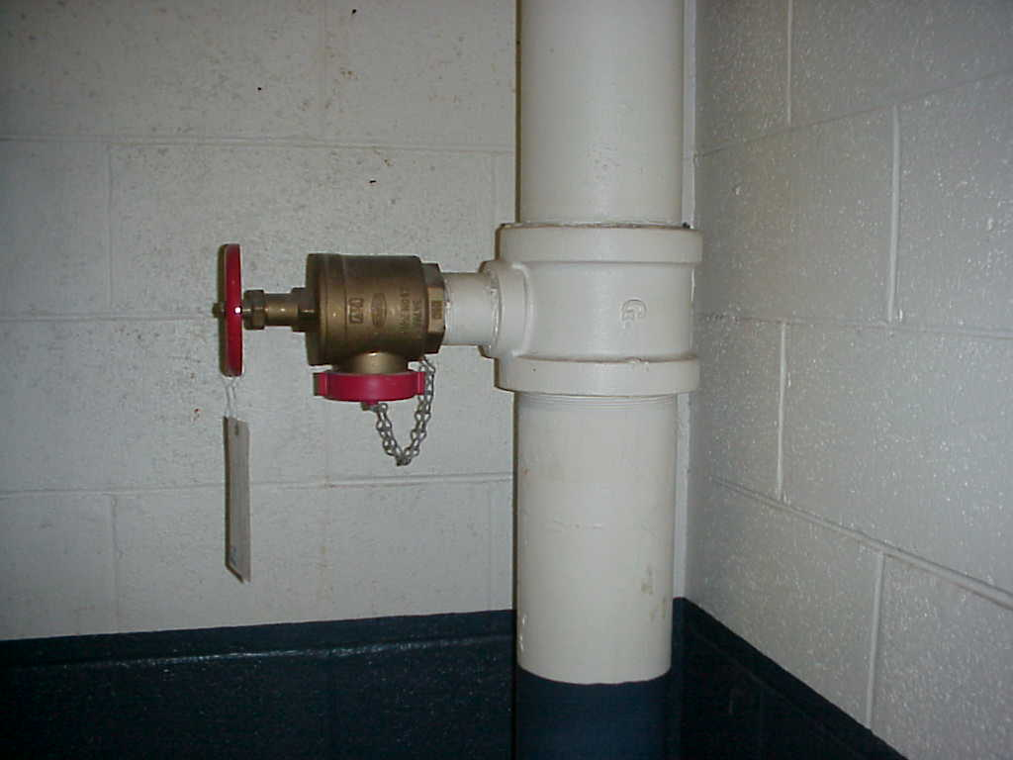
3 - fire fighting system
Fire protection is the study and practice of managing the unwanted effects of fires.
Standpipe system
A standpipe is a type of rigid water piping which is built into multi-story buildings in a vertical position.
the diameter of the risers is
usually (4’’), and for the line
which goes to the landing valve is
(2.5’’) .

Slide 59
Fire fighting pump calculation.
The total pressure drop due to friction = 14.8 psi
The total pressure drop in pipes and fittings = 1.8 *14.8 = 26.6 psi
Δp due to head = 12*9.81 = 117.72 Kpa = 17 psi.
Δp due to flow = 100 psi
Total head for the pump = 26.6 + 17 + 100 = 144 psi .
The jockey pump pressure is 149 psi, and its flow rate is 7. 5 gpm.
Tank capacity:
Total demand=750 gallon/min = 750* 3.8*90*10⁻³ = 257 m³
standard size of tank by calculation the tank size should be 260 m³

Slide 60
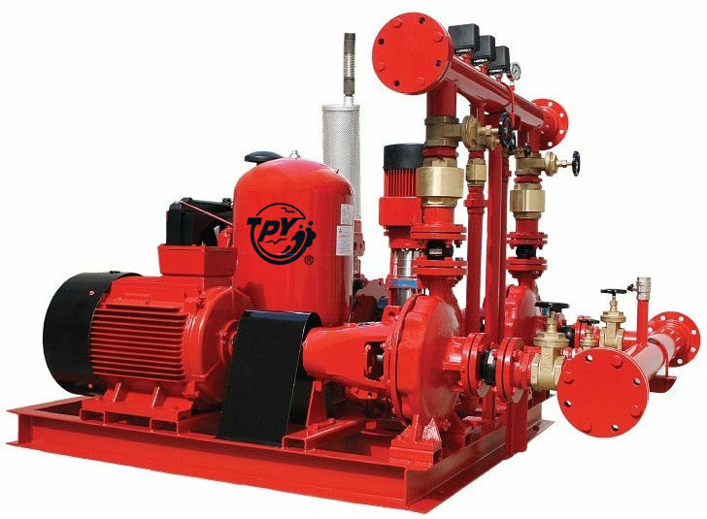
firefighting pump selection:
Total head for the pump = 144 psi .
flow rate = 750 gpm.

Slide 61
Cost Analysis

Slide 62
Cost analysis
Normal System:
1. Initial cost:
The mechanical room that needed for (104.43)KW heating will has a 1300 $ initial cost.
The chiller required for (131.05)KW cooling has a 44000 $ cost.
Initial cost = (1300) + (44000) = (45300)$

Slide 63
Cost Analysis
Normal System:
2. Running cost:
Heating cost:
By using the Daily Average Method
$$m_{f=\frac{Q ×3600 ×DD ×8 ×Cd }{\left(T_{o− T_{i}}\right)×CV ×eff}}$$
Where:
$m_{f}$ = mass of fuel consumed.
Q = required heating load Kwh.
Cd = empirical correction factor for heating effect versus degree.
CV = calorific value for fuel used for (diesel 39000 KJ/Kg).
eff = efficiency for (fuel 80%).
DD = degree-day for estimated period.

Slide 64
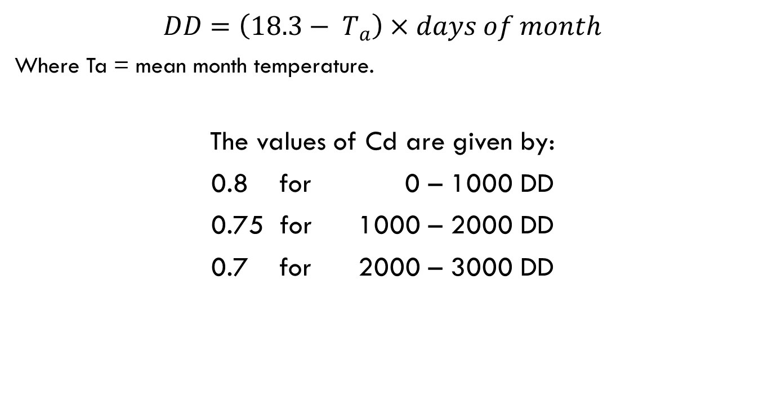
Cost Analysis
$DD=\left(18.3− T_{a}\right)×days of month$
Where Ta = mean month temperature.
The values of Cd are given by:
0.8 for 0 – 1000 DD
0.75 for 1000 – 2000 DD
0.7 for 2000 – 3000 DD

Slide 65
Cost Analysis
DD values of each month:
The Sum of DD is equal to 909.
$$m_{f= \frac{\left(104.43 ×3600 ×909 ×8 ×0.8\right)}{\left(22−5.7\right)×39000 ×0.8}=4300.6 Kg of diesel}$$
For a (2 $) cost of 1 letter, the running cost for heating is:
Rc = (2 $×$ 4300.6) = 8601 $
Month | 1 | 2 | 3 | 4 | 5 | 10 | 11 | 12
Mean temp. | 10.2 | 10.4 | 11.7 | 17 | 20.7 | 21.3 | 17.7 | 12.7
DD value | 251 | 221 | 205 | 40 | 0 | 0 | 18 | 174

Slide 66
Cost Analysis
Cooling cost:
Power consumed each hour:
 |  | Time Hr. | 11 | 12 | 13 | 14 | 15 | 16 | 17 | 18
 |  | Hour ratio | 0.7 | 0.73 | 0.75 | 0.78 | 0.8 | 1 | 0.8 | 0.85
Month | Month ratio
June | 1 | Power (KW) | 91.8 | 95.7 | 98.325 | 102.12 | 107.5 | 131.1 | 107.1 | 112.47
July | 0.84 |  | 76.8 | 80.04 | 82.25 | 85.56 | 89.7 | 109.7 | 89.64 | 93.84
August | 0.78 |  | 71.58 | 74.52 | 76.73 | 80.04 | 83.83 | 102.12 | 83.56 | 87.77
September | 0.75 |  | 68.86 | 71.76 | 73.14 | 77 | 80.04 | 98 | 80.04 | 84.18
Total Power |  | KW | 309 | 322 | 330.45 | 344.72 | 361.1 | 440.92 | 360.34 | 378.26

Slide 67
Cost Analysis
We can estimate the total power of needed to be (2847 KW).
From which we have the power input to be (2847*60/2.9) = 58903 KWh.
If the 1 KWh cost is 0.3 $, then the annual cost will be Rc=17670 $.

Slide 68
Cost Analysis
Geothermal System:
1. Initial cost:
High initial cost due to the holes drilling and pipe system.
The cost of finishing one borehole will be about 5000 $ (we need 25 holes).
The price of the water to water heat pump for 131 KW cooling and 104 KW heating is about 40000 $.
Then:
The initial cost will be about (40000) + (5000*25) = 165000$.

Slide 69
Cost Analysis
2. Running cost:
The input power will be about 8441.25 Kwh. From which the running cost is determined by multiplying the power with 0.3 $ and will be about 2533 $.
The input heat pump power to be (2847*60/5.7) = 29970Kwh (29970*0.3) = 8990 $.
Then:
The annual running cost will be Rc =(2533+8990) = 11523$.

Slide 70
Cost Analysis
Final Result:
High initial cost for the geothermal system (165000 $).
Low initial cost for the normal system (45300 $).
The running cost for normal system will be about (8601+17670) = 26271 $.
The running cost for geothermal system is about (2533+8990)= 11523 $.
The running cost of the geothermal system is almost 43% of the running cost for the normal system.

Slide 71
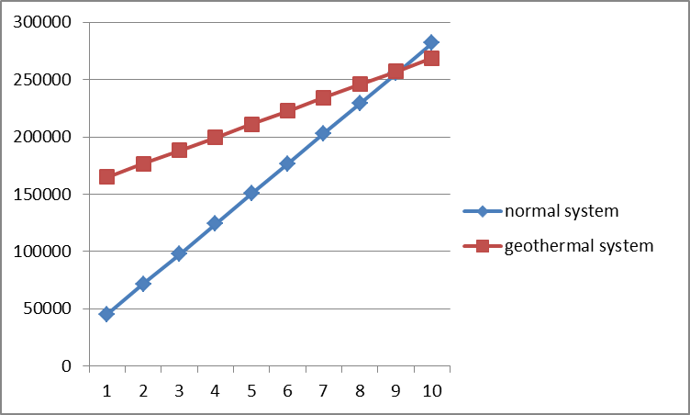
Cost Analysis
We can see that after about 10 years, geothermal system is less cost than the normal system.
Then, geothermal system is more economic than the normal system.

Slide 72
Thank you any question??

