Slide 1
Assessment and Design
of Al- Jam’a Tower
Prepared by: Ghaithaa’ Lahlooh
Rabab Jarrar
Salam Kharrousheh
Supervised by : Dr. Monther Diab

Slide 2

OUT LINE
Chapter One: INTRODUCTION
Chapter two: STRUCTURAL SYSTEM FOR ASSESSMENT
Chapter three: MODELING AND CHECKS FOR ASSESSMENT
Chapter four: REDESIGN THE TOWER
Chapter Five: DESIGN

Slide 3
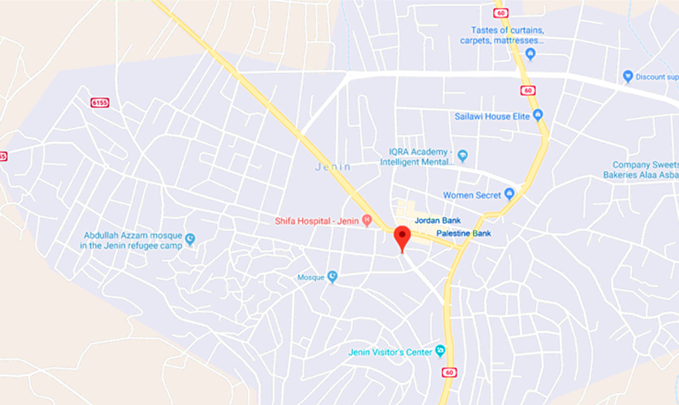
Chapter One: INTRODUCTION
1.1 Project Description
Al- Jam’a Tower is located in Jenin city
It have a total area about 11018 m²
The Tower have 9 floor and roof
Bearing capacity =225 KN/m2

Slide 4
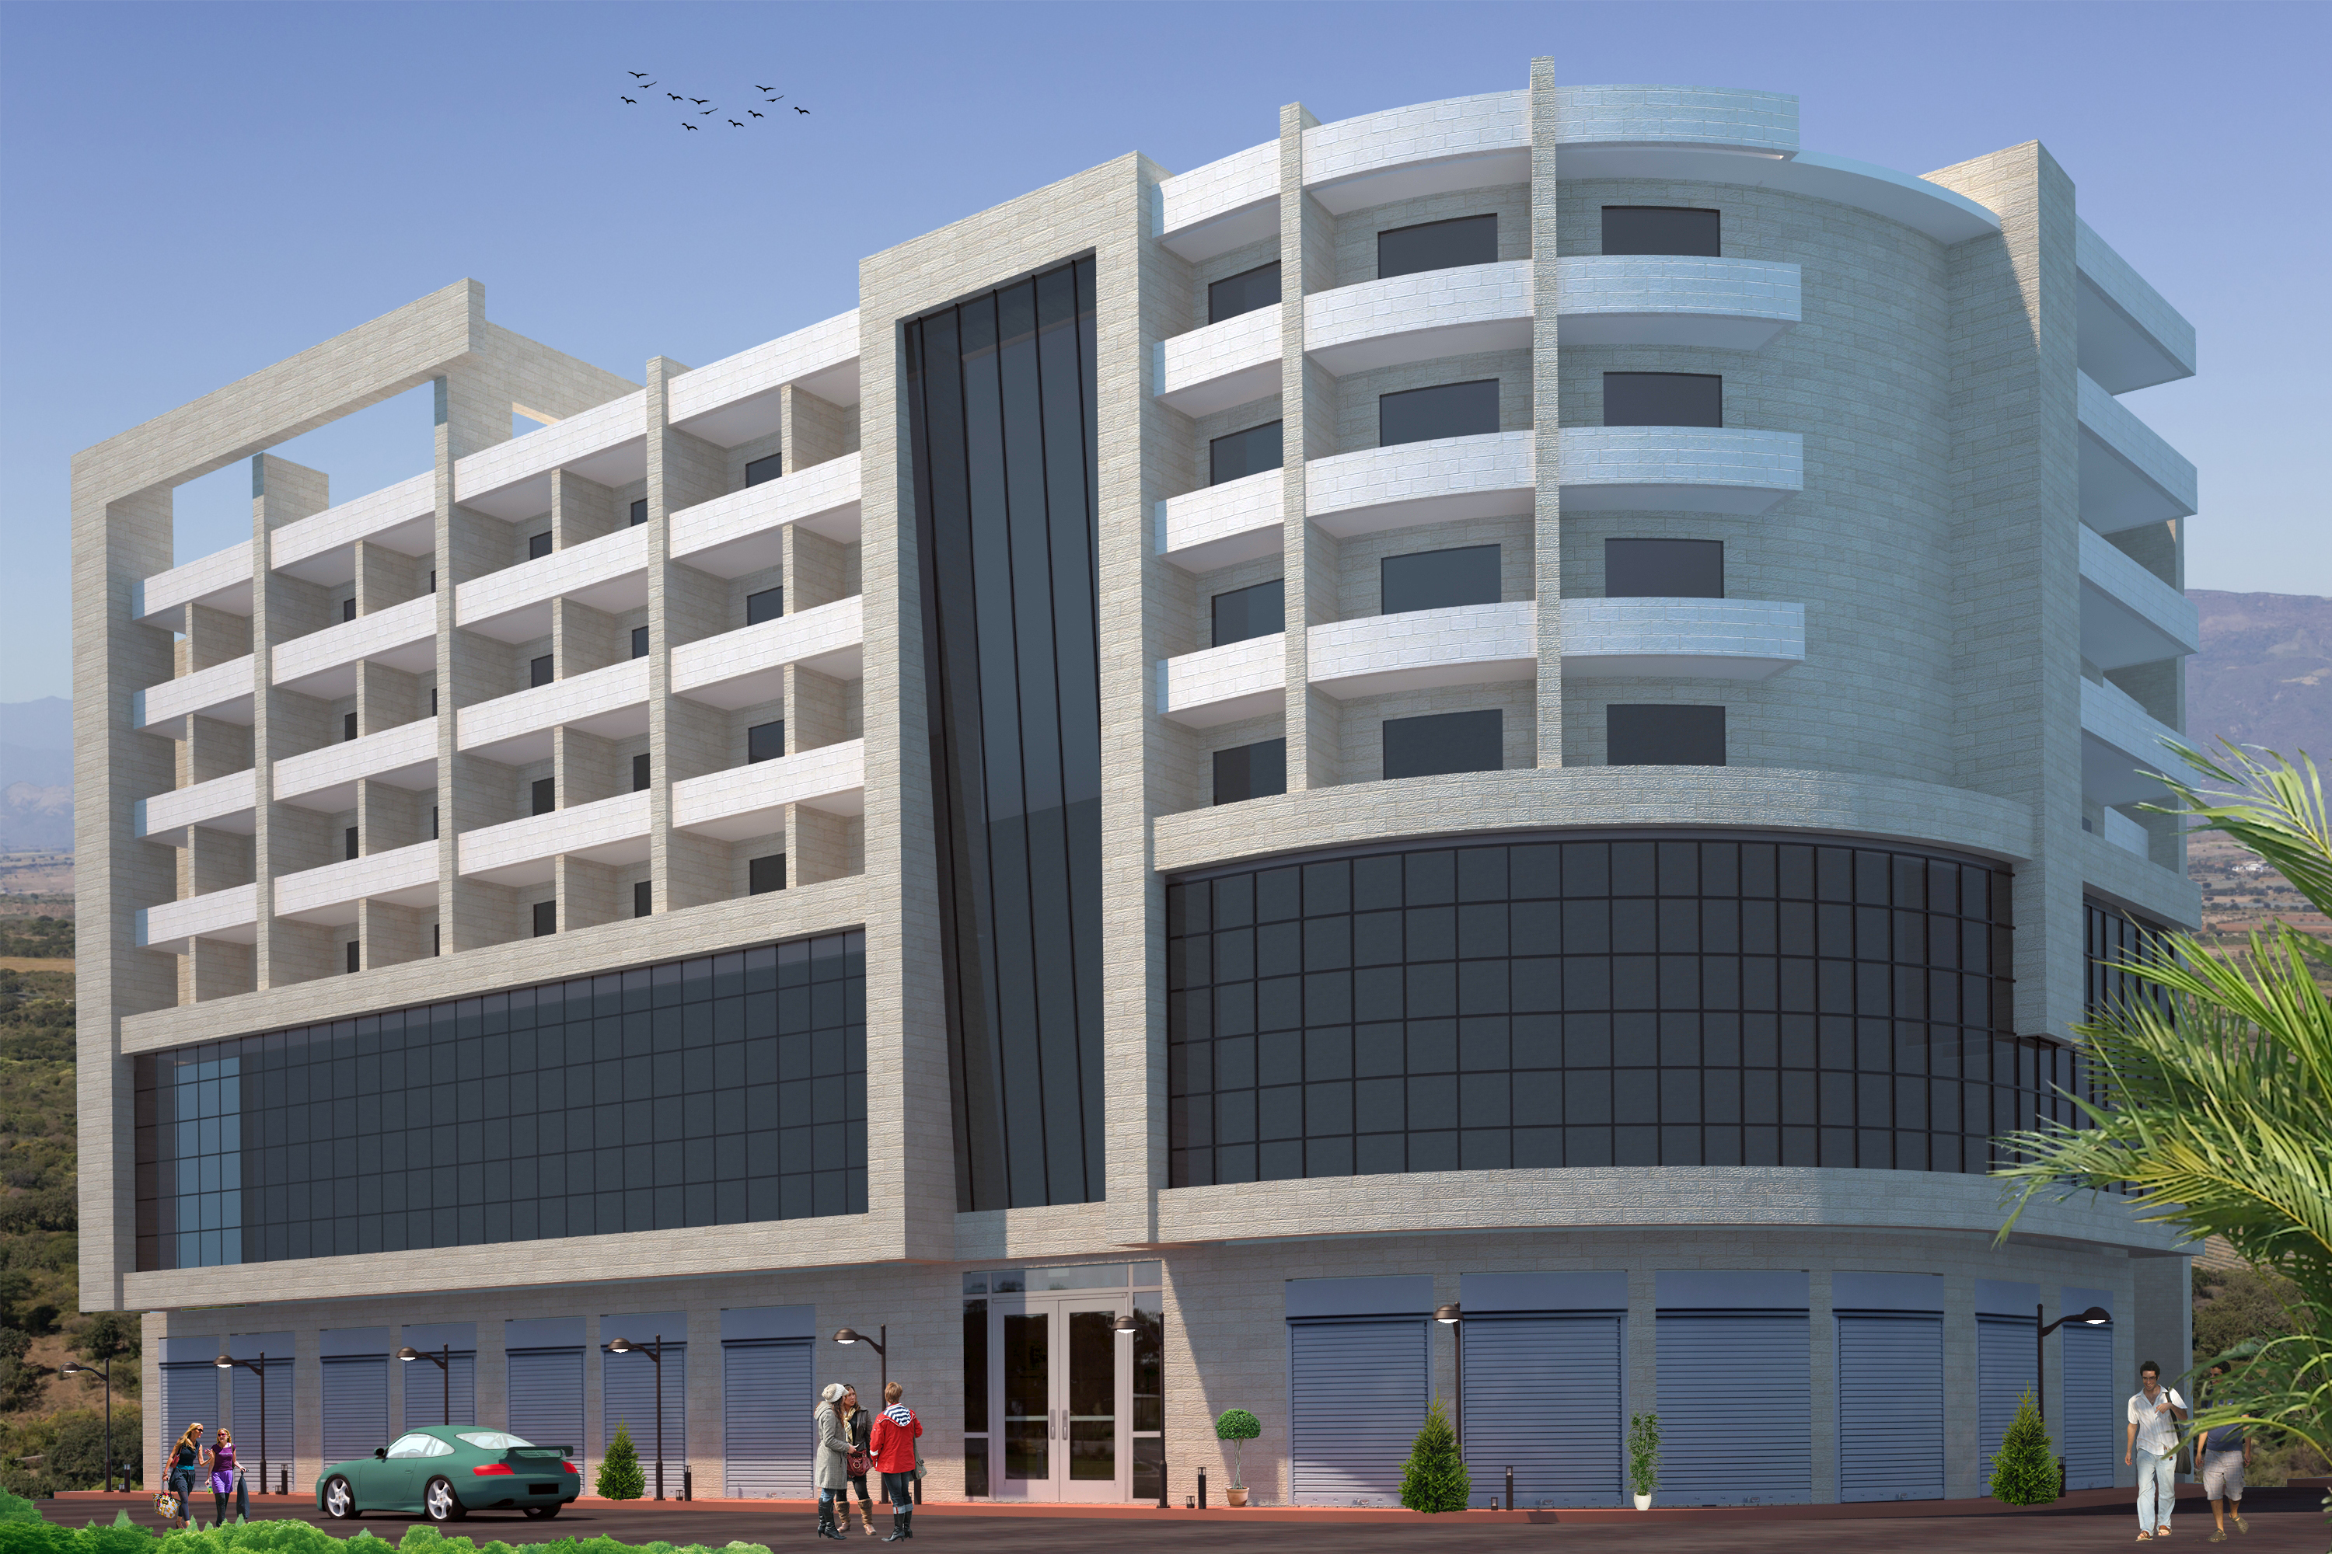
3D-view

Slide 5
The area and height of each floor in Tower is shown in the following tables:
Floor name | Area(m²) | Height (m)
Roof | 59.37 | 2.66
sixth floor | 1207.72 | 3.38
Fifth floor | 1204.41 | 3.38
fourth floor | 1207.42 | 3.38
Third floor | 1199.76 | 3.38
Second floor | 1219.77 | 3.38
First floor | 1272.84 | 3.38
Ground floor | 1200.52 | 5.56
Basement one | 1219.65 | 3.35
Basement two | 1226.24 | 3.25

Slide 6
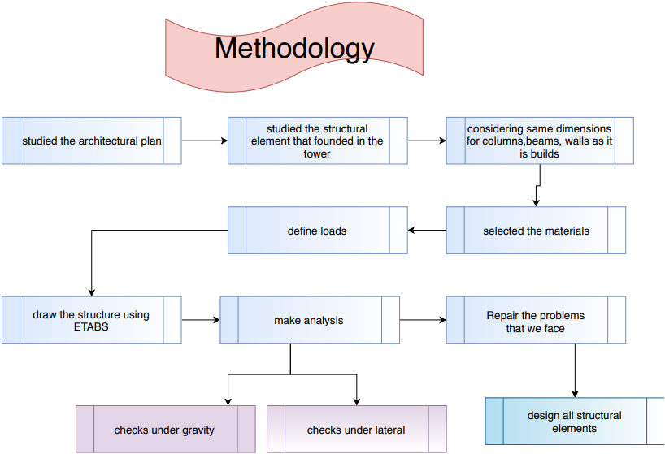
1.2 Objectives and Methodology
The main objective of this projects is to make assessment and design for Al- Jam’a Tower

Slide 7
1.3 Materials
A- Structural materials
1- Concrete:
2-Reinforcement steel:
Concrete properties | Property Value
Compressive strength of concrete, (f’c) For slab and beam | 24MPa
Compressive strength of concrete, (f’c) For column, walls and footing | 28 MPa
Unit weight of plain concrete, 𝛾 | 23𝑘𝑁/𝑚3
Unit weight of reinforced concrete, 𝛾 | 25 𝑘𝑁/𝑚3
Property | Value
Yield strength (fy) | 420 𝑀𝑝𝑎
Modulus of elasticity, (Es) | 200000 𝑀𝑃𝑎
Materials | 𝜸𝒊𝒏𝑲𝑵/𝒎𝟑.
Block | 12
Tiles | 27
Plastering | 23
Sand | 15
Aggregate | 18
Concrete mortar | 23
Polyethylene | 9
Stone | 26
B- Non –structural material

Slide 8
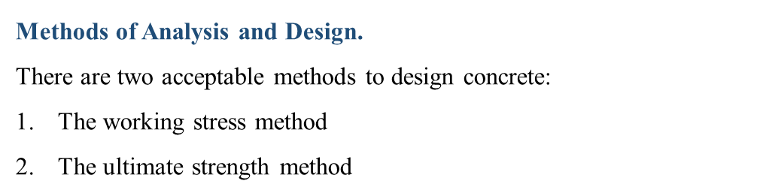
1.4 Philosophy of analysis and design
1.5 Codes and Standards
ACI 318-14
ASCE 7-10
IBC2012
1.6 Computer programs
ETABS 2016
AutoCAD

Slide 9
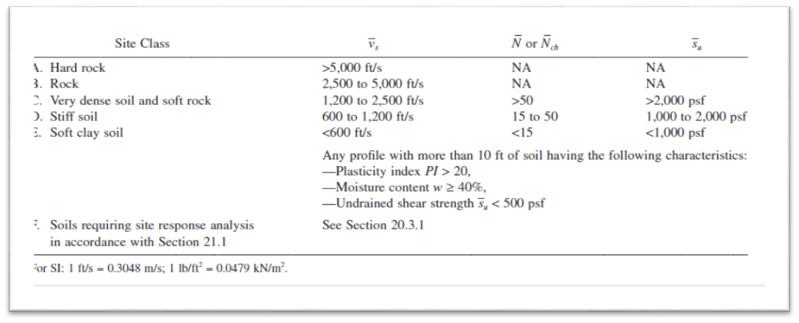

1.7 Seismicity of site and structure
$σ all$= 225 $KN/m^{2}$‾Su =225/2 =112.5$KN/m^{2}$

Slide 10
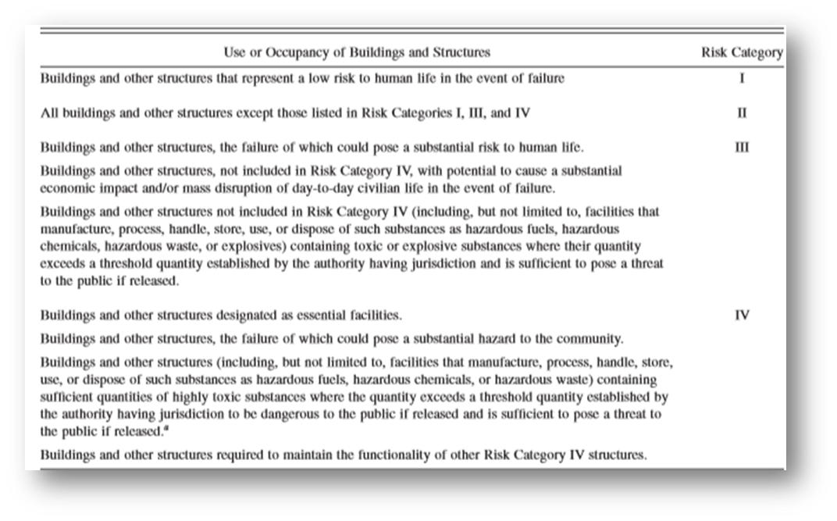
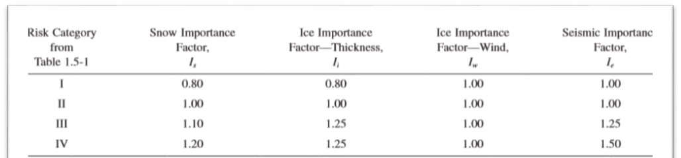
1.7 Seismicity of site and structure
1- Select the most appropriate risk category
2- Find the importance factor

Slide 11
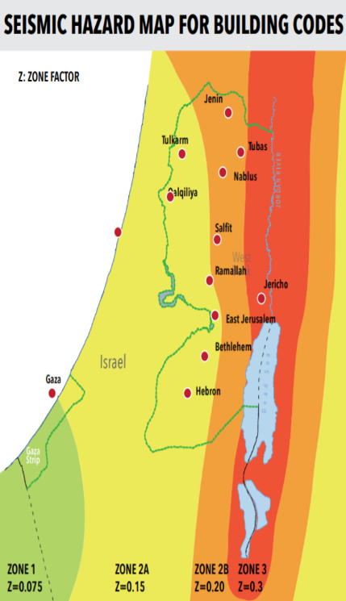
3- Find peak ground acceleration which expressed by Z factor
our project is located in Jenin
→ zone 2B→ Z factor = 0.2
4- Determine Acceleration parameters maps:
Ss=2.5Z =2.5*0.2=0.5
S1=1.25Z =1.25*0.2= 0.25

Slide 12
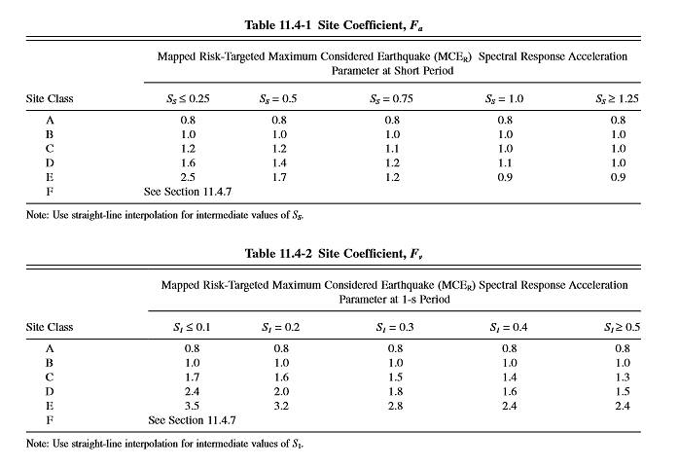
5- Calculate Response accelerations (Sms &Sm1)
Sms=Fa*Ss
Sm1 =Fv*S1
Sms=1.2*0.5 =0.6
Sm1 =0.25*1.55=0.3758
6- Calculate the design spectral acceleration ( SDs &SD1)
SDs =Sms =0.6 SD1=Sm1=0.3875

Slide 13
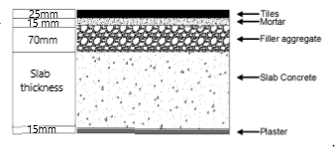
1.8 Loads
Gravity loads
1- Dead load (DL)
2-Superimposed load (SD)
A-floor layer
W_{SD} = W tile + W mortar + W fill + W plastering
Total weight of layers = 0.675+0.345+1.26+0.345=2.625 KN/m^2
Consider the superimposed load for the Tower as 3 KN/m²

Slide 14
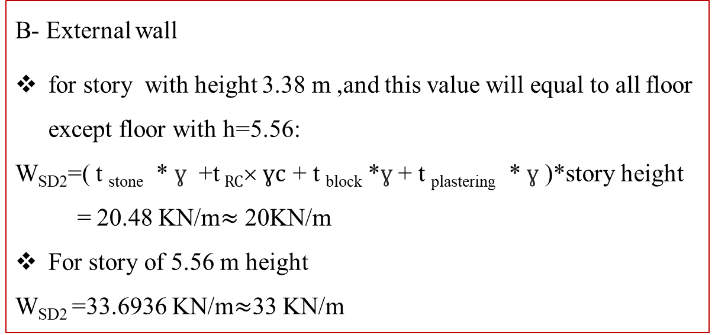
2-Superimposed load (SD)
B- External wall
for story with height 3.38 m ,and this value will equal to all floor except floor with h=5.56:
W_{SD2}=( t _{stone} * $ɣ$ +t $RC ɣc$ + t _{block} *$ɣ$+ t _{plastering} *$ɣ$ )*story height
= 20.48 KN/m$≈$ 20KN/m
For story of 5.56 m height
W_{SD2} =33.6936 KN/m$≈$33 KN/m
C- Glass Load: We assume it to be 10 KN/m

Slide 15
3- Live load (LL)
Uses in Tower | Uniform (KN/m^2)
Office use | 2.4
garages | 1.92
Residential private room | 1.92
Office building, corridor above first floor | 3.83
To be more conservative take LL
equal to 4 KN/m².

Slide 16
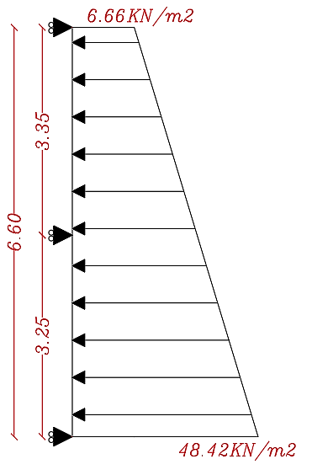
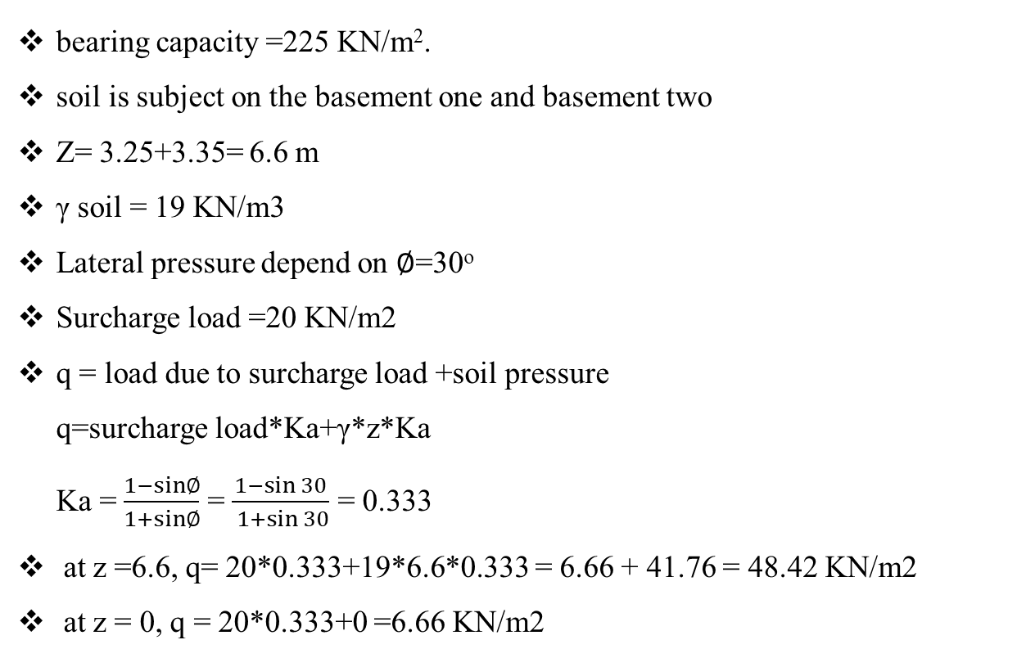
Lateral loads
Soil loads
bearing capacity =225 KN/m².
soil is subject on the basement one and basement two
Z= 3.25+3.35= 6.6 m
γ soil = 19 KN/m3
Lateral pressure depend on ∅=30º
Surcharge load =20 KN/m2
q = load due to surcharge load +soil pressure
q=surcharge load*Ka+γ*z*Ka
Ka = $\frac{1−sin∅}{1+sin∅}$ = $\frac{1−\sin{30}}{ 1+\sin{30}}$ = 0.333
at z =6.6, q= 20*0.333+19*6.6*0.333 = 6.66 + 41.76 = 48.42 KN/m2
at z = 0, q = 20*0.333+0 =6.66 KN/m2

Slide 17
1.9 Load combinations
1- Load combination under gravity loads
Ultimate load combination
1.2D+1.6L
Service Load Combinations
D+L
2- Load combination under lateral loads
Comb. number | Ultimate Load combination under lateral loads | modification
1 | 1.2D+1.6L | 1.2D+1.6L
2 | 1.2D+L+E | 1.32D+L+1.3Q
3 | 0.9D+E | 0.78D +1.6Q

Slide 18
Service Load combination
Comb. number | Load Combination | Modifications
1 | D+0.75L+0.75*0.7E | 1.063D+0.75L+ 0.6825Q
2 | D+0.7L | 1.084D+0.91Q
3 | 0.6D+0.7E | 0.684 D+0.91Q

Slide 19
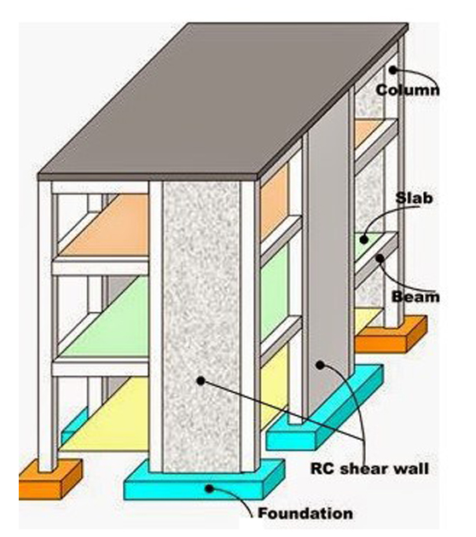
Chapter Two: STRUCTURAL SYSTEM FOR ASSESSMENT
2.1 Structural system
1- slabs
2- beams
3- columns
4- shear wall
5- Foundation

Slide 20
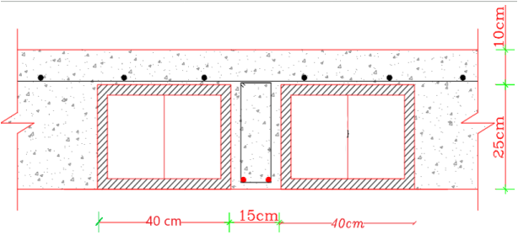
2.2 Data collection and structural element dimensions
considering all element and dimensions as its build in the Tower
slab system
System of slab used is two way ribbed slab with thickness 350 mm

Slide 21
Beams
System of beam used is hidden beams between all column
Section name | Depth(mm) | Width(mm)
B35*40 | 350 | 400
B35*50 | 350 | 500
B35*60 | 350 | 600
B35*80 | 350 | 800
B35*90 | 350 | 900
B35*100 | 350 | 1000
B35*120 | 350 | 1200

Slide 22
columns
sections | column dimensions
Rectangular | Width | depth
Rectangular | 300 | 700
Rectangular | 400 | 700
Rectangular | 400 | 900
Rectangular | 700 | 300
Rectangular | 700 | 400
Rectangular | 900 | 400
circular section | Diameter equal to 700 mm
shear wall
The thickness of shear wall used is 200 mm

Slide 23
Chapter Three: MODELING AND CHECKS FOR ASSESSMENT THE TOWER
3.1 Modeling on ETABS
Import drawings from AutoCAD
Define the material property
Define structural elements sections (dimensions and modifiers)
Structural Element | Stiffness Modifier | Mass& weight modifier
Slab | 0.35 | 1.29
Beam | 0.35 | 0.714286
Column | 0.7 | -
Shear wall | 0.7 | -
 | 0.35 | -

Slide 24
Add the load
1- On slab :
SD =3 KN/m2 , LL =4 KN/m2
2- On external beams
Glass load =10 KN/m
Stone load for height 3.38m: SD = 20 KN/m
Stone load for height 5.56 m: SD =33 KN/m
3- soil load on the basement shear wall
At z =6.6, q =48.42 KN/m2
At z = 0, q =6.66 KN/m2

Slide 25
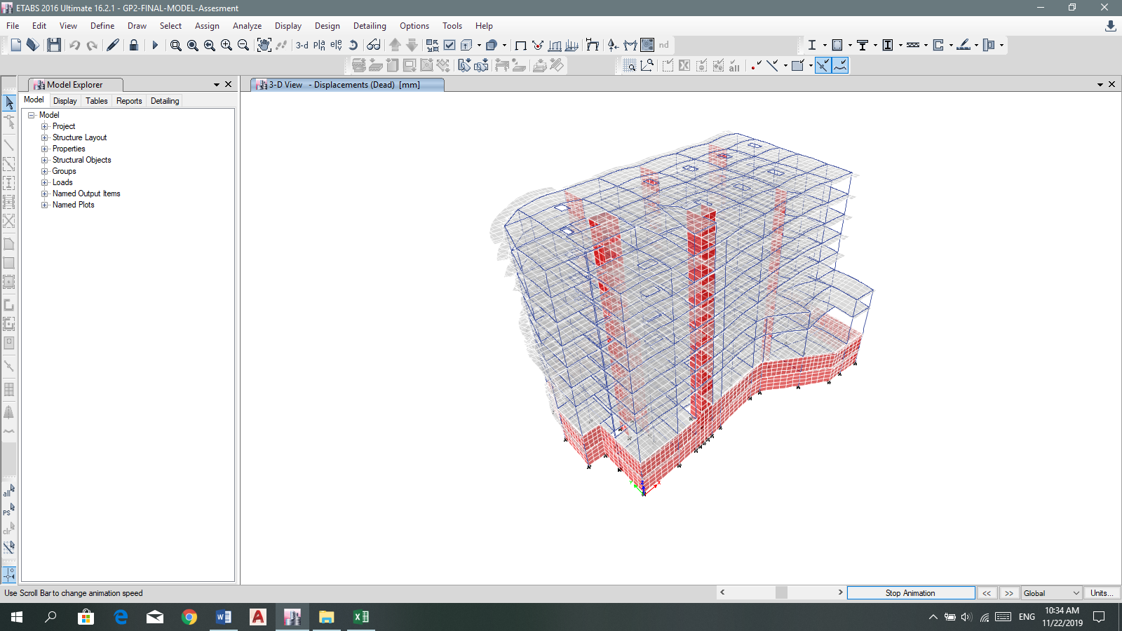
3.2 Checks and Structural Model Verification
Compatibility Check:

Slide 26
Equilibrium check
Load type | Manual results | ETABS results | % Error
Dead | 117156.3011 | 114971.2559 | 1.87%
Live | 44070.76 | 44101.0391 | 0.068%
Super dead | 54599.604 | 54996.85 | 0.73%
Error is less than 5% → ok

Slide 27
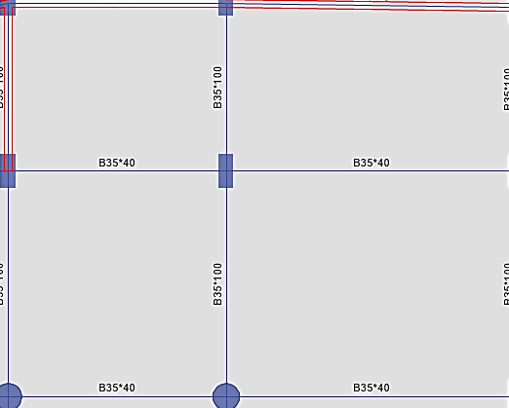
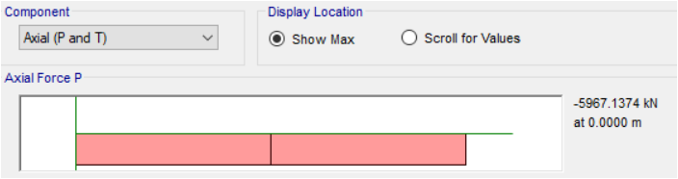
Internal force check
1- Columns
Pu = (tributary area * Wu slab + Wu beams + Wu column )* number of story
Pu =5544.837+349.272+579.0528 = 6473.162 KN
Axial load from ETABS =5967.1374 KN
Error = 7.8 % →Less than 10% → ok

Slide 28
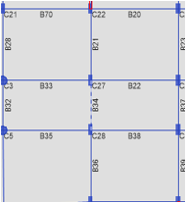
2- Frame moment
Hand calculations
Wu slab = 18.388 KN .m2
L2= 5 m , Ln = 5.7 m
Wu beam= 3.24 KN .m
MO =(( Wu slab * l2 + Wu beam)* ln^2) /8 = 300.07 KN.m
Etabs results
M11 = 238.01 KN.m
M22 = 129.39 KN.m
M33 = 238.01 KN.m
Total moment = (M1+M3)/2 +M2 =366.75 KN.m
Error =5.398%→ less than 10% → ok

Slide 29
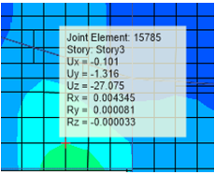
Deflection Check
1- Immediate deflections
From service combination ( D+SD+L )
Story | ∆middle | ∆ avg the corner | ∆ | ∆allowable = L/240
Story3 | 27.075 | 7.7425 | 19.33 | 17.125
The actual deflection ∆ (mm)>∆ allowable →not ok

Slide 30
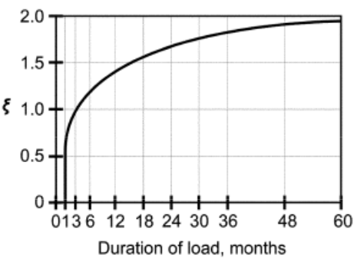
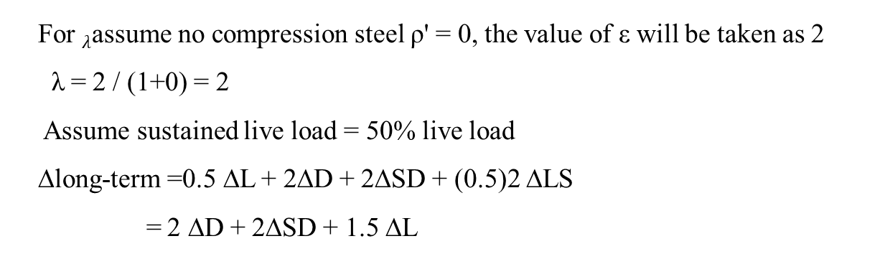
2- Long term deflections
Δ long term =Δ_{L}+ λ∞ Δ_{D}+ λt Δ_{LS}
For $λ$assume no compression steel ρ' = 0, the value of ε will be taken as 2
λ = 2 / (1+0) = 2
Assume sustained live load = 50% live load
∆long-term =0.5 ∆L + 2∆D + 2∆SD + (0.5)2 ∆LS
= 2 ∆D + 2∆SD + 1.5 ∆L

Slide 31
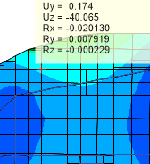
2- Long term deflections
Story | ∆middle | ∆avg the corner | ∆ | ∆allowable = L/240
Story6 | 40.065 | 15.423 | 24.642 | 10.41
The actual deflection ∆ (mm) > ∆ allowable → not ok

Slide 32
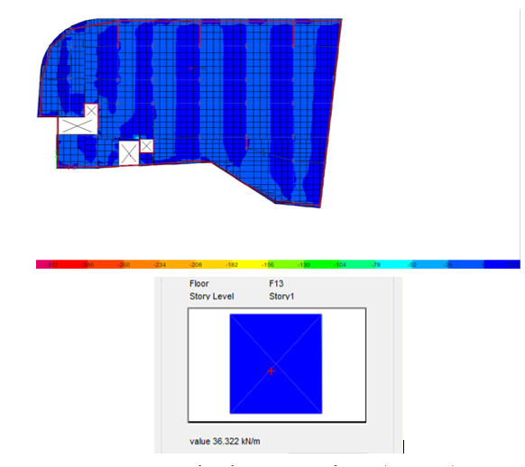
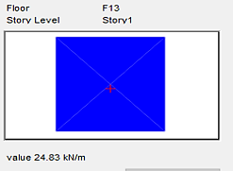
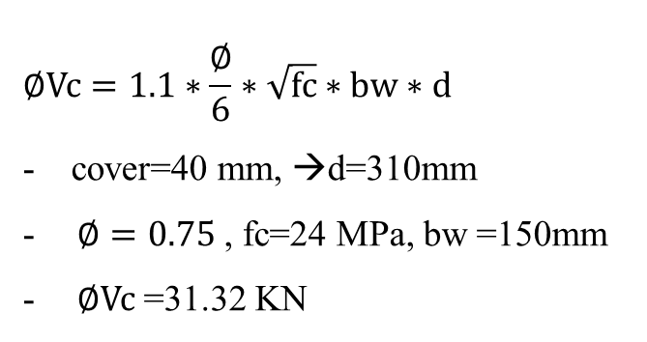
Check Shear of slab
V13
$$∅Vc=1.1∗\frac{∅}{6}∗\sqrt{fc}∗bw∗d$$
- cover=40 mm, →d=310mm
$∅=0.75$ , fc=24 MPa, bw =150mm
$∅Vc$ =31.32 KN
V23
The value of V13 & V23 is less than ΦVc → OK

Slide 33
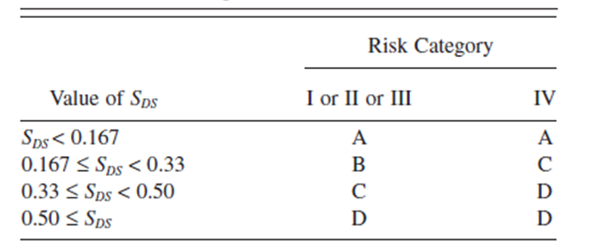
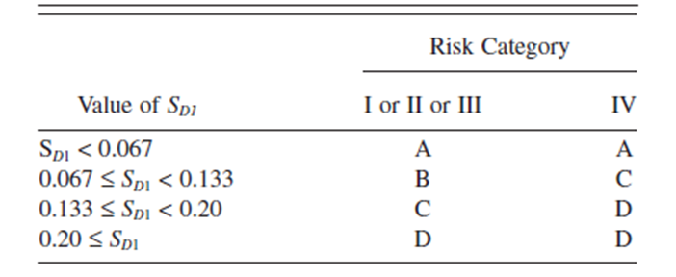
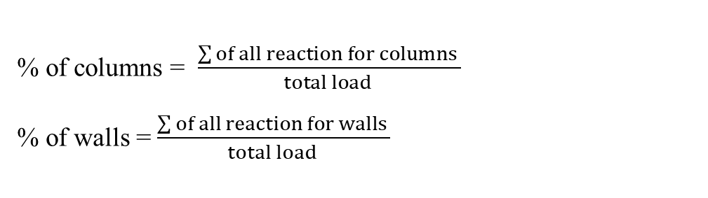
3.3Seismic Force
3.3.1 Seismic force resisting system
knowing the type of seismic force resisting system, we add load with value equal to 100 KN/m2
% of columns = $\frac{\sum{of all reaction for columns }}{total load }$
% of walls = $\frac{\sum{of all reaction for walls }}{total load }$
Type of system: Building frame system
seismic design category (D)

Slide 34
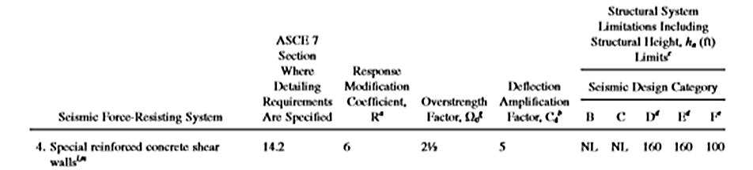
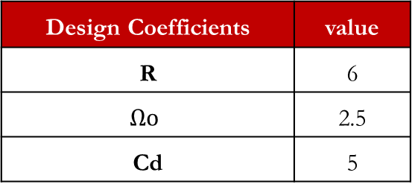
From ASCE, find Design Coefficients, according to structural limitation height and
Design Coefficients | value
R | 6
$$Ωo$$ | 2.5
Cd | 5

Slide 35
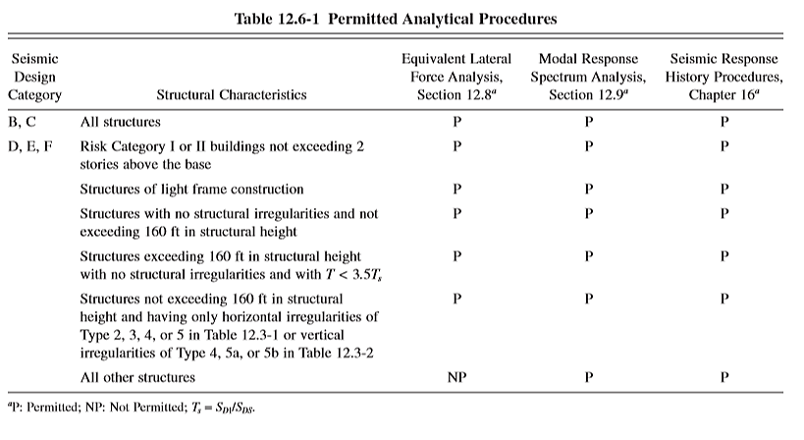
3.3.2 Seismic analysis method
There are three method for seismic force:
Equivalent lateral force analysis.
Model response spectrum analysis MRS.
Seismic response history procedures
We will use the modal response spectrum analysis because it’s permitted in all types of structures according to ASCE code.

Slide 36
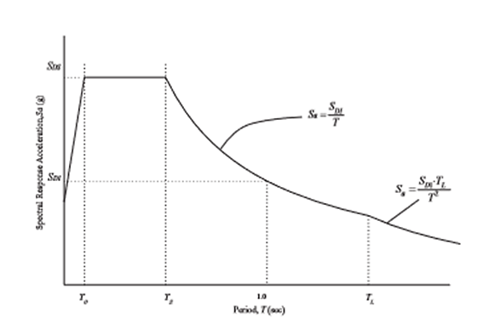
3.3.3 Design Response Spectrum
parameter to design response spectrum
S1=0.5
Ss =0.25
SD1=0.3785
SDs=0.6
TL= 4 sec
T = the fundamental period

Slide 37
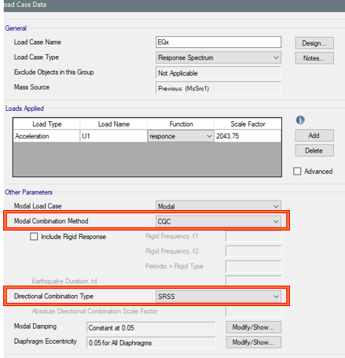
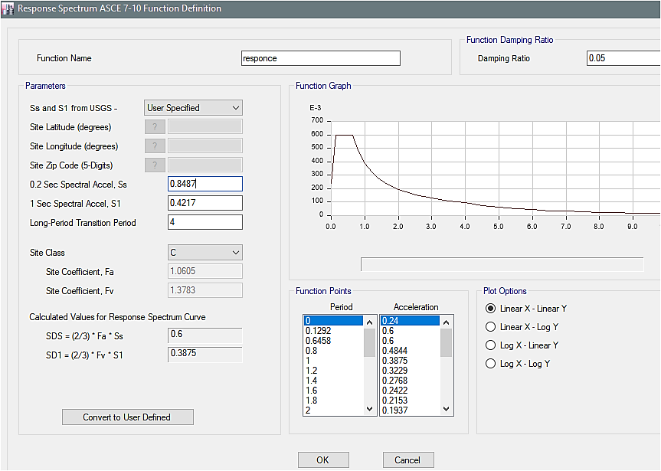
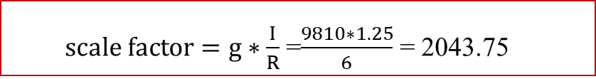
3.3.4 Modeling on ETABS
define function with type response spectrum
define load case
$scale factor=g∗\frac{I}{R}$ =$\frac{9810∗1.25}{6}$ = 2043.75

Slide 38
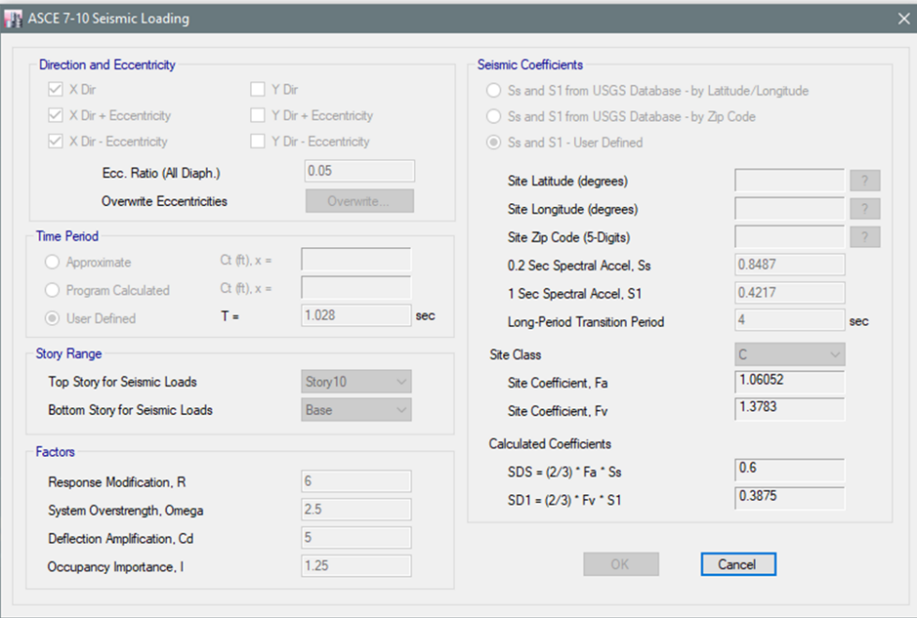
Define equivalent lateral static force in X-direction and y-direction

Slide 39
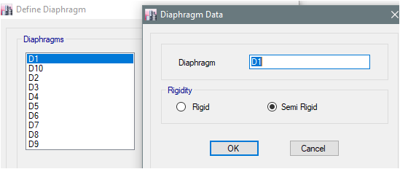
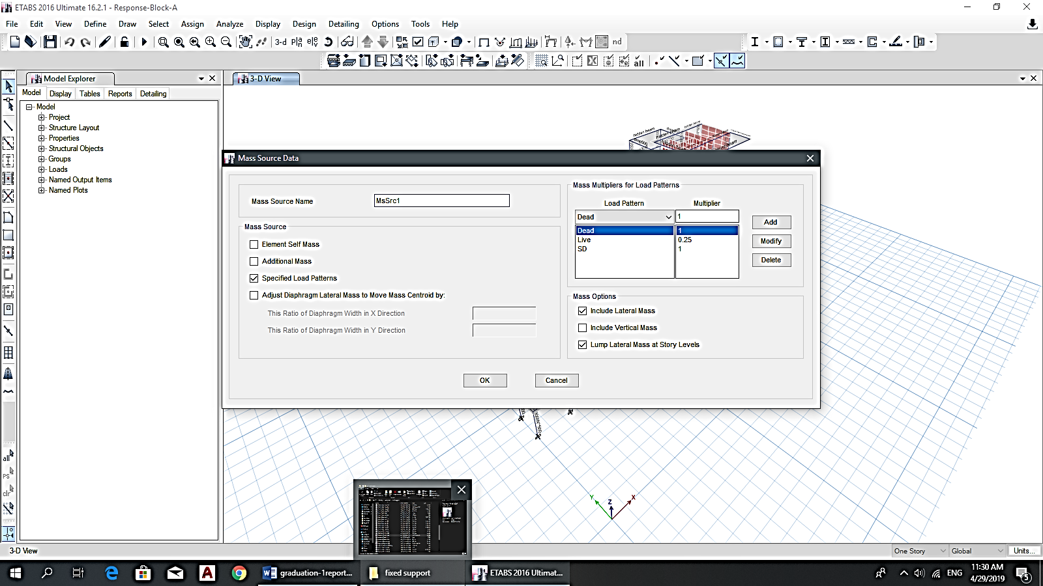
Define diaphragms with type semi rigid for each story
Define mass source
Checks on Number of Modes
the modal mass participation ratio is reach 90% at the mode 25

Slide 40
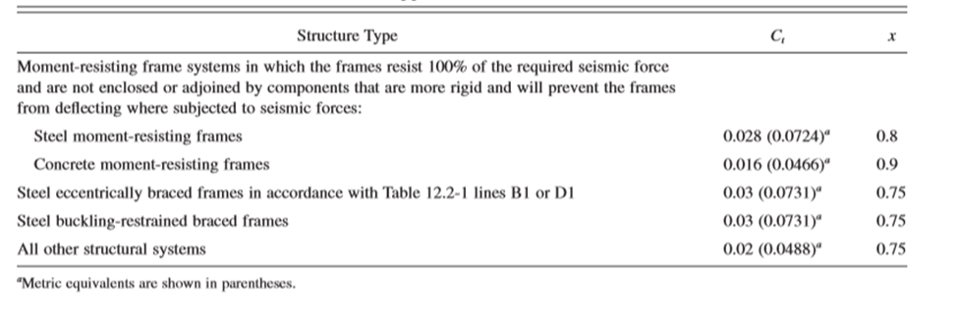
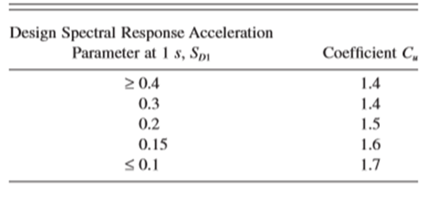

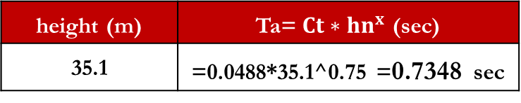
3.3.5 Approximate Fundamental Period
Ta= $Ct∗hn^{x}$
Ct & x
height (m) | Ta= $Ct∗hn^{x}$ (sec)
35.1 | =0.0488*35.1^0.75 =0.7348 sec
Cu
Cu Ta | fundamental period from ETABs | T To be use
1.4*0.7348 =1.028 | 2.464 | 1.028

Slide 41
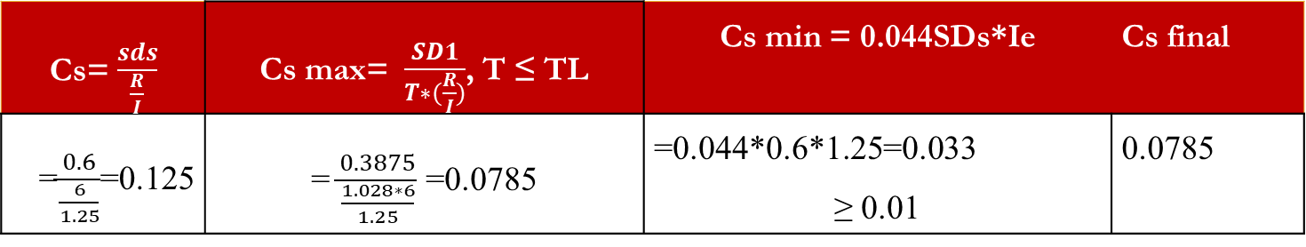
3.3.6 Base shear
3.3.6.1 Calculation of Seismic Response Coefficient
Cs= $\frac{sds}{\frac{R}{I}}$ | Cs max= $\frac{SD1}{T∗(\frac{R}{I})}$, T ≤ TL | Cs min = 0.044SDs*Ie | Cs final
=$\frac{0.6}{\frac{6}{1.25}}$=0.125 | = $\frac{0.3875}{\frac{1.028∗6}{1.25}}$ =0.0785 | =0.044*0.6*1.25=0.033 ≥ 0.01 | 0.0785

Slide 42
3.3.6.2Calculate the base shear
Base shear for response spectrum from ETABS results
V Response value in X- dir | V Response value in Y- dir
5284.5674 KN | 7057.3438 KN
Base shear form hand checks using equivalent static method
Weight (KN) | Cs | V= Cs*W (KN)
180993.3657 | 0.0785 | 14207.97921KN

Slide 43
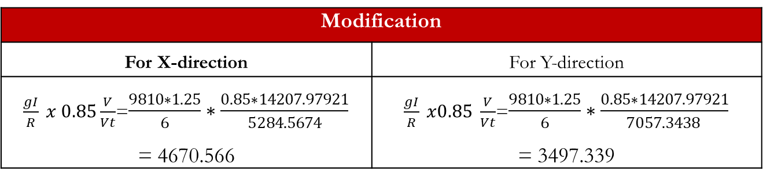
Scaling of Forces
Modification
For X-direction | For Y-direction
$\frac{gI}{R} x 0.85\frac{V}{Vt}$=$\frac{9810∗1.25}{6}∗\frac{0.85∗14207.97921}{5284.5674}$ = 4670.566 | $\frac{gI}{R} x0.85 \frac{V}{Vt}$=$\frac{9810∗1.25}{6}∗\frac{0.85∗14207.97921}{7057.3438 }$ = 3497.339
Final result
axis | Base shear from response Before modification | Base shear static(hand) | Base shear After modification
x | 5284.5674 | 0.85*14207.97921 =12076.78232 | 12076.7822
y | 7057.3438 | 0.85*14207.97921 =12076.78232 | 12076.7823

Slide 44
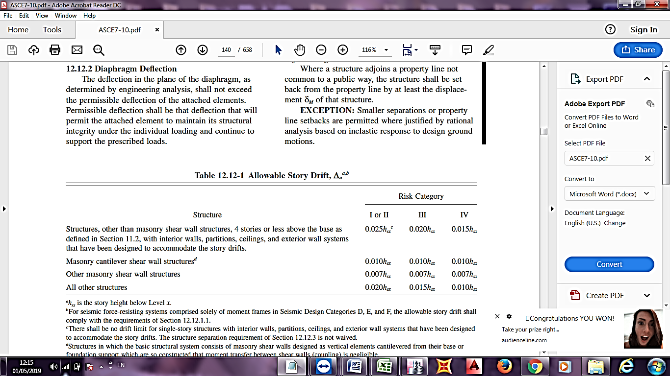

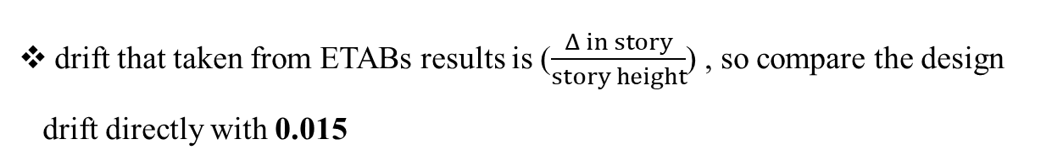
3.3.7 Checks
Drift check
δx$= \frac{Cd∗δxe}{Ie}$
Δ in story= Δ_{x}- Δ _{x-1}
Allowable story drift
drift that taken from ETABs results is ($\frac{Δ in story}{story height}$) , so compare the design drift directly with 0.015

Slide 45
Drift check
Drift in X- direction
Story | Load Case/Combo | Direction | Drift | design drift | < 0.015
Story10 | envelop ser Max | X | 0.005842 | 0.023368 | no
Story9 | envelop ser Max | X | 0.005505 | 0.02202 | no
Story8 | envelop ser Max | X | 0.00683 | 0.02732 | no
Story7 | envelop ser Max | X | 0.007438 | 0.029752 | no
Story6 | envelop ser Max | X | 0.007833 | 0.031332 | no
Story5 | envelop ser Max | X | 0.008011 | 0.032044 | no
Story4 | envelop ser Max | X | 0.007639 | 0.030556 | no
Story3 | envelop ser Max | X | 0.007127 | 0.028508 | no
Story2 | envelop ser Max | X | 0.001069 | 0.004276 | oK
Story1 | envelop ser Max | X | 0.000255 | 0.00102 | oK
in story (3 to 10) the drift is larger than the allowable value=0.015.

Slide 46
Drift check
Drift in Y- direction
Story | Combination | Direction | Drift | design drift | < 0.015
Story10 | envelop ser Max | Y | 0.005999 | 0.023996 | no
Story9 | envelop ser Max | Y | 0.004682 | 0.018728 | no
Story8 | envelop ser Max | Y | 0.005249 | 0.020996 | no
Story7 | envelop ser Max | Y | 0.005449 | 0.021796 | no
Story6 | envelop ser Max | Y | 0.005483 | 0.021932 | no
Story5 | envelop ser Max | Y | 0.005306 | 0.021224 | no
Story4 | envelop ser Max | Y | 0.004949 | 0.019796 | no
Story3 | envelop ser Max | Y | 0.004455 | 0.01782 | no
Story2 | envelop ser Max | Y | 0.001214 | 0.004856 | oK
Story1 | envelop ser Max | Y | 0.000279 | 0.001116 | oK
in story (3 to 10) the drift is larger than the allowable value=0.015.

Slide 47

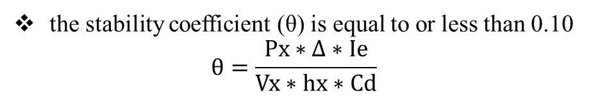
P-Delta Effects
the stability coefficient (θ) is equal to or less than 0.10
$$θ=\frac{Px∗∆∗Ie}{Vx∗hx∗Cd}$$
θ < θmax =$\frac{0.5}{β∗Cd}=0.1≤0.25$
In x-direction
Story | P | VX | drift elastic | delta elastic | < 0.1
Story10 | 1841.928 | 361.1909 | 0.005842 | 0.029791845 | OK
Story9 | 22336.1205 | 3192.905 | 0.005505 | 0.038510492 | OK
Story8 | 45779.4936 | 5196.6839 | 0.00683 | 0.060167974 | OK
Story7 | 69228.9781 | 6216.7167 | 0.007438 | 0.082829114 | OK
Story6 | 92643.0968 | 6862.1933 | 0.007833 | 0.105749481 | no
Story5 | 115608.7822 | 7586.6756 | 0.008011 | 0.122074806 | no
Story4 | 139702.6054 | 8646.0452 | 0.007639 | 0.123430792 | no
Story3 | 164196.1509 | 9791.5762 | 0.007127 | 0.119513543 | no
Story2 | 191408.9543 | 10936.7695 | 0.001069 | 0.018709014 | OK
Story1 | 214069.1451 | 12076.7822 | 0.000255 | 0.004520048 | OK
story 3, 4, 5 and 6 is more than 0.1
→not ok, there is p-delta effect

Slide 48
In y-direction
Story | P | VY | drift elastic | delta elastic | < 0.1
Story10 | 1841.928 | 374.5373 | 0.005999 | 0.029502338 | OK
Story9 | 22336.1205 | 3339.7521 | 0.004682 | 0.031313018 | OK
Story8 | 45779.4936 | 5565.7892 | 0.005249 | 0.043173852 | OK
Story7 | 69228.9781 | 6989.0959 | 0.005449 | 0.053973891 | OK
Story6 | 92643.0968 | 8085.4473 | 0.005483 | 0.062824242 | OK
Story5 | 115608.7822 | 9109.8329 | 0.005306 | 0.067336054 | OK
Story4 | 139702.6054 | 10247.0615 | 0.004949 | 0.06747185 | OK
Story3 | 164196.1509 | 11363.0763 | 0.004455 | 0.064374632 | OK
Story2 | 191408.9543 | 11822.2672 | 0.001214 | 0.019655322 | OK
Story1 | 214069.1451 | 12076.7823 | 0.000279 | 0.004945464 | OK
all story in y-direction is less than 0.1→ ok, no p-delta effect in this direction

Slide 49
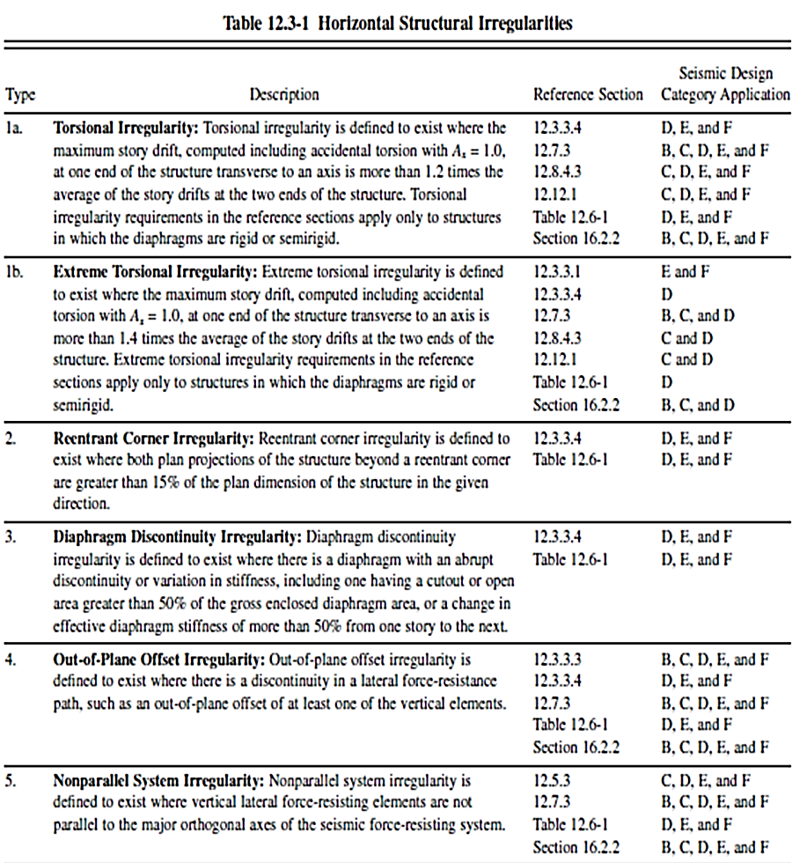
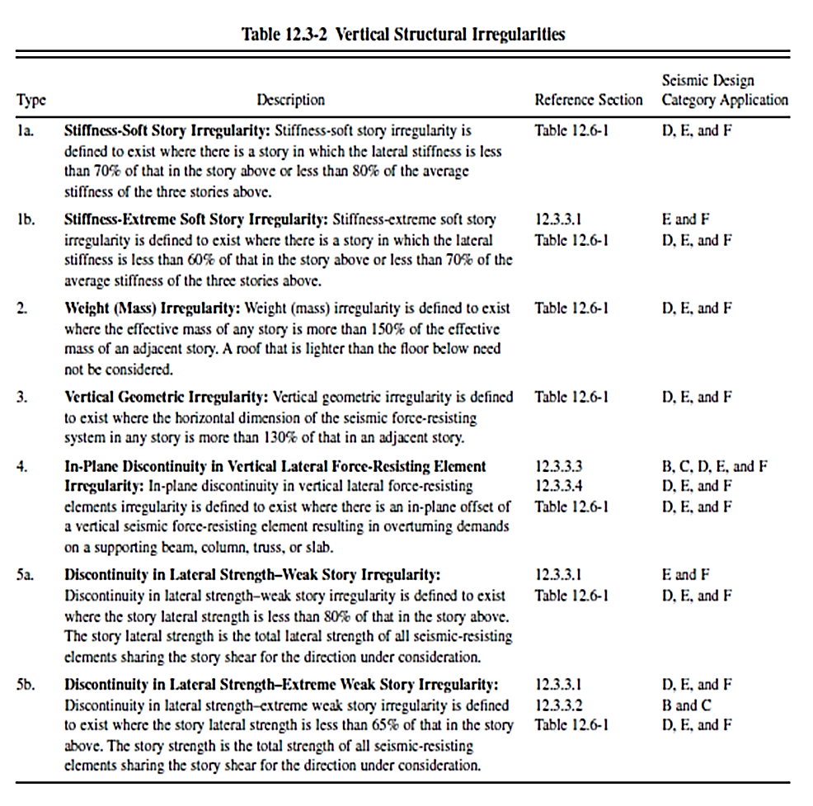
Irregularity check
Irregular Classification
1- Horizontal Irregularity
2- Vertical Irregularity

Slide 50
Irregularity check
Horizontal irregularity
Torsional Irregularity
In x-direction
Story | Load Case | Direction | Max Drift | Avg Drift | Ratio
 |  |  | mm | mm
Story10 | qx 1 | X | 17.611 | 15.636 | 1.126
Story9 | qx 1 | X | 21.569 | 20.94 | 1.03
Story8 | qx 1 | X | 25.808 | 25.242 | 1.022
Story7 | qx 1 | X | 180.939 | 104.396 | 1.733
Story6 | qx 1 | X | 33.14 | 31.699 | 1.045
Story5 | qx 1 | X | 35.105 | 33.199 | 1.057
Story4 | qx 1 | X | 34.419 | 31.608 | 1.089
Story3 | qx 1 | X | 51.315 | 46.143 | 1.112
Story2 | qx 1 | X | 4.391 | 2.38 | 1.845
Story1 | qx 1 | X | 0.734 | 0.3 | 2.444
ratio $\frac{∆ max}{∆ avg}$ in (story 1,2) in x-direction >1.2, so there is torsional Irregularity.
ratio $\frac{∆ max}{∆ avg}$ in story 1 to 8 in y-direction >1.2, so there is torsional Irregularity.

Slide 51
Vertical irregularity
Stiffness-Soft Story Irregularity
In x-direction
Story | Load Case | Stiffness X | 0.7*Stiffness
 |  | KN/m
Story10 | EQx | 29835.588
Story9 | EQx | 194203.184 | 20884.9116 | no soft story
Story8 | EQx | 259793.61 | 135942.2288 | no soft story
Story7 | EQx | 283861.625 | 181855.527 | no soft story
Story6 | EQx | 296861.83 | 198703.1375 | no soft story
Story5 | EQx | 319913.311 | 207803.281 | no soft story
Story4 | EQx | 381902.752 | 223939.3177 | no soft story
Story3 | EQx | 287389.655 | 267331.9264 | no soft story
Story2 | EQx | 6998444.788 | 201172.7585 | no soft story
Story1 | EQx | 28926026.29 | 4898911.352 | no soft story
no Stiffness-Soft Story Irregularity

Slide 52
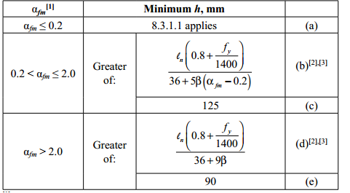

CHAPTER FOUR: REDESIGN THE TOWER
4.1 Introduction:
Due to | problem
Gravity load | Immediate and Long term deflection is more than the allowable
lateral load | High period
 | The drift is more than the allowable
 | p-delta effect
 | Torsion irregularities
4.2 Preliminary design
4.2.1 Slab preliminary design
h =$\frac{ln}{39}$.
h =$\frac{ln}{39}$ = 7.6/39 =0.19 m, try h=0.25 m

Slide 53



for curved cantilevers, we will use h= 0.35 m
4.2.2 Beams preliminary design
The largest span =7.7 m
h =$\frac{l}{18.5}$ =7.7/18.5=0.42m, try h=0.65 m and width b=0.3 m

Slide 54

4.2.3Columns preliminary design
No change in columns dimensions
4.2.4 Walls preliminary design
Minimum thickness of walls, h =L/25
h =l/25 = 5.56/25= 0.2 m.
h =l/25 = 3.38/25= 0.13 m
h =0.30 m for walls around stairs and elevators and external walls in basement floors
h=0.25 m for others wall
- change the fc for columns and walls to be 35 MPa

Slide 55


4.4 Gravity load check
4.4.1 Deflection Check
immediate deflections
2. Long term deflections
all panel in the structure have deflection less than the allowable
4.4.2 Check Shear of slab
$$∅Vc=\frac{∅}{6}∗\sqrt{fc}∗bw∗d$$
H= 250mm so d=210mm
$∅=0.75$ , fc=24 MPa, bw =1000mm
$∅Vc$ =128.59 KN
V13 &V23 is less than $∅Vc$→ok

Slide 56

  4.5 SEISMIC FORCE
Same system as Assessment model:
Building frame system
R=6, $Ωo$=2.5, Cd=5
Approximate Fundamental Period =$0.7348$
$CuTa=1.4∗0.7348=1.028$
Fundamental period from ETABs, which equal to 1.038 sec
$CuTa=1.4∗0.7348=1.028$
The fundamental period of the structure (T) is the minimum =1.028 sec
Cs =0.0785
axis | Base shear from response Before modification | Base shear static(hand) | Base shear After modification
x | 8413.909 | 0.85*13918.5797 = 11830.79273 | 11830.7927
y | 9885.887 | 0.85*13918.5797 = 11830.79273 | 11830.7928

Slide 57
Checks for seismic force
Drift check in X- direction
Story | Comb. | Direction | Drift | design drift | <0.015
Story10 | envelop ser Max | X | 0.001659 | 0.006636 | OK
Story9 | envelop ser Max | X | 0.002122 | 0.008488 | OK
Story8 | envelop ser Max | X | 0.00249 | 0.00996 | OK
Story7 | envelop ser Max | X | 0.002578 | 0.010312 | OK
Story6 | envelop ser Max | X | 0.0026 | 0.0104 | OK
Story5 | envelop ser Max | X | 0.002512 | 0.010048 | OK
Story4 | envelop ser Max | X | 0.002193 | 0.008772 | OK
Story3 | envelop ser Max | X | 0.002179 | 0.008716 | OK
Story2 | envelop ser Max | X | 0.000565 | 0.00226 | OK
Story1 | envelop ser Max | X | 0.000277 | 0.001108 | OK
the drift in X- direction for all story is less than the allowable value=0.015
the drift in Y- direction for all story is less than the allowable value=0.015

Slide 58
P-Delta Effects in X- direction
Story | P | VX | drift elastic | delta elastic | < 0.1
Story10 | 1662.2022 | 250.5057 | 0.002231 | 0.014803548 | OK
Story9 | 21777.7388 | 3159.8794 | 0.002513 | 0.017319477 | Ok
Story8 | 44470.014 | 5967.3981 | 0.002822 | 0.02103 | OK
Story7 | 67162.1654 | 8074.8259 | 0.003116 | 0.025917253 | OK
Story6 | 89815.9478 | 9697.8948 | 0.003184 | 0.029488253 | OK
Story5 | 112058.501 | 10994.0278 | 0.002937 | 0.029935873 | OK
Story4 | 135289.5843 | 12179.1871 | 0.002741 | 0.030447742 | OK
Story3 | 159685.3175 | 13218.0176 | 0.00246 | 0.029718971 | OK
Story2 | 187338.3251 | 13592.0781 | 0.000695 | 0.009579119 | OK
Story1 | 210382.5227 | 13918.5797 | 0.000236 | 0.003567194 | OK
stability coefficient (θ) in X- direction& Y- direction all story is less than the allowable value=0.1

Slide 59
Irregularity check
X- direction
Story | Comb. | Direction | Max Drift | Avg. Drift | Ratio
 |  |  | mm | mm
Story10 | qx 1 | X | 3.686 | 3.39 | 1.087
Story9 | qx 1 | X | 5.309 | 4.47 | 1.188
Story8 | qx 1 | X | 6.205 | 5.246 | 1.183
Story7 | qx 1 | X | 6.46 | 5.478 | 1.179
Story6 | qx 1 | X | 6.571 | 5.553 | 1.183
Story5 | qx 1 | X | 6.417 | 5.429 | 1.182
Story4 | qx 1 | X | 5.797 | 4.689 | 1.236
Story3 | qx 1 | X | 9.658 | 7.627 | 1.266
Story2 | qx 1 | X | 1.699 | 0.886 | 1.917
Story1 | qx 1 | X | 0.788 | 0.426 | 1.85
story 1 to 4 in x-direction is more than 1.2

Slide 60

Torsional Irregularity shall have the effects accounted for by multiplying diaphragm eccentricity at each level by a torsional amplification factor (Ax)
$$Ax={\left(\frac{∆max}{1.2∗∆avg}\right)}^{2}$$
Story | Comb. | Dir. | Max Drift | Avg. Drift | Ratio | Ax | new e=0.05*Ax
 |  |  | mm | mm
Story10 | qx 1 | X | 3.686 | 3.39 | 1.087 | 0.821010617 | 0.041050531
Story9 | qx 1 | X | 5.309 | 4.47 | 1.188 | 0.979598051 | 0.048979903
Story8 | qx 1 | X | 6.205 | 5.246 | 1.183 | 0.971548548 | 0.048577427
Story7 | qx 1 | X | 6.46 | 5.478 | 1.179 | 0.965736149 | 0.048286807
Story6 | qx 1 | X | 6.571 | 5.553 | 1.183 | 0.972400325 | 0.048620016
Story5 | qx 1 | X | 6.417 | 5.429 | 1.182 | 0.970201414 | 0.048510071
Story4 | qx 1 | X | 5.797 | 4.689 | 1.236 | 1.061411144 | 0.053070557
Story3 | qx 1 | X | 9.658 | 7.627 | 1.266 | 1.113536398 | 0.05567682
Story2 | qx 1 | X | 1.699 | 0.886 | 1.917 | 2.553623239 | 0.127681162
Story1 | qx 1 | X | 0.788 | 0.426 | 1.85 | 2.376132993 | 0.11880665

Slide 61


adjust ratio that exceeding 1.2
increase the value of diaphragm eccentricity to be 0.127098 for all story in x-direction
The Same Step for y- direction
diaphragm eccentricity =0.114101 for all story
Vertical irregularities
no Stiffness-Soft Story Irregularity

Slide 62
CHAPTER FIVE: DESIGN
system is building frame with special reinforced concrete shear wall → two models will be used to determine the final dimensions of the structural members.
The first model “full model” → for design the frames
the second model “ walls model” → for design shear walls

Slide 63
5.1 Frames Design
5.1.1 Design of beams
Group number | Dimensions (mm) (depth*width)
1 | 650*300
2 | 350*300
3 | 250*300
4 | 450*300
5 | 750*300
6 | 1000*300

Slide 64



5.1.1.1 Verification of Structural Design for beam.
Choose B650*300 in story 2
P_{u} =21.7241 <=0.1 A_{g}f′_{c}= 0.1(650*300)(24)/1000 = 468 KN → treat as beam
Design for flexure:
Check on top side
M = 78.27 KN.m

Slide 65



Design for Shear

Slide 66
5.1.2 Design of Columns
Group number | Dimensions (mm)
1 | 300*700
2 | 400*700
3 | 400*900
4 | 500*1000
5 | 600*1100
6 | 700*400
7 | 700*300
8 | 900*400
9 | 1000*500
10 | 1100*600
11 | C85

Slide 67


5.1.2.1 Verification of Structural Design for column.
Choose C30*70 in story 7
Slenderness effect can be ignored if:
$$\frac{K Lu}{r}≤34−12\frac{M1}{M2}≤40$$
To determine value of K.
$φA=φb=\frac{\left(\frac{I}{L}\right)c}{\left(\frac{I}{L}\right)b}=5.45$
$\frac{K lu}{r}$=0.925*2.73/0.09=28.058
the column is short

Slide 68

forces on column
P =909.0941 KN comp.
M3-3 = 55.9675 KN.m
M2-2 = 47.6706 KN.m
Using equation, check adequacy on ETABS reinforcing design result which is 1% for the column
$$\frac{1}{φPn}=\frac{1}{φPn3}+\frac{1}{φPn2}−\frac{1}{φPno}$$
$$Pno=0.65∗0.8 ∗(0.85 ∗ fc^{′} Ag(1−)+fyAg)$$
$pn=3674.853 KN more than 909.0941 , then 1\% is adequate$

Slide 69
5.3 Design of Shear walls
final dimensions
Group number | Thickness (mm)
1 | 500
2 | 400

Slide 70



5.3.1 Verification of Structural Design for Shear walls
Wall in story 6
Lw = 4.3 m, h = 0.40 m, hw= 3.38m
Shear design:
Minor, out of plane shear
d = 0.8 Lw =0.8*4.3. Then, d= 3.44 m.
$Vc=\frac{1}{6}φ × \sqrt{{fc}^{′}} × Lw ∗(h−cover)$
$$ Vc=\frac{1}{6}× 0.6 ∗ \sqrt{35}∗4300∗\left(400−40\right)=915.81 KN>32.4365 OK$$

Slide 71



2- Major, in of plane shear
Vc$= \frac{1}{6}×\sqrt{fc }∗ h ×0.8d$ = $\frac{1}{6}×√35×400×3440$ = $1356.75$kN
V_{u}=892.47 kN.
$Vn=\frac{Vu}{∅}=\frac{892.47}{0.6}=1487.45 KN$
$\frac{Vu}{∅}$>Vc➔ Vs =Vn - Vc= 1487.45-1356.75= 130.7 kN.
$\frac{Av}{s} =\frac{Vs}{Fy∗ d }$= 130.7*1000/420*3340= 93.1mm2/m
A_{s, shear} = 0.0025*4300*400 = 4300mm2
For 1 m strip taken, A_{s} = 4300/3.4 = 1000 mm2/m

Slide 72

Spacing of horizontal shear reinforcement ,the smallest of:
lw /5 =4300/5= 860mm
3h=3*400 = 1200mm
450 mm
Then, Smax =450 mm for horizontal steel.
As for each layer =1000/2=500mm2
Spacing=1000*113/500=226→200mm →1$∅$12mm/200

Slide 73



Flexural design:
For vertical steel( longitudinal)
$ρ$L=0.0025
area of vertical steel = 0.0025 × h ×Lw = 0.0025*400*4300=4300${mm}^{2}$.
Spacing of vertical steel reinforcement , smallest of
lw /3 = 4300/3=1433.3mm
3h =1200mm
450 mm
Then, Smax = 450mm
As for each layer =4300/2=2150 mm2 along d for the wall, 3.34m.
As/m=2150/4.3=500mm2/m
Spacing=1000*113/500=226→200mm →1$∅$12mm/200

Slide 74



P= 2538.2592KN
M3=1154.39 Kn.m
M2 =88.33 KN.m
1/$∅$P_{n} = 1/$∅$P_{nx} + 1/$∅$P_{ny} – 1/$∅$P₀
$∅$P₀ = $∅∗λ∗(0.85∗fc∗\left(Ag−As\right)+fy∗As)$
= 0.65*0.8*(0.85*35*(1-0.0025)*4300*400 + 0.0025*400*4300*420) = 27480.999 KN
Two interaction diagrams will be developed using the indicated current area of steel in order to determine P_{nx} and P_{ny}.
$∅$P_{n} = 22929.87 KN. > 2538.2592 KN →OK.

Slide 75


Boundary element check
Stress method:
If compressive stresses > 0.2fc
→The stress is to be calculated for the factored forces
Max limit of stress =0.2Fc =0.2*35=7
Comp Stress=4.6 Mpa
Error comp Stress =4.91-4.6/4.6=6.7%

Slide 76

5.4 Design of Slab
The design and verification will be done on “full model”
Design basis will be strip based.
Flexural design:
As, min =$ρ∗b∗d$
For strips →b =1000 mm, cover =40 mm →d= 210 mm
As, min =0.0018*1000*210 = 378 mm2/m (4Ø12)
$a=\frac{As min∗fy}{0.85∗fc∗b}$ = 4*113*420/0.85*24*1000=9.3 mm
$∅Mn=∅∗fy∗As (d−\frac{a}{2})$ =0.9*420*4*113*(210-9.3/2) =35.1 KN.m
Assume Top mesh: 1Ø16/100 mm and Bottom mesh: 1Ø16/100mm

Slide 77


5.5 Design of Foundation.
use mat foundation
thickness to be 1 meter
The type of mat is Flat plate mat, with area = 1431.61 m2.
(f’c) for the mat is 35 Mpa
area spring with stiffness =q_{all}*100= 225*100=22500 KN/m2

Slide 78

Checks on mat foundation
Check on pressure
pressure under the mat is less than q_{all}

Slide 79


Check wide beam shear
Shear capacity ØV_{c}= 0.75*(1/6)*$\sqrt{fc}$*b*d
Where fc=35 MPa, take cover 100 mm so d=900 mm
=0.75*(1/6)*$\sqrt{35}$*1000*900=665.55 kN.
V13
Not that V13,V23 < Shear capacity
→h =1m is adequate for the mat

Slide 80
Punching shear
The thickness of mat foundation is adequate for punching
Flexural design
A_{s,min} = 0.0018bh = 0.0018*1000*1000 = 1800 mm2/m
→use 1Ø16/100mm top and bottom.

Slide 81



5.6 Design of Stairs.
Design of flight:
Preliminary dimensions
length of flight =3.3 m
Thickness of flight = L/20=3.3/20 =0.165 m, try 0.16 m
The rise of stair =16 cm and run = 30 cm
Loads on stair
1-Dead load
Slab = 0.16 x 25 = 4. KN/m2
Stairs (forming the triangle shape) = ½ x 0.16 x 0.30 x 25/1m = 0.6 KN/m2
2- Super imposed dead load
Load SD = Thickness of layer * γ =2.2 K/m2
3- Live load
for corridors and stairs, live load = 4.79 KN/m2 take it 5 KN/m2
Layer | Thickness | $$γ$$ | Load SD(KN/m2)
Sand layer | 30 mm | 15 | 0.45
Cement mortar | 50 mm | 22 | 0.4
Tiles | 50 mm | 27 | 1.35
sum |  |  | 2.2

Slide 82

5.6 Design of Stairs.
Design of flight
Mu = wu l²/8 = 16.16 x 3.3²/8 = 21.99 KN.m
Vu = wu l/2 = 16.16 x 3.3 /2 = 26.66 KN.
Check shear:
Taking a cover 2 cm
ØVc = 0.75 x 1/6 $\sqrt{f′c}$ x bw x d
ØVc = 0.75 x 1/6 $\sqrt{24}$ x 1000 x 140 = 85.5 KN > Vu = 26.66 KN, ok.
Flexural design:
As,min = 0.0018 bd = 0.0018 x 1000 x 140 = 252 mm2
Mu = 21.99 kN.m, ρ = $\frac{0.85 f’c}{fy} (1−\sqrt{1−\frac{2.61 Mu}{b d^{2}f^{′}c}})$ = 0.00305
A_{s} = ρ*b*d = 0.00305*140*1000= 427 mm2, use 1Ø12/250 mm.
Use 1Ø12/250 mm in longitudinal direction and 1Ø10/300 mm in transverse direction.

Slide 83

Design of landing:
The length of landing =3 m
Thickness of landing = L/20=3/20 =0.15 m, try 0.16 m
Loads on stair:
1- Dead load=0.16 x 25 = 4 KN/m2
2- SD will be as same for the flight
3- Live load= 5 KN/m2
Wu = 1.2 (4+2.2) + 1.6 (5) = 15.44 KN/m2
Reaction from flight =16.16*3.3/2 per 1m=26.664 KN/m
Total load on landing =15.44+ 26.664 = 42.104 KN/m
Use 1Ø16/200 mm in longitudinal direction and 1Ø10/300 mm in transverse direction.

Slide 84


