Slide 1








FarmX
Smart Farm Management System
Presented by: Samaa & Tala

Slide 2
Table of contents
1.
Introduction
2.
Problem & Solution
3.
Technology
4.
Features & Roles
5.
Constrains & Limits
6.
Conclusion
7.
Future Work

Slide 3

What is FarmX ?
A smart and user-friendly system that helps farmers manage their farms, crops, orders, and sales – all in one place.

Slide 4
Why We Created FarmX
1.
2.
3.
Farming is essential but full of challenges
Farmers need support with planning, selling, and making smart decisions.
We wanted to create a tool that really helps them.

Slide 5
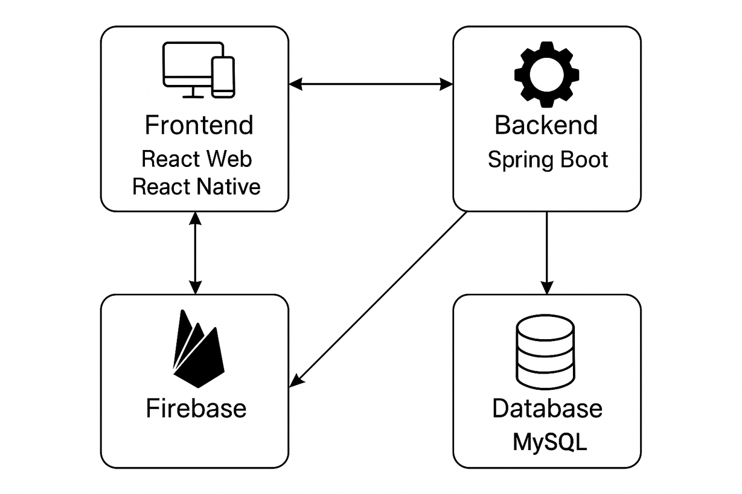
System Design

Slide 6

Technologies

Slide 7





Frontend-Web
  ReactTS + NExt
  React three fiber
  Chakra UI
  TypeScript
Frontend-App
  React Native with Expo
  React Native Styles

Slide 8






Backend
  Spring boot
  Postman
  Docker
  Swagger
  jwt
  Maven
  Spring security
Database
  MySQL

Slide 9


Deployment
For Bakend & Frontend :
For Database :

Slide 10
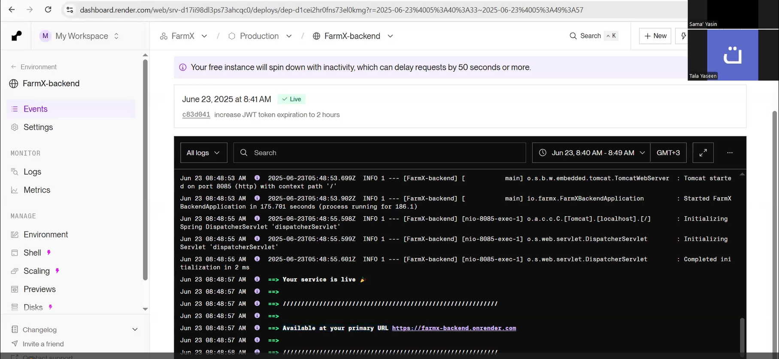
Bakend Deployment

Slide 11
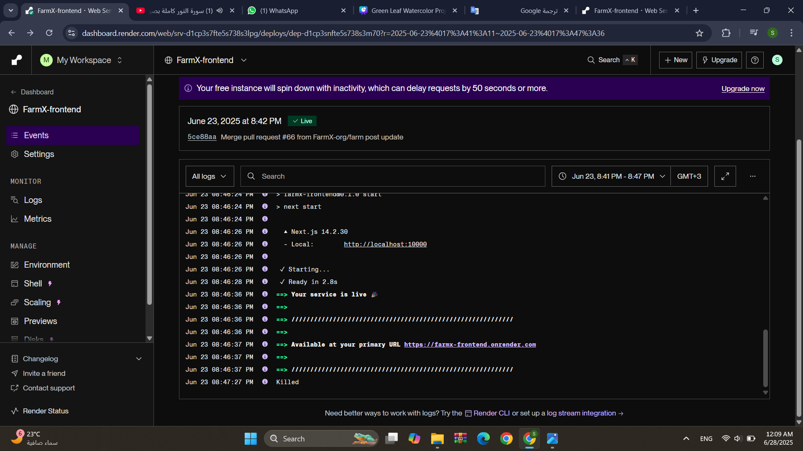
Frontend Deployment

Slide 12
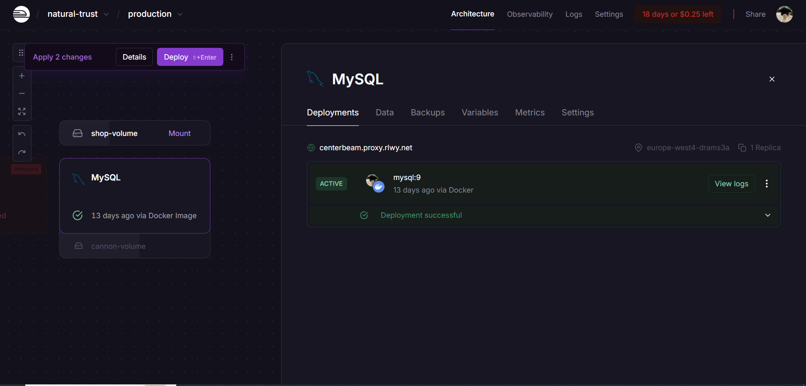
Database Deployment

Slide 13




Other Tools

Slide 14
Authentication Authorization

Slide 15
Roles :
  Farmer
  Consumer
  Handler
  Admin

Slide 16
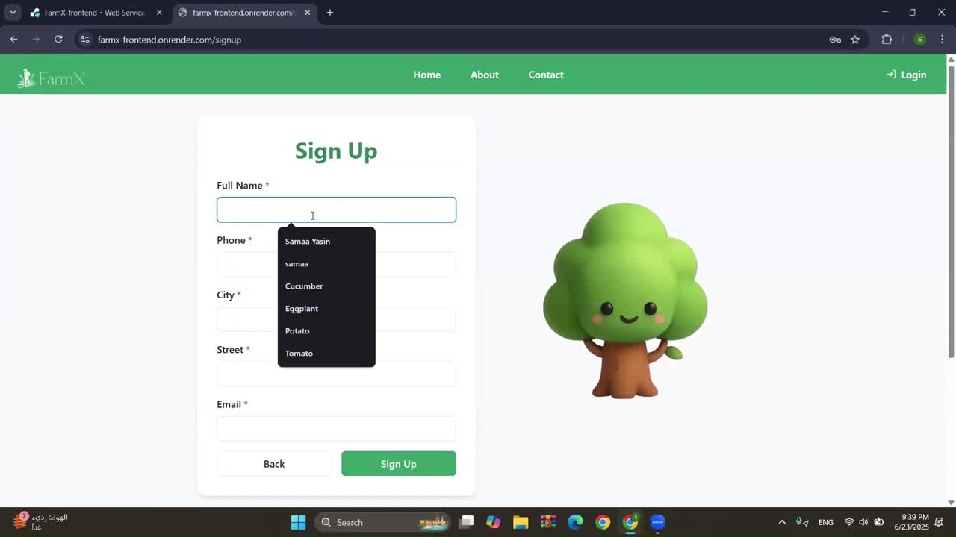
Login & Sign up

Slide 17
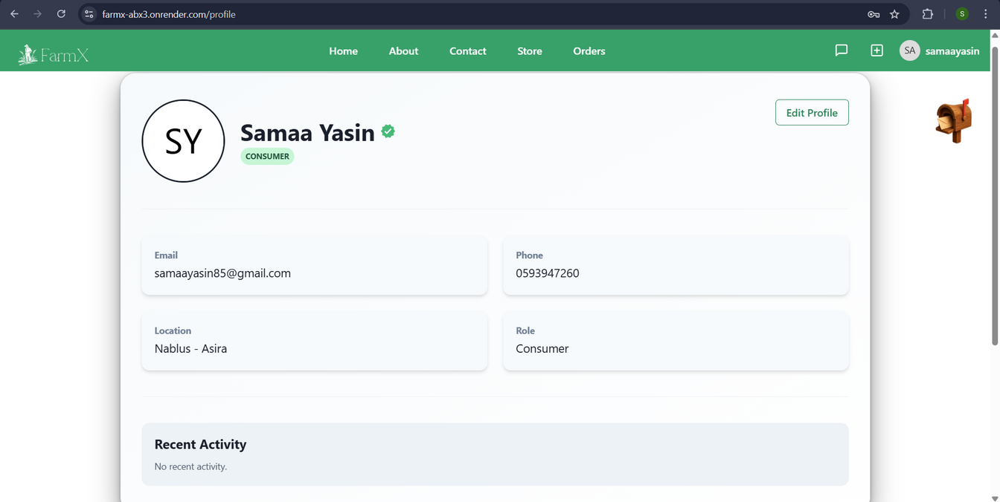
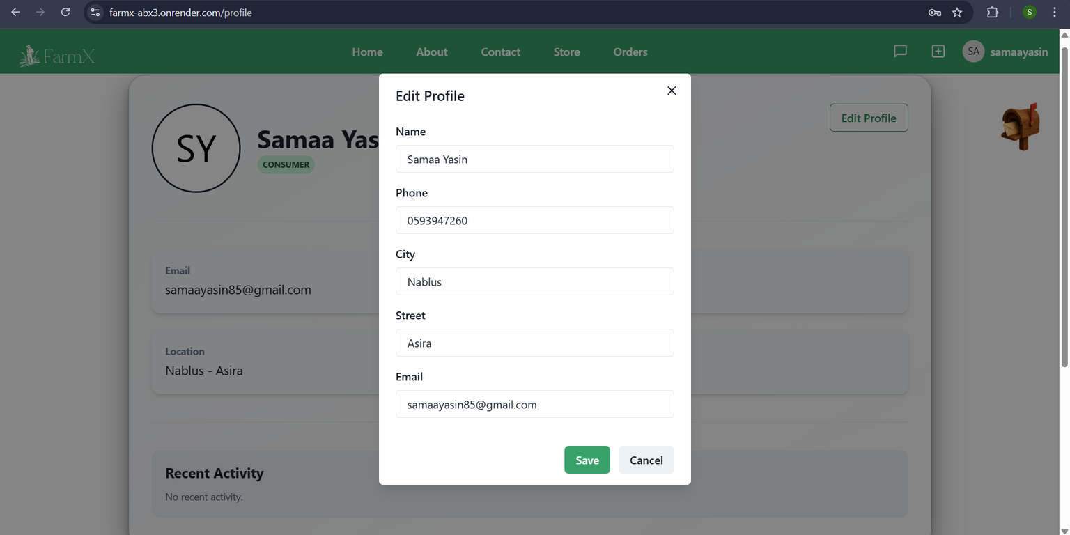
Profile :

Slide 18
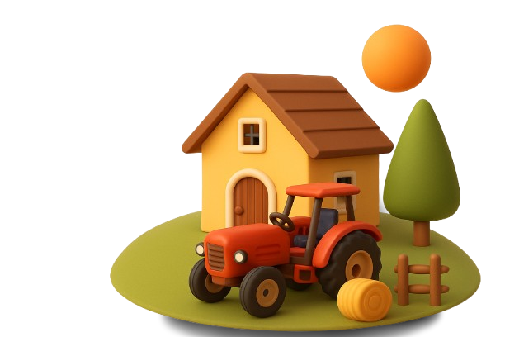
Home Page

Slide 19
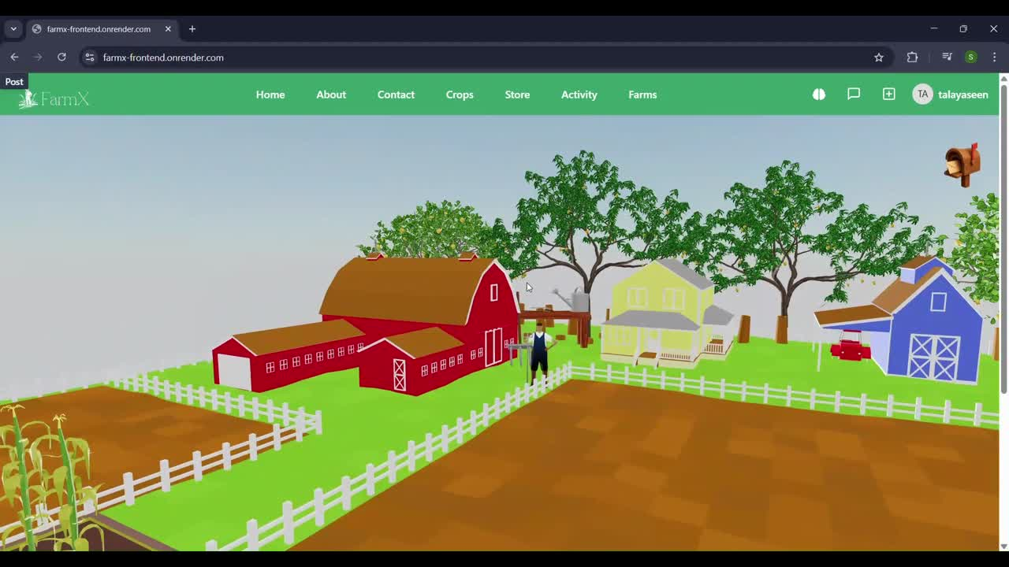
3D Design For Home

Slide 20
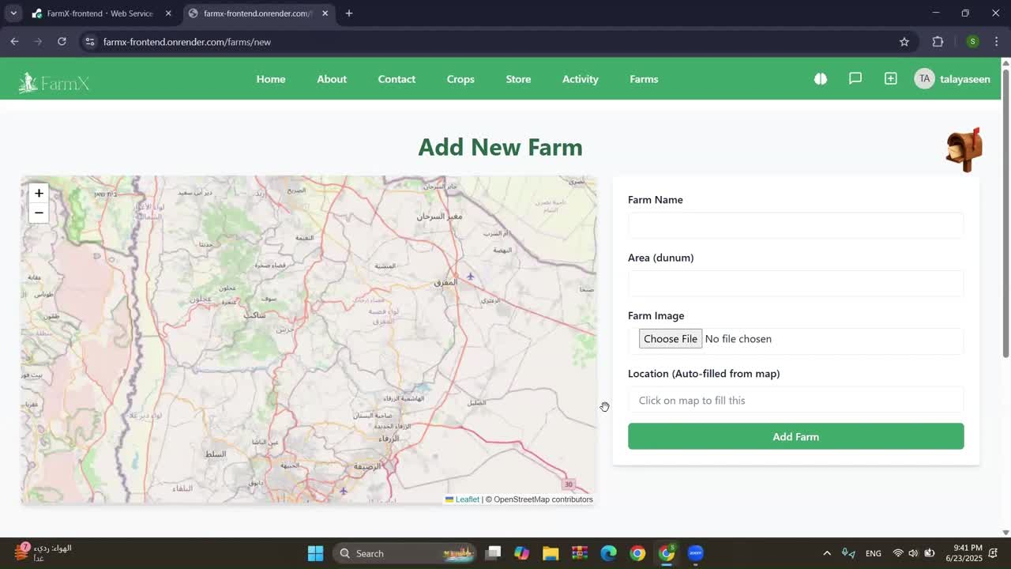
Add Farm :

Slide 21
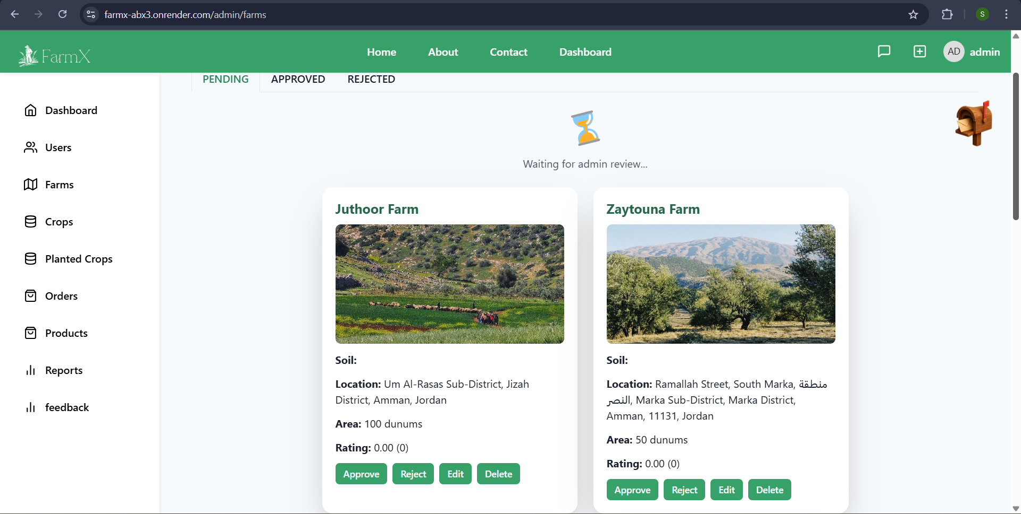
Admin approval:

Slide 22
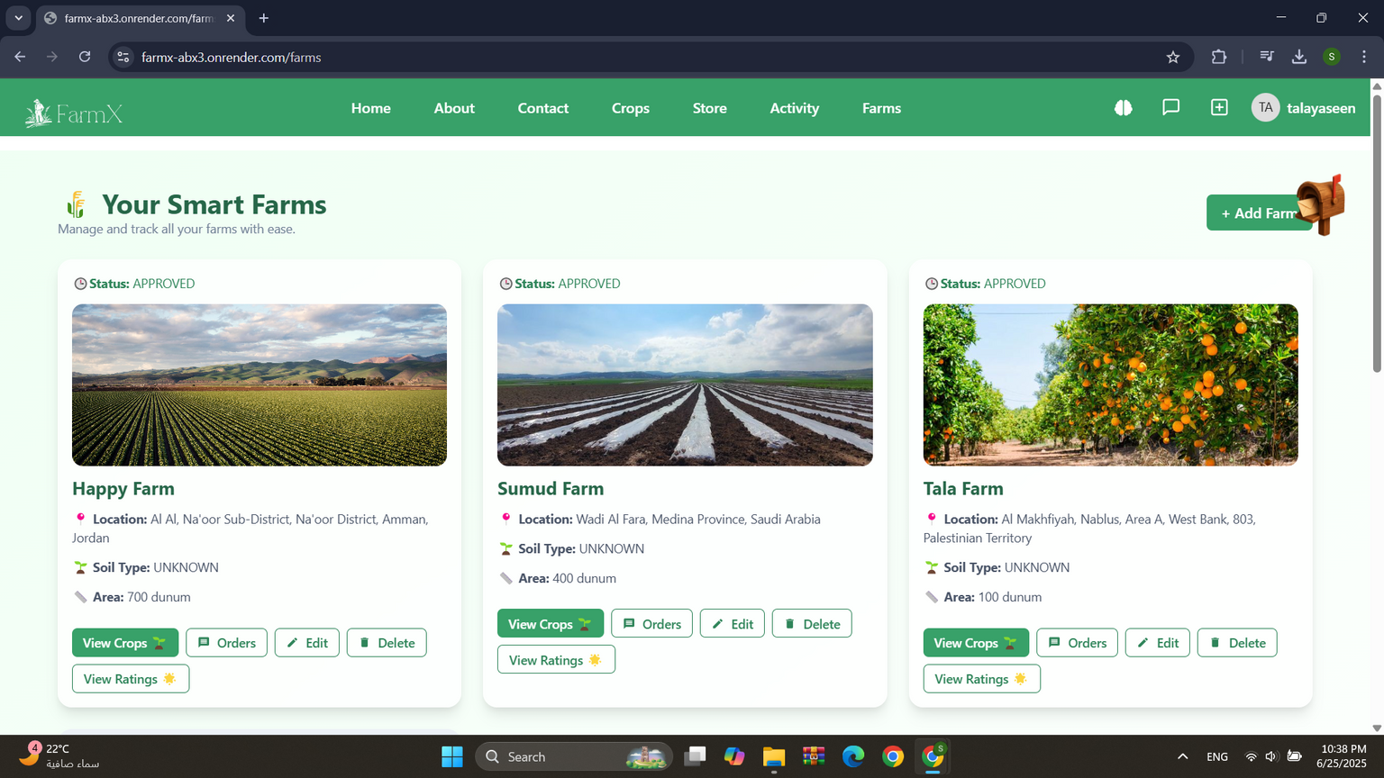


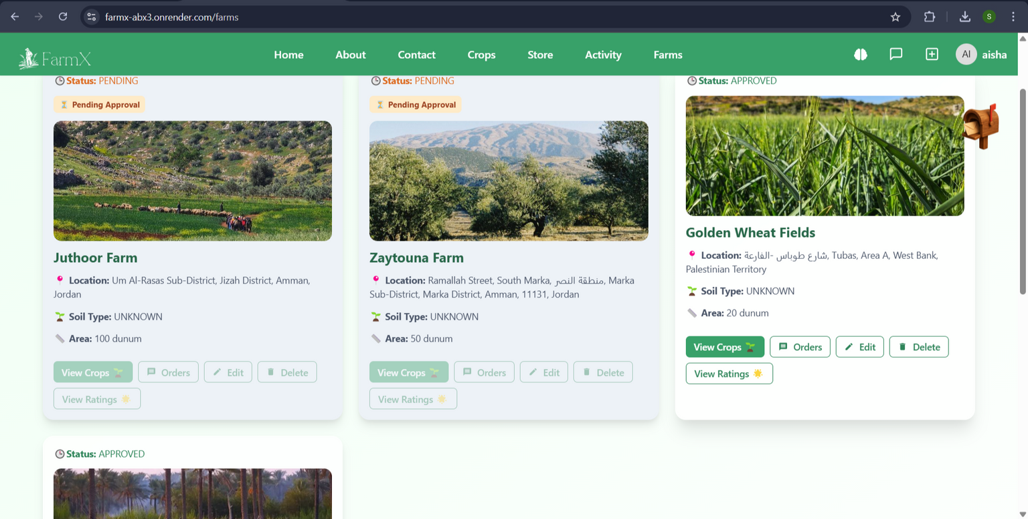
Farms Page:
approved Farm
Pending Farm

Slide 23
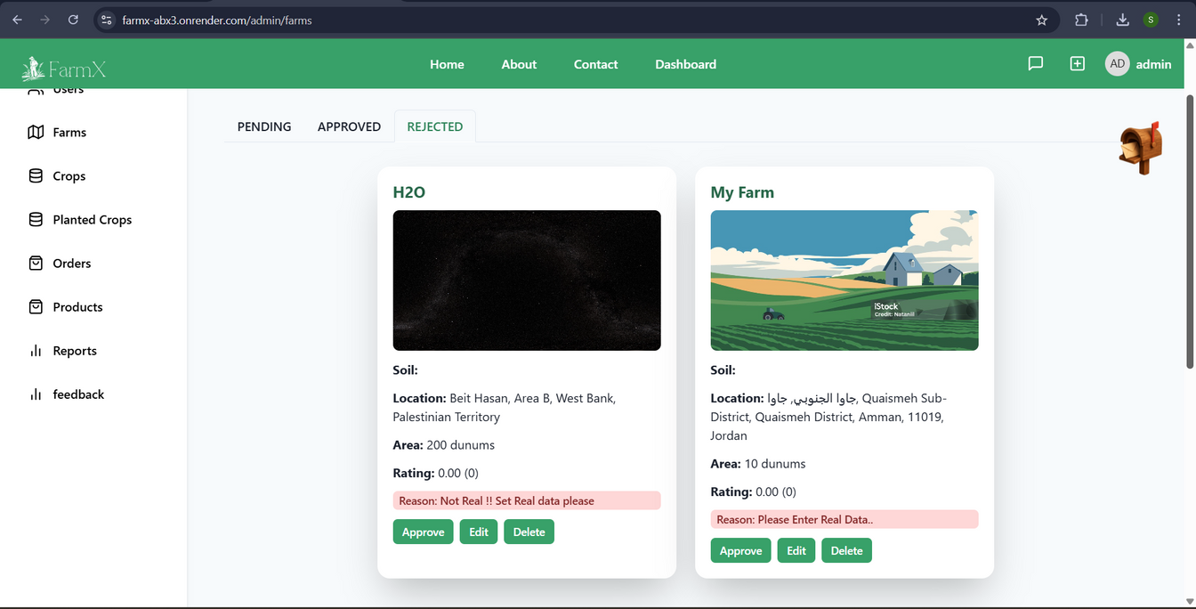
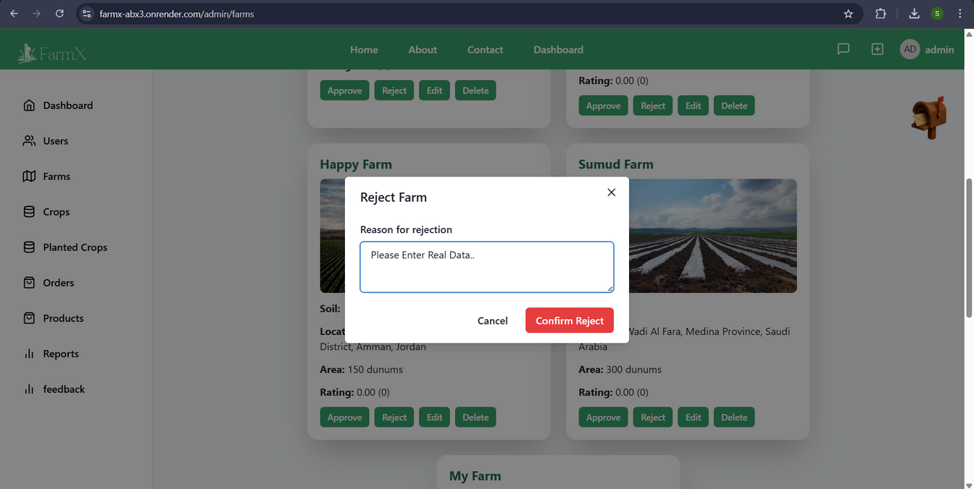
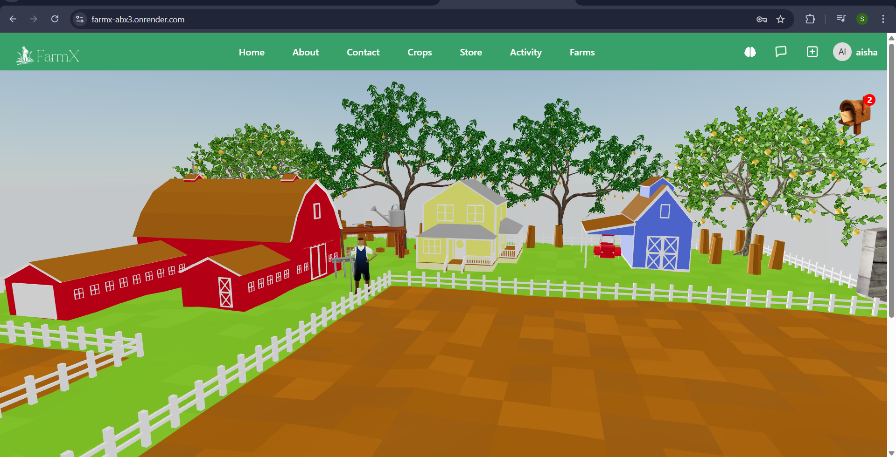
Farm Rejection :
Reason for rejection
after rejection

Slide 24
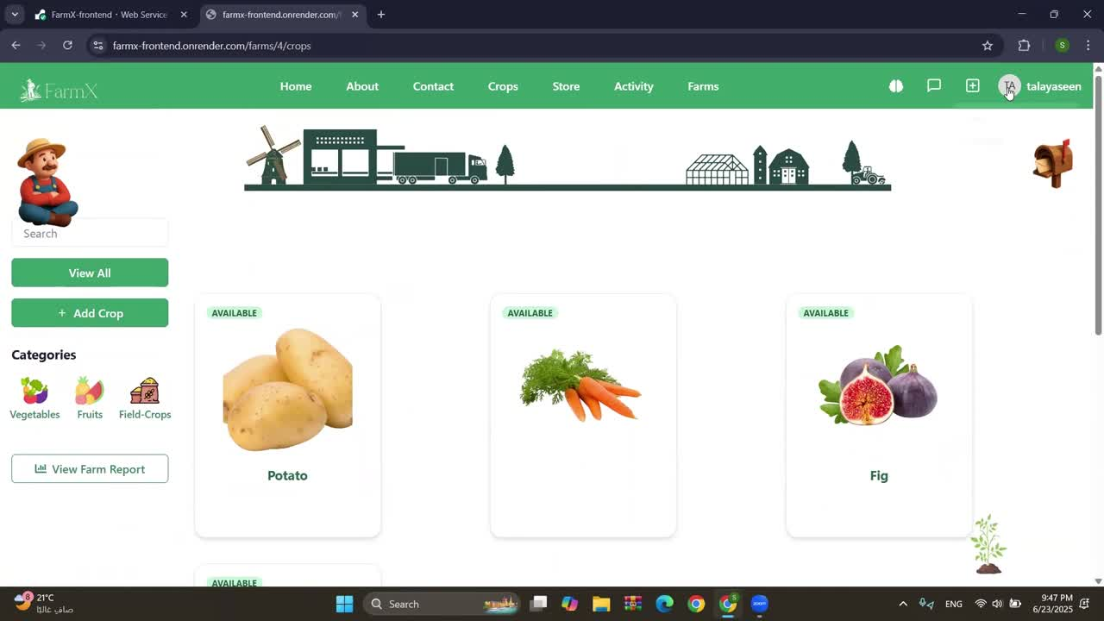
Crops :

Slide 25
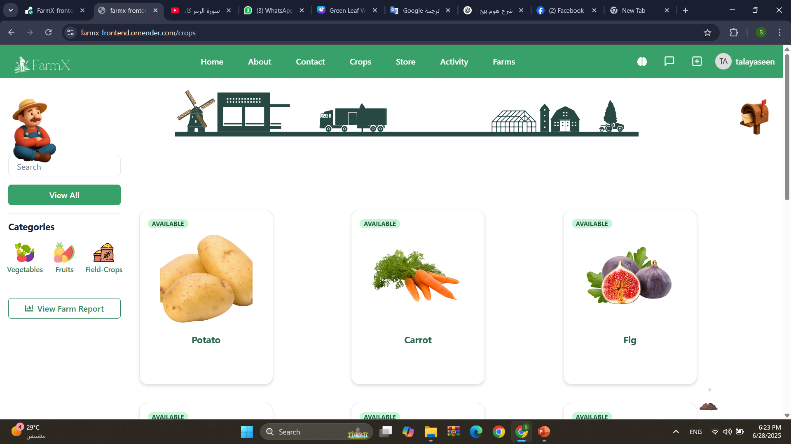
All Planted Crops :

Slide 26
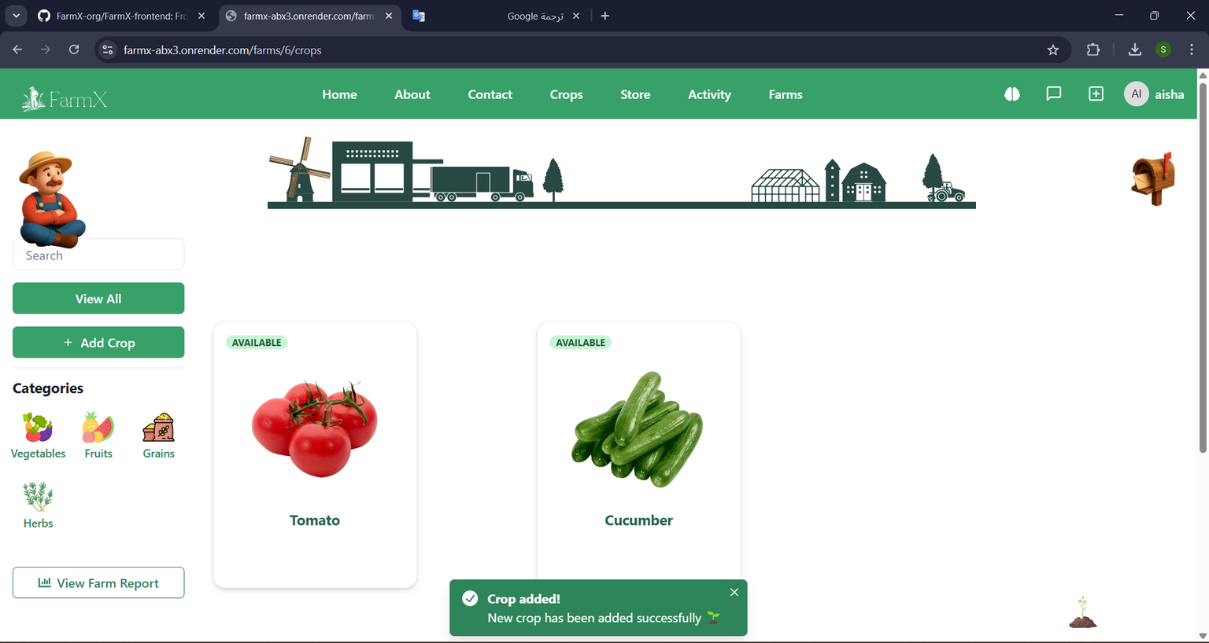

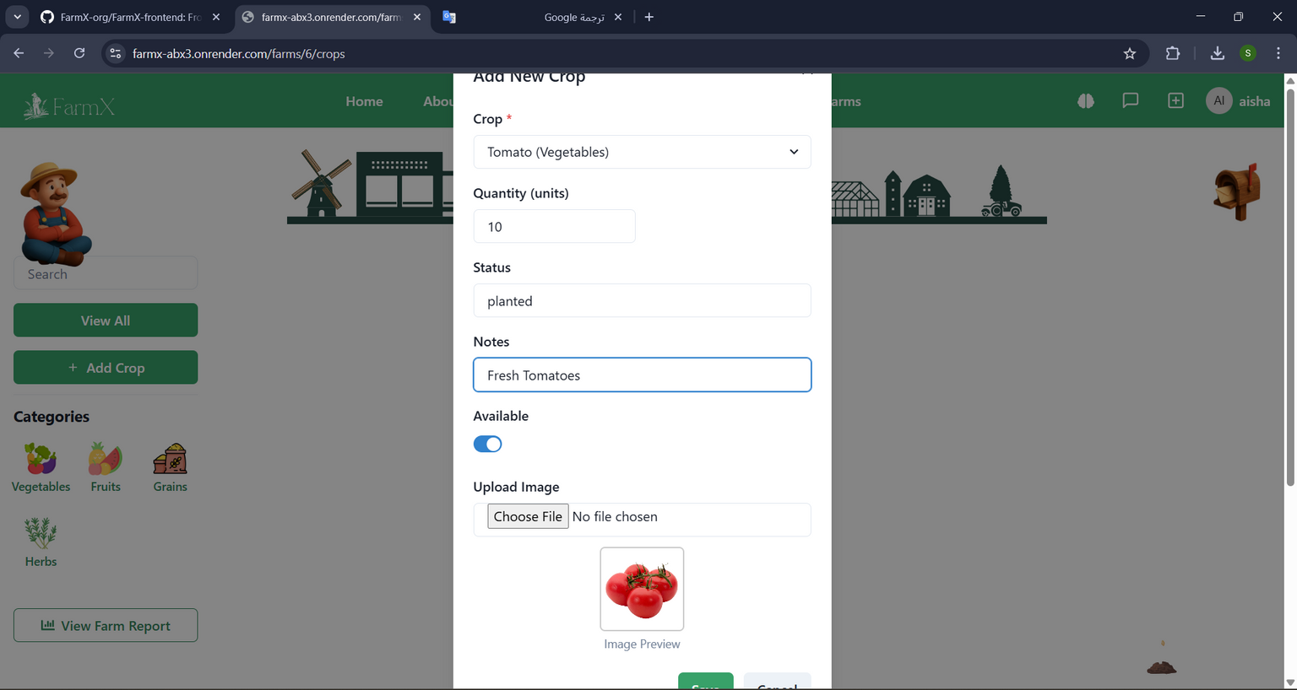
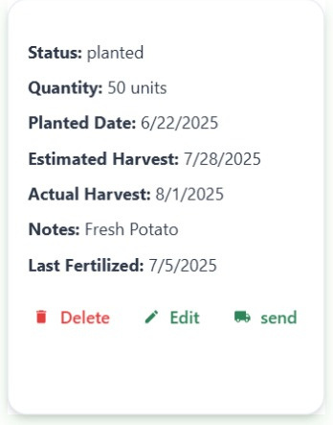
Add Planted Crop :
After Add

Slide 27
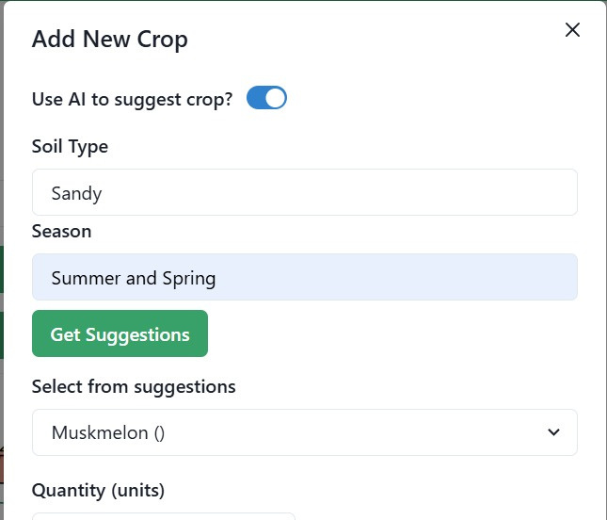
Add Planted Crop Ai :

Slide 28
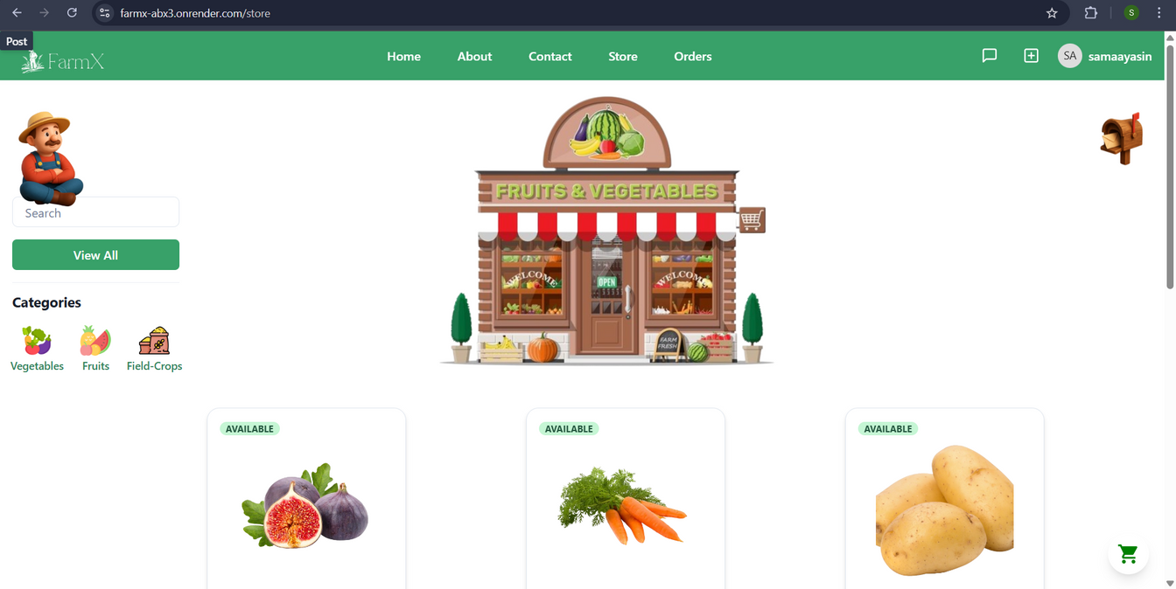
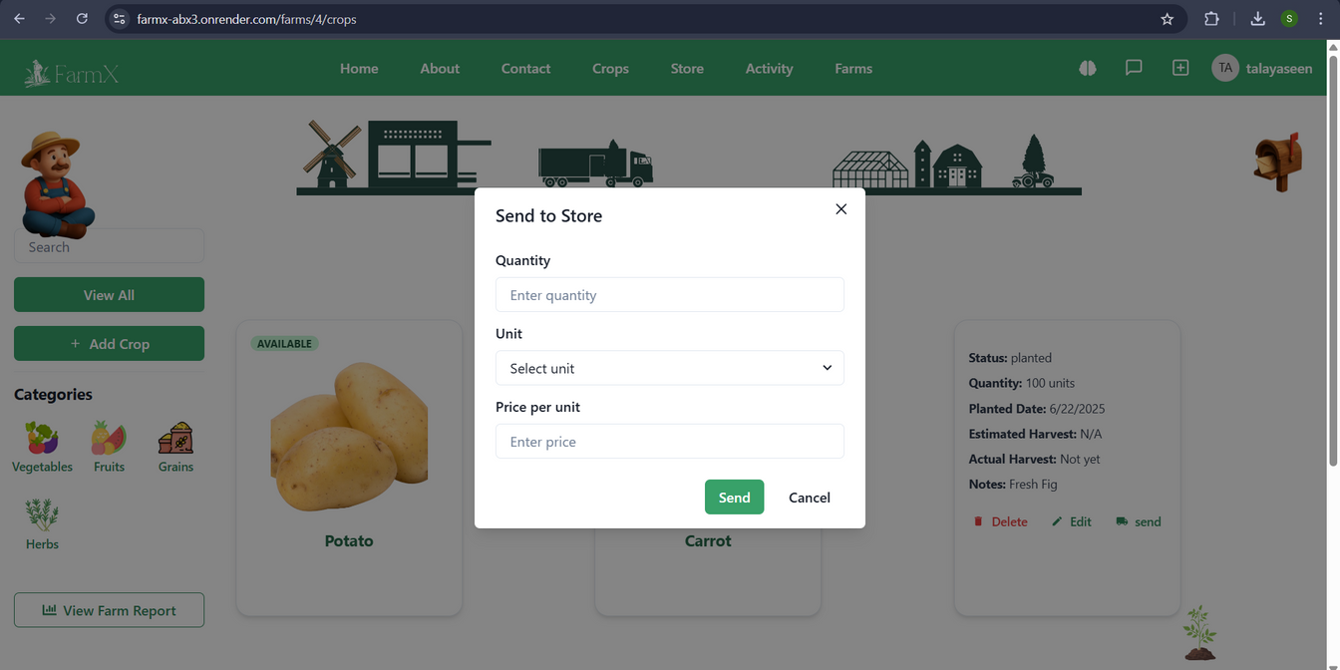
Send Crop to store :
After Send

Slide 29
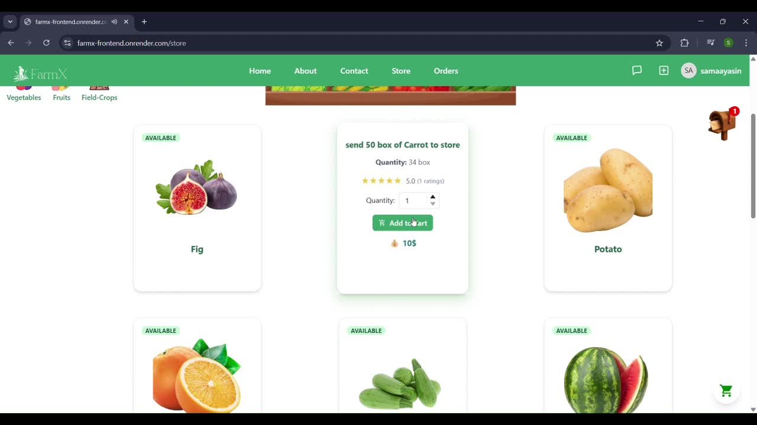
ADD To Cart :

Slide 30
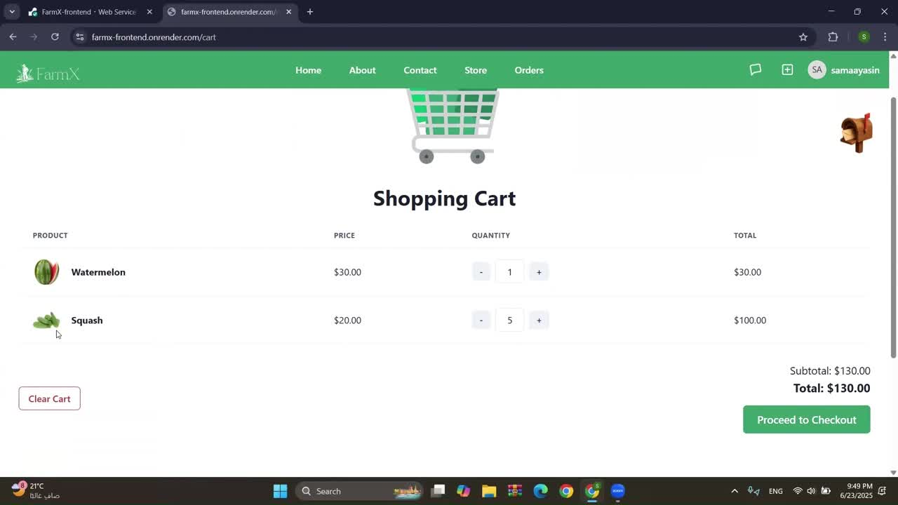
Cart & CheckOut:

Slide 31
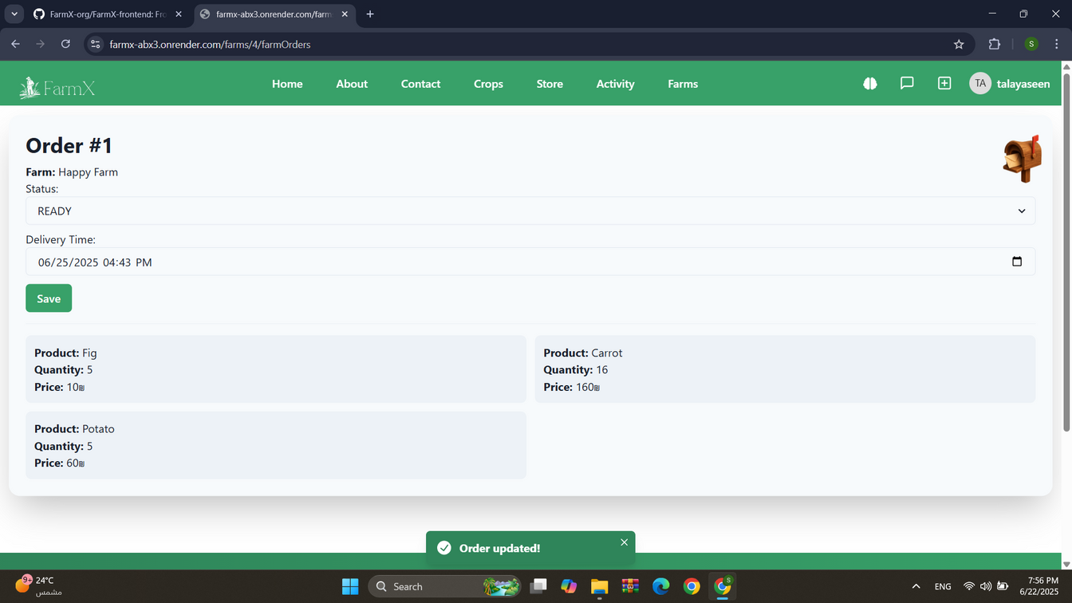
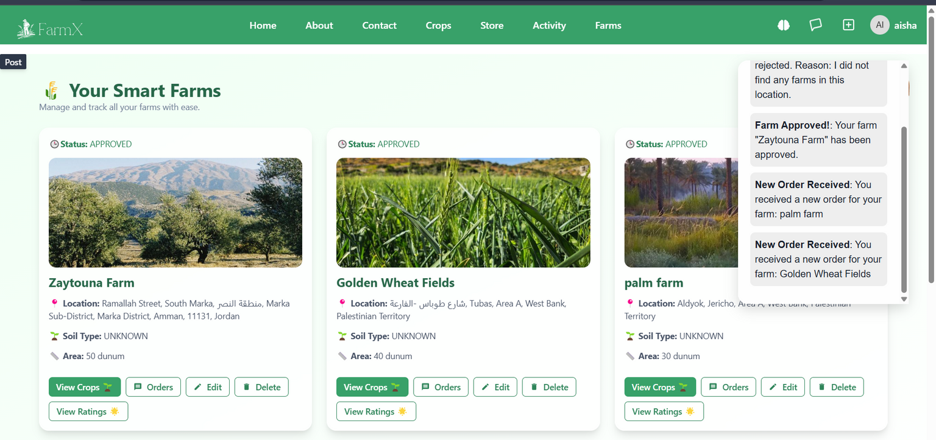
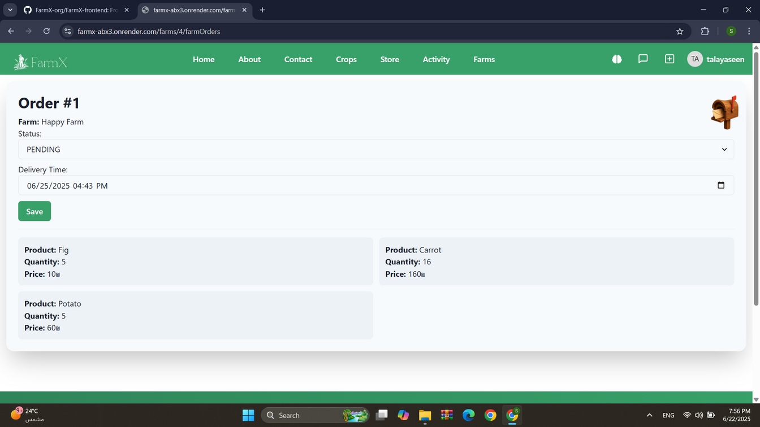
Farm orders :
Ready
Pending

Slide 32
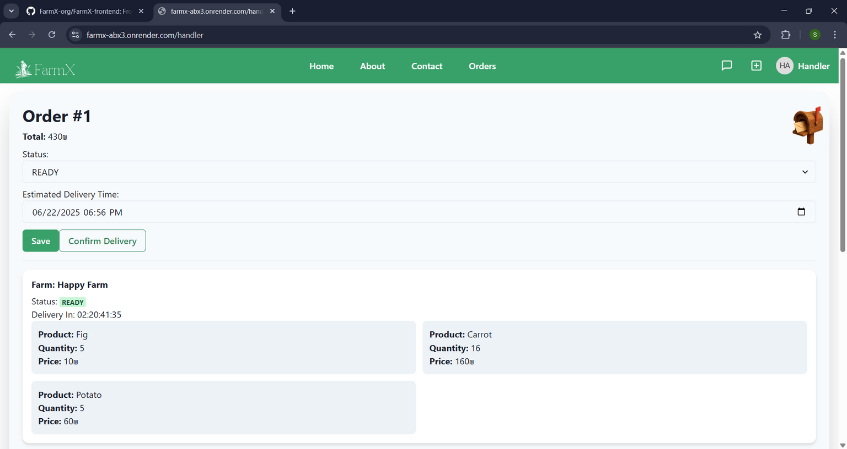
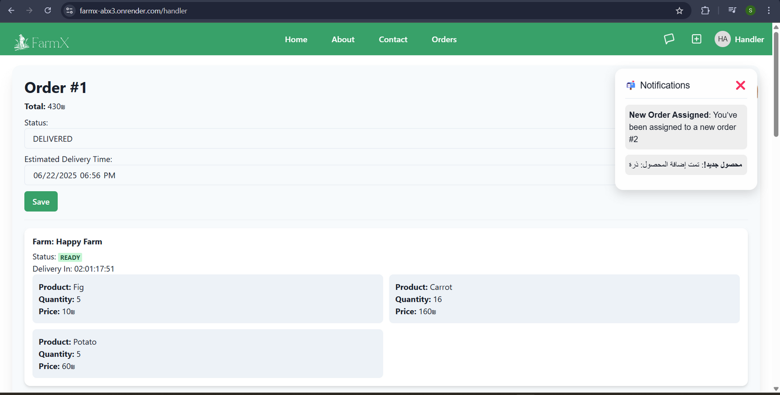
Handler :

Slide 33
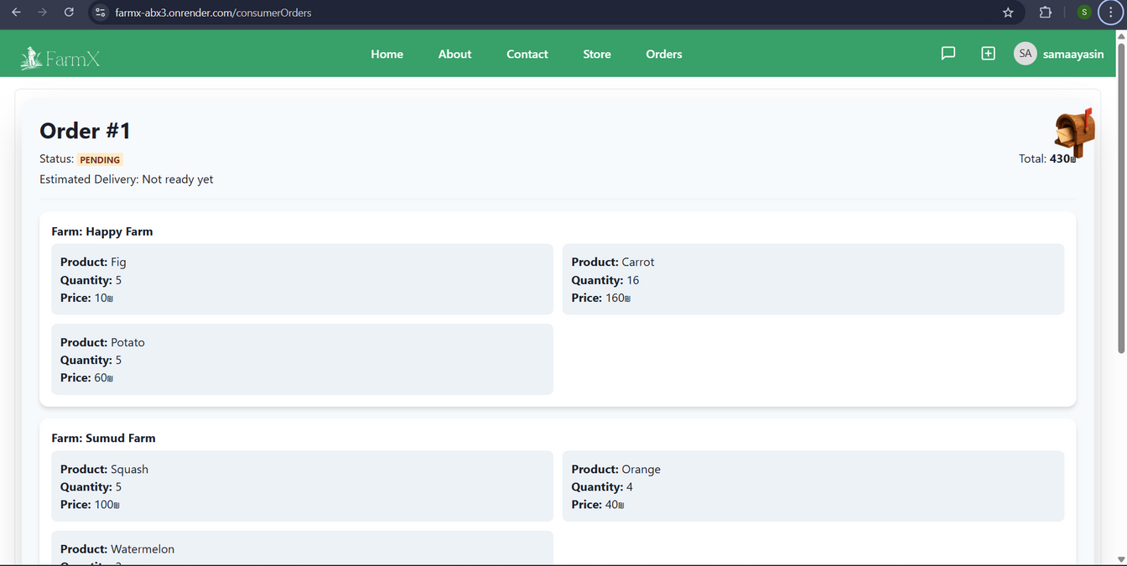
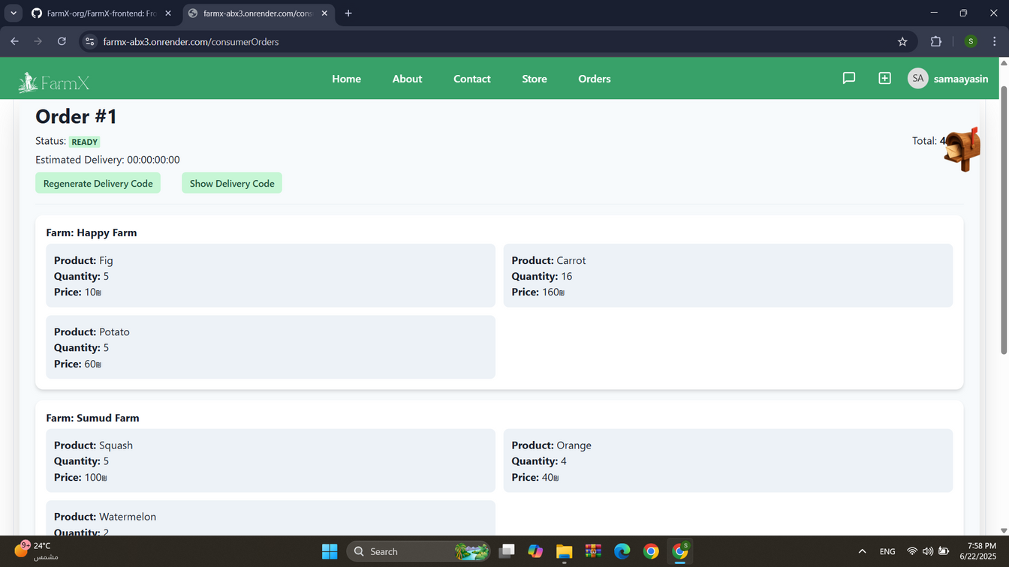
Consumer order:

Slide 34
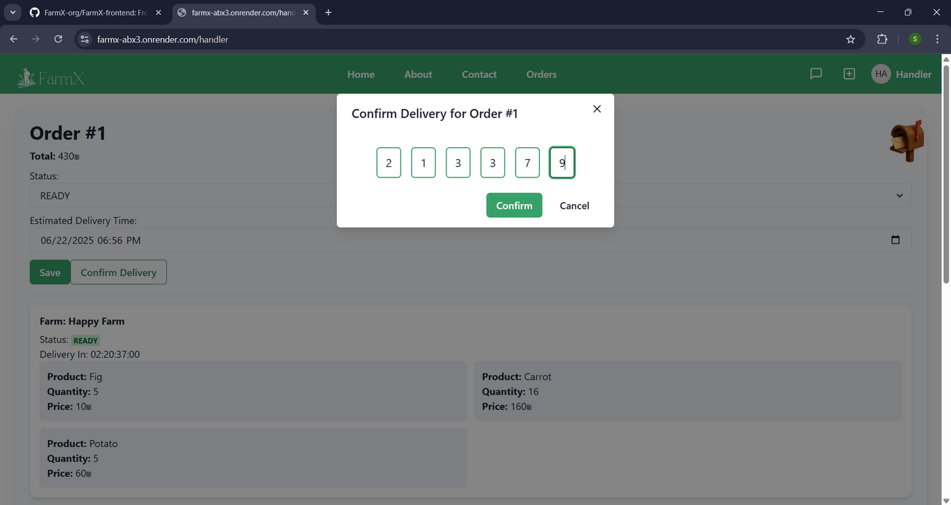
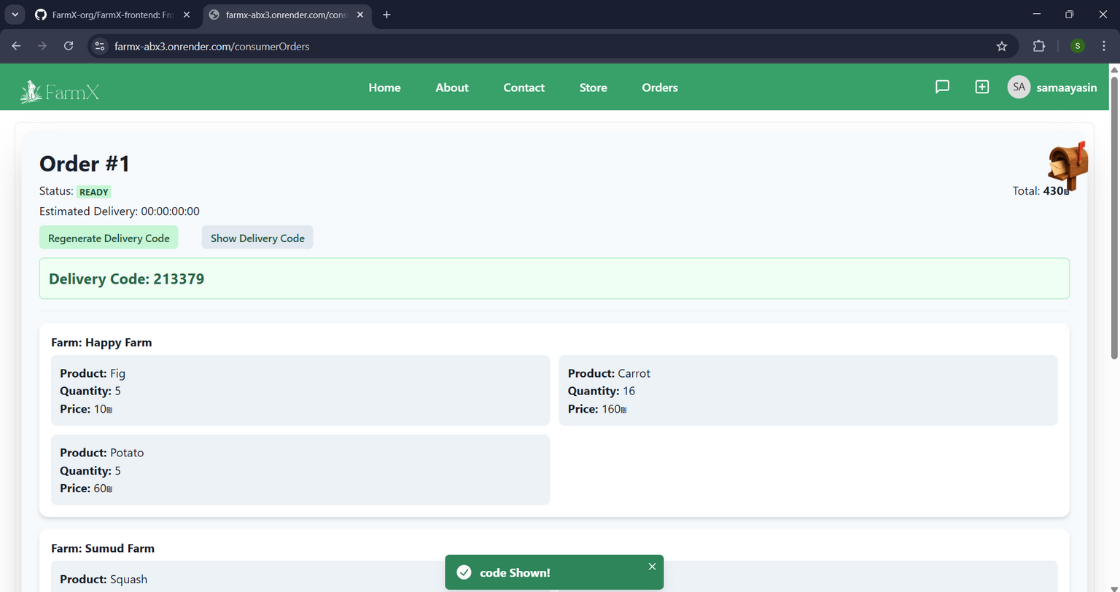

Confirm Order:

Slide 35
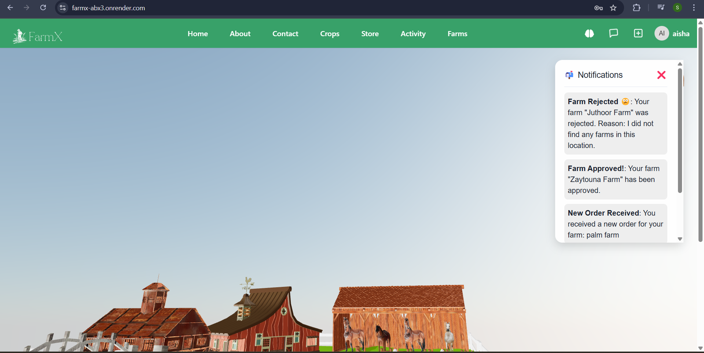
Notification :

Slide 36
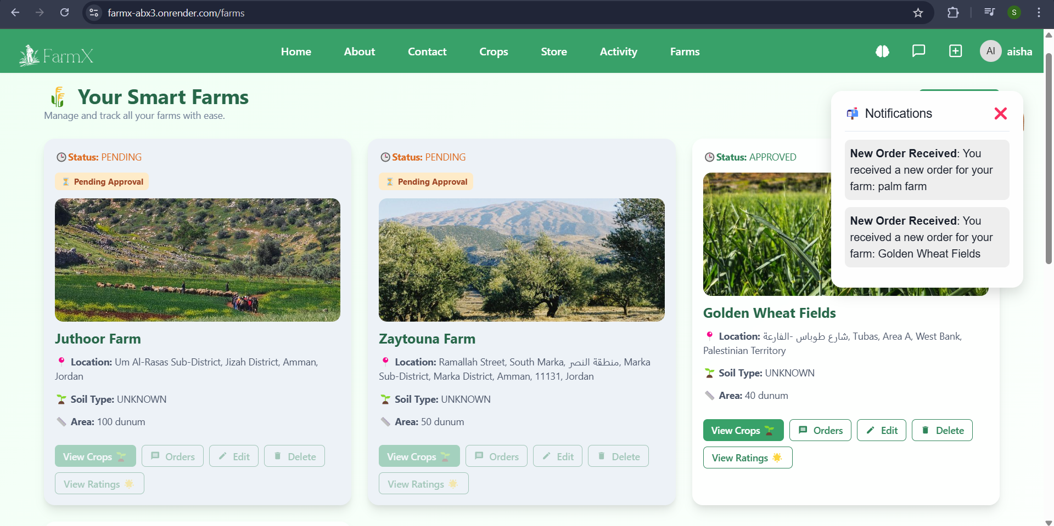

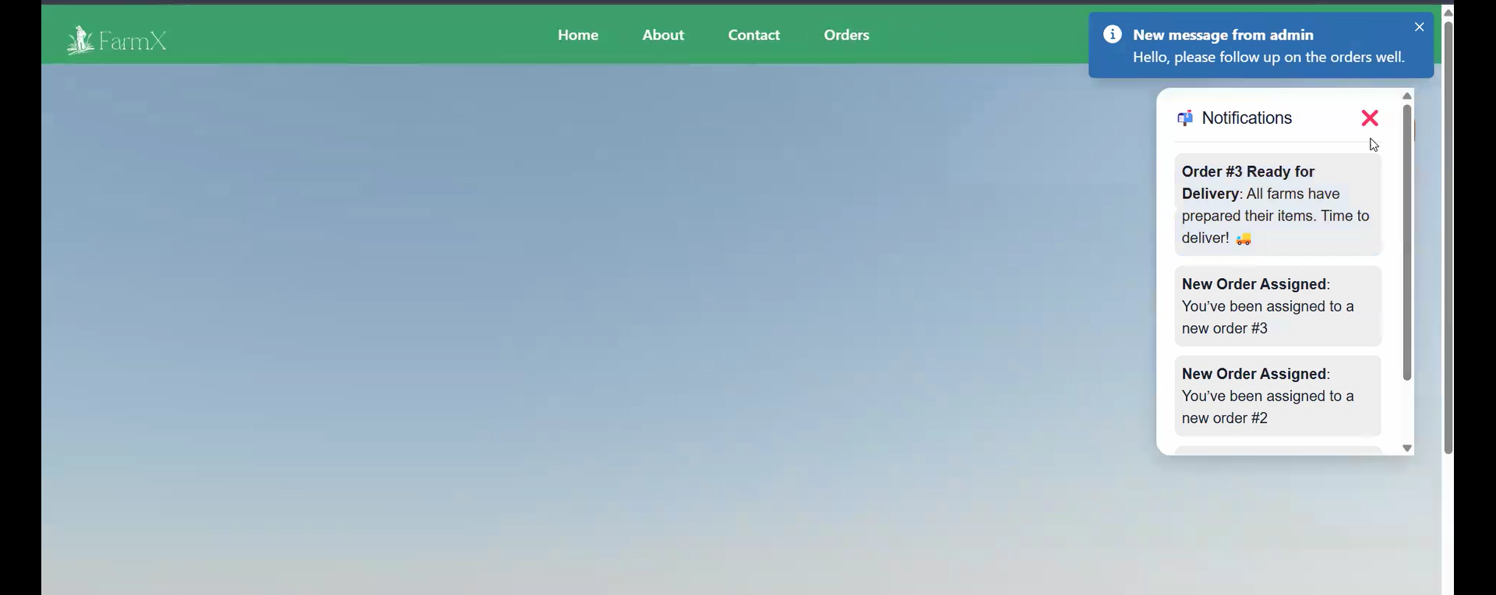
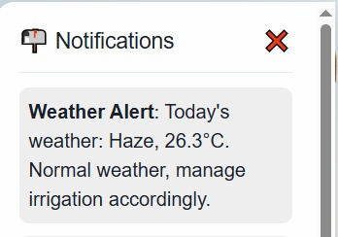
Consumer Notification
Handler Notification
Farmer Notification

Slide 37
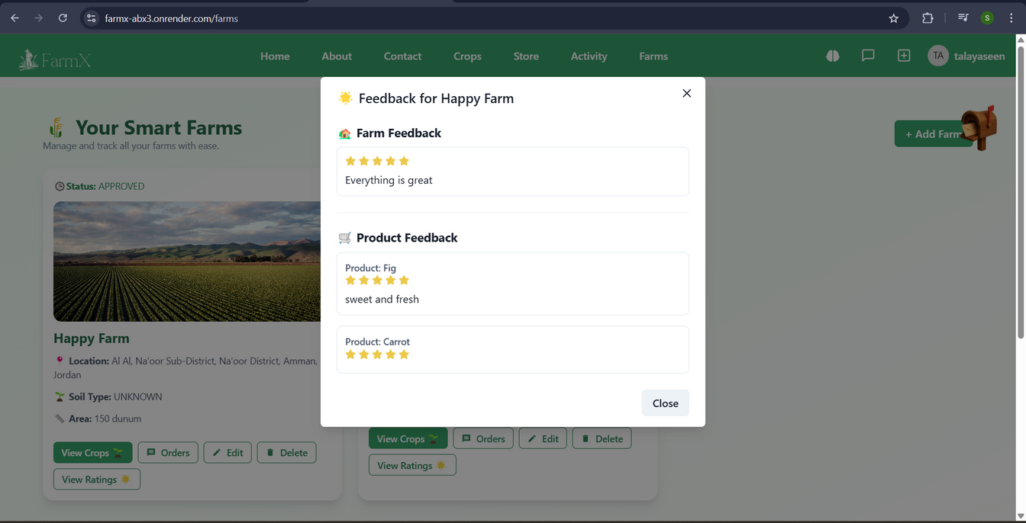
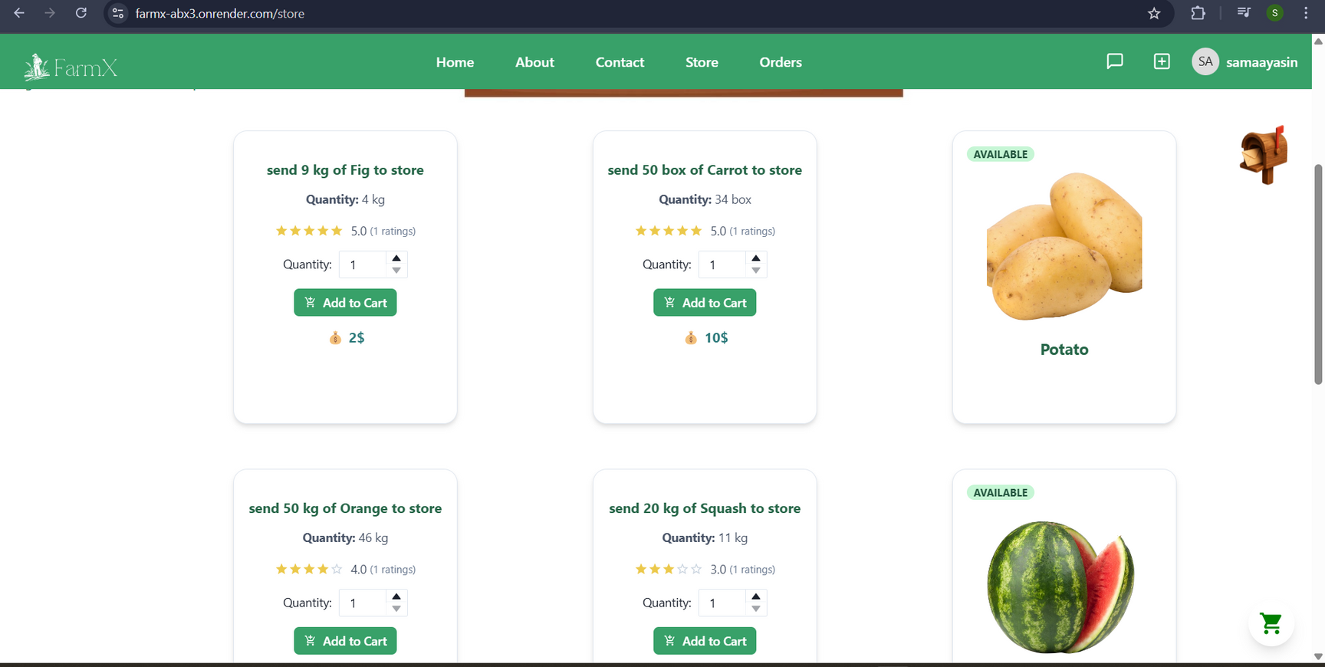
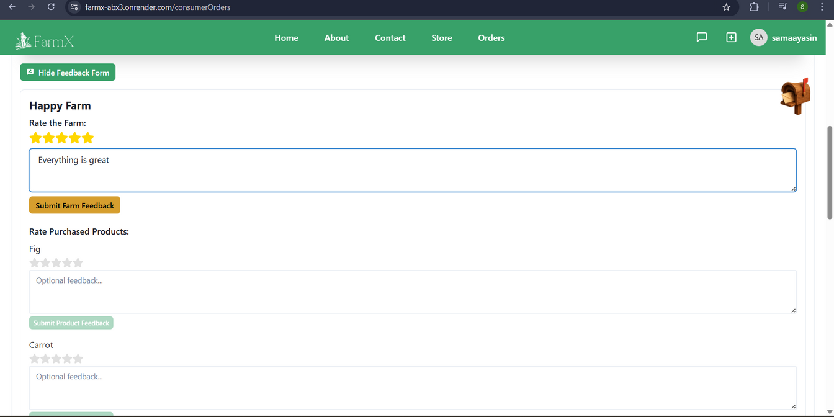
Rate & Feedback :

Slide 38
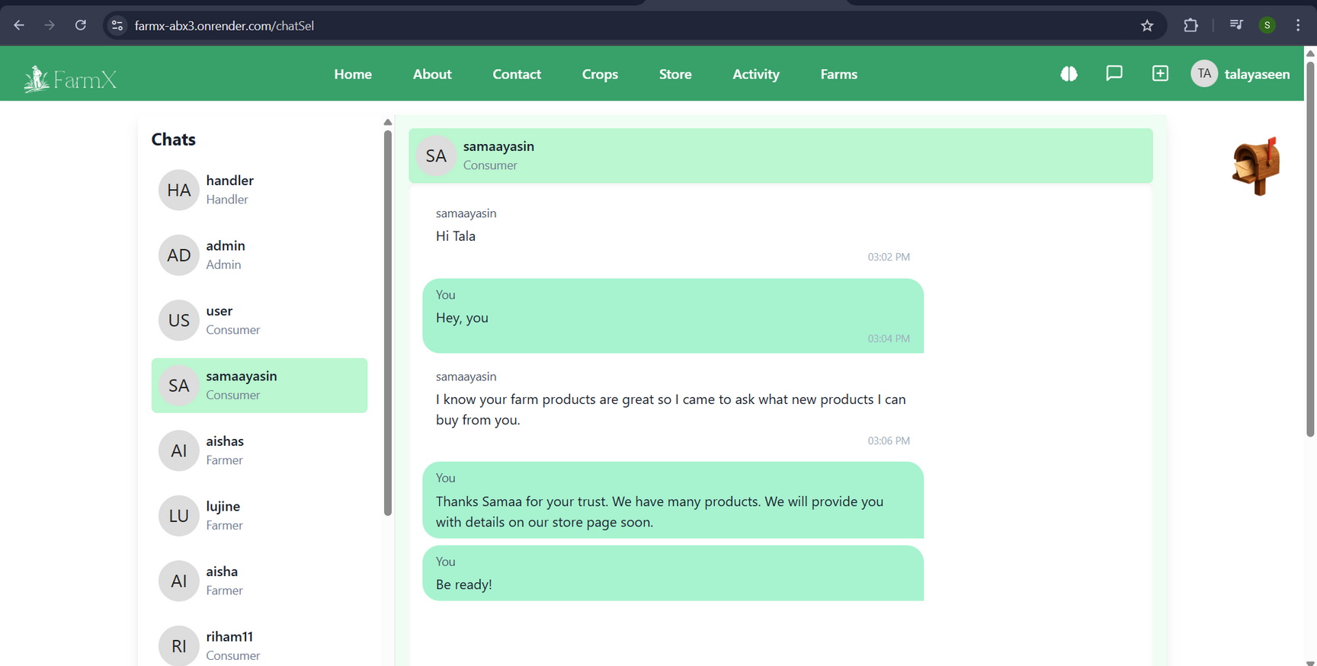

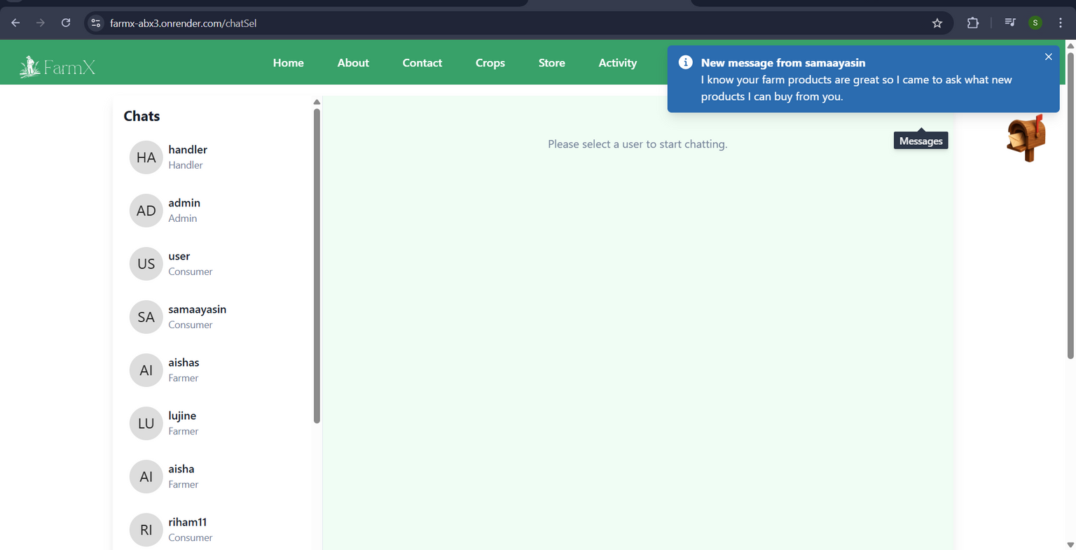
Chatting :

Slide 39
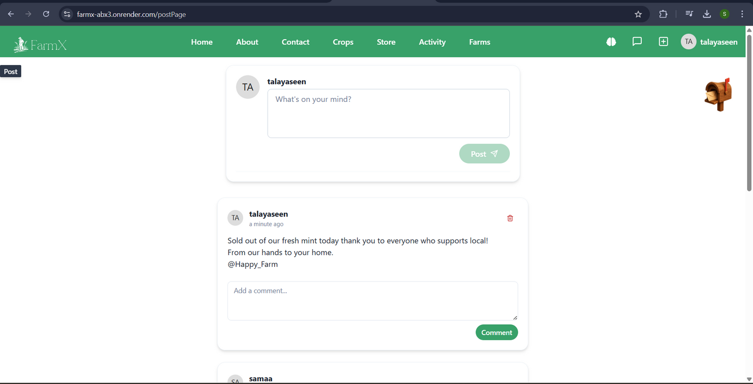
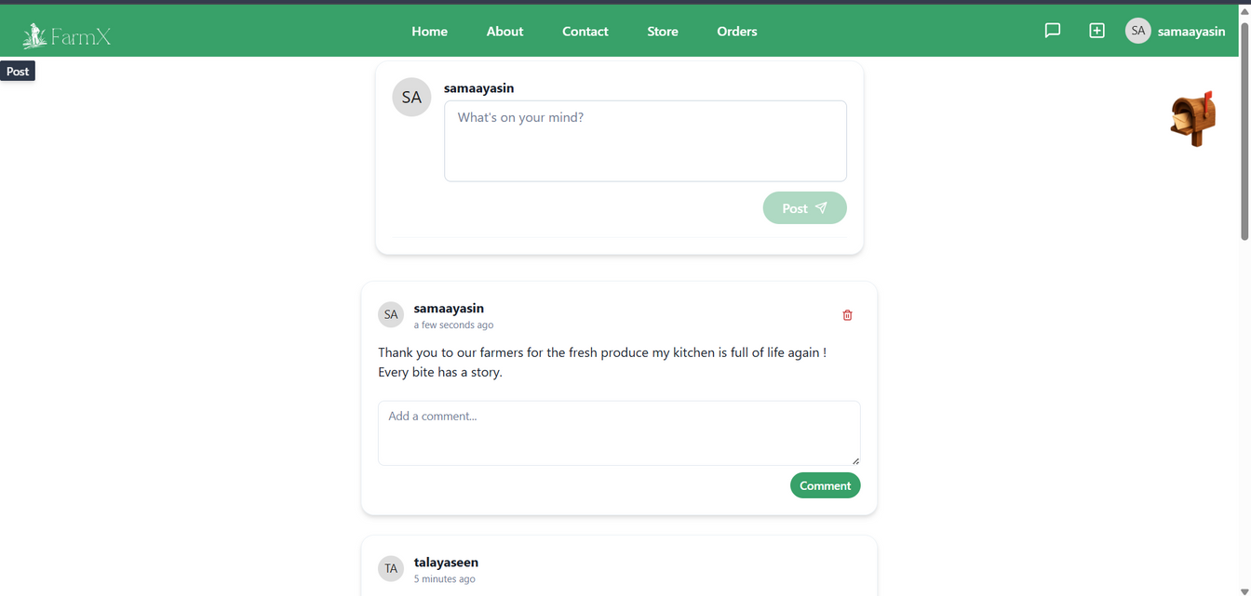
Posts :

Slide 40
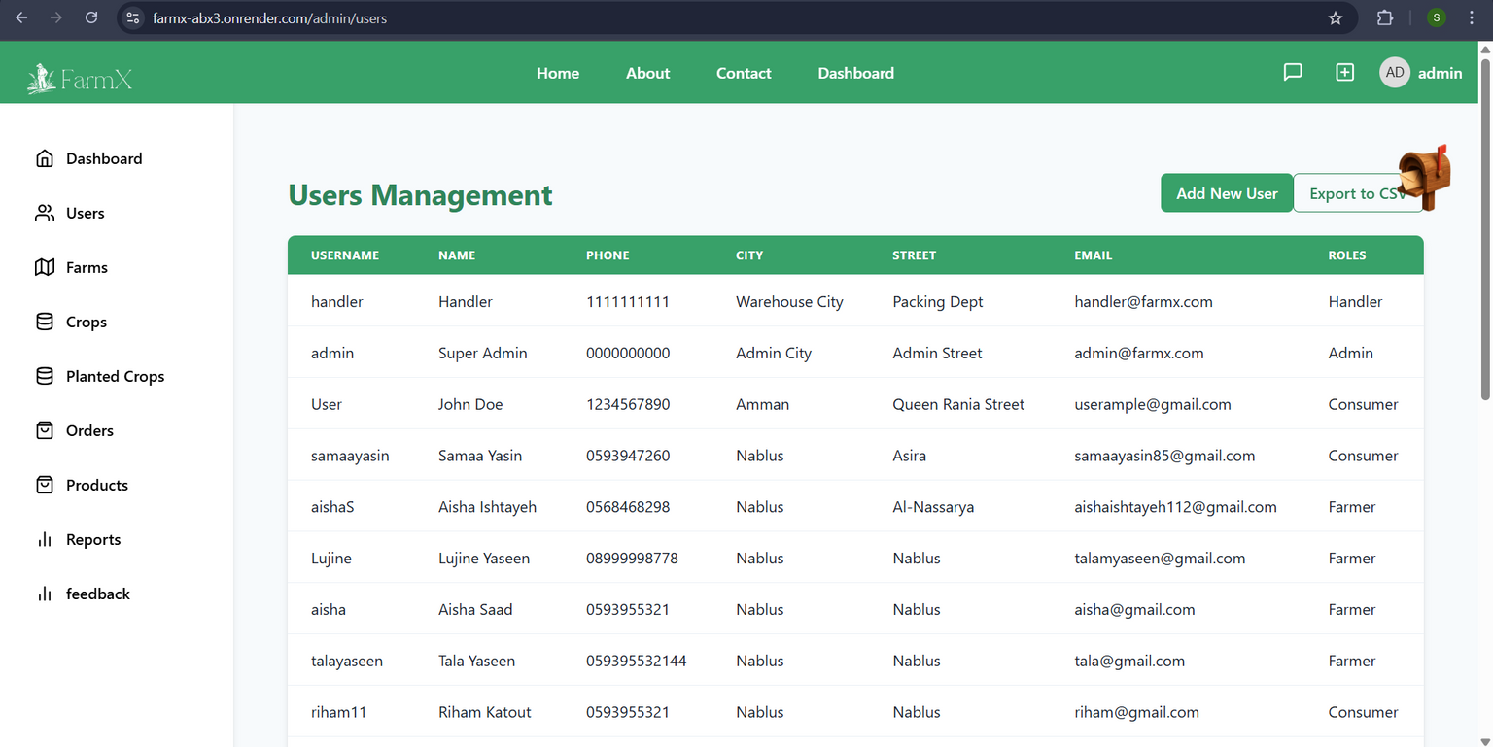

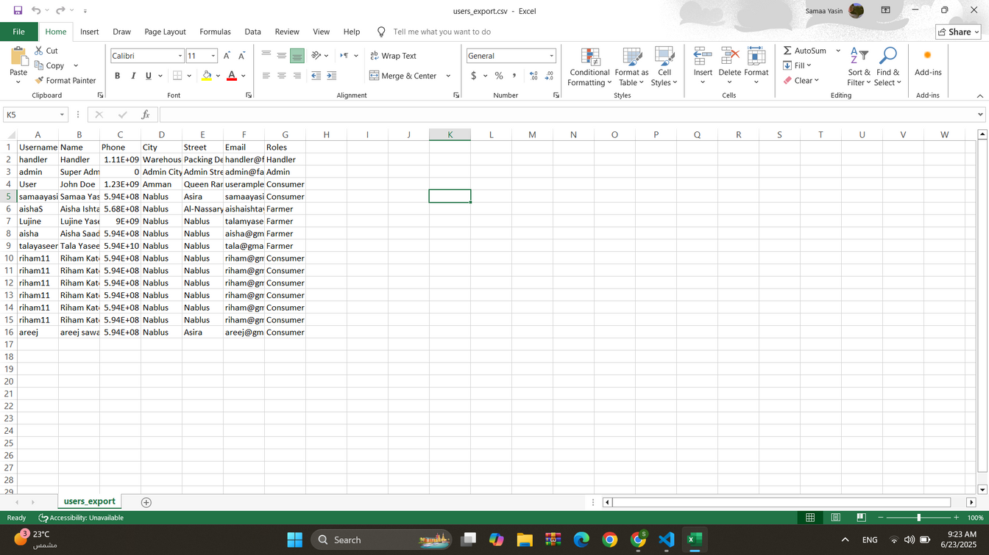
Admin :
added by the admin only

Slide 41
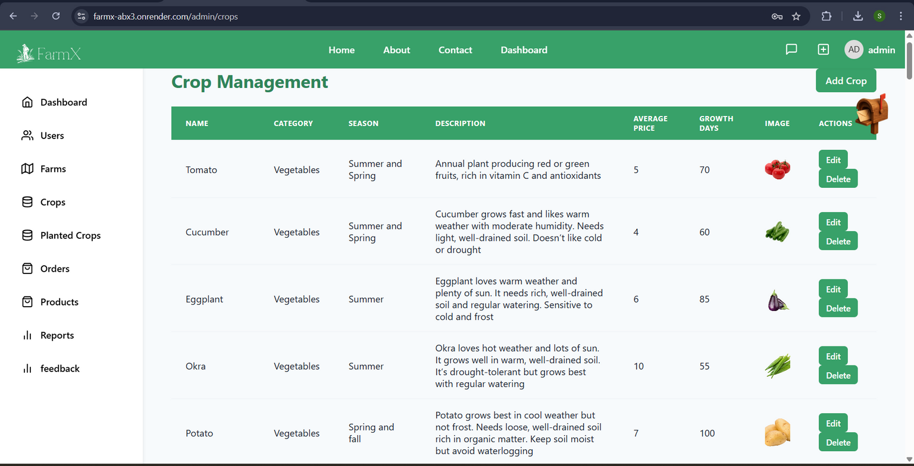
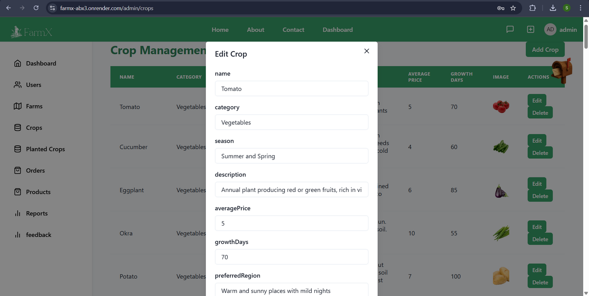
Admin :

Slide 42


Admin :

Slide 43


Admin :

Slide 44

Admin :

Slide 45


Admin :

Slide 46
Mobile Application

Slide 47





Slide 48




Slide 49




Slide 50





Slide 51
Constraints
  Limited soil data for all regions → manual entry needed
  Outdated agriculture statistics → weaker AI decisions
  Notification issues → switched to Firebase Notification
  Cloud resource limits → affected performance

Slide 52
Future Work
  AI Crop Health: Detect diseases from satellite images, suggest treatments
  Livestock Management: Track animal health, feeding, and breeding

Slide 53
Conclusion
In the end, our project aims to help farmers and consumers connect in an easy and modern way. We tried to make the system clear, useful, and comfortable for all users. We enjoyed working on it and learned a lot during the process.

Slide 54
Thank
You

