Slide 1
YOUR FUTURE
Eman Qaqa
Dunia Saffarini

Slide 2
Outline
Why you need our website?
Actors of our website.
Project Content.
Programming Languages.
Constrains
Conclusion and Future work.

Slide 3
Why you need our website?
Recommendation system, Advisory system.
Important decision for:
1- 10th Grade students.
2- Tawjehi students.
3- University students.

Slide 4
Actors of our website
1-Admin.
2-Students.
3-Advertisers.

Slide 5
Project Content.
Personality.
Marks.
Relationship between users and Companies
or Training centers.

Slide 6
Personality
Why we should consider personality in choosing
major?
History of MBTI
Why we choose the MBTI personality Test ?
1) 16 personalities .
2) Trusted and Reliable test and can be converted to
another tests
3) 89 from 100 companies used it in HR.

Slide 7
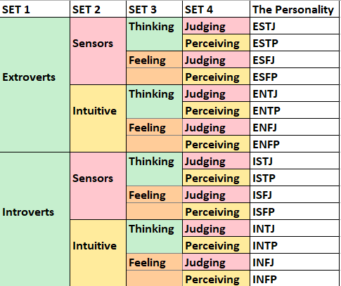
Personality-MBTI Test

Slide 8
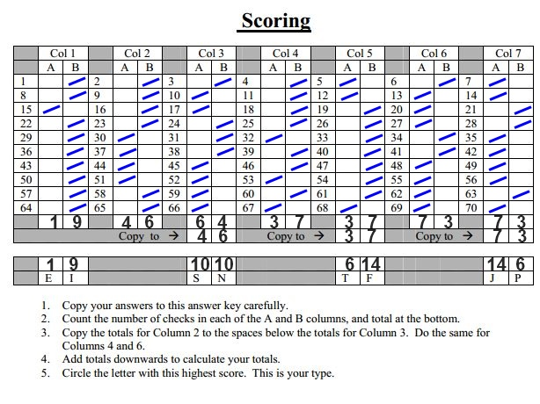
Personality-MBTI Test

Slide 9
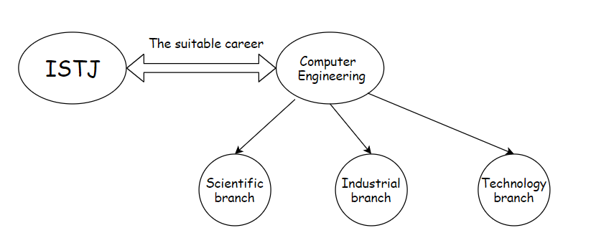
Personality-Education Major match
The best Education section for each MBTI
personality ?

Slide 10
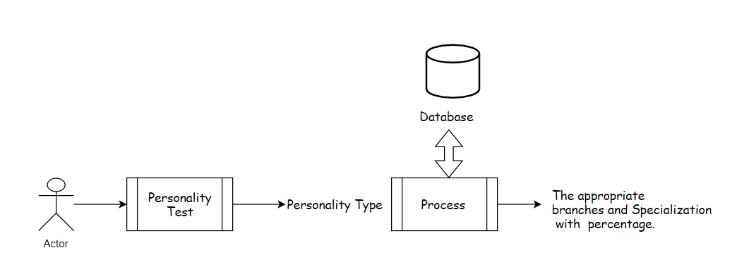
Personality-Education Major match

Slide 11
Marks
Why we should consider Marks in choosing major?
First impression for the suitable branches
Second main condition to select the branch

Slide 12
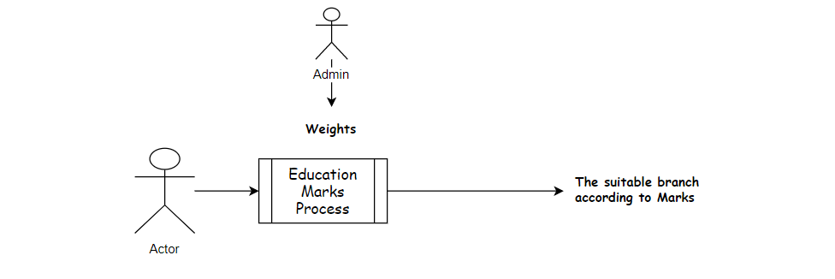
Marks

Slide 13
Relationship between users and Companies
1-What is different in this page ?
2- Skills-personality type match.
Notes:
jj

Slide 14
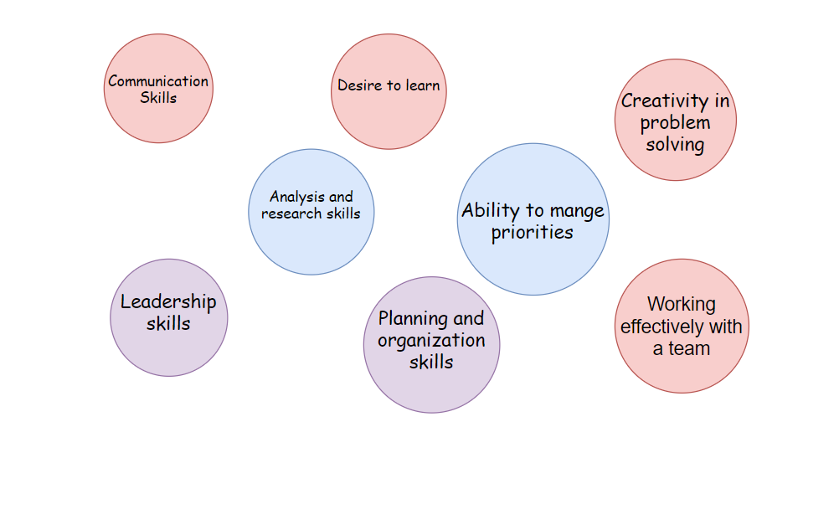
The top skills Employers wants in their Employment Ad.
Scaling 1 to 3

Slide 15
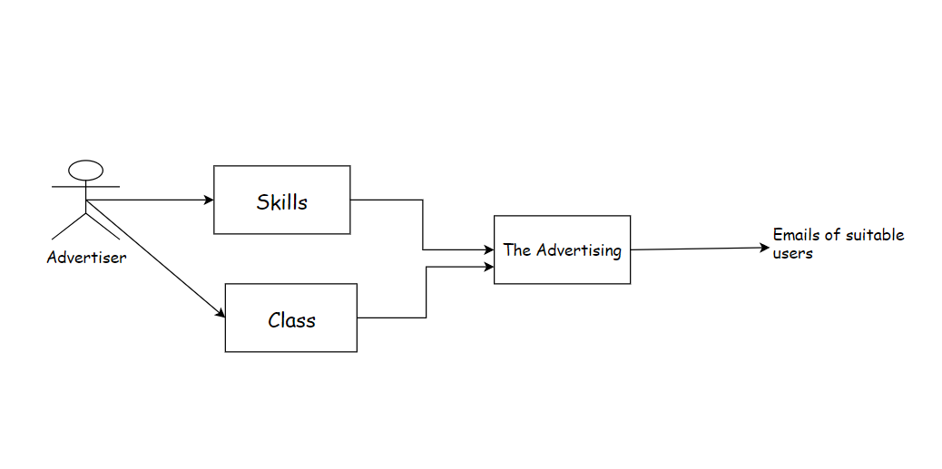
Process

Slide 16
Programming Languages & Tools
1)HTML , JavaScript , CSS , PHP.
2)AJAX Technology.
Tools: 1) PhpStorm.
2) XAMPP Control panel
3)PHP myAdmin.

Slide 17
Constrains
1-Not all the Specializations are exist
in our Universities.
2-There is no specific threshold to
enter a specific branch.
3-some questions hard to understand
and need more explanation

Slide 18
Future work
1-Add more specializations.
2-Adding more than one test.
3-Generate questions using
machine Learning.

Slide 19
Demo

Slide 20
Thank you
☺

