Slide 1
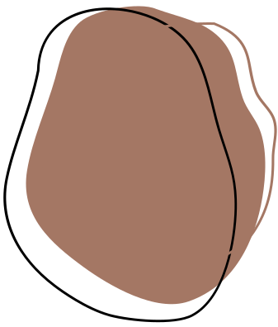
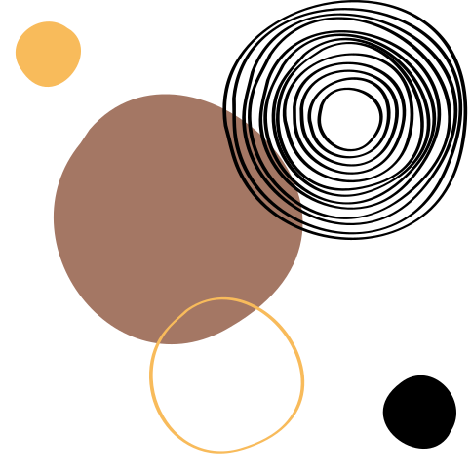

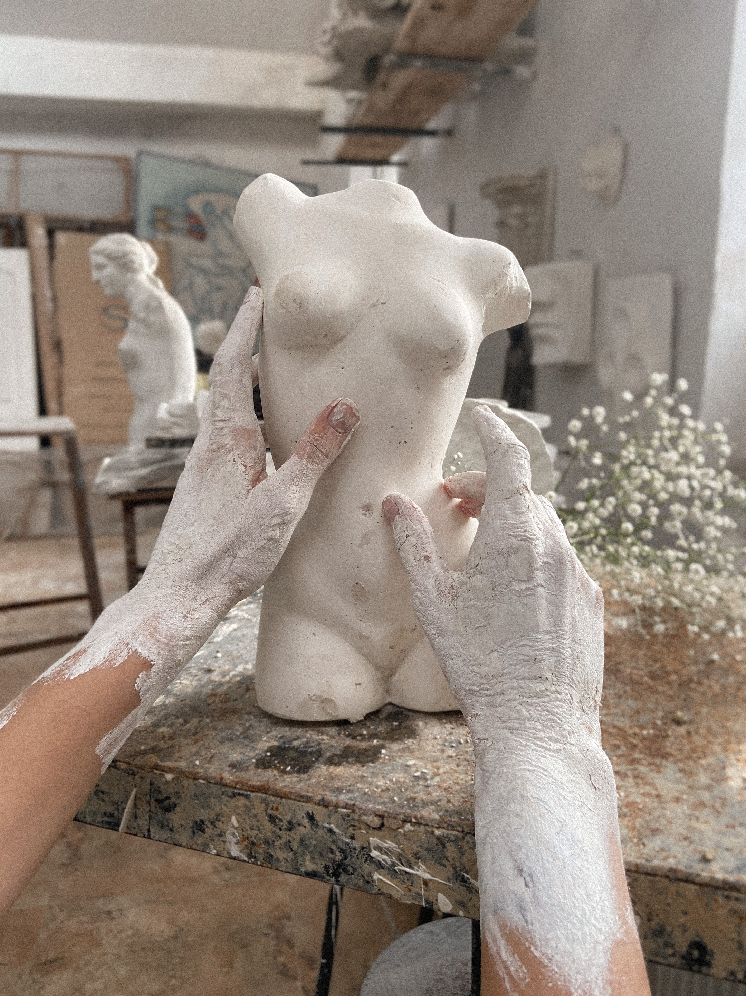
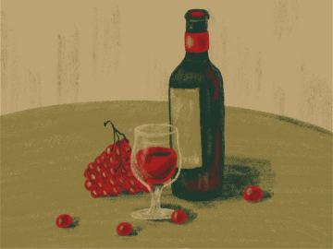
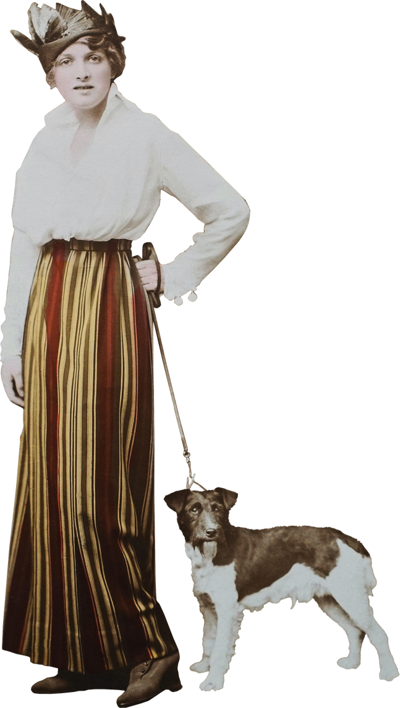
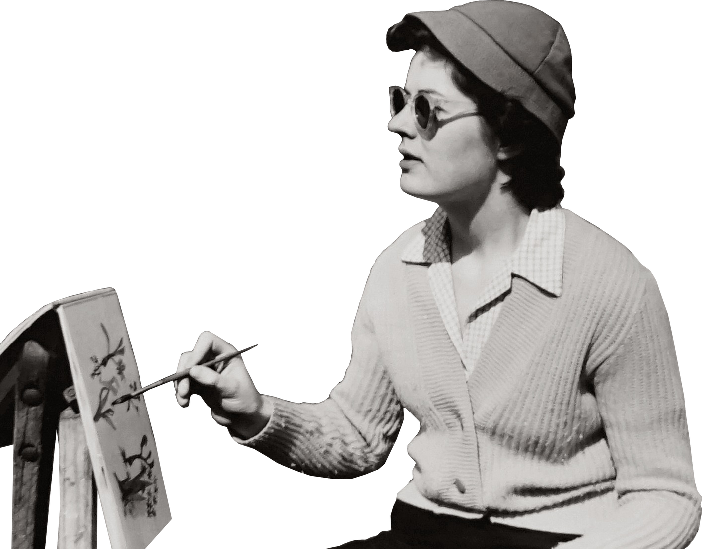
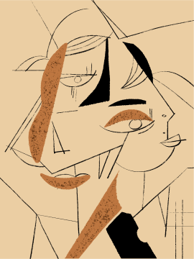

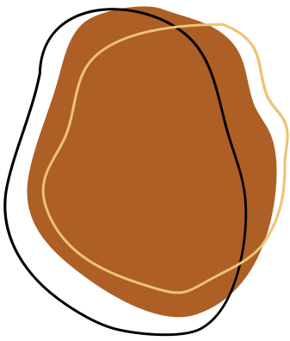
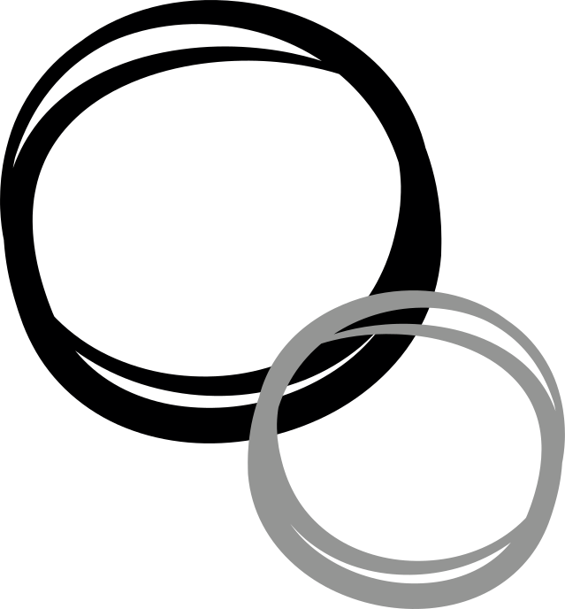
The Artist
By : Nabeel Jamous & Mahmoud Shouli
Supervised By : Dr. Manar Qamhieh &
Dr.Omar Tamimi

Slide 2
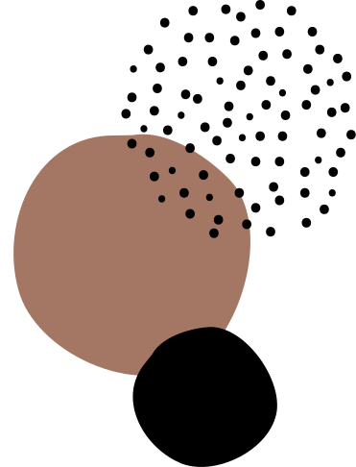

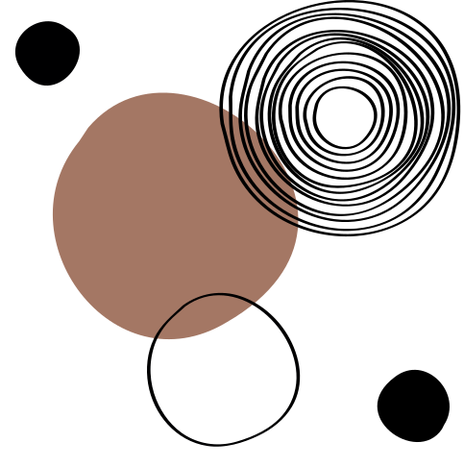
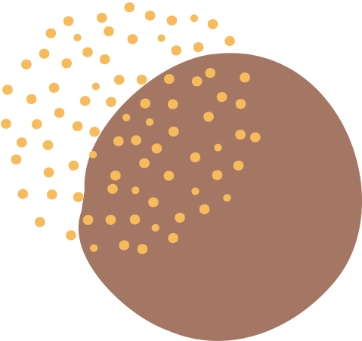
What We’ll Cover
Stage 3
Our Progress
&
Components
Stage 1
Idea&OverView
01
02
Stage 4
Constraints
05
03
Stage 2
Project Pipeline
Stage 5
04
Future Work

Slide 3

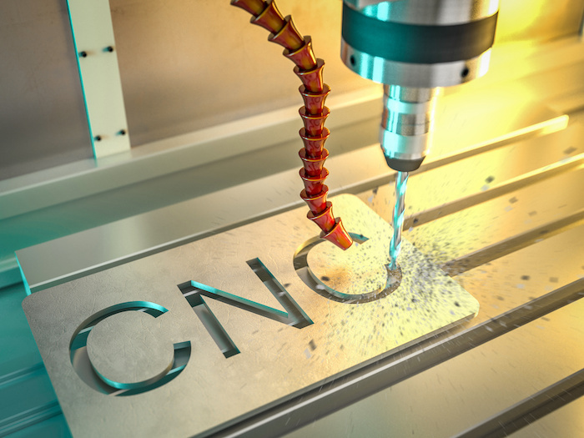
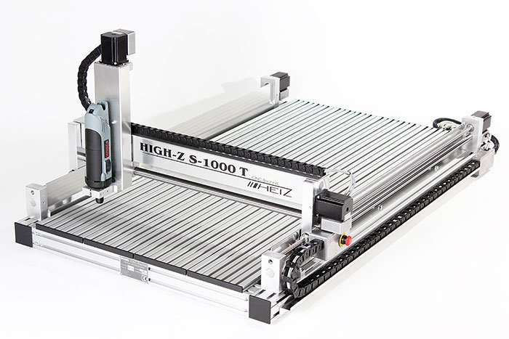
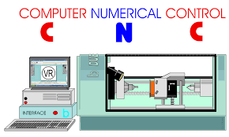
Idea&OverView
CNC : Computer Numerical Controlled Machines
Pen Plotters are part of CNC machines

Slide 4

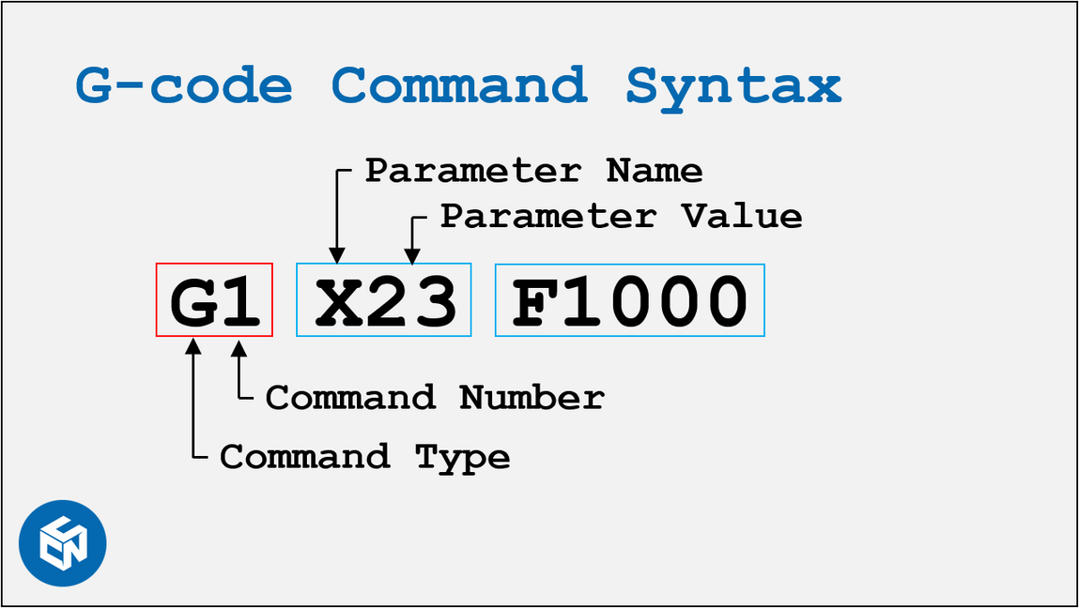
GRBL
G-Code Reference Block Library
GRBL is a free, open source, high
performance software for controlling the
motion of the CNC machine

Slide 5
WHATS
NEW?!

Slide 6
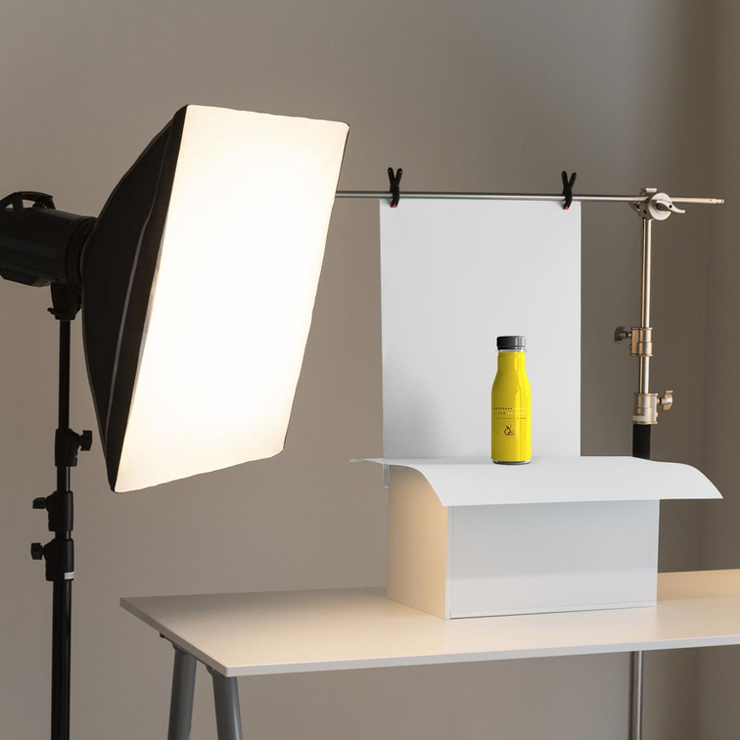
WHATS
NEW?!
  Real-Time Photo & Uploading G-Code Files

Slide 7
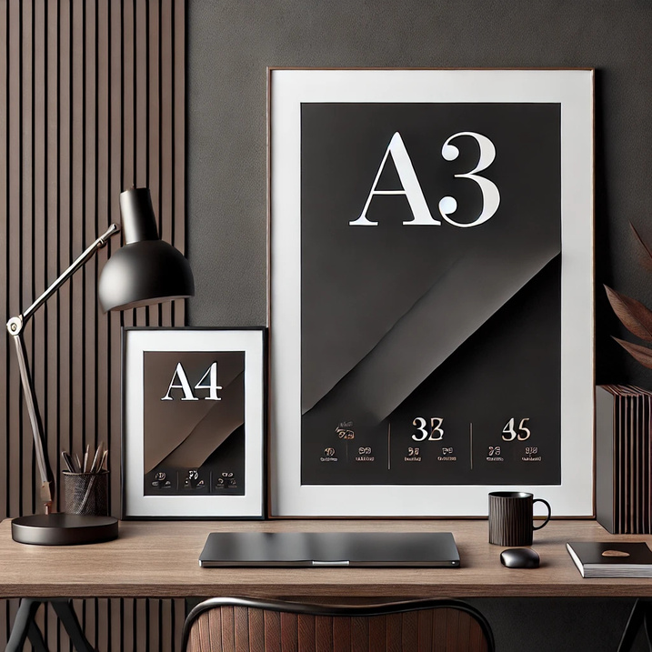
WHATS
NEW?!
  Real-Time Photo & Uploading G-Code Files
  Dynamic Paper Size (A3 & A4)

Slide 8
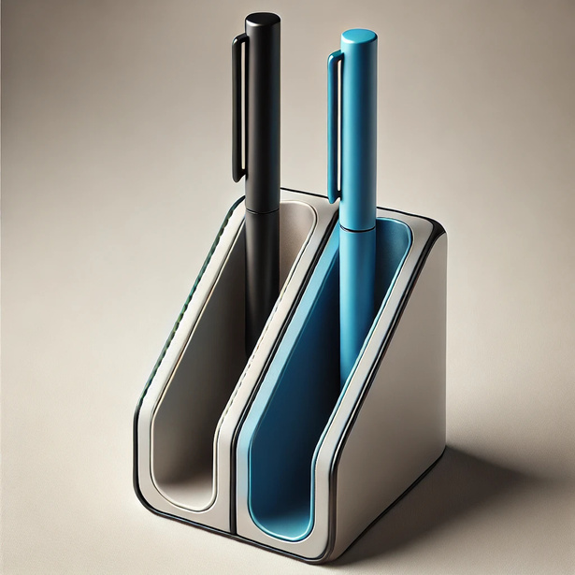
WHATS
NEW?!
  Real-Time Photo & Uploading G-Code Files
  Dynamic Paper Size (A3 & A4)
  Multiple Pen Colors

Slide 9
Project Pipeline

Slide 10
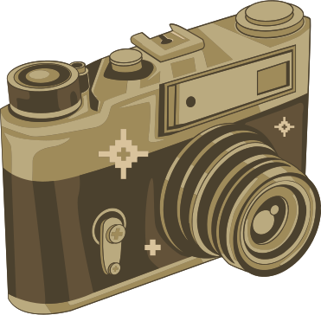

Project Pipeline
  Take a photo
or upload one

Slide 11
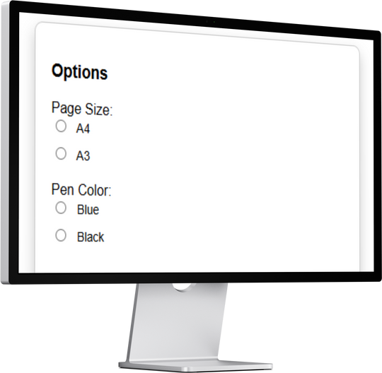
Project Pipeline
  Take a photo
or upload one
2. Choose the paper size
and the pen color

Slide 12
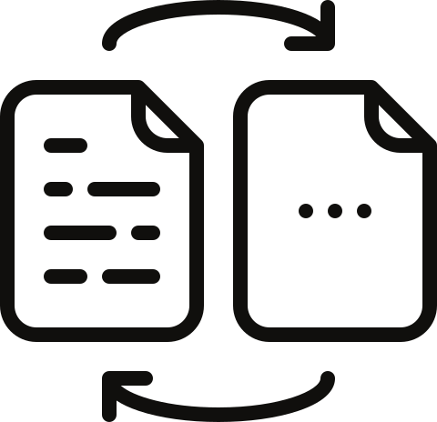
Project Pipeline
3. Convert the photo
to a line art sketch
  Take a photo
or upload one
2. Choose the paper size
and the pen color

Slide 13

Project Pipeline
3. Convert the photo
to a line art sketch
  Take a photo
or upload one
2. Choose the paper size
and the pen color
4. generate G - Code

Slide 14
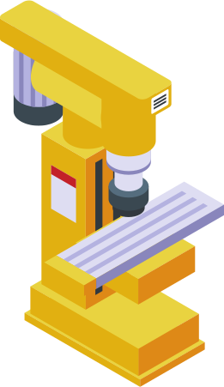
Project Pipeline
3. Convert the photo
to a line art sketch
  Take a photo
or upload one
2. Choose the paper size
and the pen color
5. send the Code to the machine
4. generate G - Code

Slide 15

Project Pipeline
3. Convert the photo
to a line art sketch
  Take a photo
or upload one
2. Choose the paper size
and the pen color
6. the image has been drawn
Successfully
5. send the Code to the machine
4. generate G - Code

Slide 16
Stages

Slide 17
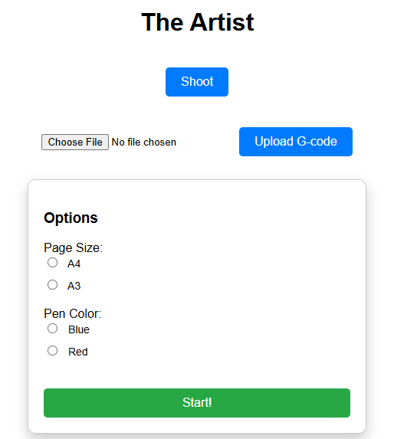
Stage 1:
Website

Slide 18
Stage 2:
image processing & converting to line art

Slide 19
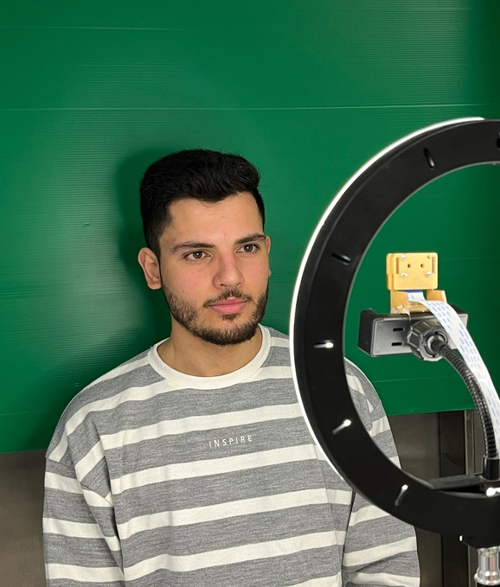

Stage 2:
Edge detection using openCV
*green screen removal using green mask

Slide 20
Stage 2:
Edge detection using openCV
*green screen removal using green mask
*Converting to gray scale

Slide 21
Stage 2:
Edge detection using openCV
*green screen removal using green mask
*Converting to gray scale
*Gaussian blur for noise reduction

Slide 22
Stage 2:
Edge detection using openCV
*green screen removal using green mask
*Converting to gray scale
*Gaussian blur for noise reduction
*Canny edge detection

Slide 23
Stage 2:
Edge detection using openCV
*green screen removal using green mask
*Converting to gray scale
*Gaussian blur for noise reduction
*Canny edge detection
*Edges inversion to make it look like a sketch
using the bitwise not

Slide 24
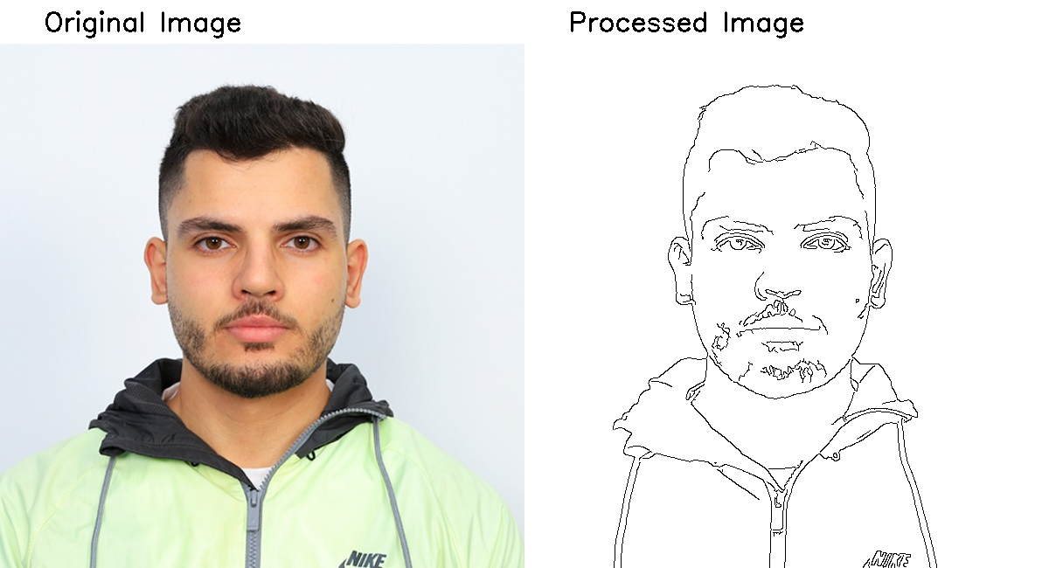

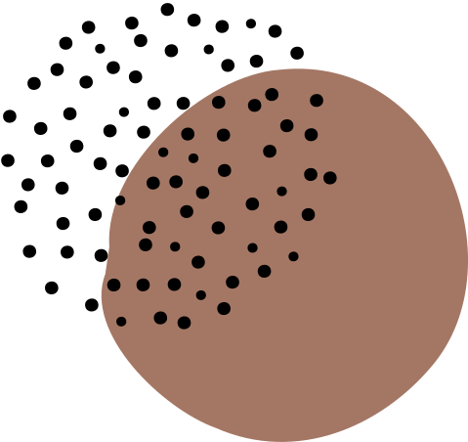
shooting result

Slide 25


Stage 2:
Line art conversion using AI
*green screen removal using green mask

Slide 26
Stage 2:
Line art conversion using AI
*green screen removal using green mask
*sharpening filter to sharpen the outlines and details

Slide 27
Stage 2:
Line art conversion using AI
*green screen removal using green mask
*sharpening filter to sharpen the outlines and details
*enhancing brightness and contrast
using ....

Slide 28
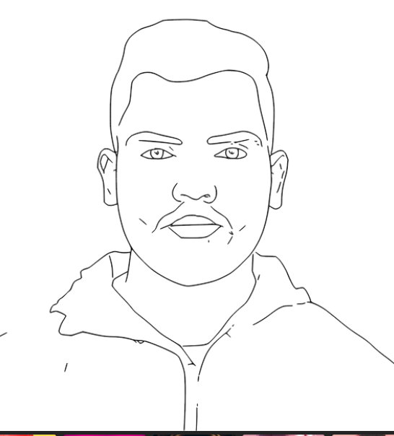
shooting result
original image
processed image

Slide 29
Components

Slide 30
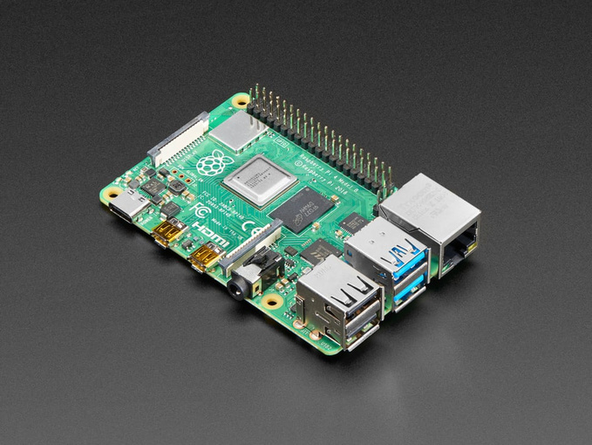
Components
-Raspberry pi 4

Slide 31
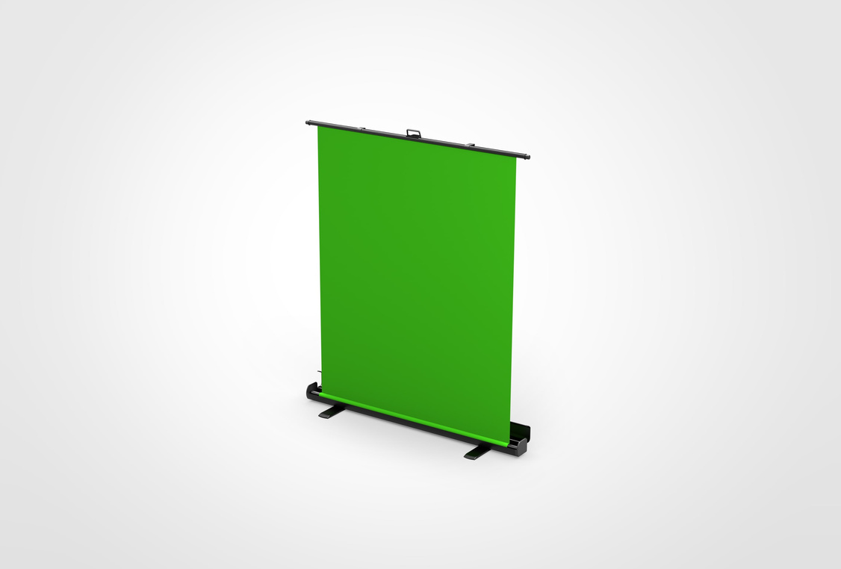
Components
-Raspberry pi 4
-Green screen

Slide 32
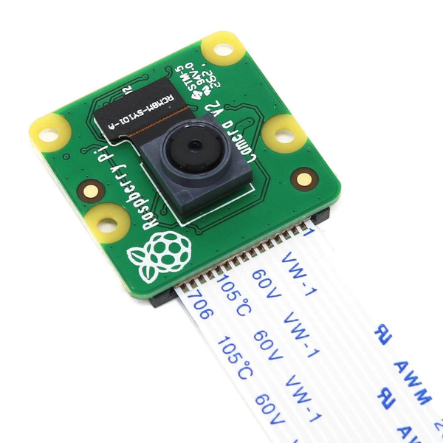
Components
-Raspberry pi 4
-Green screen
-Raspberry pi Cam

Slide 33
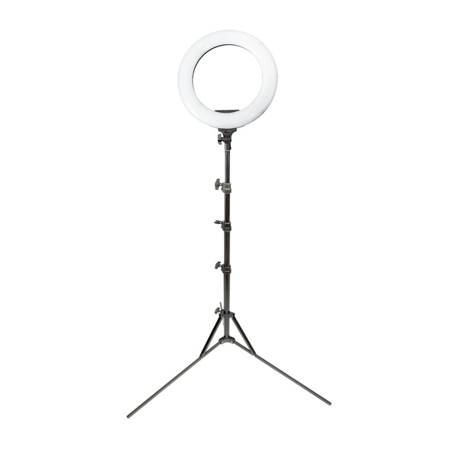
Components
-Raspberry pi 4
-Green screen
-Raspberry pi Cam
-Led ring

Slide 34
Stage 3:
Generating G-Codes

Slide 35
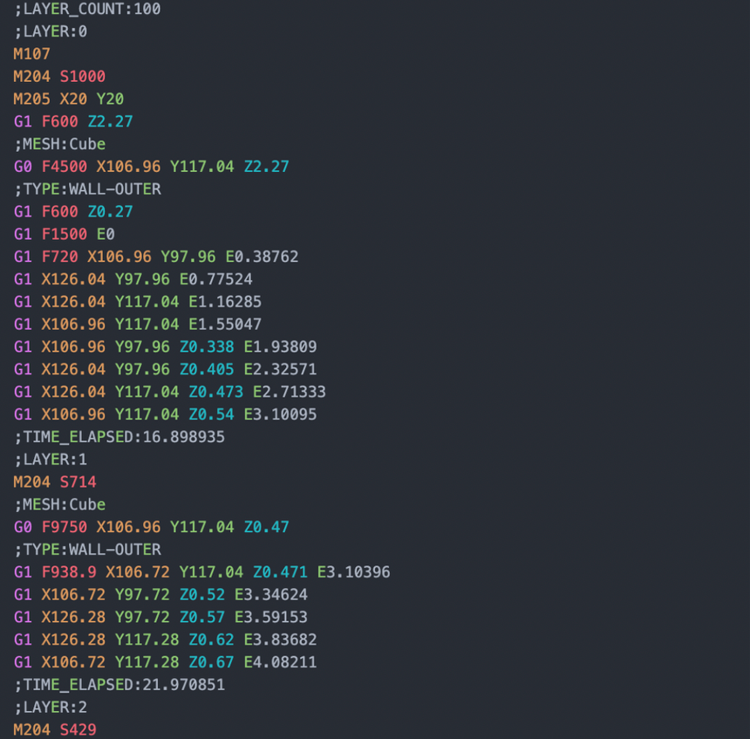
Here’s the G-Codes we use

Slide 36
Here’s the G-Codes we use
-G10 L20 P1 X0 Y0 Z0

Slide 37
Here’s the G-Codes we use
-G10 L20 P1 X0 Y0 Z0
-G90

Slide 38
Here’s the G-Codes we use
-G10 L20 P1 X0 Y0 Z0
-G90
-G00 X... Y... Z...

Slide 39
Here’s the G-Codes we use
-G10 L20 P1 X0 Y0 Z0
-G90
-G00 X... Y... Z...
-G00 X... Y... F...

Slide 40
Here’s the G-Codes we use
-G10 L20 P1 X0 Y0 Z0
-G90
-G00 X... Y... Z...
-G00 X... Y... F...
-G01 X... Y... F...

Slide 41
Here’s the G-Codes we use
-G10 L20 P1 X0 Y0 Z0
-G90
-G00 X... Y... Z...
-G00 X... Y... F...
-G01 X... Y... F...
-M03 S...

Slide 42

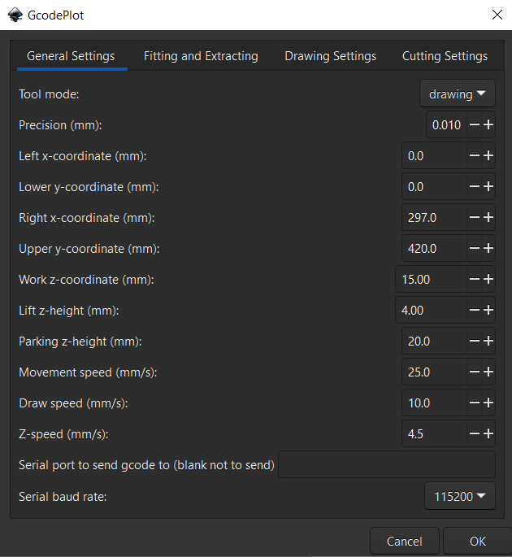
*we use the Inkscape app for generating the G-Code
By using the GCodePlot extension that serve our need

Slide 43
Stage 4:
Grabbing pens

Slide 44
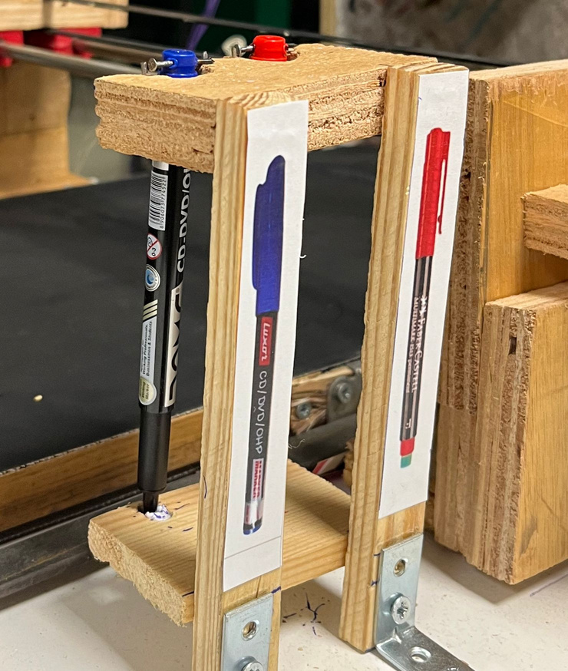
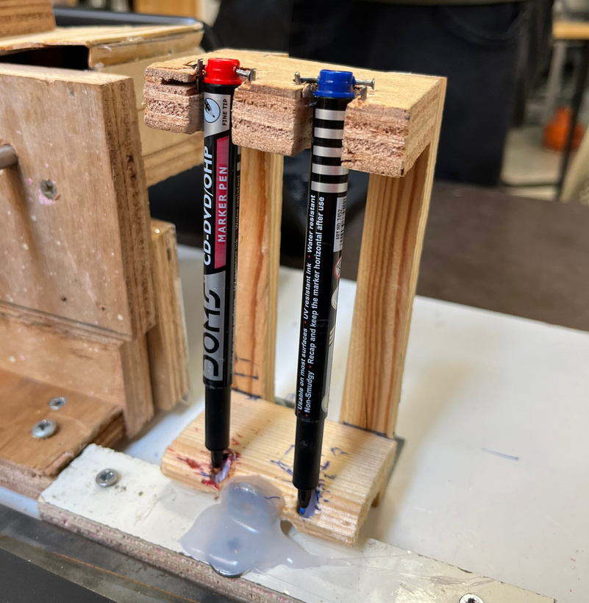
we made a shelf to hold two pens
Red&Blue

Slide 45
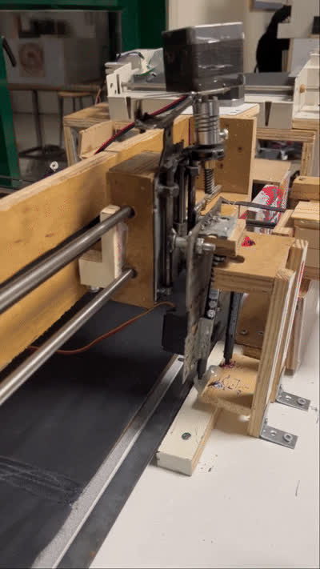
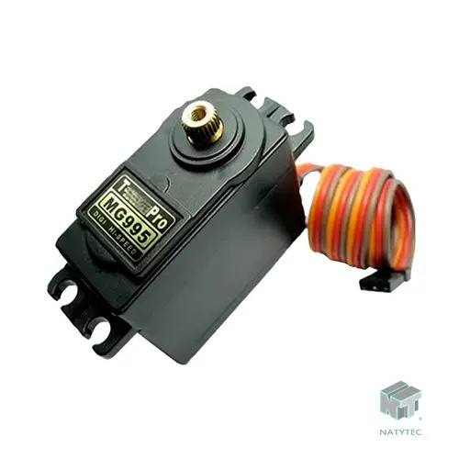
we use a servo motor to pick up pen

Slide 46
Stage 5:
Paper Rolling

Slide 47
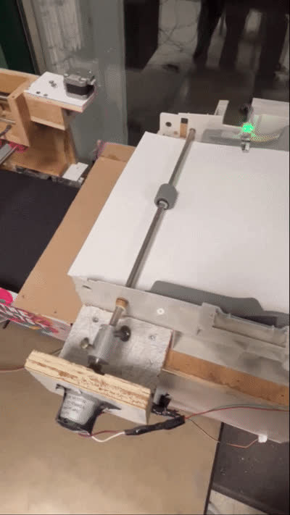
we reuse the printer paper feeder by adding a stainless steel bar and a DC motor

Slide 48
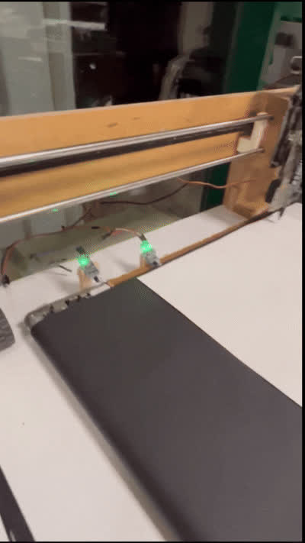
The paper keeps rolling until the IR sensor
on the belt detect it

Slide 49
Components

Slide 50
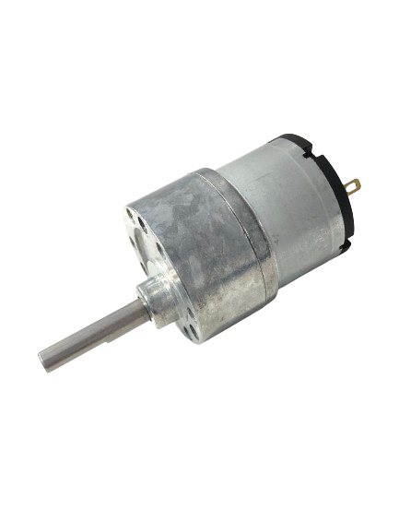
Components
-DC Motor

Slide 51
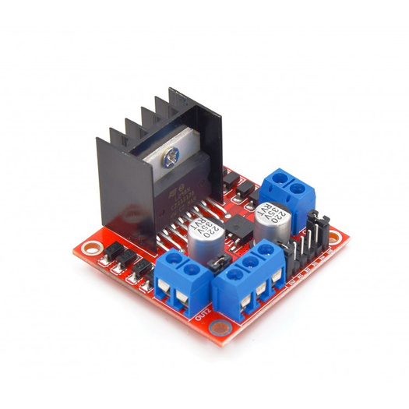
Components
-DC Motor
-H bridge

Slide 52
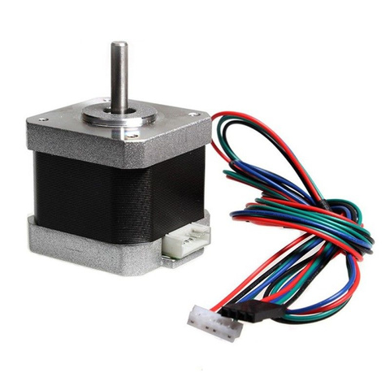
Components
-DC Motor
-H bridge
-Stepper motor Nema 17

Slide 53
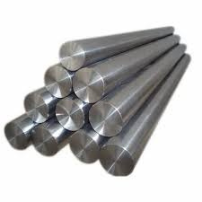
Components
-DC Motor
-H bridge
-Stepper motor Nema 17
- stainless steel bar

Slide 54
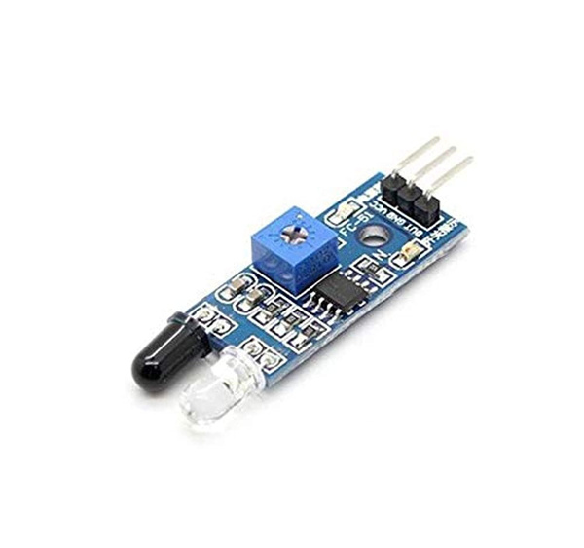
Components
-DC Motor
-H bridge
-Stepper motor Nema 17
- stainless steel bar
-IR sensor

Slide 55
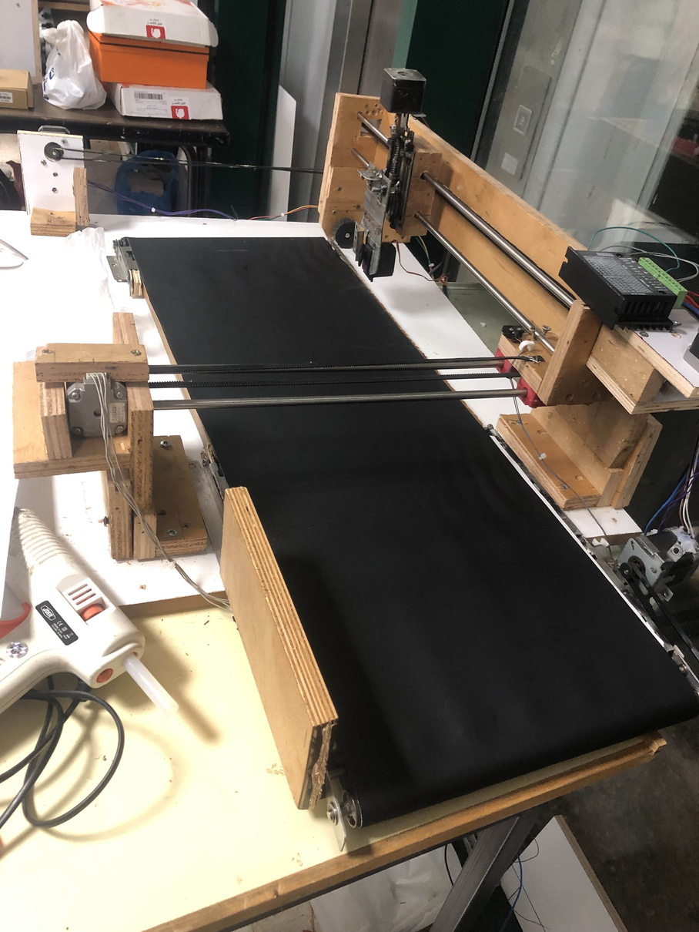
Components
-DC Motor
-H bridge
-Stepper motor Nema 17
- stainless steel bar
-IR sensor
-belt

Slide 56
Stage 6:
Drawing & signing

Slide 57
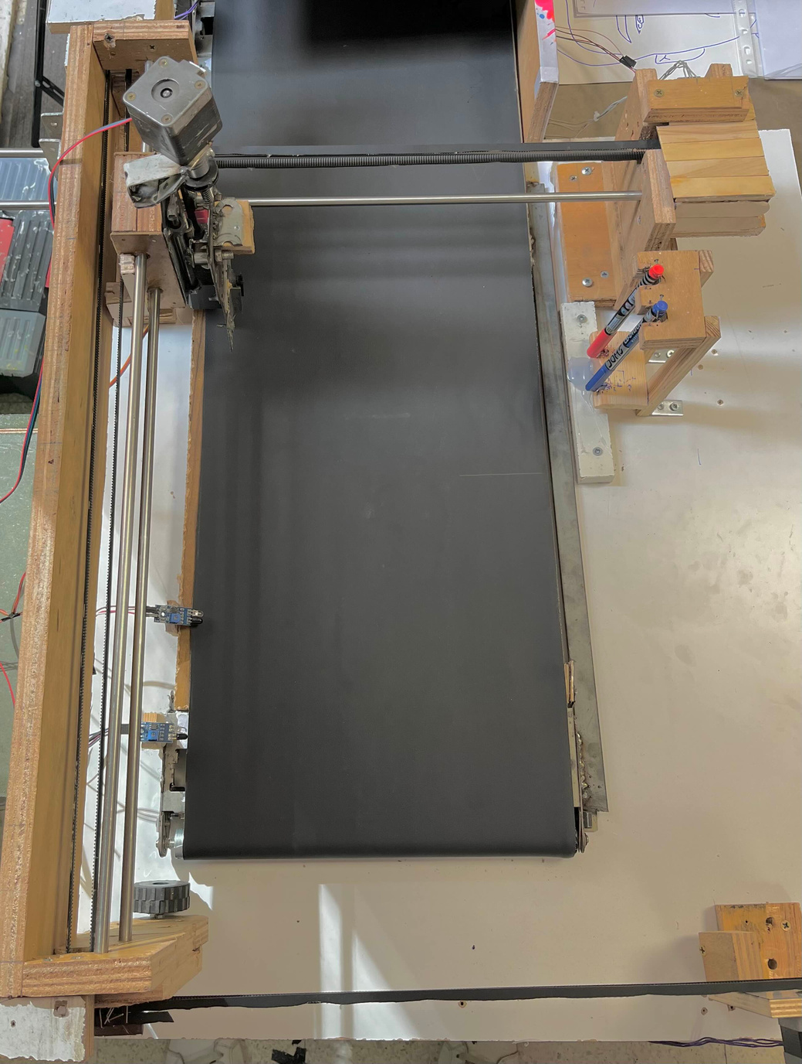
-our plotter contain 3 axis X Y and the Z axis

Slide 58
Y axis Length: 46.8 CM
-our plotter contain 3 axis X Y and the Z axis
- 68 step/ mm for the y axis

Slide 59
Y axis Length: 46.8 CM
-our plotter contain 3 axis X Y and the Z axis
X
Axis
Length:
33.2 CM
- 68 step/ mm for the y axis
- 39 step/ mm for the x axis

Slide 60

we calculate the perfect speed settings for the motors

Slide 61
we calculate the perfect speed settings for the motors
-During pen grabbing and returning the speed is:
1100 mm/min to the x and y axis

Slide 62
we calculate the perfect speed settings for the motors
-During pen grabbing and returning the speed is:
1100 mm/min to the x and y axis
-During the drawing we decrease the speed to 800mm/min for better accuracy

Slide 63
we calculate the perfect speed settings for the motors
-During pen grabbing and returning the speed is:
1100 mm/min to the x and y axis
-During the drawing we decrease the speed to 800mm/min for better accuracy

Slide 64
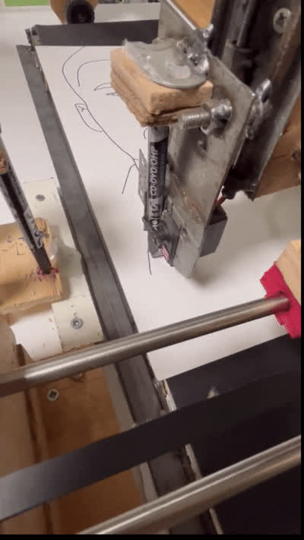
Signing
We created a simple signature and added it to every photo we draw

Slide 65
Components
-Stepper motor Nema 17

Slide 66
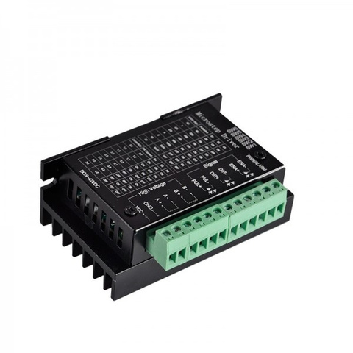
Components
-Stepper motor Nema 17
-3A Driver

Slide 67
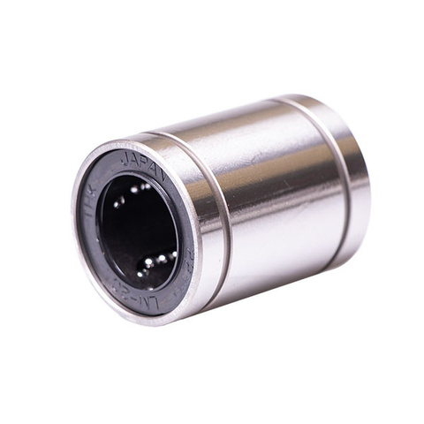
Components
-Stepper motor Nema 17
-3A Driver
-linear ball bearing

Slide 68
Components
-Stepper motor Nema 17
-3A Driver
-stainless steel bars
-linear ball bearing

Slide 69

Components
-lead screw

Slide 70

Components
-lead screw
-lead screw nut

Slide 71

Components
-lead screw
-lead screw nut
-timing Belt Pulley

Slide 72

Components
-lead screw
-lead screw nut
-timing Belt Pulley
-belt

Slide 73

constraints

Slide 74
constraints
-Inability to automate sketch generation

Slide 75
constraints
-Inability to automate sketch generation
-Inability to automate G-Code generation

Slide 76
constraints
-Inability to automate sketch generation
-Inability to automate G-Code generation
-GRBL supports only one servo motor

Slide 77

Future Work

Slide 78

DEMO

