Slide 1

Faculty of Engineering and Information Technology
Civil Engineering Department
Rehabilitation of
Jenin-Haifa Road

Slide 2
Prepared by:
Adan Ateeq
Rawan Badad
Under Supervision of:
Prof. Sameer Abu-Eisheh

Slide 3
Outline
Study Area.
Objectives.
Methodology.
Data Collection.
Data Analysis.
Conclusion.
Next Steps in The Project.

Slide 4
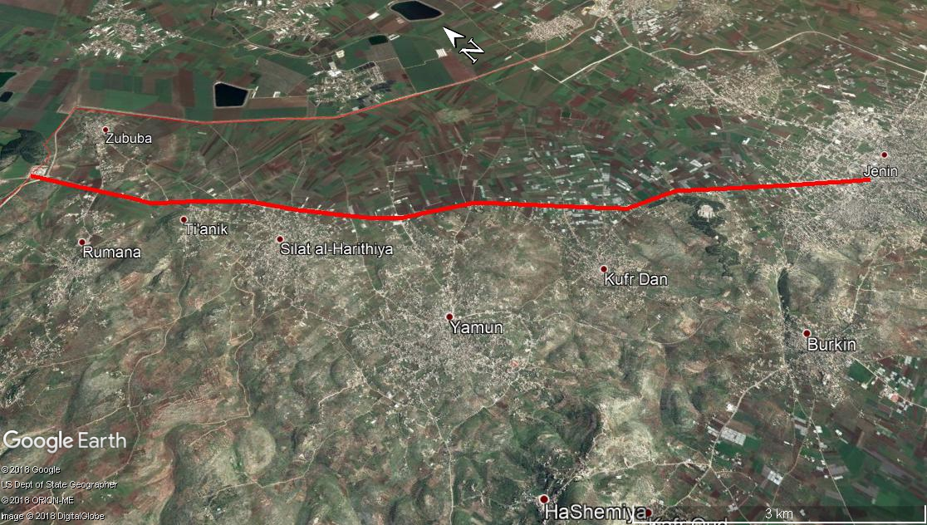
Study Area
WP: 55,412 capita
Jenin: 49,908 capita

Slide 5
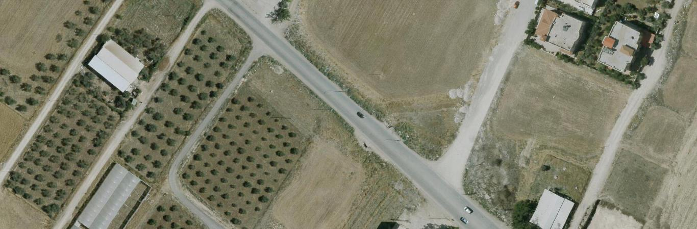
Jenin Entrance

Slide 6
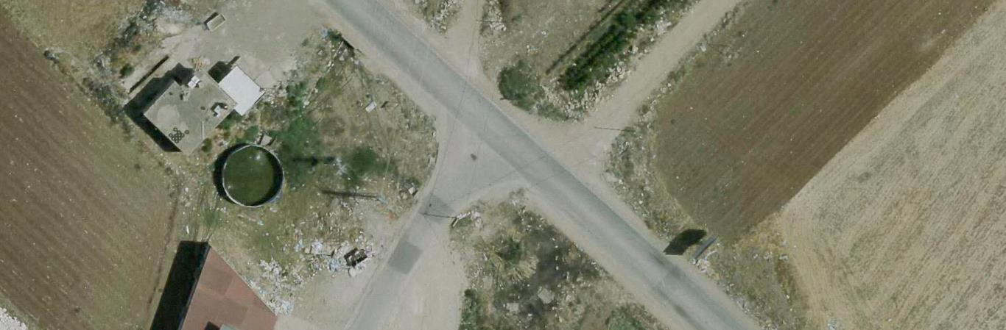
Burqin Intersection

Slide 7
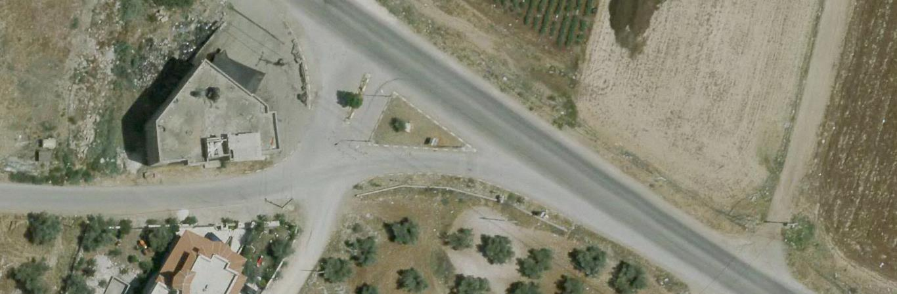
Kafr Dan Intersection

Slide 8
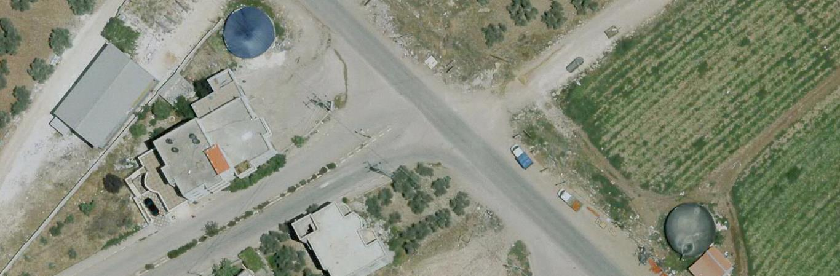
Al-Yamoun Intersection

Slide 9
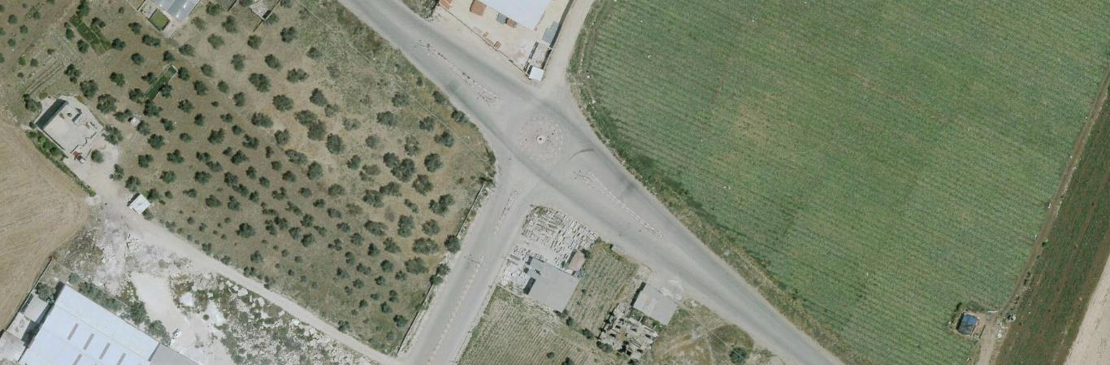
Al-Yamoun Circle

Slide 10
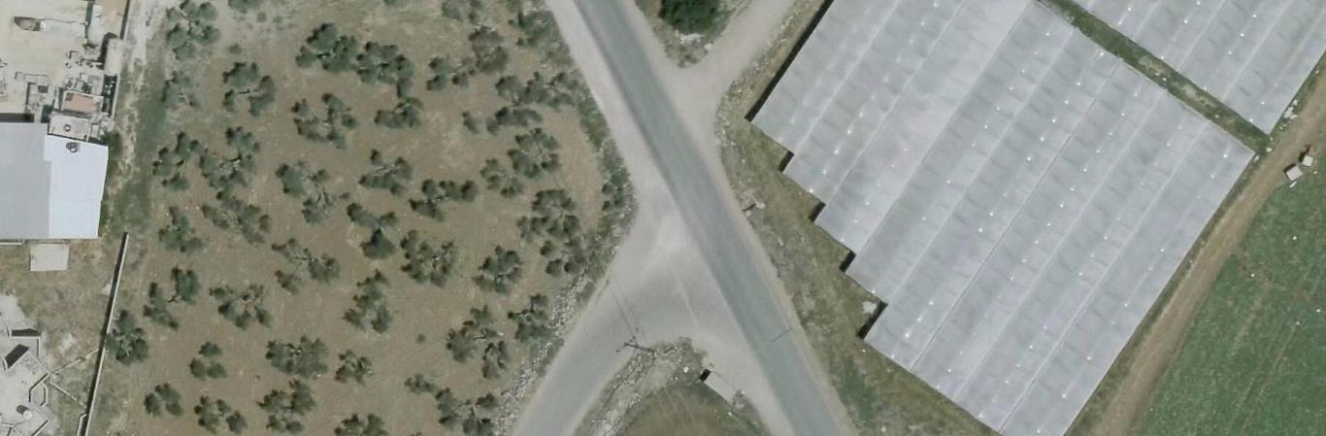
Silat Al-Harithia Intersection

Slide 11
Objectives
Conduct traffic studies and field investigation to classify the soil in the road area, and find relevant CBR values.
Define sections that require re-construction and those that require only maintenance.
Determine the existing and future LOS.
Identify the design criteria in order to propose a new design later.

Slide 12
Methodology
Data collection:
  Visits and contact with concerned Institutions
  Traffic Count Study
  Soil Investigation
  Pavement Inspection
Design criteria:
  Road Classification
  Summery of Selected Design Criteria
Data Analysis
  PHV and LOS
  CBR Test
  Condition Survey and Detailed Inspection of Pavement

Slide 13
Data Collection
  Visits and contacts with concerned Institutions:
    Jenin Municipality on Feb 5th, 2018
    MPWH-Jenin on Feb 16th, 2018
    MPWH- Ramallah Feb 27th, 2018
    Universal Group for Engineering and Consulting (Ma’alem)

Slide 14
Data Collection
  Traffic Count Study:
    Road Link (Jenin Entrance) on Feb 19th, 2018
      9 hours (7:00-11:00 a.m. and 12:00-5:15 p.m.) to select peak periods.
      Peak periods were (7:00-9:00 a.m.) and (1:00-3:00 , 4:15-5:15 p.m.)
      Decided to check the critical evening period at the next count (at Burqin Intersection)

Slide 15
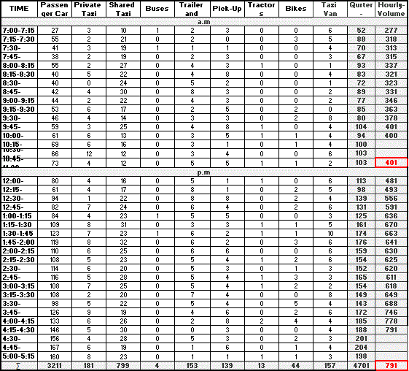
Counting Data of East App

Slide 16
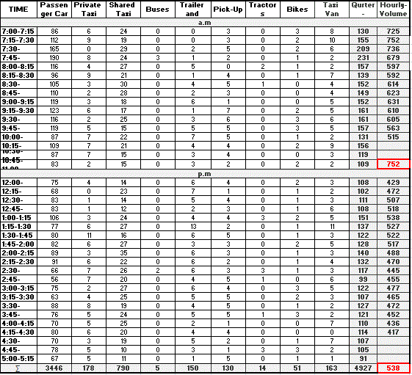
Counting Data of West App

Slide 17
Data Collection
  Traffic Count Study:
    Intersections:
      Burqin Intersection on Feb 26th, 2018 (7:00-9:00 a.m.) and (1:00-3:00 , 4:00-6:00 p.m.)
      Kafr Dan Intersection on Feb 28th, 2018 (7:00-9:00 a.m.) and (4:00-6:00 p.m.).
      Al- Yamoun Circle on Mar 5th, 2018 (7:00-9:00 a.m.) and (4:00-6:00 p.m.)
      Al- Yamoun Intersection on Mar 12th, 2018 (4:00-6:00 p.m.)
      Silat Al- Harithia on Mar 14th, 2018 (7:00-9:00 a.m.) and (4:00-6:00 p.m.)

Slide 18
Data Collection
  Soil Investigation:
    Same type of soil along the road
    Two representative samples from the entrance of Silat Al-Harithia:
      1.5m-depth
      0.5m-depth

Slide 19
Data Collection
  Pavement Inspection:
    Dividing the study area into 500m-long sections
    Checking pavement condition at two stages:
      Condition Survey (3 points scale)
      Detailed Inspection for average conditions (10 points scale)

Slide 20
Design Criteria
  Road Classification:
    According to the location, main function (mobility) and criteria of the road, it is classified to be Rural Arterial.

Slide 21
Design Criteria
  Summery of Selected Design Criteria:
Item No. | Item Description | Used
1 | Functional Classification | Rural Arterial Road
2 | Design Speed | 90 Km/hr.
3 | Design Vehicle | WB-15
4 | Stopping sight distance | 160 m
5 | Passing sight distance | 280 m
6 | Max Grade | 4%
7 | Supper elevation | Less than 12 %
8 | Width of Lane | 3.6 m
9 | LOS (after 20 years) | B

Slide 22
Design Analysis
  Summery of PHV for Road Link and Intersections:
Intersection | Peak hour | PHV (vph)
Jenin Entrance | 4:00-5:00 pm | 1214
Burqin | 4:00-5:00 pm | 1192
Kafr Dan | 7:30-8:30 am | 856
Al-Yamoun | 4:45-5:45 pm | 891
Al-Yamoun Circle | 4:45-5:45 pm | 563
Silat Al-Harithia | 4:30-5:30 pm | 510

Slide 23
Design Analysis
  Summery of LOS:
  For Road link: D
  For Intersections:
Intersection | Major LOS | Minor LOS
 |  | North bound | South bound
Burqin | A | E | -
Kafr Dan | A | C | -
Al-Yamoun | A | B | D
Silat Al-Harithia | A | B | C

Slide 24
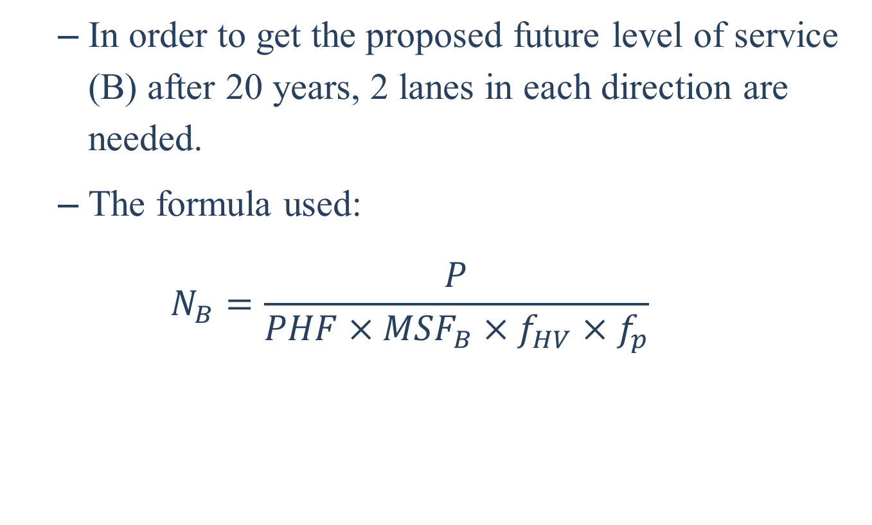
Design Analysis
  In order to get the proposed future level of service (B) after 20 years, 2 lanes in each direction are needed.
  The formula used:
  $$N_{B}=\frac{P}{PHF×{MSF}_{B}×f_{HV}×f_{p}}$$

Slide 25
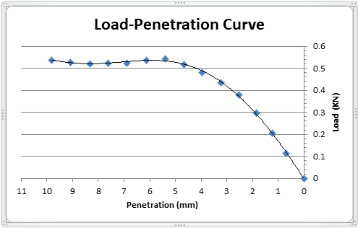
Design Analysis
  CBR Test:
    1.5m-depth Sample: CBR= 2.77

Slide 26
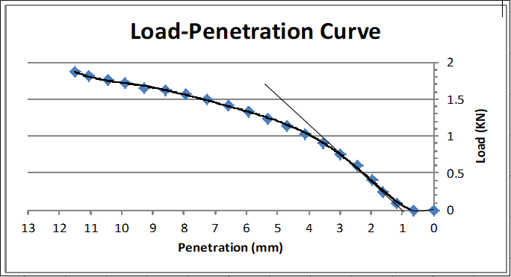
Design Analysis
  CBR Test:
    0.5m-depth Sample: CBR= 6.75

Slide 27
Design Analysis
  Condition Survey and Detailed Inspection of Pavement:
    Stage 1: Condition Survey

Slide 28
Design Analysis
  Condition Survey and Detailed Inspection of Pavement:
    Stage 2: Detailed Inspection for average conditions

Slide 29
Design Analysis
  Condition Survey and Detailed Inspection of Pavement:
    Summary of results:
Sub-Section Limits | General Condition | M&R No. | Treatment Needed
0+00-0+500 | Average | 3.200277778 | Crack Sealing
0+500-1+000 | Average | 3.878333333 | Surface Patching
1+000-1+500 | Good | - | No Treatment
1+500-2+000 | Average | 2.528333333 | Crack Sealing
2+000-2+500 | Good | - | No Treatment
2+500-3+000 | Average | 3.205 | Crack Sealing
3+000-3+500 | Poor | - | Reconstruction
3+500-4+000 | Poor | - | Reconstruction
4+000-4+500 | Average | 3.063333333 | Crack Sealing
4+500-5+000 | Poor | - | Reconstruction
5+000-5+500 | Poor | - | Reconstruction
5+500-6+000 | Average | 3.296190476 | Crack Sealing
6+000-6+500 | Poor | - | Reconstruction
6+500-7+000 | Average | 2.255 | Apply Hot Sand and Roll
7+000-7+500 | Average | 2.532142857 | Crack Sealing
7+500-8+000 | Good | - | No Treatment

Slide 30
Conclusion
An overall view of the obtained results:
  Poor sub-grade quality.
  Bad pavement conditions take over the majority of the road.
  The need for expansion to two lanes in each direction instead of one.
    It is recommended to reconstruct the whole facility.

Slide 31
Next Steps in The Project
  Propose a full rehabilitation design.
  Estimation of project cost.

Slide 32


