Slide 1

An Najah University – Faculty of engineering
Electrical Eng. Department
Introduction to graduation project
Studying and analyzing the electrical network for Tulkarem
Supervisor:
Dr. Moen Omar
Prepared by:
Moawya sawalmeh
Ajwad mohsen

Slide 2
Abstract:
Electricity and power grids are very important elements in our world, it's not just about having lights or cocking or to have interest in our free time, electricity is very substantial resource especially in providing public security, safety and health and making possible everything from emergency response to medical care in hospitals, so it's very important to have a perfect electrical network without any problems or faults.
Our project is about studying the electrical network of Tulkarem city and analyzing the problems related with the parameters of power system such as
"current, voltage, power factor …… etc. "
After that we will analysis the single line network on ETAP program to discover the problems and faults in the network.
The main purpose of this project is to create some practical solutions for the problems we have forced in the network.

Slide 3

Overview
The power system is complicated electrical networks used to supply, transmit, and use electrical energy. the networks supply s towns containing houses hospitals industrial region called CRID. the grid is containing generators that supply the power, the transmission system that carries the power from the generating center to the load center and the distribution system that feeds the power to the nearby home and industries. the majority of these system rely upon three-phase AC power –the standard for large-scale power transmission and distribution across the modern world. specialized power systems that do not always rely three-phase AC power are found in aircraft, electric rail systems, ocean linear and automobiles.

Slide 4

Power flow study:
In power engineering, the power flow study (also known as load-flow study) is an important tool involving numerical analysis applied to a power system. Unlike traditional circuit analysis, a power flow study usually uses simplified notation such as a one-line diagram and per-unit system, and focuses on various forms of AC power (reactive, real, and apparent) rather than voltage and current. It analyzes the power systems in normal steady-state operation. There exist a number of software implementations of power flow studies. In addition to a power flow study itself, sometimes called the base case, many software implementations perform other types of analysis, such as short- circuit fault analysis and economic analysis. In particular, some programs use linear programming to find the optimal power flow, the conditions which give the lowest cost per kilowatt generated.

Slide 5
Bus classification
1. Load bus
2 . Generator bus or voltage-controlled bus
3 . Slack (swing) bus

Slide 6
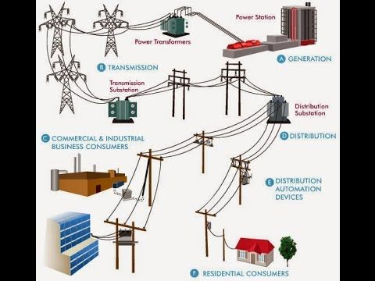
Components of power system
1. Power station
2 . Transformers
3 . Transmission lines
4 . Distribution lines
5 . Loads

Slide 7

Key performance indicators
1. voltage
Voltage is the pressure from an electrical circuit's power source that pushes charged electrons (current) through a conducting loop, enabling them to do work such as illuminating a light.
$V=R∗I$
The problems of voltage:
Voltage unbalance
Voltage fluctuations
Voltage deviation
Voltage drop

Slide 8

Key performance indicators
Current :
An electric current is a flow of electric charge in a circuit. More specifically, the electric current is the rate of charge flow past a given point in an electric circuit. The charge can be negatively charged electrons or positive charge carriers including protons, positive ions or holes.
$I=V/R$
And here a problem of the current:
Current unbalance

Slide 9
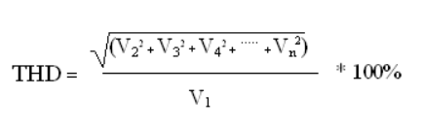

Key performance indicators
3. Frequency
$F=ω∕2π$
4. power factor
$P.F=cos\left(∅v−∅i\right)$
$PF=P_{\left(ω\right)}∕\left|S\left(vA\right)\right|$
5. Total Harmonic Distortion (THD) in Power Systems

Slide 10
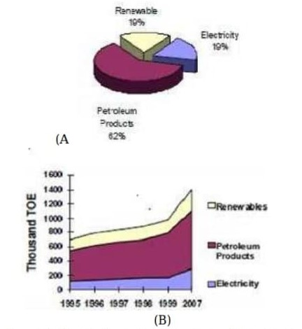
Energy sector in Palestine
Palestine depends mainly on fossil fuels and electricity. Which are fully controllable by Israel, in which it is used as a weapon to destroy the Palestinians and Palestinian economy. Figure 1 shows the energy needs for Palestine. The largest energy consumed is the fossil fuel.

Slide 11
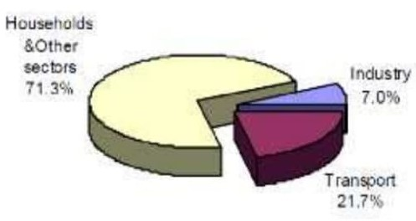
Energy consumptions in different sectors in Palestine
Figure 2 shows that most of the energy consumed in Palestine is in the residential sector, it also shows the small amount of energy used in industry. To solve this problem renewable energy must be considered to provide a continuous sustainable source of energy for both residential and industrial sectors

Slide 12
Close view of Tulkarem electrical network
Tulkarem Governorate is fed by Israel Company, and it contain two networks 1&2, the capacity of the first one is 16MVA (rated) and the rated voltage is 22KV, the second is 16MVA (rated) and the voltage is 22KV also. These networks contain 132 distribution transformers with different rating power depending on the region (or the residential) and the consumption of energy.
The quantity needed by the city of electrical power is 42 megawatts, while the quantities received from the "Israeli" side are only 32 megawatts, with a deficit of 10 megawatts, and the quantity needed by the city of electrical current 630 Ampere while the quantities received from the "Israeli" side are only 400 Ampere for each line.

Slide 13
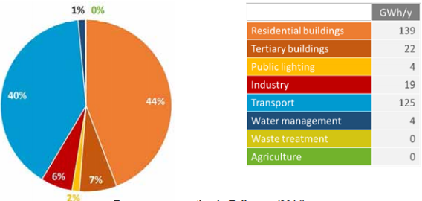
Energy consumption in Tulkarem city
The total energy consumption (final energy) for Tulkarem city perimeter is estimated to be 314 GWh/year in 2014, which corresponds to about 3.11 MWh/person/year (equivalent to 1.9 barrel of oil per year per person). The following table and pie chart show distribution among sectors:

Slide 14
Energy consumption in Tulkarem city
total | Other | Fuels | LPG | solar | Electricity
139.0 | 0.7 | 0.4 | 36.5 | 23.9 | 77.5 | Residential buildings
22.2 | 0.1 | 0.4 | 2.8 | 0.0 | 18.9 | Tertiary buildings
4.5 | 0.0 | 0.0 | 0.0 | 0.0 | 4.5 | Public lighting
18.7 | 0.3 | 4.3 | 2.7 | 0.0 | 11.4 | Industry
125.4 | 0.0 | 125.4 | 0.0 | 0.0 | 0.0 | Transport
4.2 | 0.0 | 0.0 | 0.0 | 0.0 | 4.2 | Water management
0.1 | 0.0 | 0.1 | 0.0 | 0.0 | 0.0 | Waste
0.3 | 0.0 | 0.2 | 0.0 | 0.0 | 0.1 | Agriculture
314.5 | 1.1 | 130.9 | 42.0 | 23.9 | 116.6 | Total

Slide 15
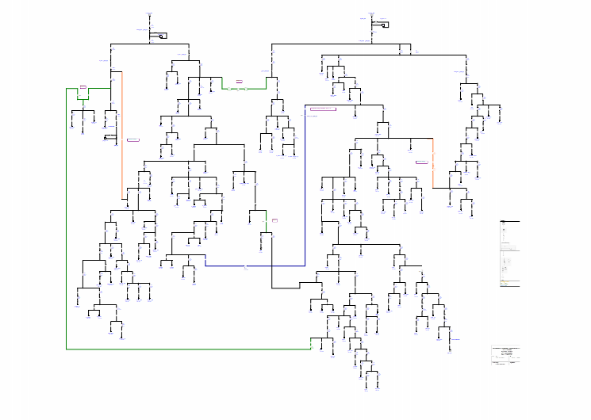
The electrical network of Tulkarem city
Tulkarem Governorate is fed by Israel Company, and it contain two networks 1&2, the capacity of the first one is 16MVA (rated) and the rated voltage is 22KV, the second is 16MVA (rated) and the voltage is 22KV also. These networks contain 132 distribution transformers with different rating power depending on the region (or the residential) and the consumption of energy.

Slide 16
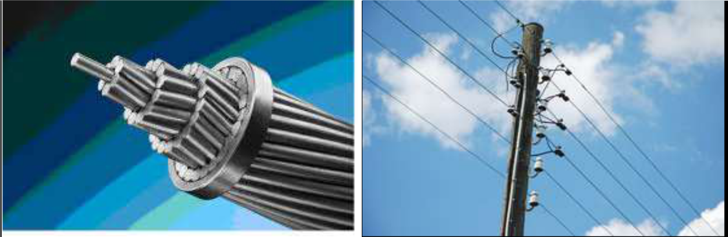
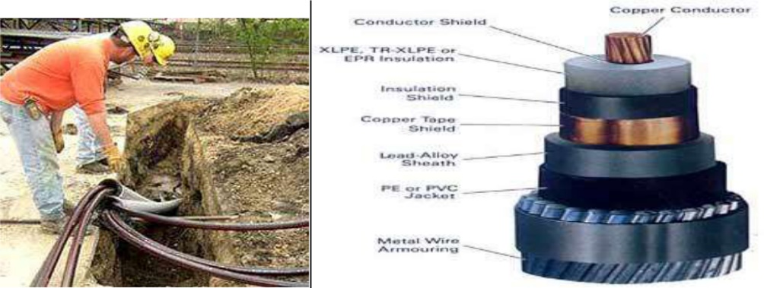
Transmission line
1. Overhead transmission
2. Underground transmission

Slide 17
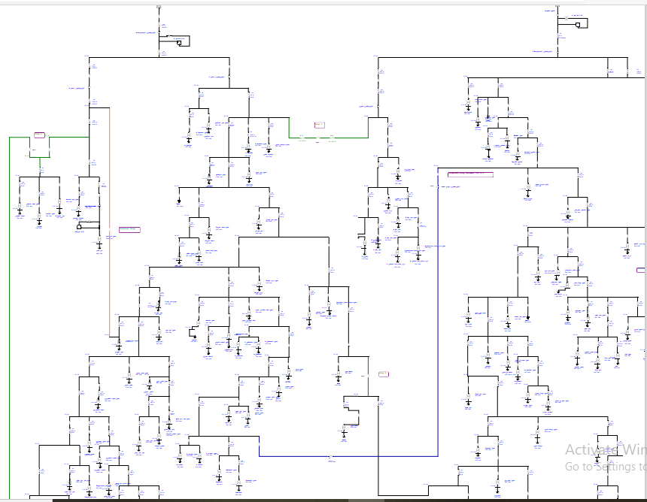
Analyzing of the network
Our network consists the following elements:
1. 314 buses
2. 130 transformers
3. 130 loads
4. 2 swing
5. 168 transmission lines

Slide 18
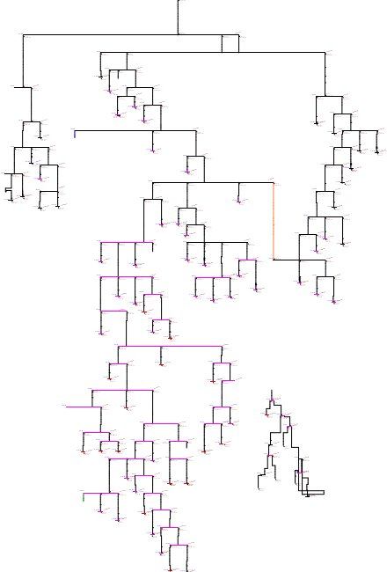
Analyzing line (1) of Tulkarem network
The capacity of the first one is 16MVA (rated) and the rated voltage is 22KV, and it contains 68 transformers with different rating power depending on the region, and here is the figure that shows the line 1.

Slide 19
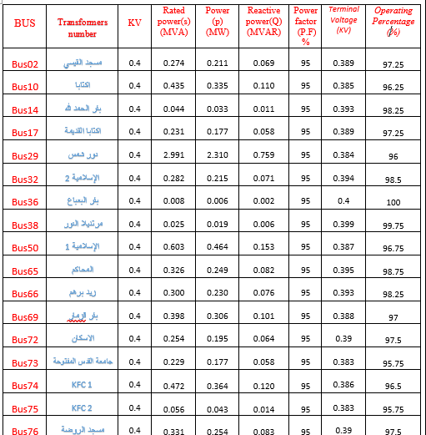
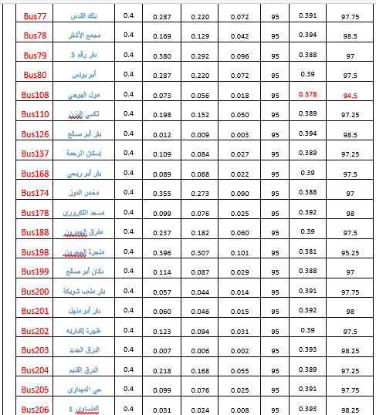
Results of analyzing line (1)

Slide 20
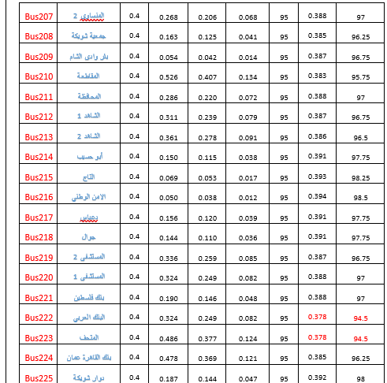
Results of analyzing line (1)

Slide 21
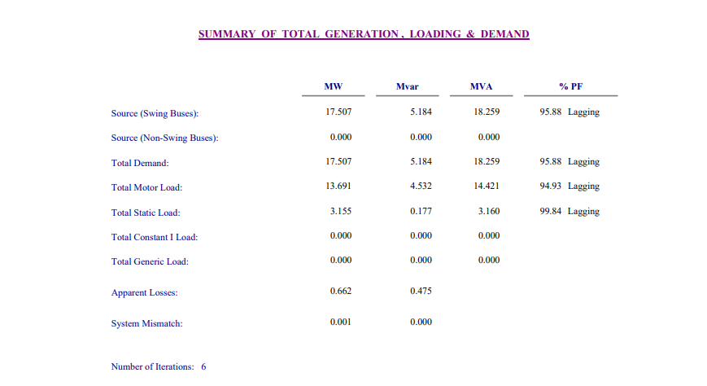
Results of analyzing line (1)
after analyzing the first line we find that the source rated power is equal to 17.507 MW and this value is not acceptable for this network.
From the above table we can see the value of real power for the swing bus (source) is equal to 17.507 MW which is more, this is the real power that consuming by the first network and the reactive power for this network is equal to 5.184 MVAr.
We note that the apparent power of the network which is 18.259 MVA and this value unacceptable. Also, we note that the losses in the network for the real power is equal to 0.662 MW and for reactive power is equal to 0.475 MVAr.

Slide 22
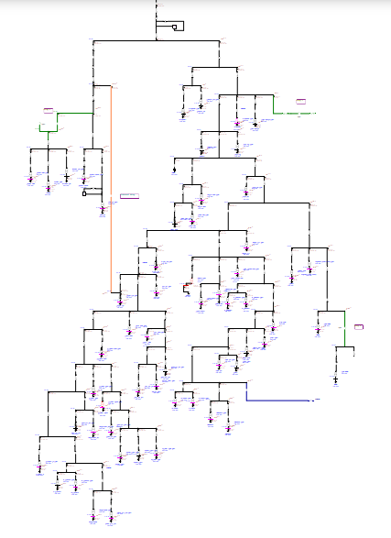
Analyzing line (2) of Tulkarem network
The capacity of the second one is 16MVA (rated) and the rated voltage is 22KV, and it contains 58 transformers with different rating power depending on the region, and here is the figure that shows the line 2

Slide 23
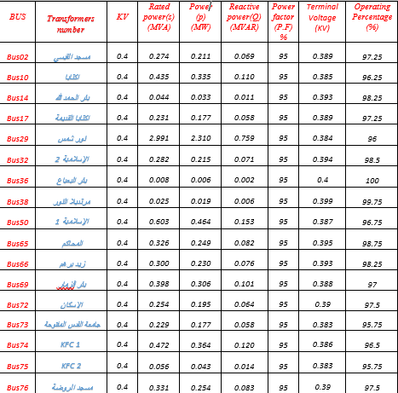
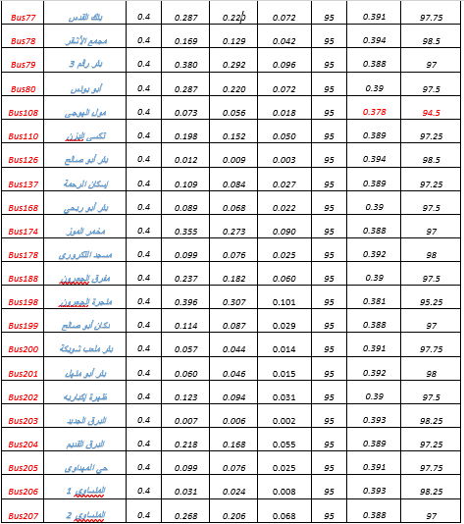
Results of analyzing line (2)

Slide 24
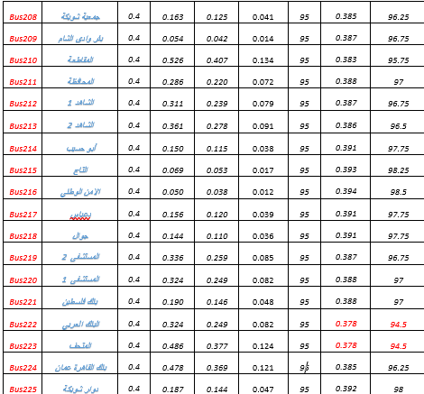
Results of analyzing line (2)

Slide 25
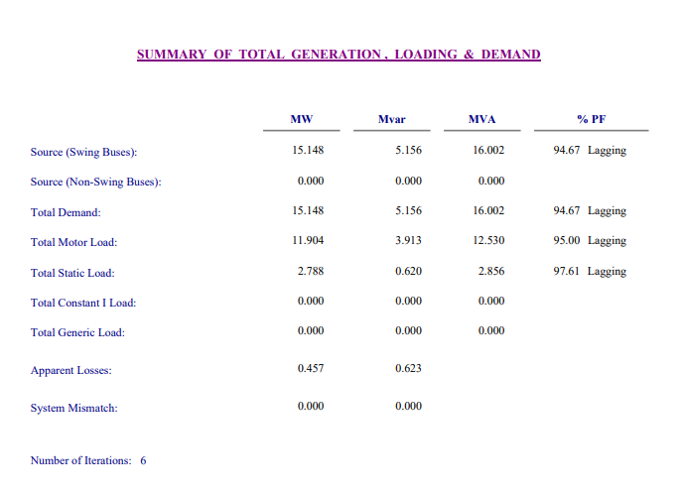
Results of analyzing line (2)
The source rated power for the second network is equal to 15.148 MW and this value of power is suitable and enough for this network.
From the above tables we can see the value of real power for the swing bus (source) is equal to 15.148 MW, this is the real power that consuming by the second network and the reactive power for this network is equal to 5.156 MVAr. We note that the apparent power of the network which is 16.002 MVA and this value does not make a problem for consuming power.
Also, we note that the losses in the network for the real power is equal to 0.457 MW and for reactive power is equal to 0.623 MVAr

Slide 26
problems in the network:
1. voltages
The voltage must be in the range: 0.95 V nominal < V < 1.05 V nominal.
After we doing the analyzing for the networks on the ETAP program we see that the voltages in some buses are not located desired range.
2.overloaded transformers
There are three transformers in the first line -AL-Dalhoum, French bakery, Mrabaet hanoun- are connected to over load.
We have also one transformer- the museum- in the second line which connected to over load.

Slide 27
How to improve the network?
There are different methods in order to improve the network to increase the voltages and reduce the losses. then the problems for the consumer will decrease and the cost of KWH will decrease.
These methods are:
1. Increasing the swing bus voltage
2. Tap changing in the transformer
3. Adding capacitors
Overloaded Transformers Problem
After the improvement of the network in the maximum case there is the problem of the overloaded transformers. This problem must be solved by changing transformers where the transformers which are small and the load on them large must be changed with large highly loaded transformer. this will need to buy new transformers.

Slide 28
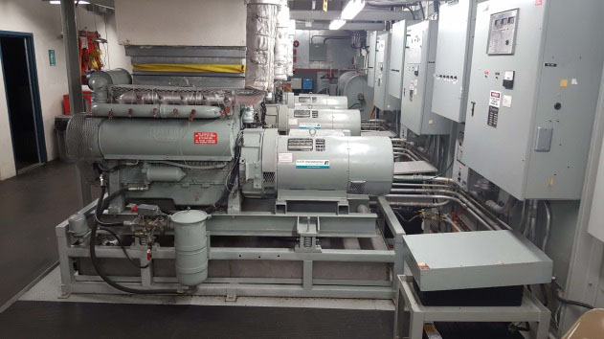

solutions for the network
1. Rationalization of energy consumption
2 . Diesel Electric Stations
3. Solar system

