Slide 1

Faculty of Engineering & Information Technology
Department of Building Engineering
Retrofitting and Enhancement for Nablus Municipality
Prepared by :
BushraDwaikat
Hanan Abo-Hassan
Haneen Ghanem
Supervisor :Eng:Moayad Salhb

Slide 2
Outline:
Site location
Artchitecture Design
Enviromntail Design
Structural Design
Electro mechanical Design
Quantity surveying

Slide 3
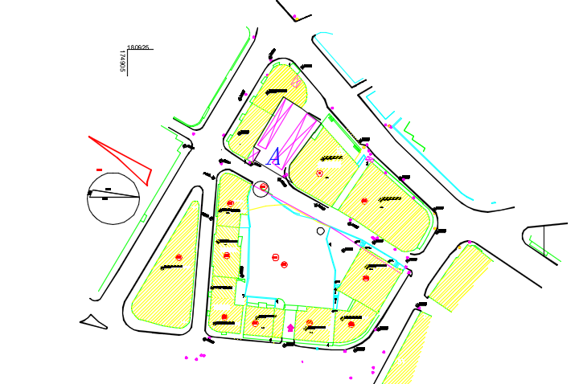
Site location
Site location and description:
Site location in Nablus city, Faisal Street, near the commercial center of Nablus.
This is located on latitude of 32.13 norths and longitude of 35.15 easts.

Slide 4
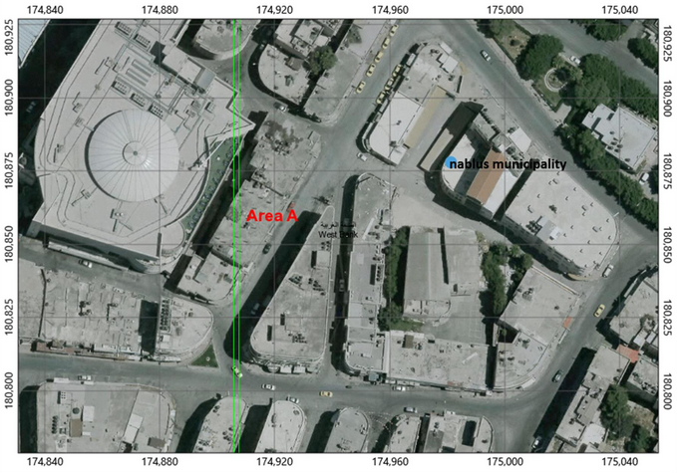
Figure: A clear picture of what surrounds Nablus Municipality.

Slide 5
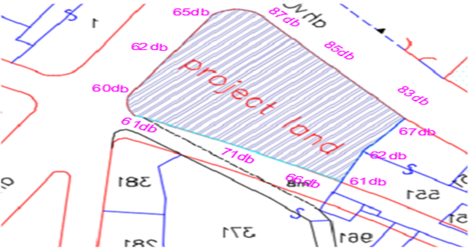
Noise analysis
Figure: Sound levels in the land.

Slide 6
Architectural design
Current state VS New Design

Slide 7
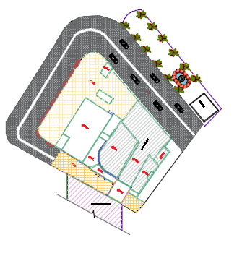
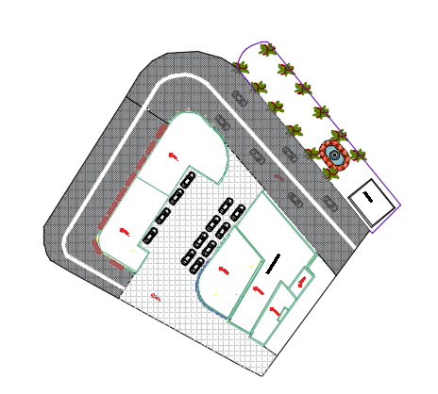

Architectural plan
The total area of the project is 6940.62 m² above the basement; and the project consist six floor.
Figure: site plan before and after redesign

Slide 8
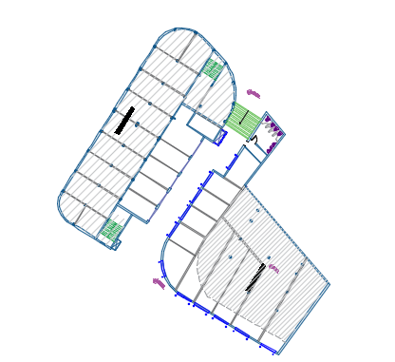
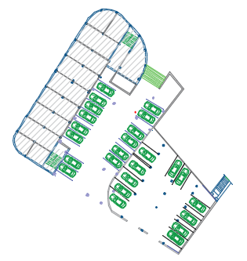
Figure: two proposal for basement floor

Slide 9
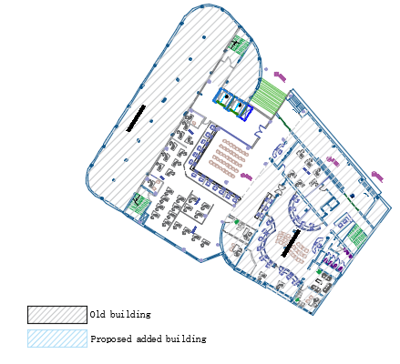
Figure: Ground floor plan

Slide 10
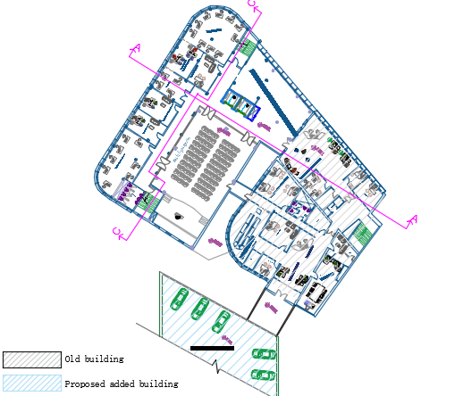
Figure: First floor plan

Slide 11
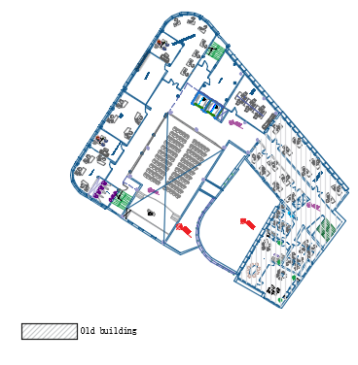
Figure: second floor plan

Slide 12
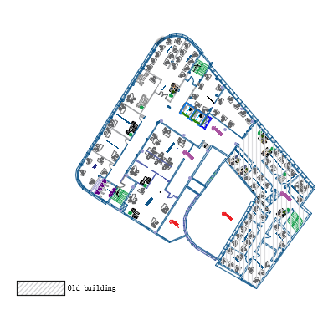
Figure: third floor plan

Slide 13
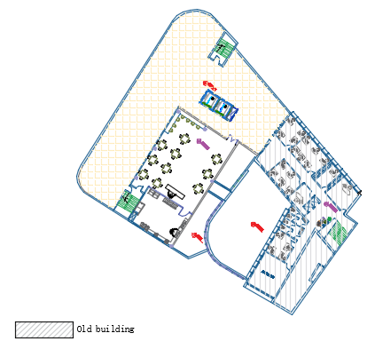
Figure: Four floor plan

Slide 14
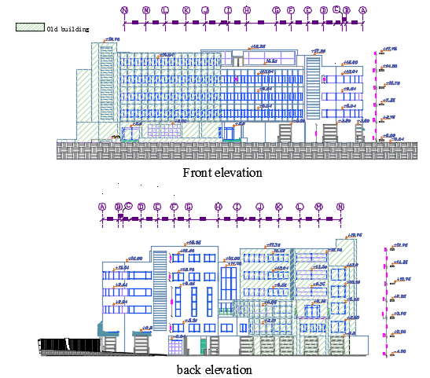
Section and Elevation
Figure: Front and Back elevation

Slide 15
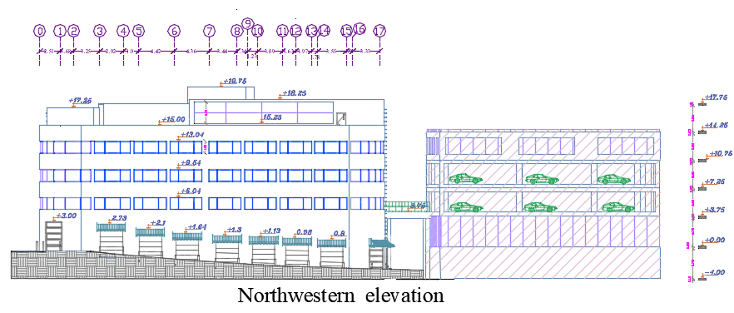
Figure: northwestern elevation

Slide 16
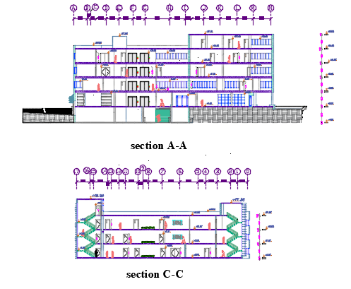
Figure: section A-A and C-C

Slide 17
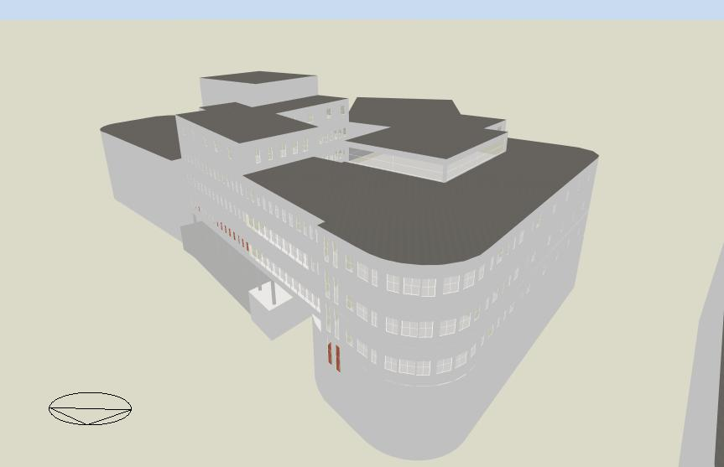
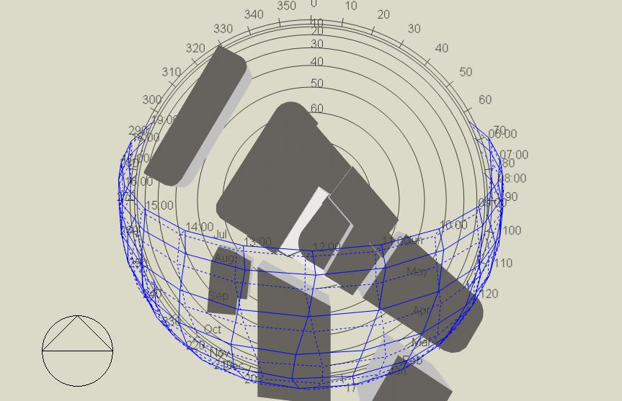
Environmental design
      Building Massing &Orientation
As analysis
Figure : envelop to volume ratio on energy efficiency.
Figure ‎: Orientation of Nablus municipality

Slide 18
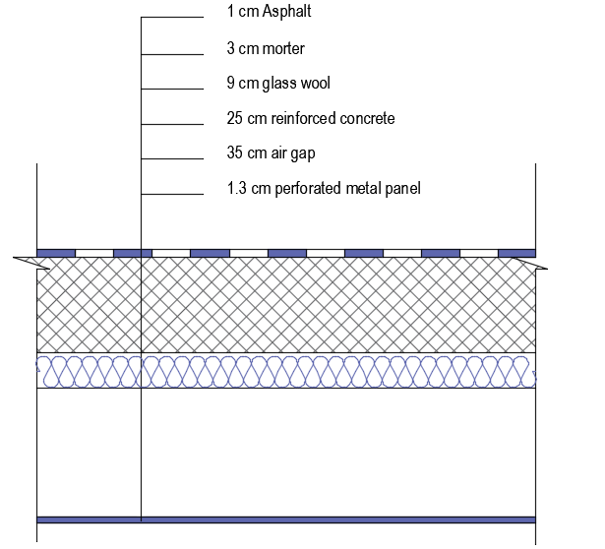
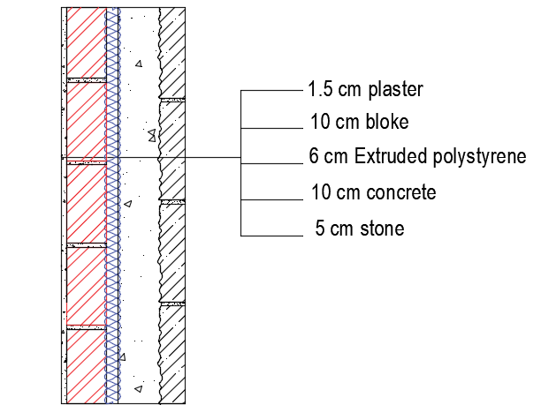
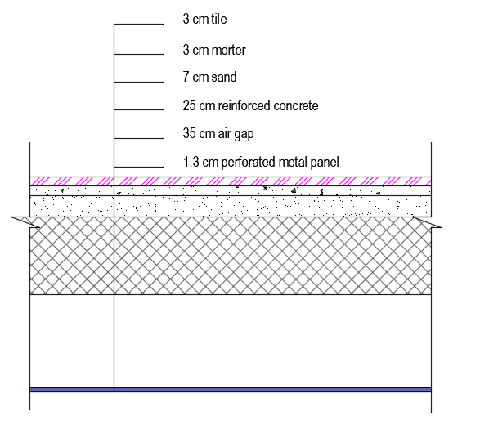
Analysis using Design Builder Software.
Material definition
Figure ‎ layer of roof
Figure ‎: layer of external wall.
Figure layer of floor
Tabel :U value for construction item compared with the U effective.
item | U value | U effective | note
External wall | 0.466 | 0.5 | Satisfy
roof | 0.36 | 0.39 | Satisfy
floor | 0.4 | 0.9 | Satisfy

Slide 19
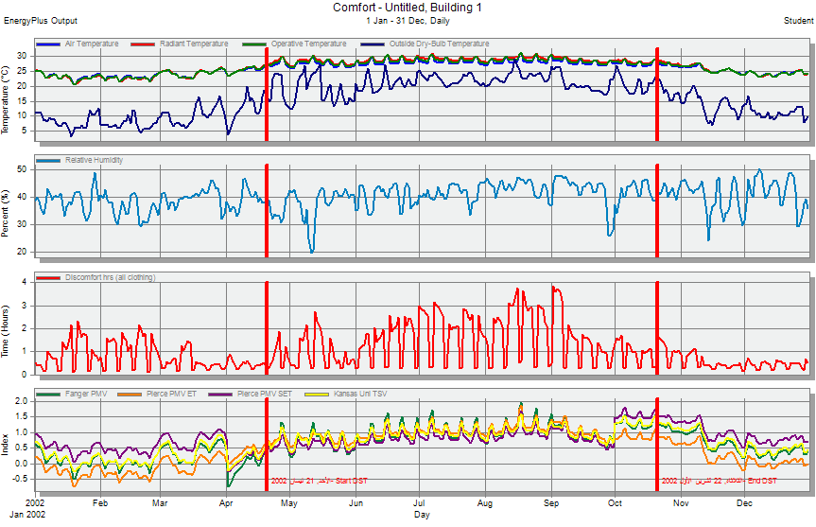
Comfortable analysis result by Design Builder
Figure ‎: Simulation comfort result for the building

Slide 20
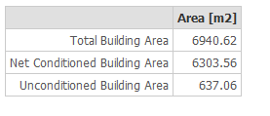
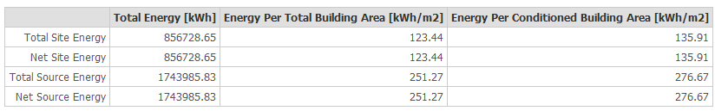
Design builder simulation result
Table: Building Area.
Table: Site and Source Energy.
Note: In the administrative buildings Energy per area (KWh/m²) are usually around 207 KWh/m²

Slide 21
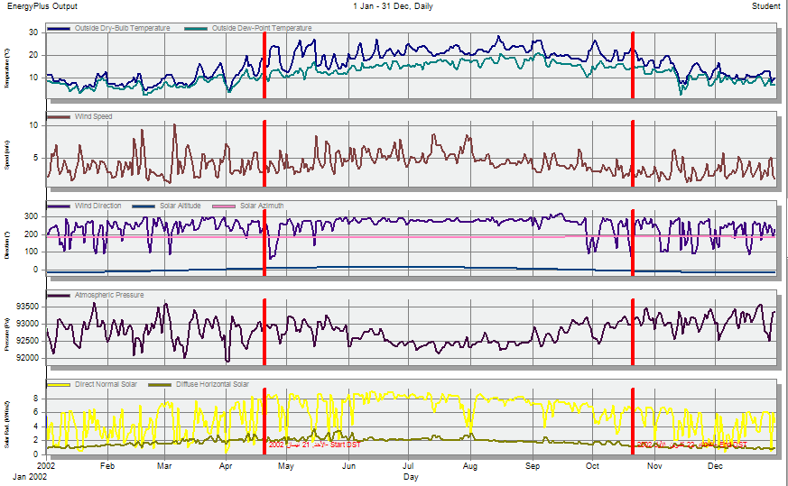
Figure : site data for building.

Slide 22
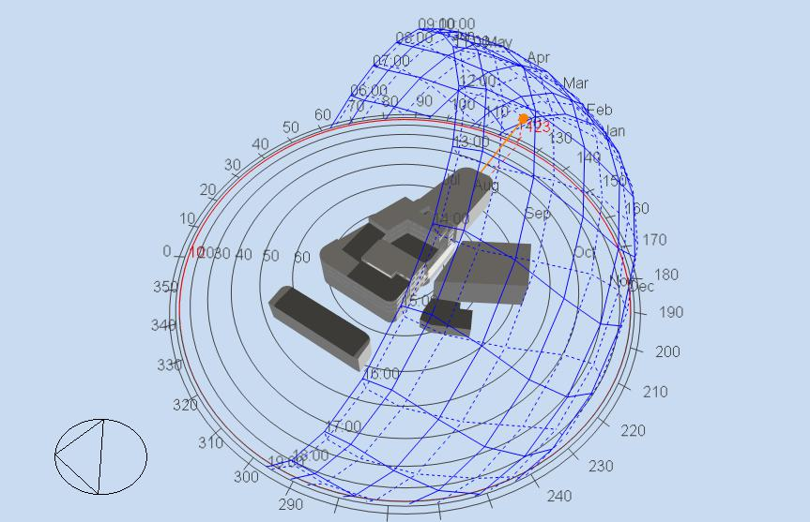
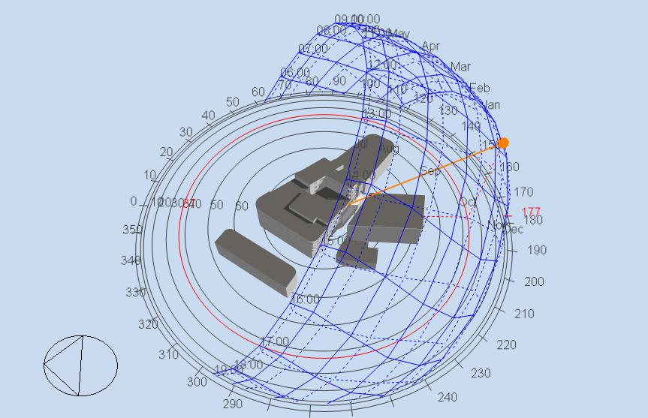
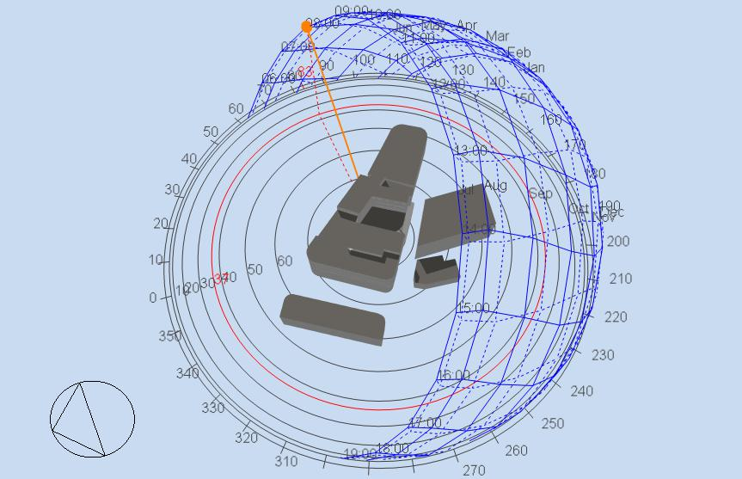
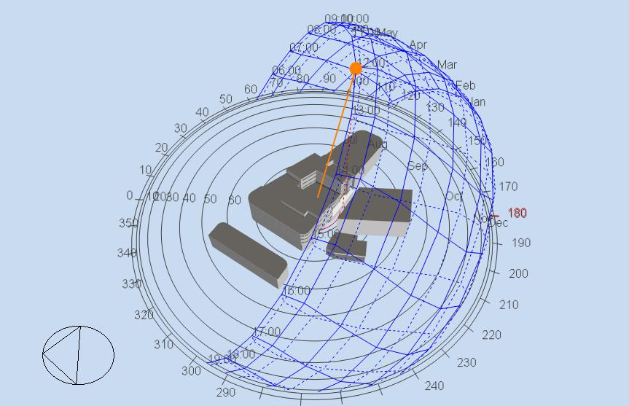
Shadows on the building
In 21th January
8:00 am
12:00 pm
In 21st June
8:00 am
12:00 pm

Slide 23
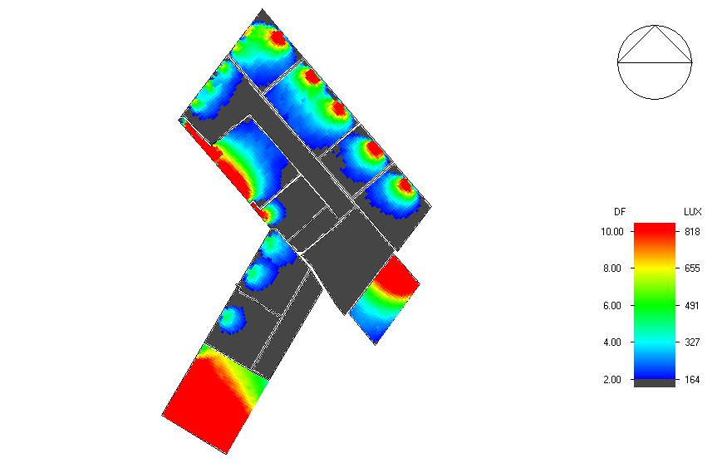
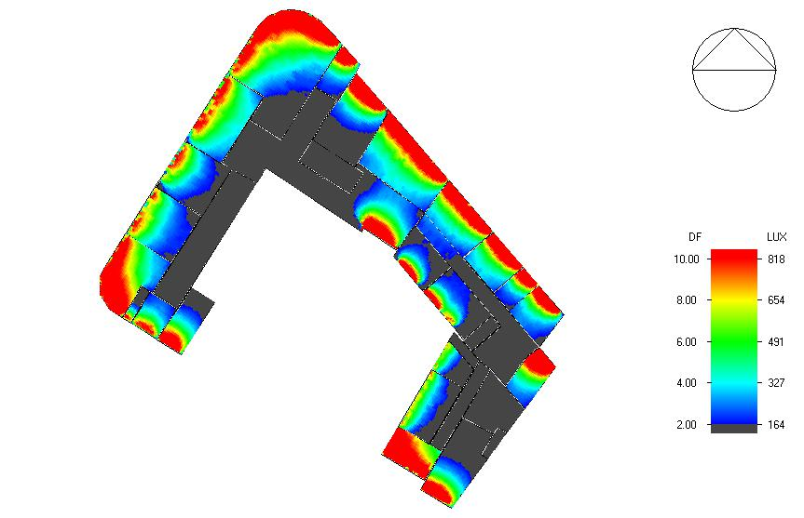
Daylighting analysis
Figure‎: Daylight factor in fourth and third floor

Slide 24
Acoustical design
Tabel:RT60 result by Ecotect analysis
Room | RT60 | room | RT60
Meeting room | 0.3-0.54 | Privet office | 0.32-0.6
Multipurpose | 0.8-1.57 | General office | 0.33-0.58
Open office | 0.35-0.74 | Cafeteria | 0.36-061
Tabel:STC and IIC by INSUL analysis
item | STC/IIC
Internal floor | STC = 68 dB
External wall | STC = 55 dB
roof | IIC= 55 dB
Partition | STC =47 dB

Slide 25
Table :STC between adjacent spaces :
Room1 | Room2 | STC component | STC dB | STC Requirement dB | Satisfy or not
public hall | Head office of public | Partition +glass | 46 | 43 | satisfy
Affairs office | corridor | Partition(27.625m²)+wood door (2.25 m²⁾ | 43 | 43 | satisfy
President office | Corridor +reception | Partition(36.9)+2 wood door (5 m²) | 45 | 47 | satisfy
Human resource | Affairs office | Partition(21.9m²) | 47 | 31 | satisfy
Meeting room | corridor | Partition(9.13m²) door 2.25 m² | 40 | 40 | Satisfy
Multipurpose | corridor | Partition(63 m²)+2 wood door (5 m²) | 43 | 40 | satisfy

Slide 26
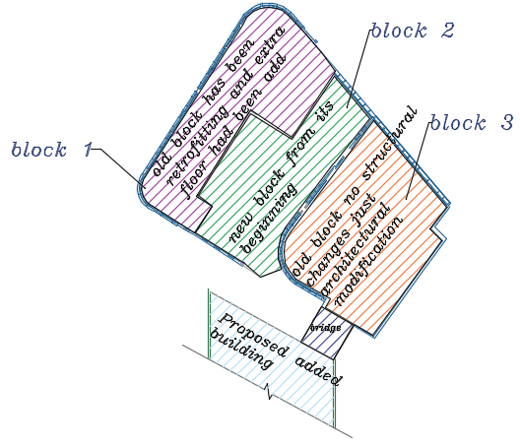
Structural Design
The project consist of three blocks :

Slide 27
      DESIGN CODES
The codes use for concrete structural members design is:
1. ACI -318-14 for reinforced concrete structural design.
2. UBC -97 for earthquake load computations.
3.(ASCE 7 2010) for loads combination
Loads
1.Live Load (L.L)= 3 KN/m²
2.Super imposed dead load (SI)=6.44KN/m²
3.Weight of wall =20 KN/m
4.Bearing capacity of soil = (150-200) KN/m²

Slide 28
EQ factors (UBC97):
I= 1 | Cv=0.4
R= 5.5 | Ca=0.28
Z= 0.2 (2B) | Ct= 0.0488
Material
1.concrete f′c = 24 MPa for columns , beams and slab
2.Yielding strength of steel Fy = 420 MPa.

Slide 29
Structural system
One way ribbed slab with drop beam
Final Design Sections
**Slabs thickness 0.35 m
**Columns(square) , (0.6×0.6),(0.7×.7 m) and Columns circular with Diameter .65 m
**Beams - Main drop beams (0.8×0.4),(0.6×0.3) m*m,
- secondary beams (0.35*0.65) m*m
**Walls thicknesses 0.2 m

Slide 30
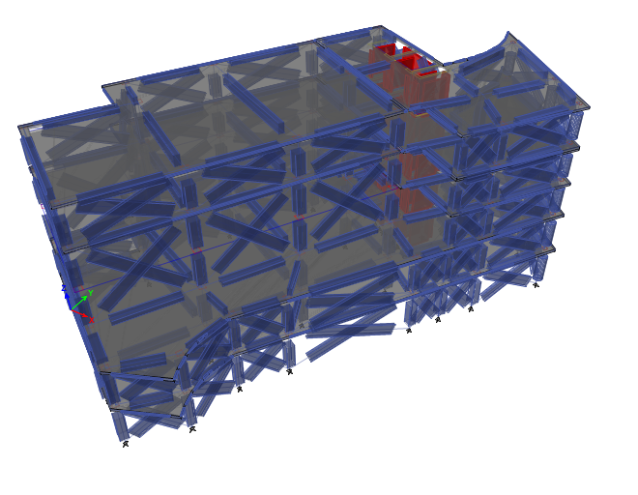
3D model for the designed block 2 using ETABS software.
Figure ‎ 3D model from ETABS for block 2.

Slide 31
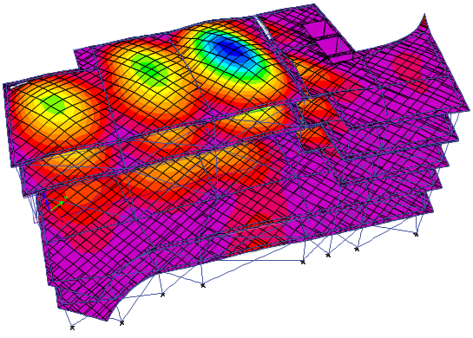
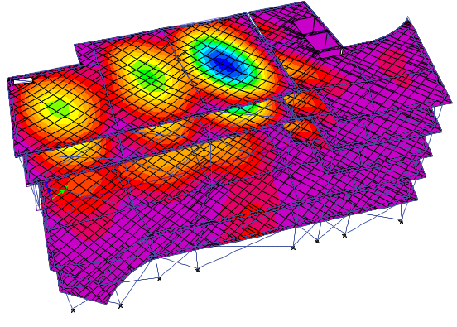
Compatibility Check
Figure ‎:the animation of the deformed shape

Slide 32
Equilibrium check
Table: Equilibrium check for live ,dead and superimposed dead load
Difference (%) | Calculations from ETABS (KN) | Manual calculations | load
< 5%% 3.99 | 20970.6 | 21843.35 | Dead load
< 5%% 0.2 | 6889.7 | 6904.8 | Live load
4.5% < 5% | 25904.5 | 27138 | Superimposed dead load

Slide 33
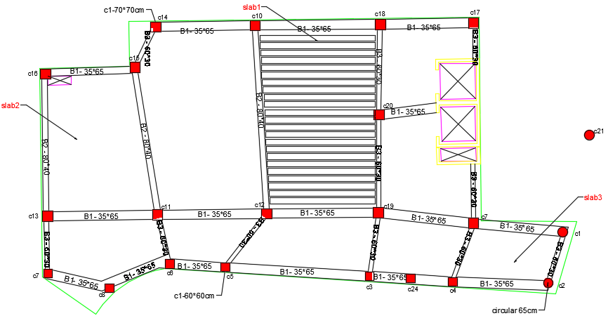
Internal Forces Check
Figure : beams distribution for basement and ground floor

Slide 34
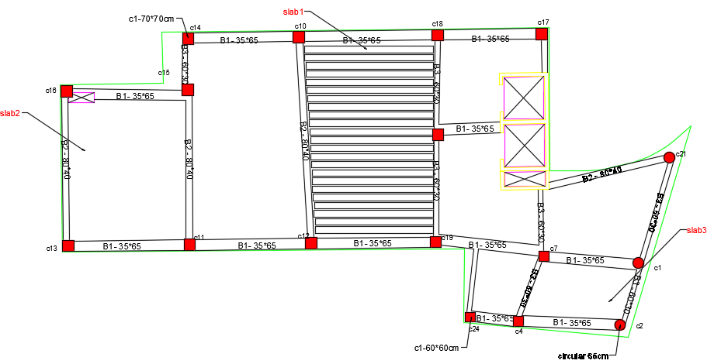
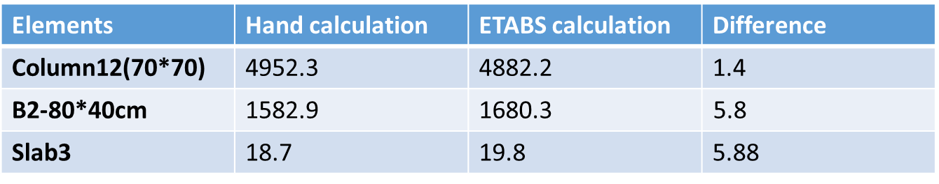
figure :beams distribution for first ,second and third floor
Table : internal force check
Difference in internal force < 10%

Slide 35
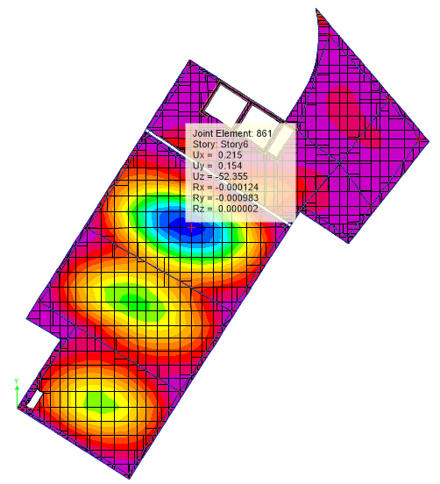
Deflection
Limit = 12900/240 = 53.75 mm (According to ACI 318-11)
Figure : deformation value of slab (Uz) ,Max deflection in slab =52.35mm

Slide 36
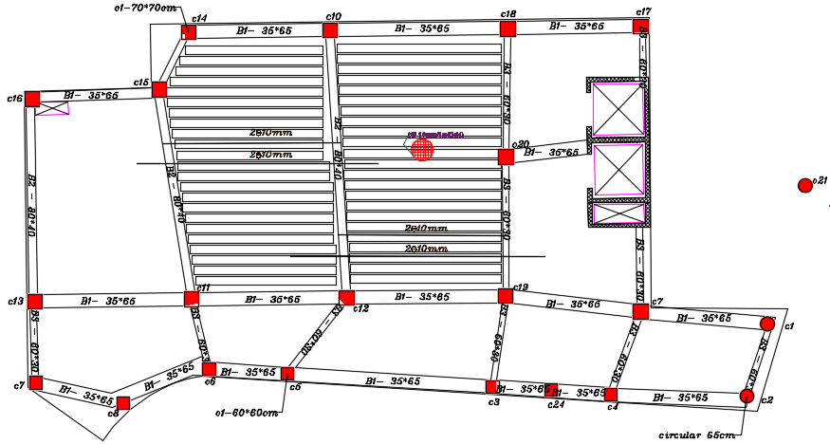
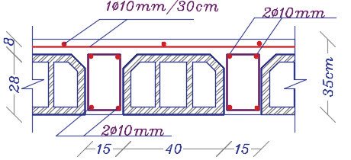
Slab :one-Way Ribbed Slab
Figure : slab section and reinforcement

Slide 37
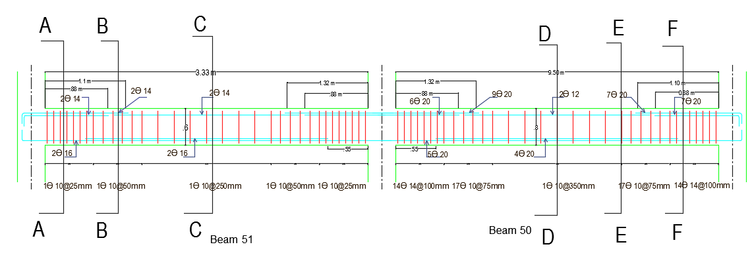
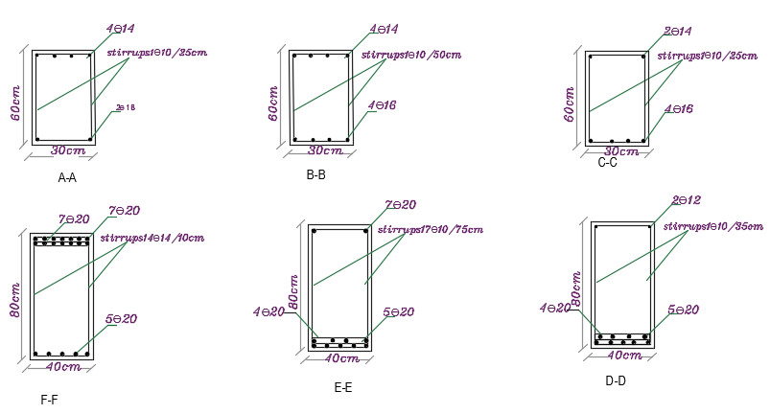
Beam Design example
Figure :detailing of frames available in six floor (story 6 on ETAbS).

Slide 38
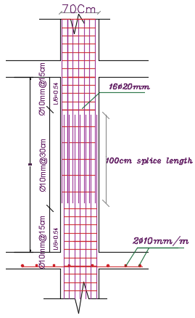
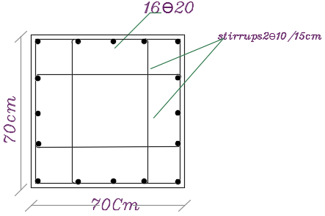
Column Design
Table :column summary design
Stirrups zone B | Stirrups zone A | reinforcement | Section mm | column
2 Ø10/300 | 2Ø10/150 | 16Ø20mm | 700*700 | C(19.12.11.13.20.16.15.14.10.18.17
2 Ø10/200 | 2Ø10/150 | 14Ø18mm | 600*600 | C(4.24.3.5.6.8.7)
 |  | 16Ø18mm | Circular (650) | C(1.2.21)
Figure: sections in column 12

Slide 39
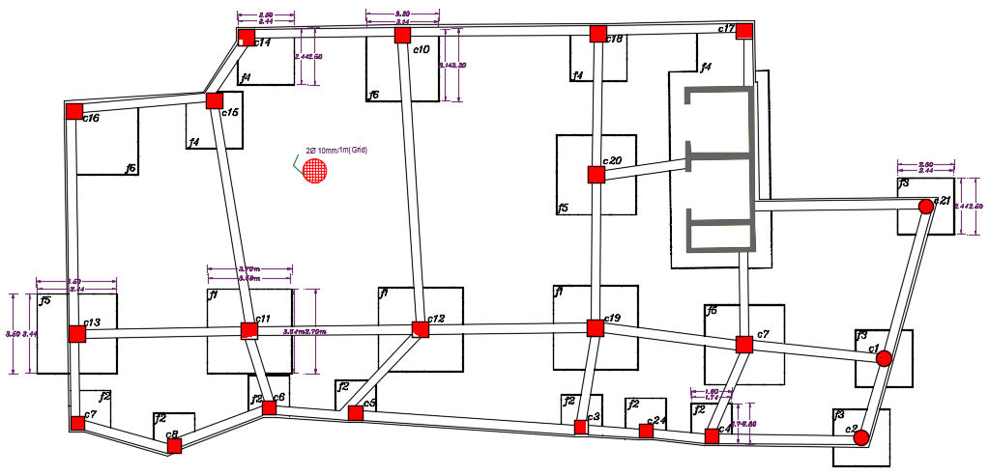
Footing Design
Figure : Footings plan

Slide 40
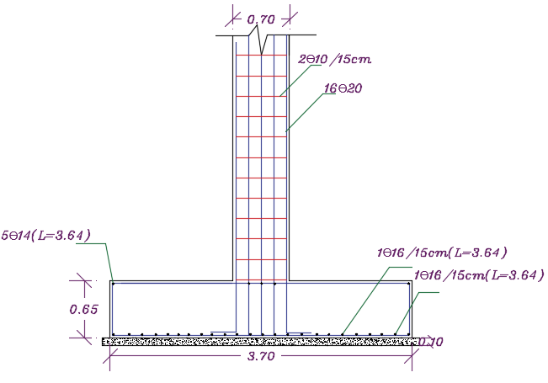
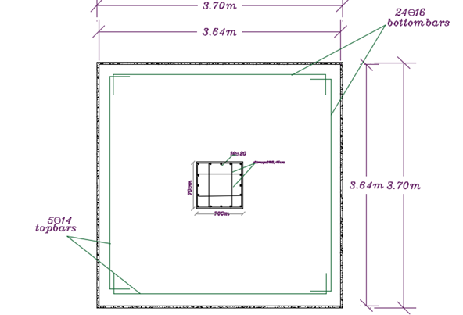
Fig :Top view of a single footing (1)
Fig :Section in a single footing (1)

Slide 41
Footing summary Design
Table: footing design
group | dim/col mm*mm | B (m) | L (m) | D (mm) | h (mm) | # of bars in longitudinal direction | # of bars in transverse direction
1 | 700*700 | 3.7 | 3.7 | 590 | 650 | 24 Ø16 | 24 Ø16
2 parapets footing | 600*600 | 1.8 | 1.8 | 440 | 500 | 12 Ø14 | 12 Ø14
3 | D650 | 2.5 | 2.5 | 480 | 550 | 16Ø14 | 16Ø14
4 parapets footing | 700*700 | 2.5 | 2.5 | 590 | 650 | 22 Ø16 | 22 Ø16
5 | 700*700 | 3.5 | 3.5 | 480 | 550 | 23 Ø16 | 23 Ø16
6 parapets footing | 700*700 | 3.2 | 3.2 | 730 | 800 | 28 Ø20 | 28 Ø20

Slide 42
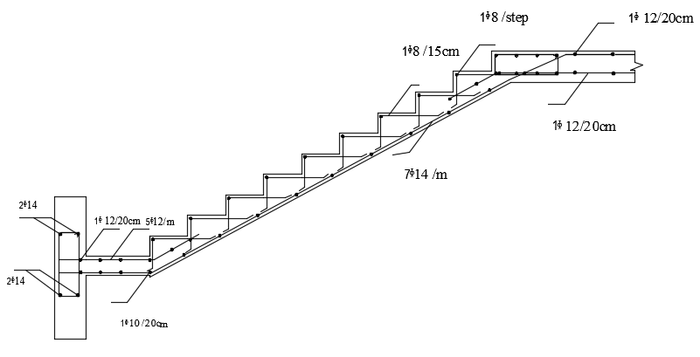
Stair Design
Fig :section in stair

Slide 43
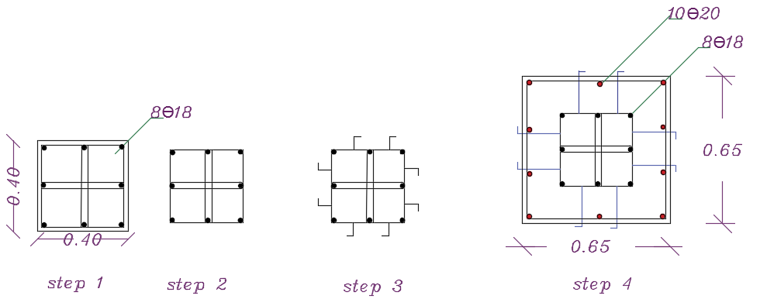
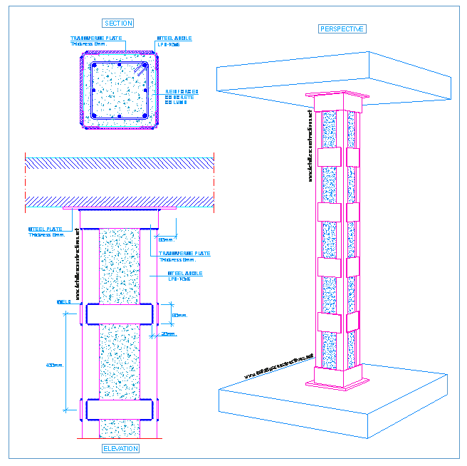
Method of retrofitting for block 1
1.Concrete retrofitting method
2- steel retrofitting

Slide 44
Retrofitting
1- Concrete retrofitting
In new building we have 3 types of columns
**Column 1=65*65cm with area of steel 4225mm^2 with # of bars =14Ø20
**Column 2=50*50cm with area of steel 2500mm^2 with # of bars =10Ø18
**Column 3=45*45cm with area of steel 1600mm^2 with # of bars =8Ø18
In existing story we have 40*40 cm with area of steel 1600mm^2 with # of bars =8Ø18
The difference between Column 1 and Column 40*40 in # of bars =10Ø20
The difference between Column 2 and Column 40*40# of bars =4Ø20
There is no difference between Column 3 and Column 40*40 in steel bars just the difference in concrete area

Slide 45



The bridge between the municipality and parking
1. SLAB design
2. BEAMS
3. Columns
Main drop beams were given the dimensions of 45x25 cm
Column dimensions, 30x30 cm

Slide 46


Electro mechanical Design
Electrical Design
    **Artificial lighting by DIAlux evo
**meeting room design by Dialux
Lamp type:
Table ‎:Dimming table if we used natural lighting for meeting room

Slide 47



Figure ‎: Room summery
Figure :Lamps layout plan
Figure :3D views for meeting room

Slide 48


3D views for other room
Figure :3D views for public hall
Figure :3D views for multipurpose

Slide 49


3D views for other room
Figure :3D views for cafeteria
Figure :3D views for office

Slide 50




    **camera and sensor plan
Figure :Distribution of camera and sensor at ground floor

Slide 51

Figure :Lighting distribution for ground floor

Slide 52

Figure ‎:Picture shows the calculated distribution panel

Slide 53
Mechanical Design
Outline:
Fire escape
Fire Fighting
Drainage system
Water supply
Elevator design
HVAC system

Slide 54


Fire escape design
Figure: Ground floor escape plan

Slide 55



Fire fighting system
Figure :Sprinkler distribution for ground floor

Slide 56


Drainage system
Figure :drainage system for first floor

Slide 57

Figure ‎: stack 1 calculation diameter and slope

Slide 58


Water supply system
The capacity of roof tank 45 m3
The found one 18 tank the extra 13 tank
Figure ‎: water supply for first floor

Slide 59
    Mechanical analysis for elevator
According calculation:
Table ‎elevator calculation to compute requirement number of elevator needed in Nablus municipality
Option | (2500/350) | Standard | (2500/400) | Standard
Capacity (person) | 13 |  | 13
RT | 96.25 |  | 93.50
hc | 40.52 |  | 41.71
N=HC/hc | 1.05 |  | 1.02
N' | 2 |  | 2
Check
PHC=N''*hc/pop | 26.79% | (12-14)% | 26.27% | (12-14)%
I=RT/N'' | 44.38 | (25-29)sec | 40.75 | (25-29)sec
For N''=2 not ok for PHC not ok for Interval Try N'''=3
Option | (2500/350) | Standard | (2500/400) | Standard
N''' | 3 |  | 3
Check
PHC=N'''*hc/pop | 40.20% | (12-14)% | 39.41% | (12-14)%
I=RT/N''' | 29.58 | (25-29)sec | 27.17 | (25-29)sec
For N'''=3 ok for PHC ok for I for 2500/400 with car speed 2m/s with capacity of 13 passenger

Slide 60
      HVAC system
Table: Heating and cooling design capacity for each floor
Floor /zone | cooling design capacity kw | Heating design capacity kw
Ground floor | 72.97 | 56.44
First floor | 136.11 | 70.7
Second floor | 103.96 | 44.52
Third floor | 129.36 | 63.88
Fourth floor | 69.25 | 43.05
Table: Recommended fresh air for different spaces
space | L/s/person | occupancy | Fresh air L/s | building
cafeteria | 10 | 30 | 300 | added
kitchen | 10 | 10 | 100 | added
multipurpose | 8 | 100 | 800 | added
Collection dep | 10 | 40 | 400 | added
Public hall | 10 | 40 | 400 | old

Slide 61


Figure ‎: FCUs and diffusers distributed for first floor

Slide 62
Table ‎: summary result of FCU and model name for first floor
Group according capacity | Fan number | Real capacity | Model name | Model number
Group A | 02 ,09 | 15 KW | MSP 16 KW | MMD-AP0566BHP-E
Group B | 05,08,10,11 | 12.16 KW | MSP 14 KW | MMD-AP0486BHP-E
Group C | 01,012,03,06,04 | 10 KW | MSP 11.2 KW | MMD-AP0366BHP-E
Group D | 07 | 7.3 | MSP 9.0 KW | MMD-AP0306BHP-E
Table: Outdoor unit capacity for municipality
description | Total Capacity kw | Capacity per each /model name
For old building | 207.09 | MMY- AP4014HT8P-E/106.5KW
For multipurpose + cafeteria+ Drawers+coll dep | 99.23 | MMY- AP3614HT8P-E 101 KW
New office building | 205.81 | MMY- AP4014HT8P-E/106.5KW

Slide 63
Quantity surveying
Table: summaries for all calculation cost

Slide 64

Thanks
For
Listening

