Slide 1





HTTPS://AYLANACAKE.SHOP
E-COMMARCE
AYLENA CAKE
NAGHAM BARJAS
ABRAR HAMANHI
DEEMA SALHI
SUPERVISED BY DR.AHMAD SHRIDEH

Slide 2

Table of Contents:
01
02
03
04
05
06
Introduction
Problem & Solution
tools & Used Technologies
Website Features
Reports
Future Plans

Slide 3
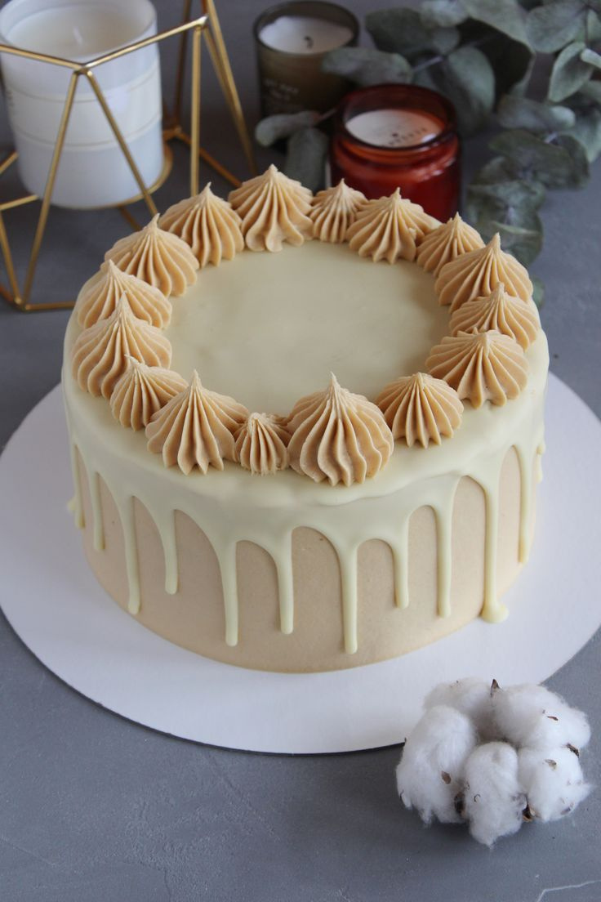
About Aylena Cake:
Aylena Cake is an e-commerce store offers a seamless shopping experience, allowing customers to place orders easily online with the convenience of home delivery, transparent pricing, and personalized options to meet every need.

Slide 4





Problem
& Solution
Decline in sales due to an ineffective product display.
We have made online ordering easy by clearly and attractively displaying the product.
Lack of transparency in pricing and ordering
Simplify the ordering process and clarify pricing and discounts.
No customization options for customers.
Added flexibility to personalize orders

Slide 5







Used Technologies & Tools :

Slide 6



Website Features:
Customization
Order tracking
Choose a pickup and delivery date
Mailpoet
Multiple payment methods
Reports

Slide 7
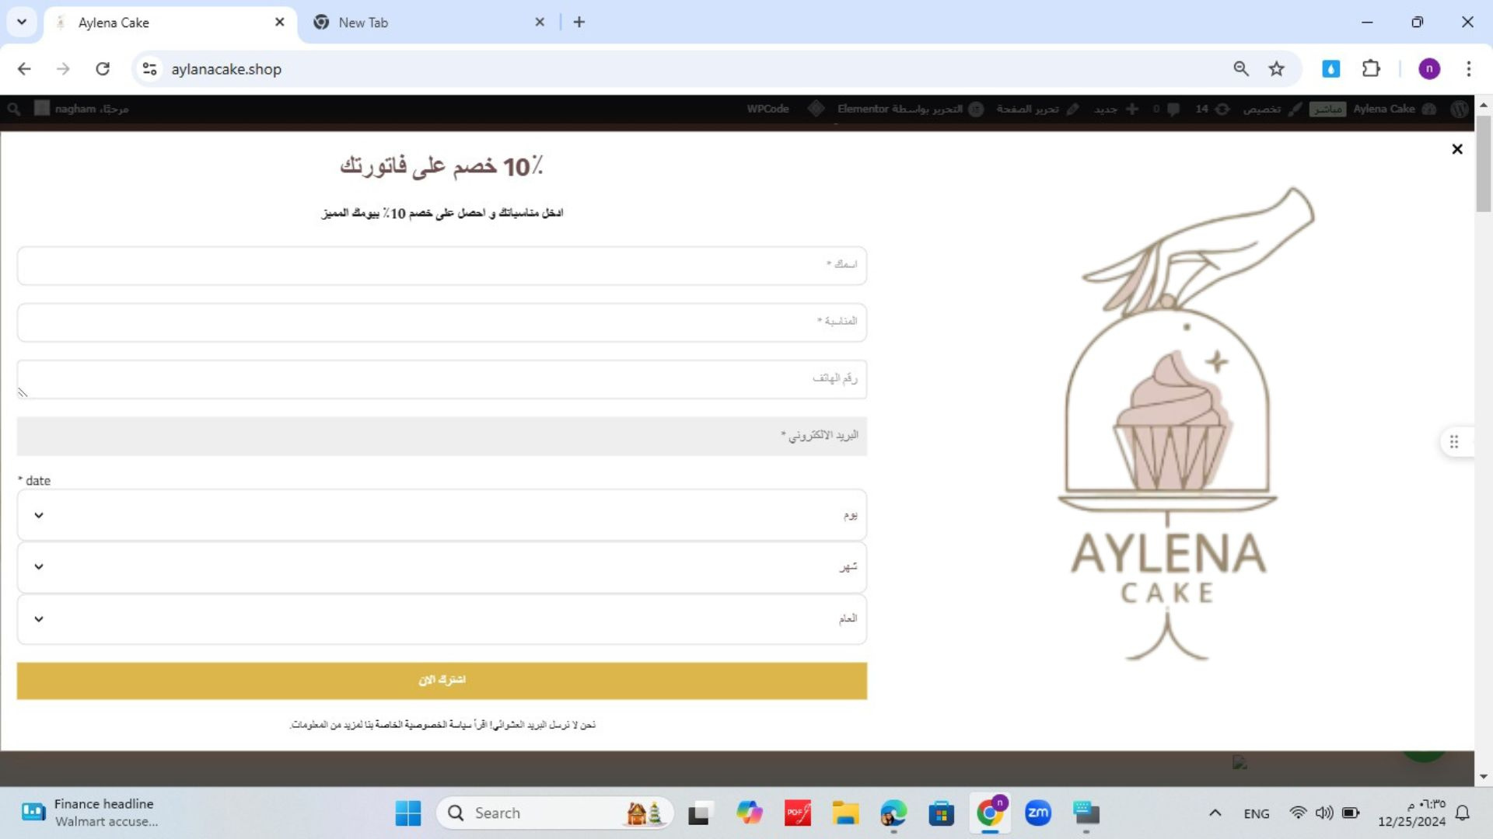
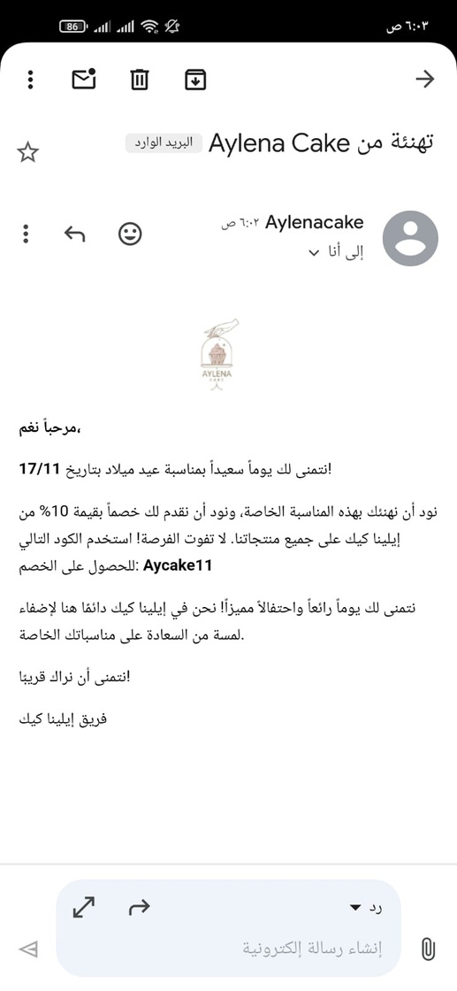
Mailpoet:
When the customer enters the site, it will appear to him if he wants to enter his personal event to congratulate him with discounts

Slide 8
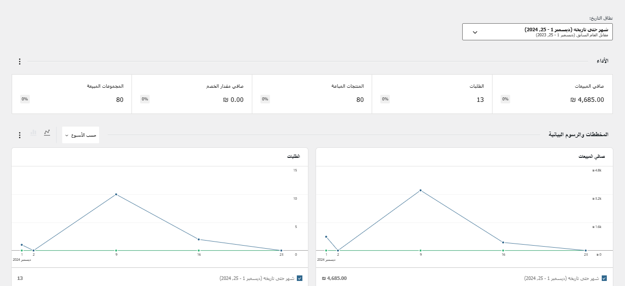


Reports:
Reports that include net and gross sales, best-selling products, inventory status, and customer data help improve store performance by understanding market needs, improving inventory management, and facilitating effective strategic decision-making.

Slide 9
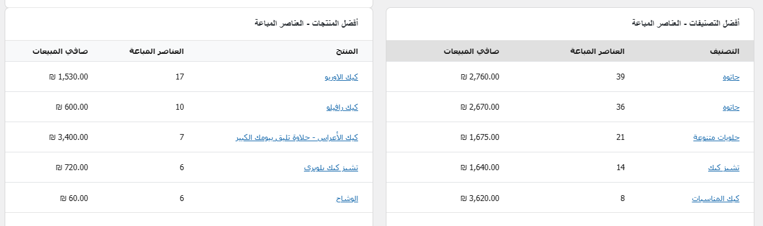

Slide 10
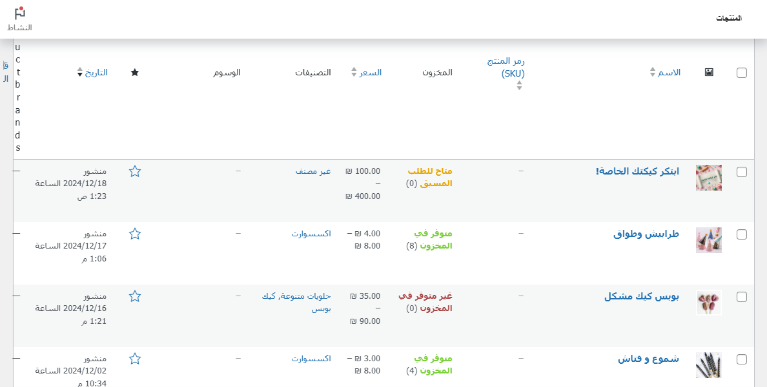
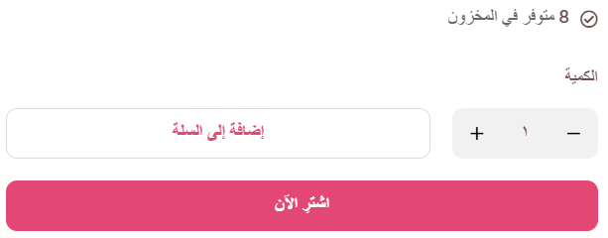
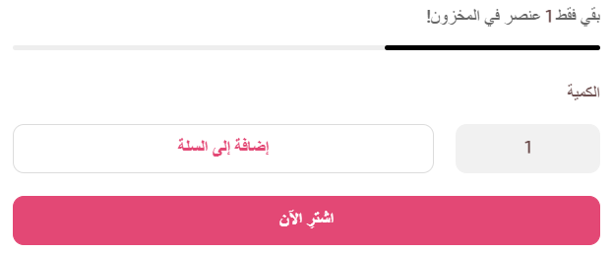

Slide 11


Future Plans:
Implement a feature that allows customers to design their cakes interactively, resembling a Lego-style assembly.
Interactive Cake Design
Introduce a real-time chat system to facilitate quick and easy communication with customers
Instant Chat Support
Send SMS messages to customers to confirm orders, ensuring clarity and convenience.
SMS Notifications

Slide 12


‎‏(وَآخِرُ دَعْوَاهُمْ
(أَنِ الْحَمْدُ لِلَّهِ رَبِّ الْعَالَمِينَ
19 January , 2025

