Slide 1

Implementation of ISO 45001 in Al-Rajeh Factory
Graduation project 2
Malak Raie
Leen Halabi
Samia Baara
Submitted to :
Dr.Tamer Haddad

Slide 2
TABLE OF CONTENTS
01
02
03
04
Introduction
Objectives
Documentation
Procedures
05
Recommendations and Conclusion
06 Appendices

Slide 3

INTRODUCTION
In Project 1 :
Choose Al-Rajeh Factory and searching for a problem in it.
Finding the biggest problem : the low level of safety.
Choosing ISO 45001 which specialize in improving the occupational health and safety
Made a risk assessment and develop recommendations.

Slide 4
In this project, we are going to :
* Implementation of ISO 45001 regulations in AL-Rajeh Factory in order to strengthen and develop the factory's safety system
* Measuring and improving the performance of Occupational Safety and Health management systems on a continuous basis
* Occupational safety and health guidelines must be established, as well as a proper working environment.
* Make Gap analysis by analyzing the current state and compare it to its target state
Objectives :

Slide 5

Documentation
General policy for occupational safety and health:
The policy of Al-Rajeh Detergent Factory works to provide means of occupational safety and health for all employees as it is the main driver of daily activities. It also works to provide a safe work environment free from the causes of accidents or occupational diseases through a set of rules and regulations within a legislative framework aimed at preserving human and property from Risk of injury and damage

Slide 6
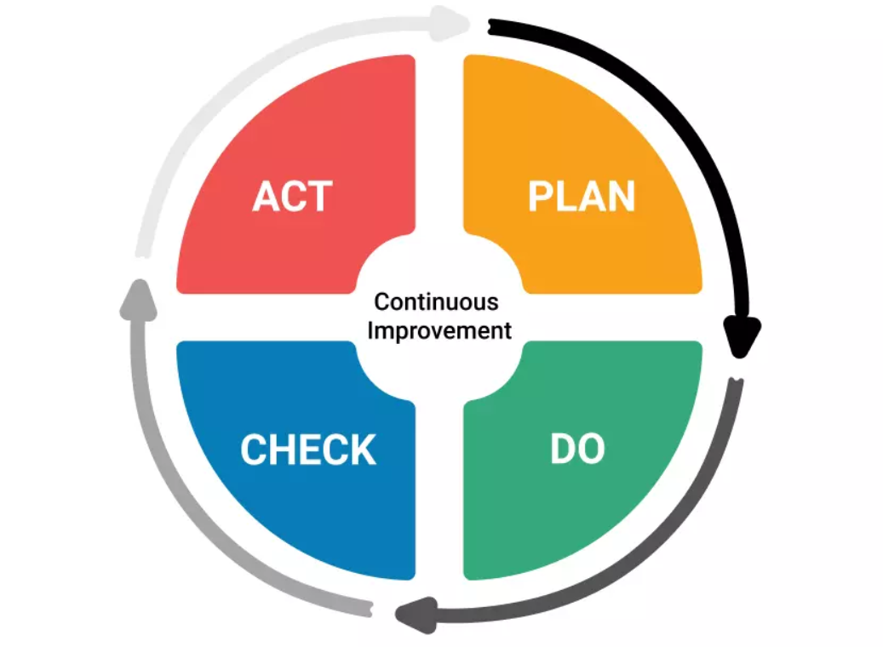
Occupational Safety and Health Manual:
Is the standard basis for reference to the international standard and should be used internally to provide an overview of the requirements of ISO 45001: 2018 and how they are applied to Al-Rajeh factory
We used a template to help us apply the Occupational Safety and Health System Manual (Plan Do-Check-Act).
The PDCA cycle : can be applied to all operations and to the OSH management system.
Plan: defining the goals of the system and its operations
Do: implement what was planned.
Check: Monitor and measure processes
Act: take action to improve performance.

Slide 7

Occupational Safety and Health Manual:
The project is limited to preparing the factory to apply the provisions of ISO 45001 for occupational safety and health management to minimize the risks or try to eliminate the risks completely in Al-Rajeh factory, including the factory building, warehouses and production lines including workers and all concerned parties.

Slide 8
The requirements of ISO 45001: 2018 and how applying them to Al-Rajeh factory :
1- Understanding the organization and its context
2- Recognizing the needs and expectations of employees and other stakeholders
3- Determining the OH&S management system's scope
4- Occupational health and safety management system requires the organization to establish, implement, maintain, and enhance its OH&S management system.
5- Leadership and commitment
6- OH&S policy
7-Organizational roles, responsibilities, and authorities:

Slide 9
The requirements of ISO 45001: 2018 and how applying them to Al-Rajeh factory :
8 -Consultation and participation of workers
9- Planning
10 – Support
11 - Operation
12 – Performance evaluation
13 – Improvement

Slide 10
Procedures
Policies and procedures govern how decisions are made and how people work in factory . Policies and procedures that are clearly stated promote organizational responsibility and transparency, and they are required to assure occupational safety and health programs

Slide 11
To make it easier for all those who interact with it, the processes were written in Arabic.
Each procedure comprised the following items:
Goals.
Responsibilities.
Scope.
Operation.
Performance indicators.
Relevant document and records

Slide 12
Procedure for Hazard Identification and Assessment.
Objectives:
Provide clear and structured instructions on how to identify, manage and assess risks and opportunities and ways to deal with these risks
Scope:
This procedure ensures that all relevant risks and opportunities at Al Rajeh plant are identified and assessed.
In all operations related to the occupational safety and health system and its control

Slide 13
Procedure for Hazard Identification and Assessment
Responsibilities :
The CEO is responsible for approving and following up on the implementation of the procedure in the correct manner.
The Occupational Safety and Health Officer is responsible for: - Ensure that this procedure is carried out and adhered to by the relevant personnel within the plant and Develop, manage and review the register of risks and opportunities and ensure that all business-related risks are identified and managed to the extent possible
Department managers are responsible for identify, review and mitigate, in conjunction with the Occupational Safety and Health Officer, risks and opportunities and give input and Information requiring the development

Slide 14
Procedure for Hazard Identification and Assessment
Processes :
1 - The process of identifying and evaluating risks by examination
3-The risks were analyzed in AlRajeh factory using the (analysis effects and mode failure)
4 -Managing Opportunities
2- Risk management

Slide 15
Procedure for Consultation and Participation of Workers.
Objectives :
Ensuring that all employees and workers are qualified and trained in a correct and good manner on all the tasks assigned to them and which have direct relationship to occupational safety and health.
Scope :
This procedure includes all employees and workers in the factory whose work affects occupational safety and health.

Slide 16
Procedure for Consultation and Participation of Workers.
Responsibilities:
1 - The Executive Director is responsible for approving and evaluating operational control procedures.
2 - The Occupational Safety and Health Officer in the factory is responsible for:
1- Defining operations and activities for the needs of operational control documents and documenting the selected operations.
2-Reviewing work instructions and operational control documents on an annual basis and making any necessary adjustments.
3- Ensure that operational control procedures and work instructions are communicated and implemented to workers.

Slide 17

Procedure for Consultation and Participation of Workers.
Processes:
1- Training of new employees
2- Training of existing staff
3- Determining training needs
4- Determining the annual training plan
5- Accreditation of training bodies
6- Implementation of training programs

Slide 18

قياس الضوضاء داخل المصنع
Sound level meter

Slide 19
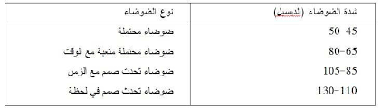
“الضوضاء: هي الأصوات المتنافرة غير المرغوب فيها الناجمة عن مصادر داخلية أو خارجية وتؤثر بشكل أو بآخر على الصحة العامة ونوعية الحياة اليومية للإنسان.
الديسبل : هي وحدة قياس شدة الضوضاء التي تتعرض لها الأذن البشرية، وتحسب بالفرق اللوغاريتمي بين ضغط الصوت المراد قياس شدته وضغط أقل صوت يمكن للأذن البشرية أن تسمعه وهو (20) ميكروباسكال، وذلك كما يحددها جهاز القياس المطابق للمواصفات القياسية الدولية

Slide 21
مستوى شدة الصوت (ديسبل) | اقصى مدة للتعرض
90 | 8 ساعات
93 | 4 ساعات
96 | ساعتان
99 | ساعة
102 | 30 دقيقة
105 | 15 دقيقة
108 | 7 دقائق
111 | 4 دقائق
114 | دقيقتان
117 | دقيقة واحدة
120 | 30 ثانية

Slide 22
النتائج داخل المصنع :
قسم المحارم
مدخل قسم المحارم | 78.5 | 3 ساعات
على بعد 3 متر من الماكينة | 85.1 | 3 ساعات
على بعد 2 متر من الماكينة | 86.5 | 3 ساعات
عند الماكينة | 100 | 3 ساعات

Slide 23
قسم البلاستيك
مدخل قسم البلاستيك | 87.5 | 7 ساعات
عند الماكينة (1) | 94 | 7 ساعات
عند الماكينة (2) | 87 | 7 ساعات
عند الماكينة (3) | 97 | 7 ساعات
وسط قسم البلاستيك | 90 | 7 ساعات

Slide 24
قسم المنظفات
عند ماكينة تعبئة الكلور | 85 | 7 ساعات
عند ماكينة تعبئة سائل الجلي | 83 | 7 ساعات
على مدخل المصنع | 75
في وسط المصنع | 70

Slide 25
الاجراءات المقترحة :
1.تقليل مدة تعرض العمال للضوضاء.
2.استخدام معدات الوقاية الشخصية وخاصة للعمال المعرضين للضوضاء باغطية للاذن وتكون عازلة للصوت بالاضافة للخوذات وسماعات الاذن.
3.تركيب الماكينات على قواعد عازلة للصوت تقلل من تاثير الذبذبات المنبعثة عند تشغيل الالات.
4.استخدام بعض المعدات التي لا تحدث اصوات عالية.
5.السعي لتصميم الات واجهزة لا تصدر الضوضاء.
6.عزل الاماكن التي تصدر الضوضاء عن بقية اماكن العمل.
7.عمل الفحص الدوري للعمال لمعرفة وتحديد مستوى السمع لديهم واستبعاد العمال الذين لديهم مشاكل بالسمع الى اقسام اخرى لا تحدث ضوضاء.
8.استخدام المواد الماصة للضوضاء في الجدران والاسقف.

Slide 26

Thank you
Do you have any question?

