Slide 1


Slide 2
OUTLINES
- location & Description.
Material properties.
Slab system & load transfer.
Preliminary design & Load calculations.
3D sap model.
Static design.
Dynamic analysis.
Soil-Structure interaction.

Slide 3
location & Description
Zamzam commercial building is located in Nablus city, Rafidia ward, Main Street, near Al-Tadamon Clinic.
It consists of 8 floors with roof.
Architectural plan

Slide 4
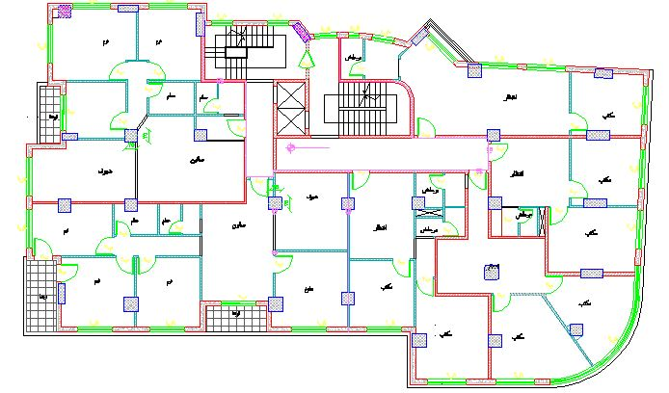

Slide 5
Material properties
MATERIAL | TYPE | PROPERTIES
Reinforced concrete | Structural | fc’ = 28MPa
Reinforcement steel | Structural | fy = 420MPa
sand | Non-structural | γ = 20KN/m³
Plain concrete | Non-structural | γ = 24KN/m³
Block | Non-structural | γ = 12KN/m³
Stone | Non-structural | γ = 26KN/m³
Tile | Non-structural | γ = 28KN/m³
Mortar | Non-structural | γ = 23KN/m³

Slide 6
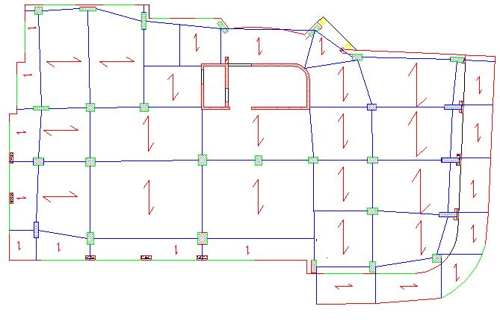
Slab system & load transfer

Slide 7
Preliminary design & Load calculations
Minimum thickness requirement
MEMBER | SS | IEC | 2EC | CANT
1WSS | L/20 | L/24 | L/28 | L/10
BEAMS or 1WRS | L/16 | L/18.5 | L/21 | L/8

Slide 8
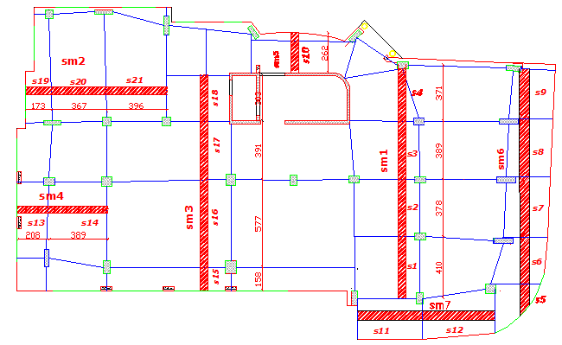
slab thickness
The thickness required is 27 cm .
The thickness used is 35 cm .

Slide 9
Check thickness of slab for shear
Maximum ultimate shear on ribs:
Vu =31KN
Shear capacity for rib:
ɸVc =34.9 KN

Slide 10
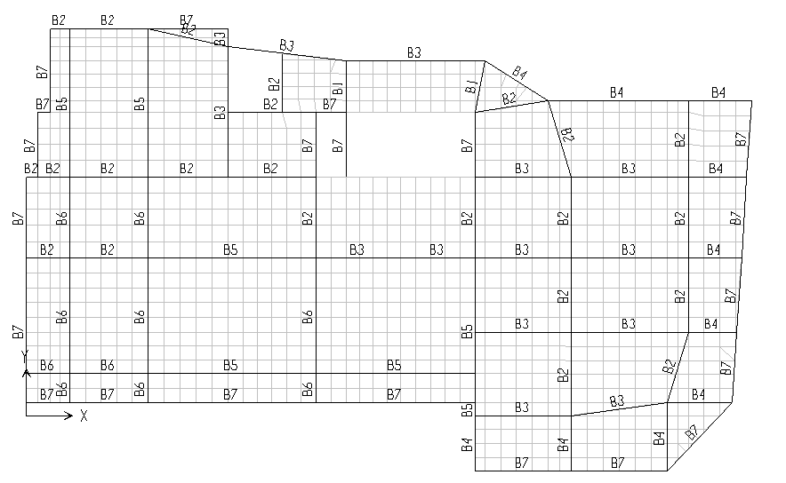
Beams distribution

Slide 11
Beams dimensions
BEAM | Size: width X depth (cm)
B1 | 40X35
B2 | 60X35
B3 | 80X35
B4 | 80X50
B5 | 100X60
B6 | 100X35
B7 | 30X35

Slide 12
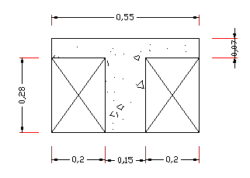
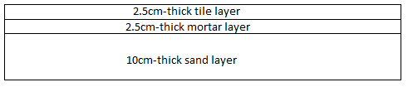
Load calculations
Rib own weight = 3.36 KN/m
Slab own weight=6.11 KN/m2
Super imposed dead load =3.3 KN/m2
Partitions load = 1 KN/m2
Live load = 3 KN/m2

Slide 13
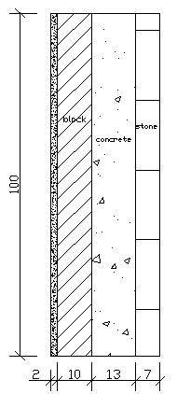
Parameter wall=21KN/m

Slide 14
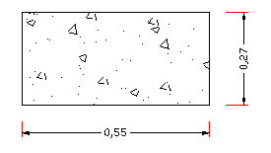
SOLID EQUIVALENT TO RIBBED SLAB
I rib = I solid

Slide 15
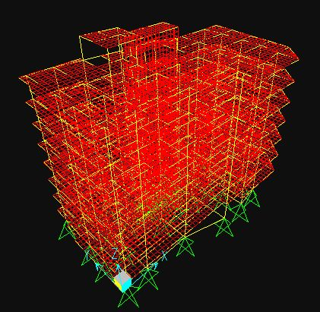
3D sap model

Slide 16
SAP MODEL VERIFICATIONS
Compatibility
Compatibility is ok as the model move as a one unit
Equilibrium
TOTAL Building own weight by hand = 60032.33 KN
TOTAL Building own weight from sap = 60010.61 KN
Error = (60032.33 - 60010.61)/60032.33=0.036%....ACCEPTED

Slide 17
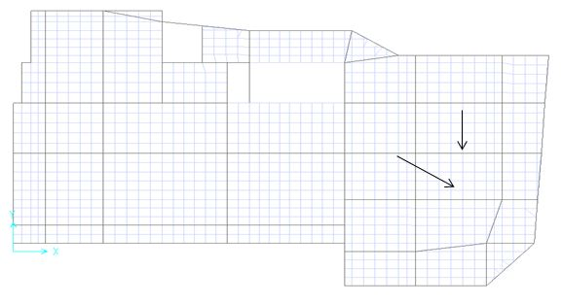
Stress strain relationship
      FOR beam
SAP total moment = (36.5+21.8)/2 +17.5=46.65KN.m
Moment by hand = (3 x 3.82 x 5.73^2)/8=47KN.m
Percentage of error= (47-46.65)/47 = 0.74 %< 10%...accepted

Slide 18
      FOR slab
Total moment = (19.4 + 17.2)/2 + 12.5 =30.8KN.m
Moment by hand= (3KN/m² x 3.65²/8) x 5.73m = 28.63KN.m
Percentage of error = (30.8 – 28.63)/28.63=7.5%<10%...accepted.

Slide 19
Static design.
Beams design.
Slab design.
Columns design.
Footing design.

Slide 20
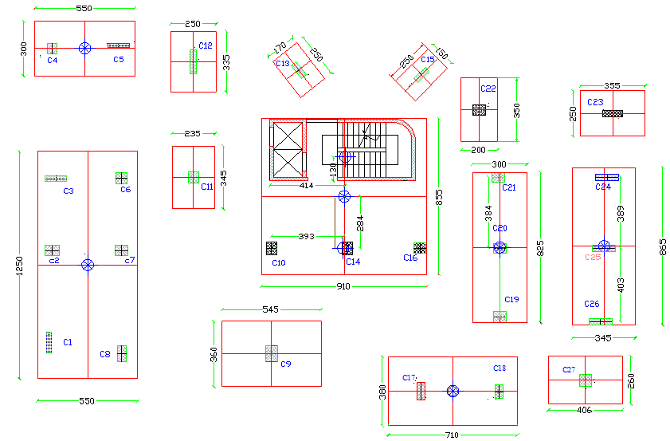
Footing design
Types of footing:
      single
combined
Strip
mat
footing dimensions
Footing thickness
Punching
Wide beam shear
2D sap Model
Design footing

Slide 21
Dynamic analysis

Slide 22
Soil-Structure interaction
There is a confusion point between structural engineer and geotechnical engineer

Slide 23
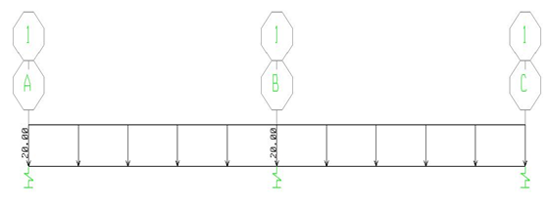
  1D analysis
The beam under consideration is 50X50 cm with length 4 m for each span.
K beam = n (EI/L³)
EI/L³ = (24e6) X (5.2e-3) / 4³
= 2000 KN/m

Slide 25
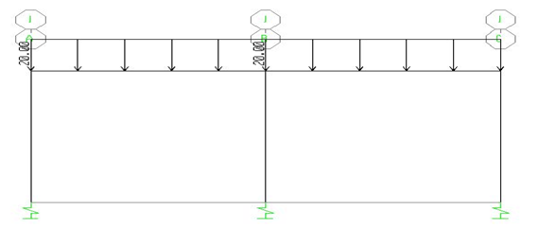
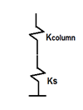
2D analysis:
Kcolumn=50000
K eq=K column/ (1+Kcolumn/Ks)

Slide 26
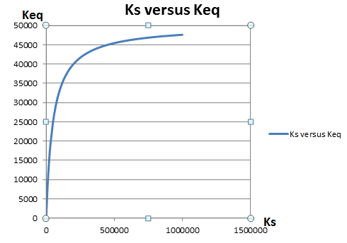

Slide 27
  Footings design operation:
Bearing design
Settlement design

Slide 28
Factors affect settlement
-Elastic properties of soil.
-Conditions of soil (density, void ratio, etc.).
-Shape of footing.
-Rigidity of footing

Slide 29
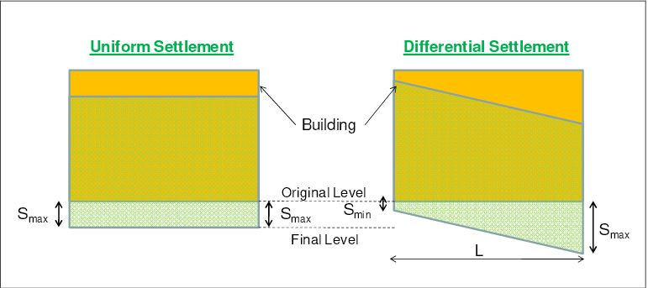

Slide 30
Thank you

