Slide 1

An-Najah National University
Faculty of Engineering
Building Engineering Department
“ Design of Ramallah Municipality”
Supervisor : Eng. Hind Tbaileh
Prepared By:
Alaa Sawalha
Ahmad Othman
Ghaith Ismail
Waleed Salameh

Slide 2
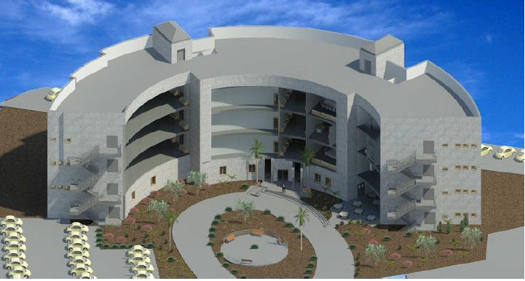
Contents:
Introduction
Site Description
Architectural Design
Structural Design
Environmental Design
Electro-mechanical Design
Fire fighting and Safety Design
Quantity survey and cost

Slide 3
Introduction :
Our project present a design of Ramallah Municipality. The main objective is to design a municipality building that provides all services and comfort to employees and citizens taking into consideration the architectural, environmental, structural, and electro-mechanical aspects.

Slide 4
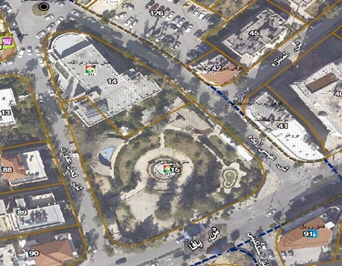
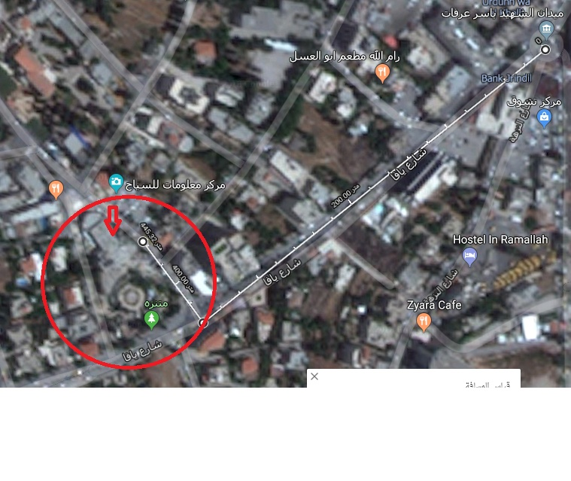
Site Description:
The site for the project is in Ramallah city, located about 605.83 meter from the city center . (2 min by car)

Slide 5
Architectural Design

Slide 6
Building Description :
The Municipality Building has 5 floors
Basement , ground, first, second and third floor
The total area of municipality is 6400 m2, each floor has an area of 1280m2.

Slide 7
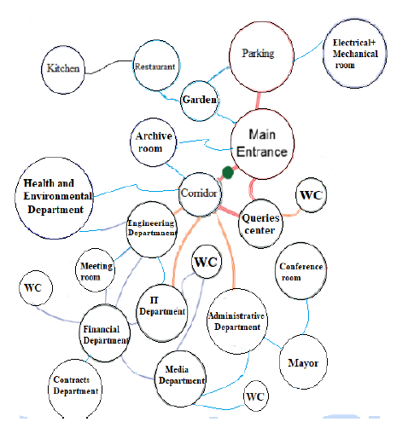
Bubble Diagram:

Slide 8
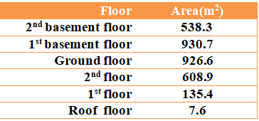
Floor | Area(m2)
BS | 1280
GF | 1280
F1 | 1280
F2 | 1280
F3 | 1280
Old areas of floors
Total area : 3145 m2
New areas of floors
Total area : 6400 m2

Slide 9
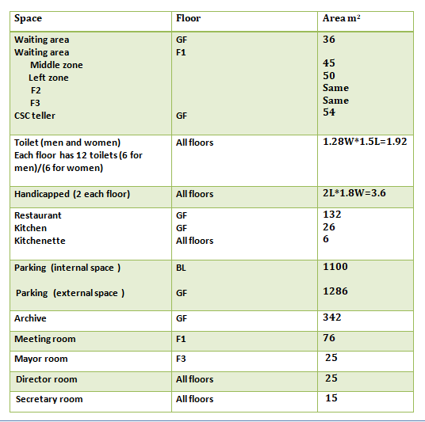

Slide 10
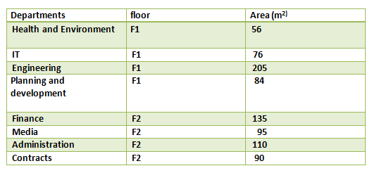


Slide 11
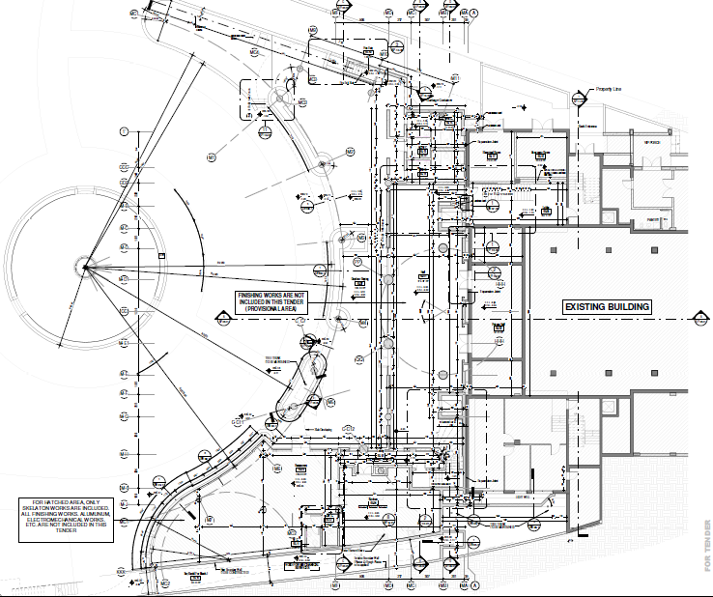
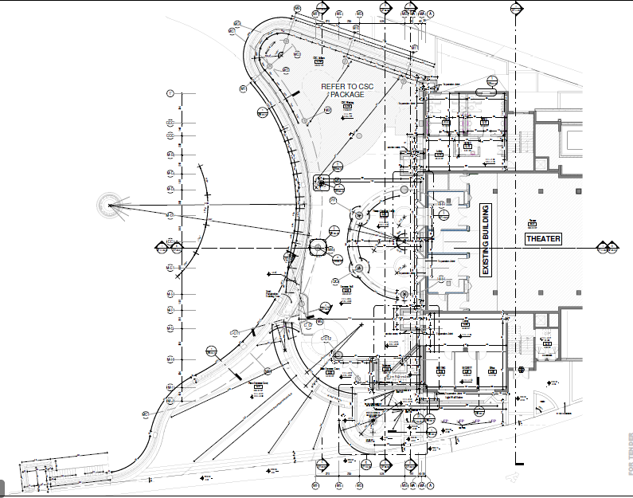
Old Plans Of Municipality :
Basement floor
Ground floor

Slide 12
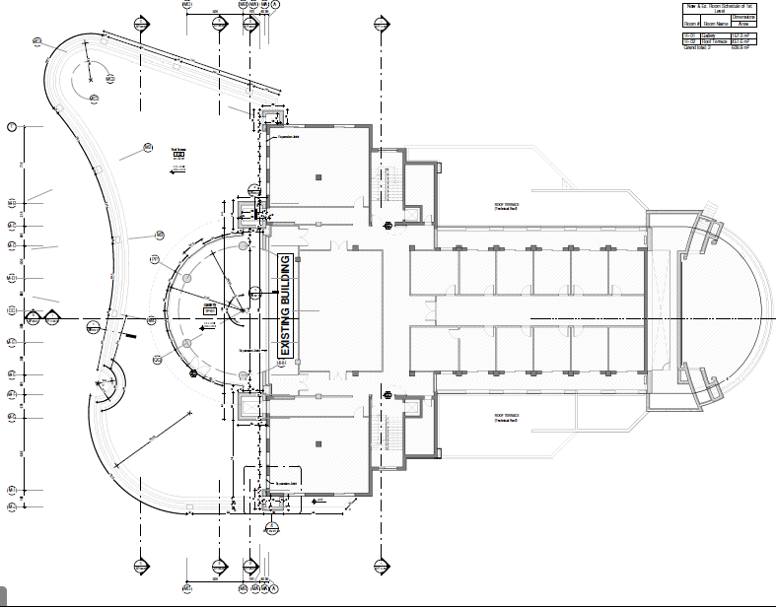
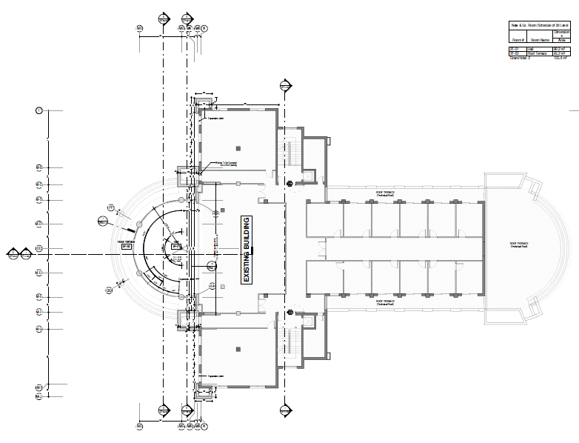
First floor
Second floor

Slide 13
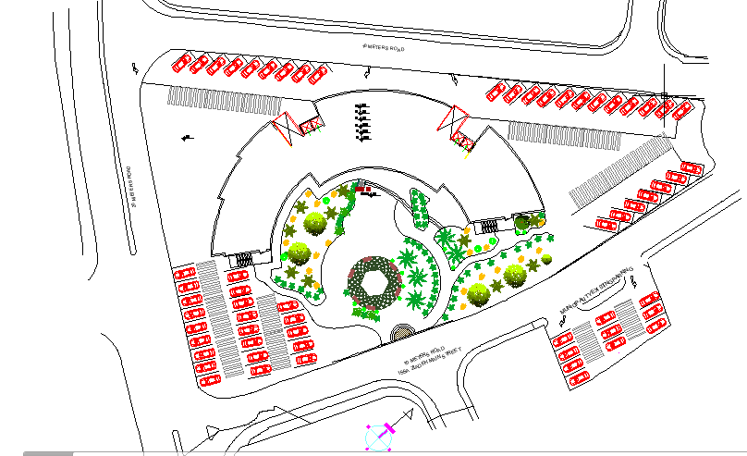
Site Plan:
New Plans Of Municipality :

Slide 14
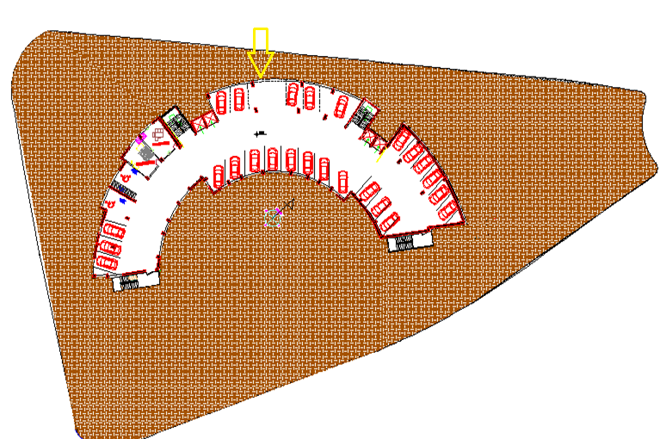
Basement Floor:

Slide 15
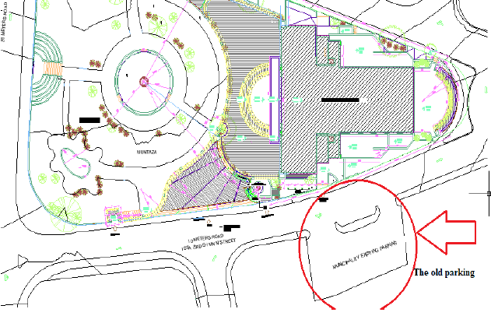
→ Parking :
Old Parking of municipality

Slide 16
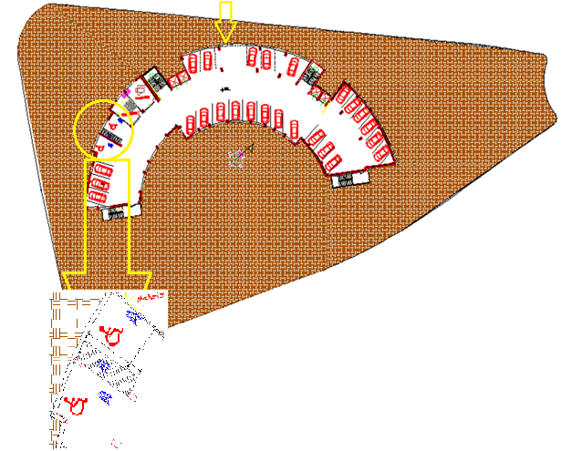
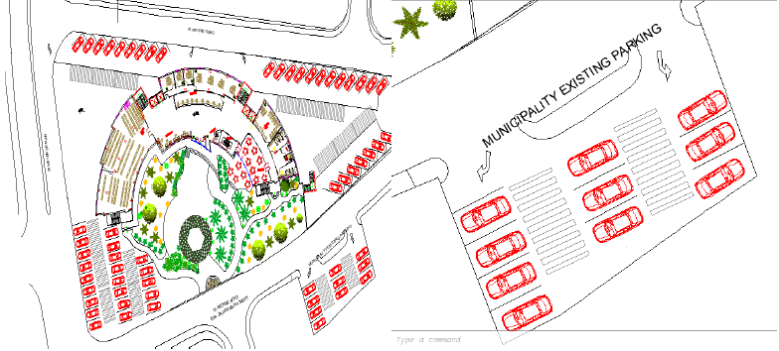
→ Parking :
New Parking of municipality

Slide 17
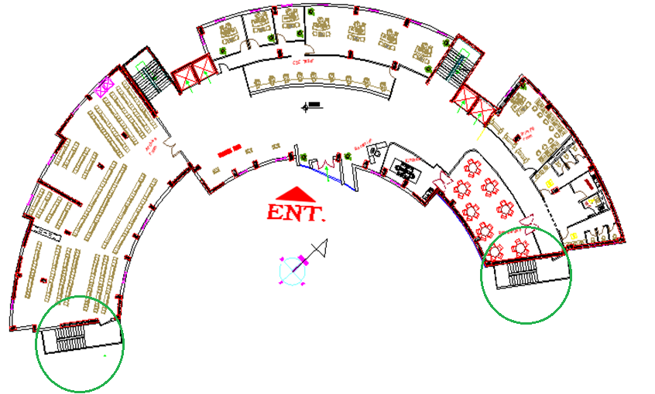
Ground Floor:

Slide 18
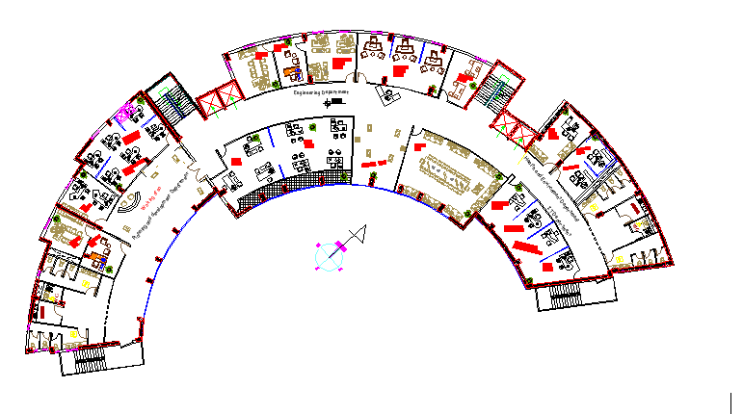
First Floor:

Slide 19
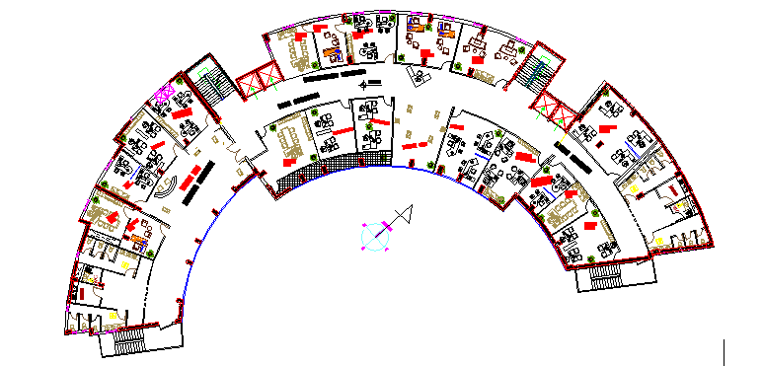
Second Floor:

Slide 20
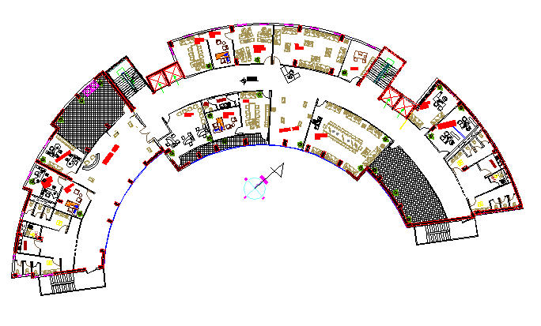
Third Floor:

Slide 21
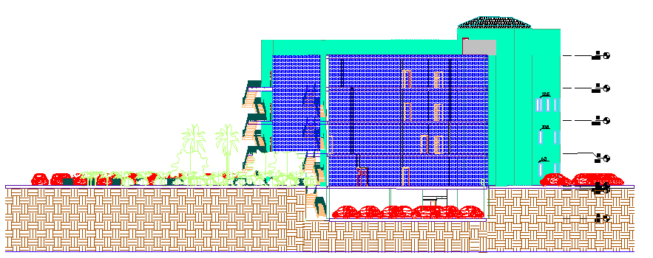
East Elevation:

Slide 22
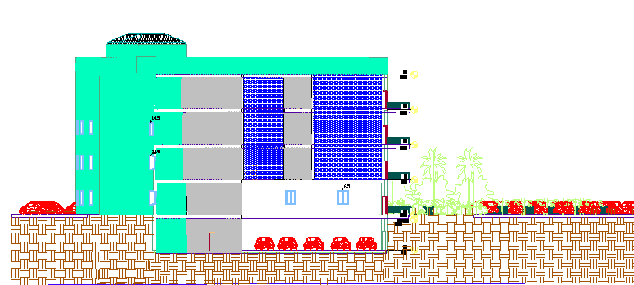
West Elevation:

Slide 23
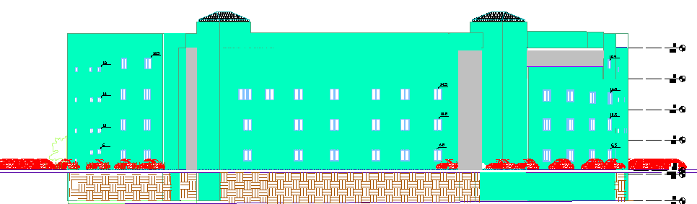
North Elevation:

Slide 24
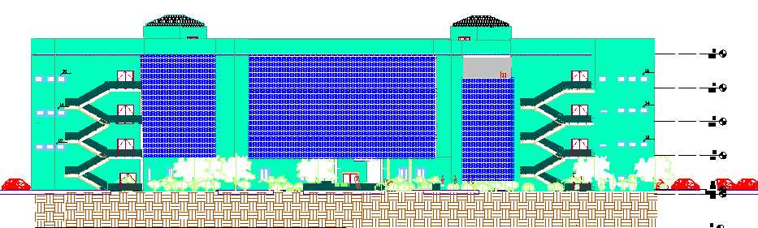
South Elevation:

Slide 25
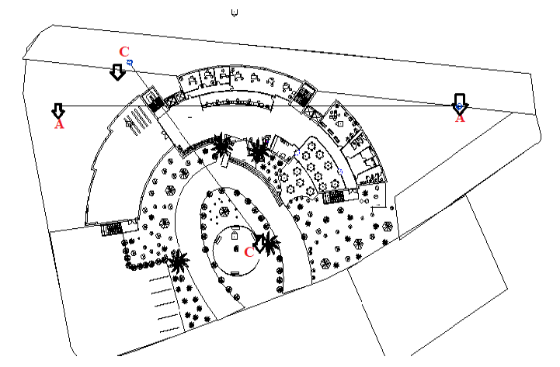
Sections:

Slide 26
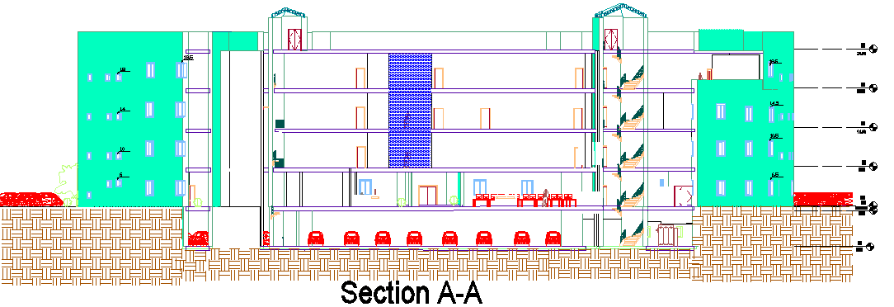
Sec A-A

Slide 27
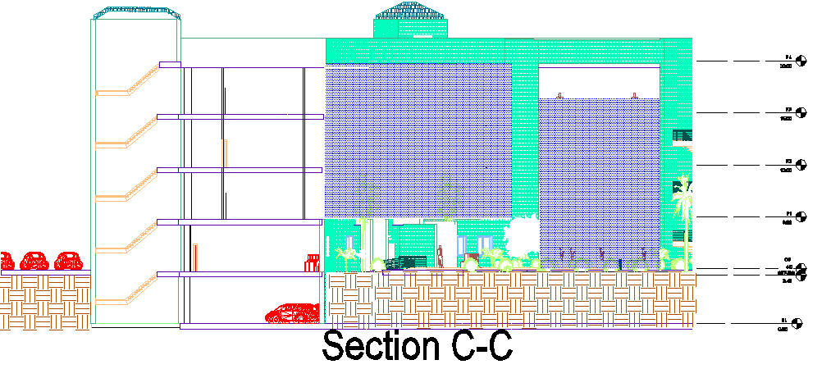
Sec C-C

Slide 28
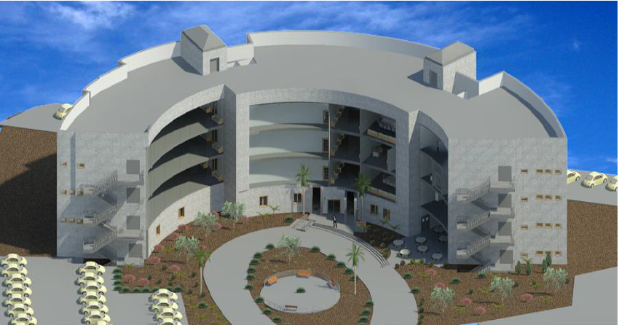
3D Model:

Slide 29
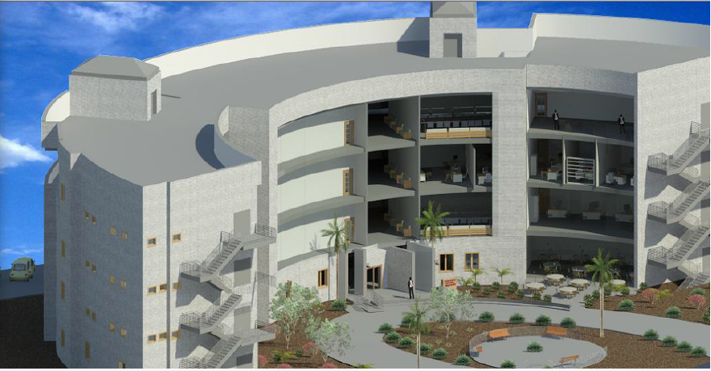
3D Model:

Slide 30
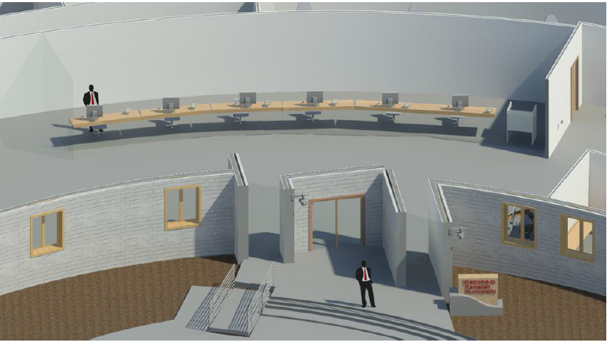
3D Model:
CSC Teller in GF

Slide 31
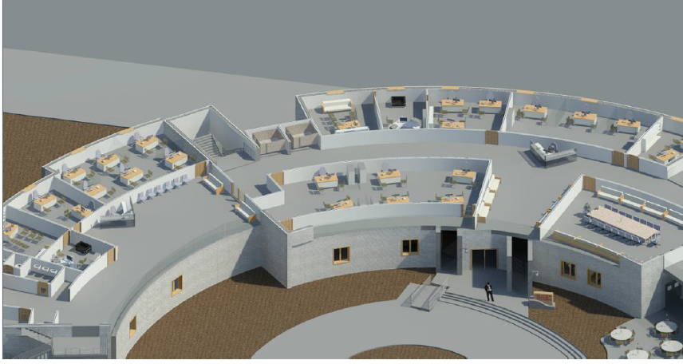
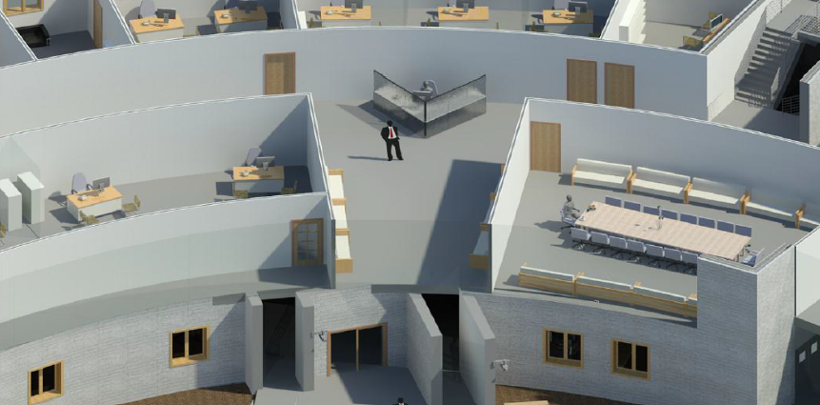
3D Model:
Offices in F1

Slide 32
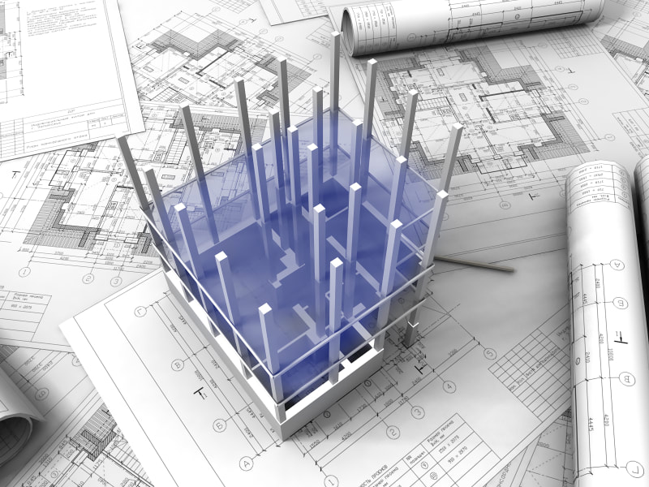
Structural design

Slide 33
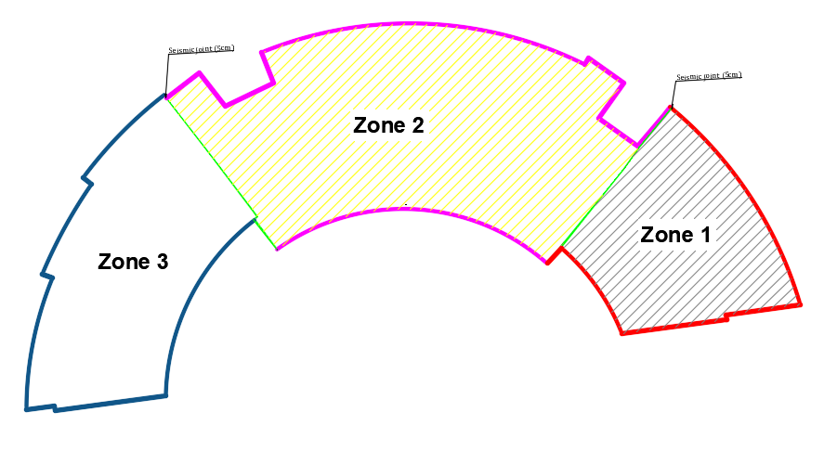
Building description
Consist of five floor

Slide 34
Design codes
ACI -318-08 (American Concrete Institution) for reinforced concrete structural design.
UBC-97 (Uniform Building Code) for earthquake load computations.

Slide 35
Materials property
Structural Item | Compressive Strength(Mpa)
Slab ,beams ,columns , shear walls | 28
MAT Foundation | 24
Structural Item | Yield strength(Mpa)
Steel | 420

Slide 36
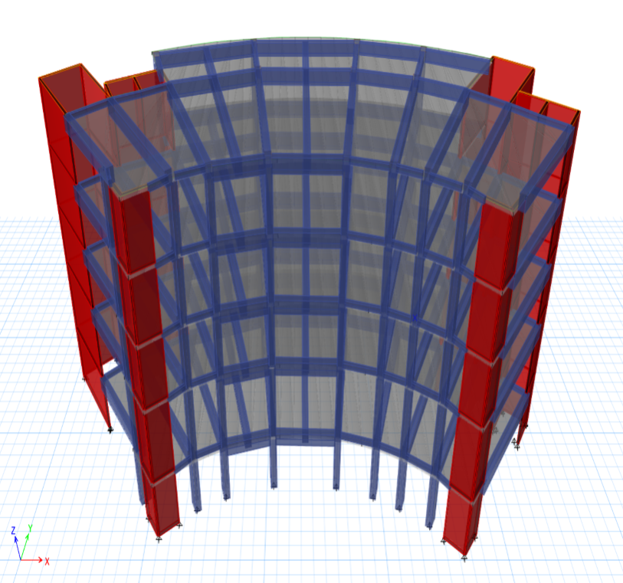
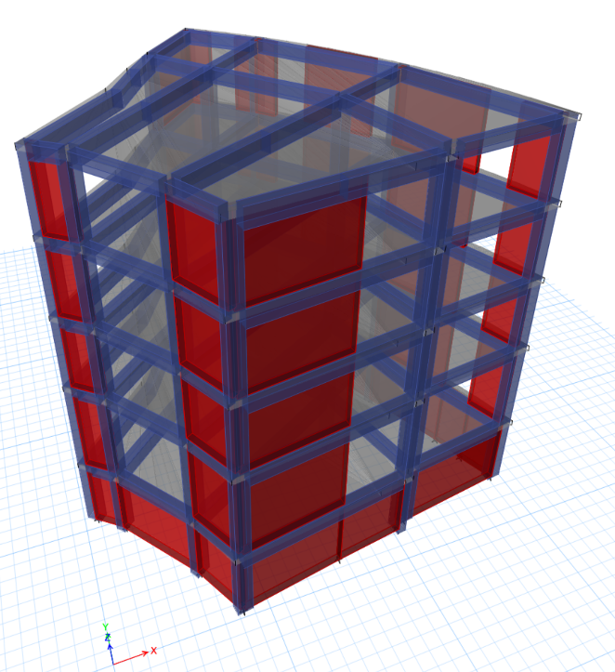
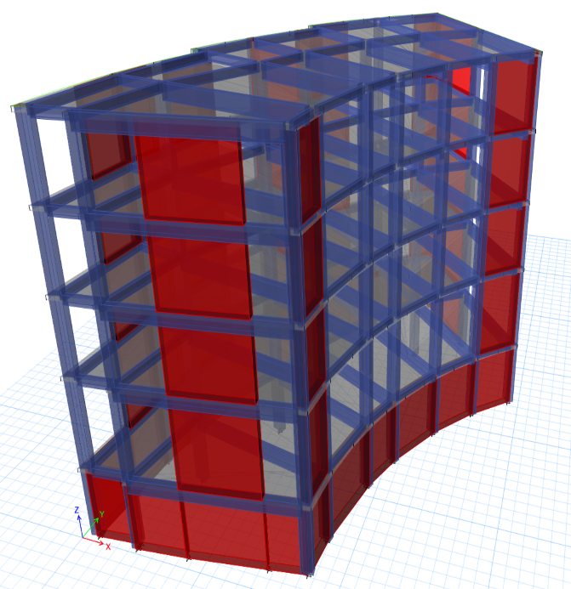
Building modeling:
Zone (1)
Zone(2)
Zone (3)

Slide 37
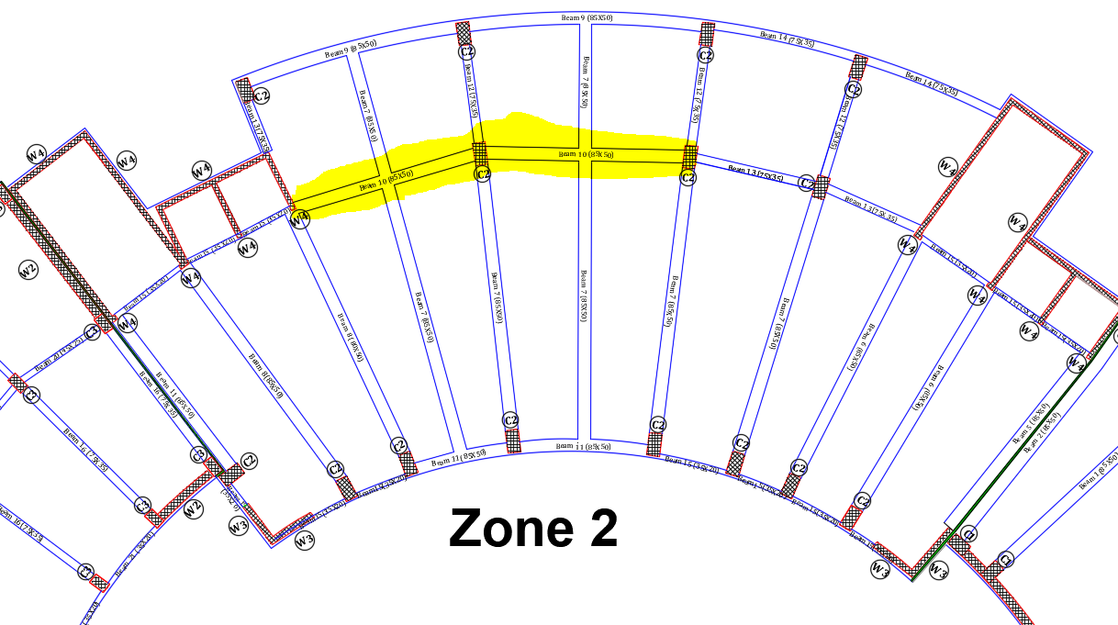
Structural System
The system of the slab is tow way solid slab with drop beams
Beam girder system were used in zone(2)
Beam girder system

Slide 38
Program inputs
Loads
modifiers
Type of load | Load KN/m2
Dead load | -----
SD load | 4
Live load | 4
Masonry wall | 6
Curtain walls | 0.6
Structural Item | Moment Modifier
slab | 0.25
beams | 0.35
columns | 0.001
Shear walls | 0.7

Slide 39
Models checks:
Compatibility check
Equilibrium Checks
Internal forces checks
Deflection checks

Slide 40
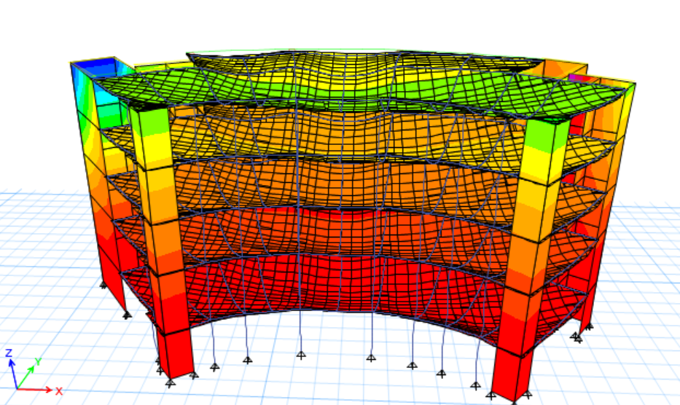
Compatibility check
Compatibility check for zone(2)

Slide 41
Equilibrium Checks
Zone
Zone(1)
Zone(2)
Zone(3)
Load type | ETABS(KN) | Manual(KN) | Error %
Dead load | 24195.8 | 23545.4 | 2.7
SD loud | 9928.5 | 10203.46 | 2.7
Live load | 5358.66 | 5358 | 0.01
Dead load | 35080 | 35068.35 | 0
SD loud | 16034.6 | 15725.52 | 1.9
Live load | 11501.4 | 11502 | 0.01
Dead load | 24931.5 | 25276 | 1
SD loud | 13081.2 | 12811.6 | 2
Live load | 7178 | 7200 | 0.3
Error % Doesn’t exceed 5 %

Slide 42
Internal forces checks
Slab | ETABS(KN.m) | Manual(KN.m) | Error %
Slab (1) | 100.25 | 95.6 | 4.6
Slab(2) | 20.2 | 19.7 | 2.5
Slab(3) | 45 | 41.8 | 7.6
Beam | ETABS(KN.m) | Manual(KN.m) | Error %
Beam(1) | 1266.1 | 1290 | 1.8
Beam(7) | 1057.5 | 1027 | 2.9
Beam(16) | 492.8 | 497.4 | 1
column | ETABS(KN) | Manual(KN) | Error %
Column(1) | 1123 | 1102.3 | 1.8
Column(2) | 846 | 805 | 5
Column(3) | 586.2 | 588.2 | 0.3
Error % Doesn’t exceed 10 %

Slide 43
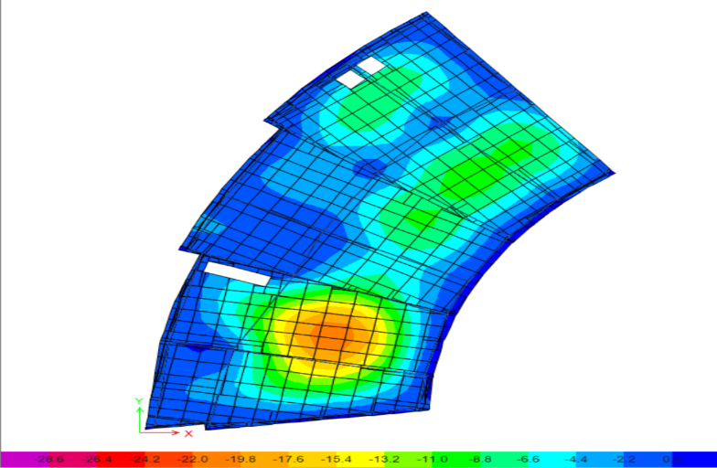
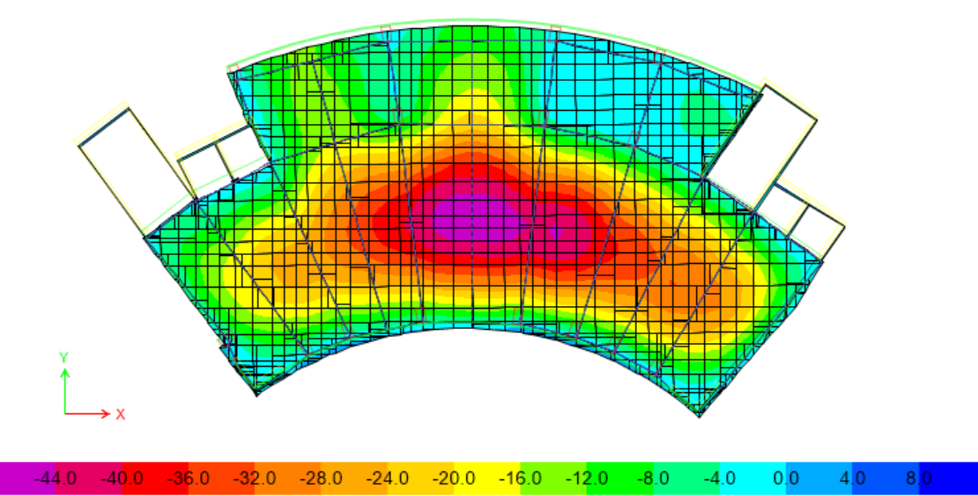
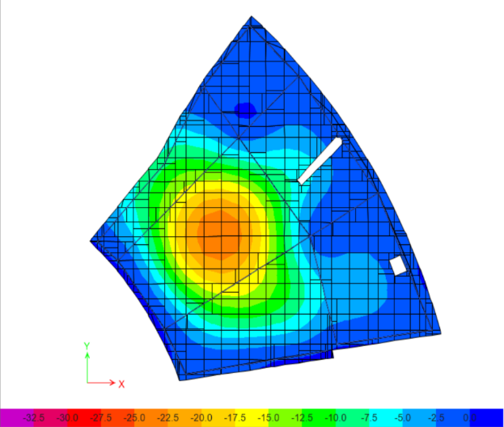
Deflection checks
Zone | Max. deflection allowed | Max. deflection by ETABS
Zone(1) | 25.75 mm | 25 mm
Zone(2) | 47.7 mm | 40 mm
Zone(3) | 21.83 mm | 21.2 mm

Slide 44
Seismic design
Period Check
Modal Mass Participation Ratios (MMPR)
Base Shear Check
Drift Check

Slide 45
Seismic design data
Seismic zone is 2A (Z=0.15) because the building is on Ramallah
Importance factor I=1
Force reduction factor (R) =5.5 (Building Frame System- Shear Walls)
Soil profiles in the project is (SD).
Acceleration-dependent seismic coefficients, Ca=0.22
Velocity-dependent seismic coefficients, Cv= 0.32

Slide 46
Period Check:
T=Ct*(hn)^{3/4} = 0.478 sec.
Zone | Max Period allowed | Period by ETABS
Zone(1) | 0.478 sec | 0.383 sec
Zone(2) | 0.478 sec | 0.462 sec
Zone(3) | 0.478 sec | 0.444 sec

Slide 47
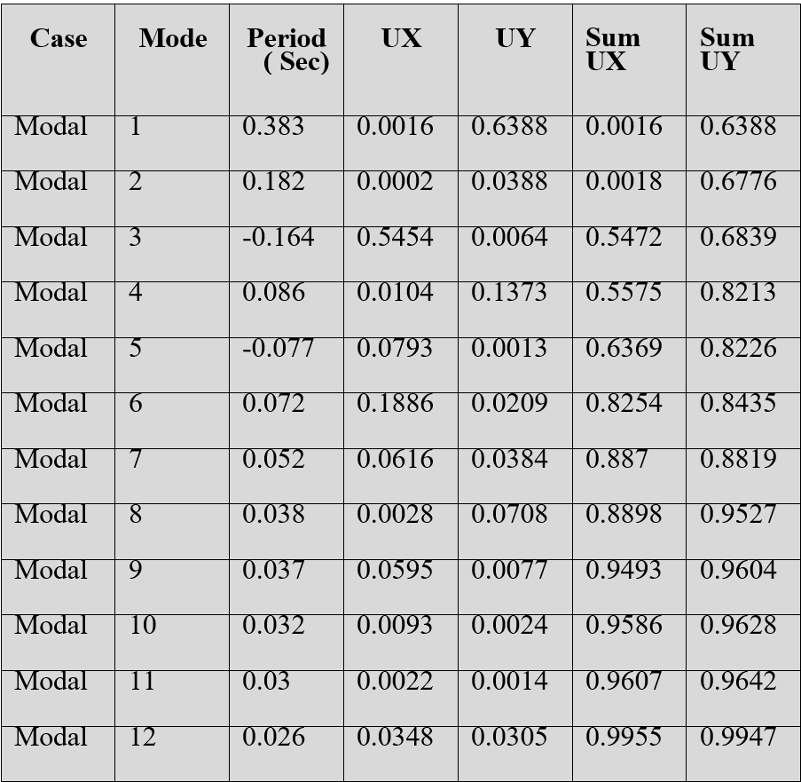
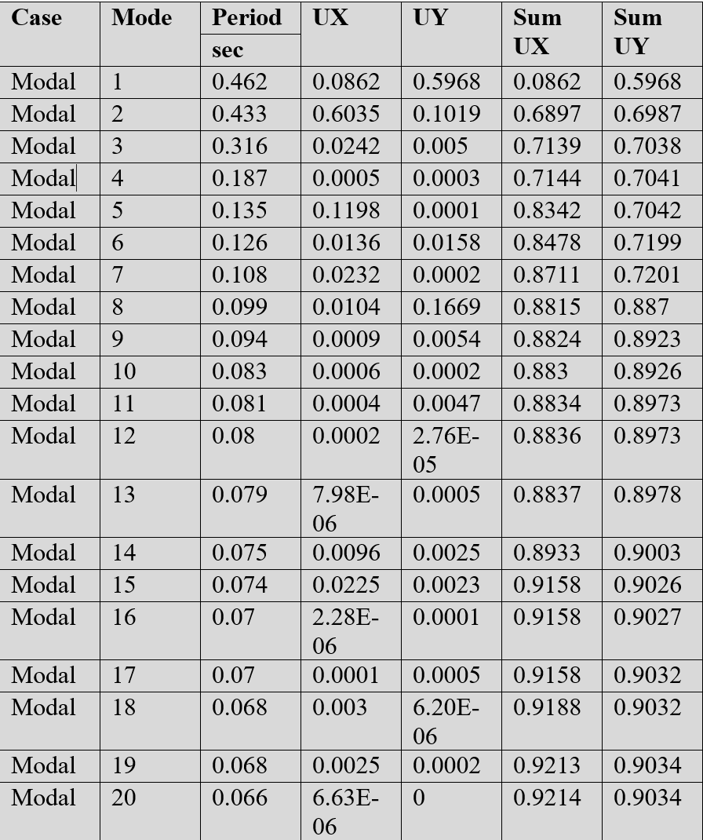
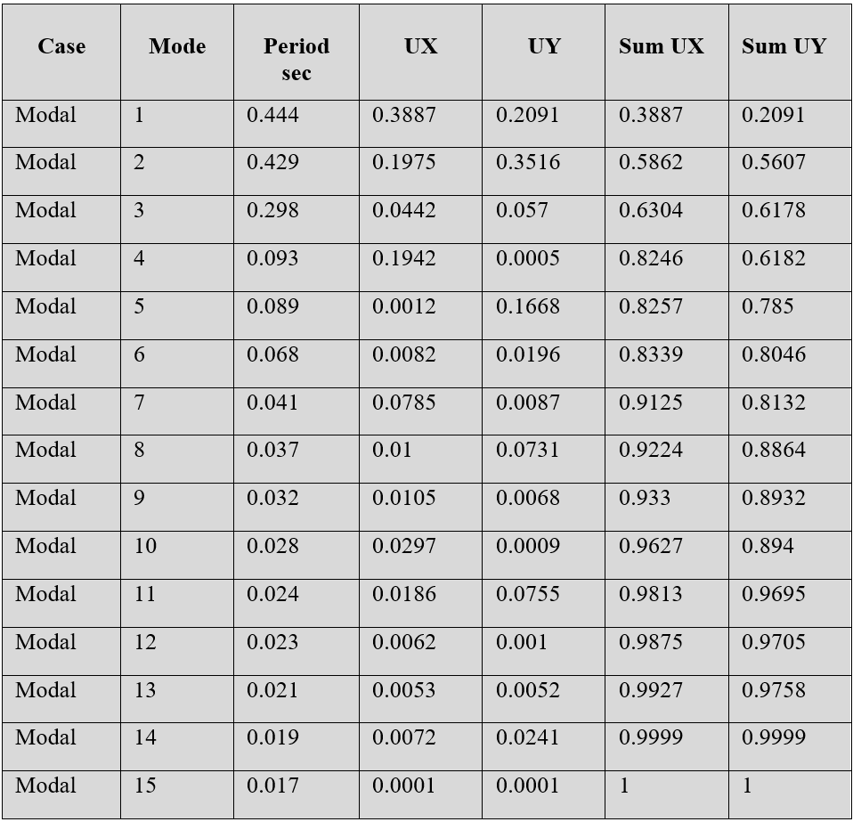
Modal Mass Participation Ratios (MMPR)
Zone (1)
Zone (2)
Zone (3)

Slide 48
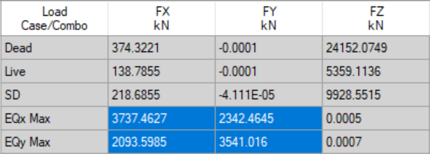
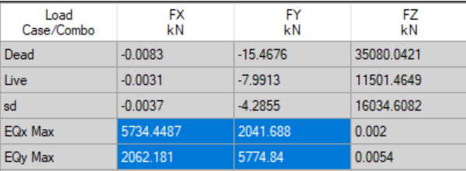
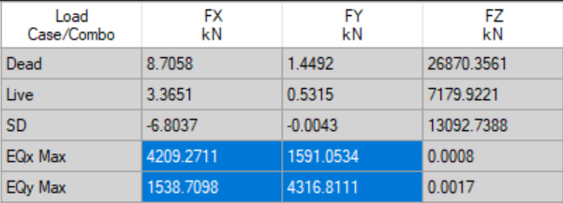
Base Shear Check
Zone | Weight (1D+1/4L) | Base shear
Zone(1) | 35420.4 KN | 3542 KN
Zone(2) | 53990 KN | 5399 KN
Zone(3) | 41724.4 KN | 4173 KN

Slide 49
Drift Check
Zone | story | ΔSy(mm) | ΔSx(mm) | Δmy (mm) | Δmx(mm)
Zone(1) | Story(1) | 0.28 | 3.43 | 1.1 | 13.2
 | Story(5)
Zone(2) | Story(1) | 17.3 | 14.29 | 66.6 | 55.7
 | Story(5)
Zone(3) | Story(1) | 12.4 | 11.87 | 47.74 | 45.5
 | Story(5)
Δmy and Δmx less than 100mm

Slide 50
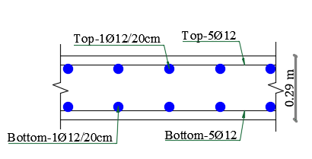
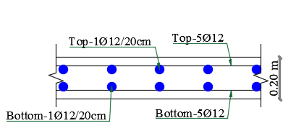

Slab Design

Slide 51



Beams Design

Slide 52


Columns Design

Slide 53



Shear Walls Design

Slide 54

Stairs design

Slide 55

Mat Foundation Design:
Bearing capacity for soil (Qall) = 200 KN/m²
Thickness = 100cm

Slide 56
Environmental Design

Slide 57
Environmental design

Slide 58

In this phase of project, full analysis has been made using Design Builder program for simulation.

Slide 59
Environmental Design Analysis
Material used.
Shading Effect Analysis
Site and Building Thermal Analysis

Slide 60

Material Used – External Wall
5 cm Lime Stone.
10 cm Cast Concrete.
5 cm Extruded Polystyrene
10 cm Concrete Block.
1 cm Cement Plaster.

Slide 61

Material Used – Roof (Out)
0.45 cm Roofing asphalt
4 cm cast concrete.
8 cm concrete.
17 cm light weight concrete block.
2 cm cement plaster.

Slide 62

Material Used – Internal Floor
3 cm Terrazzo tile.
3 cm mortar.
7 cm sand and gravel.
30 cm concrete.
2 cm cements plaster.

Slide 63

Material Used – Internal Partitions
2 cm cements plaster.
10 concrete block
2 cm cements plaster.

Slide 64

Dbl LoE (e2=.1) Clr 6mm/13mm Arg Glass

Slide 65


Through the use of Design Builder program and after checking the North direction.
Sun effect on the building 21-june (12pm)

Slide 66

Sun effect on the building 21-Jan (12pm)

Slide 67
Site & Building Thermal Analysis
Using Design Builder.

Slide 68
Design Builder Parameters.
HAVC System : VRF Units.
Fuel is Electricity from Grid.
System is used for Heating & Cooling.
Building is used from 8:00 AM to 2:00 PM.

Slide 69


Slide 70


Slide 71


Slide 72


Slide 73

Environmental design
Total net site energy after improvements were made increased as shown in the following table 64.3 kWh/m2

Slide 74


Environmental design
Net not comfort hours in the building before improvements =1766.00 hr
Net not comfort hours in the building after improvements = 2111 hr

Slide 75
Electrical Design

Slide 76


Slide 77


Slide 78


Slide 79


Slide 80
Circuit Breakers

Slide 81

G.F Floor D.B

Slide 82

1st Floor D.B

Slide 83

2nd Floor D.B

Slide 84

3rd Floor D.B

Slide 85


Slide 86

Electrical Design
Ground floor lighting plan

Slide 87



Electrical Design
Luminaries used in the ground floor

Slide 88


Electrical Design
3D rendering view for selected rooms
Office

Slide 89


Electrical Design
3D rendering view for selected rooms
Meeting room

Slide 90


Electrical Design
3D rendering view for selected rooms
Resturant

Slide 91
Acoustical Design

Slide 92

Reverberation time(RT60):
Values for materials used in the rooms

Slide 93

Reverberation time "RT60" calculations for meeting room and office using Ecotect programme
Meeting room: Volume: 180.45 m³. Surface Area: 197.229 m². Assume the room full capacity of occupants = 120 person.
From the table shown ,the allowable RT60 value for meeting rooms range between (0.4 – 0.7)s and RT60 at deferent frequencies and capacity range is between (0.39 – 1.27)s
also The room has a poor RT60 at the high and low frequencies, because the RT60 at low frequency is more than 0.7, and at the high frequency it is less than 0.4.

Slide 94

Office Volume: 44.300 m³. Surface Area: 78.140 m². # of occupants = 4
The allowable RT60 value for Office range between (0.7- 1.3)s Room RT60 at deferent frequency and capacity range between (0.20 – 0.75)s The room has poor RT60 at high frequency because the RT60 at the high frequency is less than 0.75

Slide 95

Sound Transmission Loss (STC):

Slide 96


For Director room adjacent to Secretary office

Slide 97

IIC For Ceiling
IIC = 70 dB

Slide 98
Mechanical Design

Slide 99

Mechanical Design
Water Supply :
Fixture units and collector,Zone 1

Slide 100

Fixture units and collector,Zone 2

Slide 101

Fixture units and collector,Zone 3

Slide 102
Mechanical design
Water demand = 13771.2 litre /week.
Old number of tanks = 13
New number of tanks = 18
Total number of fixture unit for building = 392 F.U.(old 178)

Slide 103

Mechanical design
Water drainage system : -
Main drainage line from municipality

Slide 104


Mechanical design
Water drainage system : -
Drainage system in bathrooms and kitchens is as shown

Slide 105

Mechanical design
Distribution of tanks on the roof

Slide 106

Mechanical design
Drainage of rain water
Rain water tank size = 80 m3

Slide 107

Mechanical design
Sanitation system : -

Slide 108

Mechanical design
HVAC system design
VRF system was used in the municipality building , the outdoor units specifications is as shown
Total cooling load = 145 kw
Total heating load = 85 kw

Slide 109

Mechanical design
HVAC system design
specifications of fan coil used is as shown

Slide 110

Mechanical design
HVAC system design
Ground floor HVAC system layout

Slide 111

Mechanical design
HVAC system design
First floor HVAC system layout

Slide 112
Firefighting and Safety Design

Slide 113


Firefighting and Safety Design
Fire fighting sprinklers system that used in the basement floor

Slide 114


Firefighting and Safety Design
Fire fighting suspended automatic fire extinguisher CO2 that used in the ground floor

Slide 115

Firefighting and Safety Design
Fire fighting suspended automatic fire extinguisher CO2 that used in the first floor

Slide 116

Firefighting and Safety Design
Fire fighting suspended automatic fire extinguisher CO2 that used in second floor

Slide 117

Firefighting and Safety Design
Fire fighting suspended automatic fire extinguisher CO2 that used in third floor

Slide 118

Firefighting and Safety Design
Escape and Evacuation plans

Slide 119

Firefighting and Safety Design
Escape and Evacuation plans

Slide 120

Firefighting and Safety Design
Escape and Evacuation plans

Slide 121

Firefighting and Safety Design
Escape and Evacuation plans

Slide 122
Quantity Surveying and Cost Estimation

Slide 123
Ramallah Municipality | Total Direct Cost (Nis)
Structure work | 583,521 ILS
Mechanical Work | 5,493,632 ILS
Finishing Work | 707,630 ILS
Electrical Work | 448,000 ILS
Total direct project cost | 12,958,745 ILS
Unit Direct Cost =12,958,745 ILS
/ 7822 = 1657 Nis /m²
Unit Direct Cost = 326 JD /m²

Slide 124
“Thank You”

