Slide 1
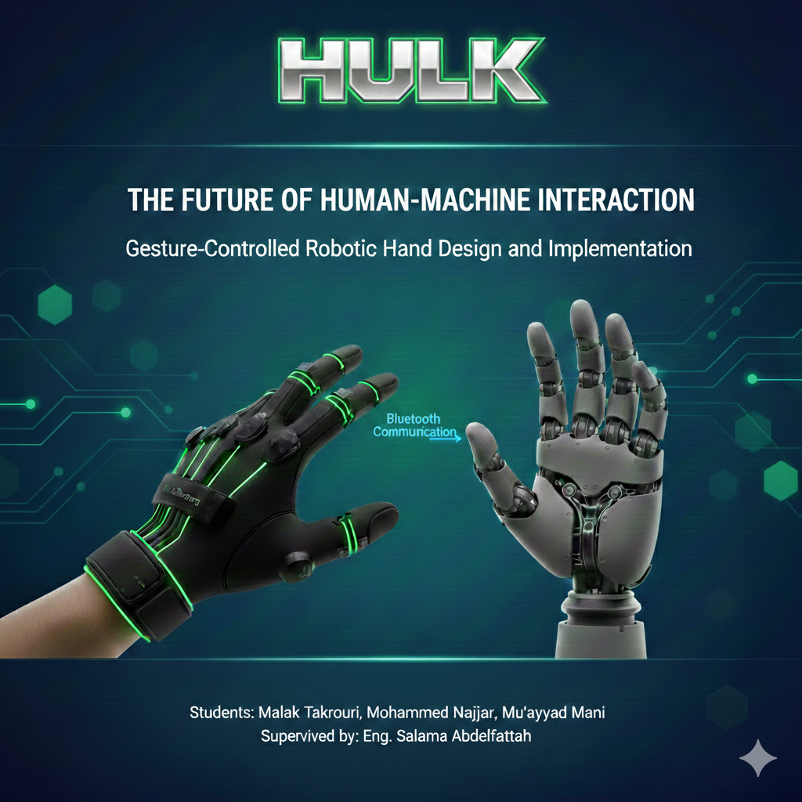

Slide 2

Project Abstract :
The Concept : "HULK" is an integrated mechatronic system designed to bridge the gap between human intent and robotic execution through a natural gesture-controlled interface.
Key Achievement: We successfully developed a low-cost, high-response system with a latency of less than 70-90ms, making it suitable for applications in prosthetics, hazardous environment handling, and teleoperation.
System Mechanism : The system utilizes a wearable smart glove equipped with resistive flex sensors to capture finger orientation, transmitting data wirelessly via Bluetooth to a robotic hand that replicates the movement in real-time.

Slide 3
Introduction
The Evolution of HMI: Human-Machine Interaction (HMI) has evolved from simple buttons to advanced touchscreens and now to natural gesture-based control.
Why a Robotic Hand? The human hand is one of the most complex tools; replicating its movement allows for high-precision tasks in various fields such as:
Prosthetics: Helping individuals with limb loss.
Robotic Interaction: The challenge in robotics is to create a control system that feels like an extension of the human body.
Hazardous Environments: Remote handling of dangerous materials.
Space & Deep Sea: Teleoperation where humans cannot go.

Slide 4
Problem Statement & Objectives
Main Objectives:
Design & Build: Develop a functional 5-finger robotic hand using low-cost components.
Intuitive Control: Implement a wearable glove system that mirrors human hand gestures.
Wireless Integration: Establish a reliable, low-latency Bluetooth communication link.
Signal Optimization: Apply hardware and software filtering (RC circuits) to ensure smooth and stable movement.
The Problem:
*Complexity and high cost of traditional robotic control systems.
*Lack of intuitive "natural" interfaces for teleoperation and prosthetics.
*The need for high-precision feedback in remote handling.

Slide 5
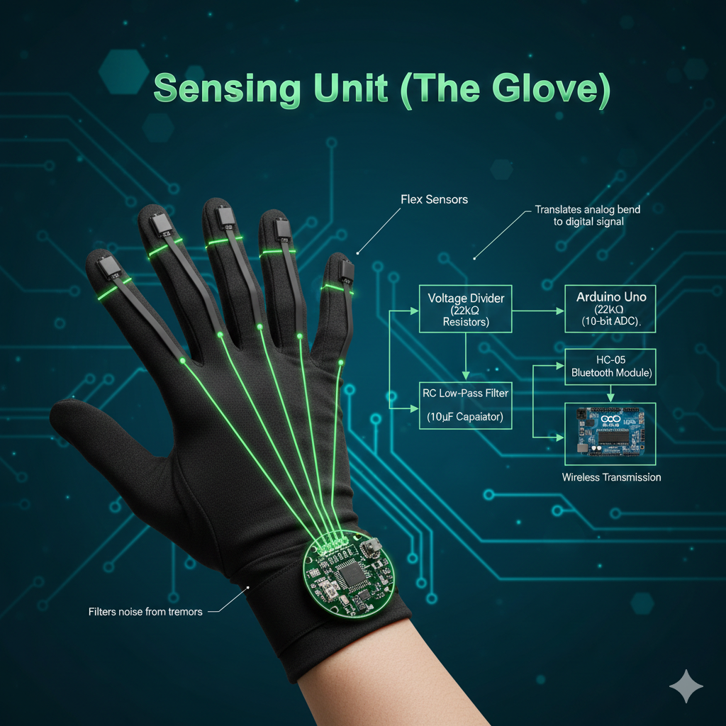
Hardware Components & Tools
1-
-4.5" Flex Sensors: Resistive sensors that change value based on finger bending.
-Voltage Divider Circuit: Using 22kΩ resistors to convert resistance to measurable voltage.
-RC Low-Pass Filter: 10µF capacitors to stabilize the signal and remove noise.

Slide 6
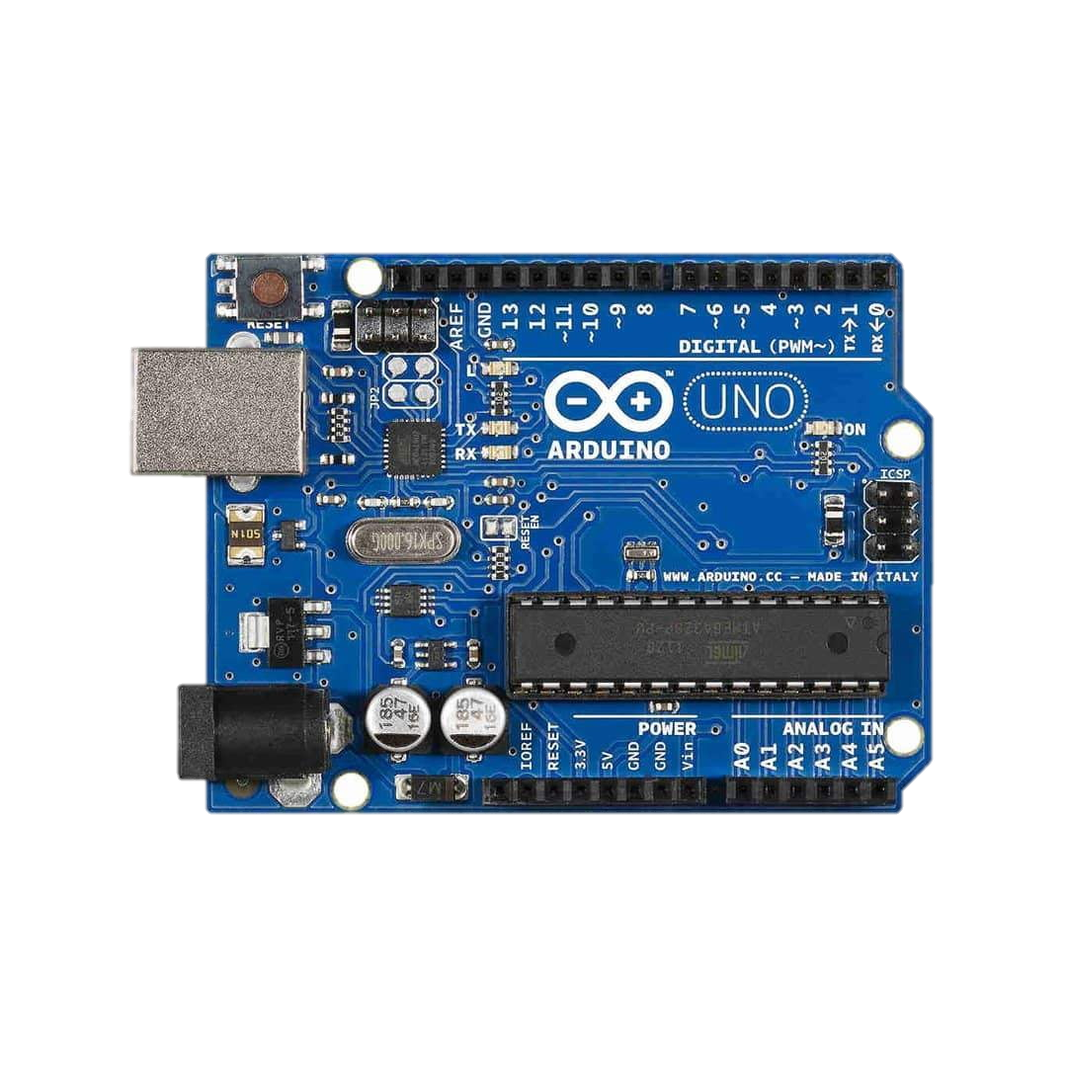
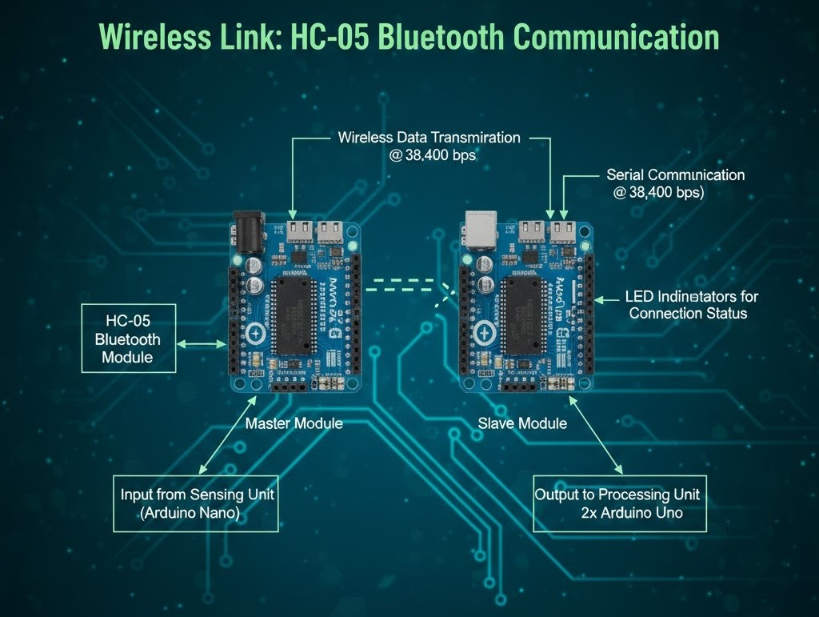
Hardware Components & Tools
2-
3-
Processing Unit :
Wireless Link :
HC-05 Bluetooth Modules: Operating in Master/Slave configuration at 38,400 bps.
2x Arduino Uno: High-performance, low-cost microcontrollers for data processing and PWM control.

Slide 7
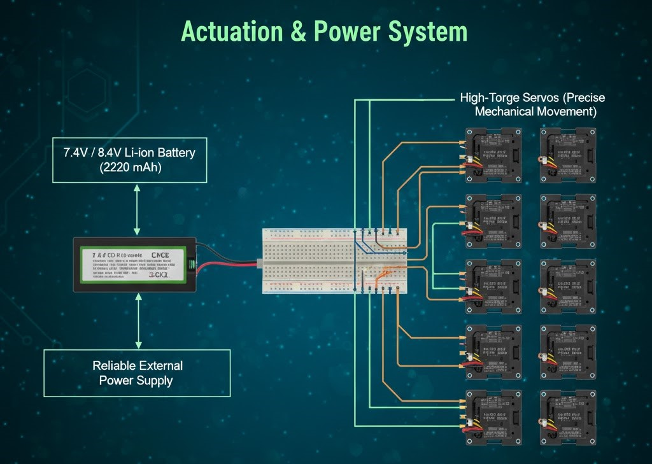
Hardware Components & Tools
4-
Actuation & Power :
High-Torque Servos: For precise mechanical movement.
External Supply: 7.4V / 8.4V Li-ion battery

Slide 8
System Methodology & Workflow
1-
Signal Acquisition (The Glove)
2-
Signal Conditioning
-Flex sensors detect finger bending
(Analog data).
-Arduino Uno processes the analog signals and converts them to digital values.
Applying the RC Low-Pass Filter to eliminate mechanical noise and hand tremors.
Mapping the sensor values (0–1023) to Servo angles (0°–180°).

Slide 9
System Methodology & Workflow
3-
4-
Wireless Transmission
Execution (The Robotic Hand)
-Data is packaged and sent via the HC-05 Master module.
-The HC-06 Slave receives the data and passes it to the main Processing Unit.
The Arduino Uno interprets the received angles.
PWM (Pulse Width Modulation) signals are sent to the High-Torque Servos to move the fingers accordingly.

Slide 10
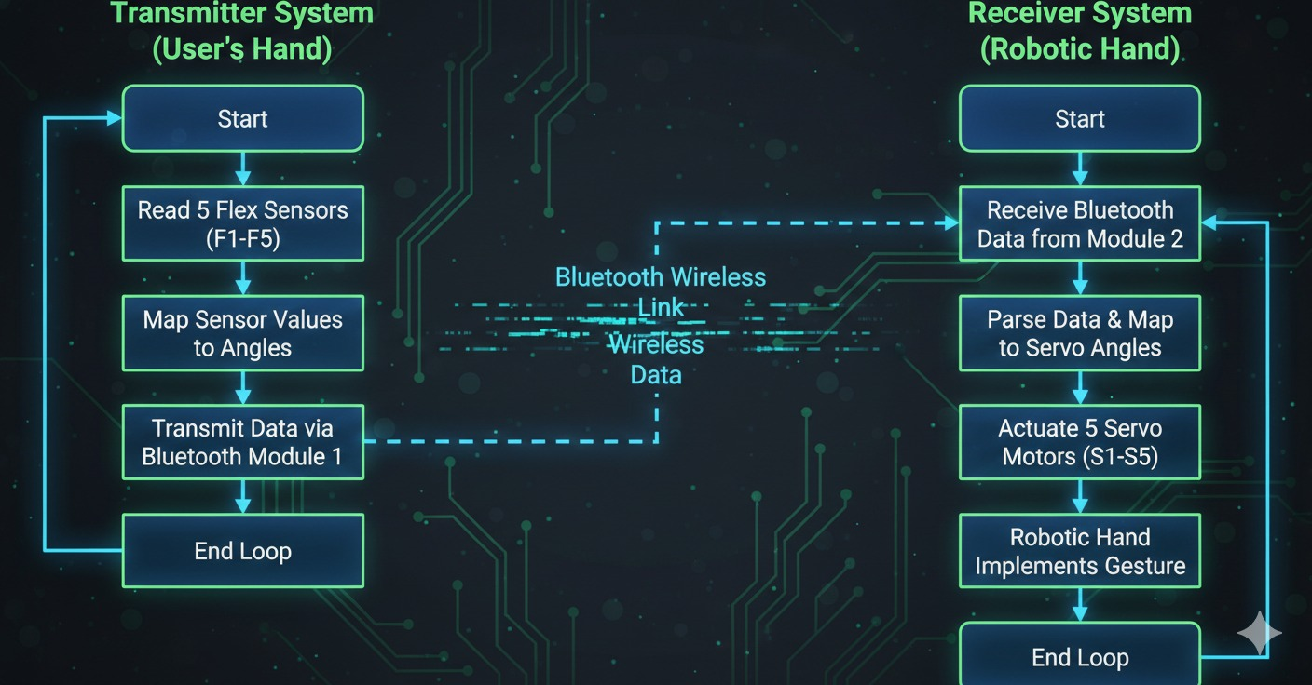
Flow Chart

Slide 11
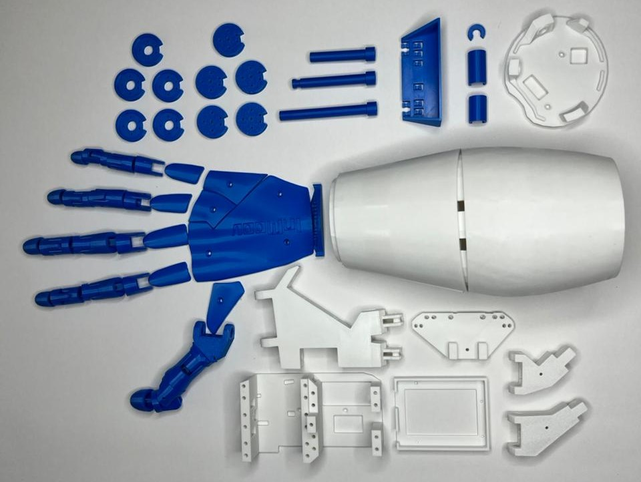
Mechanical Design & 3D Printing
1-
3D Printing Specifications :
-Material: High-quality PLA for a lightweight yet rigid
-structure.Precision: Printed with specific tolerances to allow smooth joint rotation without mechanical friction.

Slide 12
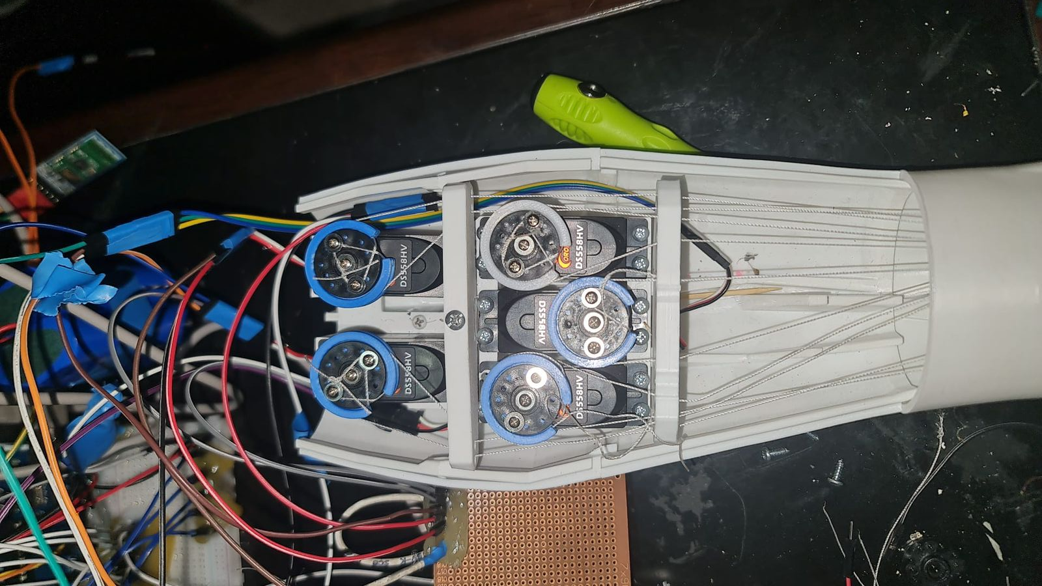
Mechanical Design & 3D Printing
2-
String-Driven Actuation:
-Direct control using High-Tension Nylon Strings connected to the servo horns.
-Each finger is actuated by a dedicated servo, allowing for independent and precise grasping movements.

Slide 13
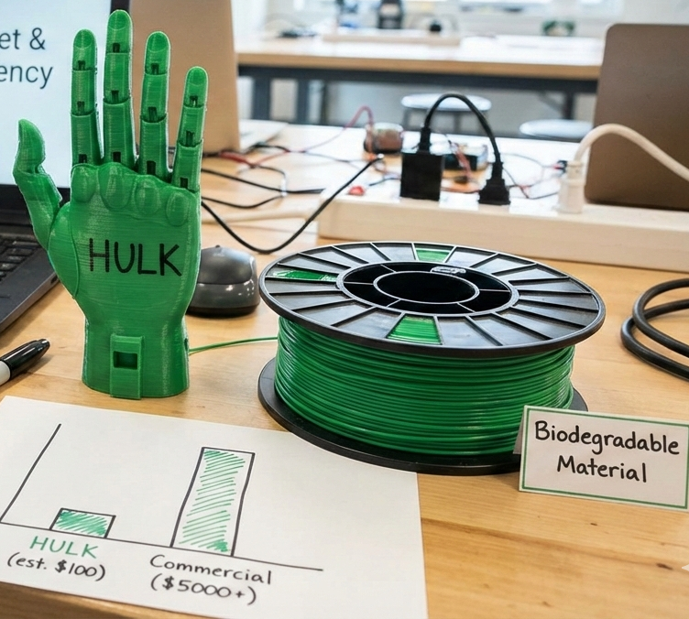
Budget & Resource Efficiency
Low-Cost Innovation: The total project cost was minimized by utilizing 3D printing and off-the-shelf hobbyist electronics
Cost-Benefit: While commercial gesture-controlled hands cost thousands of dollars, "HULK" achieves similar functionality at a fraction of the cost, making it accessible for educational and low-income prosthetic research
Sustainability: Use of PLA (Polylactic Acid) ensures the mechanical structure is biodegradable and environmentally friendly.
Gesture replication

Slide 14
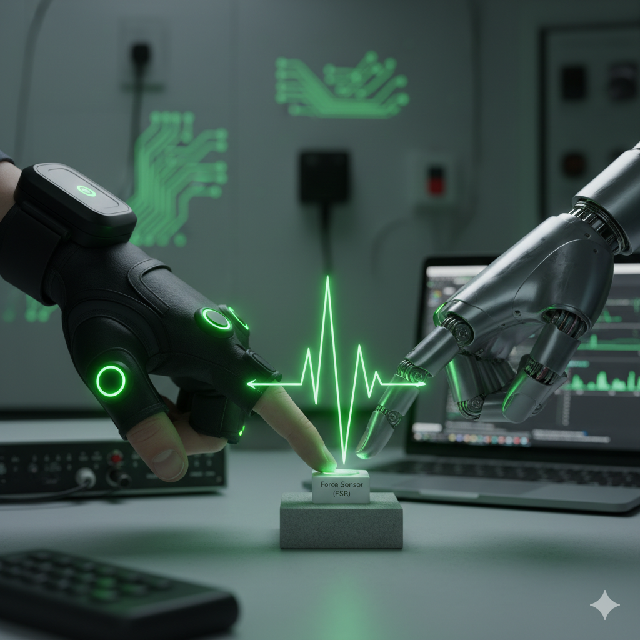
Future Work & Upgrading Possibilities
Muscle Sensors (EMG): Transitioning to Electromyography (EMG) sensors to detect small muscle electrical impulses for "hand-free" control instead of flex sensors
OpenCV Visual Operating: Implementing an OpenCV application to track pre-applied focusing points on a hand or object, executing robotic commands based on visual motion detection
Haptic Integration: Adding Force Sensitive Resistors (FSR) to allow the user to "feel" the robotic hand's grip pressure in real-time

Slide 15
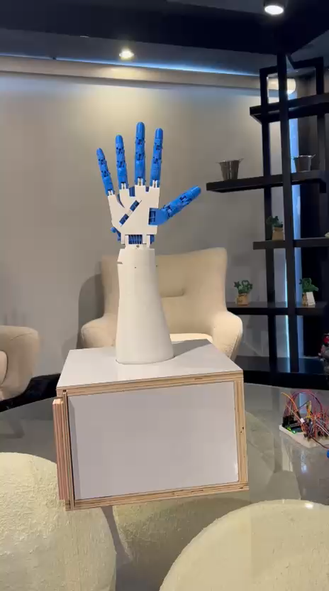
Testing Video :

Slide 16
Thank You
Any Questions?

